Slide 1
Engaging in the Deliberative Policy Analysis Process for Water Justice in Canada
Anna Wilson MEd., MLIS
PhD Student Theoretical, Cultural & International Education Policy Studies University of Alberta
amw2@ualberta.ca
Notes:
Introduction From 2014 to 2017 the World Economic Forum (WEF) identified water-related illnesses as one of the top five major global risks to human health (Adeel, 2017, p. 100). Unfortunately, this has not impeded the war on science with United States (U.S.) President Donald Trump closing the Environmental Protection Agency and the former Canadian Conservative Government closing Canada’s Ocean and Fisheries Library and ending Canada’s Navigable Waters Protection Act (Mitchell, 2017, p. 26). Despite Canadian Prime Minister Justin Trudeau’s promise to protect Indigenous lands, he approved the Kinder Morgan Pipeline Project as twelve-year-old Autumn Peltier broke down in tears pleading with him not to let them build a pipeline on her home in Wikwemikong First Nation land in Ontario (Lau, 2016, para. 3) (refer to appendix #1). Prime Minister Trudeau promised Autumn that he would protect the water and this promise has made national headlines. Deliberative policy analysis can make Trudeau’s promise Canada’s national water policy.

Slide 2
From 2014 to 2017 the World Economic Forum (WEF) identified water-related illnesses as 1 of the top 5 global risks to human health (Adeel, 2017, p. 100).
Yet the war on science persists with threats to Canada’s Water due to a lack of :
Closing Canada’s Ocean & Fisheries Library & ending Canada’s Navigable Waters Protection Act
Federal enforcement of Health Canada’ Safe Water Quality Guidelines.
Enforced provincial, territorial, and Aboriginal water regulations
Canada’s Fisheries Act
Canadian Environmental Assessment Act
Regulation & communication across municipalities, provincial, territorial, & Aboriginal watersheds (Mitchell, 2017, p. 26).
Preventing water shortages & contamination problems exacerbated from climate change & population growth requires deliberation with stakeholders, businesses, & citizens over water policies (Bakker & Cook, 2011).

Slide 3
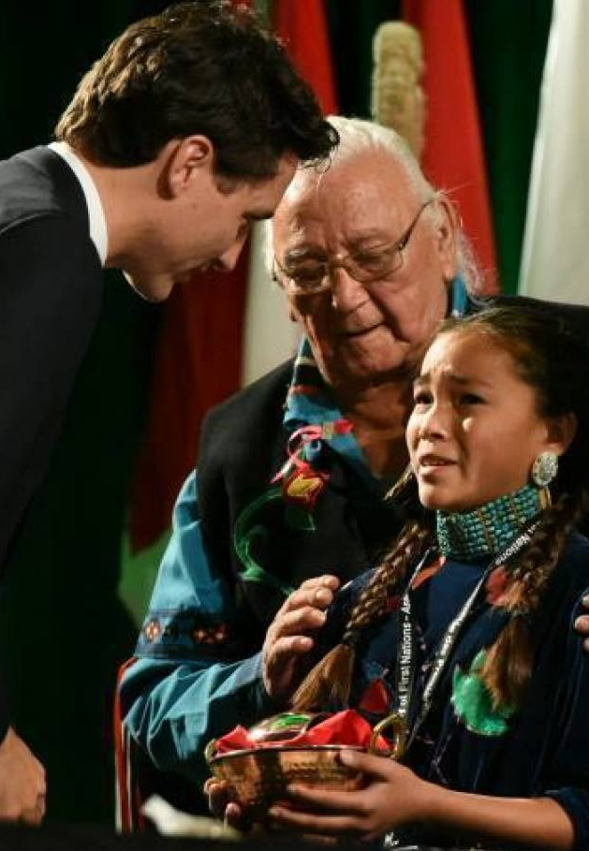
I argue that: Preventing water shortages & contamination exacerbated from climate change & population growth requires deliberation with stakeholders, businesses, & citizens over water policies (Bakker & Cook, 2011).
Prime Minister Trudeau promised Autumn that he would protect the water & this promise has made national headlines.
Deliberative policy analysis can make Trudeau’s promise Canada’s national water policy!
Notes:
Despite Canadian Prime Minister Justin Trudeau’s promise to protect Indigenous lands, he approved the Kinder Morgan Pipeline Project as twelve-year-old Autumn Peltier broke down in tears pleading with him not to let them build a pipeline on her home in Wikwemikong First Nation land in Ontario (Lau, 2016, para. 3) (refer to appendix #1).

Slide 4
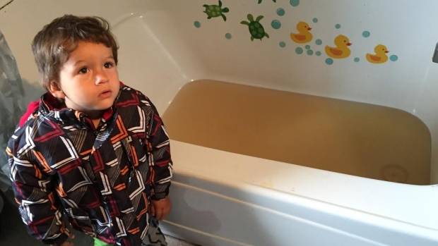
After the Walkerton crisis and the Kaschechewan First Nation evacuations, Canada’s social consciousness is plagued with the moral question:
“As a nation, have we done everything possible to prevent another crisis from water-related illnesses and deaths?” (Clancy, 2014).

Slide 5
Deliberative Policy Analysis (DPA) can be defined as a process in which policy analysts consider the: “stakeholders [and citizens’] value differences, dialogue, argumentation, & deliberation as major targets of analysis to determine a policy outcome (Li, 2015, p. 26) through the 3 models of DPA:
1. mediation and stakeholder group engagement,
2. citizens’ forums, or
3. citizens’ initiatives and referendums (Smith, 2003, p. 77).
This paper defends the urgency of Canada adopting a deliberative federal water policy that follows World Health Organization (WHO) water policy guidelines.

Slide 6
Canada’s adoption of WHO water quality guidelines will be supported by the case studies of other countries who have adopted the WHO water quality standards.
First, Canada’s current water policies will be examined,
second, Canada’s water policies will be compared with the WHO water policies.
Third, a deliberative national water policy will be synthesized through the conceptual framework of critical deliberative policy analysis through specific water management case studies from the, U.S., Italy and Brazil. Implications for future water policy practices under the guidelines of the WHO will conclude this paper.

Slide 7
Canada’s Current Water Policies and the Abyss of Water-Related Health Problems
Drinking water management in Canada is complicated with a regionalized, three-tiered governance structure consisting of:
water sources,
treatment systems,
distribution systems.
(CCME 2004, as cited in Bereskie, & Rodriguez, 2017, p. 246)

Slide 8
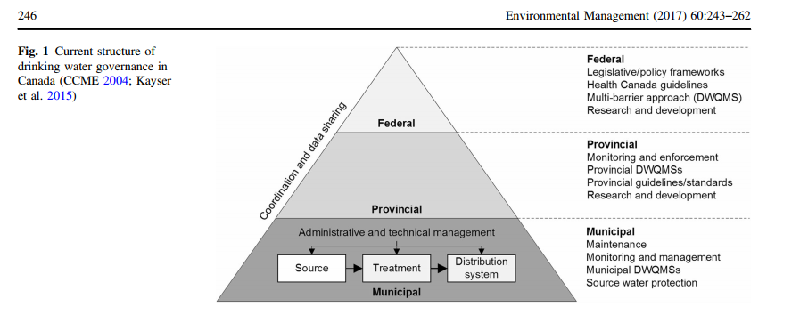
Figure 1 -Structure of Drinking Water Governance in Canada
Bereskie, T., Rodriguez, M. J., & Sadiq, R. (2017). Drinking Water Management and Governance in Canada: An Innovative Plan-Do-Check-Act (PDCA) Framework for a clean Drinking Water Supply. Environmental Management, 60(2), 246. doi: 10.1007/s00267-017-0873-9.
Bereskie, T., Rodriguez, M. J., & Sadiq, R. (2017). Drinking Water Management and Governance in Canada: An Innovative Plan-Do-Check-Act (PDCA) Framework for a clean Drinking Water Supply. Environmental Management, 60(2), 246. doi: 10.1007/s00267-017-0873-9.
Notes:
Politicians on provincial and municipal levels may promise that each of these tiers are integrated to provide clean drinking water quality throughout the country as indicated in figure one on the current structure of drinking water governance in Canada.
This water policy model is criticized as fractured, leading to governance gaps, and an absence of accountability and enforcement (Gemma & Bakker, et al., 2014, p. 4635). The federal government monitors research, development, and recommendations for clean drinking water practices without any enforcement of these recommendations (Bakker, & Cook, 2011, p. 277). The provincial and territorial governments dictate water quality standards and regulations, manage monitoring and provide provincial/territorial drinking water management systems (DWMS) (Bereskie, 2017). The Canadian Council of Ministers of the Environment (CCME) (2004), states that: “In Canada, water suppliers are committed to providing high quality drinking water at the consumer’s tap ” (Bereskie, & Rodriguez, 2017, p. 244). In spite of this commendable commitment there have been a consistent number of boil water advisories (BWAs) issued nationally from 2010 to 2015 in rural, small watershed residential regions with the majority of them persisting in First Nation communities (Bereskie, & Rodriguez, 2017, p. 244). This is owing to the responsibility for clean drinking water being given to the public authority of municipal governments (Hrudey, 2011, as cited in Bereskie, & Rodriguez, 2017, p. 244). Unfortunately, there are no legal enforcement procedures in place to ensure that the water safety requirements are adequately met.

Slide 9
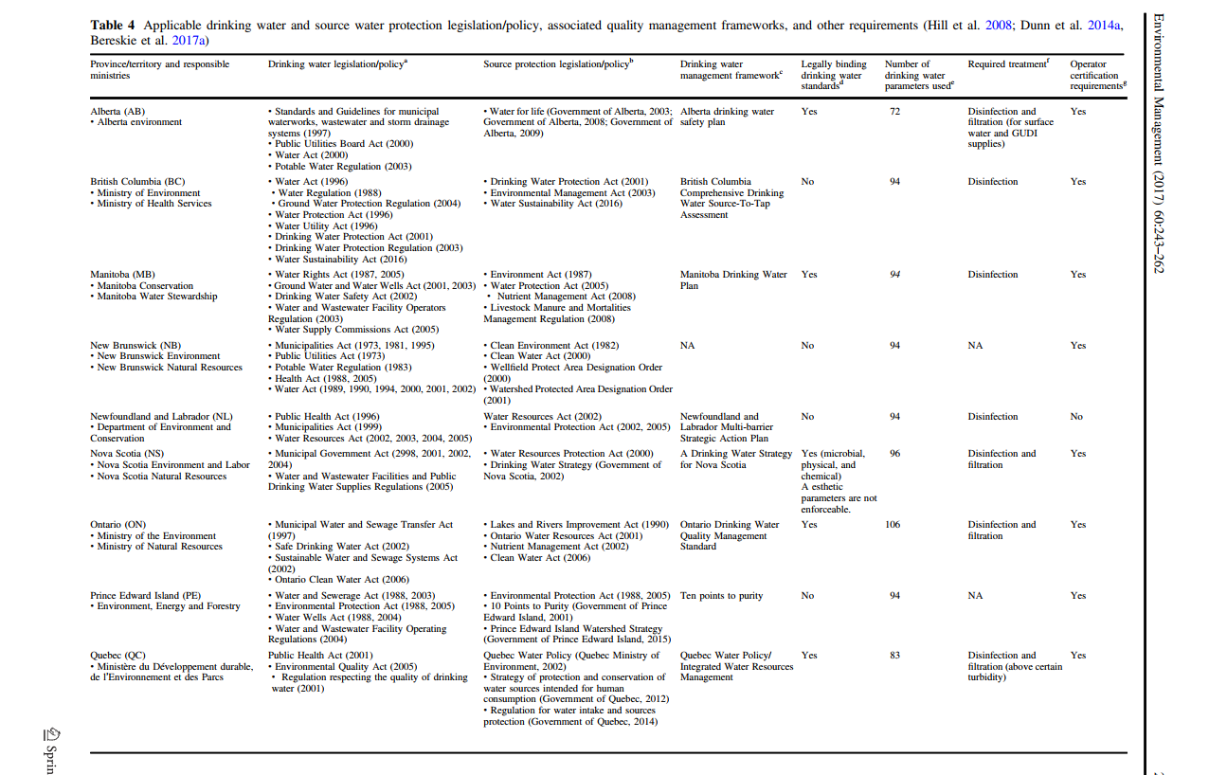
Comparing Canada’s Decentralized Water Policy Problem to the WHO Policy Framework
Notes:
Health Canada (2014) publishes voluntary health-based guidelines, the Guidelines for Canadian Drinking Water Quality (GCDWQ) which are only suggestions to provinces, territories and municipal governments which lack legislation and are not legally enforced (Bereskie &
Rodrieguez, 2017, p. 247). Since 2011, only the Northwest Territories, had adopted all 94 GCDWQ (Dunn & Harris, et al., 2015, p. 245). However, the European Union and the U.S. apply enforceable national standards with legal consequences supported by the states and provinces. This makes Canada’s need for a national water policy more urgent.

Slide 10
UN-Water Global Assessment of Sanitation & Drinking-Water (GLAAS)
Be a resource for stakeholders to extend & sustain WASH services
Strengthen national processes to improve WASH status
Minimize data collection burdens & maximize existing data uses
Focus on areas where GLAAS is well-positioned for impacting other WASH actors
Ensure High quality data
Align with SDGs, & integration of SDG principles of universality & equity
Inclusive of different perspectives, national governments & development partners
Work with other sectors, education & health to learn from their experience
Notes:
ource water, including filtration for turbidity and parasite removal” (Christensen et al. 2010; Bakker and Cook 2011, as cited in Bereskie, 2017, p. 250).
Since provinces and territories are permitted to interpret these guidelines to suit their economic interests, this often results in compromising regulations like the E. coli outbreak in Walkerton Ontario. Justice Dennis O’Connor was the Commissioner of the Walkerton Inquiry on the E. coli contamination in Walkerton Ontario. Justice Dennis O’Connor, found that the original contamination originated from farm waste located on a field which washed into an improperly capped well from extreme heavy rains (Mitchell 2017, p. 15). Justice O’ Connor reported that: “Due to improper practices that had stretched back years, the contamination went undetected and inadequately treated (Christensen & Goucher, et al., 2010, p. 5). Justice O’Connor detected that a “lack of binding standards and provincial government cutbacks contributed to the event” (Christensen & Goucher, et al., 2010). Justice Dennis O’ Connor recommended a multi-barrier approach (MBA) to provide a backup safety system in case the water system was contaminated (Christensen & Goucher, et al., 2010, p. 6). He also recommended the legislation of federal water management laws to ensure that all Canadians have access to clean drinking water and clean water systems for sanitation and hygiene (Mitchell 2017, p. 15). The citizens of Winnipeg suffered from E. coli in their public water system in 2015 (Mitchell 2017, p. 15). The deaths and illnesses from the Walkerton water tragedy make the need for Canada to follow the WHO water quality standards more urgent.

Slide 11
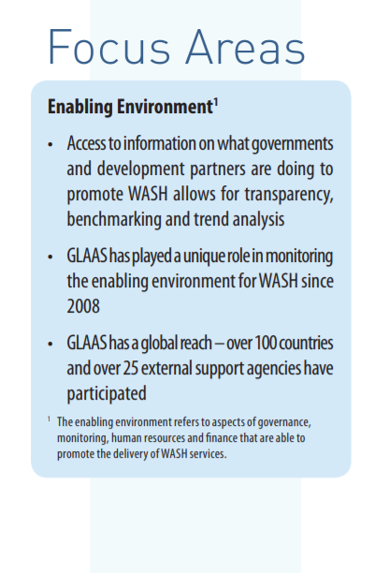
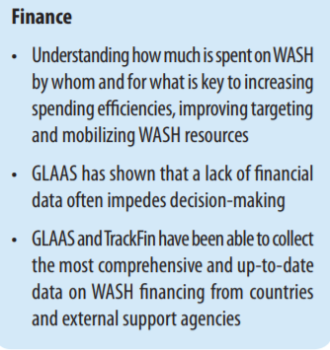
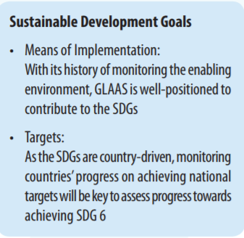

Slide 12
WHO Policy Framework
Notes:
Health Canada (2014) publishes voluntary health-based guidelines, the Guidelines for Canadian Drinking Water Quality (GCDWQ) which are only suggestions to provinces, territories and municipal governments which lack legislation and are not legally enforced (Bereskie &
Rodrieguez, 2017, p. 247). Since 2011, only the Northwest Territories, had adopted all 94 GCDWQ (Dunn & Harris, et al., 2015, p. 245). However, the European Union and the U.S. apply enforceable national standards with legal consequences supported by the states and provinces. This makes Canada’s need for a national water policy more urgent.

Slide 13
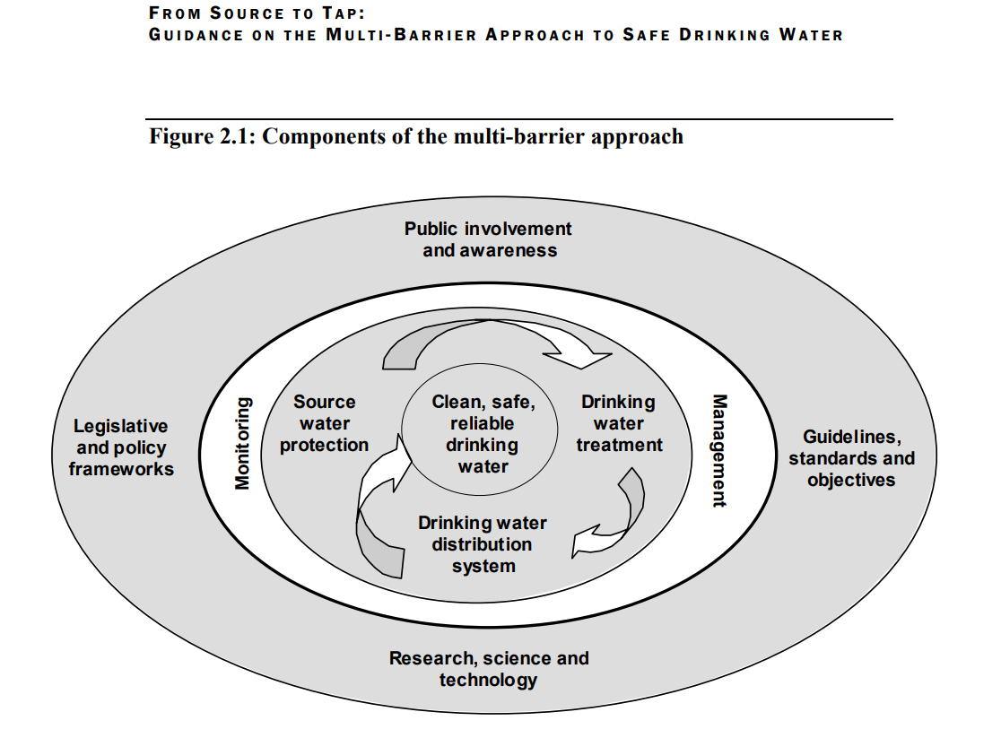
Canadian Council of Ministers of the Environment (CCME). (2002). From Source to Tap: The multi-barrier approach to clean drinking water. 16. Retrieved from http://www.hc-sc.gc.ca/ewh-semt/alt_formats/hecs-sesc/ pdf/water-eau/tap-source-robinet/tap-source-robinet-eng.pdf

Slide 14
The Mission of the WHO Water Safety Plan (WSP)
Develop national access to safe drinking water sources from sustainable watersheds to support sanitation & hygiene (GLAAS, 2017).
Canada currently assists rural communities with contaminated water through building & maintaining on-site water treatment facilities.
The WHO WSP links water technicians with foreign water technicians to ensure that potential global contaminants do not flow into their watersheds.
The solidarity of nations supporting the WHO WSP provides a global united front of water research, water protection strategies, & 24 hour online support for water emergencies (GLAAS, 2017).

Slide 15
Health Canada (2014) publishes voluntary health-based guidelines for Canadian Drinking Water Quality (GCDWQ) as suggestions lacking legislation & are not legally enforced.
Since 2011, only the Northwest Territories, had adopted 94 GCDWQ (Dunn & Harris, et al., 2015, p. 245).
The European Union and the U.S. apply enforceable national standards with legal consequences supported by the states and provinces.
Canada’s need for a national water policy is urgent!
Notes:
Health Canada (2014) publishes voluntary health-based guidelines for Canadian Drinking Water Quality (GCDWQ) which are only suggestions to provinces, territories and municipal governments which lack legislation and are not legally enforced (Bereskie &
Rodrieguez, 2017, p. 247). Since 2011, only the Northwest Territories, had adopted all 94 GCDWQ (Dunn & Harris, et al., 2015, p. 245). However, the European Union and the U.S. apply enforceable national standards with legal consequences supported by the states and provinces. This makes Canada’s need for a national water policy more urgent.

Slide 16
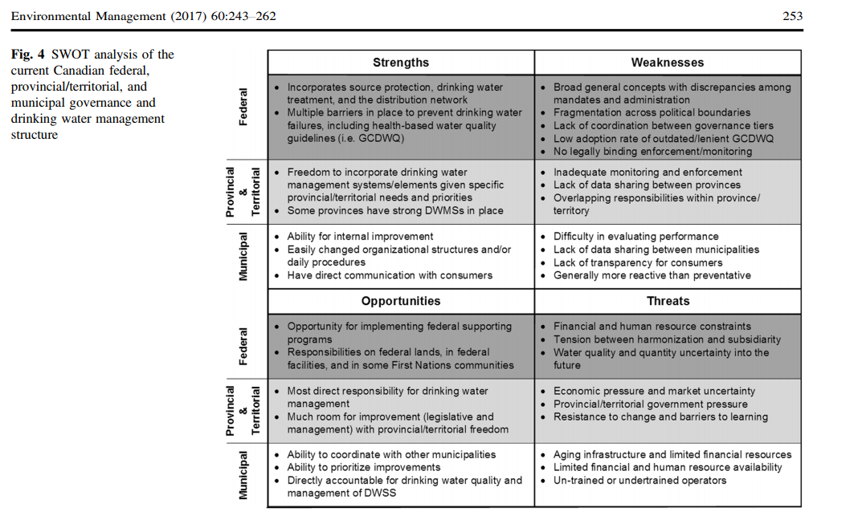
SWOT Analysis of Canadian federal, provincial/territorial & municipal governance drinking water management structure
Bereskie, T., Rodriguez, M. J., & Sadiq, R. (2017). Drinking Water Management and Governance in Canada: An Innovative Plan-Do-Check-Act (PDCA) Framework for a clean Drinking Water Supply. Environmental Management, 60(2), 253. doi: 10.1007/s00267-017-0873-9.
Notes:
summarized through the difficulty in communicating breaches in water treatment systems across municipal and provincial jurisdictions. In rural and isolated communities limited infrastructure, finances, resources and operators exacerbates timely reporting and repair of contaminated water systems and watersheds. Federal intervention and expertise can provide a foundation to build a strong water system workforce.

Slide 17
Resistance to National Water Policy
Trade relations with U.S. Transboundary Waters
Changes from Government to Governance
Conflicts with Stakeholders -Corporations
Indigenous Land Rights Supreme Court Ruling
Urgent Need for Authentic Dialogue!
Notes:
partner; and the countries share significant transboundary water resources (International Joint Commission, 2000, as cited in Mitchell, 2017, p. 14). Water-related issues also fall within the mandate of the Commission on Environmental Cooperation (created under the North American Free Trade Agreement). Other examples of bilateral water-related initiatives include the Great Lakes Water Quality Agreement (Bakker, & Cook, 2011, p. 279).
A second reason is the shift from government to governance. Since the 1980s, environmental non-governmental organizations (eNGOs) have taken on an increasing importance in environmental and water governance in both Canada and the United States (Parson, 2001, as cited in Bakker, & Cook, 2011, p. 280). A third reason involves the new actors of governance consisting of stakeholders, land owners and environmental organizations who have conflicting interests that challenge water policies in Canada. Water governance in Canada is also complicated by Aboriginal and treaty rights, especially those rights deemed by “the Supreme Court of Canada that are lands where treaties were not signed, [therefore] Aboriginal rights and title were not extinguished" (Bakker & Cook, 2011, p. 278). Unceded First Nations lands such as these are also lands upon which twelve-year-old Autumn Peltier resides at Wikwemikong First Nation land in Ontario (Lau, 2016, para. 3). Therefore, the vulnerable First Nations People have a right to determine the policies that impact their watershed.

Slide 18
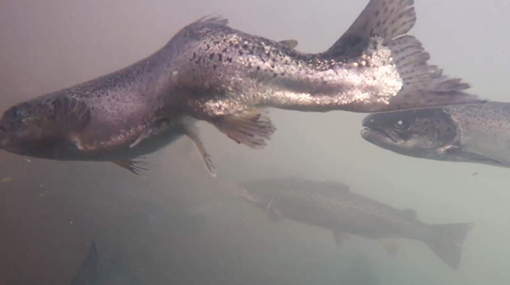
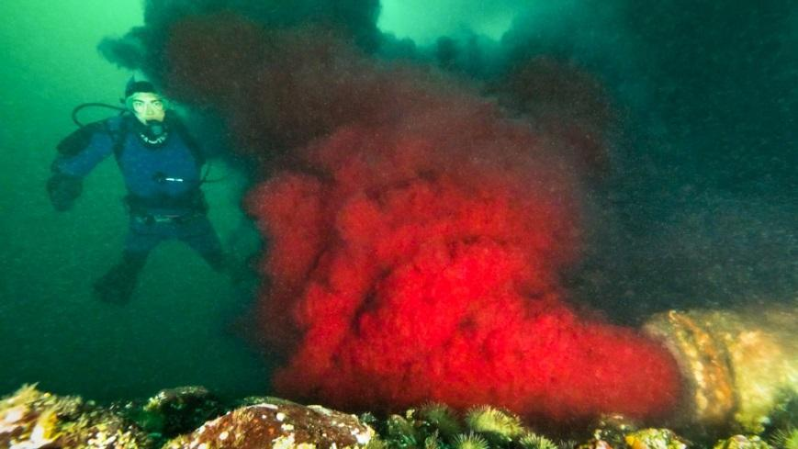
Transboundary U.S. Farmed Fish Infect B.C. Waters
Current with Anna Maria Tremonti.CBC Tavish Campbell
Notes:
For example, diseased farmed salmon from Atlanta swam into British Columbia (B.C.) waters and infected wild B.C. salmon. Jennifer Nener, director of Salmon management of the department of Oceans and Fisheries Canada, said: “Sockeye salmon return on a four-year cycle, and the 2017 run is based on the previous returns from 2013 and 2009. The lowest return every recorded was in 2016 when just 850,000 sockeye came back [owing to] warmer temperatures in the Pacific Ocean (McSheffrey, 2017, para.9). The salmon’s journey of swimming upstream to their mother’s place of spawning is disrupted by the Atlantic farmed salmon accidental invasion (Linnett, 2017, para. 9). Atlantic farmed salmon are diseased and deformed from being in cramped living conditions and fed synthetic fish food pumped full of antibiotics. When they swim with wild salmon they disrupt the natural ecosystem which impacts the wild salmon (refer to appendix #7 pictures).

Slide 19
Flood/ Water Related illnesses
Potlotek First Nation,
Cape Breton
Kashechewan First Nations, Ontario
MacPhee, , N.J. (2016). Cape Breton's Potlotek First Nation protests dirty water: Thick, black liquid pouring out of taps at the Cape Breton reserve. CBC News Paling, E. (2016). Kashechewan First Nation's Children at Front and Centre of Recurrent Crisis. The Huffington Post Canada.
Notes:
s. The suffering in Canada’s waterways extends into the homes of First Nations children who do not have access to clean tap water which exacerbates water-related illnesses. Dr. Loewen and Booking et al (2017) conducted a review at the Sioux Lookout Meno Ya Win Health Centre (SLMHC) from 2009 to 2014 to examine rates of streptococcus infection and found that:
The rate of invasive group A Streptococcus infection in the predominantly First Nations population served by the SLMHC exceeded the Canadian rate eightfold and is comparable to rates observed in low-income countries and among Indigenous populations in Australia. This disparity may result from inadequate housing, overcrowding or limited access to clean water.
(Loewen, & Booking, et al, 2017, p. 138)
The suffering of the First Nations people of Sioux Lookout reverberates with their children and the marine wildlife who have no voices in the water policies requiring the federal government to facilitate deliberative policy analysis processes with stakeholders, citizens, provincial legislators and municipalities to find a common ground through authentic deliberative dialogue. It is not enough for Health Ministers to make promises with gallons of bottled water when no time frames are established with First Nations to have clean water running from their taps so they can bathe.

Slide 20
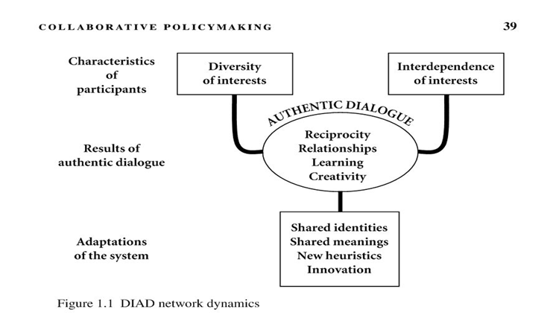
Collaborative Policymaking through Authentic Dialogue
Hajer, M. A., & Wagenaar, H. (2003). Collaborative policymaking. Deliberative policy analysis: understanding governance in the network society. Cambridge, UK: Cambridge University Press. (39).
Notes:
Two equally effective deliberative policy analysis processes are the citizen initiatives and referendums. These processes enable populations to vote directly on policy issues. Referendums can be advisory or mandatory – in certain countries, laws and constitutional changes require a popular vote. The initiative offers a process through which citizens can propose new legislation or extinguish unfair laws (Smith, 2003 p. 93). A case in point is the Italian Forum of Water Movements who collaborated with other Non-Governmental Organizations (NGO) to conduct a citizen's referendum against water privatization in Italy. Citizens were contacted online and in person. Together, they formed the "Water Common Good" social movement and gathered enough votes to control the regulation of private water companies in Italy (Francesca, 2015, p. 649). Through reciprocal relationships they creatively governed their policy solution through collaborative dialogue as indicated in figure three.
Mediation and stakeholder group engagement involves diverse groups who are in conflict with each other and are willing to achieve a resolution in which all groups are in agreement with the policy. Some mediators believe that for this process to be productive that all groups must be cooperative so they can focus on collective concerns instead of personal interests. The final policy decision is a collective group conscience of the stakeholders involved. Therefore, the final policy decision is not imposed by an outside corporation. In the stakeholder model of the deliberative policy process there is the successful case study of the San Francisco Estuary project. The San Francisco Estuary project involved two years of collaboration between stakeholders who learned that the health of the estuary was related to the land use, the water use, the fisheries, the water quality and biodiversity (Hajer, & Wagenaar, 2003, p. 41).

Slide 21
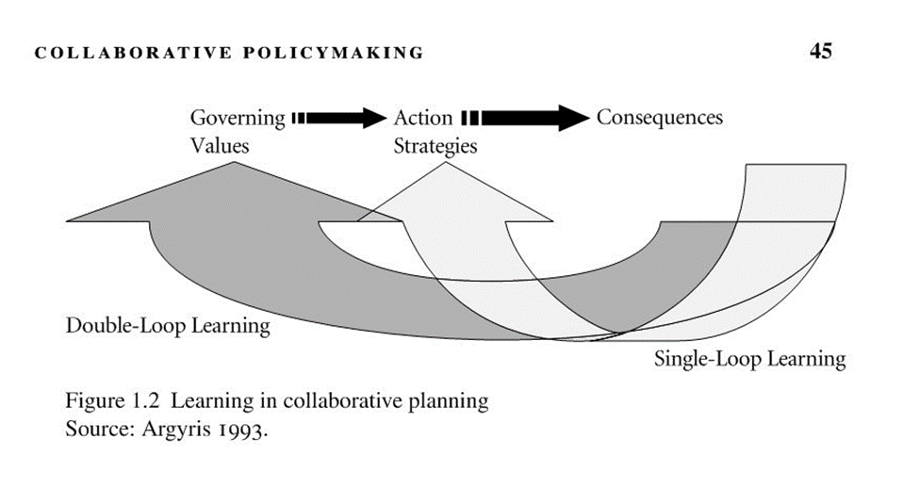
Double-Loop Learning
Hajer, M. A., & Wagenaar, H. (2003). Collaborative policymaking. Deliberative policy analysis: understanding governance in the network society. Cambridge, UK: Cambridge University Press. (p. 45).
Notes:
In double-loop learning actors must re-contemplate and re-evaluate their primary objective through reframing their conflicts, re-orientating their values and reconsidering their interests (Schon & Rein, 1994, as cited in Hajer, & Wagenaar, 2003, p. 45). For example, during Sacramento Water Forum, people catalyzed four types of changes within their values, their relationships with their opposing parties and their perceptions of policy solutions. They moved their complex policy problem into an adaptive policy solution through their capacity to listen to each other, learn and evolve through reciprocal feedback (Hajer, & Wagenaar, 2003, p. 47). Therefore, Canada’s national water policy must evolve through the reciprocal deliberation of engaged citizens over time, space and consensus.
Brazil struggled with water shortages and contamination of the great Amazon watershed. Brazil’s National Water Agency (ANA) helped states collectively form a National Water Management Pact. State level stakeholders, council authorities, civil society representatives, water user sectors and river basin committees collaborated on water development goals (Brazil National Water Agency, 2015, as cited in OECD, 2015, p. 123). Through signing a bilateral contract with the Brazil National Water Agency, each state in Brazil receives federal funding to achieve their watershed management goals (Brazil National Water Agency, 2015, as cited in OECD, 2015, p. 123). This has improved water governance through closer cooperation between Brazil’s states, stakeholders, businesses and citizens. The following diagram (figure five) is an OECD analytical framework of stakeholder engagement in water governance:

Slide 22
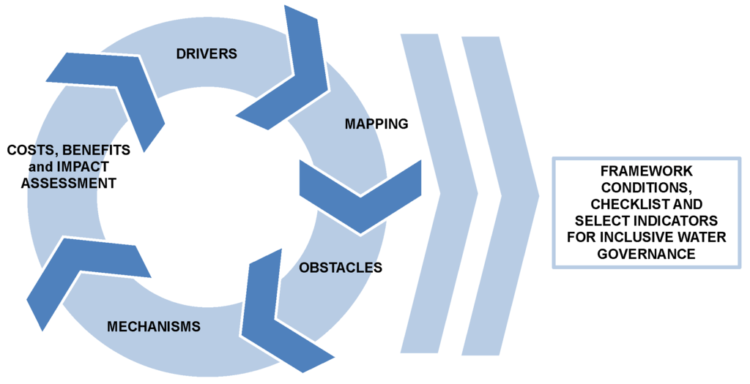
Framework for Stakeholder Engagement
Organisation for Economic Co-operation & D&Development (OECD)
Organisation for Economic Co-operation & Development
(OECD)
Akhmouch, A. & Clavreul, D. (2016). Stakeholder Engagement for Inclusive Water Governance: “Practicing What We Preach” with the OECD Water Governance Initiative. Water, 8, (204), 5.
Notes:
This is a diagram of a policy framework that examines five areas of deliberative stakeholder engagement in global and national water management that encompasses the drivers of deliberative stakeholder water system engagement, the role that these stakeholders play (eg. who they are, their interests), how these stakeholders engage in the policy frameworks, their
obstacles they are driven to overcome, the mechanisms for engaging stakeholders and the “assessment of costs and benefits (Akhmouch & Clavreul, 2016, p. 5). This analysis is based on a qualitative and quantitative survey conducted online in 2014 to gather data on a diverse scope of stakeholders with conflicting interests and experiences. This survey engaged stakeholders through deliberative dialogue on the premise that exploring a common ground with our greatest critics will improve our moral reputation and our economic sustainability. This mixed method approach of data collection provides quantitative data that can inspire stakeholders’ funds and qualitative data that can open their hearts (Akhmouch & Clavreul, 2016, p. 6). For example, the “Water and Waste Services Regulation Authority of Portugal has developed a mobile application
that provides water service quality to users in 278 municipalities” (Akhmouch & Clavreul, 2016, p. 6). Figure six in the following diagram reveals how the stakeholders' commitment to the deliberative policy analysis process evolved from the initial survey to collaboration with citizens.

Slide 23
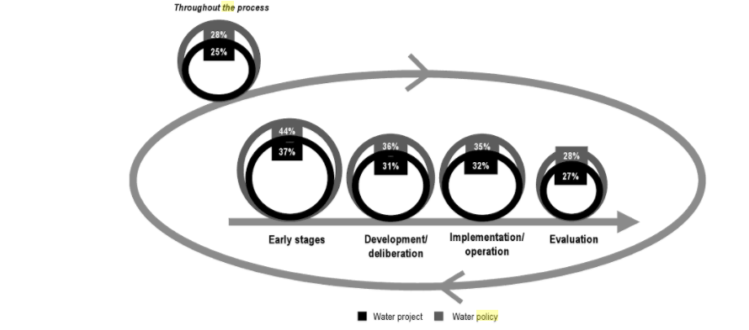
Involvement of stakeholders across stages of policy/project cycle
OECD, (2015). Stakeholder Engagement Mechanisms in the Water Sector, in OECD. (2015). Stakeholder Engagement for Inclusive Water Governance, OECD Studies on
Water, OECD Publishing, Paris.
Notes:
In figure six, the survey results are mapped across the policy process cycle considering data in relation to the average between target and promoters for the responses as “always” and “almost always” to the question “At which stage of a water-related project and/or reform does your organization usually get involved?” (OECD, 2015, p. 130). These survey results reveal the stakeholder interactions in the initial “stages of conception, planning, design, and feasibility studies when most of the respondents surveyed [stakeholders] intervene” (OECD, 2015, p. 130), throughout the stakeholder engagement of deliberating over the most effective policy for everyone. Stakeholders can be encouraged to engage in ethical deliberation with OECD countries to enable their organization to wear the OECD seal of approval for following the OECD Environmental Performance Guidelines (OECD, 2010, pp. 57-79). Canada could benefit from adopting a similar stakeholder engagement policy process with provinces and territories. The Ontario Environment Minister has initiated a similar stakeholder engagement process across Ontario’s municipalities.

Slide 24
Chris Ballard Minister of the Environment Ontario
Engages citizens on climate change, through utilizing their input to transform carbon taxes into energy saving incentives and affordable renewable energy programs (De Souza, 2017, para. 11).
We can make positive actions on provincial and municipal levels by learning from California and Ontario (De Souza, 2017, para. 11).
Canada’s federal engagement in mixed methods stakeholder research inspires authentic dialogue to bring corporate stakeholders & Indigenous peoples into negotiation through deliberative policy analysis processes.
https://youtu.be/Fz4kzEGOMNE
Notes:
The Ontario Environment Minister engages citizens on climate change, through utilizing their input to transform Prime Minister Justin Trudeau’s carbon taxes into energy saving incentives and affordable renewable energy programs (De Souza, 2017, para. 11). All Canadian citizens can make positive actions on provincial and municipal levels by learning from California and Ontario (De Souza, 2017, para. 11). Canada’s federal engagement in mixed methods stakeholder research can also inspire deliberative dialogue to bring corporate stakeholders and Indigenous peoples to the table of negotiation through deliberative policy analysis processes. For example, Lytton First Nation installed a water treatment plant that was built in a lab at the University of British Columbia UBC by Indigenous students and by RES'EAU-WaterNET, which was an engineering project for clean water development so people in remote areas can drink water from their tap (Fontaine, 2017, para. 5). This project was initiated by Indigenous Affairs and Northern Development (INAC) and IC-IMPACTS, an initiative of water experts from Canada and India who strive for integrated water management in remote areas (IC-IMPACTS, as cited in Fontaine, 2017, para. 9).

Slide 25
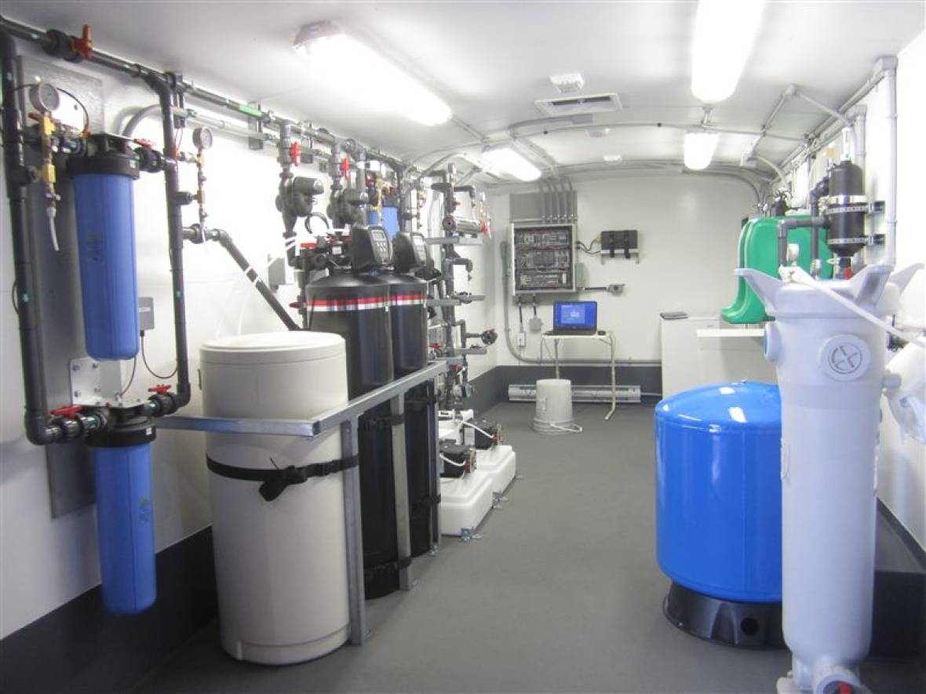
Lytton First Nation installed a water treatment plant by UBC Indigenous students & RES'EAU-WaterNET,
Notes:
Lytton First Nation installed a water treatment plant that was built in a lab at the University of British Columbia UBC by Indigenous students and by RES'EAU-WaterNET, which was an engineering project for clean water development so people in remote areas can drink water from their tap (Fontaine, 2017, para. 5). This project was initiated by Indigenous Affairs and Northern Development (INAC) and IC-IMPACTS, an initiative of water experts from Canada and India who strive for integrated water management in remote areas (IC-IMPACTS, as cited in Fontaine, 2017, para. 9). The stakeholders from IC-IMPACTS also trained University of Alberta engineering students to utilize special water deionization processes through solar nanotechnology for constructing onsite water treatment plants in remote northern First Nations communities so they can get clean tap water. This is a program called Engage North which occurred in the summer of 2017 through two graduate Fellowship projects in the Yellowknife’s Dene First Nations (YKDFN) communities of Ndilo and Dettah, Northwest Territories (Fehr, 2017, para. 11).

Slide 26
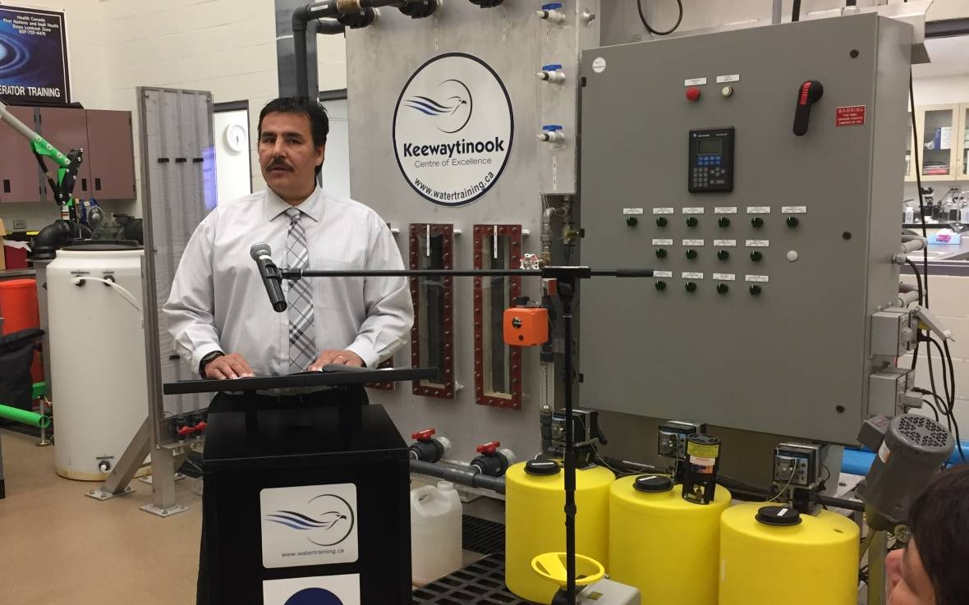
Fort Severn Chief Paul Burke with Water Quality Monitoring Equipment from the Safe Water Project in Ontario
Notes:
This project was initiated by Indigenous Affairs and Northern Development (INAC) and IC-IMPACTS, an initiative of water experts from Canada and India who strive for integrated water management in remote areas (IC-IMPACTS, as cited in Fontaine, 2017, para. 9). The stakeholders from IC-IMPACTS also trained University of Alberta engineering students to utilize special water deionization processes through solar nanotechnology for constructing onsite water treatment plants in remote northern First Nations communities so they can get clean tap water. This is a program called Engage North which occurred in the summer of 2017 through two graduate Fellowship projects in the Yellowknife’s Dene First Nations (YKDFN) communities of Ndilo and Dettah, Northwest Territories (Fehr, 2017, para. 11).

Slide 27
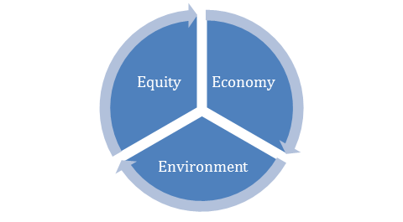
3-E’s of Citizenship Sustainability: Equity, Environment & Economy & Peace, Order, Good Government (POGG)
“An environmentalist sees an environmental problem and says, ‘Let’s regulate it!’ An entrepreneur sees an environmental problem and says ‘How can I make money by solving it?” (Keilbach, 2009, p. 294). They collaborate for equity in the environment & economy.
Notes:
The government will save millions of healthcare dollars spent on contaminated water related illnesses. Water quality equity reduces health costs for the economy and sustains the environment. This reflects the 3-E’s of citizenship sustainability instilling equity, environment and the economy into the political framework of Canada’s waterways. This is illustrated in the following diagram figure seven which is the writer’s synthesis of the 3-E’s of citizenship sustainability instilling equity, environment, and the economy integrated to the shape of the peace sign symbol to represent the federal government’s jurisdiction to protect drinking water quality under the “peace, order and good government” (Sprague, 2007, p. 23) (POGG) with authentic deliberative dialogue and reciprocity flowing in the circular arrows:
There is a media misconception that Canada has an abundance of water when in truth Canada only has just over “six percent of the world’s annual renewable water supply” (Sprague, 2007, p. 22). Climate change alters clean water availability and communities need to alter their methods of management. “An environmentalist sees an environmental problem and says, ‘Let’s regulate it!’ An entrepreneur sees an environmental problem and says ‘How can I make money by solving it?” (Keilbach, 2009, p. 294). Environmentalists and economists must be open-minded enough to embrace the interdependent relationship between the environment, the economy and equity. Environmentalists' and economists' collaboration will diffuse the arguments and utilize the scientific expertise available to find solutions. The question of what needs to be done to move toward safe drinking water involves complex political and technical frameworks.
Bleaching the water is similar to how the government bleached the school curriculum with white European authors, history and language. This is a common pattern for political frameworks that infiltrate culturally diverse populations with white European culture and values (Mander, & Tauli-Corpuz, 2006). The bleached water is a metaphor for the white veil the government uses to hide the injustice of contaminated water. Just as the white European curriculum absorbed Aboriginal culture, the white bleach absorbs the pathogens in the water. This political framework of the subaltern view has contributed to compromised drinking water standards in Canada. Political conflicts over unhealthy chemical water treatment methods put uninformed citizens at the mercy of unethical politicians. Empowering citizens through deliberative policy processes can give Canadians the political equity they need to establish higher quality water treatment standards. The government will save millions of healthcare dollars spent on contaminated water related illnesses. Water quality equity reduces health costs for the economy and sustains the environment. This reflects the 3-E’s of citizenship sustainability instilling equity, environment and the economy into the political framework of Canada’s waterways. This is illustrated in the following diagram figure seven which is the writer’s synthesis of the 3-E’s of citizenship sustainability instilling equity, environment, and the economy integrated to the shape of the peace sign symbol to represent the federal government’s jurisdiction to protect drinking water quality under the “peace, order and good government” (Sprague, 2007, p. 23) (POGG) with authentic deliberative dialogue and reciprocity flowing in the circular arrows:

Slide 28
The Forum for Leadership on Water (FLOW) identifies 7 priorities for federal action:
creating a federal water strategy;
prioritizing water in assessments from the impacts of energy production;
ensuring clean drinking water through legally enforceable drinking water standards;
recognizing Aboriginal water rights;
enforcing water protection laws
fostering water conservation,
supporting transboundary water governance; & expanding the federal government’s role in water science.
(Morris et al., 2007, as cited in Bakker & Cook, 2011, p. 281)
Reinstating Canada’s Navigable Waters Act can protect Canada’s waters from transboundary pollution and foreign farmed fish.
Notes:
The provinces, territories, municipalities and Aboriginal communities can be collaborated with to determine and improve the enforcement of the water governance policies in Canada. Recent water governance initiatives have the potential to make significant changes. A viable possibility is the development of a federal water strategy that follows WHO water quality standards and is coordinated with provincial, territorial and First Nations’ policies. In order to protect the rights of the people directly impacted by these policies, the creation of these policies should be deliberative processes to allow for true participation by engaged citizens (Bakker & Cook, 2011, p. 287).

Slide 29
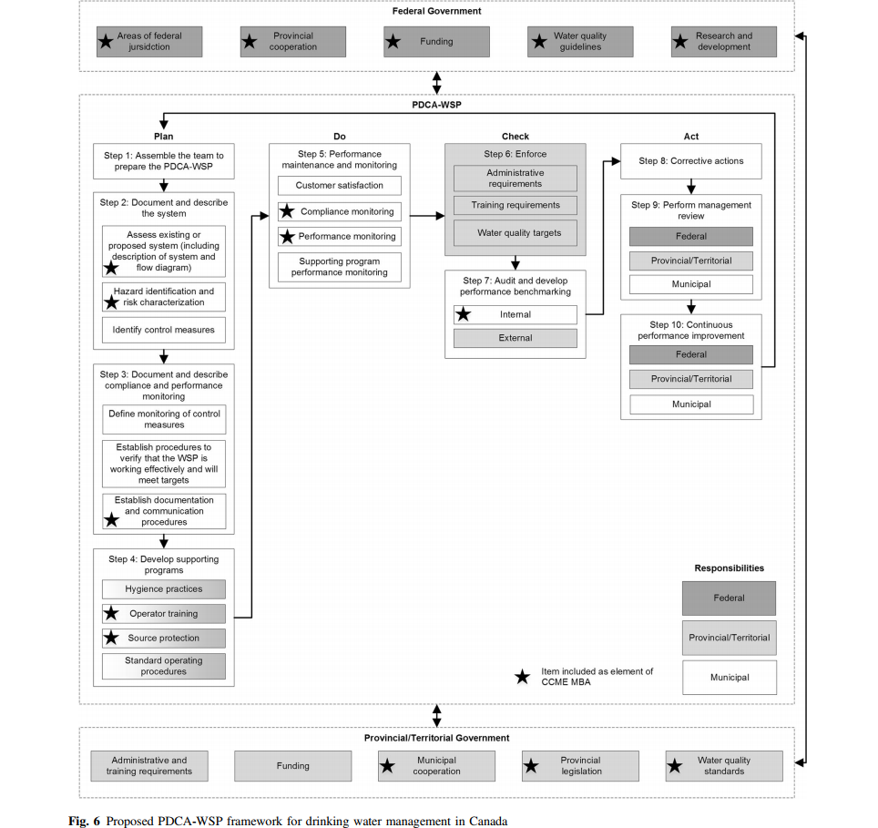
Notes:
The proposed PDCA-WSP framework is based on the recommendations by the WHO water standards:
The arrows out of the top box are the flow of resources and information between the Federal Government, the provincial/territorial governments, and the PDCA-WSP.
The bottom box of Fig. 6 describes the monitoring responsibilities of the provincial/territorial governments.
The arrows out of the top box represent the flow of resources and information between the Provincial/Territorial Government, the Federal Government, and the PDCA-WSP.
The large middle box at the center of Fig. 6 represents the bulk of the proposed PDCA-WSP framework.
(Bereskie, 2017, p. 256)

Slide 30
Federal Water strategy following WHO Standards with Provincial, Territorial and First Nations’ Policies
The provinces, territories, municipalities and Aboriginal communities can be collaborated with to determine and improve the enforcement of the water governance policies in Canada.
Recent water governance initiatives have the potential to make significant changes.
In order to protect the rights of the people directly impacted by these policies, the creation of these policies should be deliberative processes to allow for true participation by engaged citizens (Bakker & Cook, 2011, p. 287).

Slide 31
WHO, OECD, Stakeholders & Canada
A mixed methods approach of quantitative data & qualitative data across the policy project cycle can encourage key stakeholders to invest in communities & replenish their watersheds.
The WHO water quality standards and the OECD environmental performance evaluations can educate businesses on ecosystem management and water conservation while enhancing their moral reputation.
Information acquired could then be analyzed to tailor the framework to the unique governance structure and environmental factors impacting the diverse ecosystems throughout Canada. https://canadians.org/nestle
Notes:
During Hurricane Katrina in 2005, many Canadians commented that they would never neglect people in disasters like the hurricane in New Orleans, yet water emergencies are a continuous occurrence for First Nation Reserves. Deliberative authentic dialogue across Canada with citizens could help people to solve this water crisis as a nation instead of turning to the Nestle Bottled Water company who has been illegally siphoning Ontario’s watershed without an updated permit (Lui, & Barlow, et al, 2017). Then Nestle sells the water to Indigenous Affairs and Northern Development (INAC) so that INAC can provide bottled water to the First Nations in Ontario who lack a clean, plentiful watershed. Economic injustices of illegal water extraction require the consequences enforced through a national water policy deeming the theft of this life saving resource as a federal crime so the corporation is prosecuted in court while the whole world is watching!
Unsafe drinking water and water-related illnesses in Canada have been extensively researched by medical doctors and legal officials as caused by absence of nationally enforced water regulations standards (Loewen, & Booking, et al, 2017, p. 138). Voluntary Health guidelines have been poorly interpreted by many provinces, territories and municipalities resulting in the compromised safety and health of many innocent Canadians. As a result, First Nations and rural communities suffer from waterborne diseases, endure boil water advisories and depend on bottled water dreaming of the day when they can flow clean water from their taps for a bath. This “patchwork of drinking water laws across the country” (Christensen et al. 2010; Bakker and Cook 2011), can be seen as checkered chess board where poor rural, isolated and Aboriginal communities are the “pawns in the [corporate neo-liberal] game” of marketing water as a commodity instead of sustaining water as a human right (Dylan, 1963, as cited in Margotin, & Guesdon, 2015, p. 9).

Slide 32
The deliberative policy processes of
citizen forums,
mediation,
stakeholder engagement and
referendums can co-create collective reciprocity strengthening Canada as a unified nation. Through the ebb and flow of authentic dialogue the conservation of Canada’s sacred waters are Canadians’ responsibility of stewardship that they all mutually understand, so they will stand on guard for Canada’s waters through deliberative policy analysis processes.
P.M. Justin Trudeau’s national promise to protect Canada’s waters can become a national water policy flowing with justice and “righteousness like a mighty stream!” (King, 1963, p. 4).

Slide 33
References

