Slide 1
WILU
LIGHTNING TALK
Using animated GIFs to walk the line between skill development and higher-level concepts in information literacy instruction
MAY 24/17

Slide 2
What is an animated GIF?
Using GIFs
Finding GIFs
Creating GIFs
Making GIFs accessible
jkvan.com/WILU2017GIFs
Notes:
https://giphy.com/gifs/pony-goggles-lets-do-this-PuWNMebKGIKNG

Slide 3
WHAT IS AN ANIMATED GIF?
jkvan.com/WILU2017GIFs
Animated GIF, n.
GIF = Graphics Interchange Format
Comprised of frames that are displayed in succession in a continuous loop
.gif
Notes:
https://giphy.com/gifs/animated-friends-swaXFSeBVHpHq

Slide 4
USING GIFS
jkvan.com/WILU2017GIFs
pop culture GIFs
Enjoyment
Engagement
Build Relevance
Notes:
Why should we use pop culture GIFs in information literacy instruction?
Enjoyment - They’re fun! They can be humourous or silly.
Engagement & building relevance - Animated GIFs have quickly become a channel for visually expressing emotion in our modern culture. They are widely prevalent on the web - found on digital forums, message boards, social media and websites of every genre. They’re familiar to most, while also perhaps being unexpected in the classroom setting.

Slide 5
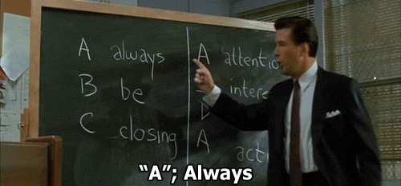
FINDING GIFS
jkvan.com/WILU2017GIFs
Tips:
Items tagged “gif”
Add emotions or ideas to your search
Consider your audience
Giphy.com
Reddit
Tumblr
Search Google for “Buzzfeed GIF”
KnowYourMeme.com
Notes:
Google image search doesn’t always cut it.
Heads up some for NSFW (not safe for work)
Tips:
Items tagged gif
Add emotions
Consider your audience
I.e. does your audience understand the Glengarry Glen Ross reference? (it came out in 1992)
https://images2.newscred.com/Zz1hYzI1YjNhODEzYTJhZWQwNDVlMjE4NzlhNGIzM2QyNQ==
https://www.lifewire.com/where-to-find-funny-gifs-online-3486447
*it’s a little more difficult to track down educational gifs - at this this time there isn’t a great single repository, adding tasks or searching for “educational” tag can help

Slide 6
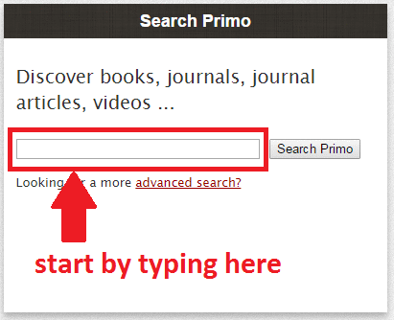
USING GIFS
jkvan.com/WILU2017GIFs
instructional/ “how-to” GIFs

Slide 7
USING GIFS
jkvan.com/WILU2017GIFs
instructional/ “how-to” GIFs
Why use GIFs for how-tos?
Quick, easy, and free to make
Small files are easily shared
Series of static screenshots are more usable than screencasts (Mestre, 2012)
How can “how-to” GIFs be used?
In-class or out-of-class
Great for “point-and-click” demos of discrete tasks
Saves instructional time > develop concepts instead
Be careful of potential for distraction
Mestre, L. (2012). Student preference for tutorial design: A usability study. Reference Services Review, 40(2), 258-276.

Slide 8
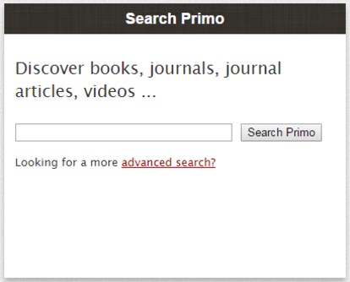
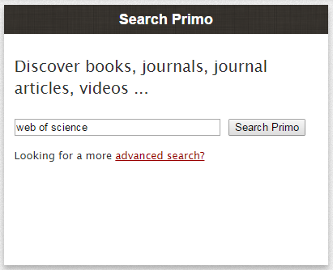
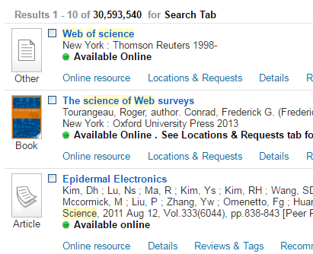
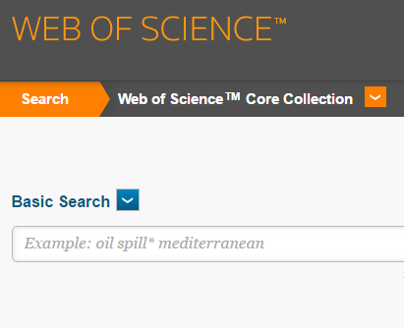
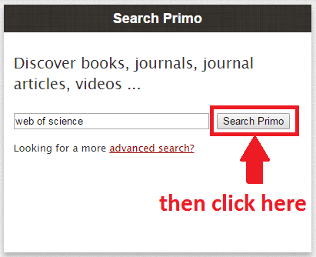
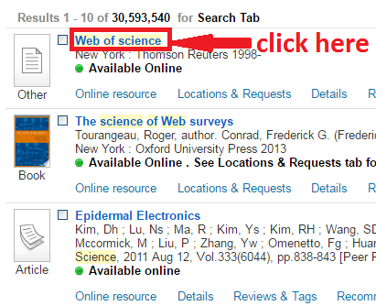
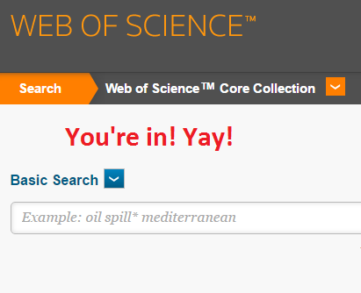
CREATING GIFS
jkvan.com/WILU2017GIFs
Choose a discrete task
Break the task down
Take a screenshot of each step
Zoom in
Don’t jump around
Match image sizes
Add annotations
Indicate the start
Focus viewer’s attention
Create the GIF
Define speed
Define # of repeats
Notes:
Choose a discrete task that can be accomplished in relatively few clicks.
Break the task down to the essential actions. Each action will be a still image in the GIF.
Take a screenshot of each step and save as a still PNG or GIF.
Zoom in on the action, but don’t jump around the screen unnecessarily
Make sure each still image has the same dimensions and scale (measure using pixels)
Add annotations to images using an image editor
Indicate the start of the GIF
Focus viewer’s attention on the essential actions
Create the GIF using an online service
Define speed (~1 sec but play around with yours) and # of repeats

Slide 9
MAKING GIFS ACCESSIBLE
jkvan.com/WILU2017GIFs
GIFs are intended for web environments
LMS
Avoid content that flashes rapidly (more than 3x/sec)
Provide a version of your content that does not include animations.

Slide 10
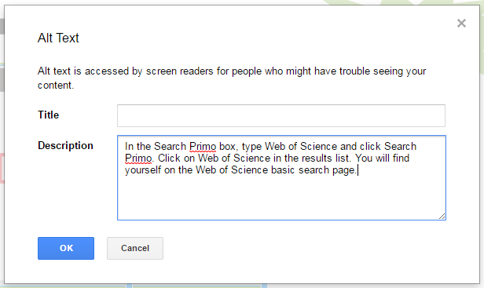
MAKING GIFS ACCESSIBLE
jkvan.com/WILU2017GIFs
GIFs need alt text to be accessible.

Slide 11
MAKING GIFS ACCESSIBLE
jkvan.com/WILU2017GIFs
Alt tags should be < 120 characters. Put longer descriptions elsewhere.
In the Search Primo box, type Web of Science and click Search Primo.
Click on Web of Science in the results list.
You will find yourself on the Web of Science basic search page.

Slide 12
Handout: jkvan.com/WILU2017GIFs
Notes:
https://giphy.com/gifs/mailchimp-thank-you-l3vR4yk0X20KimqJ2

