Slide 1
Introduction to Copyright
*October 2022
Notes:
*Updated: January 2024
Hello and welcome to an introduction to copyright from the University of Alberta’s Opening Up Copyright Instructional Module Series.

Slide 2
WHAT IS COPYRIGHT?
C
Copyright
Notes:
You’ve definitely heard the word, and it is one of the most recognizable marks in the world. But what exactly is copyright?

Slide 3
DEFINING COPYRIGHT
Copyright is the exclusive legal right to produce, reproduce, sell or license, publish or perform an original work or a substantial part of it.
… okay??
Notes:
Copyright, as the name suggests, is a legal right, but it is more complicated than just the right to copy. The Government of Canada’s Canadian Intellectual Property Office defines it as follows:
Copyright is the exclusive legal right to produce, reproduce, sell or license, publish or perform an original work or a substantial part of it.
So what does that mean? Well, for example, when a book is published, sold, copied, adapted into a film, etc… copyright has to be considered.

Slide 4
COPYRIGHT AS INCENTIVE
It’s my right – to exclude you
It’s mine
… and if you copy it, I’ll sue
I don’t want a copy that bad
I guess I can’t just copy that
Cool!
I want that
©
… it really wasn’t that good anyway.
Notes:
Theoretically, copyright is supposed to encourage the creation of new original works by providing an economic incentive to the creators of those works. It limits economic uses of those works by anyone except the rights holder, enabling creators to receive compensation for the copying and use of their work. Copyright is a limited monopoly that functions as a legal right to exclude.
And just what is a “right to exclude”? Well, the copyright holder of a book has the legal right to sue someone who makes a copy or adapts it into a film without their permission.
With copyright law, it is the threat of infringement and legal penalties associated with infringement that prevent or limit uses.

Slide 5
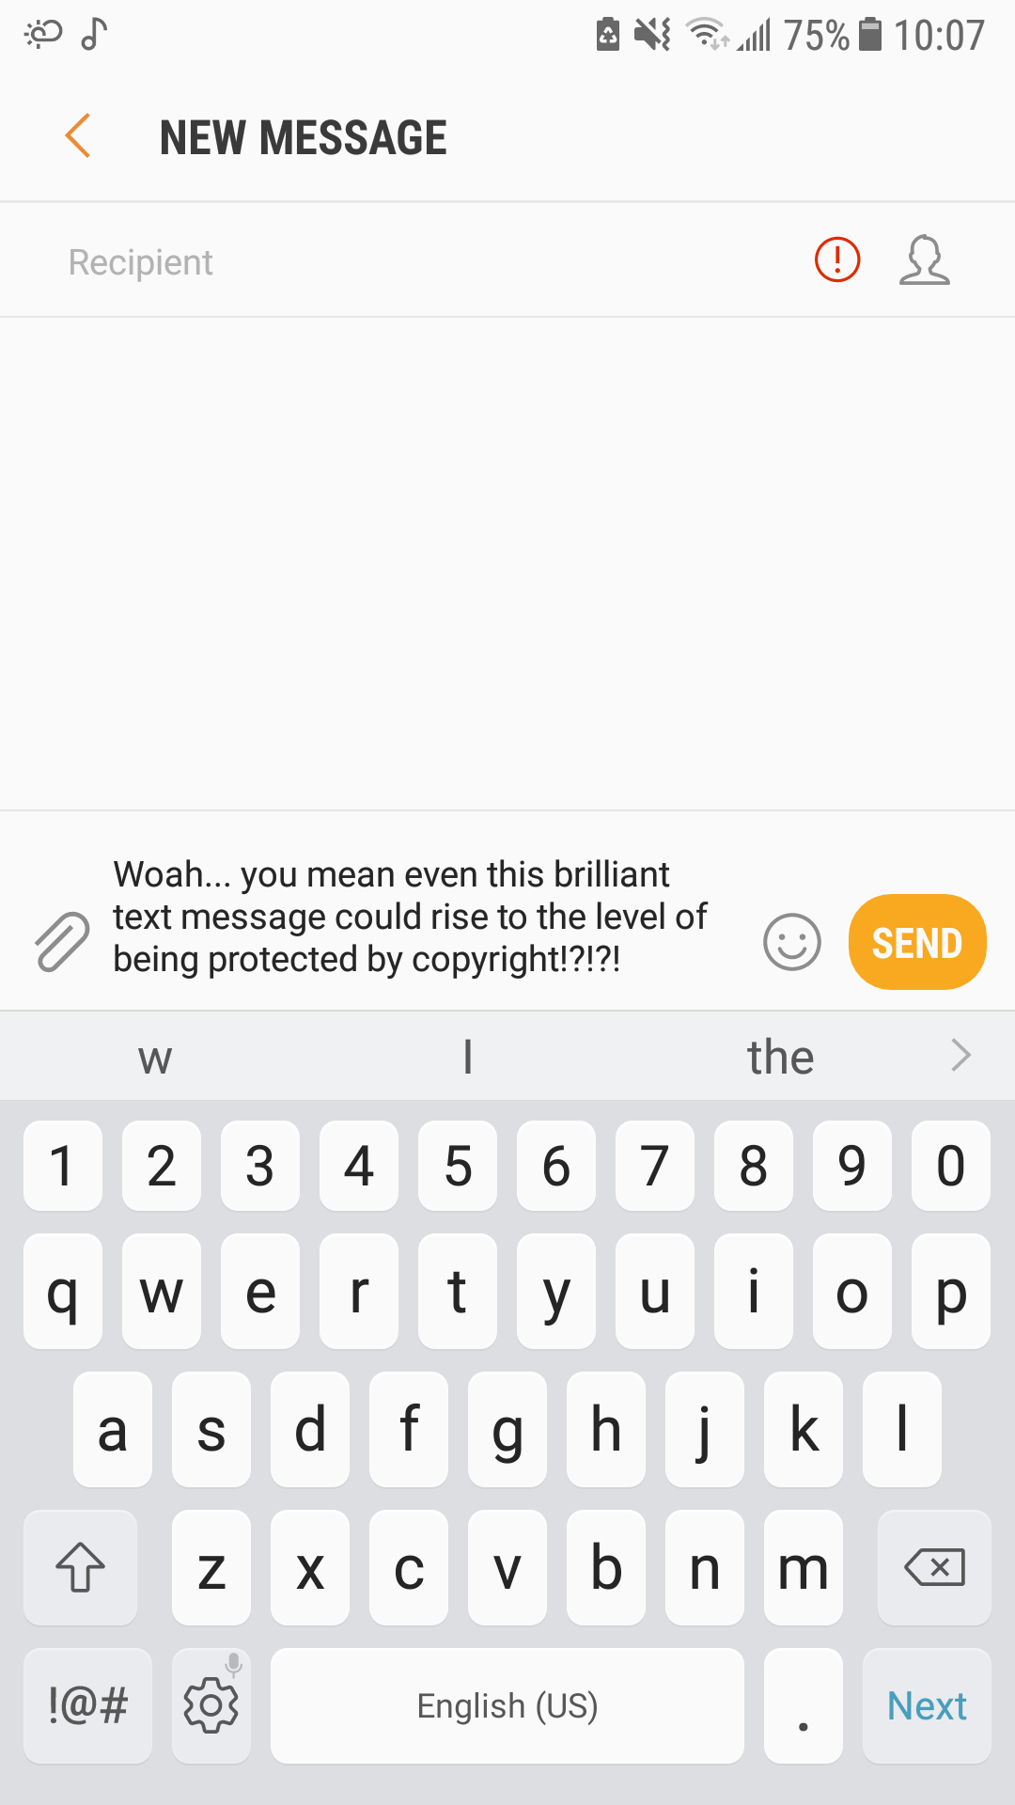
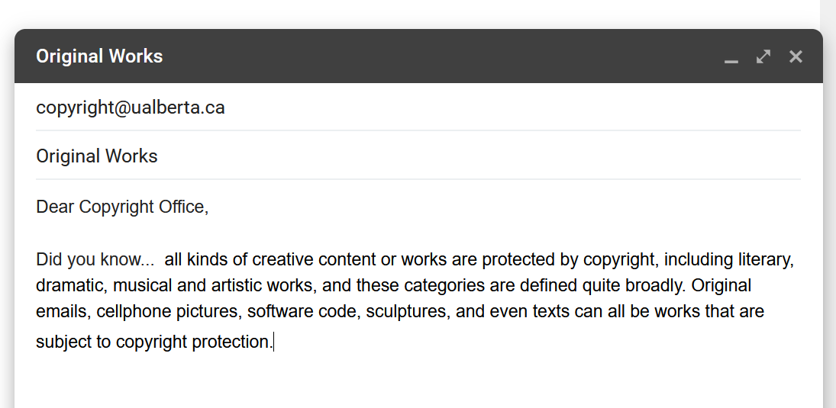
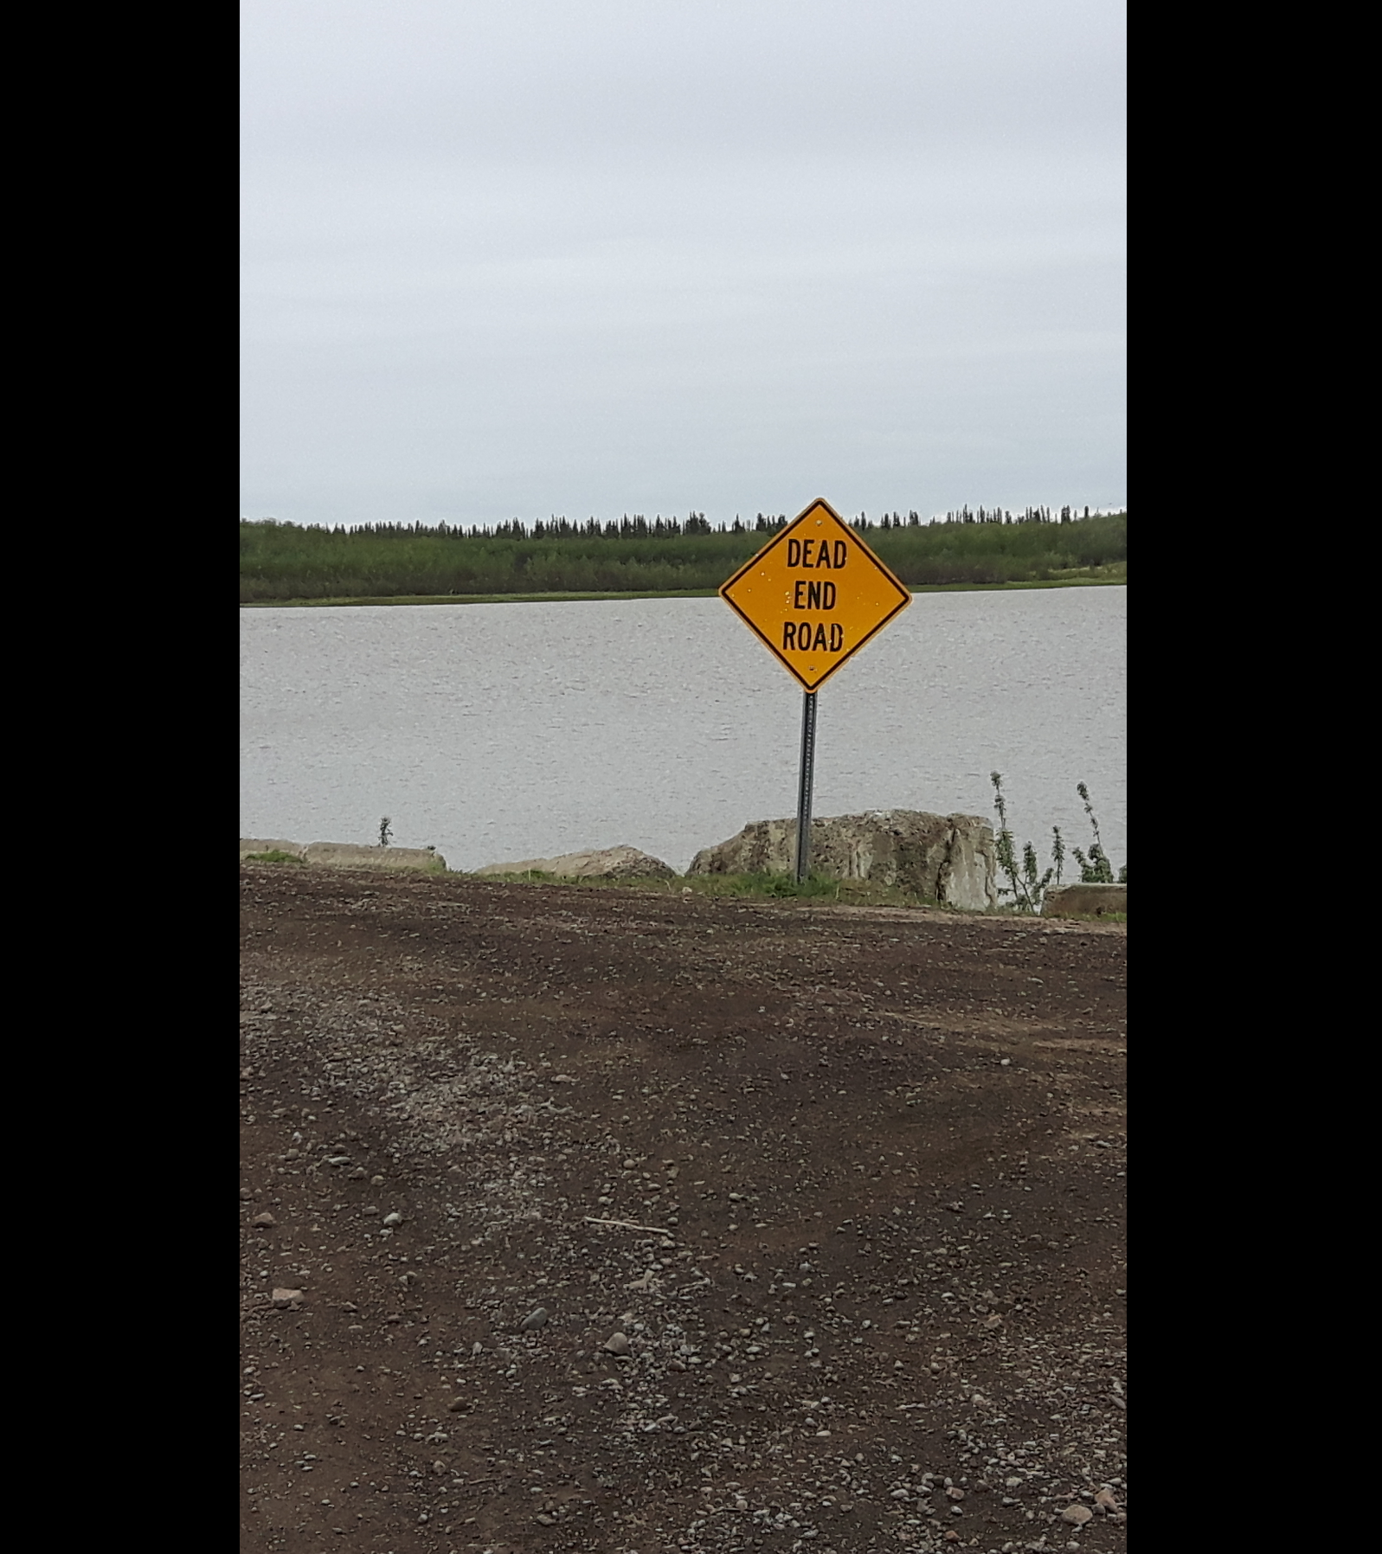
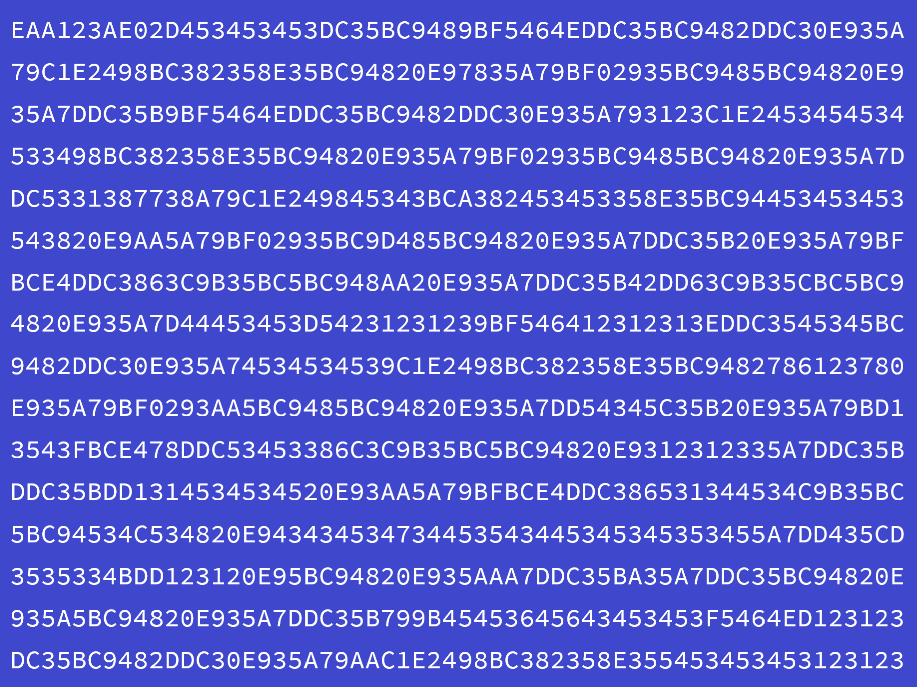
PROTECTION OF EXPRESSIONS, NOT IDEAS
I’ve got a great idea for a book…
My masterpiece is written
Notes:
So what kinds of works are protected by copyright? Most types of original, creative content, including literary, dramatic, musical and artistic works are protected.
It is important to note that copyright applies to the expression of an idea and not the idea itself. These expressions are covered under copyright if they are original, in the sense that they are not “slavishly” copied, have originated from the creator and require at least a little bit of intellectual effort, and if they are in a fixed form. Original emails, cellphone pictures, software code, screenplays, sculptures, and even texts can all be works that are subject to copyright protection.

Slide 6
COPYRIGHT PROTECTION IS AUTOMATIC
You mean someone holds the copyright for that thing??
Creator… and Copyright Holder
Yup. Me!
Notes:
Whether you know it or not, you are a creator and there are works that you already hold the copyright for. That’s because copyright is something that happens automatically when you create an original work – while registration is available, it’s not required. Whether it is a short story you have poured your heart into, a voice memo on your phone, or a finger painting you did as a child, you automatically hold the copyright for the original works you’ve created.
And you have to think about how these rights might impact you, both as a copyright holder and as a user of others' copyright protected works.

Slide 7
MORAL AND ECONOMIC RIGHTS
There’s nothing money can’t buy!
Except my moral rights [evil, faceless corporate dude]
Recording deals, publishing agreements… I do them all for the copyrights
$$$
Boss even gets the copyright on my thrilling work reports!
Notes:
Did you know there are both economic and moral rights associated with copyright? It’s important to understand that economic rights can be transferred to another person or company, such as a publisher, who then becomes the economic “rights holder” of the original work. Therefore, the “rights holder,” may or may not be the creator. Your favourite musician likely signed away their copyright to get that big record deal. Moral rights – the right of a creator to be associated with the work and to preserve the integrity of the work – cannot be transferred, although they can be waived.
Additionally, the rights in works that you have made over the course of your employment are normally held by your employer. Copyright allows the rights holder alone – or exclusively – to determine how works can and cannot be used in most cases.

Slide 8
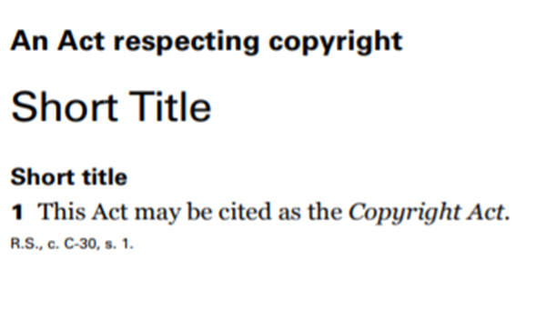
BALANCING OF INTERESTS
©
Individual Exceptions (s. 29.21 to 29.23)
Fair dealing (s. 29)
Institutional Exceptions (s. 29.4 to 30.4)
Notes:
In Canada, copyright is governed by the Copyright Act, which is a piece of federal legislation that, like all legislation, is intended to serve the public interest. This Act, in particular, attempts to do this by maintaining a balance between encouraging creators to produce and distribute new works and encouraging the public to use and benefit from those works. Exceptions to infringement, like fair dealing, are an important component of this balancing act. This commitment to balance is also one of the reasons copyright doesn’t last forever – it has a specific term of protection, allowing for broad public use of the works after that term has ended.

Slide 9
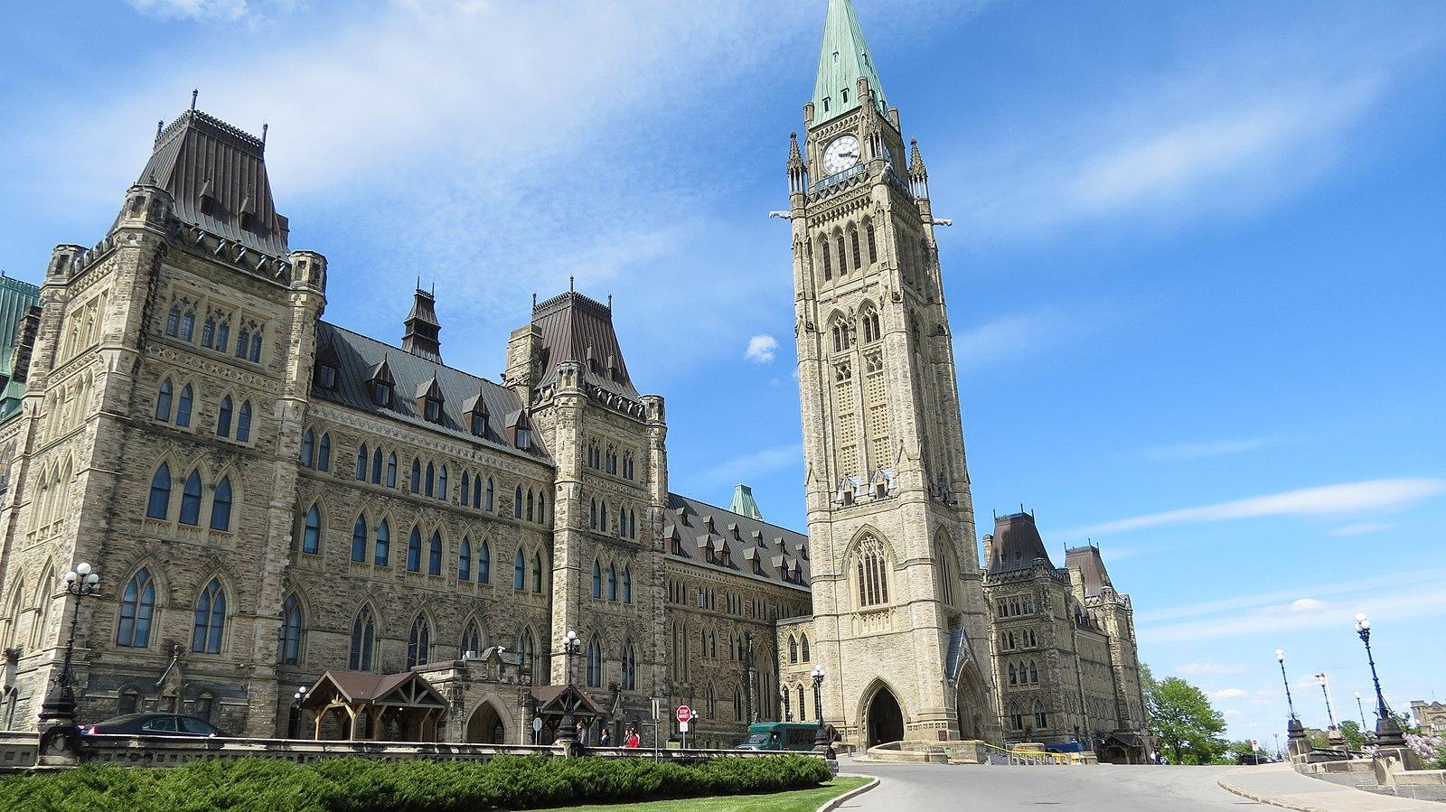
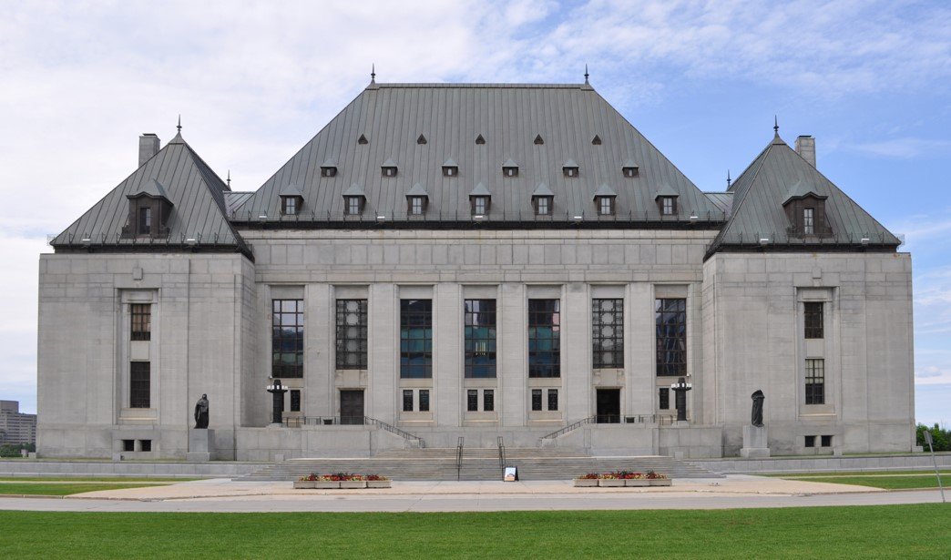
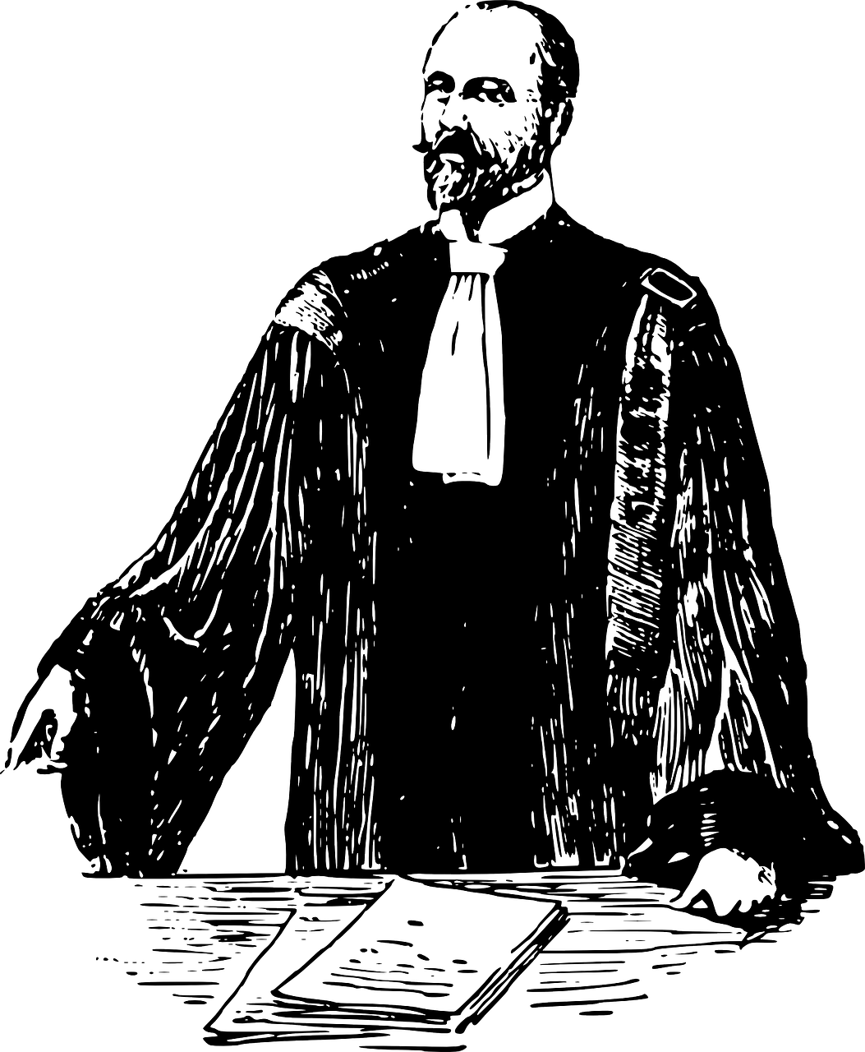
LAW AND JURISPRUDENCE
Justices… I submit the people should be allowed to fairly copy small portions of “thrilling” work reports for private study.
Notes:
Parliament is not the only player though. Over the years Canadian courts, up to and including the Supreme Court of Canada, have provided decisions that shape our understanding of copyright law in Canada. In particular, these legal precedents, also known as jurisprudence, have had a major impact on how we understand the permitted, or legally defensible uses, of copyright-protected works.

Slide 10
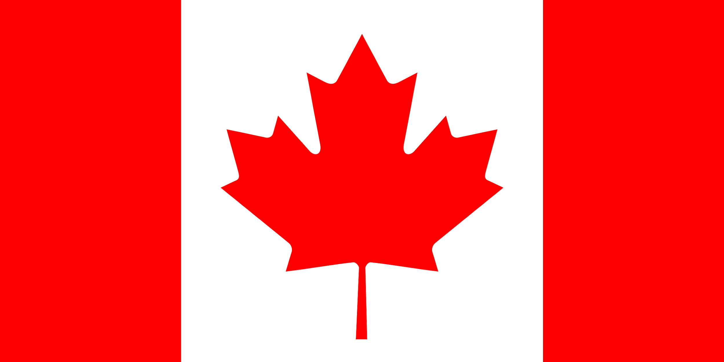
NATIONAL APPLICATION
Justices… I submit the people should be allowed to fairly copy small portions of “thrilling” work reports for private study.
Notes:
Copyright is administered at a national level. Sometimes people make reference to “international copyright law,” but there is really no such thing. While there are international treaties that aim to provide common rules for countries, what happens in Canada is governed by Canadian copyright law. US copyright law is similar, but not the same as Canadian copyright law.

Slide 11
SUMMARY
Hey everyone, did you know…
How did you get so smart?
Legal exclusionary right
Controls certain uses
Has limitations
Aims to serve public interest
Balances creators’ and users’ interests
Cool thanks
Notes:
So copyright is a legal exclusionary right that gives the holder of that right, who may or may not be the creator or author, the ability to control certain uses of works or content. There are limitations to this legal right to control the uses of works; the Canadian Copyright Act and courts have given users certain limited rights to do things with copyright-protected works as well. And the point of all this is to serve the public interest through a balance that encourages the creation of new works, as well as promoting the social benefits that arise from the use of those works by the public.

Slide 12
LEARN MORE
Notes:
That’s a good starting point, but there is a lot more to learn. Luckily, there are numerous other modules to help further explore copyright. Or if you need a bit more help understanding the whole Opening Up Copyright series, see our introductory module.

Slide 13
LEARNING OBJECTIVES
You should now be able to:
Define key terms including “copyright”; “work”; “rights holder” and “creator”
Recognize that copyright includes both economic and moral rights
Identify balance of user and creator rights as a fundamental principle of copyright
Understand that copyright is governed by Canadian law, specifically the Copyright Act and decisions by Canadian courts
Notes:
You should now be able to:
Define key terms including “copyright”; “work”; “rights holder” and “creator”
Recognize that copyright includes both economic and moral rights
Identify the balance of user and creator rights as a fundamental principle of copyright
Understand that copyright in Canada is governed by federal law, specifically the Copyright Act and the decisions by Canadian courts

Slide 14
Notes:
This has been an introduction to copyright from the University of Alberta’s Opening Up Copyright Instructional Module Series. Thank you for your attention.

Slide 15
QUESTIONS
Copyright is an exclusive legal right that gives rights holders control over all of the following activities for works they own except for… which one?
Producing
Reproducing (or copying)
Selling or licensing
Publishing
Reading
The “right to exclude” in a copyright context is exercised by the rights holders’ having the legal right to sue others for doing something that only they have the right to do (e.g., publishing, reproducing, etc.).
True
False
Original ideas, both good and bad, are protected by copyright.
True
False

Slide 16
QUESTIONS
Copyright deals with two sets of rights according to the Copyright Act. Which of the following is the correct pair of rights?
Moral rights and economic rights
Economic rights and human rights
Human rights and moral rights
French rights and English rights
The Copyright Act, like all legislation, is intended to serve what?
The Prime Minister’s next electoral campaign
The public interest
The financial viability of corporations
The gainful employment of lawyers
Under Canadian law, copyright lasts forever.
True
False
Users of copyright-protected works have limited rights in Canada. These rights are established by all of the following democratic institutions except one… which one?
The Canadian court system, including the Supreme Court of Canada
The Parliament of Canada
Copyright Board of Canada

Slide 17
Murray, L. J., & Trosow, S. E. (2013). Canadian copyright: A citizen’s guide (2nd ed.). Between the Lines.
Vaver, D. (2011). Intellectual property law: Copyright, patents, trade-marks (2nd ed.). Irwin Law.

Slide 18
Kimmi Studio. (2017). Shield. The Noun Project. CC BY. https://thenounproject.com/term/shield/874630/
Basadev4. (n.d.). [Andre]. Pixabay. https://pixabay.com/illustrations/black-avatar-cute-cheerful-3025348/
Tomas Knopp. (2016). Innovation. The Noun Project. CC BY. https://thenounproject.com/term/innovation/772765/
ProSymbols. (2018). Art. The Noun Project. CC BY. https://thenounproject.com/icon/1976897
Enshia. (2018). Book. The Noun Project. CC BY. https://thenounproject.com/icon/1787402/
Blair Adams. (2017). Drama. The Noun Project. CC BY. https://thenounproject.com/term/drama/953398
Atif Arshad. (2017). Gramophone. The Noun Project. CC0. https://thenounproject.com/icon/1306170/
Rawpixel. (n.d.). [Isabelle]. Pixabay. https://pixabay.com/illustrations/cartoon-casual-character-drawing-3685566/
Ghan Koon Lay. (2018). Boss. The Noun Project. CC0. https://thenounproject.com/icon/1587076
Start Up Graphic Design. (2020). Barrier. The Noun Project. CC BY. https://thenounproject.com/term/barrier/3372114/
GraphicMama-team. (2016). Arab girl. Pixabay. CC0. https://pixabay.com/en/arabian-arab-girl-female-ethnic-1456184/
Eucalyp. (2017). Moral. The Noun Project. CC BY. https://thenounproject.com/icon/moral-901639/
Nikhil Dev. (2013). Scale. The Noun Project. CC BY. https://thenounproject.com/icon/15744/

Slide 19
AFY Studio. (2019). Scale. The Noun Project. CC BY. https://thenounproject.com/icon/scale-2772463
Oksana Latysheva. (n.d.). People group [Modified]. The Noun Project. CC BY. https://thenounproject.com/icon/people-group-1310753/
Rob Crosswell. (2017). Library. The Noun Project. CC BY. https://thenounproject.com/term/library/1122689/
Bieu Tuong. (2018). School. The Noun Project. CC BY. https://thenounproject.com/icon/school-1983588/
Robert Linsdell. (2013). Parliament Hill. Wikimedia Commons. CC BY. https://commons.wikimedia.org/wiki/File:Parliament_Hill,_Wellington_St,_Ottawa_(491650)_(9450178550).jpg
Dig deeper. (2017). [Supreme Court of Canada]. Wikimedia Commons. CC BY 4.0. https://commons.wikimedia.org/wiki/File:Supreme_court_of_Canada_in_summer.jpg
Clker-Free-Vector-Images. (n.d.). Lawyer. Pixabay. Pixabay Licence. https://pixabay.com/vectors/lawyer-attorney-barrister-judge-28838/
Illegitimate Barrister. (2014). Flag of Canada. Wikimedia Commons. CC0. https://commons.wikimedia.org/wiki/File:Flag_of_Canada_(Pantone).svg
Penubag. (2008). Globe. Wikimedia Commons. CC0. https://commons.wikimedia.org/wiki/File:Ambox_globe.svg

Slide 20
Dbenbenn, Zscout370, Jacobolus, Indolences and Technion. (2005). United States Flag. Wikimedia Commons. CC0. https://commons.wikimedia.org/wiki/File:Flag_of_the_United_States.svg
Unattributed materials are contributions from the Opening Up Copyright Project Team and placed in the Public Domain
Closing Slides Music: Rybak, Nazar. “Corporate Inspired.” HookSounds. (n.d). http://www.hooksounds.com (used under a CC-BY 4.0 Licence)

Slide 21
University of Alberta. (2022). Introduction to Copyright. Opening Up Copyright Instructional Module. https://sites.library.ualberta.ca/copyright/

