Slide 1
Rotten by Design: Shortened Expiry Dates for Government of Canada Web Content Presented at the 43rd Annual Conference of the Canadian Association of Information Science June 4, 2015, Ottawa, ON
Michael B. McNally – School of Library and Information Studies, University of Alberta,
Amanda Wakaruk – University of Alberta Libraries, and
Danoosh Davoodi – School of Library and Information Studies, University of Alberta

Slide 2
Outline
Introduction and Context
Related Literature
Access to Information Requests
Findings
Implications
Acknowledgements

Slide 3
Introduction and Context
Government information has significant current and historical value
“Information is the lifeblood of a democracy. Without adequate access to key information about government policies and programs, citizens and parliamentarians cannot make informed decisions, and incompetent or corrupt governance can be hidden under a cloak of secrecy.”
Montreal Gazette Editorial, June 7, 2005
Stephen Harper, Leader of the Official Opposition

Slide 4
Introduction and Context
Jodhan case (2010 (FC)/2012 (FCA)) found that federal websites violated s. 15(1) of the Charter and must be made more accessibly to the visually impaired
Jodhan v. Canada (Attorney General), 2010 FC 1197
Canada (Attorney General) v. Jodhan, 2012 FCA 161
Treasury Board of Canada Secretariat (TBS) launches Web Renewal Action Plan to improve website accessibility
November 2012 at the GTEC Conference, Tony Clement (President of the TBS) casually notes, “We are, for example, working on consolidating our Web presence from 1,500 to 6 or fewer websites.”
In 2014 Corinne Charette, Chief Information Officer for the Government of Canada (GoC) confirmed that target date for consolidation of all GoC websites is Dec. 2016 (Charette, 2014)

Slide 5
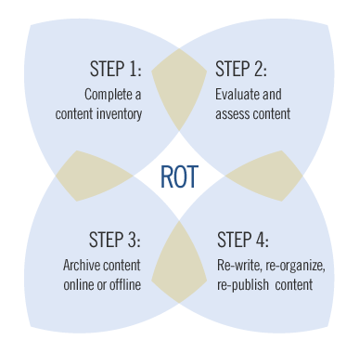
ROT Website
TBS has sparse information about the ‘Reduce Redundant, Outdated and Trivial Content’ plan
Notes the purpose of the initiative is to ensure that GoC websites provide “easy-to-find, clear, accurate, up-to-date information to their visitors” (TBS, 2012)
No indication of the scope/size of the initiative
Source: TBS, 2012

Slide 6
Related Literature
No literature specifically addressing GoC’s ROT plan
Burgeoning body of legal literature on problem of link rot, particularly is US
Some related Canadian media stories
Petrou, M. “Jason Kenney’s Speech to the Islamic Society of North America Removed from Government (and Personal) Websites” Macleans, 18 Jul. 2013.
Fekete, J. “Critics Fear Tory Plan to Merge Websites an Effort to Cut off Access to Information” National Post, 28 Mar. 2013.

Slide 7
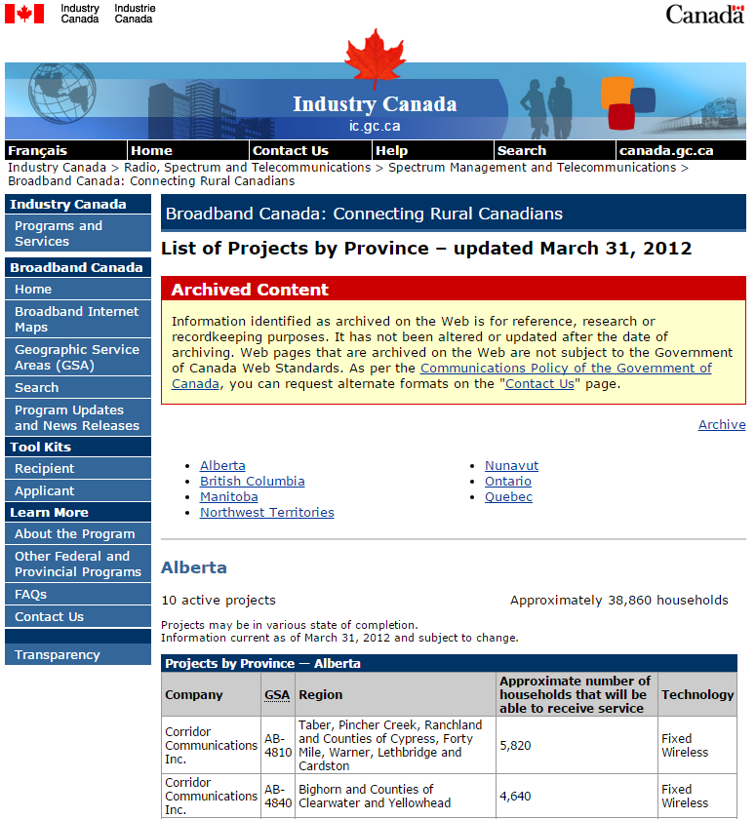
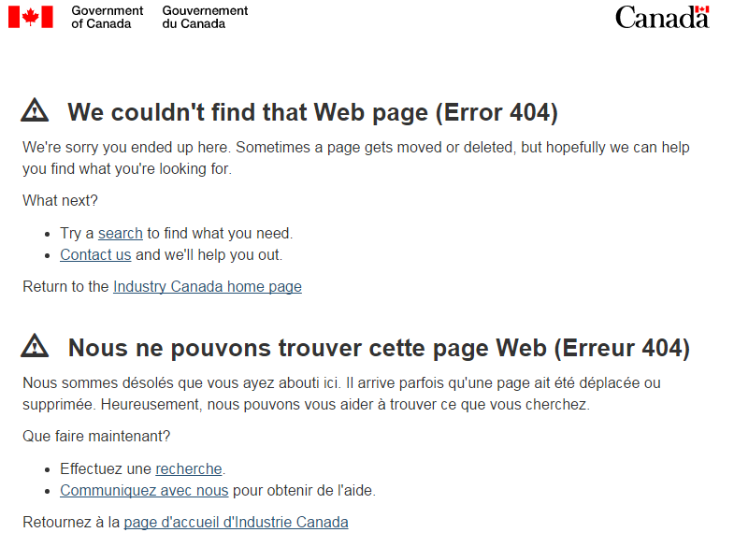
Research Problem
Disappearing GoC web content

Slide 8
Research Objective and Design
Objective: understand the scope and implications of the Web Renewal Action Plan and Reduce ROT imitative
Identify, where possible, content removed from Government websites
Methodology of U.S. link rot studies can’t be used
Mix of approaches:
Examination of changes (decline) in federal databases
Longitudinal analysis and comparison of GoC websites using Internet Archive
Access to Information requests for federal documents relating to ROT

Slide 9
Access to Information (ATI) Requests
Identical requests to Health Canada, Citizenship and Immigration Canada (CIC) and Industry Canada made July 25, 2014
Departmental guidelines, practices, frameworks and/or rubrics for assessing redundant, outdated or trivial web content developed in relation to the Treasury Board Secretariat's “Reduce Redundant, Outdated and Trivial Content (http://www.tbs-sct.gc.ca/ws-nw/wu-fe/rot-rid/index-eng.asp) web usability plan. Limit to documents in English.
Unique request to the TBS made July 25, 2014
All documents related to the “Reduce Redundant, Outdated, and Trivial Content” (http://www.tbs-sct.gc.ca/ws-nw/wu-fe/rot-rid/index-eng.asp) web usability plan including any reports, guidelines, practices, frameworks and/or rubrics provided to departments on how to assess and identify redundant, outdated and trivial content. Limit to documents in English.

Slide 10
ATI Requests
Summary of ATI process and Results
Based on the findings from the Health documents we have since made an additional ATI request to the TBS and 18 other federal departments
 | Cost | Extensions | Days to fill the Request | Response Size (pages)
CIC | $5 | none | 17 days | 3
Health | $5 | 150 days | 199 days | 242
Industry | $5 | none | 21 days | 24
TBS | $5 | 60 days | 110 days | 134

Slide 11
Findings –Origin for the ROT Initiative
Current ROT project was initiated in spring of 2011 (IC, p. 23), though TBS public website on ROT appears to be created in early 2012
Various departments have undertaken ROT projects over the past decade prior to the 2011 undertaking
Between 2006 and 2011 Fisheries and Oceans removed 40% of its web content (DFO, p. 4)
Between Feb 2008 and July 2009 the TBS removed 88,900 of 127,000 of its webpages (77%) (DFO, p. 114-5)
Exact origin of the current ROT plan is unclear
One document notes it was a Sept 14, 2010 GoC Web Managers’ Council Meeting (DFO, p.46)
Another document notes: “Prime Minister requested President of Treasury Board to: Renew the government web presence by significantly reducing the number of web sites…” (Health, p. 15)

Slide 12
Findings –Motives for the ROT Initiative
Publicly declared motive is to make information easier to find
Internal documents reflect this (TBS, p. 133), but also suggest the primary motive is reducing maintenance costs and limiting the amount of content that has to be compliant with new web standards (post Jodhan) (TBS, p. 87)
Improving public perception of the government is listed as another motive for ROT projects (TBS, p. 133)
TBS also cautions departments to consider keeping information if “there is a risk associated with removing it (e.g. politically embarrassing)” (TBS, p. 75)

Slide 13
Findings – Timeframes for Retention/Removal
General rule is two year retention for websites (TBS, p. 16)
Based on guidelines for retention of personal information from Privacy Regulations s.4(1)(a) (SOR/83-508)
Some departments have tailored retention periods based on content type; for example,
Industry Canada notes content about a retired or cancelled program information should be removed after 1 year (IC, p. 15)
Canadian Heritage requires websites about events and initiatives to be removed 3 months after the event (Heritage, p. 20)

Slide 14
Findings – Use of Web Metrics
TBS encourages departments to use usage statistics on how frequently a web page is accessed to determine if it should be retained
Metrics used by departments vary widely
Transport Canada suggests retaining content that gets 1,000+ visits a year (TC, p. 2)
CIC suggests retaining material that gets more than 200 hits per month (CIC, p. 2-3)
Public Health Agency of Canada (part of Health Canada) used 100 visits a year as a threshold for retention, but determined this resulted in too many retained pages
So the number was increased to 200 hits per year to remove more content (Health, p. 67)

Slide 15
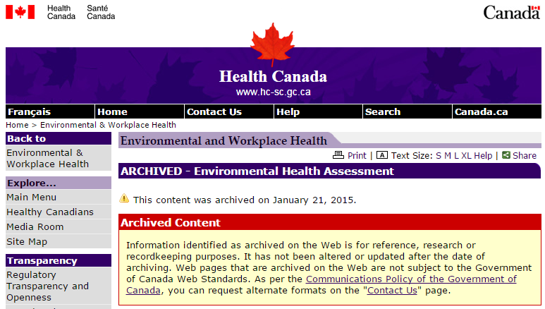
Findings – Scope of the ROT Initiative
TBS suggests web archiving to ensure websites are “made available for reference, research and contextual continuity” (TBS, p. 4)
Web archived content should also indicate the “ultimate date for removal of web content” (TBS, p. 8, 28, 61)

Slide 16
Findings – Scope of the ROT Initiative
While web archiving for outdated content is possible, the TBS has instructed departments to completely remove 50% of their departmental web content (based on Fall 2011 levels) (Health, p. 3, 13, 35, 71; Justice, p. 2)
Some departments have even more ambitious targets
Justice and Health both aim to remove 60% of their web content (Justice, p. 4; Health, p. 45, 71)
“over-pruning is required to ensure future growth of the web sites.” (Health, p. 46)

Slide 17
Findings – Scope of the ROT Initiative
GoC has 10.7 million webpages; however, 7.6 million are from Statistics Canada which is exempt from the ROT imitative (Justice, p. 2)
Still means of the 3.1 million remaining pages, 1.55 million pages are to be (or already have been) removed from the internet
Note: not clear if this number is English only or both English and French
GoC estimates it takes 6.5 hours to create a government web page (Health, p. 85); thus, the ROT initiative will eliminate 5 million + hours of government work
x 1,550,000

Slide 18
Implications
Perhaps there is just a lot of ROTten content on federal webpages?
However, a 2011 GCPedia User Experience Working Group concluded that only 40% of GoC content could be eliminated for not meeting the needs of its target audience (DFO, p. 30)
This echoes a similar finding from a smaller ROT project at Canadian Business in 2008 (TBS, p. 90)
We don’t need to worry because Library and Archives Canada (LAC) will archive GoC websites
LAC is archiving departmental websites in whole at least once a year (Heritage, p. 2)
However, the publicly accessible LAC archives (https://www.collectionscanada.gc.ca/webarchives/index-e.html) are only current to 2007
Furthermore LAC archival links are often dead

Slide 19
Implications
Internet Archive, University of Toronto Libraries and University of Alberta Libraries have been working to archive GoC websites
Some gaps exist in these captures
Critical these initiatives be maintained
LAC must also make available more recent captures of GoC websites
Individual researchers may want to archive key pages of interest

Slide 20
Future Work
Continued analysis of ATI documents
New ATI requests for content inventories
Examination of Internet Archive captures with current versions of departmental websites to identify removed content and its significance
Increase public awareness

Slide 21
Acknowledgements
Research funded in part by:
University of Alberta Libraries – Research Support Fund
Graphics, Animation and New Media NCE
Thank you to the audience and CAIS organizers

Slide 22
References
Canada (Attorney General) v. Jodhan, 2012 FCA 161
Charette, C. 2014 “Speaking Notes for GTEC 2014 by Corine Charette, Chief Information Officer for the Government of Canada.” Treasury Board of Canada Secretariat. 28 Oct. 2014: http://www.tbs-sct.gc.ca/cio-dpi/gtec/ks-do-2014-eng.asp
Clement, T. 2012 “Archived – Speaking Notes for the Honourable Tony Clement, President of the Treasury Board of Canada – ‘Using Technology to Challenge the Status Quo in Government Operations’ – GTC.” Treasury Board of Canada Secretariat. 6 Nov. 2012: http://www.tbs-sct.gc.ca/media/ps-dp/2012/1106a-eng.asp
Fekete, J. 2013. “Critics Fear Tory Plan to Merge Websites and Effort to Cut off Access to Information.” National Post. 28 Mar. 2013: http://news.nationalpost.com/news/canada/canadian-politics/critics-fear-tory-plan-to-merge-websites-an-effort-to-cut-off-access-to-information

Slide 23
References
Jodhan v. Canada (Attorney General), 2010 FC 1197
Petrou, M. 2013. “Jason Kenney’s Speech to Islamic Society of North America Removed from Government (and Personal) Websites: But the Internet Never Forgets.” Macleans. 18 Jul. 2013: http://www.macleans.ca/authors/michael-petrou/jason-kenneys-speech-to-islamic-society-of-north-america-removed-from-government-and-personal-websites/
Privacy Regulations SOR/83-508: http://laws-lois.justice.gc.ca/eng/regulations/sor-83-508/index.html
Treasury Board of Canada Secretariat (TBS). 2012. “Reduce Redundant, Outdated and Trivial Content.” http://www.tbs-sct.gc.ca/ws-nw/wu-fe/rot-rid/index-eng.asp
ATI documents from federal departments (CIC, DFO, Health, Heritage, IC Justice, TBS, and TC) available by request from the author (mmcnally@ualberta.ca)

