Slide 1
Building Foreign Language Collections for the Communities We Serve
Mary Bennett – Edmonton Public Library
Lindsay Johnston – University of Alberta Libraries
Denis Lacroix – University of Alberta Libraries
Alberta Library Conference – April 2013
Notes:
My name is DL and I have the pleasure of starting off this session with a brief introduction to the University of Alberta where I work as romance languages librarian. I will continue to speak on collections issues, like acquisitions and evaluation, relating to my subject area. My colleague Lindsay Johnston will add her Slavic Studies perspective and Mary Bennett will bring the EPL context to building foreign language collections.

Slide 2
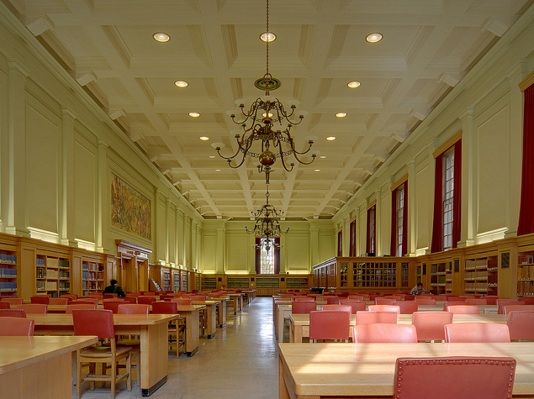
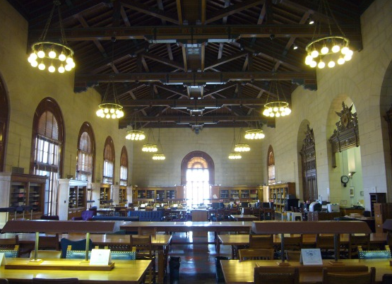

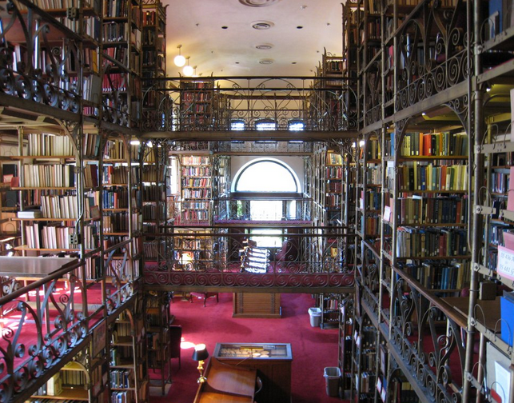


Notes:
UAL is
11th among members of the ARL (ARL investments index)
Above Cornell and almost tied with Texas U.
Texas U known for its LATam coll
1st acad lib in Western Canada and 2nd in all of Canada for holdings count (1st for copies per capita – 7 million titles and 10 million copies)
Sharing standings with big names
Responsibility for future scholarship
Holds true for small user community
This responsibility determinues our Collection mandate...

Slide 3



Notes:
The collection mandate is independent of format (not only print materials)
Library of record (defined as the ability to acquire, retain amd preserve information sources) = acquire and preserve items unique to Alberta or Western Canada, along with fundamental titles.
Curatorial stewardship is subsumed under the record mandate: nurture and grow the collection
Above mandate has one goal = scholarship for present and future generations
My development of romance lang. Collections will determine to some extent the scholarship in my liaison department, Modern Languages and Cultural studies.
Contribute to the choice romance language, lit and history researchers (faculty and students) make to the UofA
Feed research ideas and interests.

Slide 4
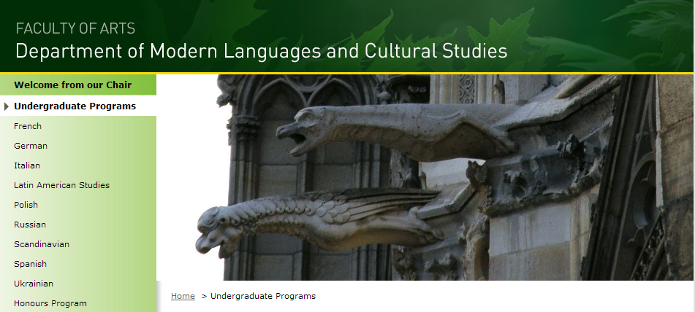
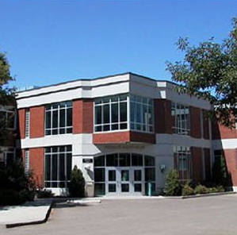
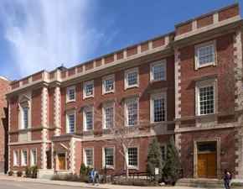
Notes:
MLCS subsumes all romance languages, as well as slavic, germanic, etc.
Undergraduate and graduate programs
Interdisciplinary dept focusing on linguistic, literary, and cultural research and teaching with the help of community partners.
The UAL has been a partner with MLCS to have students work on library related projects, e.g. lat am video digitization project.
Two libraries serve the French collections at UAL: HSS-Rutherford and BSJ.
Collection agreement between HSS and BSJ
HSS all French publications outside of Canada
BSJ all French publications in Canada
Serve the French-Canadian community
Materials are sent from one library to the other in a max of 2 business days
Spanish section of MLCS is large like French (but 1 campus), Focus is on
Lat Am topics with some Modern Spain
LAST (udergrad only) in English, but Poli Sci and Hist (grad)
Italian is small withh only 2 profs who support the library and use it extensively.
Translation Studies Certificate

Slide 5


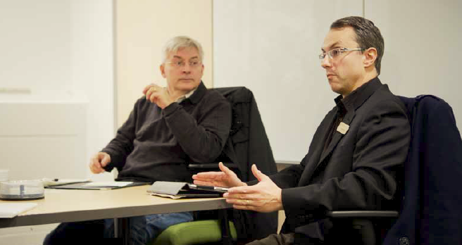
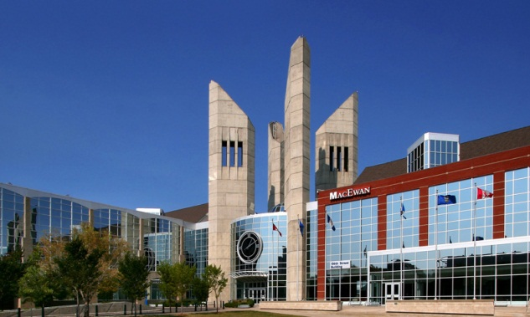

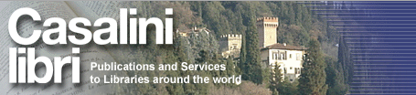
Notes:
I am pictured here in consultation with a French faculty member seeking advice on a research project. Such consultations are essential in developing the most appropriate collection
open to emerging and new research endeavours, which leads to new acquisitions and new collections
To develop foreign language collections efficiently and effectively we need vendors
UAL consolidated our acquisitions with a smalll number of loyal vendors (pictured here)
Approval plans, focusing predominantly on fiction, were created for Spanish Latin American titles with the Latin American Bookstore, whereas French titles published in France are acquired from Touzot in Paris.
I still receive slips, which are sent automatically according to a profile
Touzot and LABS send slips by email: orders can be placed online with Touzot or by sending an email reply with LABS.
Ingram, formerly Coutts, is used for English titles relating to my subject areas: I have access to a database for ordering and selecting
Similarly, Casalini Libri allows online selection and ordering from their database.
Another partnership that facilitates collection development is with other institutions, like in the case I want to highlight Grant MacEwan University Library
travel guides have historical value for UAL
GMUL regularly weeds its travel/tourism collection to make room for newer guides
GMUL sends its obsolete travel guides to UAL, which will preserve them for future scholarship in its BARD.

Slide 6
Collections Evaluation and Usage
Notes:
These graphs show the UAL’s title holdings across the Romance languages obtained from Sirsi’s Director’s Desktop.
The top graph shows that French language and literature is by far the strongest collection area at the UofA with close to 100,000 titles. Spanish language and literature comes next and then it is Italian.
To calculate usage, I based myself on Sirsi’s Director’s Desktop turnover rate calculation over 10 years:
The Turnover Rate divides the total checkouts by the total copies held. I chose to present the median and not the mean, in order to deemphasize small collections with very high or very low checkout rates.
.
French language and literature: the French collection has 2.4 check-outs per copy (54087 copies and 120,192 check-outs) and French Canadian materials have only 2. The data for French Canadian is to be taken lightly, because of how Director’s desktop presents data relating to French Canadian literature (DD does not distinguisch French-Canadian lit from English-Canadian lit.). What I have done in this graph is limited the data to titles published in French within PS, but this would not take into accound English titles about French Canadian literature.
To place this number in perspective, the entire UA Libraries system has a median turnover rate of 3.2.

Slide 7
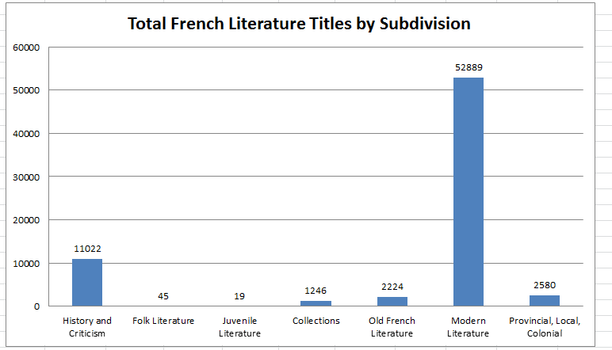
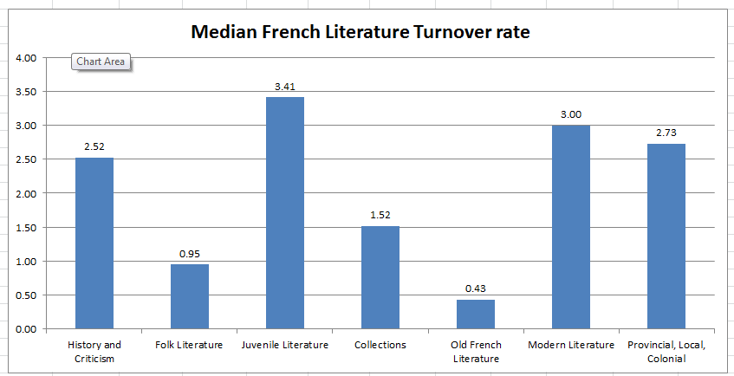
Notes:
Prezi: http://prezi.com/v707ercbjjqo/romance-language-collections-at-the-ual/?auth_key=953115d8a13213a65d52eac56417e69221f40dd9&kw=view-v707ercbjjqo&rc=ref-2173112
These two graphs break down French Literature into its constituent Library of Congress sub-classifications and represent the holdings at the top and turnover rate at the bottom.
As you can see, Modern literature (16th century to 21st century) comprises the greatest part of the holdings and circulates the most, if we disregard juvenile literature which is extremely small. Most Modern literature holdings relate to 20th and 21st century publications.
Spanish, Italian, and Portuguese collections are smaller, which impacts on the turnover rate calculation. Nonetheless, I think it is instructive to point out that usage of literature in all three of these languages falls in the category of Provincial, Local, and Colonial, as well as Individual Authors. The latter corresponds to Modern Literature for French.

Slide 8






Notes:
Ebook acquisitions by libraries = still in their infancy, but this is even more the case for ebooks in foreign languages.
My subject areas still rely on English titles, which are well served by our regular vendors Ingram or Coutts (MyiLibrary platform) and YBP (Ebrary platform). A similar model does exist to the same extent in the Romance languages.
The model I am referring to is purchasing ebooks online from one of our regular vendors (perhaps along with print titles) with perpetual access to the ebooks and from a catalogue of new titles.
The model offered by Romance language vendors is 3 fold:
Casalini Libri a regular vendor of Italian and Spanish titles offers ebooks in Italian and Spanish, but it is a separate catalogue from the print and only offers older titles (at least 2 years old) that were already published in print and probably already acquired by the UAL.
Digitalia hispanica also offers old titles already published in print with no predictability has to which titles will be coming out in electronic format from the impressive list of publishers (many academic). They would be yet another vendor to contend with.
E-libro is the most promising as it integrates ebook title selection with a regular vendor, YBP, and viewable using ebrary. I will be investigating whether e-libro titles are new imprints or not with perpetual access.
Thankfully, there are consortia, like CIFNAL.
the Collaborative Initiative for French Language Collections, was founded in 2006 to promote and facilitate the cooperative exchange of ideas and resources between Francophone and North American research libraries. It helps in negotiating consortial pricing models, which was the case recently for the French Bibliography, Klapp Online, and the Encyclopedia Universalis (equivalent to Britannica).

Slide 9

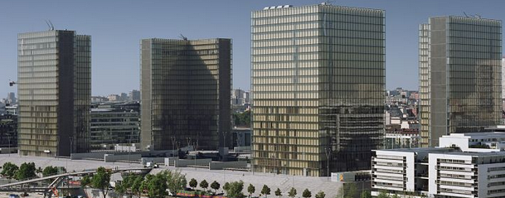

Notes:
The picture is not a rendering of the new UA BARD (although we could definitely use the space), but rather the National Library of France in Paris or BNF. What is the connection with the UAL?
I regularly acquire reproductions of out-of-print titles for faculty
microformat: stored on library shelves like any other physical item
digital files: stored in ERA (the institutional repository), this solves the problem of where to house digital acquisitions and how to make them available.
there may be certain restrictions imposed on us for online access (private or non-commercial use), but ERA has usage agreement and the reproductions I obtain are in the public domain anyway.
Nonetheless, ERA allows restricting access with an id and password.
Another connection with the BNF, is that a few years ago the BNF came to the UAL for acquiring a reproduction of a book title which was only located at the UAL and which they needed. Perhaps the UAL could develop a new commercial model selling reproductions around the world?
We are, however, quite committed to reproducing digitally titles that fit the Peel’s Prairie Provinces collection policy for Western Canada.
The Peel database contains many Alberta Francophone newspapers and will soon add Francophone newspaper from Manitoba, La Liberté. There are many more from Alberta and other Western Canadian Provinces yet to digitize.
(finally) Nosotros Latin American Video Digitization Project = 30 years worth of videos produced by the Alberta Latin American community and broadcast on Shaw Television. The UAL has embarked on digitizing them with the help of the Arts Resource Centre. They will be made available through the Internet Archive and hopefully in ERA as well.
Lindsay Johnston will now speak to you about Slavic language collections at the UAL.

Slide 10
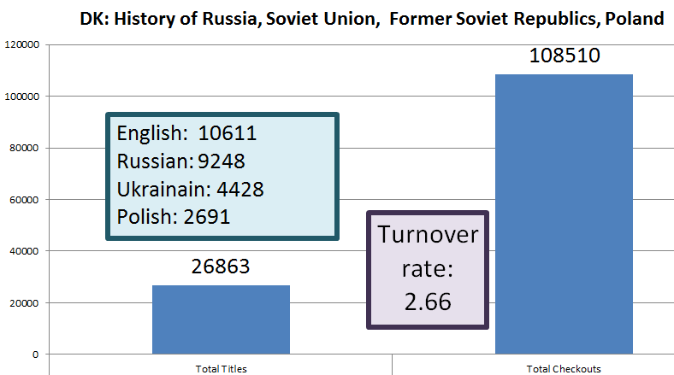
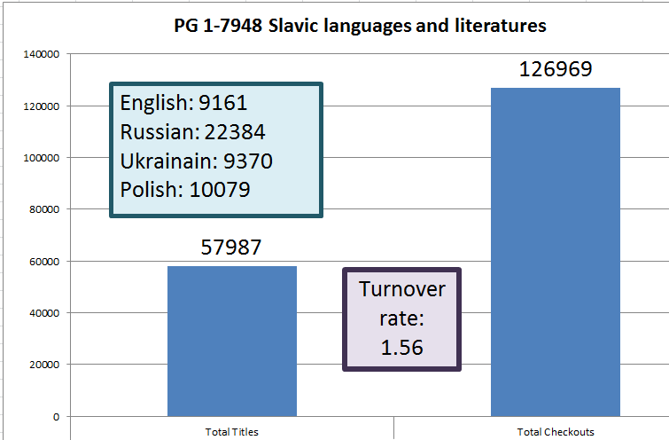
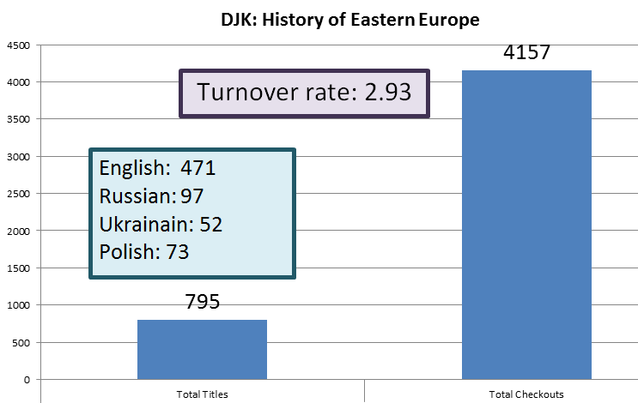
Slavic Studies Collection
Monograph Holdings and
Circulation & Turnover rates over the last 10 years
Notes:
So, Denis has given you an idea of how foreign-language collecting is done at the U of A. My processes and challenges are similar to his.
Here’s an overview of the Slavic Studies Collection at the U of A Libraries, by LC call number. We could get into a long involved political debate about the antiquated way that the Library of Congress classifies Eastern European countries and Europe, but that is for another day.
Here, I’ve used Director’s Station to pull total numbers of titles, total checkouts over the last ten years, and average turnover rates over the last 10 years for books in DK: History of Russia, Soviet Union, Former Soviet Republics and Poland as wel as the general DJK class for the History of Eastern Europe, which you can see is a much smaller area; and also for the largest part of the collection titles in Slavic languages and literatures. The estimates of how many of these books are in each language come directly from searches in our library catalogue.
So you can see that in History, we collect a lot of analyses in English for use by a large user base, but also a lot in Russian, Ukrainian and Polish, which are our three major focus areas of study. In both History and Languages & Literatures, we also collect small numbers of titles in Czech, Slovak, Bulgarian, South Slavic languages, and so on.
Not surprisingly, in Languages and Literatures, we have more titles in the original languages, but we also have a lot of translations and analyses in English as well.
From the total checkouts and turnover rates, you can see that while there aren’t any stampedes, the books are getting borrowed.
*Number of English titles is slightly off, because the PG class includes some 600 books in Albanian and Baltic languages, including some in English about Albanian and Baltic languages and literatures

Slide 11
Slavic Studies Collection Development
Databases
  Major Databses: MLA Bibliography, Historical Abstracts, PAIS International, ABSEES & EBSEES
  New Database: Slavic Humanities Index (U of T)
  News archives – Current Digest of the Russian Press, Pravda; need to evaluate new collections (Izvestiia, etc.)
  Include National Bibliographies, National Library Catalogues on databases lists
Title by title selection for monographs – want to change
  Ingram for English language – mostly print, some e
  MIPP, Eastview, Lexicon, independent Ukrainian bookseller for Ukrainian, Russian, and Polish titles – all print
  analyze recent acquisitions to set up approval plan parameters, investigate possibilities for e-books
  Recommendations from researchers, rely on ILL requests
Notes:
We have a good collection of databases for access into the journal literature [ABSEES: American Bibliography of Slavic & East European Studies EBSEES: European Bibliography of Slavic & East European Studies]. There’s a new databases created at U of T, the Slavic Humanities Index, that attempts to provide a single index to Slavic Language humanities journals.
More news archives are becoming available, so I’ll have to evaluate those.
We also try to include free online National Bibliographies and some National Library Catalogues on our database lists, because they allow us and researchers to find out about materials that aren’t listed anywhere else.
My challenge right now is to move from title by title selection of books in Slavic languages to approval plans.
From my work so far, I am learning the interests of my researches from the Departments of Modern Languages and Cultural Studies and History & Classics – cultural studies (including film), folklore, emerging literature in each language and some study of classics; many aspects of Religion – historical up to the present day, nationalism, the Ukrainian state – history and present day, etc.
Several of the vendors that we deal with for our Russian, Ukrainian, and Polish titles are willing to work on approval.
Here’s what I’ve discovered so far…

Slide 12
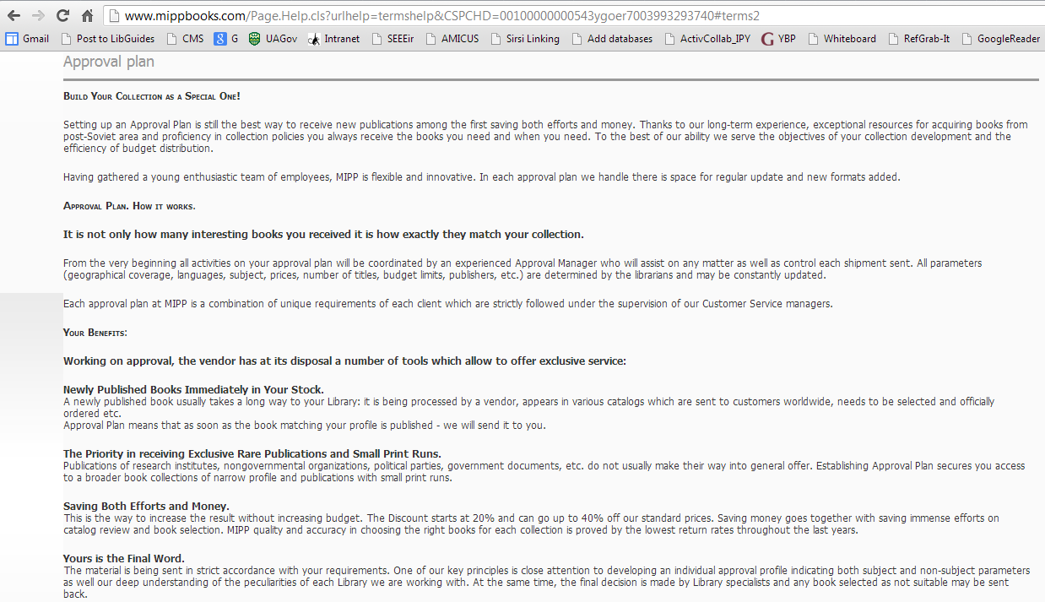


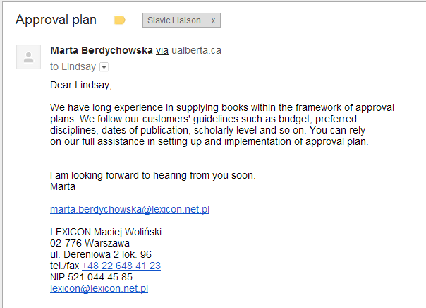
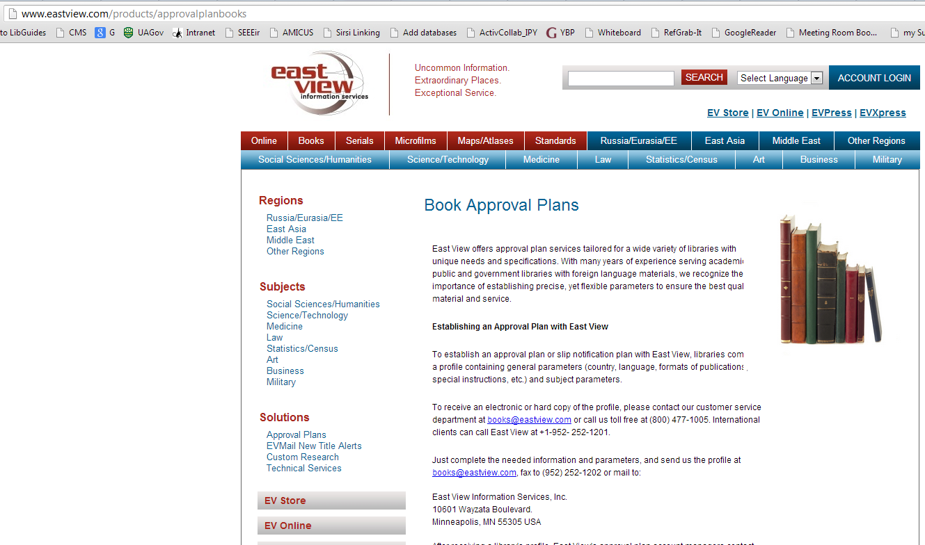
Notes:
MIPP and Eastview are two major vendors. We usually purchase Ukrainian and Russian titles from them. Lexicon is our major vendor for Polish titles. They are all willing to work on approval.
You can see an email message here from my contact at Lexicon, confirming that they work on approval.
We also get a lot of our Ukrainian titles from an individual bookseller, so I’ll have to decide whether MIPP and Eastview can supply what we need, or could even work with her as part of an approval plan. I’m going to start by contacting Eastview, because they are capable of providing publications in Ukrainian, Russian and Polish.

Slide 13
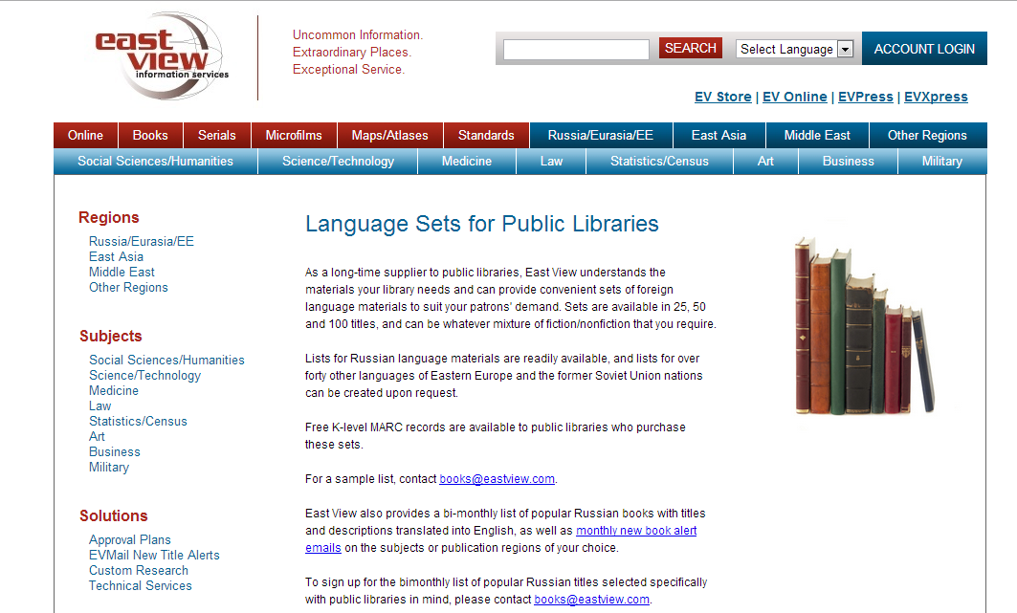
Notes:
I noticed that Eastview has plans for Public Libraries – I don’t yet know what they’re like to deal with on approval, but hopefully I will soon – I thought this info might be useful for some of you.

Slide 14

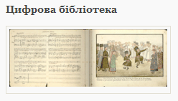

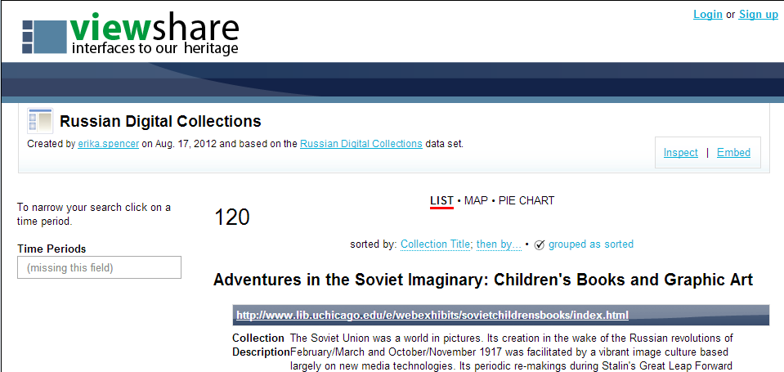

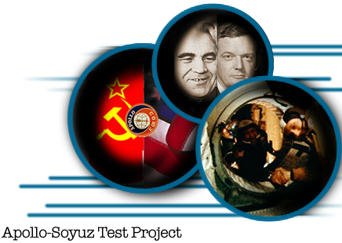
Maybe you don’t even have to buy it: Digital Portals
Free Online Digital Collections
  National Library of Russia
  Vernadsky Library
  Russian Digital Collections (Library of Congress)
  ALA ACRL SEES Preservation & Access Committee
Notes:
So, moving on from print purchasing -- when it comes to classical works, if your users are happy with e-books, you may not even have to buy anything.
Many Eastern European Libraries are engaged in digitization projects, and you’ll find the same when you investigate many language selection areas.
For example, the National Library of Russia and the Vernadsky Library (Ukrainian National Library) both provide growing digitized collections.
You can also find inventories – for example, the Library of Congress provides this inventory of Russian Digital Collections. This one so far lists 120 collections on all topic areas. You can see the first one (alphabetically) on the list is “Adventures in the Soviet Imaginary: Children’s Books and Graphic Art”.
Just to show the range of subjects, another provides reports and records of the Appollo-Soyuz Test Project from NASA – so, depending on the interests of your users, there might be something out there free online that already meets their needs.

Slide 15
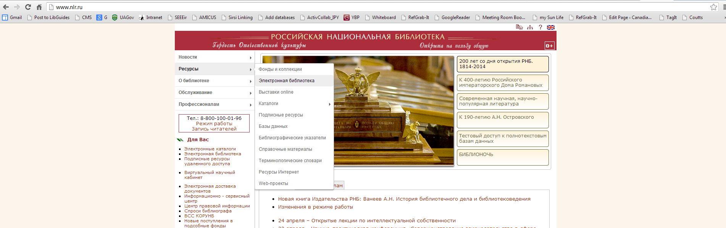
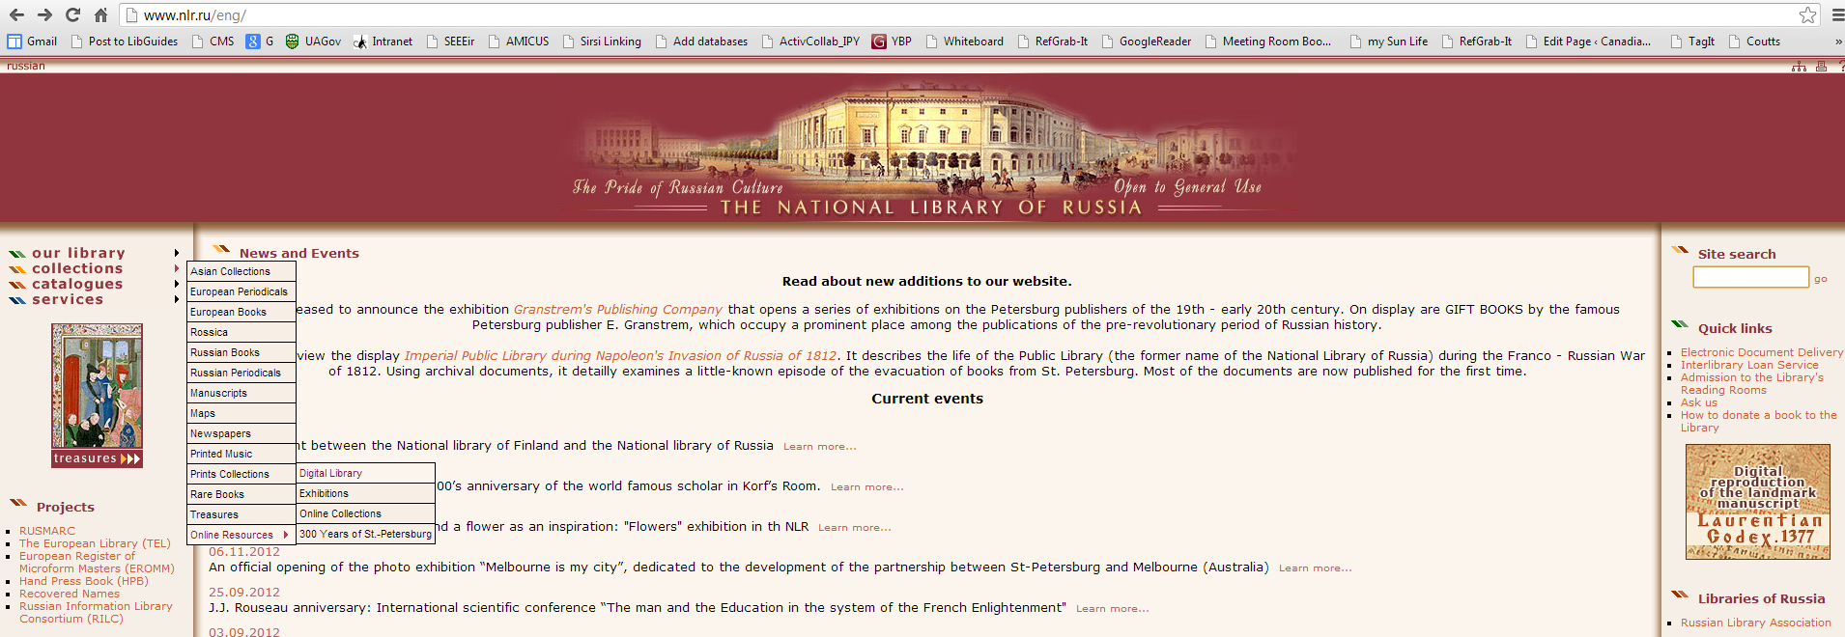
Notes:
The website of an organization like the National Library of Russia is daunting if you don’t read Russian, but some of these sites have versions in other languages [CLICK FOR ARROW TO UNION JACK]. They’re guaging their audiences, and in this case, decided that an English portal would be useful as well.
[CLICK FOR ENGLISH VERSION]
[CLICK FOR ARROWS TO DIGITAL LIBRARY]
On both versions, you can find a link to their Digital Library. Many libraries in Eastern Europe are active in digitization and creating fulltext digital collections. These include classics of literature, children’s literature, archival records, and more.
This link leads us to their extensive Digital Library, which continues to grow.

Slide 16
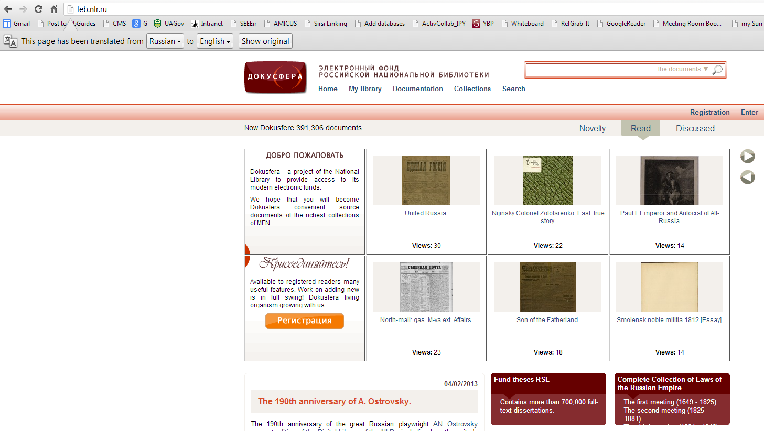
Notes:
The National Library of Russia’s Digital Library is called Dokusfera (Document-Sphere). Google translator allows you to use the sites that don’t have an English version [CLICK FOR ARROW]
The translations aren’t perfect, but they’ll allow you to tell whether materials that are of interest to your users are available – “strechable publications”.
[CLICK FOR CIRCLE] – let’s take a look at the list of collections…

Slide 17
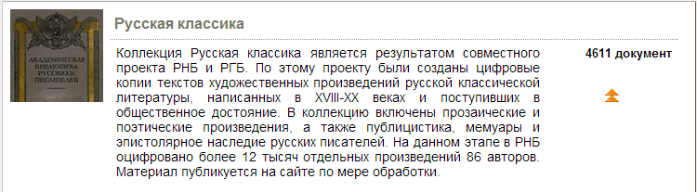
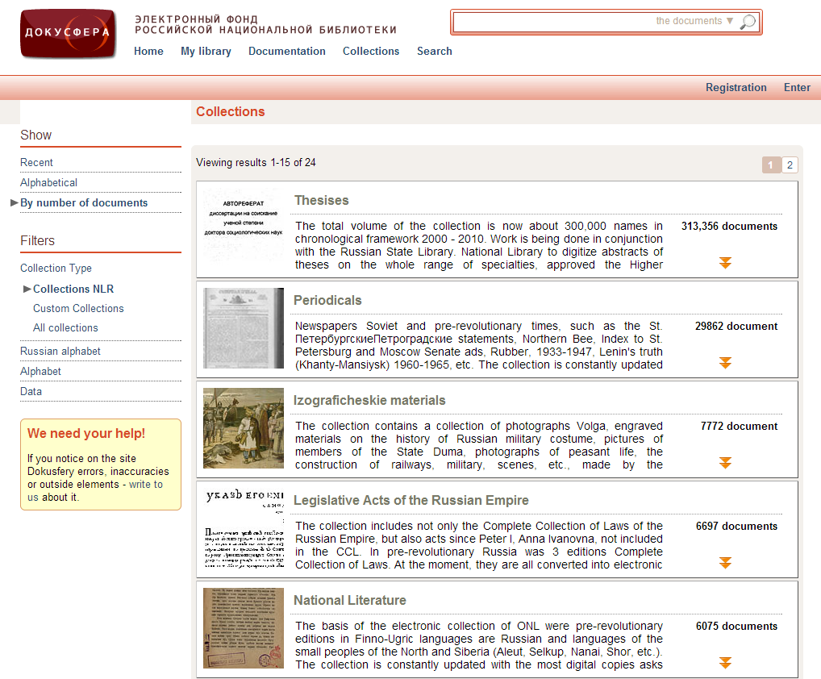
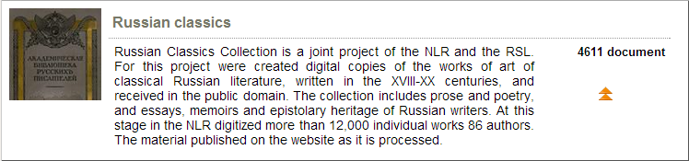
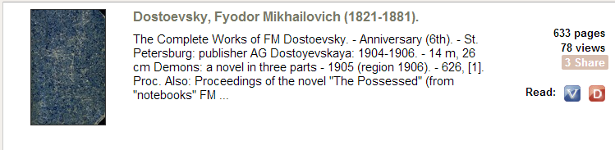
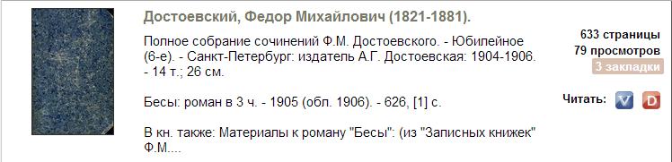
Notes:
Theses – very important for academic (not available from North American subscriptions such as Proquest Dissertations & Theses database)
Periodicals collection, including old newspapers – useful for research, geneology, etc.
One that doesn’t show in the list is Russian Classics [CLICK] – so, if you have users who want to read Tolstoy, Dostoyevsky, Pushkin, and so on, a lot of these works are available [CLICK FOR COMPLETE WORKS OF DOSTOYEVSKY]

Slide 18
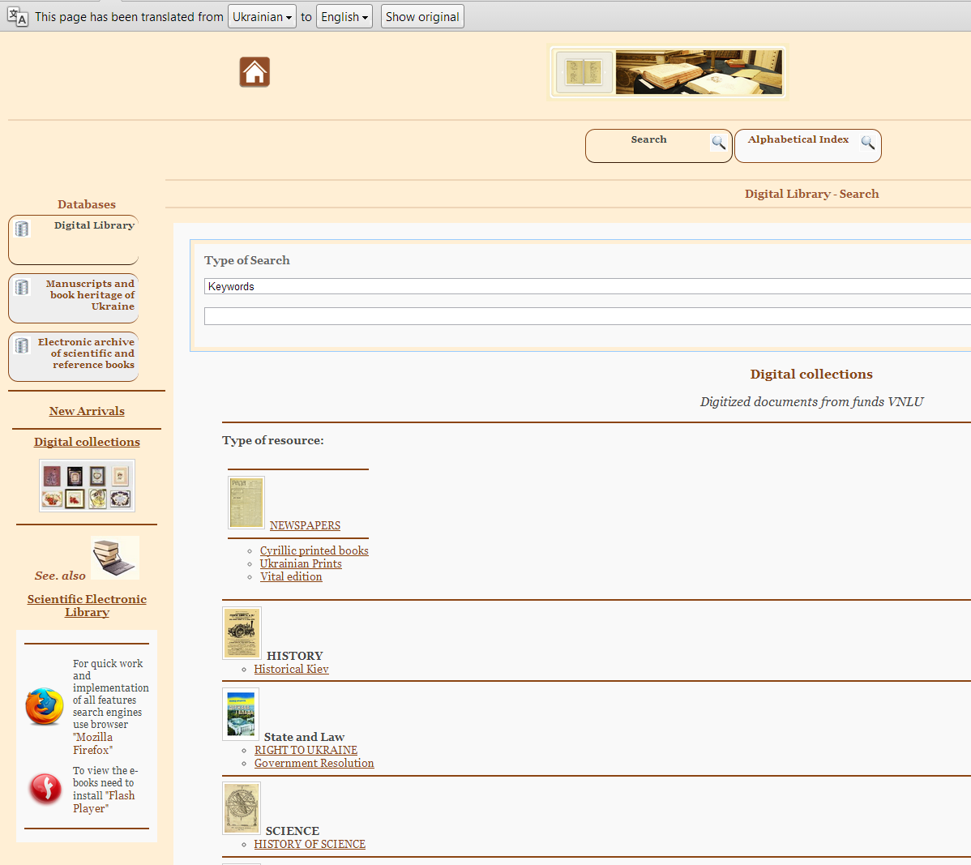
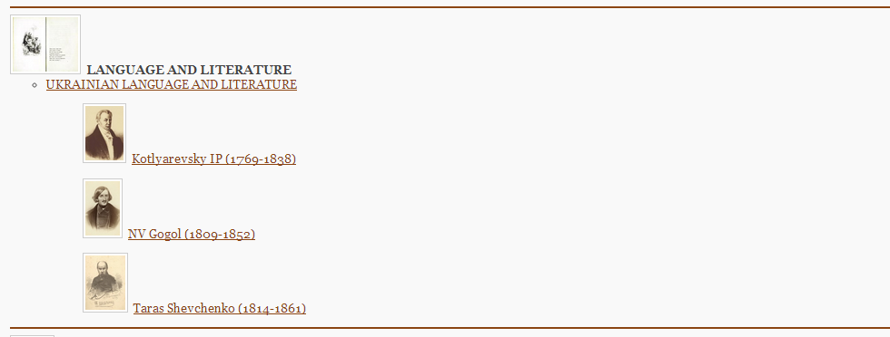
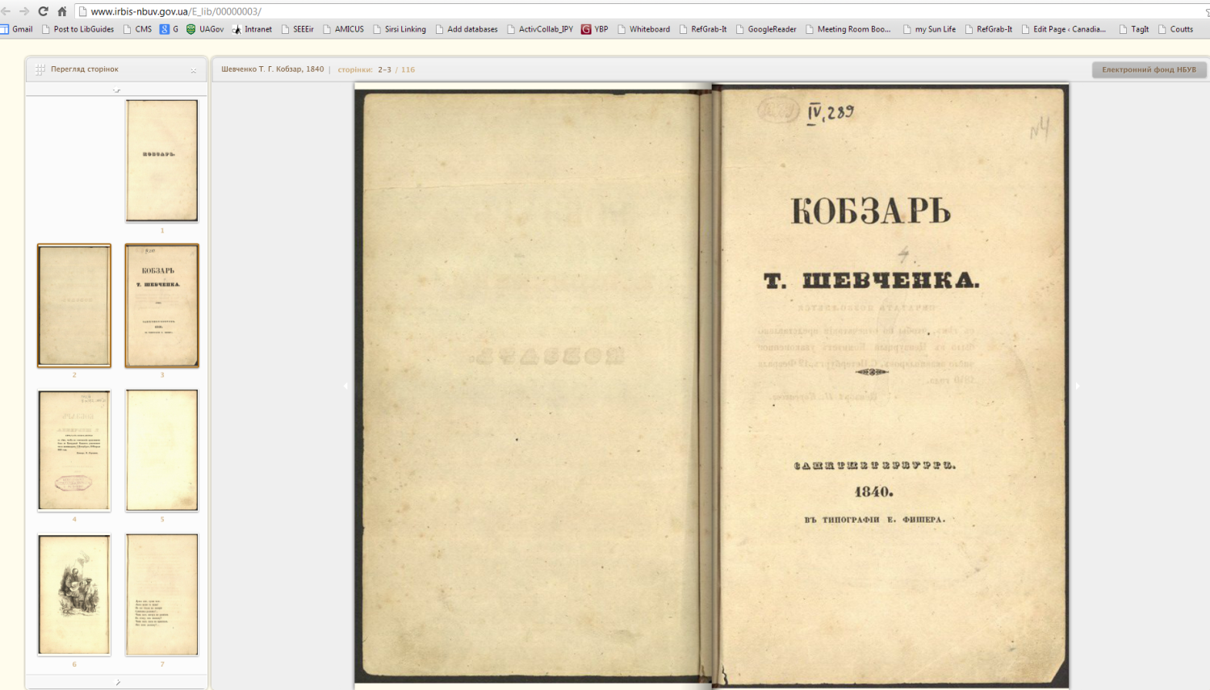
Notes:
Here we are on the site of the Ukrainian National Library: Vernadsky Library Digital collection, again using Google Translator
- Their digital library includes a “Language and Literature” section, and here, I’ve followed the links to the fulltext of a work by Ukraine’s National Poet – there it is, Kobzar’ by Taras Shevchenko

Slide 19
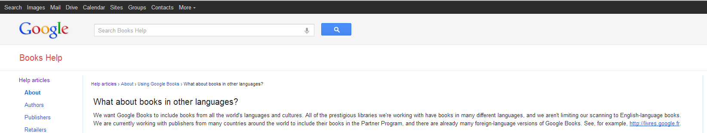
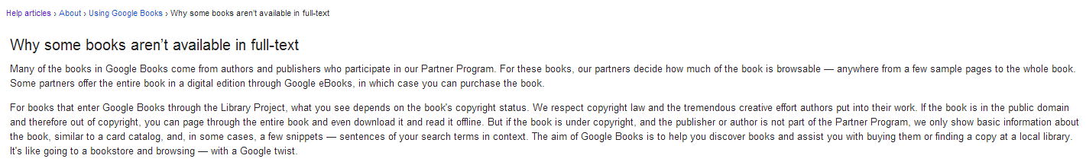
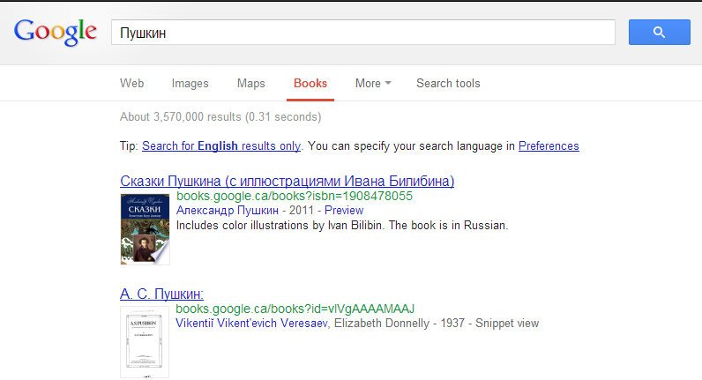
Google Books
translit.ru – website provides transliterations for you from Latin to Cyrillic and vice versa for many languages
books.google.com - all
books.google.ru - Russia
books.google.fr - France
books.google.com.br - Brazil
books.google.cn - China
…
Notes:
And, what about Google Books?
In their help section for Google Books, the company explains, “We want Google Books to include books from all the world's languages and cultures. All of the prestigious libraries we're working with have books in many different languages, and we aren't limiting our scanning to English-language books. We are currently working with publishers from many countries around the world to include their books in the Partner Program, and there are already many foreign-language versions of Google Books.”
You don’t have to be able to search for them yourself – you just have to be able to instruct your library users on how to search in the language of their choice.
You can search the entire Google Books site, as I have done here, or you can go to the Google Books page for a particular country, and the interface is in the home language [CLICK]
Of course, the problem with Google Books is that so many of their books are limited by copyright and publisher agreements, so often only a section of the book is currently available fulltext online. So, you have to experiment with it to see whether it might be useful to you. That’s why I wanted to start by showing you National Library projects that digitize full works.
If using these types of online collections proves successful in your library, you’ll need to learn about installing foreign language keyboards, and find out about web tools for specific languages and scripts, such as the website, translit.ru, for doing searches in the Cyrillic alphabet [CLICK].

Slide 20

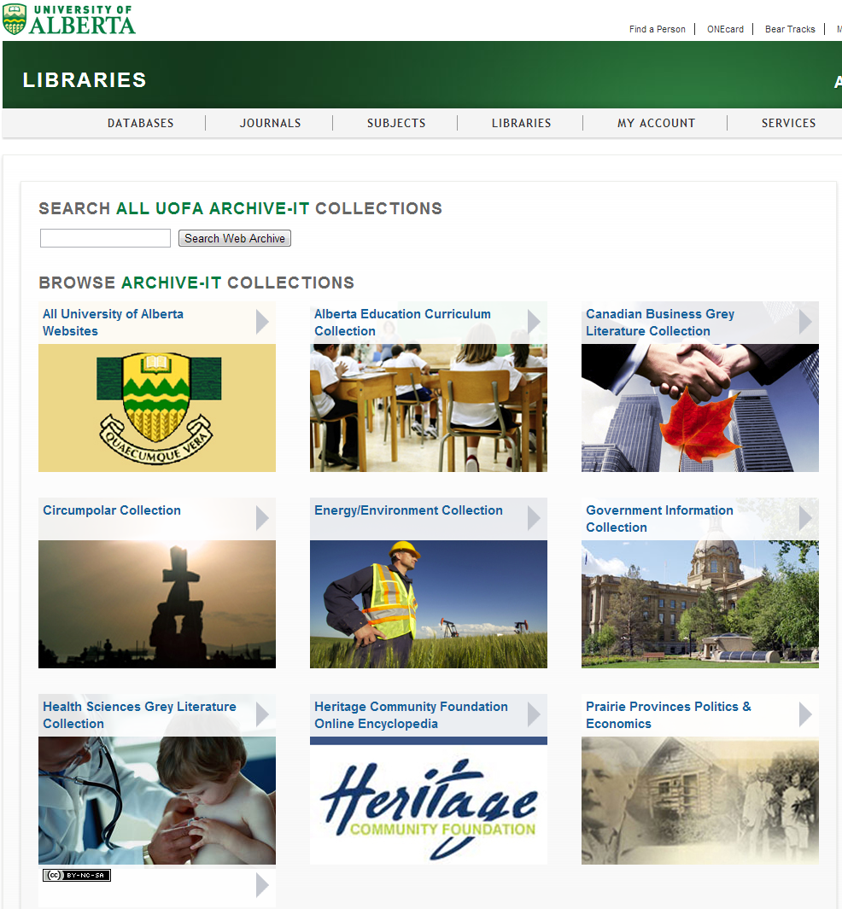



Web Archiving
Preservation of born-digital content
Archive-It
UAlberta Libraries Web Archive
www.library.ualberta.ca/webarchive
Wayback Machine
wayback.archive-it.org
Archive-It
www.archive-it.org
Notes:
As Denis mentioned, one of our goals at the U of A is to be a Library of Record, so we’ve become involved in web archiving – the long-term preservation of free online content, or “born digital” content, as we call it.
We licence a software called Archive It from a non-profit organization called Internet Archive, which is based in California. Internet Archive’s goal is to preserve the entire content of the internet, so they need a few partners to get this done. Many national libraries, academic libraries, and other organizations work together to preserve websites using Archive It. We all contribute to the Wayback Machine, which is a search engine that allows you to search for websites that no longer exist, and for older versions of sites.

Slide 21
Notes:
With our current subscription to Archive It, we’re able to preserve content in 9 subject areas…
You can search across all of them at once, or by collection. Every time we register a new website or “seed” in Archive It, it also eventually gets included in the Wayback Machine. We ask for permission from the content owner when necessary, but for the most part, since all we’re doing is preserving the sites, we can go ahead and choose the content we want to preserve.
So, if you were to search for Ukraine and Alberta in the Prairie Provinces Collection, you’d find some of the types of things that I’ve been working on with my colleagues.

Slide 22
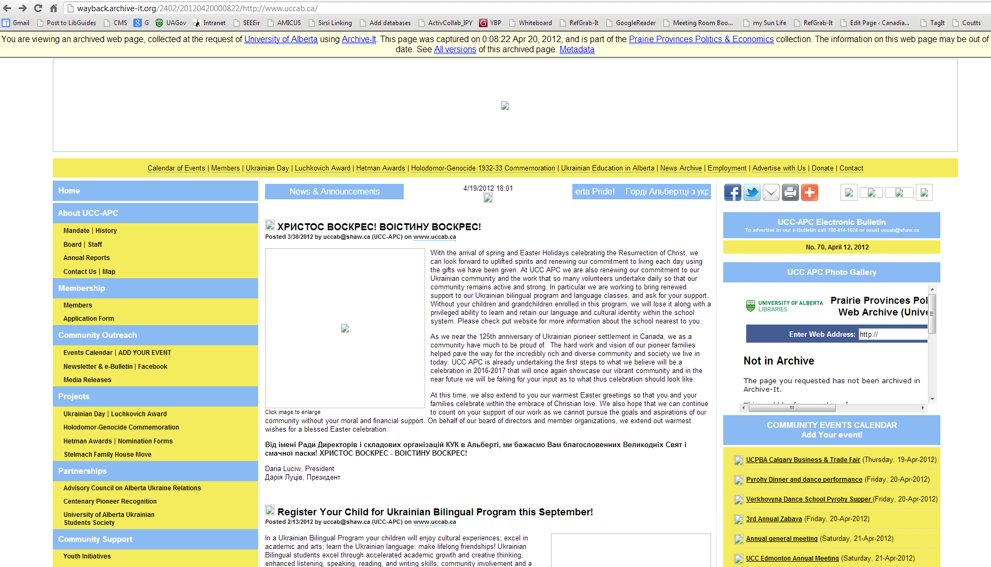
Notes:
So, for example, here is an archived version of the website of the Ukrainian-Canadian Congress.
For our purposes as an academic library, we’re often after the formal publications that these types of pages contain – so now we can choose to catalogue the Annual Reports of this organization. We can run reports in Archive It to identify .pdf files that may be substantive publications that we’d like to include in our catalogue. In future, our Discovery Tools should allow us to do through some kind of automated process.
Every site that gets archive has this note across the top, clearly stating that it’s an old version of the page. Because websites are always changing, when we register a site, we can choose to have it crawled and preserved on a repeating basis – annually, quartlerly, monthly, or even daily. Here [CLICK FOR ARROW], you can choose to see all of the versions of the site that have been archived.

Slide 23
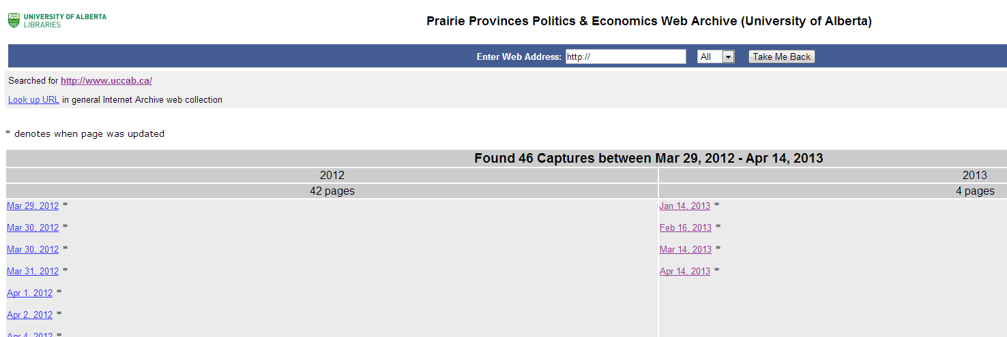
Notes:
So, you can click through to the version of the site from the time period that interests you…
So, that’s all I wanted to cover. Now I’m going to turn it over to Mary to tell you about foreign-language collecting at Edmonton Public Library…

Slide 24
World Language Collections at EPL

Slide 25
Our mandate is different from an academic library.
We collect material to meet the leisure and recreational needs of customers.
Eg. Novels, magazines, children’s books, cookbooks, DVDs, recorded music.
We also collect material used to support programming (such as YRCA, French Story Time).
We get input from our branches when we consider adding new languages. We must strike a balance between responding to every request, the availability of material in certain languages and practical considerations such as shelf space.

Slide 26
Which languages do we collect?
Chinese
French
Japanese
Vietnamese
German
Arabic
Hindi
Russian
Persian
Spanish
Panjabi
Urdu
Polish
Korean
Tagalog
Ukrainian
Gujarati
Japanese
Italian
Hebrew
Turkish
Portuguese
Bengali
Kurdish

Slide 27
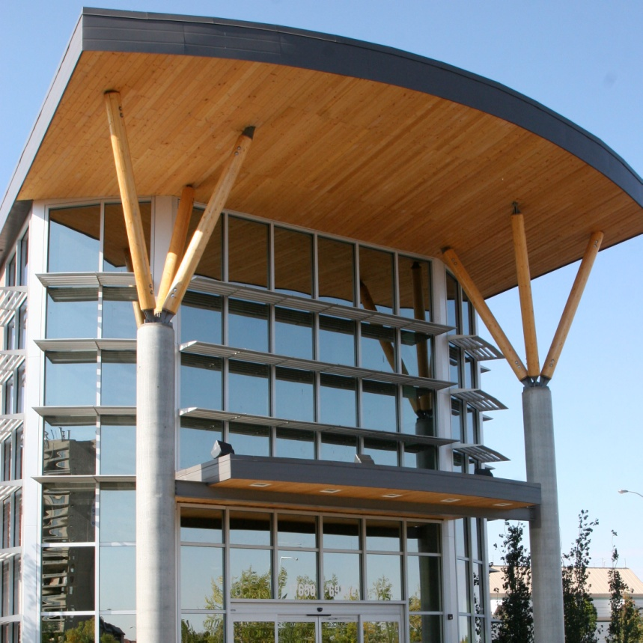
How big are these collections?
Largest collections are Chinese (17001 items, 30 % of WL collection) and French (10183 items, 18 % of WL collection).
14 languages with between 3000 and 1000 items.
6 languages with fewer than 1000 items in the collection.
** All material at EPL floats, so these items do not “live” at any one branch.

Slide 28
Some popular Spanish books

Slide 29
Turnover rates in descending order

Slide 30
Turnover rates continued

Slide 31
How is material selected?

Slide 32
We let our vendors do the work!
Eastview: Polish, Russian and Ukrainian
www.eastview.com Minneapolis, MN
Everything Deutsch: German, Portuguese, Italian, Turkish, Dutch
www.everythingdeutsch.com Edmonton, AB
Multicultural Books & Video: Gujurati, Hebrew, Arabic, Hindi, Kurdish, Panjabi, Persian, Tagalog, Urdu
www.multiculturalbooksandvideos.com Madison Heights, MI and Belle River, ON
PanAsian www.panap.com Union City, CA

Slide 33
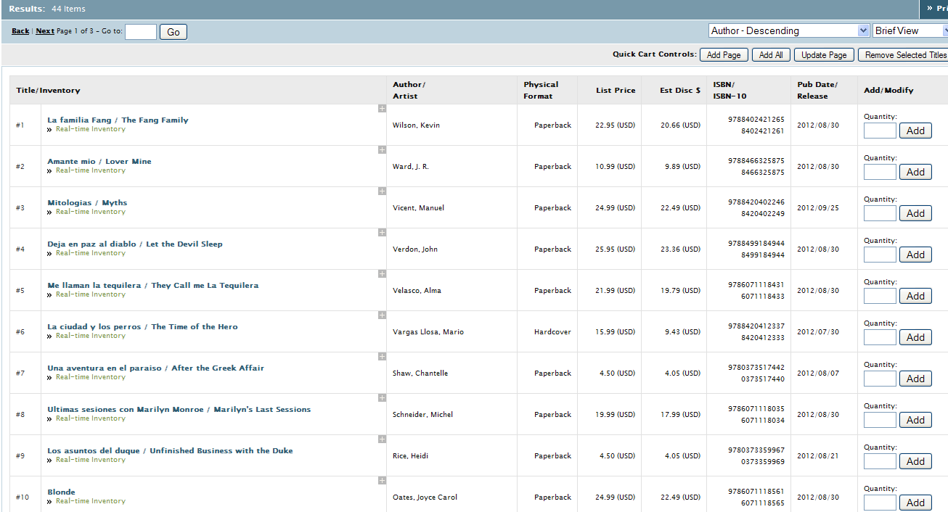
I did some of the work……

Slide 34
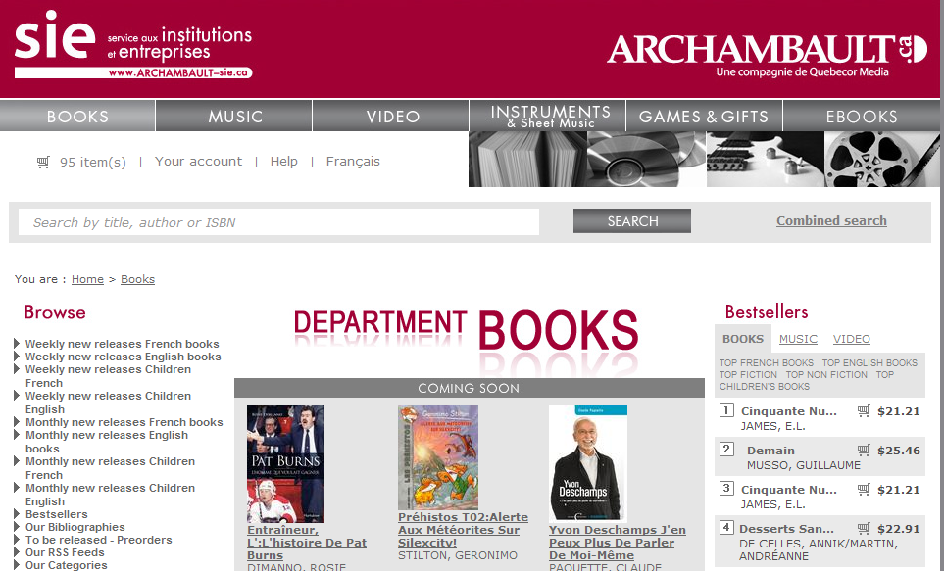
And a bit more work………

Slide 35


Specific requests from staff
Hi Mary,
I think we still need more French board books. Some new ones have come through (and I don't know if more are on their way from cataloguing?) but they are lending like hot cakes! It still seems like we never have enough.
We also seem to have ploughed through pretty much all of the books in our collection that are suitable for French storytime.... books that have no more than a sentence per page. (So many picture books are too text heavy).
I know this is a really tall order! It's almost impossible to see inside the books online, so I'm not sure how to help with suggestions.
Is there something we could be doing to find some appropriate books?
Wendy is thinking maybe we could head over to campus st jean's library to get ideas from their education collection.
Do you have any ideas?
Thanks!
Kate

Slide 36
And from customers………
Title: Sanna¯t?a¯num? sarana¯mum?
Artist(s): Ojha-Vaidya, Kajala
Media: Book Fiction (Gujarati)
Audience: Adults
Where did you hear about it?
Why should it be in the library?
Sanna¯t?a¯num? sarana¯mum? is listed in the catalogue however it is only vol.1. There is a vol 2 under the same name.
Received: Mar 26, 2013
Finished: Item will be ordered - by mbennett on Mar 27, 2013 09:12:20

Slide 37
Some are more involved.
Title: Marina
Artist(s): Carlos Ruiz Zafon
Media: Book Fiction
Audience: Adult
Why should it be in the library?
You do have the book, along with Zafon's other books, but I would like to see it in the language in which it was written, i.e. Spanish. You have it in English, Turkish, Portuguese, Italian, and French but not in the original language, one which is spoken by significant numbers of Edmontonians. My concern to have Zafon's books in Spanish extends to all his other titles, although I actually own copies of his earliest works in Spanish. Is it possible to obtain his work as an ebook? I had been told that you would be obtaining ebooks in foreign languages beginning this year. Is that really going to happen, and, if so, will you be including Spanish books?
El prisionero del cielo
Received: Mar 01, 2013
Finished: by mbennett on Mar 05, 2013 02:25:36
Additional Comments: We will order Marina, as well as any Spanish titles that are still in print/available. As far as eBooks go, we have had some discussions about adding Spanish eBooks, but have not decided when this will happen. Please stay tuned. FYI, there are only 2 Carlos Ruiz Zafon books available in Spanish from Overdrive, our eBook vendor, El Juego del øngel and La Sombra del Viento. http://search.overdrive.com/

Slide 38
What about Overdrive and other Digital Resources?

Slide 39
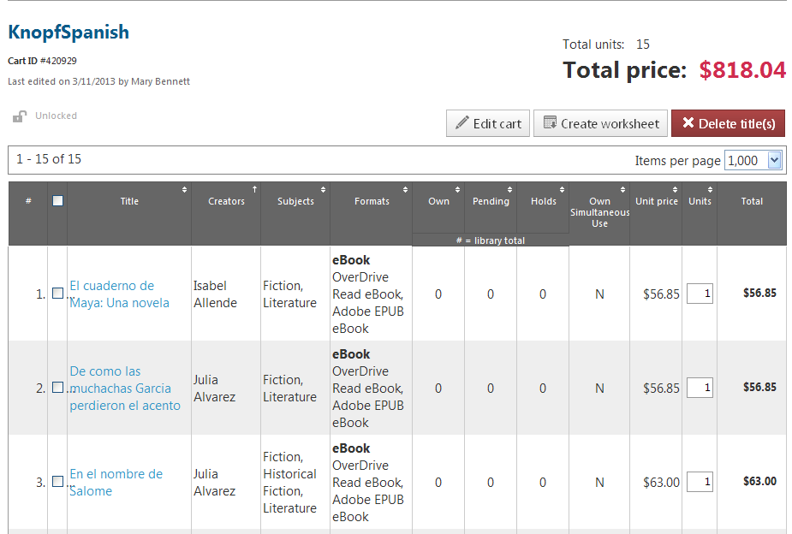
We are looking to add Chinese, Russian, Spanish and French from Overdrive

Slide 40

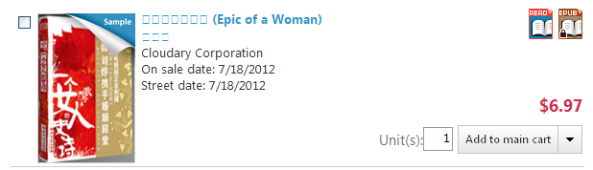
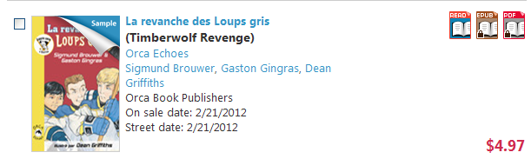
Will take advantage of Overdrive’s advanced search!

Slide 41
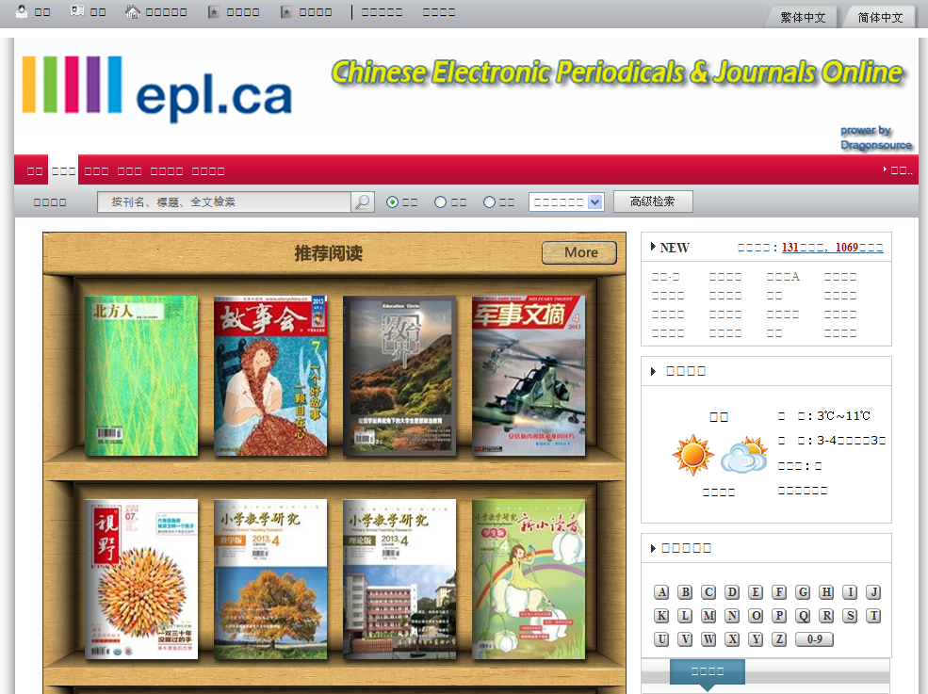
Dragon Source

Slide 42
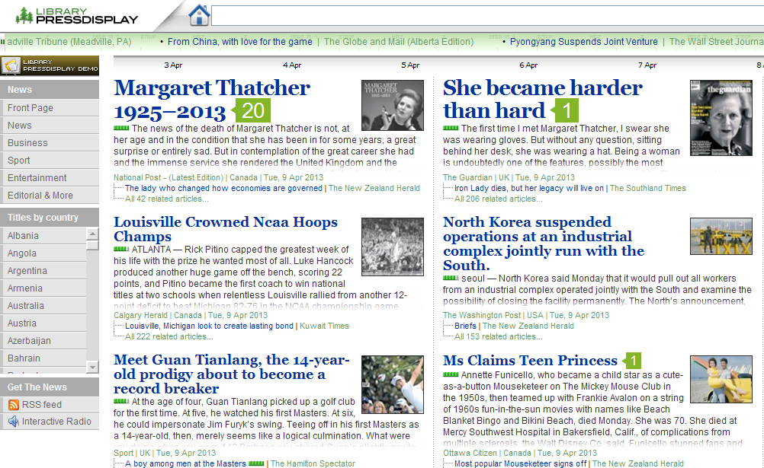
Press Display

Slide 43
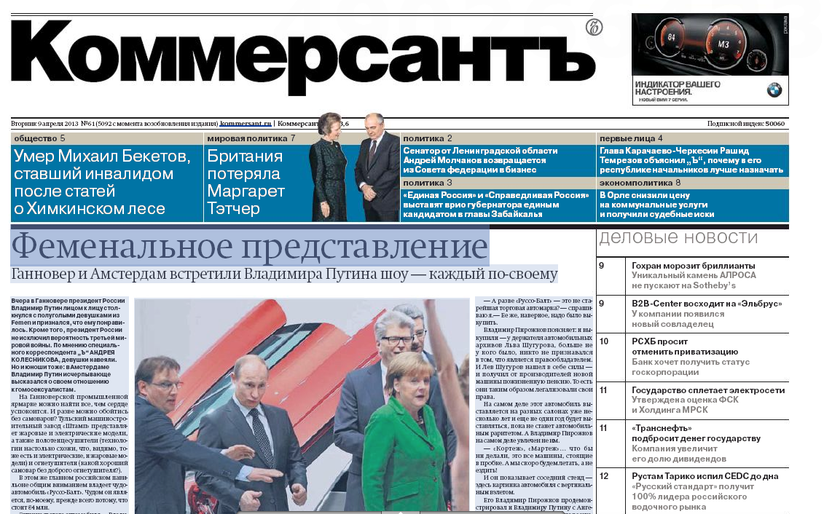
Catlog > Russia9
Press Display

Slide 44
Questions for Discussion
Are any of you currently partnering with colleagues or other organizations on collecting foreign langugage titles?
How do you collect? Are any of you using approval plans for foreign language titles? Print? E-?
Do any of you collect usage statistics? Do you know how your foreign language collections are being used?
Would an inventory of foreign language collections in Alberta Libraries be useful?

Slide 45



Thank you
ના○
Спасибо
Gracias
Merci
Дякую
Mary Bennett - mbennett@epl.ca
Lindsay Johnston - lindsay.johnston@ualberta.ca
Denis Lacroix - denis.lacroix@ualberta.ca

