Slide 1
Finding More Canadian Indigenous Health Articles Using Search Filters
Sandy Campbell
Marlene Dorgan
Lisa Tjosvold
John W. Scott Health Sciences Library University of Alberta Libraries
Wisdom Engaged: Traditional Knowledge and Northern Community Well Being
University of Alberta, Edmonton, AB
March 20, 2015

Slide 2
The Challenge
Researchers often want to find studies related to health topics among Aboriginal People in a particular province or territory.

Slide 3
Examples
I want to find studies about the health benefits of country food among Aboriginal people in Saskatchewan
I want to find studies about the role of Aboriginal grandmothers in the health of newborn babies in the Northwest Territories
I want to find traditional methods of treating depression among Aboriginal people in British Columbia

Slide 4
Challenges in Searching
Many words mean or imply the presence of Aboriginal people in a study
Aboriginal, First Nations, Metis, Indigenous, tribal names, etc., on-reserve, off reserve, country food, residential school
Many words mean or imply that a study was done in a particular jurisdiction
Northwest Territories, NWT, MacKenzie Valley, Inuvialuit Settlement Area, Inuvik

Slide 5
Text-word Challenges
Broad linguistic groups
Regional names
Tribal/district/reserves
Former/current names
Names in different languages
Spelling variations
Groups that have been historically mis-named
Words that imply “Indigenous”
Notes:
Through the process of creating the searches we identified challenges in text-word searching for Canadian Indigenous peoples
Broad linguistic group names
Athapascan, Cree
Regional names
Dene includes Denesuline, Tlicho, T’atsat’ine, Deh Cho and Sahtu
Tribal/district names / reserve
Tribal Chiefs Ventures/ Cold Lake / Cold Lake 149A - For example there in Alberta there are 45 first nations, 3 treaty areas, and 140 reserves.
Former and current names
Yellowknives/T’atsaot’ine
Names in different languages
Innu/Montagnais/Naskapi
Slavey/Deh Gah Got’ine or Deh Cho
Spelling variations
Gwich’in/Kutchin/Gwitchin
Names that have other meanings
Hare/Dog Head/Dogribs
Groups that have been historically mis-named
Blackfoot of Southern Alberta/Blackfeet in the United States
In addition there are terms which imply the presence of information about Indigenous people:
(Read from slide)
Numbered treaties (eg: Treaty 8), “off-reserve/on-reserve”, “traditional use”, “urban Indian”, “Native people*” (“native” retrieves plants, etc.), “first nation”, “country food*”

Slide 6
Geographic Name Challenges
MESH vocabulary for Canada restricted to ten provinces and three territories
Regional descriptions
Many place names for the same area
Former and current place names
Names in different languages
Spelling variants and common errors in spelling
Names of cities, towns, villages, settlements, and reserves
People who live on both sides of the border
Notes:
A variety of types of keywords which indicate Canadian geography must also be searched because MESH vocabulary for Canada restricted to ten provinces and three territories
Regional Descriptions
Arctic region, Western Arctic, Northern Canada
Many place names for the same area
Canada, Yukon Territory, Inuvik, Mackenzie Valley, Beaufort-Delta, Inuvaluit Settlement Area
Former and current place names
Eskimo Point/Arviat
Frobisher Bay/Iqaluit
Names in different languages
Hudson Bay/Kangiqsualuk ilua/baie d’Hudson
Spelling variants and common errors in spelling
Hudson Bay/ Hudson’s Bay
Names of cities, towns, villages, settlements, and reserves
Samson 137 Reserve/Sampson First Nation/Hobemma
People who live on both sides of border
Mohawk in Eastern Ontario, Southern Quebec and upstate New York
Blackfoot Confederacy
Blackfeet in Montana
Blackfoot in Alberta

Slide 7
Objectives
To create first-generation search filters that retrieve studies from the Ovid MEDLINE database related to Canadian Indigenous Peoples
To determine whether or not the filters retrieve more records than do searches using the MeSH headings alone
To determine how many of the additional records are relevant
Notes:
In light of these issues our objectives were to…
[READ SLIDE – AND COME BACK]
First generation filters are "subjectively derived, based on librarian searcher expertise, relying on knowledge of the database structure, content and thesaurus, along with the clinicans' subject knowledge. Measures of how effective the search filter performs on an independent set of relevant records are not calculated."

Slide 8
Methods – Creating the Filters
Identifying key terms
Canadian Indigenous peoples and Canadian Geography
Appropriate MeSH terms, broad Indigenous groups, linguistic groups or names
Indigenous groups or terms specific to the province or territory
Indigenous place names that also occur out of Canada and qualified with Canadian geographic terminology
Notes:
A team of three practicing health librarians created the filters. Searches were executed between May 1, 2013 and December 20, 2013 on the Ovid MEDLINE database (Ovid MEDLINE(R) In-Process & Other Non-Indexed Citations, Ovid MEDLINE(R) Daily and Ovid MEDLINE(R) 1946 to Present).
Sources: We used government, historical and ethnographic publications, gazettes. Our terms include current and historical names in multiple languages, as well as local and settlement names, and names of linguistic groups.

Slide 9
Methods – Creating the Filters
Single line search that could be cut and paste into the Ovid Medline search box
Reviewed results and removed terms that retrieved high levels of irrelevant materials using “NOT”
Notes:
Filters were constructed employing Boolean operators, adjacency, truncation, and nested logic as appropriate, to create a single line search which can be cut and pasted into the Ovid MEDLINE search box.

Slide 10
Methods – Testing the Filters
Initial searches were conducted using MeSH terms and geographic headings only
Searches were conducted using the filters
The results of the MeSH searches were removed from the results of the filtered searches
Titles and abstracts of the remaining results were reviewed for relevance
Notes:
Full articles were not reviewed

Slide 11
MeSH Search for Newfoundland & Labrador
Ovid Technologies, Inc. Email Service ------------------------------ Database: Ovid MEDLINE(R) In-Process & Other Non-Indexed Citations, Ovid MEDLINE(R) Daily and Ovid MEDLINE(R) <1946 to Present> Search Strategy: -------------------------------------------------------------------------------- 1 exp Indians, North American/ (11548) 2 exp Inuits/ (3233) 3 exp Health Services, Indigenous/ (2079) 4 exp Ethnopharmacology/ (564) 5 exp Medicine, Traditional/ (26371) 6 exp Shamanism/ (162) 7 1 or 2 or 3 or 4 or 5 or 6 (41096) 8 exp "Newfoundland and Labrador"/ (1060) 9 7 and 8 (49)

Slide 12
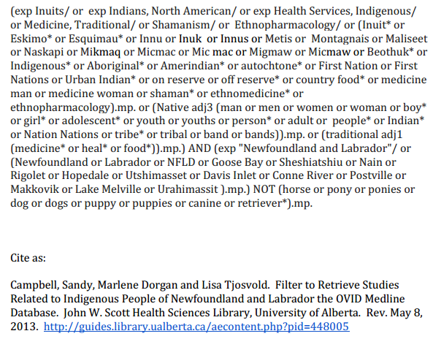
Filter for Newfoundland & Labrador
Notes:
An example of one of our search filters. They have been designed so one can cut and paste easily.

Slide 13
Assessing Relevance
Reference to Indigenous Group
Reference to health related topic
Clear indication that the study included people in the province or territory
Notes:
Health-related topics were broadly interpreted to include not only clinical, genetic and epidemiological studies, but also health policy health and administration and environmental health.
Studies of environmental pollutants were included if there was an indication that the pollutant was entering human food and water sources.
Review of the records for relevance was done either by the authors or by a graduate level assistant who had been trained for this task.

Slide 14
Results
12 Ovid MEDLINE filters for Canadian provinces and territories
Filters retrieved 73% to 464% additional results over MeSH searches alone, with relevance ranging between 28-100%
Notes:
Individual filter for all provinces and territories with the exception of Prince Edward Island, where very few studies contain words that indicate the presence of Indigenous Peoples.

Slide 15
Comparison of MeSH and filtered Ovid MEDLINE searches for publications related to Canadian Indigenous peoples by province or territory
Province Region | BC | AB | SK | MB | ON | QC | NB | NS | NL | NU | NWT | YT
MESH Search | 333 | 100 | 137 | 237 | 304 | 279 | 7 | 15 | 48 | 82 | 138 | 19
Filter Search | 643 | 243 | 231 | 410 | 934 | 935 | 16 | 27 | 102 | 463 | 457 | 82
Difference | 366 | 143 | 118 | 173 | 630 | 656 | 9 | 12 | 54 | 381 | 319 | 63
% Difference | +110% | +143% | +86% | +73% | +207% | +235% | +128% | +80% | +112% | +464% | +231% | +332%
% relevant publications retrieved from the filter search | 69% | 74% | 77% | 87% | 28% | 37% | 67% | 92% | 100% | 83% | 64% | 83%
Date Searched | 17-Dec 2013 | 19-Dec 2013 | 17-Dec 2013 | 12-Nov 2013 | 19-Dec 2013 | 12-Nov 2013 | 20-Dec 2013 | 12-Nov 2013 | 12-Nov 2013 | 11-Dec 2013 | 20-Dec 2013 | 20-Dec 2013
Notes:
Percentages have been rounded to the nearest whole number
Prince Edward Island is not included because all combinations of terms relating to PEI and Indigenous Peoples results in only two articles.
Notes:
Give some examples from the table

Slide 16
Discussion
Search filters
Retrieve more relevant results than MeSH terms alone
improve efficiency for searching
have implications for practice
Notes:
Given the limitation of the MeSH terms, it’s not surprising that the filters retrieved additional relevant materials.
Having identified challenges in searching for this material, we hope to inform the practice of others in their searching for Indigenous peoples of Canada.
Both of these should improve efficiency in searching.
We also feel the search filters will have implcations for practice [CHANGE SLIDE]

Slide 17
Implications for Practice
Will have an impact on clinical decision making and policy decisions
Will capture studies province by province, and eventually Canada wide using a main Canada filter
Notes:
Because the Canadian Indigenous population is under-represented in medical research studies, the improved retrieval of pertinent material will have an impact on clinical decision making and policy decisions. The filters will also capture studies province by province or territory.

Slide 18
Filter Limitations
Specific to provincial/territorial jurisdiction
May not be complete
Terms may change
May have to be modified for specific search purposes

Slide 19
Publication of the Filter
Freely available on the web
Most current versions on Health Sciences Search Filters LibGuide http://guides.library.ualberta.ca/content.php?pid=448005&sid=3671231
Campbell S, Dorgan M, and Tjosvold L. Creating provincial and territorial search filters to retrieve studies related to Canadian Indigenous Peoples from Ovid MEDLINE. Journal of the Canadian Health Libraries Association, Vol 35, No 1, 2014 [cited 2015 February 19].
Notes:
This work is a first attempt at creating comprehensive filters to retrieve studies related to Indigenous Peoples by Canadian Province or Territory in any subject area. The documentation of the challenges involved in creating filters for the Ovid MEDLINE database will be useful for others attempting to do similar work.
The filters continue to be refined and updated. Updated versions of the filters resulting from this project will continue to be published on a University of Alberta Libraries LibGuide, Health Sciences Search Filters (6) and searchers are encouraged to look there for the most current versions. Searchers are encouraged to modify the filters for their own use and to incorporate local knowledge.
Future projects include rigorous testing of these filters, the creation of regional and national filters, and the creation of filters for other databases and platforms.

Slide 20
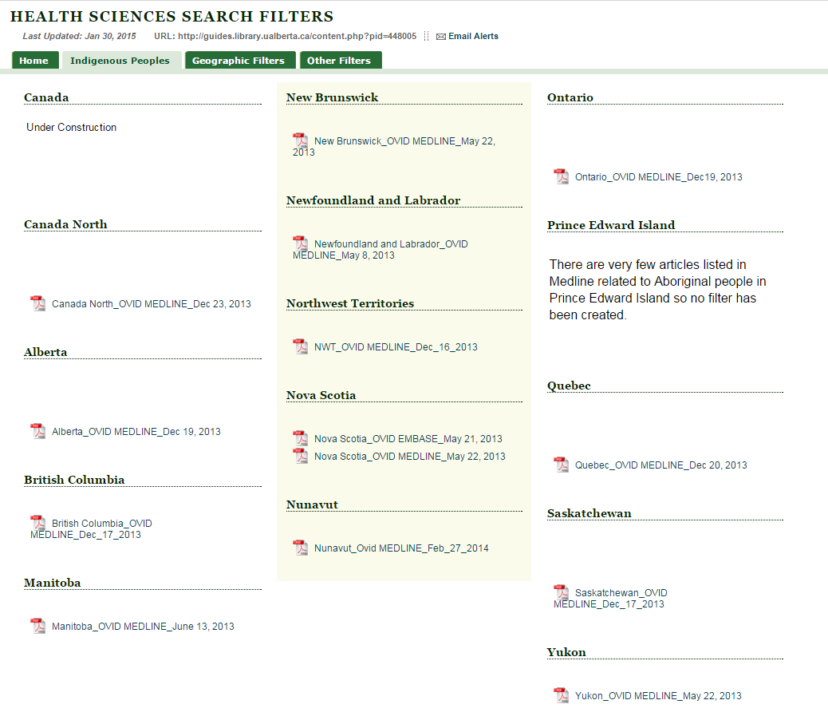
http://guides.library.ualberta.ca/content.php?pid=448005&sid=3671231
Notes:
The most current fitlers are available on the University of Alberta Libraries web-site.

Slide 21
References
Jenkins M. Evaluation of methodological search filters. Health Information and Libraries Journal,[Internet]. 2004 [cited 2014 February 7] 21 148-163, Available from: http://onlinelibrary.wiley.com/doi/10.1111/j.1471-1842.2004.00511.x/pdf
Campbell S, Dorgan M, and Tjosvold L. Creating provincial and territorial search filters to retrieve studies related to Canadian Indigenous Peoples from Ovid MEDLINE. Journal of the Canadian Health Libraries Association, Vol 35, No 1, 2014 [cited 2015 February 19].

Slide 22
Questions?

