Slide 1
Mandatory Reporting of Serious Adverse Drug Reactions and Medical Device Incidents by Hospitals Educational Support for Mandatory Reporting
Module 4:
Health Canada’s Review and Communication of Safety Findings

Slide 2
Module 4 – Learning Outcomes
Completion of Module 4 will enable you to:
Provide an overview of health product vigilance in Canada
Identify the stages of adverse reaction (AR) and medical device problem (MDP) report management
Describe post-market surveillance activities, including signal detection, signal prioritization, signal assessment/safety review, and risk mitigation
Describe risk communications from Health Canada
Recognize the various resources provided by Health Canada to share AR and MDP data and findings
Understand Health Canada’s principles for the security and sharing of AR and MDP report data

Slide 3
Module 4 – Outline
Health Product Vigilance
Health Canada’s AR and MDP Report Management
Information Sharing from AR and MDP Reporting
AR and MDP Online Databases
Health Canada Safety Reviews
Health Canada Recalls and Safety Alerts
Health Product InfoWatch
Drug and Health Product Register (DHPR)
Data Security and Data Sharing from AR and MDP Reports
Key Points to Remember
Abbreviations
Resources

Slide 4
Conceptual Model of Serious ADR and MDI Reporting by Hospitals
Module 4 describes Health Canada’s review and communication of safety findings.
Source: Serious ADR and MDI Action Cycle. ISMP Canada, HSO, CPSI; 2019.
Notes:
This conceptual model depicts the mandatory reporting cycle; Health Canada reviews and assesses reports and other data sources, such as voluntary reports, industry reports, international data, literature and other safety information.

Slide 5
Health Product Vigilance

Slide 6
Health Product Vigilance
Health Canada builds post-market safety knowledge, which is integral to effective clinical use, from several data sources, including serious adverse drug reaction (serious ADR) and medical device incident (MDI) reports.
In addition to serious ADR and MDI reports, a variety of other data sources contribute to therapeutic product safety monitoring, including:
mandatory reports from regulated parties,
voluntary reports from health care professionals and consumers,
foreign data such as manufacturer assessment of worldwide safety data,
information sharing with foreign regulatory agencies,
medical literature, and
information generated from the Drug Safety and Effectiveness Network (DSEN).
This module reflects the broad scope of Health Canada’s product vigilance activities beyond mandatory reporting by hospitals (e.g., serious ADRs and MDIs); which is reflected in the use of the AR and MDP report terminology.

Slide 7
Health Canada’s Health Product Vigilance Life Cycle
1. market authorization SUBMISSION
Product submission (pharmaceuticals, natural health products, biologics and biosimilars, radiopharmaceuticals, disinfectants and sanitizers with disinfectant claims, and medical devices) by market authorization holder (MAH)
2. Pre-market Review
5. Compliance and enforcement
1
Reviews product submissions to assess for safety, efficacy and quality
Review risk management plans with MAH to mitigate potential risks (as applicable)
Assesses product name and label (depending on class for medical devices)
Monitors quality of adverse reaction/ medical device problem reports through compliance promotion and enforcement (e.g., inspections)
Enforce regulations
5
2
4. Risk mitigation
3. Post-market surveillance
4
3
Continuing observation
Labelling changes
Risk communications
Product recall
Educational activities
Market withdrawal
Other
Monitors safety and effectiveness of health products by identifying and assessing potential safety signals through multiple sources including spontaneous reporting of adverse reactions to health products and medical device problems reports, literature review, annual safety summaries, DSEN, liaising with other regulators, etc.

Slide 8
AR Reporting Is Essential to Post-market Surveillance
Many safety issues are ONLY detected after market approval due to use of the health product in larger populations.
Phase I
Regulatory Approval
AR REPORTING
Animal Testing
Phase II
Phase III
Phase IV
Pre-clinical Research
Clinical Trial Studies in Humans
Market
Approval
Post-market Studies
Post-market Monitoring

Slide 9
MDP Reporting Is Essential to Post-market Surveillance
Many harms from medical devices are ONLY detected after market approval due to use of the device in larger populations.
Device Invention and Prototyping
Development
Validation
Design
Bench Test
Redesign
Study + Data Collections
Regulatory Approval
MDP REPORTING
Data Analysis
Device Launch
Redesign
Market
Approval
Post-market Monitoring
Research
Investigational Testing

Slide 10
AR and MDP Reporting Is Essential to Post-market Surveillance
Clinical Trials / Investigational Testing Have Limited Scope | Post-market Surveillance Identifies Emerging Safety Issues
Highly controlled environment Limited number of patients Short trial duration Highly selected patients Selected cases and diseases May not identify rare events | Real world use Varied and large population Long term use Off-label use in different patient groups Patients with multiple co-morbidities Rare events can be detected

Slide 11
Health Canada’s AR and MDP
Report Management

Slide 12
Stages of AR and MDP Report Management
Signal Assessment/
Safety Review
AR or MDP Report Received by Health Canada
Signal Detection
Possible Risk Communication
1
2
3
4
5
6
7
AR or MDP Report Processing
Signal Prioritization
Risk Mitigation
Dissemination of Findings
Notes:
Risk mitigation activities include:
Continuing observation
Labelling changes
Risk communications
Product recall
Market withdrawal
Educational activities
Other:
controlled distribution
consent forms
no addition of new patients

Slide 13
Signal Detection and Assessment
Safety signals (preliminary indications of product-related safety issues) are identified through data scanning, including review of AR and MDP reports.
Potential signals are reviewed by an internal committee of scientists, pharmacists and physicians to determine if a signal assessment will be completed.
Assessment from all data sources is used to consider possible risk mitigation activities.
Risk considerations include strength of evidence, manageability of risk, dissemination of information, and communication targets.
Following the completion of a signal assessment, recommendations are made and can include changing labels, including indication, recalling or withdrawing a product from the market, and communicating risks to stakeholders.
Protecting Canadians from Unsafe Drugs Act (Vanessa's Law) improves Health Canada’s ability to collect post-market safety information and take appropriate action when a serious risk to health is identified.¹
¹https://www.canada.ca/en/health-canada/services/drugs-health-products/legislation-guidelines/protecting-canadians-unsafe-drugs-act-vanessa-law-amendments-food-drugs-act.html

Slide 14
Risk Communications
Target Audience: Health Care Professionals / Hospitals
Health Product Risk Communication
Ad hoc communication about safety issues
Broad dissemination (web posting, RSS feed, MedEffect™ e-Notice)
Targeted dissemination by the Market Authorization Holder or by Health Canada (fax, email, mail)
Health Product InfoWatch
Monthly publication to raise awareness of safety issues and stimulate reporting of the same
Each publication includes a monthly recap of health product advisories and summary safety reviews, as well as a growing selection of new health product safety information.
Broad dissemination (web posting, Twitter, RSS feed, MedEffect™ e-Notice)

Slide 15
Risk Communications
Target Audience: General Public
Recall Notice
Written and distributed by industry; an “extract” of the information posted by Health Canada
Posted at regular intervals on Health Canada’s Recalls and Safety Alerts database
Public Advisory
Written by Health Canada for urgent, high risk issues
Broad dissemination (Newswire, Twitter, RSS feed, MedEffect™ e-Notice)
Targeted distribution to stakeholders as needed
Information Update
Written by Health Canada for less urgent, lower risk issues (e.g., labelling updates)
Broad dissemination (Newswire, Twitter, RSS feed, MedEffect™ e-Notice)
Foreign Product Alerts
Health Canada communicates information as needed about unauthorized products from other countries which may have been brought into the country by travellers or purchased online

Slide 16
Information Sharing from
AR and MDP Reporting

Slide 17
Information Sharing with Health System Partners
Health Canada makes AR and MDP data available online, produces an annual trend report and publishes risk communications to health care stakeholders through a number of forums.
Health Canada plans to continually improve its AR and MDP data analytics, ensuring health system partners have timely access to key information.
Data analytics:
Invest in information technology to support the timely analysis of the AR and MDP data and streamline the identification of potential safety signals
Invest in the optimization of the existing AR/MDP searchable databases
Sharing of information with partners, including:
Health Canada’s annual AR and MDP report
Outreach and education activities on reporting and post-market surveillance

Slide 18
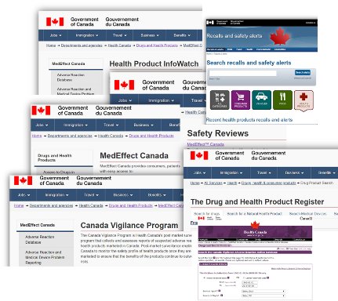
Examples of AR and MDP Safety Information Sharing
Health Canada disseminates findings to health care providers and the public to alert and educate them about identified health risks related to health products.
Multiple sources of safety information are available to provide up-to-date information on ARs and MDPs:
Adverse Reaction Online Database (https://www.canada.ca/en/health-canada/services/drugs-health-products/medeffect-canada/adverse-reaction-database.html)
Medical Device Incidents Database (https://hpr-rps.hres.ca/mdi_landing.php)
Annual AR/MDP Trends Report (https://www.canada.ca/en/health-canada/services/publications/drugs-health-products/annual-trends-adverse-reaction-case-reports-health-products-medical-device-problem-incidents.html)
Health Canada Safety Reviews (https://www.canada.ca/en/health-canada/services/drugs-health-products/medeffect-canada/safety-reviews.html)
Health Canada Recalls and Safety Alerts (http://www.healthycanadians.gc.ca/recall-alert-rappel-avis/index-eng.php?cat=3)
Health Product InfoWatch (https://www.canada.ca/en/health-canada/services/drugs-health-products/medeffect-canada/health-product-infowatch.html)
Drug and Health Product Register (DHPR) (https://hpr-rps.hres.ca/)

Slide 19
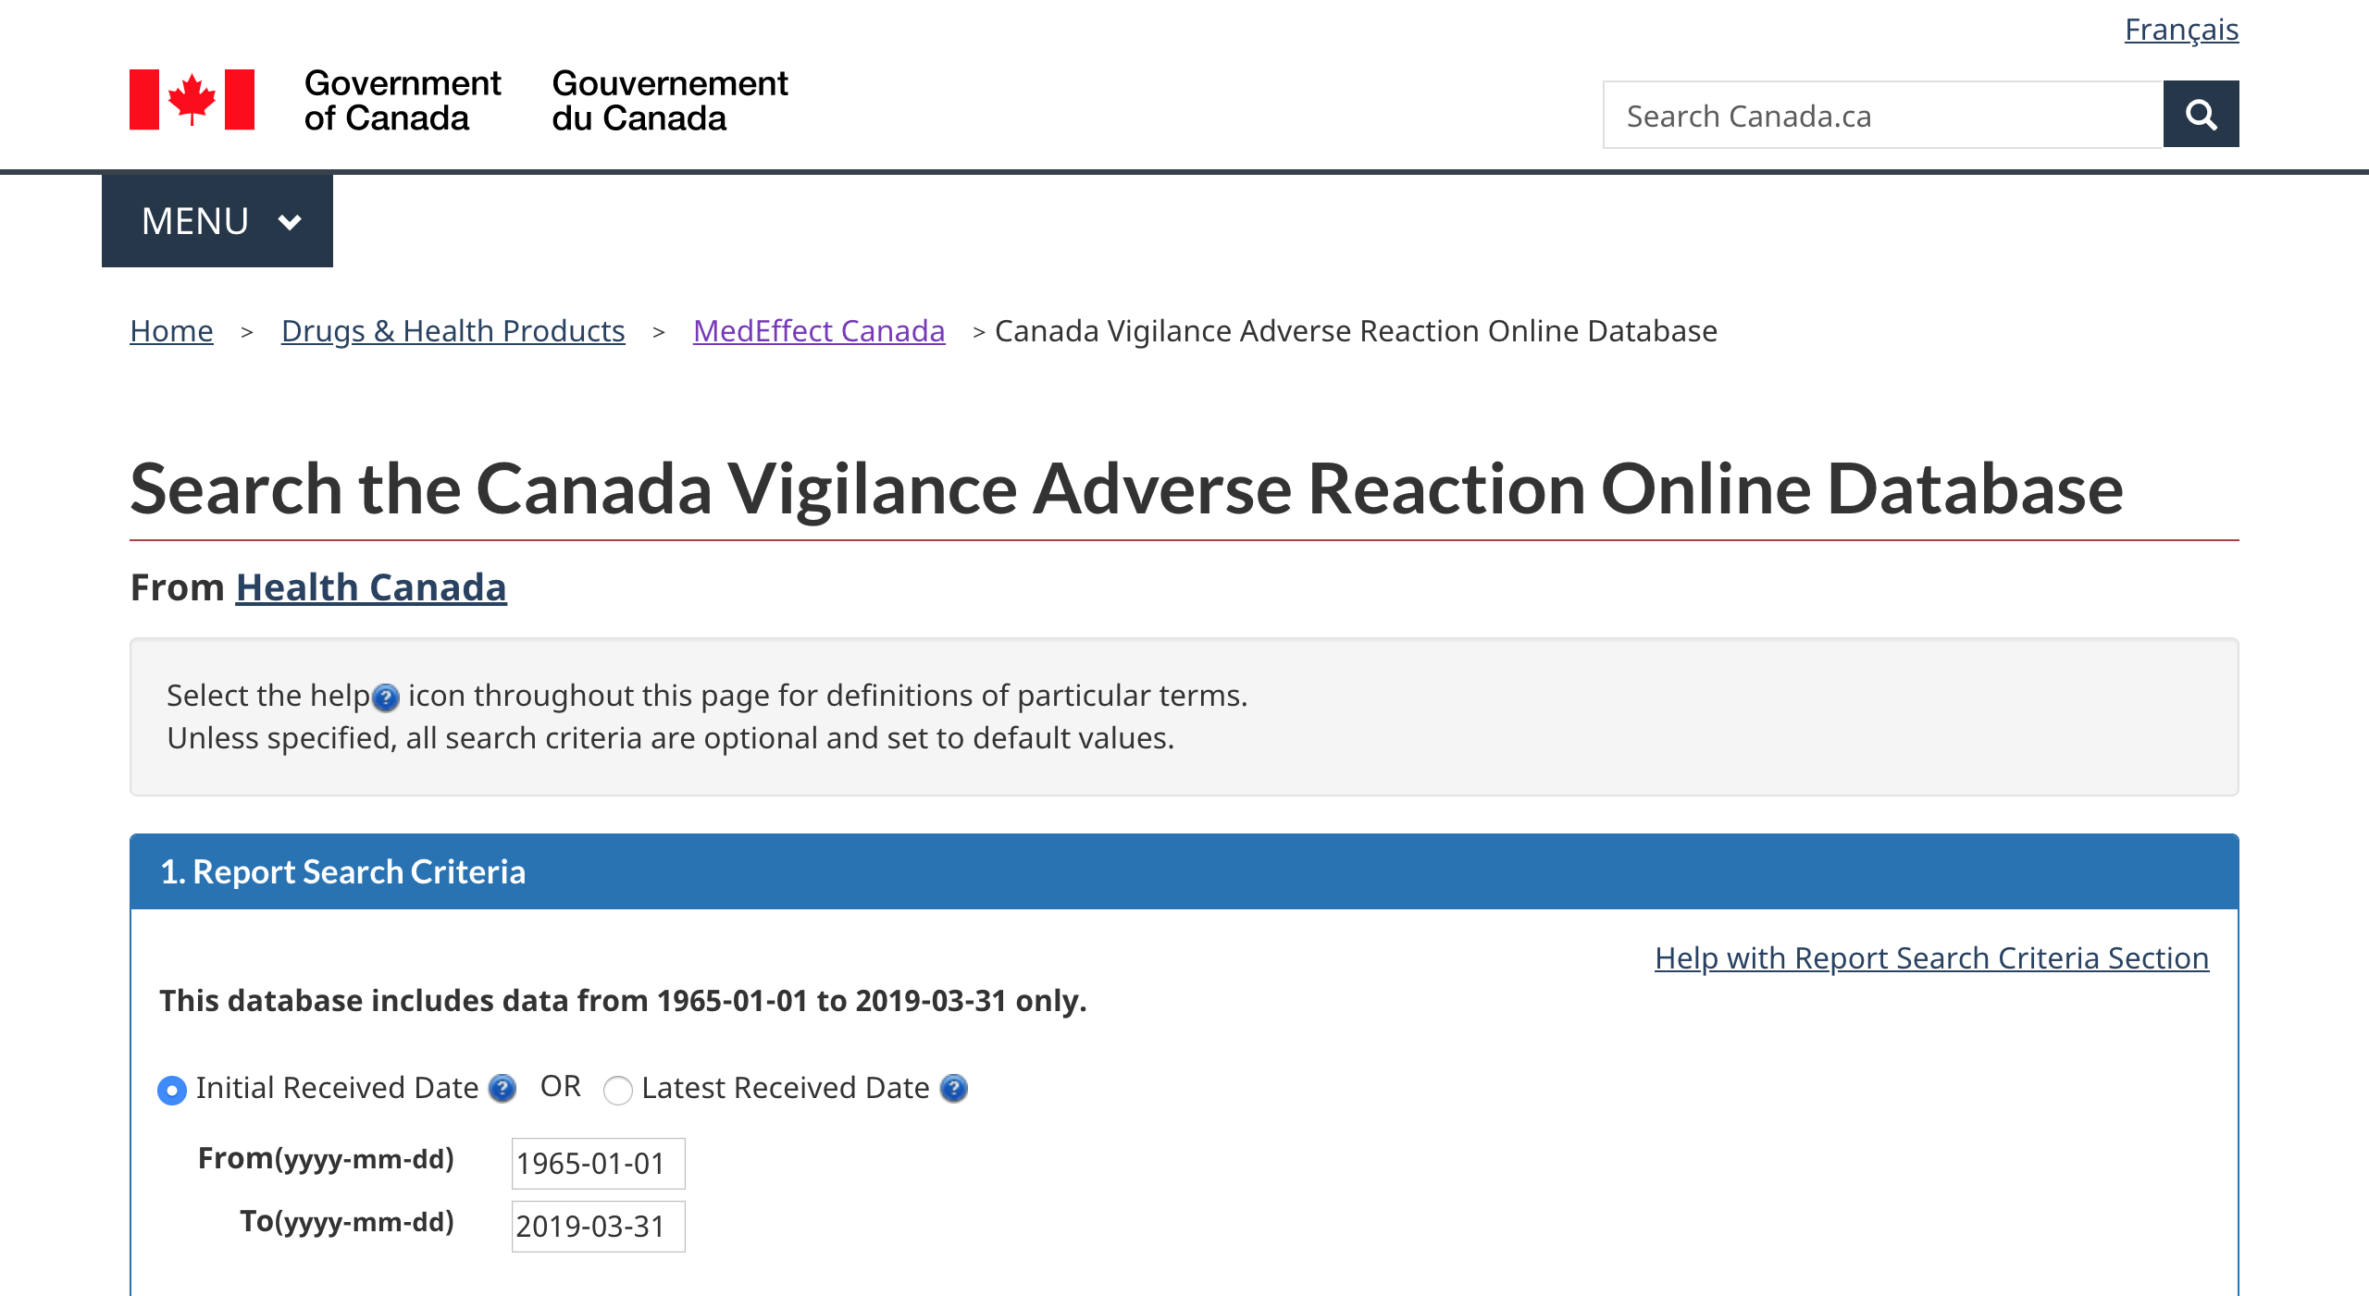
Adverse Reaction Online Database
Canada Vigilance Adverse Reaction Online Database
Searchable database that contains information from post-market AR reports since 1965
Contains suspected adverse reactions to health products
Files can be exported and saved in various formats
AR reports can be searched by:
report date, seriousness and source
patient information (gender, age and outcomes)
suspect health product by brand name and active ingredient
adverse reaction term or by system organ class
Source: https://www.canada.ca/en/health-canada/services/drugs-health-products/medeffect-canada/adverse-reaction-database.html

Slide 20
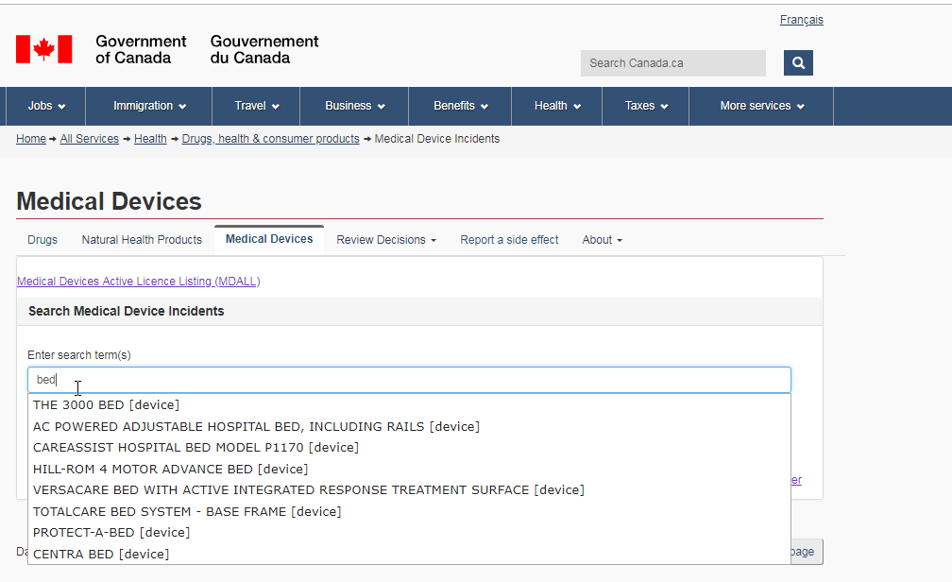
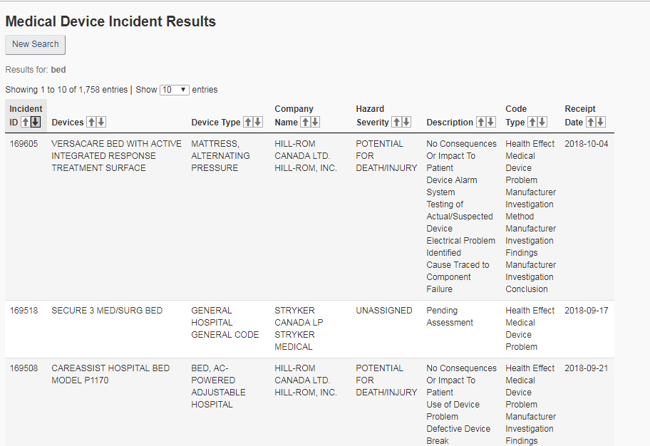
Medical Devices Online Database
Medical Device Incident Database
Searchable database that contains information from post-market MDP reports since 1980
Includes devices approved for the Canadian market
Downloadable full extract available
MDP reports are searched by free text and the following data is returned:
incident ID
receipt date
device name
device type
company name
hazard severity
description
code types assigned
Source: https://hpr-rps.hres.ca/mdi_landing.php

Slide 21
Annual Trends Report
The annual trends report provides a descriptive analysis of adverse reaction case reports of health products and medical device problem incidents that have been submitted to Health Canada between 2008 and 2017.
Source: https://www.canada.ca/en/health-canada/services/publications/drugs-health-products/annual-trends-adverse-reaction-case-reports-health-products-medical-device-problem-incidents.html

Slide 22
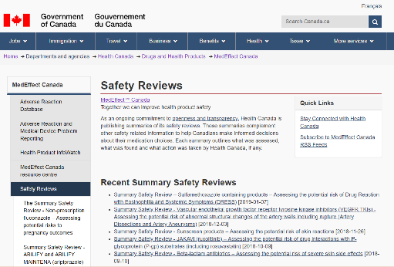
Health Canada Safety Reviews
Health Canada regularly publishes summaries of post-market signal assessment.
Summary Safety Reviews (SSRs) provide a more complete understanding of:
What was assessed
What was found
What action was taken
These summaries can help Canadians make informed decisions about their medication choices and medical devices.
Source: https://www.canada.ca/en/health-canada/services/drugs-health-products/medeffect-canada/safety-reviews.html

Slide 23
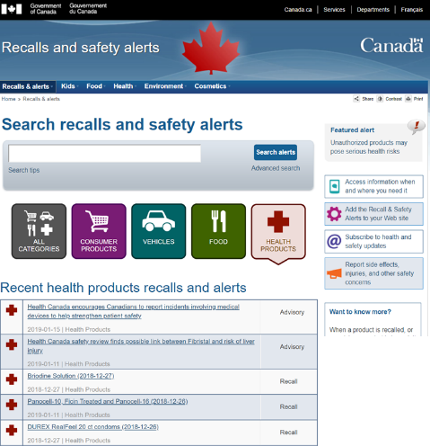
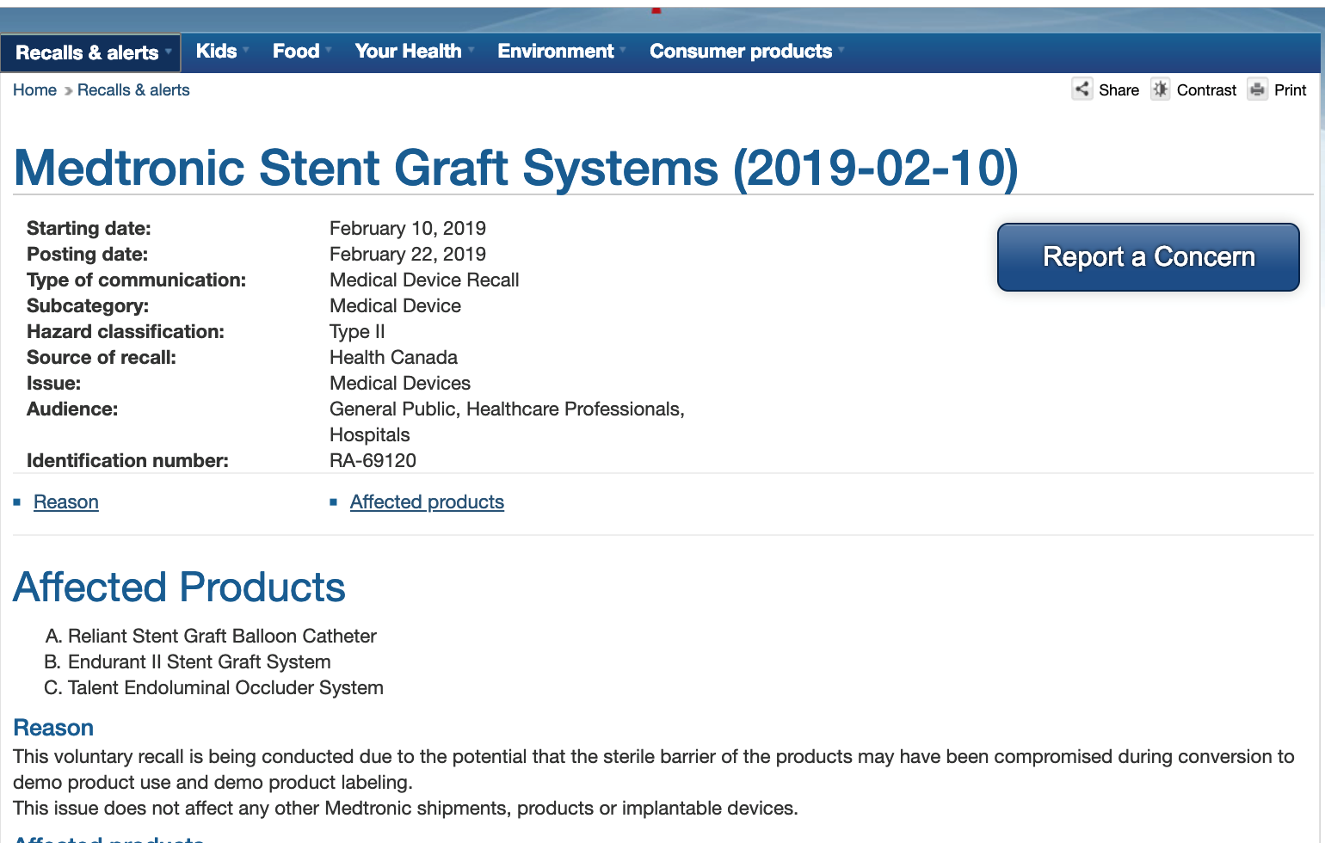
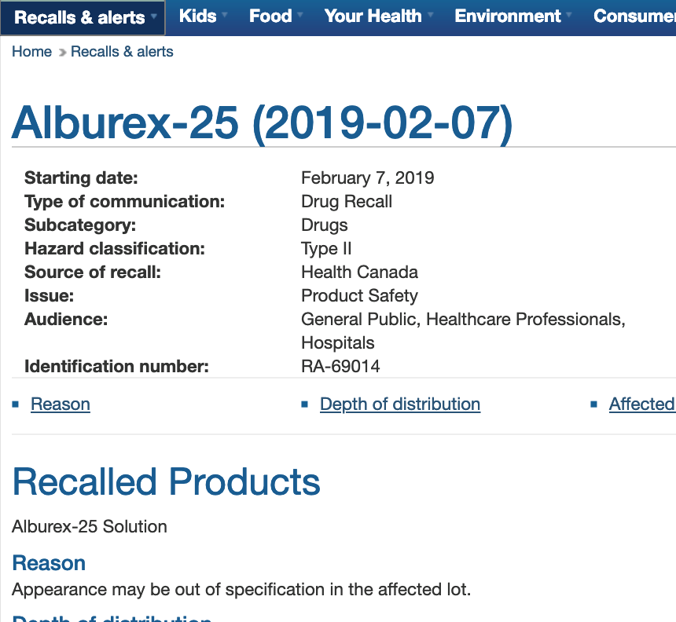
Recalls and Safety Alerts
The recalls and safety alerts database provides centralized access to recalls and safety alerts from:
Health Canada
The Canadian Food Inspection Agency
Transport Canada
Sign up for e-notifications here!
Source: https://www.healthycanadians.gc.ca/recall-alert-rappel-avis/index-eng.php?cat=3

Slide 24
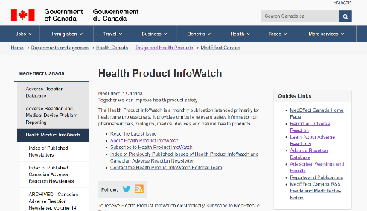
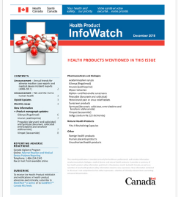
Health Product InfoWatch
A monthly publication primarily intended for health care providers
Provides clinically relevant safety information on
pharmaceuticals,
biologics,
medical devices, and
natural health products.
Each publication includes:
recap of health product advisories,
recap of summary of safety reviews,
new health product safety information, and
product monograph updates.
SUBSCRIBE NOW:
https://www.canada.ca/en/health-canada/services/drugs-health-products/medeffect-canada/health-product-infowatch.html

Slide 25
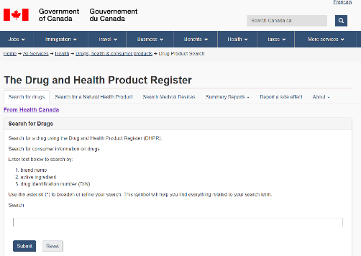
Drug and Health Product Register (DHPR)
The DHPR provides safety information on health products available to Canadians.
The public is able to:
Access plain language overviews of regulatory decisions:
Summary Safety Review
Summary Basis of Decision
Regulatory Decision Summary
Search for AR and MDP information
Search reported adverse reactions, medical device problems and summary reports of safety information
Report adverse reactions about health products
Source: https://hpr-rps.hres.ca/

Slide 26
Health Canada’s Post-market Publication Portal
MedEffect Canada provides health care professionals and consumers with access to safety information (advisories, alerts, recalls, etc.) generated by Health Canada following post-market monitoring and assessment activities.
This portal can be used to access additional resources for health products.
Source: https://www.canada.ca/en/health-canada/services/drugs-health-products/medeffect-canada.html

Slide 27
Data Security and Data Sharing from
AR and MDP Reports

Slide 28
Use of Collected Data – Security and Privacy
Health Canada:
Stores AR and MDP reports in a confidential database.¹
Follows protocols to ensure that identifying patient and reporter information is protected under the federal Privacy Act.¹
Ensures AR and MDP reports are de-identified before sharing.
Sends AR data to the World Health Organization (WHO) Global Pharmacovigilance Database.
Commits to ensure that data are used and shared in a scientifically and socially responsible way.
Procedure - The Release to the Public of Information Obtained from Adverse Reaction and Medical Device Incident Reports
¹https://hpr-rps.hres.ca/static/content/disclaimers-avisdenonresponsabilite.php
Notes:
World Health Organization (WHO) Global Pharmacovigilance Database : An international database of AR reports allows for identification and analysis of new AR signals

Slide 29
International Collaboration
Supports the monitoring and identification of new safety issues caused by health products
Facilitates identification of safety signals by providing a larger pool of data
Enhances patient safety by allowing for consistent communication around health product risks
Includes such regulatory agencies as: USA’s FDA, EU’s EMA, UK’s MHRA, Australia’s TGA, Japan’s PMDA
Advances worldwide pharmacovigilance standards, systems and learning with organizations such as IMDRF, ICH, ISoP, ICMRA

Slide 30
Key Points to Remember
AR and MDP reporting is essential because many safety issues are detected after market approval.
The stages for management of AR and MDP reports are:
AR or MDP report received by Health Canada;
AR or MDP report processing;
signal detection;
signal prioritization;
signal assessment/safety review;
risk mitigation; and
possible risk communication.
Health Canada has multiple mechanisms to share learning from reported ARs and MDPs such as the Drug and Health Product Register (online searchable databases, summary safety reviews and access to reporting) and MedEffect Canada.

Slide 31
Abbreviations
ADR: Adverse Drug Reaction
AR: Adverse Reaction
DHPR: Drug and Health Product Register
DSEN: Drug Safety and Effectiveness Network
EMA: European Medicines Agency
EU: European Union
FDA: Food and Drug Administration
ICH: International Conference on Harmonization of Technical Requirements for Pharmaceuticals for Human Use
ICMRA: International Coalition of Medicines Regulatory Authorities
IMDRF: International Medical Device Regulators Forum
ISoP: International Society of Pharmacovigilance
MAH: Market Authorization Holder
MDI: Medical Device Incident
MDP: Medical Device Problem (any type of medical device issue; not necessarily MDI)
MHRA: Medicines & Healthcare Products Regulatory Agency
PMDA: Pharmaceuticals and Medical Devices Agency
SSRs: Summary Safety Reviews
TGA: Therapeutic Goods Administration
UK: United Kingdom
USA: United States of America
WHO: World Health Organization

Slide 32
Resources
Adverse Reaction Database
Annual ADR/MDP Trends Report
Drug and Health Product Register (DHPR)
Health Canada Recalls and Safety Alerts
Health Canada Safety Reviews
Health Product InfoWatch
Mandatory reporting of serious adverse drug reactions and medical device incidents by hospitals - Guidance document
MedEffect Canada
Medical Devices Incident Database
Procedure - The Release to the Public of Information Obtained from Adverse Reaction and Medical Device Incident Reports
Protecting Canadians from Unsafe Drugs Act (Vanessa’s Law) Amendments to the Food and Drugs Act (Bill C-17)
Regulations Amending the Food and Drug Regulations (Serious Adverse Drug Reaction Reporting — Hospitals): SOR/2019-190
Regulations Amending the Medical Devices Regulations (Medical Device Incident Reporting — Hospitals): SOR/2019-191
The Privacy Act
World Health Organization (WHO) Global Pharmacovigilance Database
For additional information, please contact the Canada Vigilance Program at:
Email: hc.canada.vigilance.sc@canada.ca
Telephone: 1-866-234-2345

Slide 33
Acknowledgments
All materials were developed by the collaborating parties: Health Canada, Institute for Safe Medication Practices Canada (ISMP Canada), Health Standards Organization (HSO), and the Canadian Patient Safety Institute (CPSI).
Any stakeholder interested in using the materials should acknowledge Health Canada as the owner and source: Educational Support for Mandatory Reporting. Health Canada; 2019.

