Slide 1
Mandatory Reporting of Serious Adverse Drug Reactions and Medical Device Incidents by Hospitals
Educational Support for Mandatory Reporting
Module 2:
Reporting Processes to Health Canada

Slide 2
Module 2 – Learning Outcomes
Completion of Module 2 will enable you to:
Describe considerations for mandatory reporting
Describe reporting options to Health Canada
Differentiate among the following:
    Serious adverse drug reaction (serious ADR)
    Medical device incident (MDI)
    Medication incident
    Adverse reaction (AR)
    Medical device problem (MDP)
Describe the information contained within the Guidance Document
Describe voluntary reporting of ARs and MDPs to Health Canada

Slide 3
Module 2 – Outline
Considerations for Mandatory Reporting
Submitting Reports to Health Canada
Case Examples
Guidance Document
Voluntary Reporting to Health Canada
Key Points to Remember
Abbreviations
Resources

Slide 4
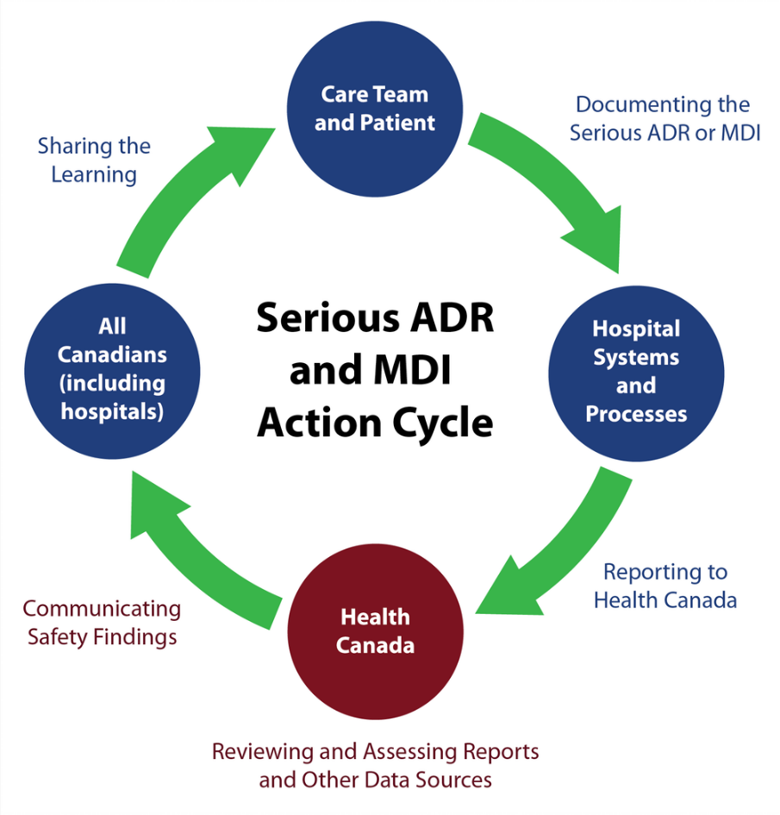
Conceptual Model of
Serious ADR and MDI
Reporting by Hospitals
Module 2 describes reporting processes to Health Canada.
Source: Serious ADR and MDI Action Cycle. ISMP Canada, HSO, CPSI; 2019.

Slide 5
Considerations for
Mandatory Reporting

Slide 6

Hospital Considerations
Hospital systems, processes, policies, procedures, and forms may need to be updated to reflect requirements for mandatory reporting of serious ADRs and MDIs to Health Canada.
Hospitals are expected to:
  Develop and maintain internal policies and procedures in order
  to comply with the requirements for mandatory reporting of
  serious ADRs and MDIs to Health Canada
  Determine and communicate internal roles and responsibilities
  of staff in meeting the mandatory reporting requirements
The mandatory reporting requirements apply to the hospital and not to the individual health care providers working in the hospital. However, health care providers will have an important role in recognizing and documenting serious ADRs and MDIs.
Source: https://www.canada.ca/en/health-canada/services/drugs-health-products/medeffect-canada/adverse-reaction-reporting/mandatory-hospital-reporting/drugs-devices/guidance.html

Slide 7




Health Care Provider Considerations
Health care providers have a role in identifying and documenting serious ADRs and MDIs, in accordance with hospital-defined processes.
Health Canada is interested in reports about a serious ADR or MDI, even if:
its association with the drug and/or medical device is only suspected;
causality is not confirmed;
all the details are not known; and/or
it hasn’t caused serious harm but has the potential to cause serious harm if it was to reoccur (only in case of MDIs).

Slide 8
Tips for Recognizing a Serious ADR or MDI
Serious harm from a drug or from a medical device can be mistaken for a symptom of a disease.
A high level of suspicion, clinical awareness, and patient dialogue are key components in identifying a serious ADR or MDI. The following can help:
  Ask about the patient’s medical history
  Consider a serious ADR or MDI if there is:
    an unexpected change in the patient’s clinical condition
    a new health problem for the patient
    a need for urgent additional therapies, procedures or surgeries
    a sudden need for a rescue drug (e.g., naloxone, epinephrine, glucagon)
    a medical order for an acute change to therapy (e.g., abrupt discontinuation)
A serious ADR or MDI can occur shortly after beginning treatment or much later

Slide 9
Considerations for Reporting to Industry/Vendors
Mandatory reporting regulations do not require hospitals to report to industry/vendors; however, reporting to industry/vendors is strongly encouraged.
Prompt voluntary reporting from hospitals to industry/vendors enables industry/vendors to conduct investigations to determine causes and corrective actions in a timely manner.
  MDIs: the hospital should inform industry/vendors of an MDI as soon as possible.
  The manufacturers/importers are required to determine causes and corrective actions.
    Hospitals should consider including a report to industry/vendors in internal reporting policies and procedures.
    Hospitals should consider sequestering the medical device involved in an MDI; it is important that industry/vendors have the device for further investigation and analysis.
Communication among all parties is an effective mechanism to ensure product improvement and patient safety.
Source: https://www.canada.ca/en/health-canada/services/drugs-health-products/medeffect-canada/adverse-reaction-reporting/mandatory-hospital-reporting/drugs-devices/guidance.html

Slide 10
Submitting Reports
to Health Canada

Slide 11
Submitting Serious ADR and MDI Reports to Health Canada
Health Canada remains flexible and is able to receive reports in various formats via multiple secure submission methods, recognizing that hospital systems vary.
  If interested in submitting reports electronically to Health Canada, please email the Canada Vigilance Program at hc.canada.vigilance.sc@canada.ca.
  Health Canada supports report submissions using a secure File Transfer Protocol (sFTP) and continues to explore system-to-system options.
The reporting forms for serious ADRs and MDIs, together with instructions, are available on the Health Canada website:
  Serious ADR reporting form: https://www.canada.ca/content/dam/hc-sc/documents/services/drugs-health-products/medeffect-canada/adverse-reaction-reporting/mandatory-reporting-hospital-drug-eng.pdf
  MDI reporting form: https://www.canada.ca/content/dam/hc-sc/documents/services/drugs-health-products/medeffect-canada/adverse-reaction-reporting/mandatory-reporting-hospital-device-eng.pdf

Slide 12

Serious Adverse Drug Reaction (Serious ADR)
A noxious and unintended response to a drug that occurs at any dose and that
  requires in-patient hospitalization or prolongation of existing hospitalization,
  causes congenital malformation,
  results in persistent or significant disability or incapacity,
  is life-threatening, or
  results in death.¹
Examples of Serious ADRs
  Kidney damage from a diuretic (water pill) that requires dialysis
  Lung damage from a chemotherapy drug that requires long-term oxygen therapy
  Allergic reaction to an antibiotic that is life-threatening
¹ https://www.canada.ca/en/health-canada/services/drugs-health-products/medeffect-canada/adverse-reaction-reporting/mandatory-hospital-reporting/drugs-devices/guidance.html

Slide 13
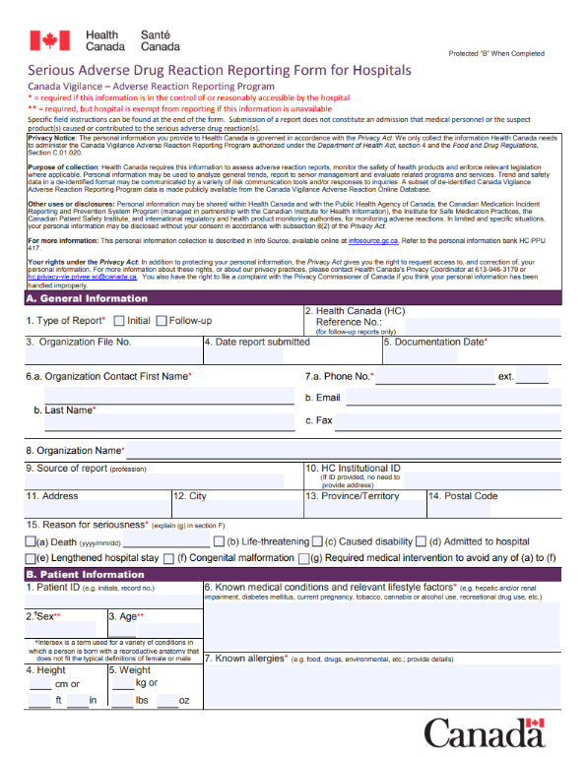
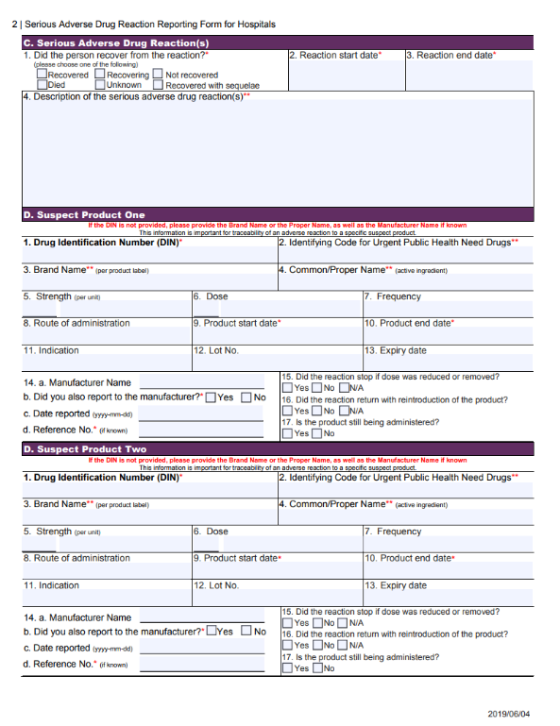
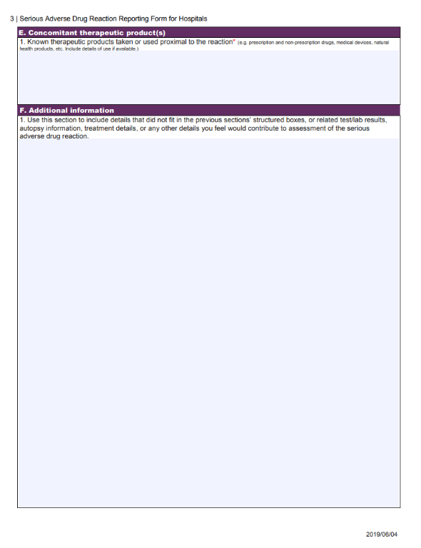
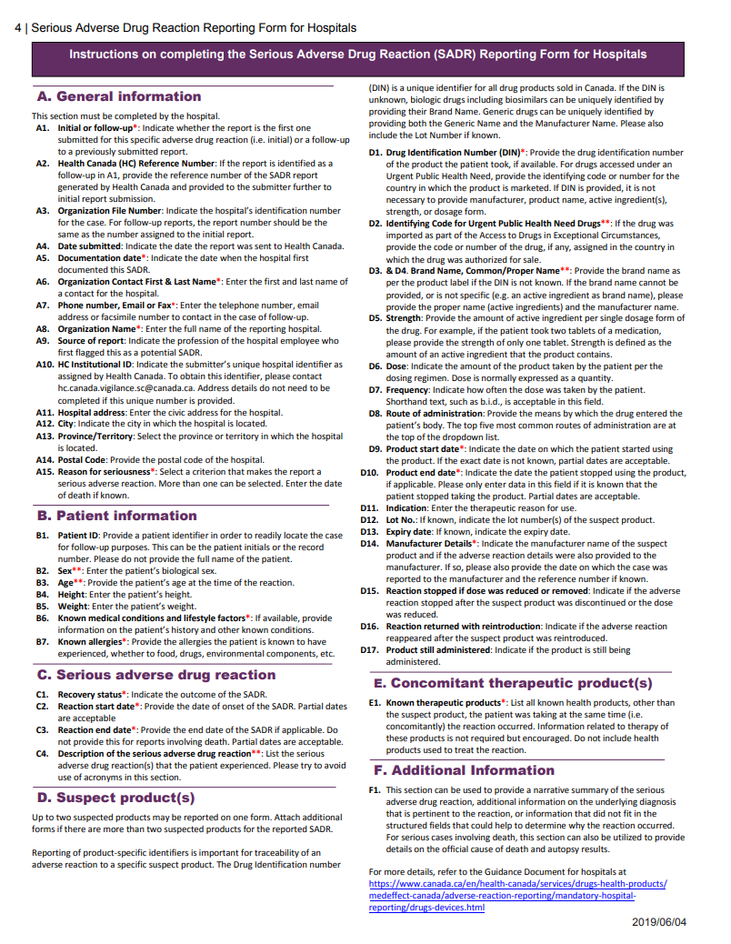
New Form for Mandatory Reporting of Serious ADRs
The new reporting form for serious ADRs, together with instructions, are available on the Health Canada website: https://www.canada.ca/content/dam/hc-sc/documents/services/drugs-health-products/medeffect-canada/adverse-reaction-reporting/mandatory-reporting-hospital-drug-eng.pdf

Slide 14
Medical Device Incident (MDI)
An incident related to a failure of a medical device or a deterioration in its effectiveness, or any inadequacy in its labelling or in its directions for use that has led to the death or a serious deterioration in the state of health of a patient, user, or other person, or could do so were it to recur.¹
Examples of MDIs
  An infusion pump stopped due to a malfunction, but failed to give an alarm. The patient received an under-infusion of antibiotics; septic shock occurred and prolonged the patient’s stay in the hospital’s intensive care unit.
  An external defibrillator failed to deliver the programmed level of energy to a patient due to a malfunction. The patient was not revived.
Note: If the patient was revived, this would be considered a potential to cause serious
harm (if it had not been for the timely intervention by a health care provider) and
would also be reportable.
¹ https://www.canada.ca/en/health-canada/services/drugs-health-products/medeffect-canada/adverse-reaction-reporting/mandatory-hospital-reporting/drugs-devices/guidance.html

Slide 15
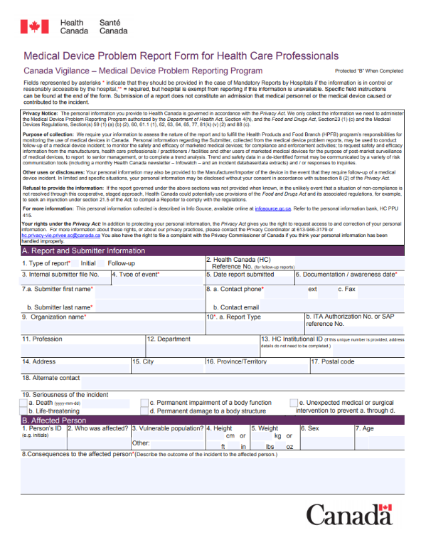
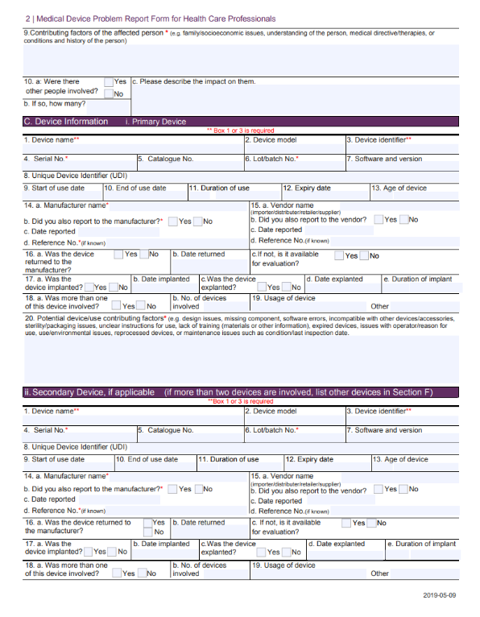
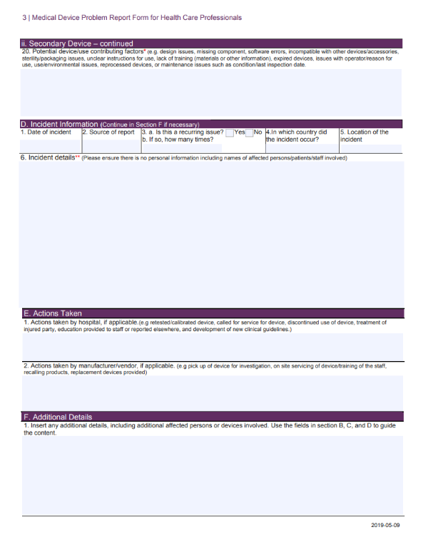
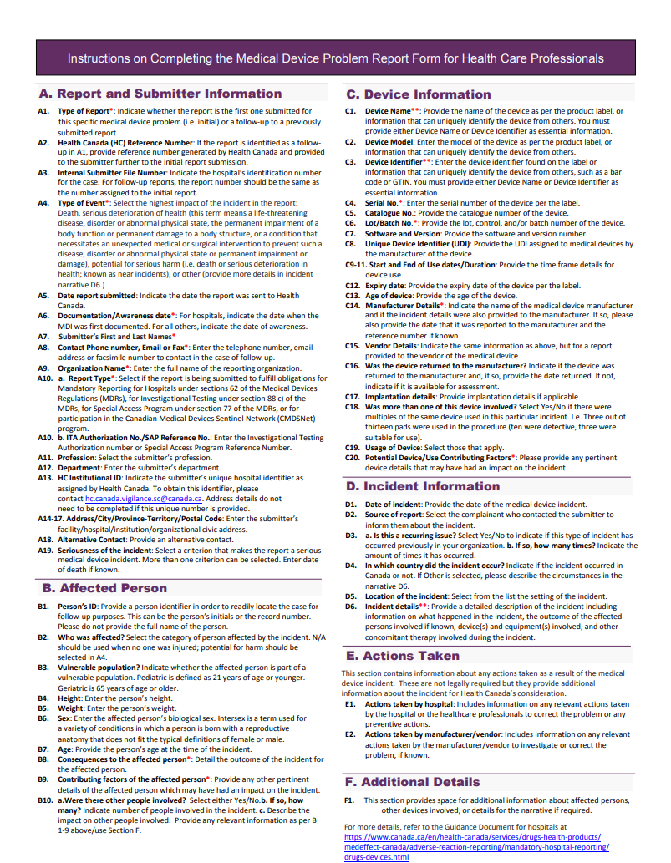
New Form for Mandatory Reporting of MDIs
The reporting form for MDPs was created for multiple reporting uses:
Mandatory reporting for
  hospitals,
  Special Access Program (SAP),
  Investigational Testing Authorization (ITA)
Voluntary reporting to Canadian Medical Devices Sentinel Network (CMDSNet) by
participating institutions
The new reporting form for MDPs, together with instructions, are available on the Health Canada website: https://www.canada.ca/content/dam/hc-sc/documents/services/drugs-health-products/medeffect-canada/adverse-reaction-reporting/mandatory-reporting-hospital-device-eng.pdf

Slide 16
Case Examples

Slide 17


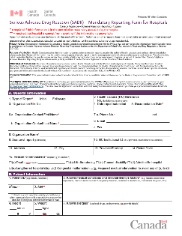
Case Example 1: Is the Hospital Required to Report?
A patient had been taking warfarin, among other medications, and presented to the emergency department with a life-threatening gastrointestinal bleed. The patient required hospitalization in order to be stabilized.
RATIONALE
and/or
Resulted in
in-patient hospitalization
ADR meets the criteria of “serious”
Life-threatening condition

Slide 18
Case Example 2: Is the Hospital Required to Report?
A patient diagnosed with Hodgkin's lymphoma was being treated with doxorubicin, bleomycin, vincristine, and dacarbazine. Following cycle 3, the patient was admitted as an in-patient with complaints of dry cough and shortness of breath on exertion. Bleomycin-induced pulmonary fibrosis was suspected.
RATIONALE
and/or
Resulted in
in-patient hospitalization
ADR meets the criteria of “serious”
Life-threatening condition
Note: This ADR also meets the criteria of "serious" because bleomycin-induced pulmonary fibrosis may be considered a persistent and significant disability as it can impact the patient's quality of life, given that it can take a long time for an improvement in pulmonary function.

Slide 19

Case Example 3: Is the Hospital Required to Report?
A patient has been recently started on the oral anticoagulant warfarin and is having international normalized ratio (INR) monitored at an out-patient anticoagulation clinic at a hospital. The patient reported a nosebleed that occurred in the time between clinic appointments. Based on the patient's INR level, the patient's warfarin dose was adjusted. The patient will continue to have INR monitored at the hospital.
RATIONALE
While the patient may be at increased risk for another bleed (with an elevated INR and recent nosebleed), the ADR does not meet the criteria for “serious”.

Slide 20
Case Example 4: Is the Hospital Required to Report?
A patient was being treated with doxorubicin and cyclophosphamide, and developed neutropenia. After assessing the severity of the neutropenia, a decision was made to continue with chemotherapy at a reduced dose with growth factor support.
RATIONALE
While the patient may be at increased risk for potentially fatal infections, the ADR is not immediately life-threatening.
Note: This ADR would need to be reported if the patient developed febrile neutropenia and required in-patient hospitalization for treatment (e.g., antimicrobials to prevent infectious complications from febrile neutropenia).

Slide 21
Case Example 5: Is the Hospital Required to Report?
A patient experienced dizziness and sweating after a dose of insulin. The patient required glucose tablets to recover. It was discovered that a short-acting insulin had been provided instead of the patient’s usual long-acting insulin.
RATIONALE
A medication incident, also referred to as a medication error, is a mistake with medication or a problem that could cause a mistake with medication.
Medication incidents are generally preventable and include errors such as receiving the wrong medication or dose, or using the wrong route of administration.
Note: Medication incident-related reporting and learning occurs through a separate and complementary program:
the Canadian Medication Incident Reporting and Prevention System (CMIRPS).
Source: https://www.canada.ca/en/health-canada/services/drugs-health-products/medeffect-canada/medeffect-canada-role-management-prevention-harmful-medication-incidents.html

Slide 22
Case Example 6: Is the Hospital Required to Report?
Patients undergoing endometrial ablation of the uterus suffered burns to adjacent organs; these burns were due to thin uterine walls and were an unanticipated side effect of ablation. The manufacturer failed to change the ablation device label to warn users of this side effect (which may be produced when the device is working within specification).
RATIONALE
Serious deterioration in the state of health of a patient
Reportable MDI

Slide 23
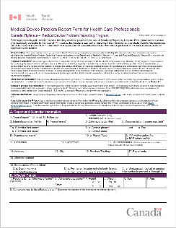
Case Example 7: Is the Hospital Required to Report?
A health care professional reported that the sewing cuff was discovered to be defective during a heart valve implant. The defective valve was abandoned, a new valve was implanted, and pumping time during surgery was extended. This defect had the potential to cause serious harm.
RATIONALE
Potential for death or serious deterioration in the state of health of this patient due to extended surgical time and this possible defect being missed prior to surgical close on other patients leading to emergency failure
Reportable
MDI

Slide 24
Case Example 8: Is the Hospital Required to Report?
A batch of out-of-specification blood glucose test strips is released by a manufacturer. The patient uses strips according to instructions, but readings provide incorrect values leading to incorrect insulin dosage, resulting in hypoglycemic shock and hospitalization.
RATIONALE
Serious deterioration in the state of health of a patient
Reportable MDI

Slide 25
Case Example 9: Is the Hospital Required to Report?
  A user performed an inflation test prior to inserting the balloon catheter into the patient, as required in the instructions for use accompanying the device. A malfunction on inflation was detected and another balloon was used.
RATIONALE
This device deficiency would always be found by the user prior to patient use and is an expected potential deficiency noted in the product’s instructions for use.
If the user performed the testing prior to use, as per the instructions, no harm would come to a patient.

Slide 26
Case Example 10: Is the Hospital Required to Report?
A patient died after dialysis treatment. The patient had end-stage renal disease and died of renal failure.
RATIONALE
When the hospital has information that the cause of the incident was definitely due to a patient's condition, the incident does not need to be reported. The patient’s condition could be pre-existing or occurring during device use. An incident due to a patient’s condition does not meet the requirements of an MDI.

Slide 27
Mandatory Reporting
of Serious ADRs and MDIs by Hospitals:
Guidance Document

Slide 28
Guidance Document
Introduction
The regulations and their purpose
  Purpose
  Serious ADR and MDI definitions
Roles and responsibilities
  Role of hospitals / health care professionals
  Other types of facilities (e.g., private clinics, nursing homes, outpatient clinics)
  Hospital’s requirement to report in other situations (examples)
Applicability of the regulations according to product type
  Applicable therapeutic products / medical devices
  Non-applicable therapeutic products / medical devices
  Determination of applicability for combination products
Source: https://www.canada.ca/en/health-canada/services/drugs-health-products/medeffect-canada/adverse-reaction-reporting/mandatory-hospital-reporting/drugs-devices/guidance.html

Slide 29
Guidance Document
5. Serious ADRs or MDIs to be reported by hospitals
  Serious ADR / MDI reportability considerations
  Serious ADR / MDI examples
  Outcomes associated with MDIs
  Causality assessment / hospital investigations
  Documentation examples
6. Information requirements for serious ADR and MDI reports
  Serious ADR / MDI data elements
When and how to submit serious ADR and MDI reports
  Reporting timeline
  Health Canada follow-up requests
  How to send reports (submission methods and formats)
  Links to ADR/MDI reporting forms
  Use of third-party reporters
  Feedback
Source: https://www.canada.ca/en/health-canada/services/drugs-health-products/medeffect-canada/adverse-reaction-reporting/mandatory-hospital-reporting/drugs-devices/guidance.html

Slide 30
Guidance Document
Privacy
Privacy considerations when submitting reports
Additional reporting considerations
  Submission of reports to manufacturers
  Submission of reports to CMDSNet
Compliance and enforcement
Health Canada compliance and enforcement actions for hospitals
Appendices
Appendix 1: Acronyms, Definitions and Terminology
Appendix 2: Third-party Reporting Authorization Form
Appendix 3: Reporting requirements for therapeutic products not subject to the new regulations for hospitals
Appendix 4: Quick Reference Guide
Source: https://www.canada.ca/en/health-canada/services/drugs-health-products/medeffect-canada/adverse-reaction-reporting/mandatory-hospital-reporting/drugs-devices/guidance.html

Slide 31
Voluntary Reporting
to Health Canada

Slide 32
Voluntary Adverse Reaction (AR) and Medical Device Problem (MDP) Reporting
Health Canada builds post-market safety knowledge integral to informing effective clinical use of health products. This safety knowledge is derived from several data sources, including serious ADR and MDI reports.
Voluntary reporting of suspected ARs or MDPs by health professionals and consumers is another method to monitor the safety and effectiveness of marketed health products.

Slide 33
Adverse Reaction (AR)
A noxious and unintended effect to a health product.¹
Examples of ARs
  Reduced kidney function from a diuretic (water pill)
  Reduced lung capacity from a chemotherapy drug
  Allergic reaction to an antibiotic
¹ https://www.canada.ca/en/health-canada/services/drugs-health-products/medeffect-canada/adverse-reaction-reporting.html#a1

Slide 34
Medical Device Problem (MDP)
A medical device problem is related to:
  inadequate labelling or instructions for use
  a failure of the device or a deterioration in its effectiveness
  an actual or potential deficiency that may affect product performance or safety¹
Note: Medical device problem reporting includes any type of medical device issue; it does not necessarily meet the definition of an MDI.
Examples of MDPs
  Tubing leaked, causing a delay in treatment, but there was no serious harm to the patient
  Needle broke during a blood draw, but it was removed with minor injury to the patient
¹ https://www.canada.ca/en/health-canada/services/drugs-health-products/medeffect-canada/adverse-reaction-reporting.html#a1

Slide 35
Canada Vigilance Program
The Canada Vigilance Program is a national post-market monitoring program that collects and assesses reports of suspected ARs and MDPs involving health products marketed in Canada.
AR Voluntary Reporting for Health Products
Online form: https://hpr-rps.hres.ca/static/content/form-formule.php
Telephone: 1-866-234-2345 (toll-free)
Fax or Mail: Download, print and complete the Side Effect Reporting Form
(please read the instructions before completing the form)
  Fax: 1-866-678-6789 (toll-free)
  Mail: Canada Vigilance Office (using the postage paid label)

Slide 36
MDP Voluntary Reporting
The Canadian Medical Devices Sentinel Network (CMDSNet) is a pro-active surveillance program that encourages the reporting of MDP reports from all types of institutions.
  Only institutions participating in CMDSNet voluntarily report MDIs occurring within their organizations directly through the Canada Vigilance Program.
Other voluntary reporting from non-participating CMDSNet institutions, consumers, and health professionals are encouraged to report device-related incidents directly to Health Canada by completing a Health Product Complaint Form via the Regulatory Operations and Enforcement Branch.

Slide 37
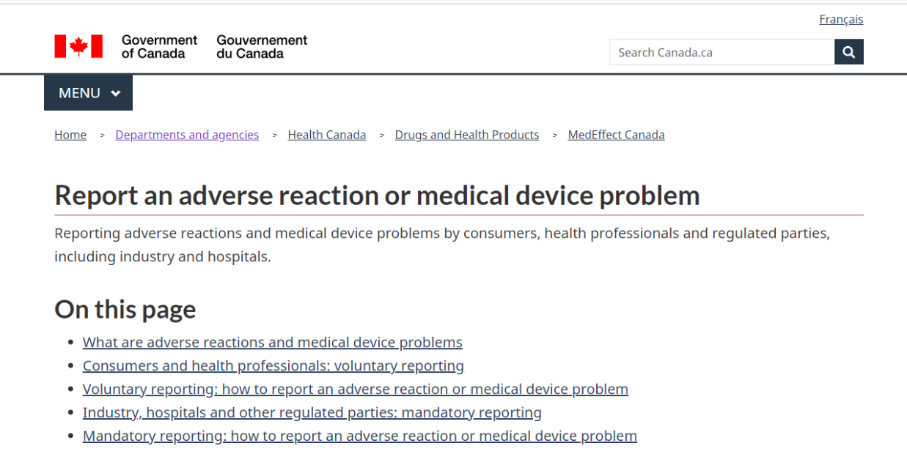
Reporting ARs and MDPs to Health Canada
The Report an Adverse Reaction or Medical Device Problem web page provides access to more information and forms.

Slide 38

Key Points to Remember
  Hospital systems, processes, policies, procedures, and forms may need to be updated to reflect requirements for mandatory reporting of serious ADRs and MDIs to Health Canada.
  Health care professionals have an important role in serious ADR and MDI reporting.
  Health Canada is open to accepting different formats for reports of serious ADRs and MDIs, recognizing that hospital systems vary.
  It is important to understand the differences between serious ADRs, MDIs, medication incidents, ARs, and MDPs, and how to report them.
  The Guidance Document offers information to help hospitals comply with the regulatory requirements for serious ADR and MDI reporting to Health Canada.
  Health Canada values voluntary reporting and has programs to support it.

Slide 39
Abbreviations
ADR: Adverse Drug Reaction
AR: Adverse Reaction
CMDSNet: Canadian Medical Devices Sentinel Network
CMIRPS: Canadian Medication Incident Reporting and Prevention System
ITA: Investigational Testing Authorization
MDI: Medical Device Incident
MDP: Medical Device Problem
SAP: Special Access Program
sFTP: Secure File Transfer Protocol

Slide 40
Resources
Applications for Medical Device Investigational Testing Authorizations Guidance Document - Summary
Canadian Medical Devices Sentinel Network
Canadian Medication Incident Reporting and Prevention System
Canada Vigilance Program
MedEffect Canada
Mandatory reporting of serious adverse drug reactions and medical device incidents by hospitals - Guidance document
Health Canada's role in the Management and Prevention of Harmful Medication Incidents
Health Product Complaint Form
Medical Devices Regulations
Medical Devices - Special Access Programme
Side Effect Reporting Form
Protecting Canadians from Unsafe Drugs Act (Vanessa’s Law) Amendments to the Food and Drugs Act (Bill C-17)
Regulations Amending the Food and Drug Regulations (Serious Adverse Drug Reaction Reporting — Hospitals): SOR/2019-190
Regulations Amending the Medical Devices Regulations (Medical Device Incident Reporting — Hospitals): SOR/2019-191
Report An Adverse Reaction or Medical Device Problem
For additional information, please contact the Canada Vigilance Program at:
  Email: hc.canada.vigilance.sc@canada.ca
  Telephone: 1-866-234-2345

Slide 41
Acknowledgments
All materials were developed by the collaborating parties: Health Canada, Institute for Safe Medication Practices Canada (ISMP Canada), Health Standards Organization (HSO), and the Canadian Patient Safety Institute (CPSI).
Any stakeholder interested in using the materials should acknowledge Health Canada as the owner and source:
Educational Support for Mandatory Reporting. Health Canada; 2019.

