Slide 1
Mandatory Reporting of Serious Adverse Drug Reactions and Medical Device Incidents by Hospitals
Educational Support for Mandatory Reporting
Module 3:
Strategies to Promote and Support Mandatory Reporting

Slide 2
Module 3 – Learning Outcomes
Completion of Module 3 will enable you to:
Identify potential barriers to serious ADR and MDI reporting
Recognize opportunities to facilitate serious ADR and MDI documentation and reporting
Describe strategies and systems to support implementation of serious ADR and MDI documentation and reporting
Describe the shared commitment to health product safety and recognize the key partners involved

Slide 3
Module 3 – Outline
Barriers and Opportunities to Facilitate Reporting
Strategies and Systems to Support Implementation
Shared Commitment to Health Product Safety
Key Points to Remember
Abbreviations
Resources

Slide 4
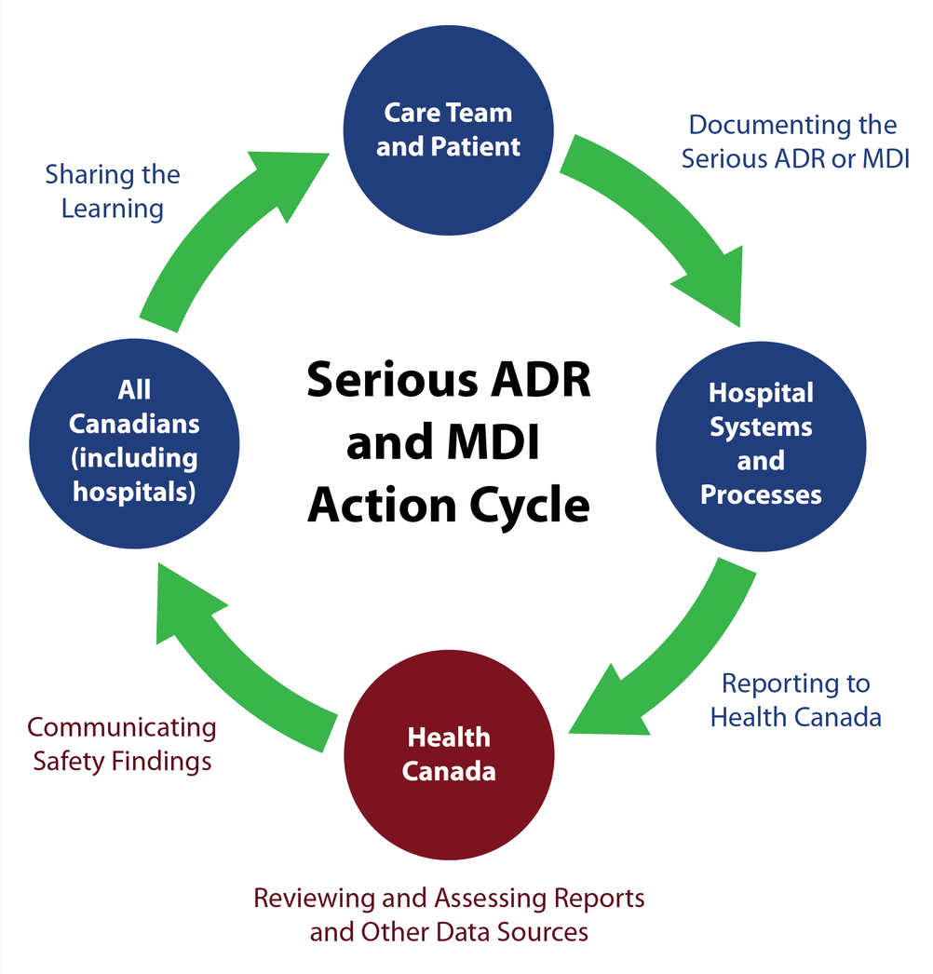
Conceptual Model of
Serious ADR and MDI
Reporting by Hospitals
Module 3 describes strategies to promote and support mandatory reporting.
Source: Serious ADR and MDI Action Cycle. ISMP Canada, HSO, CPSI; 2019.

Slide 5
Barriers and Opportunities
to Facilitate Reporting

Slide 6
Potential Barriers to Reporting
Resource and time limitations, such as work schedule and staff complement in healthcare settings
Lack of familiarity with the reporting process and the what, when, and how to report
Lack of awareness of the value of reporting
Lack of technology supports to simplify the process of reporting
Complacency and the assumption that serious ADRs and MDIs have previously been reported
Uncertainty about the association of a drug or medical device with patient harm
Fear of consequences and the perception that reporting might have negative repercussions
Limited feedback since follow-up information may not be available or accessible to those who report

Slide 7
Self-Assessment Questions for Hospitals
The following self-assessment questions may be helpful to identify opportunities to prepare for the implementation of mandatory reporting within your hospital:
In what way is serious ADR and MDI documentation and reporting promoted?
Are our hospital policies and procedures aligned with the mandatory reporting requirements?
Can our hospital systems be leveraged to facilitate documentation and reporting?
How can awareness and knowledge of serious ADR and MDI documentation and reporting be improved?
Has our hospital leadership created an environment that supports serious ADR and MDI documentation and reporting?
Are patients and families empowered to ask questions and be engaged in monitoring their treatments?
Is serious ADR and MDI documentation and reporting included in orientation or education programs?
Is the learning or feedback derived from serious ADR and MDI reports shared with health care providers?

Slide 8
Strategies and Systems
to Support Implementation
Note: Health Canada does not endorse any particular strategy or system.
The following examples, in alphabetical order, are provided for information sharing only.

Slide 9
Strategic and Operational Considerations for Teams
Create a multidisciplinary team (e.g., ‘Safety Team’) to support serious ADR and MDI documentation and reporting, and assist with:
  identifying serious ADRs and MDIs through proactive monitoring;
  completing and submitting serious ADR and MDI reports;
  disseminating learning from serious ADR and MDI reporting;
  providing coaching and education;
  enabling continuous quality improvement for serious ADR and MDI reporting processes; and
  providing regular updates to senior leadership.
Identify individual ‘Champions’ to help lead serious ADR and MDI reporting efforts and/or provide support for identifying and submitting serious ADR or MDI reports to Health Canada.
Identify networking opportunities to support collaboration and shared commitment to serious ADR and MDI documentation and reporting.

Slide 10
EXAMPLE: Province-Wide Collaboration
– Alberta Health Services
A centralized provincial approach has been developed for serious ADR reporting and for improved MDI reporting.
  Provincial Task Force is in place to coordinate the initiative
  Includes centralized process to receive, review and further report
Alberta is implementing a province-wide clinical information system
  All sites will use a single electronic health record
  There is a phased roll out across the province over five years
  Serious ADR reporting will be integrated into the electronic health record
  MDI reporting will be linked from the electronic health record, as well as from the Alberta Health Services intranet
Source: Alberta Health Services; 2019.

Slide 11
EXAMPLE: Province-Wide Collaboration
– British Columbia
The BC Patient Safety & Learning System (BCPSLS) has partnered with the BC Ministry of Health, health authorities, and Health Canada to create a provincial strategy for implementing the mandatory reporting requirements.
The provincial strategy includes:
  the use of an established, province-wide incident reporting system (BCPSLS) to report ADRs and MDIs;
  a steering committee and working groups to guide and implement the approach; and
  a communication and education campaign to promote reporting.
Members of the steering committee and working groups include representatives from BCPSLS, BC Ministry of Health, Health Canada, pharmacy, biomedical engineering, supply chain, and quality, safety and risk.
Source: British Columbia Patient Safety and Learning System Central Office; 2019.

Slide 12


EXAMPLE: Province-Wide Collaboration
– Newfoundland and Labrador Health Authorities
In Newfoundland and Labrador, the Department of Health and Community Services has partnered with the four regional health authorities in a steering committee to create a provincial strategy for implementing the mandatory reporting requirements.
The Provincial Steering Committee’s mandate includes:
  establishing the most effective and efficient method for mandatory reporting,
  promoting interdisciplinary collaboration in mandatory reporting, and
  implementing an educational approach.
Team members of the steering committee include representatives from quality, patient safety and risk management, pharmacy services, nursing, physicians, biomedical services, and information technology.
Source: Department of Health and Community Services, Newfoundland and Labrador; 2019.

Slide 13
EXAMPLE: An Individual Hospital’s Approach
– Quebec (CHU Sainte-Justine)
Goal: Collaboration between the pharmacist and medical archivist to lead implementation of mandatory serious ADR reporting.
A pharmacovigilance coordinator (pharmacist)
  manages the reporting of serious ADRs to Health Canada, and
  reviews and disseminates risk communications from Health Canada.
A medical archivist (i.e., medical records staff) codes serious ADRs from notes in the patient’s medical record and sends the information to the Pharmacovigilance Coordinator.
Notes:
A serious ADR may be missed if it is not well documented in the medical record. Providing training to health care providers about documenting ADRs is useful.
A process to document a serious ADR identified by the medical archivist after discharge is also helpful.
Source: CHU Sainte-Justine, Quebec; 2019.
Notes:
If a serious ADR was not well-documented and then later identified by the medical archivist, it should still be reported to Health Canada.
Ideally, a serious ADR is identified and well-documented while the patient is in hospital; strategies to support this are encouraged.

Slide 14
Strategic and Operational Considerations for Technology
Integrate the reporting process into workflow and technology systems to make reporting as effective and efficient as possible.
Explore opportunities to incorporate serious ADR and MDI reporting in electronic health record (or electronic medical record) systems
Explore opportunities to incorporate serious ADR and/or MDI reporting in electronic incident reporting systems
Explore opportunities to use the pharmacy information system to record serious ADRs and facilitate reporting to Health Canada

Slide 15
Strategic and Operational Considerations for Technology _{(continued)}
To facilitate serious ADR and MDI traceability to a specific product, technology systems and documentation practices may need to accommodate product-specific identifiers:
  Drug identification number (DIN) for drugs, disinfectants and biologics / biosimilars
  Device identifier, catalogue number or model name for medical devices
  Brand name for all health products
  Manufacturer’s name for all health products
Explore the feasibility of support from a designated team (e.g., health record team, patient safety team, or risk management team) to track serious ADRs and MDIs from the hospital’s documentation/coding system(s).

Slide 16
EXAMPLE: Hospital Reporting System for Serious ADRs and MDIs – Alberta Health Services
ADR Reporting
ADR reporting functionality will be fully integrated into the electronic health record
  Applies to sites that have implemented the new electronic medical record software
The existing online provincial reporting and learning system will be used as an interim approach
  Applies to sites that have not yet implemented the new electronic medical record software
MDI Reporting
There are centralized Medical Device Safety support teams to:
  receive incident report forms;
  assess, investigate, and act on reports; and
  track and trend for early detection of larger-scale issues.
There will be a link to the Medical Device Incident or Problem report form in the electronic health record and the Alberta Health Services intranet.
Source: Alberta Health Services; 2019.

Slide 17
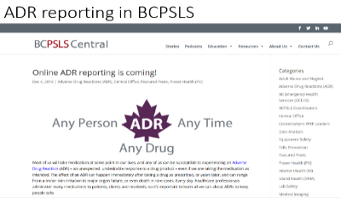
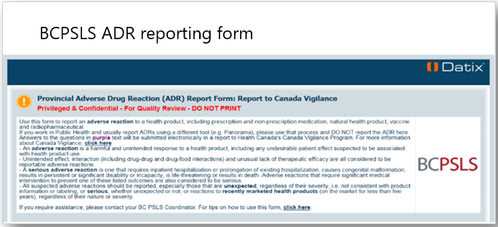
EXAMPLE: Hospital Reporting System for ADRs and MDIs
– British Columbia Patient Safety & Learning System (BCPSLS)
The BCPSLS is a provincial
online reporting system that
includes ADR and MDI reporting
Source: British Columbia Patient Safety and Learning System; 2019.

Slide 18
EXAMPLE: Hospital Reporting System for ADRs
– British Columbia Research Project
ActionADE is a software application designed to facilitate ADR reporting and integrate with electronic medical records.
ActionADE project goals are:
  Improve data to meet the needs of researchers, drug regulators, and decision-makers, and assist health institutions in complying with new federal serious ADR reporting requirements
  Integrate documentation and reporting with existing healthcare practices, electronic medical records, and a provincial database (planned for 2020 with PharmaNet)
  Improve information sharing across healthcare providers (e.g., pharmacists, emergency physicians and general practitioners), and locations (e.g., hospitals and community based pharmacies)
  Provide timely alerts to warn and inform clinicians about a previous ADR (e.g., when clinicians try to prescribe or dispense a medication that previously caused harm)
Source: http://actionade.org/about/overview/

Slide 19
EXAMPLE: Using ICD-10-CA Diagnostic Coding to Support Serious ADR and MDI Tracking
Facilities across Canada capture administrative, clinical, and demographic information on all hospital stays for reporting to the Canadian Institute for Health Information’s (CIHI) Discharge Abstract Database (DAD).
Upon a patient’s discharge, the health record is reviewed and coded, according to national standards, using ICD-10-CA .
  ICD-10-CA is the enhanced Canadian version of the 10th revision of the International Statistical Classification of Diseases and Related Health Problems.
  ICD-10-CA contains codes for diseases, signs and symptoms, abnormal findings, complaints, social circumstances, and external causes of injury or diseases.
  ICD-10-CA coding can be leveraged to support serious ADR and MDI tracking.
Source: Canadian Institute for Health Information; 2019.

Slide 20
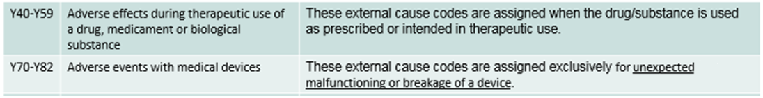
EXAMPLE: Using ICD-10-CA Diagnostic Coding to Support Serious ADR and MDI Tracking _{(continued)}
Adverse effect categories in ICD-10-CA:
There are some gaps in what is captured to meet DAD reporting requirements and what is needed to comply with mandatory reporting requirements:
  CIHI’s DAD ICD-10-CA coding does not capture specific drug/device names, therefore this information would need to be obtained from the patient’s health record for mandatory reporting.
  CIHI’s DAD ICD-10-CA coding is based on physician*-documented adverse effects that cause harm.
  CIHI’s DAD ICD-10-CA coding is based on actual events and would not identify potential for serious harm in the case of medical device incidents.
  *Mandatory reporting regulations do not require physician confirmation of a serious ADR or MDI.
Source: Canadian Institute for Health Information; 2019.

Slide 21
Strategic and Operational Considerations for Education
Refer to Health Canada’s resources:
  Modules – Educational support for mandatory reporting
  Posters to promote reporting
Include education about serious ADR and MDI reporting in:
  orientation programs,
  student teaching programs and curricula, and
  continuing education programs.
Empower patients and families to ask questions and be engaged in monitoring their treatments
Share tips for recognizing a serious ADR or MDI with health care providers
    Consider if symptoms experienced by the patient might be due to a serious ADR or MDI
Develop a process to regularly share within the hospital (e.g., newsletters, intranet) Health Canada’s safety findings related to serious ADRs and MDIs

Slide 22
Shared Commitment
to Health Product Safety

Slide 23




Shared Commitment to Health Product Safety
Hospital Leadership
Ensure processes are implemented to support the requirement for mandatory reporting of serious ADRs and MDIs
Encourage a culture of safety
Health Care Providers
Discuss potential harms with patients; identify and document serious ADRs and MDIs; report according to hospital policies and procedures
Contribute to the planning and implementing of safety initiatives, including education
Patients and Consumers
  Report a serious ADR or MDI to a health care provider, manufacturer and/or Health Canada with as much detail as possible
  Health Canada
  Operate Canada's product vigilance system and ensure that methods are in place to collect and evaluate serious ADR and MDI data
  Manage the risks and communicate new health product information to stakeholders to enable informed decisions

Slide 24
Culture of Safety
A culture of safety is defined as the underlying beliefs and values of an organization as they relate to safety as a priority.¹
A culture of safety facilitates reporting:
A positive, supportive work environment that recognizes the value of, and acknowledges, reporting efforts can increase the likelihood of reporting.
Trust, transparency, and open communication, when harm from drugs or medical devices is identified, can shape a health care provider’s approach to reporting.
Partnering with patients and families is an important component of a culture of safety.
¹ Culture of Safety Defined. ISMP Canada, HSO, CPSI; 2019.

Slide 25

Key Partners in Health Product Safety
Health Care Organizations
Patients and
Consumers
Health Care
Product Manufacturers
Federal and Provincial Governments
Health Care
Provider
Educators
Key Partners Include…
Health Care
Providers
Media
International Monitoring Organizations

Slide 26

Key Points to Remember
Potential barriers to serious ADR and MDI reporting include resource and time limitations, unfamiliarity, uncertainty, unawareness, lack of technology supports, complacency, fear of consequences and limited feedback.
Strategic and operational considerations (for teams, technology, and education) include strategies and systems to support implementation of serious ADR and MDI documentation and reporting.
A shared commitment to health product safety includes many key partners with important and complementary roles.

Slide 27
Abbreviations
ADR: Adverse Drug Reaction
BC: British Columbia
BCPSLS: British Columbia Patient Safety & Learning System
CIHI: Canadian Institute for Health Information
CHU: Centre hospitalier universitaire
DAD: Discharge Abstract Database
DIN: Drug Identification Number
ICD-10-CA: International Statistical Classification of Diseases and Related Health Problems, Tenth Revision, Canada
MDI: Medical Device Incident

Slide 28
Resources
Mandatory reporting of serious adverse drug reactions and medical device incidents by hospitals - Guidance document
Protecting Canadians from Unsafe Drugs Act (Vanessa’s Law) Amendments to the Food and Drugs Act (Bill C-17)
Regulations Amending the Food and Drug Regulations (Serious Adverse Drug Reaction Reporting — Hospitals): SOR/2019-190
Regulations Amending the Medical Devices Regulations (Medical Device Incident Reporting — Hospitals): SOR/2019-191
For additional information, please contact the Canada Vigilance Program at:
  Email: hc.canada.vigilance.sc@canada.ca
  Telephone: 1-866-234-2345

Slide 29
Acknowledgments
All materials were developed by the collaborating parties: Health Canada, Institute for Safe Medication Practices Canada (ISMP Canada), Health Standards Organization (HSO), and the Canadian Patient Safety Institute (CPSI).
Any stakeholder interested in using the materials should acknowledge Health Canada as the owner and source:
Educational Support for Mandatory Reporting. Health Canada; 2019.

