Slide 1
Copyright in the
K-12 Context
*May 2021
Notes:
*Updated: July 2024
Hello, and welcome to the University of Alberta’s Opening Up Copyright instructional module on copyright in the kindergarten through grade twelve context.

Slide 2




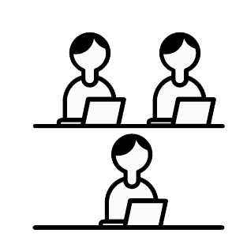



CLASSROOM COPYRIGHT ANXIETY
CMEC
…………………………………………
… use in school… ..... Copyright Act!
©
Notes:
Taylor is just settling into their new teaching position at David Vaver Elementary School. It has been a busy few weeks getting to know their students, but they have really been enjoying it. However, Taylor got a bit anxious this weekend. As they were getting their lessons ready for the coming week, they noticed a particular resource on the internet had a long, confusing statement about use in schools and the Copyright Act. In thinking back to what they learned in university, Taylor remembers the advice… “see mec?”

Slide 3

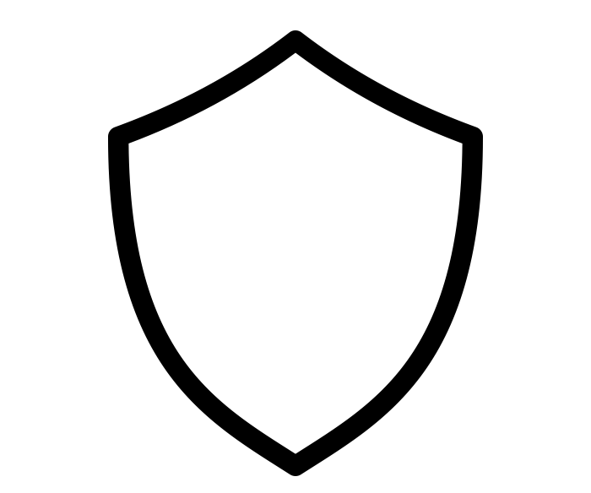

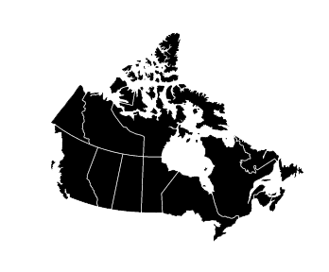
COUNCIL OF MINISTERS OF EDUCATION, CANADA
CMEC
ouncil of
inisters of
ducation,
anada
Notes:
Not “Mec the person” but CMEC: the Council of Ministers of Education, Canada. CMEC is an intergovernmental body made up of Ministers of Education from all the provinces and territories. It undertakes work on a variety of educational issues, including copyright. CMEC’s guiding principle with respect to copyright is that the rights of creators need to be balanced with the rights of educational users. CMEC plays an important role in advocacy and policy development with regard to copyright in the K-12 context.

Slide 4
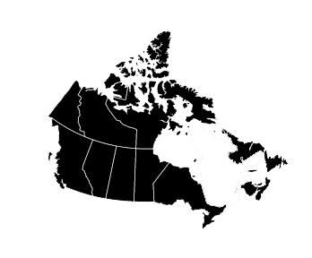

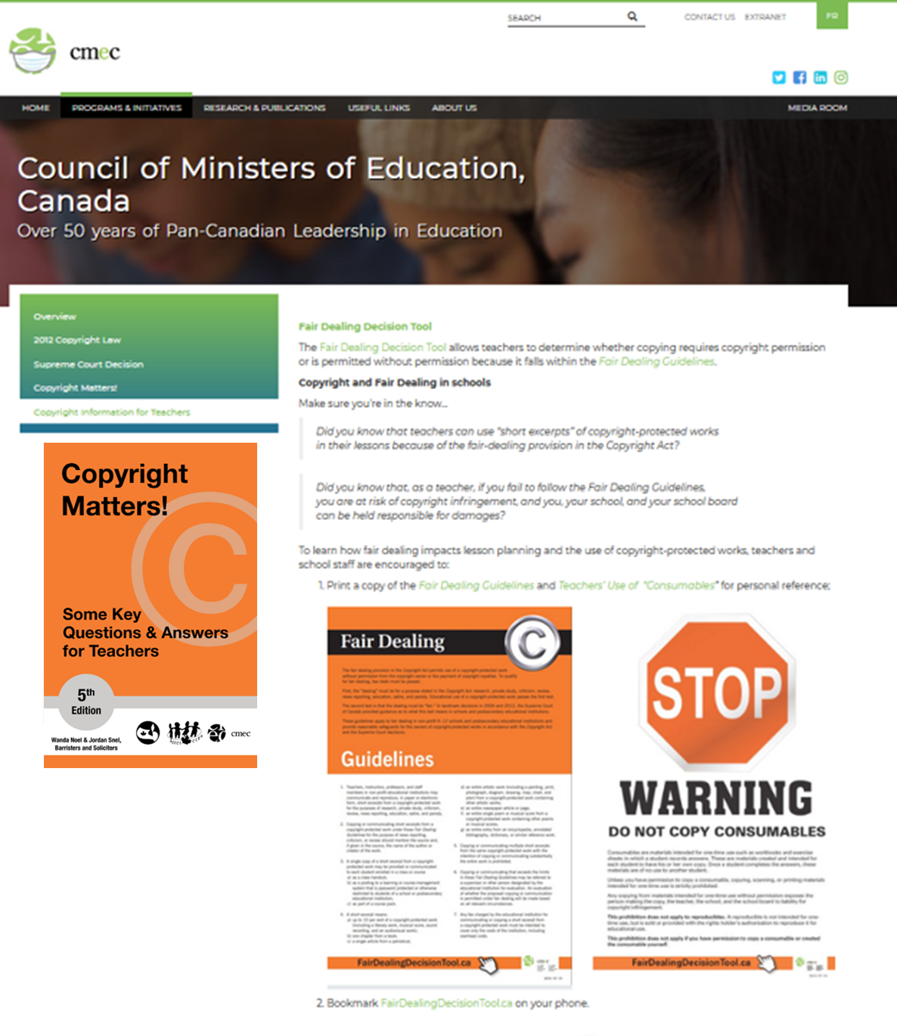


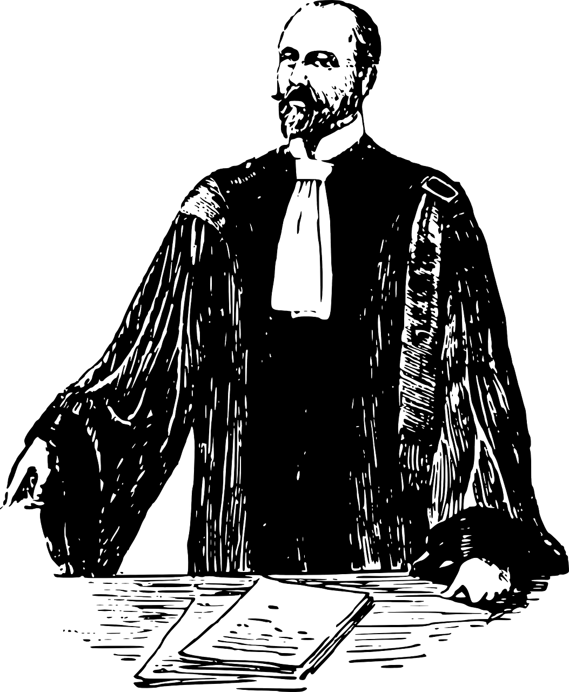

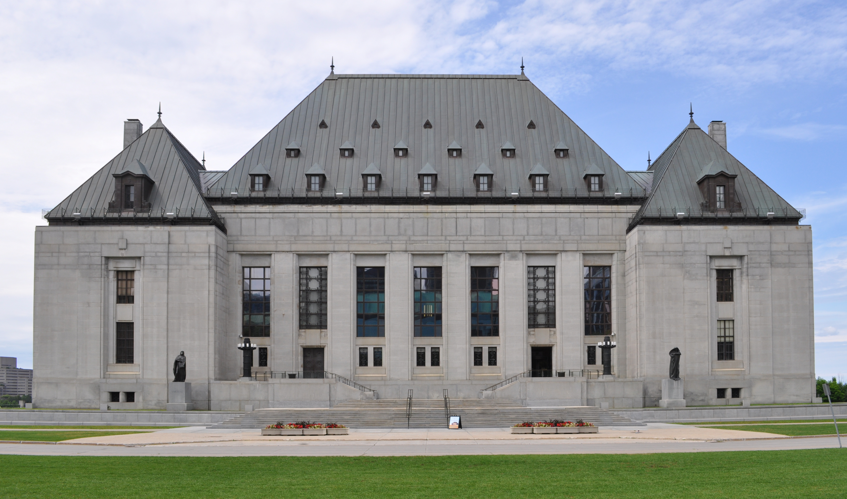
CMEC AND COPYRIGHT
CMEC Copyright Consortium
©
©
v.
Access
Copyright
Notes:
Since 1999, the CMEC Copyright Consortium, which includes members from every province and territory except Quebec, has tried to advance its members’ views on issues related to copyright and education. It’s an important area – in 2012 a legal battle between Alberta’s Ministry of Education and Access Copyright over teachers’ copying of supplemental materials went all the way to the Supreme Court of Canada. In addition to addressing issues of copyright policy and law, CMEC also provides practical resources on copyright for students, parents, school administrators, and for teachers like Taylor.

Slide 5
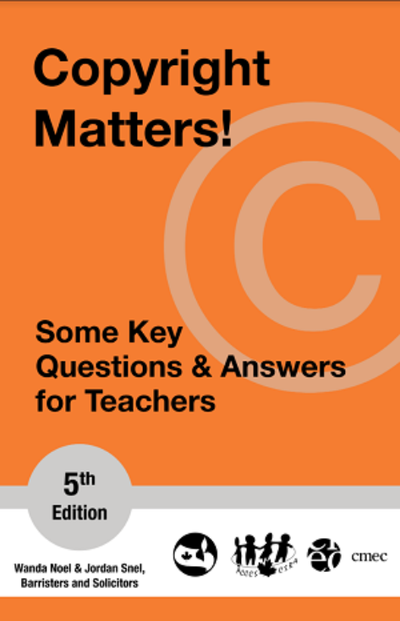
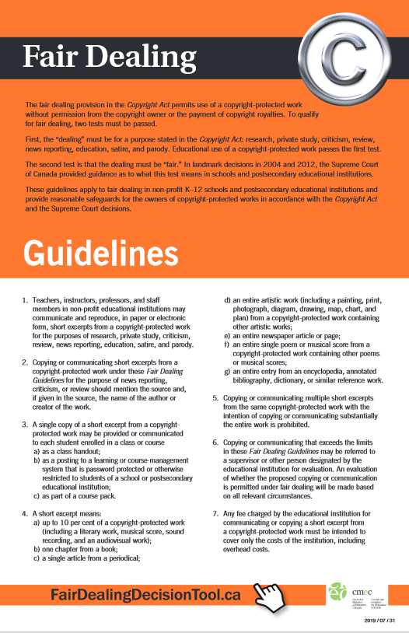
CMEC RESOURCES
???
Notes:
So what kind of resources does CMEC have to help Taylor? Their copyright website is a great place to start and the Copyright Matters guide provides many useful questions and answers for teachers. CMEC has also created fair dealing guidelines and a fair dealing decision tool, as well as a compliance checklist for teachers and principals, and a few other resources, all of which are freely available on its website.

Slide 6






FAIR DEALING
Specified purposes
Reasonable limits
Without permission
©
CMEC
No… that can’t be right???
Notes:
Taylor starts to remember what they learned in university. They remember learning about free openly-licensed educational resources – OER or open educational resources. OER materials are ones where the rights holder has made it clear that the materials can be copied and shared with students and others without having to consult any additional copyright guidelines. Then they also remember, “copyright, CMEC, fair dealing...” but what is fair dealing? Then Taylor remembers CMEC’s Copyright Matters has more information on fair dealing. Fair dealing is the right to reproduce and use copyright-protected works, for certain specified purposes and within reasonable limits, without permission or payment. It is one of the key ways the rights of users and creators are balanced. While there are other educational exceptions in the Copyright Act, fair dealing is a key means by which copyright-protected materials can be used in the classroom.

Slide 7


FAIR DEALING IN THE CLASSROOM
I know… I’ll read the Copyright Act
Omniscient Voice:
“Save yourself some trouble and start somewhere else”
Thanks, I guess?
Notes:
While fair dealing is a key exception in the Copyright Act, the Act itself isn’t really that useful for telling Taylor how they can and can’t use materials. That’s where the CMEC Fair Dealing Guidelines come in. The guidelines can help Taylor determine if their intended use of a work might be fair. In general a ‘short excerpt’ of a work can be copied for a class handout, posted in a learning management system or screen-copied to a slide, and the guidelines also explain what such a short excerpt might be in various formats. If the guidelines alone don’t have enough information for Taylor, then CMEC’s Fair Dealing Decision Tool can help simplify the process even more.

Slide 8

COPYRIGHT CONFIDENCE
…………………………………………
… use in school… ..... Copyright Act!
This is great!
©
Notes:
These resources sure are helpful, and with a couple of clicks, Taylor’s copyright anxiety starts to fade away. CMEC even provides guidance on the use of internet materials and ‘consumables’ such as exercise books. After looking through CMEC’s materials and reading through Copyright Matters, Taylor feels more confident about what they can use in the classroom, and what students can do too. They decide to have a quick look at the Compliance Checklists.

Slide 9
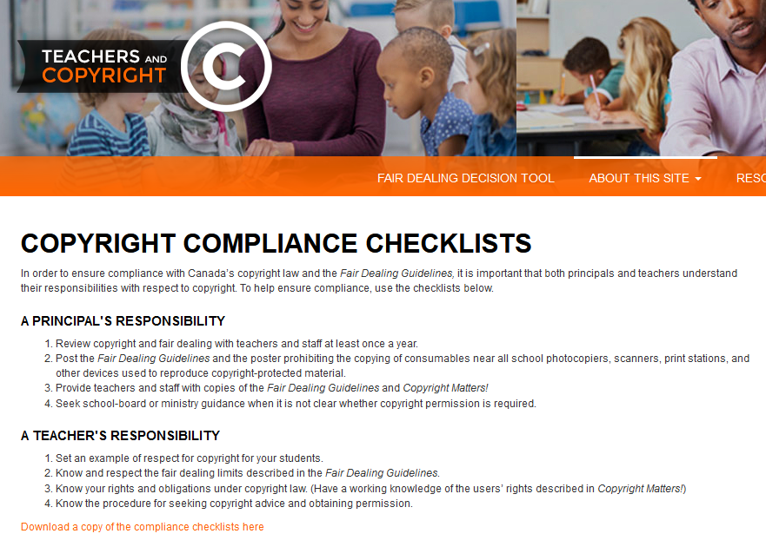

COPYRIGHT COMPLIANCE CHECKLIST
CMEC
… guidelines.
Notes:
Taylor notices that the checklist suggests principals “review copyright with teachers and staff at least once a year,” and they decide to ask their principal about this first thing Monday morning.
Taylor heads right down to the principal’s office to share the useful CMEC copyright resources they found during course prep on Sunday night. Taylor also wants to make sure the principal knows about open educational resources as well. Much to Taylor’s surprise, the principal was already reviewing new copyright guidelines issued by the municipal school division. “But what about CMEC?” Taylor asks; they’re a national group of provincial ministers. The principal points out that CMEC’s guidelines are just that – guidelines, and that it is important to remember that individual school divisions or boards may have their own guidance for teachers. The principal also notes that at the next staff meeting copyright and open educational resources will be discussed for everyone’s benefit.

Slide 10
READY FOR CLASS
Thanks CMEC
Good morning everyone!
Notes:
First bell rings, and Taylor heads off to class ready to start another week of teaching, confident that, although they can’t “see Mec” if they have a concern about copyright and fair dealing, they can certainly check with the CMEC copyright resources.

Slide 11
LEARNING OBJECTIVES
You should now be able to:
Describe the role the Council of Ministers of Education, Canada (CMEC) plays in relation to copyright and schools
Identify CMEC resources for teachers that provide guidance on the use of copyright-protected materials in schools
Recognize that school divisions, boards and districts may have their own copyright guidelines
Notes:
You should now be able to:
Describe the role the Council of Ministers of Education, Canada (CMEC) plays in relation to copyright and schools
Identify CMEC resources for teachers that provide guidance on the use of copyright protected materials in schools
Recognize that school divisions, boards and districts may have their own copyright guidelines

Slide 12
Notes:
This has been the University of Alberta’s Opening Up Copyright module on copyright in the K-12 context. Thank you for your attention.

Slide 13
CMEC stands for:
  Copyright Management in Education of Canada
  Council of Ministers of Education, Canada
  Canadian Ministers of Education and Copyright
  See Mec the person
CMEC’s guiding principle with respect to copyright is:
  The rights of educational users supersede the rights of creators
  The rights of creators supersede the rights of educational users
  The rights of creators need to be balanced with the rights of educational users
  All teachers should be free to teach without the impedances of complicated copyright legislation

Slide 14
Fair dealing: [check all that apply]
  Is an exception within Canada’s Copyright Act
  Is the right to reproduce and use copyright-protected works, for certain specified purposes and within reasonable limits, without permission or payment
  Means all players have an equal number of cards to start a game
  Can allow the free use of ‘short excerpts’ of copyright-protected works in the classroom
  Is intended to relieve copyright anxiety for teachers
Teachers should abide by CMEC copyright guidelines unless their local school division has different copyright guidelines.
  True
  False

Slide 15
CMEC hosts a website with multiple resources to help teachers determine when they may use a copyright-protected work. These resources include: [check all that apply]
  A Fair Dealing Decision tool
  A Compliance Checklist
  Copyright Matters!
  An AI-based Chatbot that accepts any digitized copyright-protected work as input
  A group photo of the Ministers of Education from all the provinces and territories

Slide 16
Athabasca University. (n.d.). Multiply K-12 OER Project. http://bolt.athabascau.ca/index.php/oer/multiply-k-12-alberta-oer-project/
CMEC. (n.d.). Fair dealing decision tool. http://www.fairdealingdecisiontool.ca/DecisionTool/
Council of Ministers of Education, Canada [CMEC]. (2019). Fair dealing guidelines. https://cmec.ca/docs/copyright/CMEC_POSTER_FDG_EN.pdf
Noel, W., & Snel, J. (2022). Copyright matters! Some key questions and answers for teachers (5th ed.). Council of Ministers of Education, Canada. http://cmec.ca/Publications/Lists/Publications/Attachments/291/Copyright%20Matters%205th%20Edition%20FINAL%20EN.pdf
OER Commons. (n.d.). K-12 remote learning. https://www.oercommons.org/hubs/k12

Slide 17
Coffeebeanworks. (n.d.). [Taylor]. Pixabay. Pixabay Licence. https://pixabay.com/illustrations/avatar-women-girls-faces-portraits-2191931/
Bieu Tuong (n.d.). School. The Noun Project. CC BY. https://thenounproject.com/term/school/1983588/
Universal Icons. (n.d.). Calendar. The Noun Project. CC BY. https://thenounproject.com/term/calendar/3693091/
Marie Van den Broeck. (n.d.). Kids. The Noun Project. CC BY. https://thenounproject.com/term/kids/235684
Guilherme Fertado (n.d.). Sign. The Noun Project. CC BY. https://thenounproject.com/term/sign/1859815/
Coffeebeanworks. (n.d.). [Professor]. Pixabay. Pixabay Licence. https://pixabay.com/illustrations/avatar-clients-customers-icons-2155431/
Massupa Kaewgahya. (n.d.). University. The Noun Project. CC BY. https://thenounproject.com/term/university/1574556/
Timo Schmid. (n.d.). Students. The Noun Project. CC BY. https://thenounproject.com/term/students/2506819/

Slide 18
Bence Bezeredy. (n.d.). Canada Map. The Noun Project. CC BY. https://thenounproject.com/term/canada-map/1053546/
Kimmi Studio. (n.d.). Shield. The Noun Project. CC BY. https://thenounproject.com/term/shield/874630/
Kick. (n.d.). Scales. The Noun Project. CC BY. https://thenounproject.com/term/scale/1320645/
Nithinan Tatah. (n.d.). Advocacy. The Noun Project. CC BY. https://thenounproject.com/term/advocacy/2274598/
Dave Dawson. (n.d.). Alberta. The Noun Project. CC BY. https://thenounproject.com/term/alberta/996912/
Clker-Free-Vector-Images. (n.d.). Lawyer. Pixabay. Pixabay Licence. https://pixabay.com/vectors/lawyer-attorney-barrister-judge-28838/
Star and Anchor Designs. (n.d.). Building. The Noun Project. CC BY. https://thenounproject.com/term/building/164596/
Dig Deeper. (2017). [Supreme Court of Canada]. Wikimedia Commons. CC BY. https://commons.wikimedia.org/wiki/File:Supreme_court_of_Canada_in_summer.jpg

Slide 19
Creative Stall. (n.d.). Avatar [Parent 1]. The Noun Project. CC BY. https://thenounproject.com/term/avatar/1089498/
Creative Stall. (n.d.). Avatar [Parent 2]. The Noun Project. CC BY. https://thenounproject.com/term/avatar/1089499/
Creative Stall. (n.d.). Avatar [Parent 3]. The Noun Project. CC BY. https://thenounproject.com/term/avatar/1089494/
Creative Stall. (n.d.). Avatar [Parent 4]. The Noun Project. CC BY. https://thenounproject.com/term/avatar/1089490/
Jesus Puertas. (n.d.). Meeting. The Noun Project. CC BY. https://thenounproject.com/term/meeting/198536/
onathasmello. (2012). Global Open Educational Resources Logo. Wikimedia Commons. CC BY. https://commons.wikimedia.org/wiki/File:Global_Open_Educational_Resources_Logo.svg\
Jeff Ahlberg. (n.d.). Circus Tent. The Noun Project. CC BY. https://thenounproject.com/term/circus-tent/9821/

Slide 20
Saishraddha Malage. (n.d.). Highlight. The Noun Project. CC BY. https://thenounproject.com/term/highlight/241534/
Caesar Rizky Kurniawan. (n.d.). Presentation Slide. The Noun Project. CC BY. https://thenounproject.com/term/presentation-slide/2710348/
Nanda Ririz. (n.d.). Notebook. The Noun Project. CC BY. https://thenounproject.com/term/notebook/1503964/
Coffeebeanworks. (n.d.). [Principal]. Pixabay. Pixabay Licence. https://pixabay.com/illustrations/avatar-clients-customers-icons-2155431/
School Bell. (2017). [Sound Effect]. Free Sound. CC0. https://freesound.org/people/deleted_user_7020630/sounds/378394/
Closing Slides Music: Rybak, Nazar. (n.d.). Corporate Inspired. HookSounds. CC BY. http://www.hooksounds.com
Unattributed materials are contributions from the Opening Up Copyright Project Team and placed in the Public Domain.

Slide 21
University of Alberta. (2021). Copyright in the K-12 Context. Opening Up Copyright Instructional Module. https://sites.library.ualberta.ca/copyright/

