Slide 1
Alberta (Education) v. Canadian Copyright Licensing Agency (Access Copyright)
*April 2019
Notes:
*Updated: May 2024
Hello, and welcome to the University of Alberta’s Opening Up Copyright instructional module on Alberta (Education) v. Access Copyright.

Slide 2
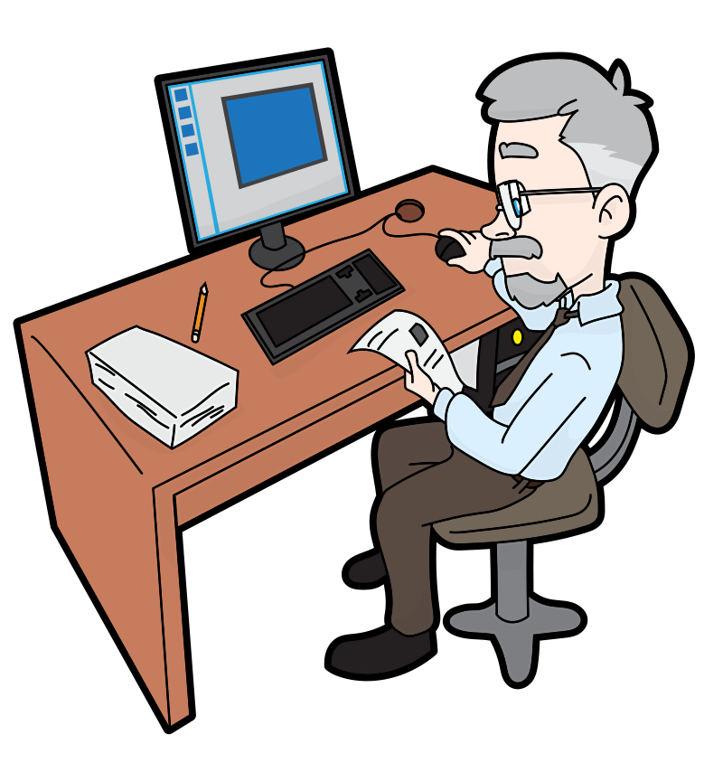
SHARING RESOURCES WITH STUDENTS
Is this covered by fair dealing?
Notes:
Sam teaches social studies at a junior high school. All the students have a copy of the main textbook, and the school owns copies of a number of other print resources. Sam wants to share excerpts from these resources with students in his classes. Given that the school does not have a sufficient number of copies of these supplemental resources for each student, Sam photocopies the excerpts from the resources and distributes these copies to the students in his class. Is the copying by Sam of these short excerpts from copyright-protected materials, and the use of those excerpts by Sam’s students, covered under fair dealing? Or would such copying and use require permission or a licence from the rights holder?

Slide 3
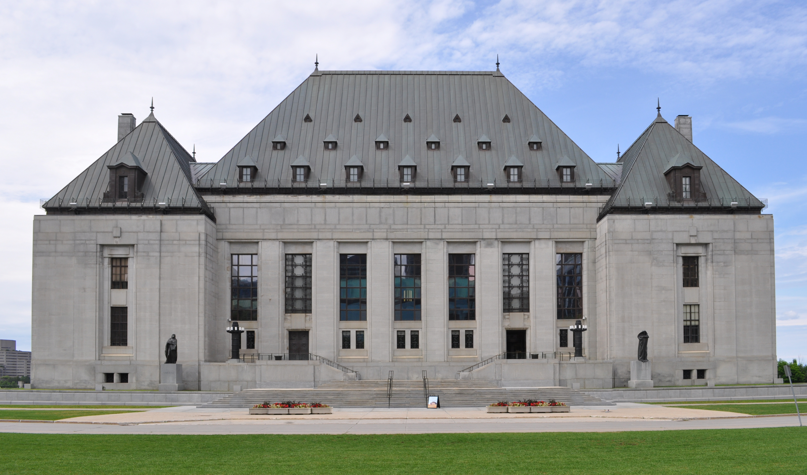
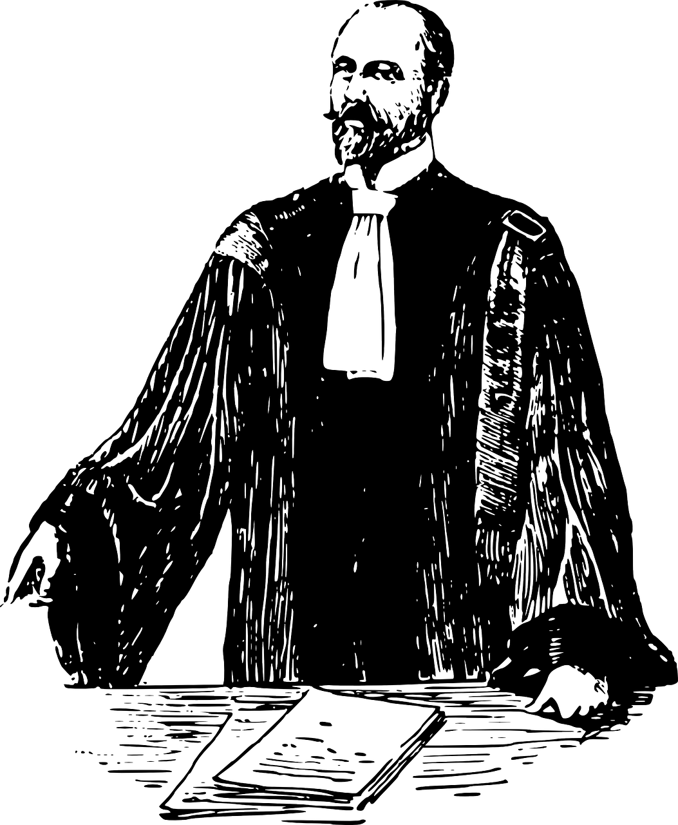
ALBERTA (EDUCATION) v. ACCESS COPYRIGHT
Supreme Court applied the two-step test introduced in CCH v. LSUC
v.
Access
Copyright
Notes:
The case of Alberta (Education) v. Access Copyright addresses this very issue. In making its determination, the Supreme Court of Canada applied the two-step test that was introduced in its 2004 CCH case.

Slide 4
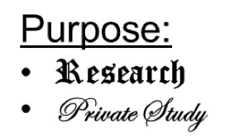
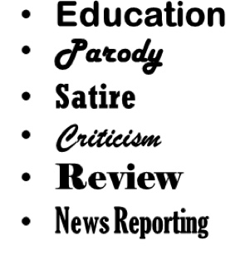
ALBERTA (EDUCATION) v. ACCESS COPYRIGHT
1st Step
2nd Step
✓
Character
Purpose
Amount
Effect
Alternatives
Nature
Notes:
The first step of this test is to consider the dealing in relation to the purposes listed in s. 29 of the Copyright Act. It is important to note that when this case was considered, “education” had not yet been added as a purpose under s. 29. The Court found the dealing to be sufficiently related to “research” and “private study” to pass this first step and to move on to the second step for making a determination of fair dealing, which is the six-factor analysis.

Slide 5
PURPOSE OF THE DEALING
Previously…
“Studying and learning are essentially personal endeavours, whether they are engaged in with others or in solitude” (para 27)
Purpose
“Teachers have no ulterior motive in providing the copies to the students” (para 23)
Instruction = Non-private study
FAIR
$$≠$$
In “splendid isolation”
Notes:
In applying the six-factor analysis, the first factor is “the purpose of the dealing”. While the dealing has a clear connection to “research” and “private study”, the Court must consider the extent to which the purpose of the dealing tends toward a finding of fairness. When the Copyright Board made its earlier decision in this same case, it found that the copies made by teachers were predominantly for “instruction” or for “non-private” study, and thus they would tend toward unfairness. The Federal Court of Appeal agreed with the Copyright Board’s decision that the copies were made for “non-private study.”
A majority of the Supreme Court disagreed. The “research” and “private study” purposes of the students were found to be consistent with the instructional purposes of teachers. “Teachers had no ulterior motive in providing the copies to the students” (para 23). Instruction and private study were found, at least in the school context, to be effectively the same thing. The majority made it clear that the word “private” in “private study” should not be interpreted to suggest that the activity must take place in “splendid isolation”. “Studying and learning are essentially personal endeavours, whether they are engaged in with others or in solitude” (para 27).

Slide 6
AMOUNT OF THE DEALING
Amount
“teachers do not make multiple copies of the class set for their own use, they make them for the use of the students” (para 29)
The amount of the work copied compared to the entire work
$$=$$
Number of copies
$$≠$$
FAIR
Notes:
The Copyright Board’s approach to the “amount of the dealing” factor was also found by a majority of the Supreme Court to be problematic. The Board had suggested that a teacher might make a large number of copies of the same short excerpt, and that this would tend toward unfairness. The majority pointed out that “teachers do not make multiple copies of the class set for their own use, they make them for the use of the students” (para 29). The Court also noted that “the quantification of the total number of pages copied … is considered under a different factor: the ‘character of the dealing’” (para 29). The majority reaffirmed that “the ‘amount’ factor is not a quantitative assessment based on aggregate use, it is an examination of the proportion between the excerpted copy and the entire work, not the overall quantity of what is disseminated” (para 29).

Slide 7
ALTERNATIVES TO THE DEALING
Alternatives
“buying books for each student is not a realistic alternative to teachers copying short excerpts to supplement student textbooks” (para 32)
FAIR
Notes:
For the “alternatives to the dealing” factor, the majority once again disagreed with the approach taken by the Copyright Board, finding that “buying books for each student is not a realistic alternative to teachers copying short excerpts to supplement student textbooks” (para 32). This suggested alternative was found to be all the more unreasonable in light of the Board’s earlier finding that only “short excerpts” from the books were being copied and distributed.

Slide 8
EFFECT OF THE DEALING
“there was no evidence that this decline was linked to photocopying done by teachers” (para 33)
Effect
FAIR
Notes:
Finally, regarding the “effect of the dealing on the work,” although there may be some evidence that textbook sales have been shrinking in recent years, “there was no evidence that this decline was linked to photocopying done by teachers” (para 33).

Slide 9
SUPREME COURT DECISION
✓
Notes:
Therefore, the majority of the Court found the dealing by teachers – the copying of short excerpts of printed works and distributing those copies to their students – to be fair.

Slide 10
SUPREME COURT REVIEW OF THE COPYRIGHT BOARD DECISION
“because the Board’s finding of unfairness was based on what was, in my respectful view, a misapplication of the CCH factors, its outcome was rendered unreasonable” (para 37)
Two Standards for Judicial Review:
“Reasonableness” standard
“Correctness” standard
“application of the CCH factors to the facts and its conclusions were not unreasonable” (para 41)
Notes:
It is important to note that the Court was divided 5 to 4 on this decision. The central issue in the dissent was whether the Copyright Board had made a reviewable error. There are two different standards for judicial review: one is the “reasonableness” standard – whether or not the decision under review was reasonable; and the other is the “correctness” standard – whether or not the decision under review was correct. The standard of review for the Court to apply to the decision of the Copyright Board is reasonableness: simply whether the Board’s decision is reasonable, not whether its decision is correct.
The dissenting judges took the position that the Board’s “application of the CCH factors to the facts and its conclusions were not unreasonable” (para 41), and argued, therefore, that the appeal should be dismissed. Writing for the majority, however, Justice Abella concluded that “because the Board’s finding of unfairness was based on what was, in my respectful view, a misapplication of the CCH factors, its outcome was rendered unreasonable” (para 37). Therefore, the appeal was allowed.

Slide 11
ALBERTA (EDUCATION) DECISION
THANKS, MR. SAM!
Notes:
The Alberta (Education) decision confirms that, under fair dealing, Sam can lawfully reproduce short excerpts of materials and distribute those copies to the students in his classes. This allows Sam to provide the most recent articles to his students to keep his classes more current and relevant, which, he hopes, will help his students remain more engaged and gain a more rounded understanding of the subject matter. This Supreme Court decision was released in July 2012.

Slide 12
2012 COPYRIGHT MODERNIZATION ACT
Notes:
Later in 2012, the Copyright Modernization Act came into force, which added “education” as a distinct purpose under fair dealing.

Slide 13
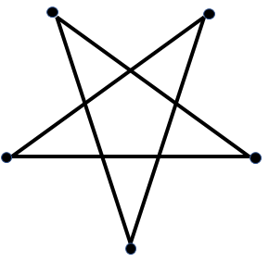
COPYRIGHT PENTALOGY
SOCAN v. Bell
Alberta (Education) v. Access Copyright
Rogers v. SOCAN
Re:Sound v. MPTAC
ESAC v. SOCAN
Notes:
The decision in Alberta (Education) v. Access Copyright, was released at the same time as the Supreme Court’s decisions on four other copyright cases. These five cases are collectively referred to as the “copyright pentalogy.”
Alberta (Education), along with the closely aligned decision in SOCAN v. Bell, another of the pentalogy, is an important piece of Supreme Court jurisprudence that reaffirms and further clarifies the application of the CCH six-factor test.

Slide 14
LEARNING OBJECTIVES
You should now be able to:
Recount the circumstances and outcome of Alberta (Education) v. Canadian Copyright Licensing Agency (Access Copyright)
Identify the more significant factors in the fair dealing analysis that contributed to the decision
Outline the main issue from the dissenting opinion in the case
Notes:
You should now be able to:
Recount the circumstances and outcome of Alberta (Education) v. Access Copyright
Identify the more significant factors in the fair dealing analysis that contributed to the decision
Outline the main issue from the dissent in the case

Slide 15
Notes:
This has been the University of Alberta’s Opening Up Copyright Module on Alberta (Education) v. Access Copyright. Thank you for your attention.

Slide 16
In this case the teachers were making copies:
Of entire texts
Of short excerpts
Of relevant book chapters
The Alberta (Education) decision confirms that, under fair dealing, Sam can lawfully reproduce an entire book if it is for the purpose of instruction.
True
False
The “amount” factor of the six-factor test refers to the number of copies made.
True
False

Slide 17
For the “purpose of the dealing” factor of the six-factor test, the Supreme Court and the Copyright Board interpreted “private study” in different ways. Provide the source for each interpretation.
The Copyright Board interpreted “private study” as something that is done in private that does not apply to teachers photocopying materials for instruction.
The Supreme Court interpreted “private study” as something that can be done with others or in isolation. Instruction in the school context is effectively the same as private study and thus using excerpts of materials for instruction should be considered fair dealing.
For the “alternatives to the dealing” factor of the six-factor test the Supreme Court found that buying books for each student was:
A realistic alternative to copying short excerpts
Not a realistic alternative to copying short excerpts
A realistic alternative to photocopying a text book
Not necessary because students already had a textbook

Slide 18
The standard of review for the Court to apply to the decision of the Copyright Board is:
“Reasonableness:” whether the decision is reasonable
“Correctness:” whether the decision is correct
The Supreme Court reached its decision that the Copyright Board’s earlier decision did not meet the “reasonableness” standard because that earlier decision had misapplied the CCH six factors.
True
False

Slide 19
Alberta (Education) v. Canadian Copyright Licensing Agency (Access Copyright), 2010 FCA 198. https://decisions.fca-caf.ca/fca-caf/decisions/en/item/36867/index.do
Alberta (Education) v. Canadian Copyright Licensing Agency (Access Copyright), 2012 SCC 37. https://decisions.scc-csc.ca/scc-csc/scc-csc/en/item/9997/index.do
CCH Canadian Ltd. v. Law Society of Upper Canada, 2004 SCC 13. https://decisions.scc-csc.ca/scc-csc/scc-csc/en/item/2125/index.do
Entertainment Software Association v. Society of Composers, Authors and Music Publishers of Canada, 2012 SCC 34. https://decisions.scc-csc.ca/scc-csc/scc-csc/en/item/9994/index.do
Re:Sound v. Motion Picture Theatre Associations of Canada, 2012 SCC 38. https://decisions.scc-csc.ca/scc-csc/scc-csc/en/item/9999/index.do

Slide 20
Rogers Communications Inc. v. Society of Composers, Authors and Music Publishers of Canada, 2012 SCC 35. https://decisions.scc-csc.ca/scc-csc/scc-csc/en/item/9995/index.do
Society of Composers, Authors and Music Publishers of Canada v. Bell Canada, 2012 SCC 36. https://decisions.scc-csc.ca/scc-csc/scc-csc/en/item/9996/index.do

Slide 21
Image credits (in order of appearance):
[Sam]. (2018). Wikimedia Commons. CC BY-SA. https://commons.wikimedia.org/wiki/File:Senior_Guy_At_The_Office_Cartoon.svg
Marie Van den Broeck. (2015). Kids. The Noun Project. CC BY. https://thenounproject.com/icon/kids-235684/
Saishraddha Malage. (2015). Highlight. The Noun Project. CC BY. https://thenounproject.com/icon/highlight-241534/
Smashicons. (2017). Printer. The Noun Project. CC BY. https://thenounproject.com/icon/printer-1127745/
Bieu Tuong. (2018). School. The Noun Project. CC BY. https://thenounproject.com/icon/school-1983588/

Slide 22
Clker-Free-Vector-Images. (n.d.). Lawyer. Pixabay. Pixabay Licence. https://pixabay.com/vectors/lawyer-attorney-barrister-judge-28838/
Icon Sea. (2015). Building. The Noun Project. CC BY. https://thenounproject.com/icon/building-164596/
Dig deeper. (2017). [Supreme Court of Canada]. Wikimedia Commons. CC BY. https://commons.wikimedia.org/wiki/File:Supreme_court_of_Canada_in_summer.jpg
Ruslan Dezign. (2017). Target. The Noun Project. CC BY. https://thenounproject.com/icon/target-1005058/
ATOM. (2017). Copy. The Noun Project. CC BY. https://thenounproject.com/icon/copy-1474212/
Тимур Минвалеев. (2016). Percent. The Noun Project. CC BY. https://thenounproject.com/icon/percent-397874/

Slide 23
B. Farias. (2017). Decision. The Noun Project. CC BY. https://thenounproject.com/icon/decision-1074053/
AFY Studio. (2018). Leaf. The Noun Project. CC BY. https://thenounproject.com/icon/leaf-1737325/
Gregor Cresnar. (2015). Dollar sign. The Noun Project. CC BY. https://thenounproject.com/icon/dollar-sign-171145/
Federal Court. (2007). [Federal Court’s Coat of Arms]. https://www.fct-cf.gc.ca/en/pages/the-federal-courts-coat-of-arms
Andrew Doane. (2017). Deserted Island. The Noun Project. CC BY. https://thenounproject.com/icon/deserted-island-1422103/
Tony Michiels. (2014). Stack. The Noun Project. CC BY. https://thenounproject.com/icon/stack-38035/

Slide 24
Bernar Novalyi. (2016). Judge. The Noun Project. CC BY. https://thenounproject.com/icon/judge-684236/
Closing Slides Music: Rybak, Nazar. (n.d.). Corporate Inspired. HookSounds. CC BY. http://www.hooksounds.com/
Unattributed materials are contributions from the Opening Up Copyright Project Team and placed in the Public Domain.

Slide 25
University of Alberta. (2019). Alberta (Education) v. Canadian Copyright Licensing Agency (Access Copyright). Opening Up Copyright Instructional Module. https://sites.library.ualberta.ca/copyright/

