Slide 1
ALBERTA (EDUCATION) v. ACCESS COPYRIGHT
April 2019

Slide 2
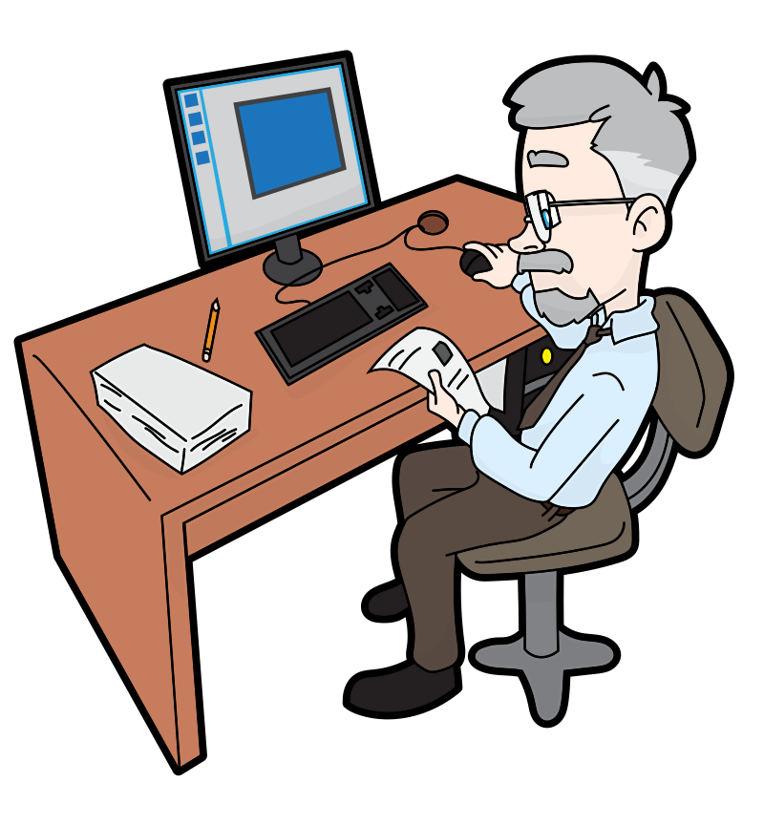
SAM WANTS TO SHARE RESOURCES WITH HIS STUDENTS
Is this covered by fair dealing?

Slide 3
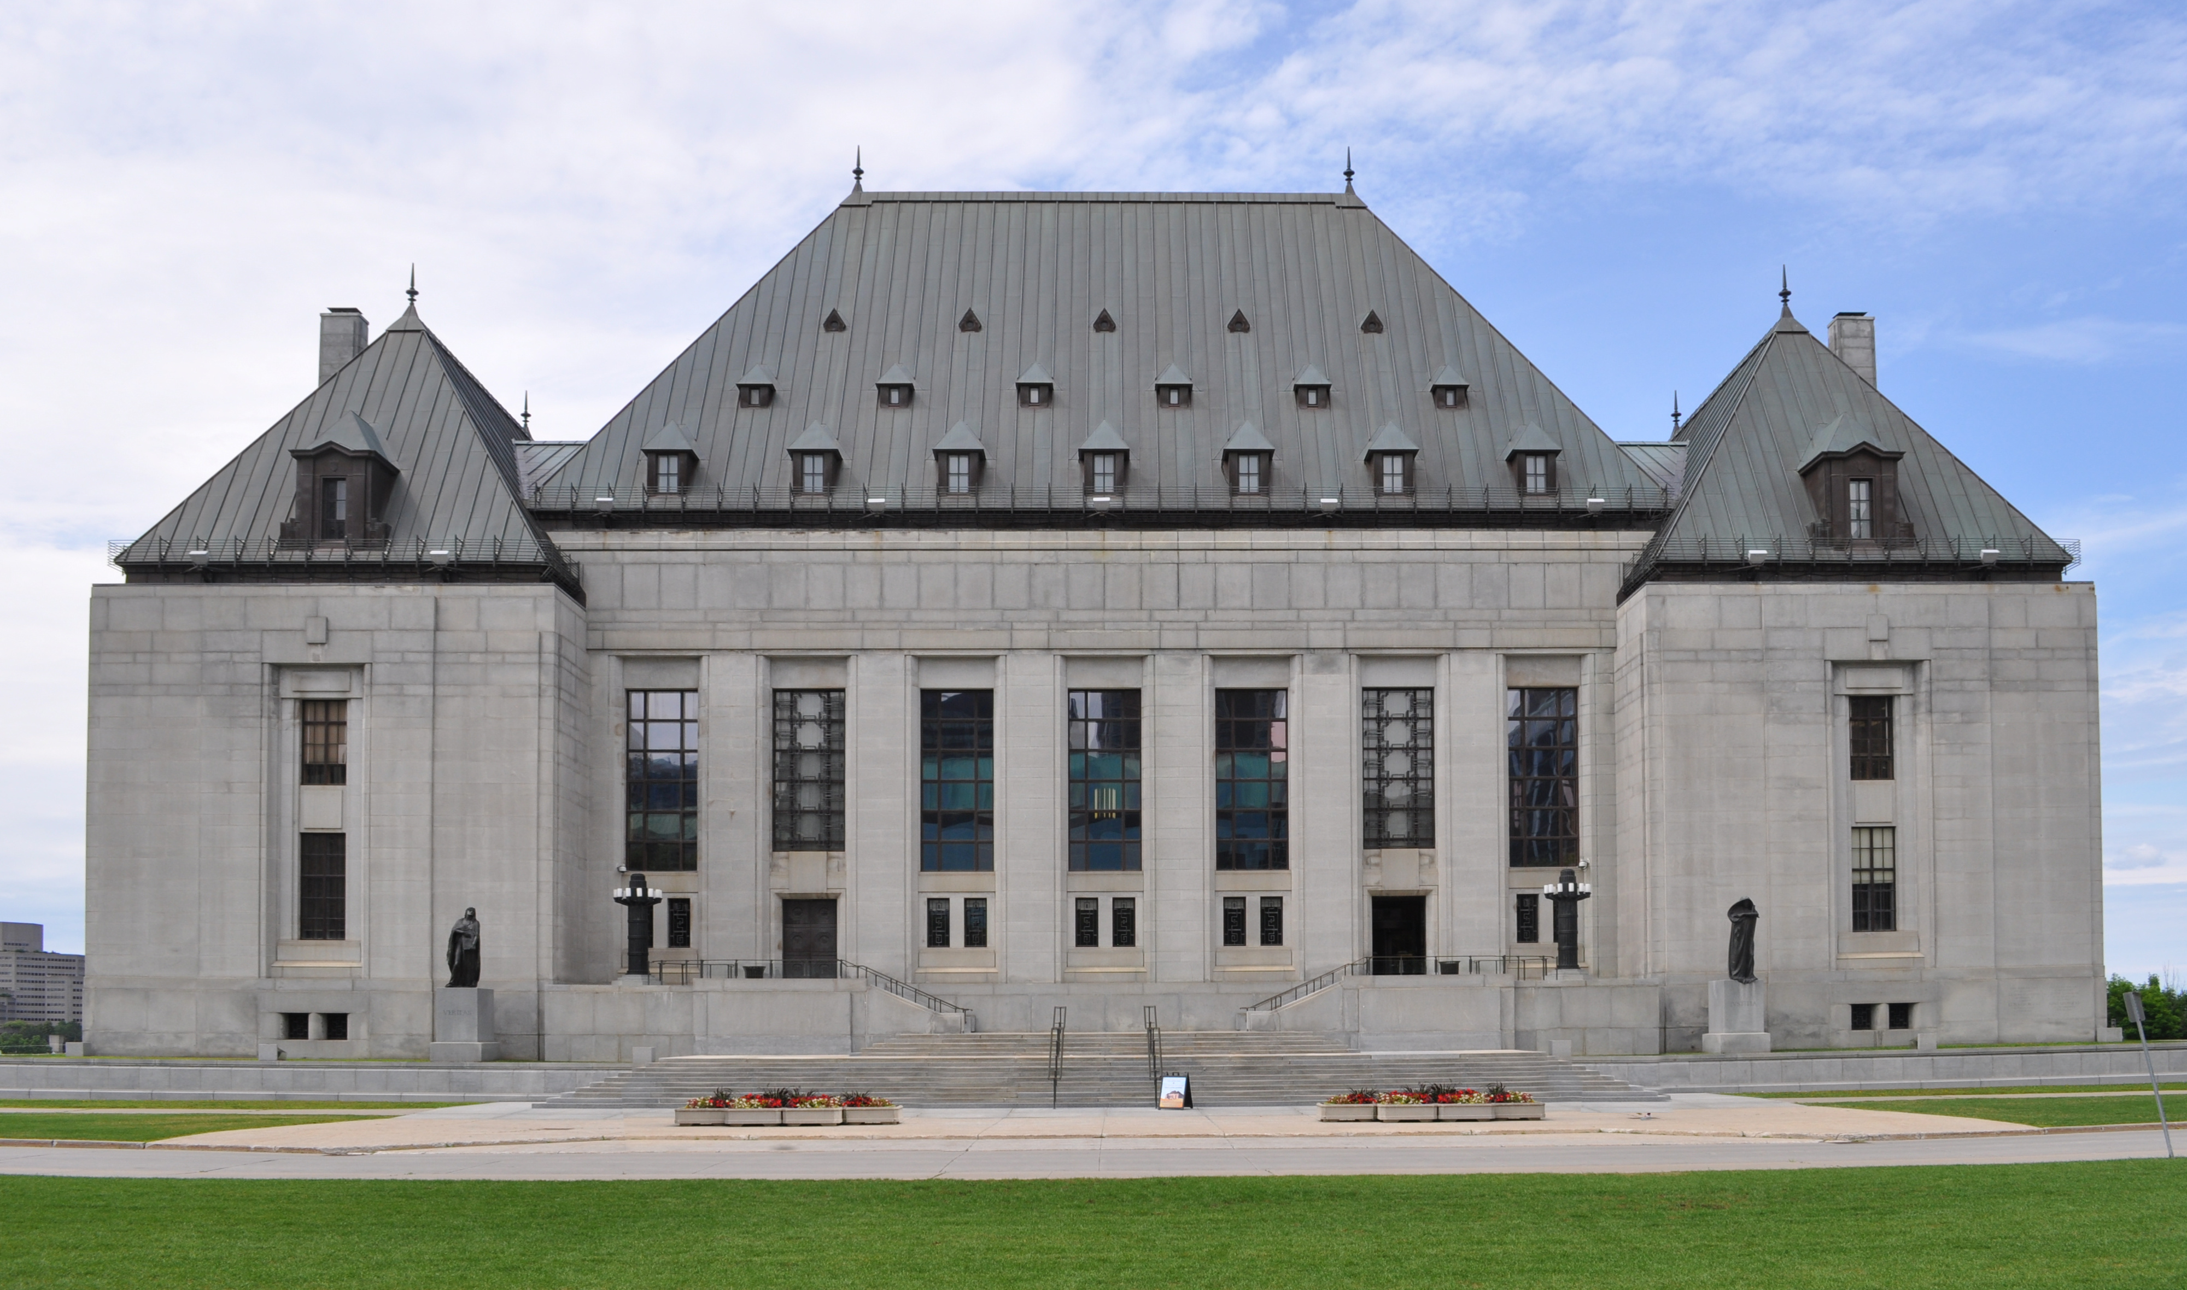
ALBERTA (EDUCATION) v. ACCESS COPYRIGHT
Supreme Court applied the two-step test introduced in CCH v. LSUC

Slide 4
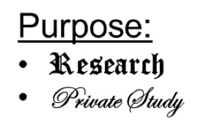
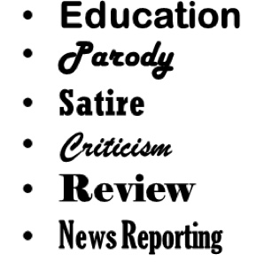
ALBERTA (EDUCATION) v. ACCESS COPYRIGHT
1st Step
2nd Step
✓
Character
Purpose
Amount
Effect
Alternatives
Nature
Notes:
14. [C] The Court suggested that research should be broadly defined in the first step. The “analytical heavy hitting is done in determining whether the dealing was fair” [C] which is the second step of the process. [C]

Slide 5
THE PURPOSE OF THE DEALING
Previously…
“Studying and learning are essentially personal endeavours, whether they are engaged in with others or in solitude” (para 27)
Purpose
“Teachers have no ulterior motive in providing the copies to the students” (para 23)
Instruction = Non-private study
FAIR
$$≠$$
In “splendid isolation”
Notes:
26. SOCAN claimed that users could rely on a wide number of alternatives to preview when choosing what music to buy. [C] Album artwork, [C] textual descriptions, and user-generated album reviews were offered as alternatives. However, [C] the Supreme Court noted that these options were not true alternatives to previewing the music, as only previews can demonstrate to a consumer what the music actually sounds like. [C]

Slide 6
AMOUNT OF THE DEALING
Amount
“teachers do not make multiple copies of the class set for their own use, they make them for the use of the students” (para 29)
The amount of the work copied compared to the entire work
$$=$$
Number of copies
$$≠$$
FAIR
Notes:
26. SOCAN claimed that users could rely on a wide number of alternatives to preview when choosing what music to buy. [C] Album artwork, [C] textual descriptions, and user-generated album reviews were offered as alternatives. However, [C] the Supreme Court noted that these options were not true alternatives to previewing the music, as only previews can demonstrate to a consumer what the music actually sounds like. [C]

Slide 7
ALTERNATIVES TO THE DEALING
Alternatives
“buying books for each student is not a realistic alternative to teachers copying short excerpts to supplement student textbooks” (para 32)
FAIR
Notes:
26. SOCAN claimed that users could rely on a wide number of alternatives to preview when choosing what music to buy. [C] Album artwork, [C] textual descriptions, and user-generated album reviews were offered as alternatives. However, [C] the Supreme Court noted that these options were not true alternatives to previewing the music, as only previews can demonstrate to a consumer what the music actually sounds like. [C]

Slide 8
EFFECTS OF THE DEALING
“there was no evidence that this decline was linked to photocopying done by teachers” (para 33)
Effect
FAIR
Notes:
26. SOCAN claimed that users could rely on a wide number of alternatives to preview when choosing what music to buy. [C] Album artwork, [C] textual descriptions, and user-generated album reviews were offered as alternatives. However, [C] the Supreme Court noted that these options were not true alternatives to previewing the music, as only previews can demonstrate to a consumer what the music actually sounds like. [C]

Slide 9
SUPREME COURT DECISION
✓
Notes:
26. SOCAN claimed that users could rely on a wide number of alternatives to preview when choosing what music to buy. [C] Album artwork, [C] textual descriptions, and user-generated album reviews were offered as alternatives. However, [C] the Supreme Court noted that these options were not true alternatives to previewing the music, as only previews can demonstrate to a consumer what the music actually sounds like. [C]

Slide 10
SUPREME COURT REVIEW OF THE COPYRIGHT BOARD DECISION
“because the Board’s finding of unfairness was based on what was, in my respectful view, a misapplication of the CCH factors, its outcome was rendered unreasonable” (para 37)
Two Standards for Judicial Review:
“Reasonableness” standard
“Correctness” standard
“application of the CCH factors to the facts and its conclusions were not unreasonable” (para 41)
Notes:
26. SOCAN claimed that users could rely on a wide number of alternatives to preview when choosing what music to buy. [C] Album artwork, [C] textual descriptions, and user-generated album reviews were offered as alternatives. However, [C] the Supreme Court noted that these options were not true alternatives to previewing the music, as only previews can demonstrate to a consumer what the music actually sounds like. [C]

Slide 11
ALBERTA (EDUCATION) DECISION
THANKS, MR. SAM!

Slide 12
2012 COPYRIGHT MODERNIZATION ACT

Slide 13
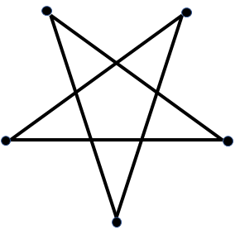
COPYRIGHT PENTALOGY
SOCAN v. Bell
Alberta (Education) v. Access Copyright
Rogers v. SOCAN
Re:Sound v. MPTAC
ESAC v. SOCAN
Notes:
31. The Court provided its decision in July of 2012, [C] along with the four other copyright cases, which are collectively referred to as the “copyright pentalogy.”
32. [C] This case, along with the closely aligned decision in Alberta (Education) v. Access Copyright, another of the pentalogy, is an important piece of Supreme Court jurisprudence as it reaffirms and further clarifies the application of CCH’s six-factor test. [C]

Slide 14
LEARNING OBJECTIVES
You should now be able to:
Recount the circumstances and outcome of Alberta (Education) v. Access Copyright
Identify the more significant factors in the fair dealing analysis that contributed to the decision
Outline the main issue from the dissent in the case
Notes:
33. You should now be able to:
[C] Recount the circumstances and outcome of the SOCAN v. Bell case
[C] Describe the role of fair dealing in the SOCAN v. Bell case
[C] Explain the use and interpretation of the CCH six-factor test in the SOCAN v. Bell case

Slide 15
THANK YOU FOR YOUR ATTENTION
Notes:
34. This has been the University of Alberta’s Opening Up Copyright Module on SOCAN v. Bell. Thank you for your attention. [C]

Slide 16
1. In this case the teachers were making copies
a. Of entire texts
b. Of short excerpts
c. Of relevant book chapters
2. Following this case in 2012, which of the following was added as a distinct purpose under fair dealing?
a. Private study
b. Research
c. Education
d. Non-private study
3. The Alberta (Education) decision confirms that, under fair dealing, Sam can lawfully reproduce an entire book if it is for the purpose of instruction. True or False?

Slide 17
4. The “amount” factor of the six-factor test refers to the amount of copies made. True or False?
5. For the “purpose of the dealing” factor of the six-factor test, the Supreme Court and the Copyright Board interpreted “private study” in different ways. Provide the source for each interpretation.
The Copyright Board interpreted “private study” as something that is done in private that does not apply to teachers photocopying materials for instruction
The Supreme Court interpreted “private study” as something that can be done with others or in isolation. I instruction in the school context is effectively the same as private study and thus using excerpts of materials for instruction should be considered fair dealing
6. For the “alternatives to the dealing” factor of the six-factor test the Supreme Court found that buying books for each student was
a. A realistic alternative to copying short excerpts
b. Not a realistic alternative to copying short excerpts
c. A realistic alternative to photocopying a text book
d. Not necessary because students already had a textbook

Slide 18
7. The standard of review for the Court to apply to the decision of the Copyright Board is
a. “reasonableness:” whether the decision is reasonable
b. “correctness:” whether the decision is correct
8. The Supreme Court’s ruling that the Copyright Board’s earlier decision did not meet the “reasonableness” standard, was reached because five of the nine judges believed the previous decision was based on a misapplication of the CCH six-factors. True or False?
9. The dissenting judges were of the opinion that the Copyright Board’s application of the CCH six-factors test in this case was
a. a correct application of the factors
b. not unreasonable
c. an incorrect application
d. an unreasonable application

Slide 19
Images Credits (in order of appearance):
[Sam] https://commons.wikimedia.org/w/index.php?title=Special:Search&limit=50&offset=500&profile=default&search=man+cartoon&advancedSearch-current={%22namespaces%22:[6,12,14,100,106,0]}#/media/File:Senior_Guy_At_The_Office_Cartoon.svg
Saishradd. (n.d.). Highlight. The Noun Project. CC BY. https://thenounproject.com/search/?q=highlight%20document&i=241534ha
Marie Van den Broeck. (n.d.). Kids. The Noun Project. CC BY. . https://thenounproject.com/search/?q=kids&i=235684
Creaticca Creative Angencyy. (n.d.).Printer. The Noun Project. CC BY. https://thenounproject.com/search/?q=photocopier&i=1127745
Federal Court of Appeal.( n.d.) [Federal Court Coat of Arms]. Federal Court. http://cas-cdc-www02.cas-satj.gc.ca/portal/page/portal/fc_cf_en/Index
Dig deeper.(2017). [Supreme Court of Canada]. Wikimedia Commons. CC BY 4.0. https://commons.wikimedia.org/wiki/File:Supreme_court_of_Canada_in_summer.jpg
Dezign, Ruslan, ID. (n.d.). Target. The Noun Project. CC BY. https://thenounproject.com/search/?q=purpose&i=1005058
ATOM, TH. (n.d.). Copy. The Noun Project. CC BY. https://thenounproject.com/search/?q=copy&i=1474212
Тимур Минвалеев, RU. (n.d.). Percent. The Noun Project. CC BY. https://thenounproject.com/search/?q=percent&i=397874
Farais, B, CL. (n.d.). Decision. The Noun Project. CC BY. https://thenounproject.com/search/?q=alternatives&i=1074053
Cresnar, Gregor. (n.d.). Dollar sign. The Noun Project. CC BY. https://thenounproject.com/search/?q=dollar%20sign&i=171145
AFY Studio, ID. (n.d.). Leaf. The Noun Project. CC BY. https://thenounproject.com/AFYstudio/uploads/?i=1737325
Andrew Doane. (n.d.). Desterted Island. The Noun Project. CC BY. . https://thenounproject.com/search/?q=DESERT%20ISLAND&i=1422103
Tony Michiels. (n.d.). Stacks. The Noun Project. CC BY. . https://thenounproject.com/search/?q=piles&i=38035
Bernar Novalyi. (n.d.). Judge. The Noun Project. CC BY. https://thenounproject.com/search/?q=judge&i=684236

Slide 20
University of Alberta. 2018. “Alberta (Education) v. Access Copyright” Opening Up Copyright Instructional Module. https://www.ualberta.ca/copyright/resources/opening-upcopyright-instructional-modules

