Slide 1
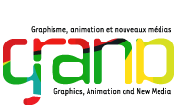
Intellectual Property, Makerspaces and 3D Printing Presentation for 2015 Ontario Library Association Super Conference Toronto, ON – January 29, 2015
Mallory Austin – Chatham Kent Public Library / Masters of Library and Information Studies Candidate, Faculty of Information and Media Studies, University of Western Ontario
Dr. Michael B. McNally – Assistant Profession, School of Library and Information Studies, University of Alberta
Dr. Samuel E. Trosow – Associate Professor, Faculty of Law and Faculty of Information and Media Studies, University of Western Ontario

Slide 2
Outline
Makerspaces, IP and Libraries
Patent, Trademark and Industrial Design Considerations
Copyright Concerns
IP Scenarios in Makerspaces
Takeaways

Slide 3
Put simply, a place where people come together to create things using technology. An environment where you are encouraged to think for yourself, to learn and be creative.
Promotes autonomous thinking and creativity
Can make emerging technologies accessible to everyone
Can help us learn to navigate the fast-evolving digital landscape
Supports the sharing of resources, information and skills among makers
A Makerspace Is...

Slide 4
As makers, we should support open source, upgradeable technology. We should also respect the artists who so generously share their creations.
Thingiverse/Makerbot- counterproductive to maker culture?
Contentious Terms of Service
Patented hardware and software
The Dizingof example
Make Magazine has a great guide to recent 3D printer models, with mention of whether or not they’re open source.
The importance of promoting “critical making”, in which the maker is coming up with their own ideas, iterations and solutions.
Maker Culture and Sharing

Slide 5
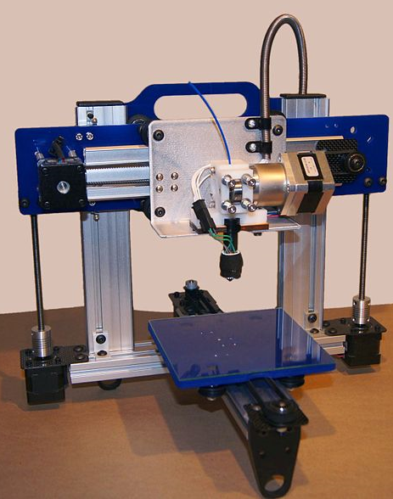
Makerspace Technologies
Some makerspace technologies (e.g. gaming consoles) present no IP concerns
Most makerspace technologies (e.g. book printing machines, digital conversion tools) simply reproduce copyright issues of other library technologies
3D printers offer some unique considerations with regard to copyright, patents and trademarks
Source: B. Dring (2011)

Slide 6
Education and/or/versus Entertainment in Public Libraries
Libraries do serve both purposes – education and entertainment
From a copyright perspective though, education, research and private study are fair dealing categories, and in general entertainment is not
Research will cover some personal interest uses, and according to the Supreme Court it:
“Can be piecemeal, informal, exploratory, or confirmatory. It can in fact be undertaken for no purpose except personal interest” (SOCAN v. Bell, para. 22)

Slide 7
Overview of Copyright, Patent and Trademark
Copyright, patent and trademark are all forms of intellectual property (IP), but each has unique characteristics
Copyright covers literary, artistic, musical and dramatic works that are original and conveyed in a fixed medium
Patents cover inventions and must be novel, useful and non-obvious
Trademarks are used to distinguish goods and services in a marketplace
Some key differences:
Copyrights and patents are conceptually linked to innovation, while trademarks are focused on reputational considerations
Patents have the most rigorous standards and application process

Slide 8
Trademark Concerns
Two types of trademark infringement
Breach of the common law tort of passing off (Trade-marks Act, s. 7)
Infringement of a registered trademark based on:
Use of identical marks on identical wares or services ((Trade-marks Act, s. 19)
Confusing marks (Trade-marks Act, s. 20)
Depreciation of a mark’s goodwill (Trade-marks Act, s. 22)

Slide 9
Trademark Concerns
Recent legislation considerably broadens what constitutes as a trademark
The three-dimensional shape of an object may constitute a trademark
However, a trademark is not registerable if its features are primarily dictated by a utilitarian function (Bill C-31, cl. 326(4))
Trademarks will no longer have to be used to be registered
However they do have to be in use if the owner wishes to litigate
However, trademark infringement is focused on reputational impacts in a market, and as such instances of potential infringement for limited personal use are significantly mitigated

Slide 10
Industrial Design Act Concerns
Industrial design protection covers the visual features of a shape, its configuration, pattern or ornament or combination of these features for useful article
Registration is required; period of protection is 10 years
Protects the shape of a thing, but protection is linked to use/function
E.g. Teddy bear shaped lamp industrial design does not have implications for teddy bear shaped non-lamp items
Complex interplay between copyright and Industrial Design Act (see s. 64 of the Copyright Act)
However, industrial design registration rates are low (less than 50,000 currently protected designs in Canada)

Slide 11
General Considerations
When thinking about 3D printing and intellectual property law it is critical to keep in mind that you are often working with two separate elements: the object and the file [.stl is standard file format].
The printed object and .stl file will attract different legal treatments under IP law
Distinction between copyright and patent is important here.
Copyright protects original expressive/creative (nonfunctional) works --- attaches automatically the moment the work is created.
In contrast, patent protects functional objects. Protection is not automatic, and one needs to apply
See https://www.publicknowledge.org/news-blog/blogs/us-legal-lessons-from-canadas-first-stl-ip-infringement-case

Slide 12
Printed object and .stl file will attract different copyright treatments
Functional object is generally not a work in which copyright subsists (important to distinguish functional object from a artistic object which may be treated as an artistic work/sculpture)
But the .stl file is CODE, and code is treated as a literary work under copyright law
Note that the files can be created several ways.... if it is scanned, then there is likely insufficient originality to warrant copyright (sweat of the brow inadequate per caselaw in US and Canada)
But if file designed independently in CAD, it is more likely original (and then under copyright the creative elements exist independently from what is needed for utility)
So even if the object is not protectable by copyright, the file may well be
Several U.S. decisions on whether there are sufficient severable artistic elements to warrant copyright protection

Slide 13
Differences between U.S. and Canadian IP laws
Major source of uncertainty (confusion) is that while much analysis is from U.S. perspectives but there are some key differences between U.S. and Canadian IP laws
Canada has separate Industrial Design Act, focus in U.S. is between the creative/expressive and useful/functional aspects and whether they can be severed
U.S. Copyright Act recognizes a broad derivative right as part of the bundle of owner's exclusive rights. Canadian Act does not)
“Notice and Takedown” (U.S.) v “Notice and Notice” (Canada) important difference
In addition to fair dealing (with similarities and differences to U.S. fair use) Canada has very broad UGC exception

Slide 14
2-pronged analysis under Canadian Copyright Act
Was there an infringement of one of the owners exclusive rights under section 3(1)?
and if so...
Is the use protected under fair-dealing, UGC exception or other exceptions/limitations?

Slide 15
Patent Issues
Generally patents provide the strongest IP protection with the fewest exceptions for use
However, in general the current limitations of 3D printing greatly limit the potential for patent infringement
Patent Act also provides a number of limited exceptions including:
Experimental use related to the subject matter of the patent (Patent Act, s. 55.2(6))
Repair of patented product (Perry and Currier, 2012)
Printing the components of a patented product with intent to sell the components as a kit constitutes infringement (Perry and Currier, 2012)
Vaver suggests that a 19th Century English case (United Telephone Co. v. Sharples (1885)) may allow non-profit educational use, but this is untested

Slide 16
Scenarios with IP Concerns and 3D Printing
A person walks into the makerspace…
a) wants to make their own design (using CAD) / then 3D print
→ original work: no concerns
b) wants to make a 3D scan / then 3D print the object
→ potential copyright infringement at both scanning and printing levels; possible fair dealing exceptions
c) wants to 3D scan / modify / and then 3D print object
→ potential copyright infringement at both scanning and printing levels; possible fair dealing exceptions
→ UGC exception likely covers modification and printing, unless the original 3D object is known to be an infringing copy

Slide 17
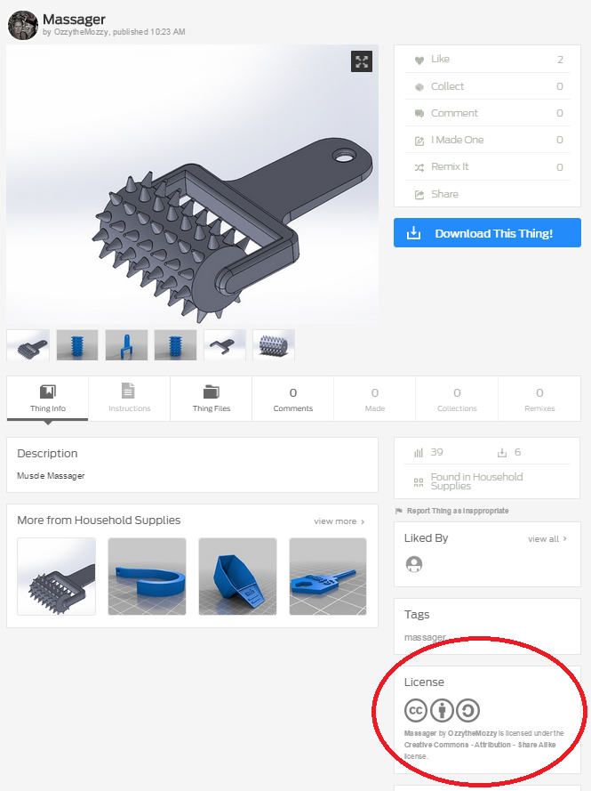
Scenarios with IP Concerns and 3D Printing
d) found a design on Thingiverse / and wants to print a 3D copy.
→ no copyright infringement so long item on Thingiverse is licensed for reproduction (which most are using some sort of CC License)
e) found a design on Thingiverse / going to modify / then want to print a 3D copy
→ Thingiverse license may allow modification;
→ if not covered by UGC exception

Slide 18
Scenarios with IP Concerns and 3D Printing
f) has a file on a USB drive / that they want to 3D print (no modification)
→ need to determine origin of file on USB drive
→ original file (i.e. their creation): no concern
→ consent/license from copyright holder: no concern
→ unknown origin: potential copyright infringement; possible fair dealing exceptions
→ known to be an infringing copy: probable copyright infringement; possible fair dealing exceptions

Slide 19
Scenarios with IP Concerns and 3D Printing
f) has a file on a USB drive / that they want to modify / and then 3D print
→ need to determine origin of file on USB drive
→ original file: no concern.
→ consent/license from copyright holder: no concern
→ unknown origin: potential copyright infringement; possible fair dealing exceptions; UGC exception may also apply if user has reasonable grounds to believe the source file is not an infringing copy
→ known to be an infringing copy: probable copyright infringement; possible fair dealing exceptions ; UGC exceptions do not apply
→ file modification generally covered by UGC unless source file is known to be an infringing copy

Slide 20
Takeaways
Don’t default to assuming that there is an IP problem with makerspace technologies, but there are some concerns
You need to be able to issue spot – most issues are not black and white
You have a lot of flexibility, but libraries offering makerspace services must develop a level of expertise on a range of IP issues
Your library should already have a copyright policy in place
You will need to supplement this with guidelines around user-generated content (i.e. non-commercial use) and makerspace activity

Slide 21
Acknowledgements and Feedback
Graphics Animation and New Media (GRAND) Networks of Centres of Excellence (NCE) has provided research funding
Graduate Research Assistant Angela Ashton (SLIS, U of A)
Mallory Austin -
Michael B. McNally – mmcnally@ualberta.ca
Samuel E. Trosow – strosow@uwo.ca

Slide 22
References
An Act to Implement Certain Provisions of the Budget Tabled in Parliament February 11 2014 and other Measures, C-31 (Economic Action Plan 2014 Act, No. 1), 41st Parl. 2nd Sess. Royal Assent, 19 June, 2014. http://www.parl.gc.ca/legisinfo/BillDetails.aspx?billId=6483626&Mode=1&Language=E
An Act to Amend the Copyright Act and the Trade-marks Act and to Make Consequential Amendments to Other Acts, C-8 (Combating Counterfiet Products Act), 41st Parl. 2nd Sess. First Reading in the Senate, 2 Oct. 2014. http://www.parl.gc.ca/LEGISinfo/BillDetails.aspx?billId=6266835&Mode=1&Language=E
Patent Act, R.S.C. 1985, c. P-4. http://www.laws-lois.justice.gc.ca/PDF/P-4.pdf
Perry, Stephen J., and Andrew T. Currier. 2012. Canadian Patent Law. Markham, ON: LexisNexis Canada.
Society of Composers, Authors and Music Publishers of Canada (SOCAN) v. Bell Canada, [2012] 2 S.C.R. 326.
Trade-marks Act, R.S.C., 1985, c. T-13. http://laws-lois.justice.gc.ca/PDF/T-13.pdf
Vaver, David. 2011. Intellectual Property Law: Copyrights, Patents and Trade-marks. 2nd Ed. Toronto: Irwin Law.

