Slide 1
MAKERSPACES AND COPYRIGHT
*April 2019
Notes:
*Updated: October 2023
Hello, and welcome to the University of Alberta’s Opening Up Copyright Instructional Module on Makerspaces and Copyright.

Slide 2

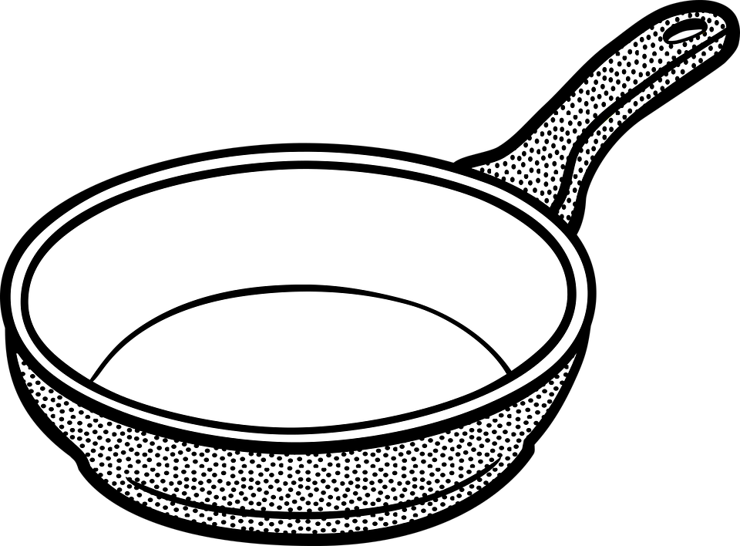
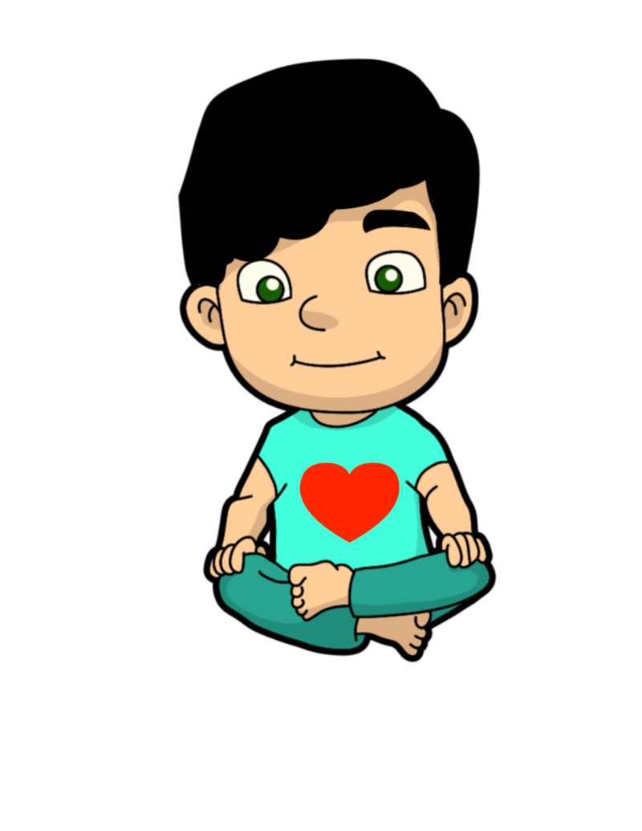

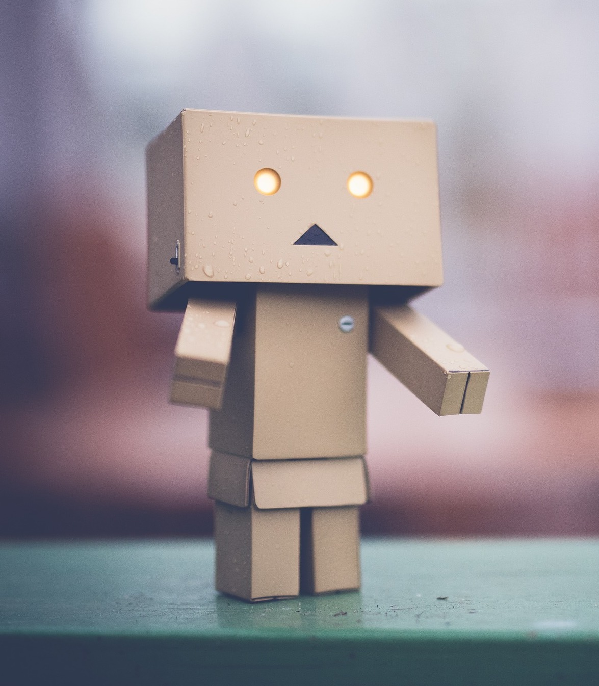
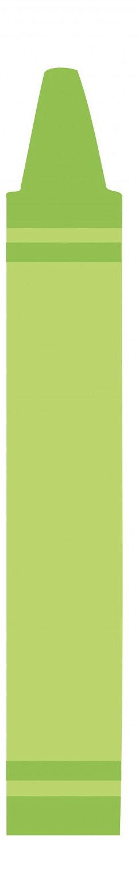
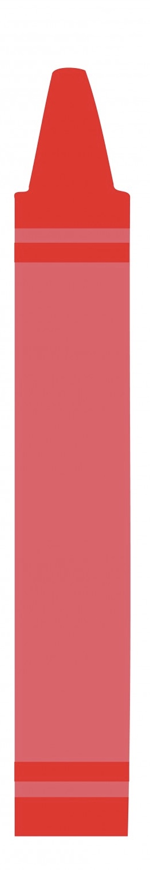
MEET SANDY
Notes:
When Sandy was a kid creativity was a constant. Sandy was always colouring with crayons, banging on pots and pans to make music and building strange creations out of leftover cardboard boxes.

Slide 3


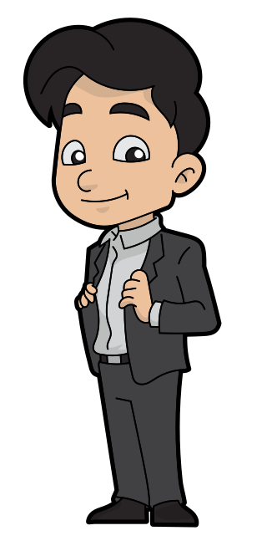

SANDY GROWED UP
Notes:
As an adult, Sandy is just as creative, but increasingly finds that they don’t always have the technology for what they want to create. Luckily Sandy can use the local library’s makerspace.

Slide 4
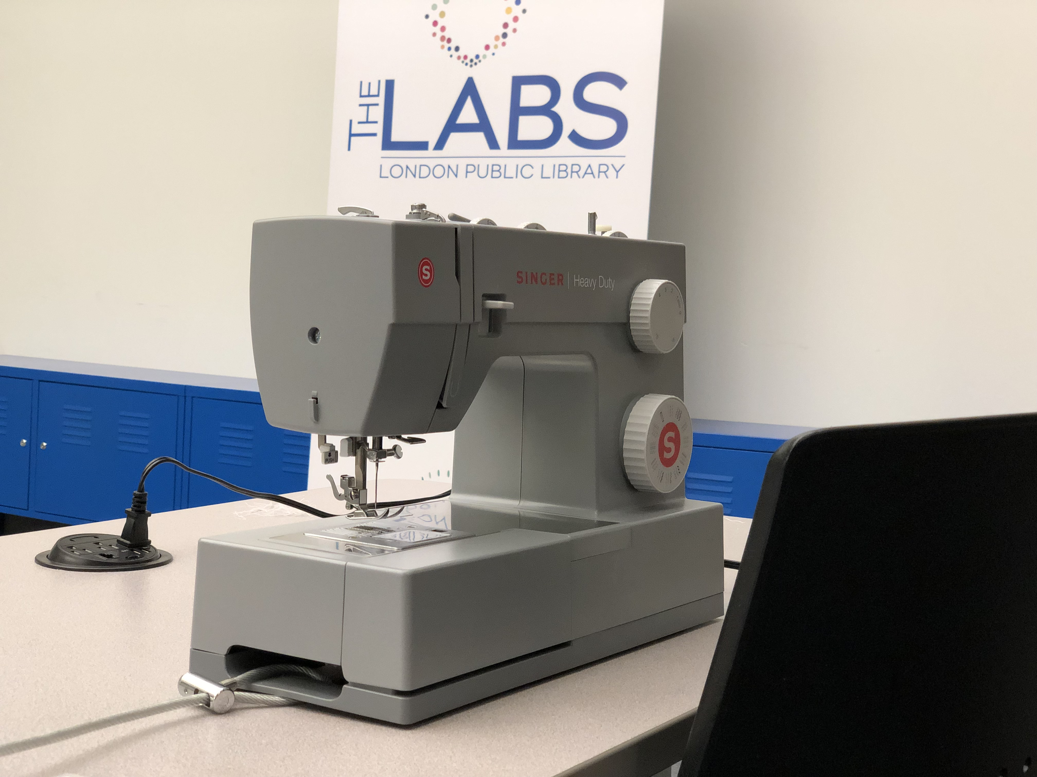
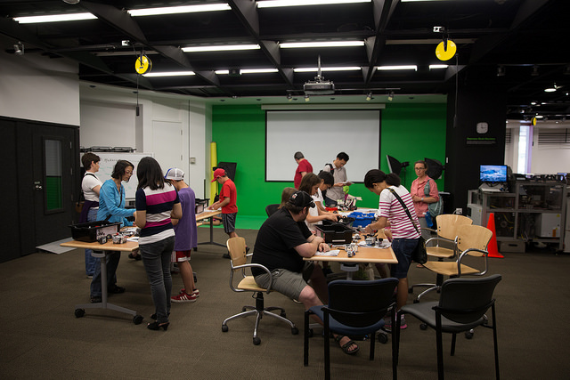
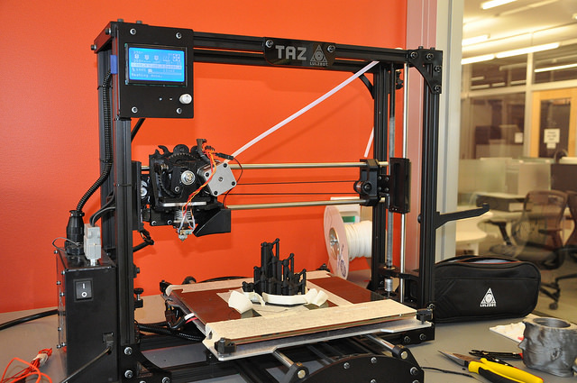
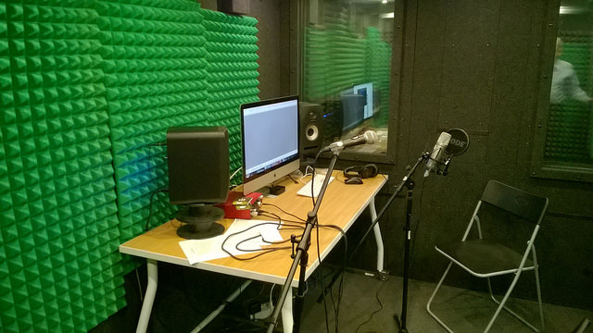
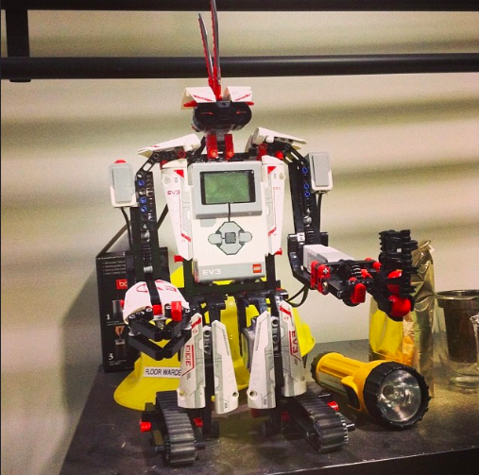
MAKERSPACES
Notes:
Libraries, both public and academic, have embraced the DIY ethos by building makerspaces with a range of technologies from 3D printing and 3D scanning to audio and visual editing tools.
However, the work created in makerspaces can be subject to a range of copyright issues not encountered with other library services.

Slide 5

MAKERSPACES
©
©
©
©
©
©
Notes:
Copyright chill can stop creative work dead in its tracks.

Slide 6

MAKERSPACES
…
Notes:
However, with a few pieces of advice, Sandy can ensure that their creativity is not hampered by the fear of infringing copyright.

Slide 7

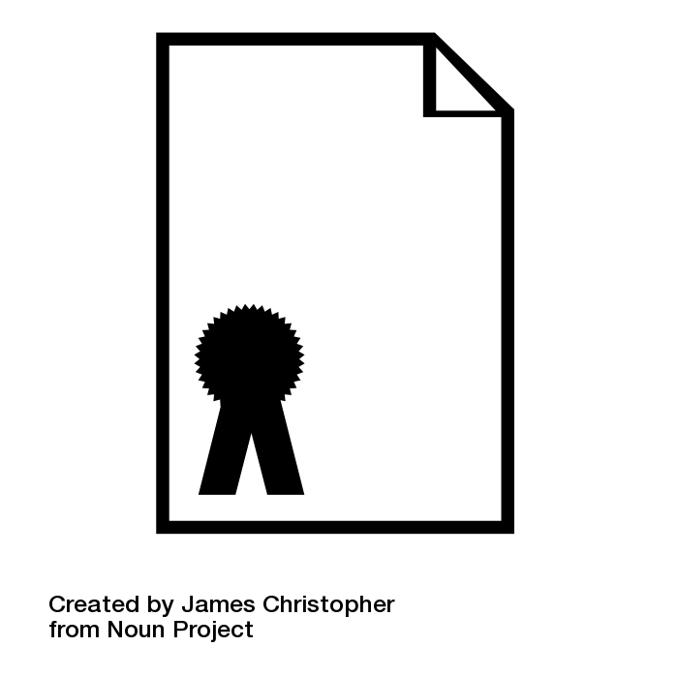
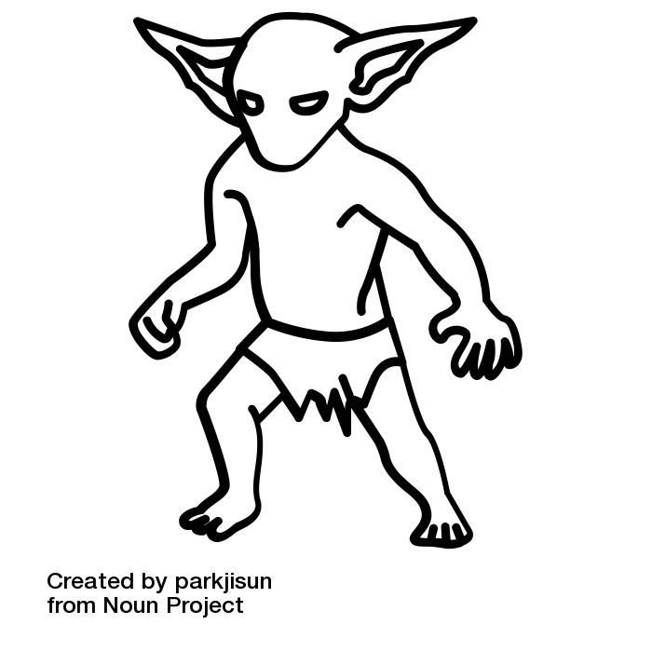

BASIC PRINCIPLES
BASIC PRINCIPLES
Is this for personal use or commercial purposes?
TM
Personal use
$$≠$$
No issues
Industrial Design
Patent
Notes:
Here are some basic principles for Sandy to keep in mind.
One important consideration is whether your use of the makerspace is for personal or commercial purposes. While personal use doesn’t mean that there are no copyright concerns, using a makerspace for commercial purposes, and specifically a 3D printer or scanner, significantly complicates the analysis, and may also implicate trademark, patent and industrial design issues.

Slide 8




BASIC PRINCIPLES
2. Are you incorporating third-party content?
Non-commercial user-generated content exception requirements:
No commercial use
Reasonable grounds to believe source material you use does not infringe copyright
What constitutes reasonable grounds?
Content provided directly from the copyright holder
Content purchased or licensed from the copyright holder
s.29.21 (1)
Notes:
A second key consideration is whether you are incorporating third party content. One important exception to infringement in Canadian copyright law for makerspaces is the non-commercial user-generated content exception. In addition to requiring non-commercial use, it requires that the user has reasonable grounds to believe the source material they are using is not infringing copyright. But what might constitute reasonable grounds that the materials are not infringing copyright? Content that has been authorised for reuse that is provided directly from the copyright holder, for example, via their website, or content that was purchased or licensed from the source is a reasonable starting point. On the flip side, one should be more cautious just taking images from a Google search or copying material off a burnt CD or DVD.

Slide 9


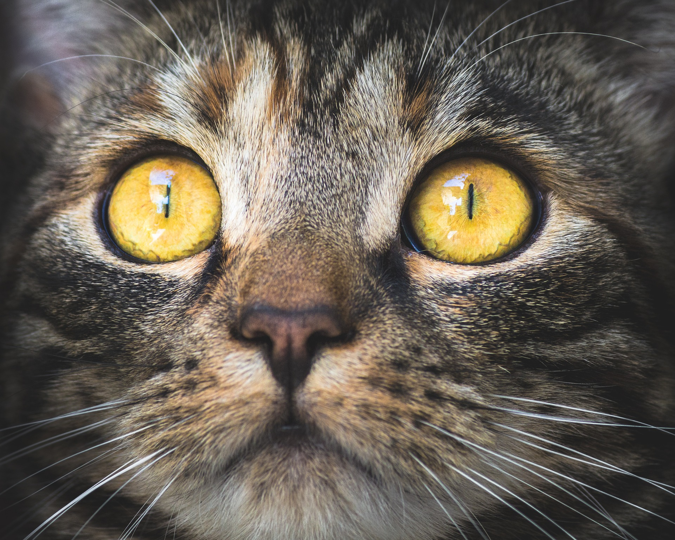

BASIC PRINCIPLES
3. You cannot circumvent a Technological Protection Measure (TPM) to use the content.
41.1 (1)
Screen capture can be considered picking a digital lock.
Notes:
Thirdly, and related to the last point, you can’t pick a digital lock, or in more legal terms circumvent a technological protection measures, and use the content. [1] [2] Under section 41 of the Copyright Act, regardless of the purpose (and with only a few very minor exceptions), if you circumvent a technological protection measure or pick a digital lock, you may be infringing copyright. For example if Sandy wanted to copy a scene out of their favourite Hollywood movie and paste it into a movie they were making with makerspace equipment, then they would likely have to circumvent a technological protection measure. While a scene from a movie playing on a computer could easily be screen captured, this could be considered a circumvention of either the content scrambling system that prevents copying of contents on DVDs or Blu Rays, or download restrictions placed on video streaming services like Netflix and YouTube.

Slide 10
BASIC PRINCIPLES
4. Three key sections of the Copyright Act that apply to makerspace activities:
Fair dealing (s. 29)
Non-commercial user-generated content (s.29.21)
Format shifting exception (s.29.22)
(s. 29)
Notes:
Another basic principle to keep in mind is that there are three key sections of the Copyright Act that often apply to makerspace activities – fair dealing, non-commercial user generated content, and the format shifting exception, all found in section 29 of the Copyright Act.

Slide 11
REVIEW
Basic principles to keep in mind:
Is this for personal use or commercial purposes?
2. Are you incorporating third-party content?
3. You cannot circumvent a technological protection to use the content.
4. Three key sections of the Copyright Act that apply to makerspaces:
Fair dealing
Non-commercial user-generated content
Format shifting exception
Notes:
With these basic principles and copyright exceptions in mind, let’s see where Sandy might run into copyright concerns and how these can be resolved. But remember, the following serves only as a guide for general considerations – the specific context in each case will have to be examined.

Slide 12
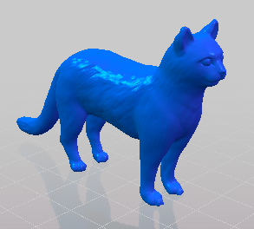
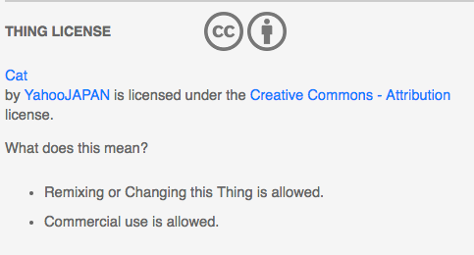
3D PRINTING
Notes:
Sandy likes creating new miniature models, and thankfully, 3D printing is a common makerspace technology.[1] Sandy tends to print things they either create themselves using CAD software, or from designs found on common 3D printing sites like Thingiverse. Sandy usually finds that designs on Thingiverse are often covered by an open licence. Most of Sandy’s makerspace activities are fairly benign from a copyright perspective. However, they should be careful when printing 50 or more copies of a design on a 3D printer, as it may implicate industrial design protection.

Slide 13
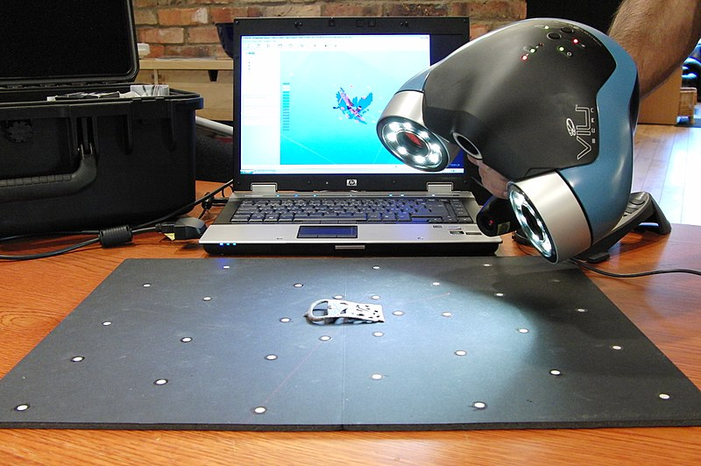
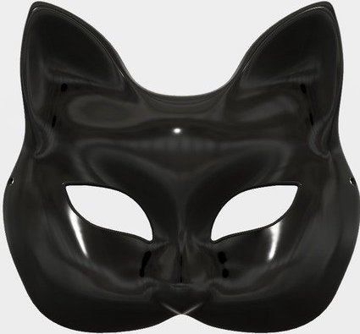
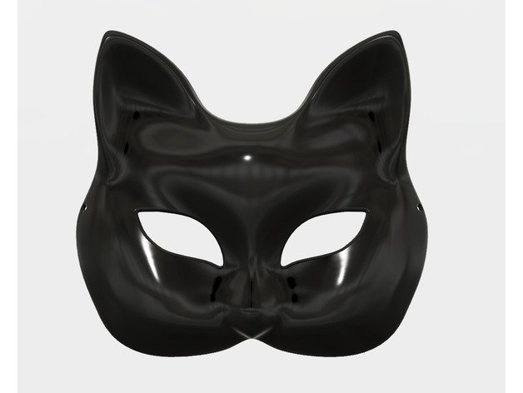
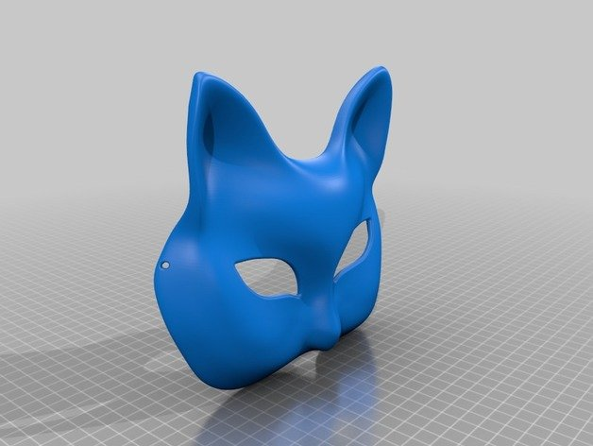
3D SCANNING
Scan
Print
©
Notes:
While 3D printing is generally straightforward, copyright issues related to 3D scanning can be much more challenging. If Sandy wants to use a 3D scanner in conjunction with a 3D printer to scan and then print something just to avoid buying it, then the 3D scanning process may be more likely to infringe copyright, depending on the object being scanned.

Slide 14
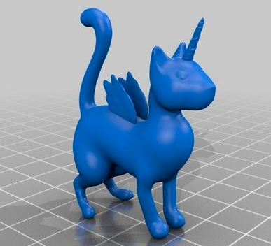
3D SCANNING AND PRINTING
Notes:
However, if Sandy wants to scan one of their old models they created to improve it, then that is fine.

Slide 15

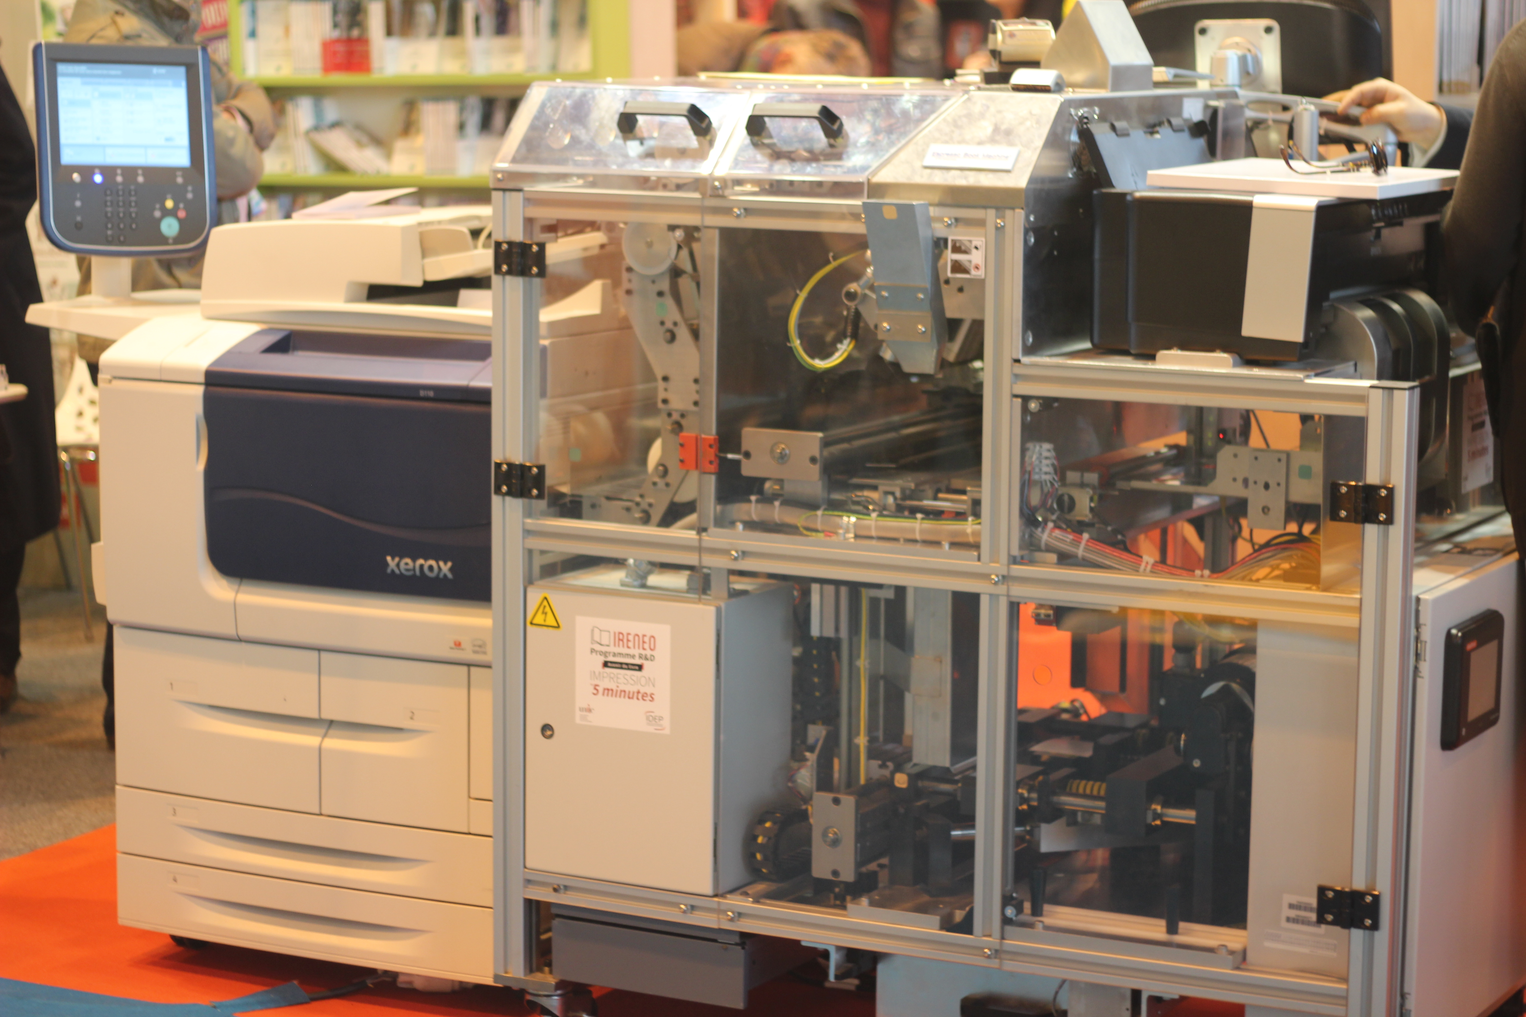
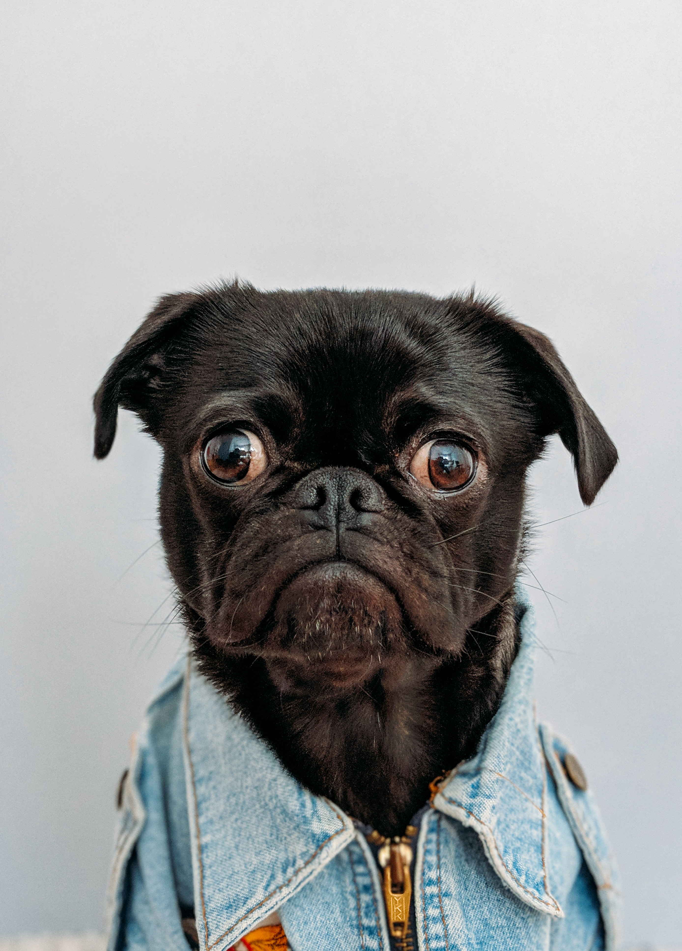


BOOK PRINTING
Sandy Jones
Being Sandy
I ❤ Dogs
Harry Potter
↑ not for commercial purposes
Notes:
It’s not just miniature models that Sandy needs the makerspace for, Sandy is also an author. Fortunately, book printing machines are another common makerspace technology. If Sandy wants to print books they wrote and own the rights for, of course there are no concerns. But if they want to print books still covered by copyright, or incorporate copyright protected material such as images, then it is important to consider how exceptions like fair dealing and non commercial user-generated content may apply. Assuming the book is not for commercial purposes, the user generated content exception should provide a fair bit of room for Sandy to remix and incorporate other’s copyright protected material.

Slide 16

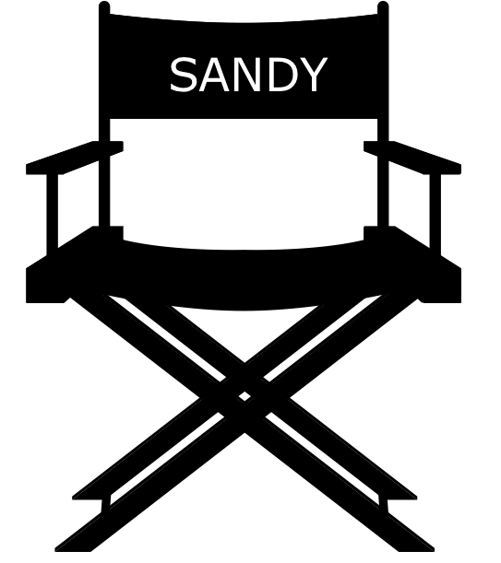
FILM
I was pretty cute.
‘89 - BABY SANDY
Notes:
Author, modeler, did we mention that Sandy is also a film aficionado? Again, Sandy can rely on the makerspace for access to digital conversion tools. As with book printing and 3D printing, if Sandy is simply interested in converting their own content, in this case old family movies, then copyright concerns are unlikely to arise.

Slide 17
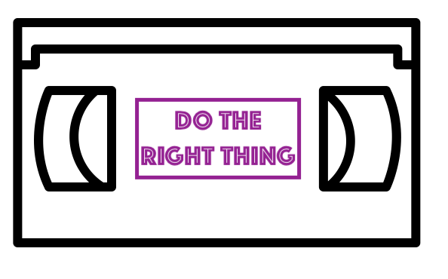
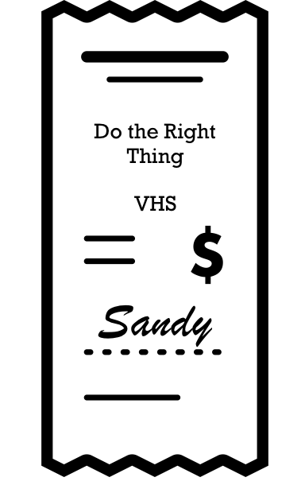
FILM
What? I just love that movie!
Do The Right Thing
s. 29.22
↑ for private use
Notes:
But what if Sandy comes in and wants to convert their favourite VHS copy of Do the Right Thing to DVD? While this may seem like a prima facie case of infringement that Sandy should avoid, under section 29.22 of the Copyright Act, Sandy can shift media across formats, subject to a number of conditions, including that they original was legally obtained, no digital locks are circumvented, the reproduction is not given away, and that it is done solely for private purposes. While it is a long list of conditions, Sandy meets them all, so no concerns.

Slide 18
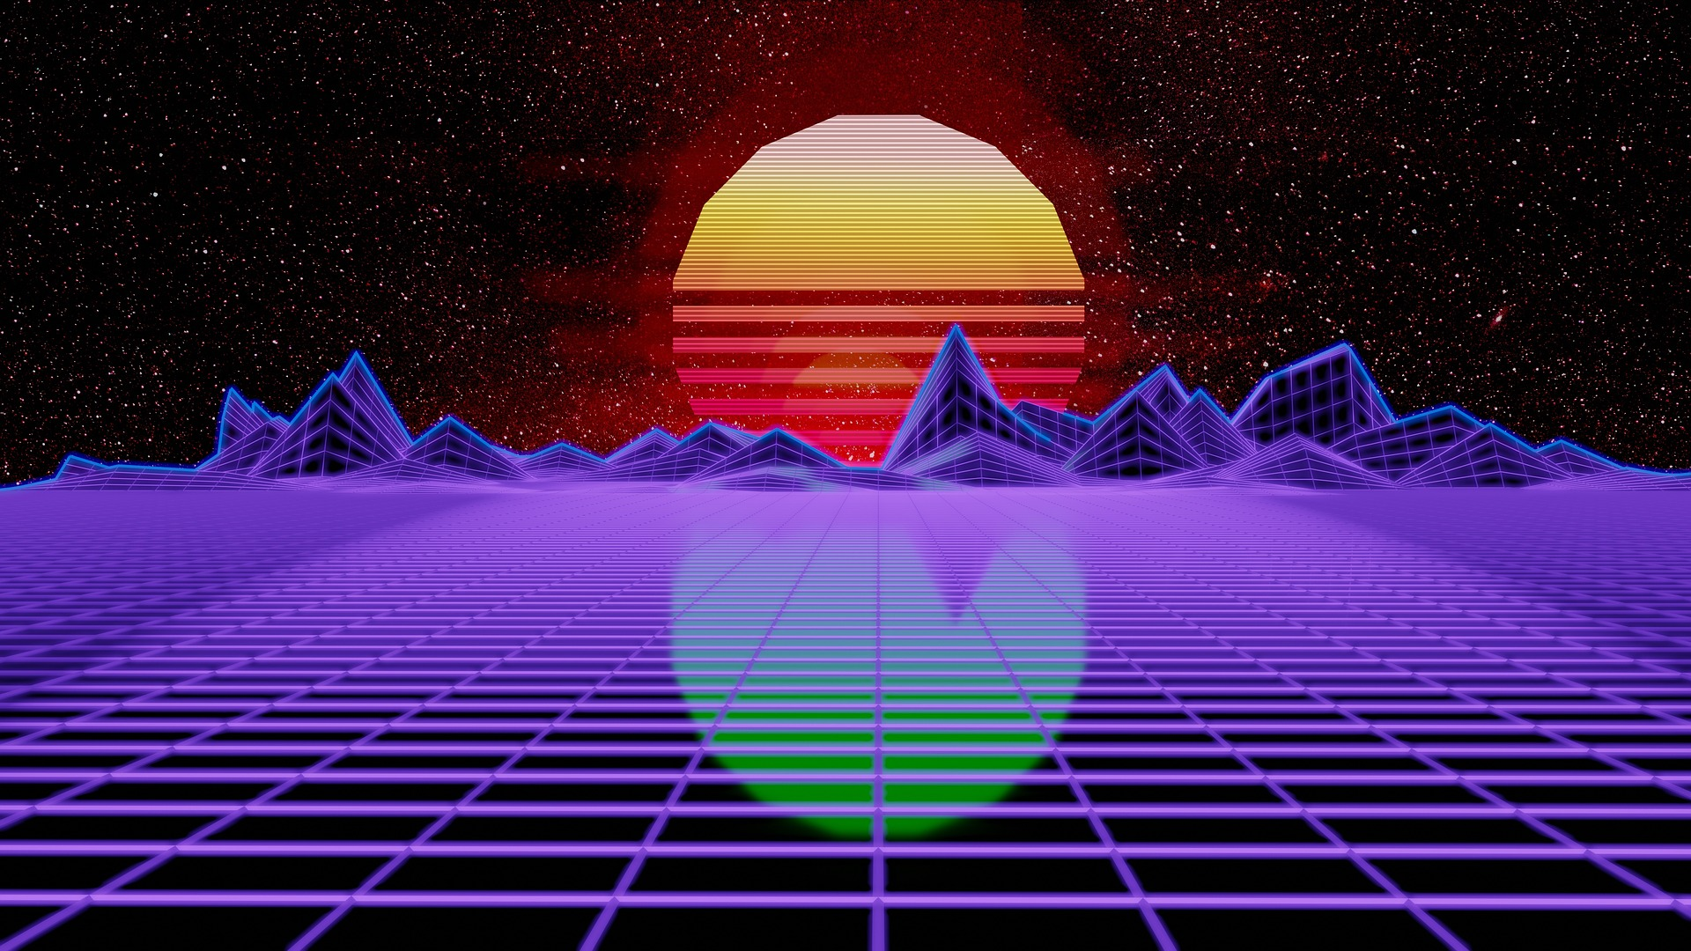


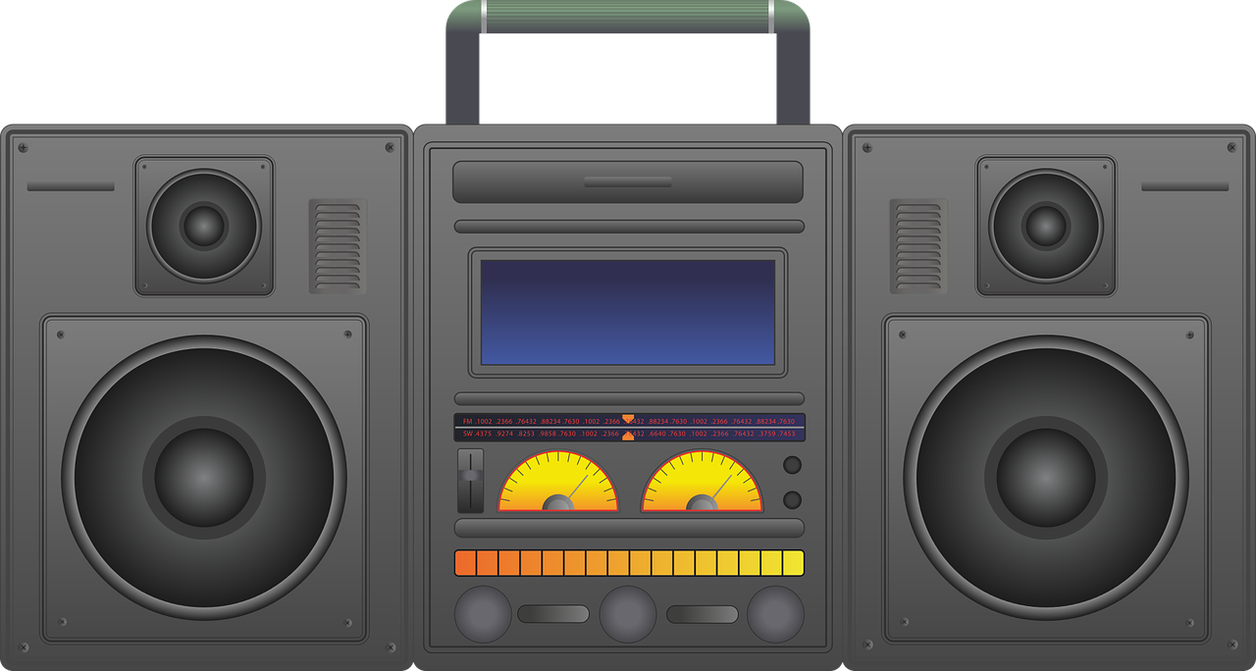

FILMMAKING
YA’LL CAN’T COPYRIGHT NO BEAT!
✓
?
s.29
Notes:
Sandy’s creativity is boiling over with all they can do in the makerspace, inspiring them to explore filmmaking more seriously. For this, Sandy will need to use the digital creation spaces within makerspaces, which can include sound booths and green screens. Again, a fair bit of what occurs here with third party content will be covered by fair dealing and non-commercial user generated content.
What if Sandy wanted to use the makerspace to convert their old home videos into a brand new musical using some classic Public Enemy beats and load it up to YouTube? The non-commercial user generated content exception was designed to support just this type of creation, provided that Sandy isn’t planning on generating revenue from the YouTube channel. One thing to note though, is that while Canadian copyright law may allow this, YouTube’s own copyright detection algorithms may not.

Slide 19

NON-CANADIAN CONTEXTS
Copyright Act provisions, such as the User-generated Content exception, may not apply in non-Canadian contexts.
29.21 (1)
Notes:
The final point is worth re-emphasizing. There are a number of flexible provisions in the Canadian Copyright Act, particularly the user-generated content exception, that do not apply in non-Canadian contexts, and may not be recognized by the United States or other content intermediaries.

Slide 20
BEING SANDY
❤️
Notes:
Overall, though, betwixt Sandy’s creativity, the makerspace’s tools and technology, and some flexible provisions in the Copyright Act, Sandy can be just as creative as when they were three.

Slide 21
LEARNING OBJECTIVES
You should now be able to:
Identify the four important considerations for dealing with copyright concerns in makerspaces
Understand the relevance of the non-commercial user-generated content exception to makerspace activity
Describe the limitations on creative activity in makerspaces imposed by digital locks (anti-circumvention protection for Technological Protection Measures)
Notes:
You should now be able to:
Identify the four important considerations for dealing with copyright concerns in makerspaces
Understand the relevance of the non-commercial user-generated content exception to makerspace activity
Describe the limitations on creative activity in makerspaces imposed by digital locks (anti-circumvention protection for Technological Protection Measures)

Slide 22

THANK YOU FOR YOUR ATTENTION
Notes:
This has been the University of Alberta’s Opening Up Copyright Module on Makerspaces and Copyright. Thank you for your attention.

Slide 23
QUESTIONS
Which of the following is not a question you should ask yourself when using makerspaces:
  Is this for personal use or commercial purposes?
  Am I incorporating third-party content?
  What is the best way to pick a digital lock?
  Is this covered under fair dealing?
According to the format-shifting exception in the Copyright Act you can convert media to a different format if:
  You obtained the original legally, it is for personal use, and you circumvented a technological protection measure
  You are making a copy for a friend, you obtained the original legally, you did not pick a digital lock
  You obtained the original legally, it is for personal use, you did not circumvent a technological protection measure
  You love this movie, selling copies of it could be your new side-hustle, and you screen captured it (the perfect crime)

Slide 24
QUESTIONS
Printing this many copies of an item using a 3D printer may implicate industrial design protection:
  25 or more
  50 or more
  100 or more
  10 or more
You likely have reasonable grounds for believing the source material you want to use is not infringing copyright if:
  You found it with a Google images search
  It is labeled for reuse on the rights holder’s website
  You got it off a DVD you picked out of the garbage
  You couldn’t find a licence anywhere

Slide 25
QUESTIONS
The user-generated content exception applies to every country in the world.
  True
  False
Content Scrambling Systems that prevent copying of contents on DVDs or Blu Rays and download restrictions placed on video streaming services like Netflix are examples of technological protection measures.
  True
  False
Which of the following are requirements of the non-commercial user-generated content exception:
  Non-commercial use and reasonable grounds that the source material you are using does not infringe copyright
  You did not pick a digital lock and you intend to make money from this
  It is solely for the purpose of education or private study
  Non-commercial use and you are making more than 50 copies

Slide 26
IMAGE AND SOUND REFERENCES
Image Credits (in order of appearance):
Free Clip Art. (n.d.). Meditating Cartoon Kid. [Baby Sandy] https://commons.wikimedia.org/wiki/File:Meditating_Cartoon_Kid.svg
Rainbow Art. (n.d.). https://pixabay.com/illustrations/pink-splash-lines-paint-decor-1219285/
Pan. (n.d.). https://pixabay.com/vectors/cooking-education-kitchen-pan-1300674/
Crock pot. (n.d.). https://www.goodfreephotos.com/vector-images/crock-pot-vector-clipart.png.php
Karen Arnold. (n.d.). [crayons]. https://www.publicdomainpictures.net/en/view-image.php?image=37304&picture=colorful-crayons-clipart
StockSnap. (n.d.). [robot]. https://pixabay.com/photos/danbo-sad-art-box-cardboard-robot-2601848/
Aaron. (n.d.). Lego mind storms robot guarding the #epl Makerspace Attribution 2.0 Generic (CC BY 2.0). https://www.flickr.com/photos/egoant/11424074956/in/photolist-vQy5zH-rTMNKu-rTMNU7-kmZ6xk-kn1dDy-kmYLN6-kn1c5S-kmYNMX-ipvntA-i5TLyU-rBmaH7
Mack male. (n.d.). [EPL Makerspace]. https://www.flickr.com/photos/mastermaq/18962871653
Williams College. (n.d.). Makerspace 3D Printing. https://www.flickr.com/photos/williamscollege/16385633137/in/photolist-qXWDSa-rfnDWR-rfe3G4-rfe3hg-qimKEW-qXNN1d-qiyPo2-qXNLVh-qXMH3h-rd5ei9-qiyMun-qXMFTJ-rfdYaP-raH2Mx-r7Y7c3-qQArGc-qQArED-r849dR-r5KVrq-r5mhiZ-qMe1vE-q7hA8J-dQA47c-r3cZyD-r38d3d-qZUTsN-qKDty3-q6cra9-qKDtxS-qKMc5n-q6pZCF-r38cNA-r33Ypi-qKDti3-qKKojT-r33Ymn-rfnyWk-rfdXDt-qSSDPV-qR8YGz-qbybDo-qR8Yjv-qbybid-r79wbw-r5qnrC-r4juHH-qLBpQB-r3XeQW-qZUTss-r33YDg
Andrey Vasiliev. (n.d.). Film Projector. The Noun Project. CC BY. https://thenounproject.com/term/film-projector/336166
Fahmionline. (n.d.). Book. The Noun Project. CC BY. https://thenounproject.com/search/?q=book&i=1299354
Corpus delicti. (n.d.). Cat. The Noun Project. CC BY. https://thenounproject.com/search/?q=cat&i=564461

Slide 27
IMAGE AND SOUND REFERENCES
Image Credits Cont. (in order of appearance):
Iconeu. (n.d.). Snow. The Noun Project. CC BY. https://thenounproject.com/iconeu/uploads/?i=731799
Dheming. Ice Crack. (n.d.). https://freesound.org/people/dheming/sounds/268023/
Locad. (n.d.). Beanie. The Noun Project. CC BY. https://thenounproject.com/search/?q=beanie&i=1179357
James Christopher. (n.d). Patent. The Noun Project. CC BY. https://thenounproject.com/icon/4467
Effach. (n.d.) Sode Bottle. The Noun Project. CC BY. https://thenounproject.com/icon/715021
parkjisun. (n.d). Goblin. The Noun Project. CC BY. https://thenounproject.com/icon/1005005
Kero. (n.d.). Caution. The Noun Project. CC BY. https://thenounproject.com/search/?q=caution&i=674137
Shastry. (n.d.) DVD. The Noun Project. CC BY. https://thenounproject.com/term/dvd/2163746
Adrian Coquet. (n.d.) Unlock. The Noun Project. CC BY. https://thenounproject.com/term/unlock/1862800
Yi Chen. (n.d.). Film.The Noun Project. CC BY. https://thenounproject.com/search/?q=film&i=60788
KatinkavomWolfenmond. (n.d.). Cat. https://pixabay.com/photos/cat-portrait-animal-pet-3374422/
Yonaldi. (n.d.). Computer. The Noun Project. CC BY. https://thenounproject.com/search/?q=computer&i=2281016
yahoo Japan. (n.d.). Cat. https://www.thingiverse.com/thing:182091/files
Creative Tools. (n.d.). [3D Scanner]. https://commons.wikimedia.org/wiki/File:VIUscan_handheld_3D_scanner_in_use.jpg
Windjunkie. (n.d.). Cat mask. https://www.thingiverse.com/thing:2618474
MakerMace. (n.d.). Caticorn (Test Model). https://www.thingiverse.com/thing:2617362

Slide 28
IMAGE AND SOUND REFERENCES
Image Credits Cont. (in order of appearance):
Nikita Kozin. (n.d.). Starfish. The Noun Project. CC BY. https://thenounproject.com/search/?q=star%20fish&i=1178199
Laymik. (n.d.). Sea shell. The Noun Project. CC BY. https://thenounproject.com/search/?q=sea%20shell&i=1078155
ActuaLitté - Xerox PUF, impression à la demande - Salon du Livre de Paris 2015. [Book printing]. CC BY-SA 2.0. https://commons.wikimedia.org/w/index.php?curid=39239340
charlesdeluvio. (2018). Black dog wearing blue denim collar. https://unsplash.com/photos/black-dog-wearing-blue-denim-collar-K4mSJ7kc0As
Vitor Gurgel Siqueira. (n.d.). Directors Chair. The Noun Project. CC BY. https://thenounproject.com/search/?q=directors%20chair&i=18550
Kristin Poncek. (n.d.). VHS Tape. The Noun Project. CC BY. https://thenounproject.com/search/?q=VHS&i=482433
Lil Squid. (n.d.). Receipt. The Noun Project. CC BY. https://thenounproject.com/search/?q=receipt&i=149995
Requasar. (n.d.). [boombox]. https://pixabay.com/illustrations/boombox-ghetto-blaster-audio-player-2138198/
Iwybr. (n.d.). [80s wallpaper]. https://pixabay.com/illustrations/synthwave-retrowave-synth-3941721/
Alexandr Cherkinsky. (n.d.). Sunglasses. The Noun Project. CC BY. https://thenounproject.com/search/?q=sunglasses&i=212418
Dbenbenn. (2008). Flag image of the United States. Wikimedia Commons. Public Domain. https://commons.wikimedia.org/w/index.php?curid=318418
Closing Slides Music: Rybak, Nazar. (n.d.). Corporate Inspired. HookSounds. CC BY. http://www.hooksounds.com/

Slide 29
LICENSING AND ATTRIBUTION
Suggested Citation:
University of Alberta. (2019). Makerspaces and Copyright. Opening Up Copyright Instructional Module. https://sites.library.ualberta.ca/copyright/
For the project overview and complete list of modules please visit the project website at: https://sites.library.ualberta.ca/copyright/
Questions, comments, and suggestions should be directed to the University of Alberta’s Copyright Office at: copyright@ualberta.ca
This module is made available and licensed under a Creative Commons Attribution 4.0 International Licence

Slide 30
CONTRIBUTORS
Copyright Office
Centre for Teaching and Learning
Technologies in Education
Adrian Sheppard
Amanda Wakaruk
Cosette Lemelin
Graeme Pate
Krysta McNutt
Anwen Burk
University of Alberta Libraries
School of Library and Information Studies
Michelle Brailey
Toby Grant
Julia Guy
Kris Joseph
Michael B. McNally

Slide 31

ACKNOWLEDGEMENT
Opening Up Copyright modules were initially funded through the University of Alberta, Centre for Teaching and Learning’s Teaching and Learning Enhancement Fund (TLEF) with in kind contributions from the Copyright Office and the School of Library and Information Studies.

