Slide 1
MAKERSPACES AND COPYRIGHT
April 2019

Slide 2
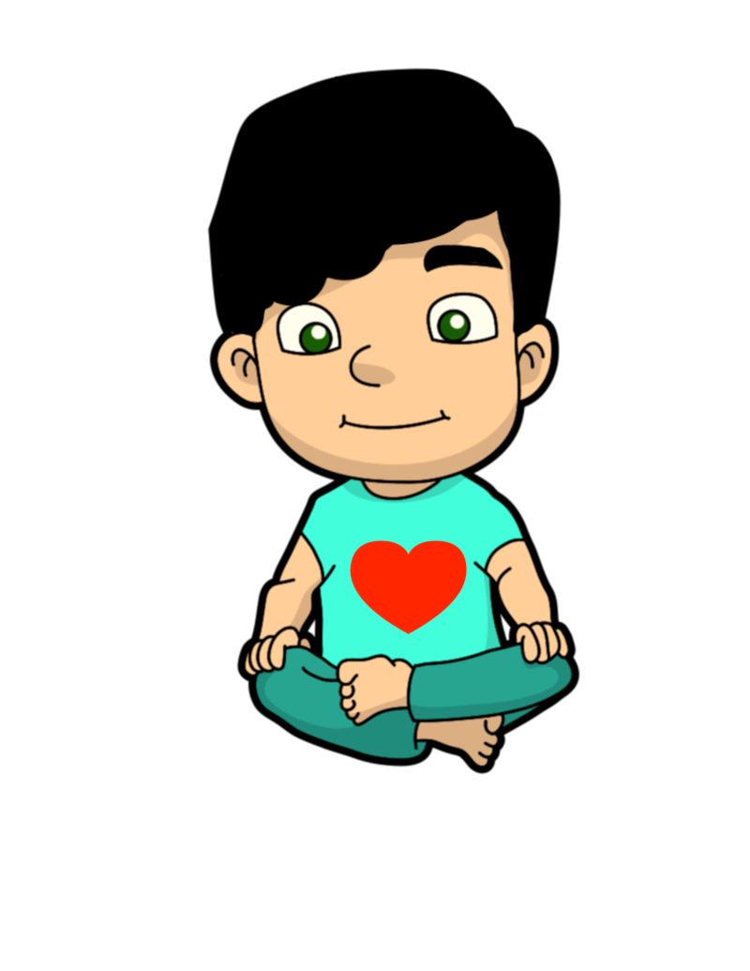
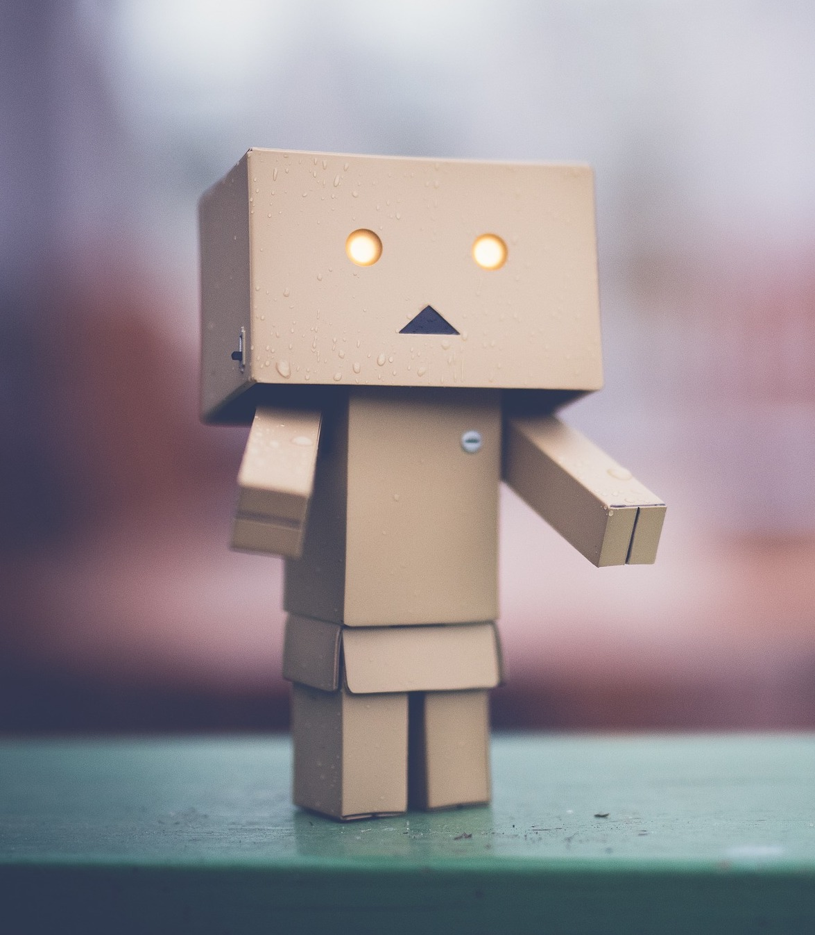
MEET SANDY

Slide 3
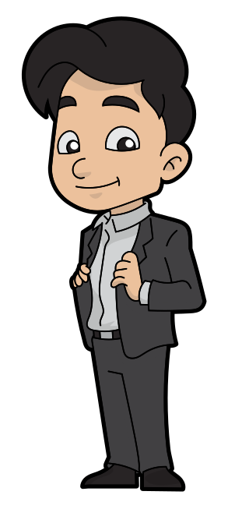
SANDY GROWED UP

Slide 4
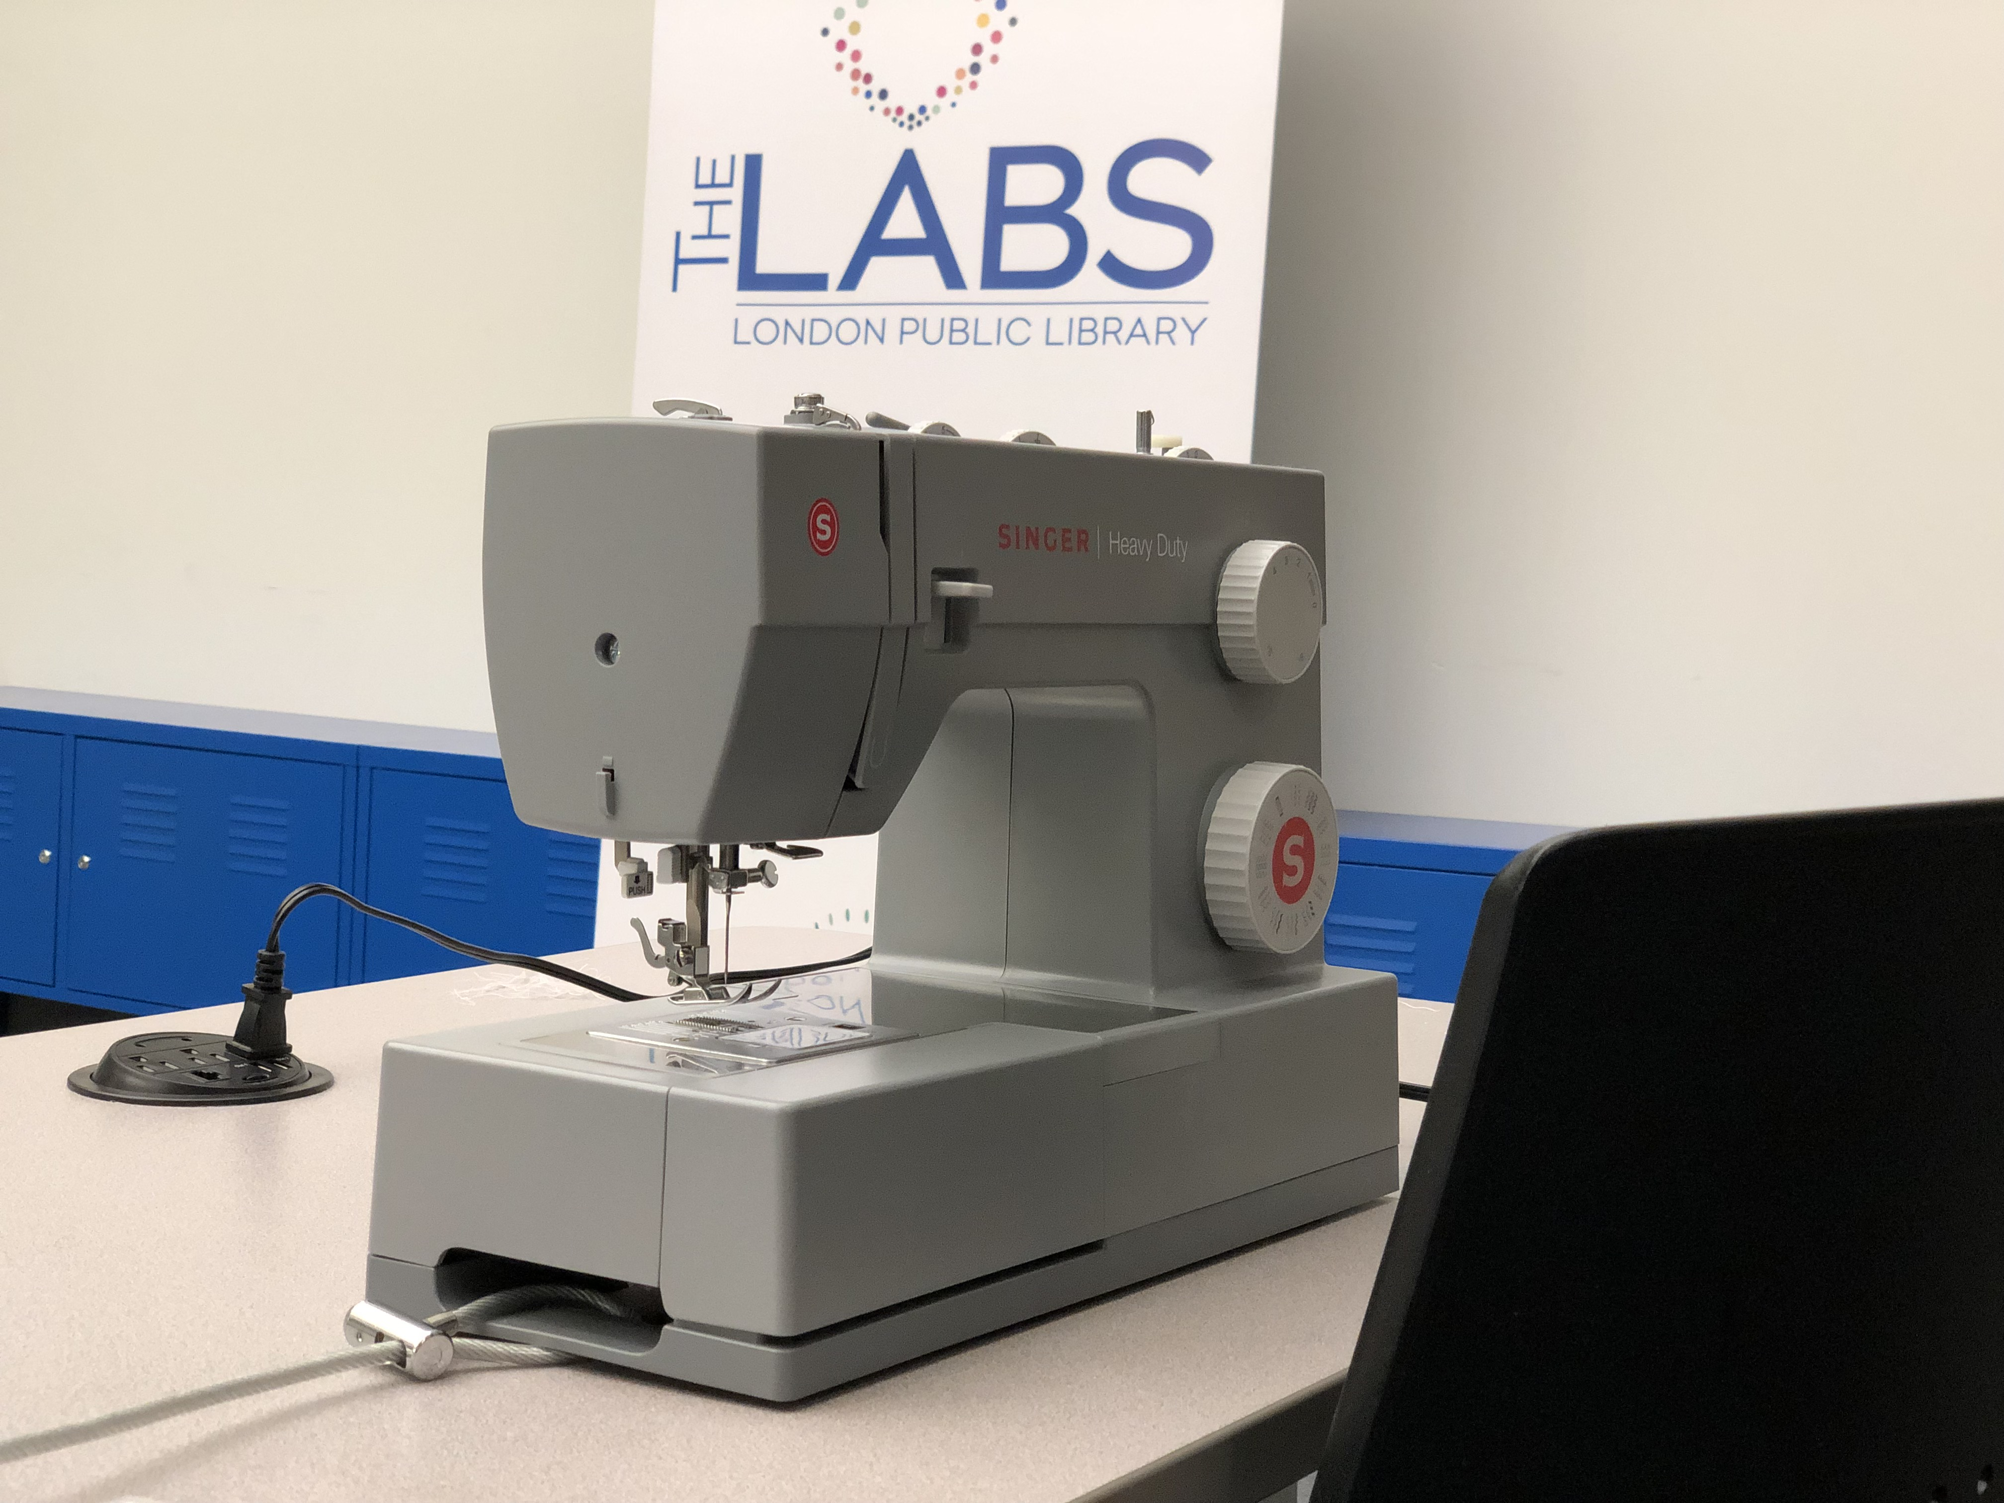
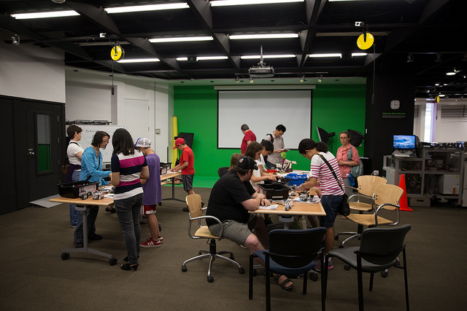
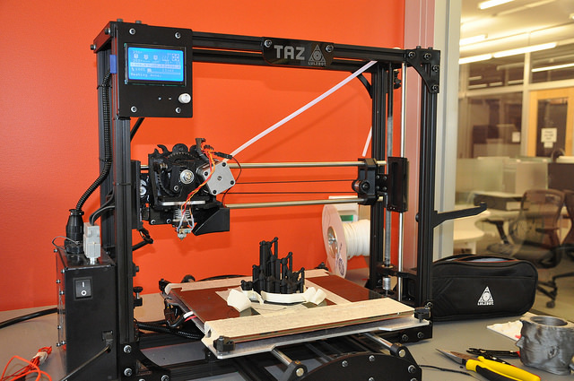
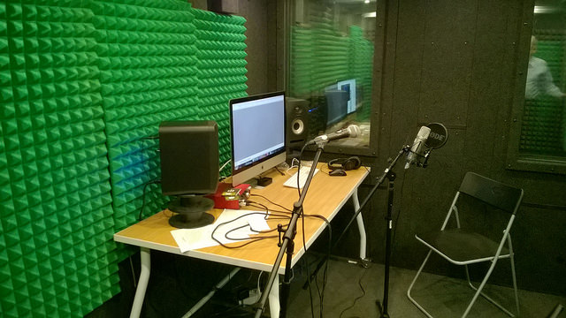
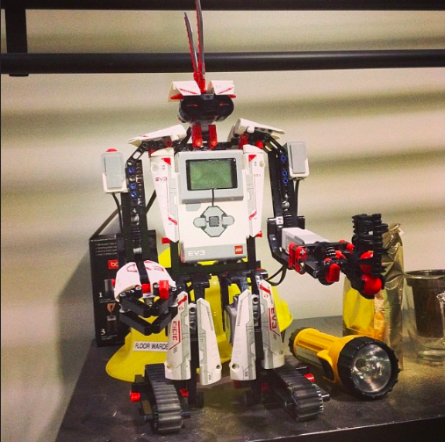
MAKERSPACES

Slide 5
MAKERSPACES
©
©
©
©
©
©

Slide 6
MAKERSPACES
…

Slide 7
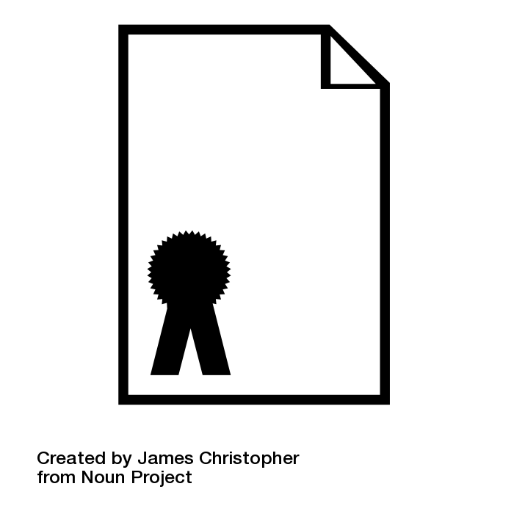
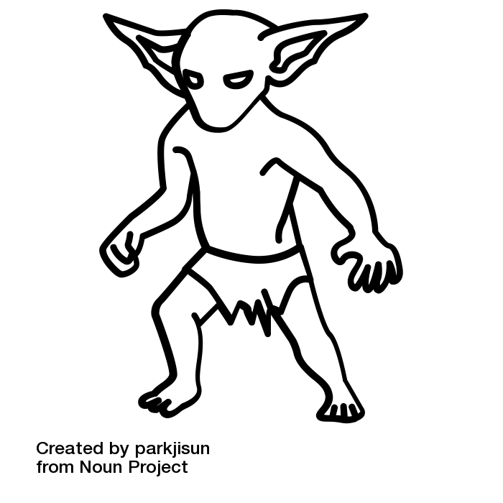
BASIC PRINCIPLES
BASIC PRINCIPLES
Is this for personal use or commercial purposes?
TM
Personal use
$$≠$$
No issues
Industrial Design
Patent

Slide 8
BASIC PRINCIPLES
2. Are you incorporating third-party content?
Non-commercial user-generated content exception requirements:
No commercial use
Reasonable grounds to believe source material you use does not infringe copyright
What constitutes reasonable grounds?
Content provided directly from the copyright holder
Content purchased or licensed from the copyright holder
s.29.21 (1)

Slide 9
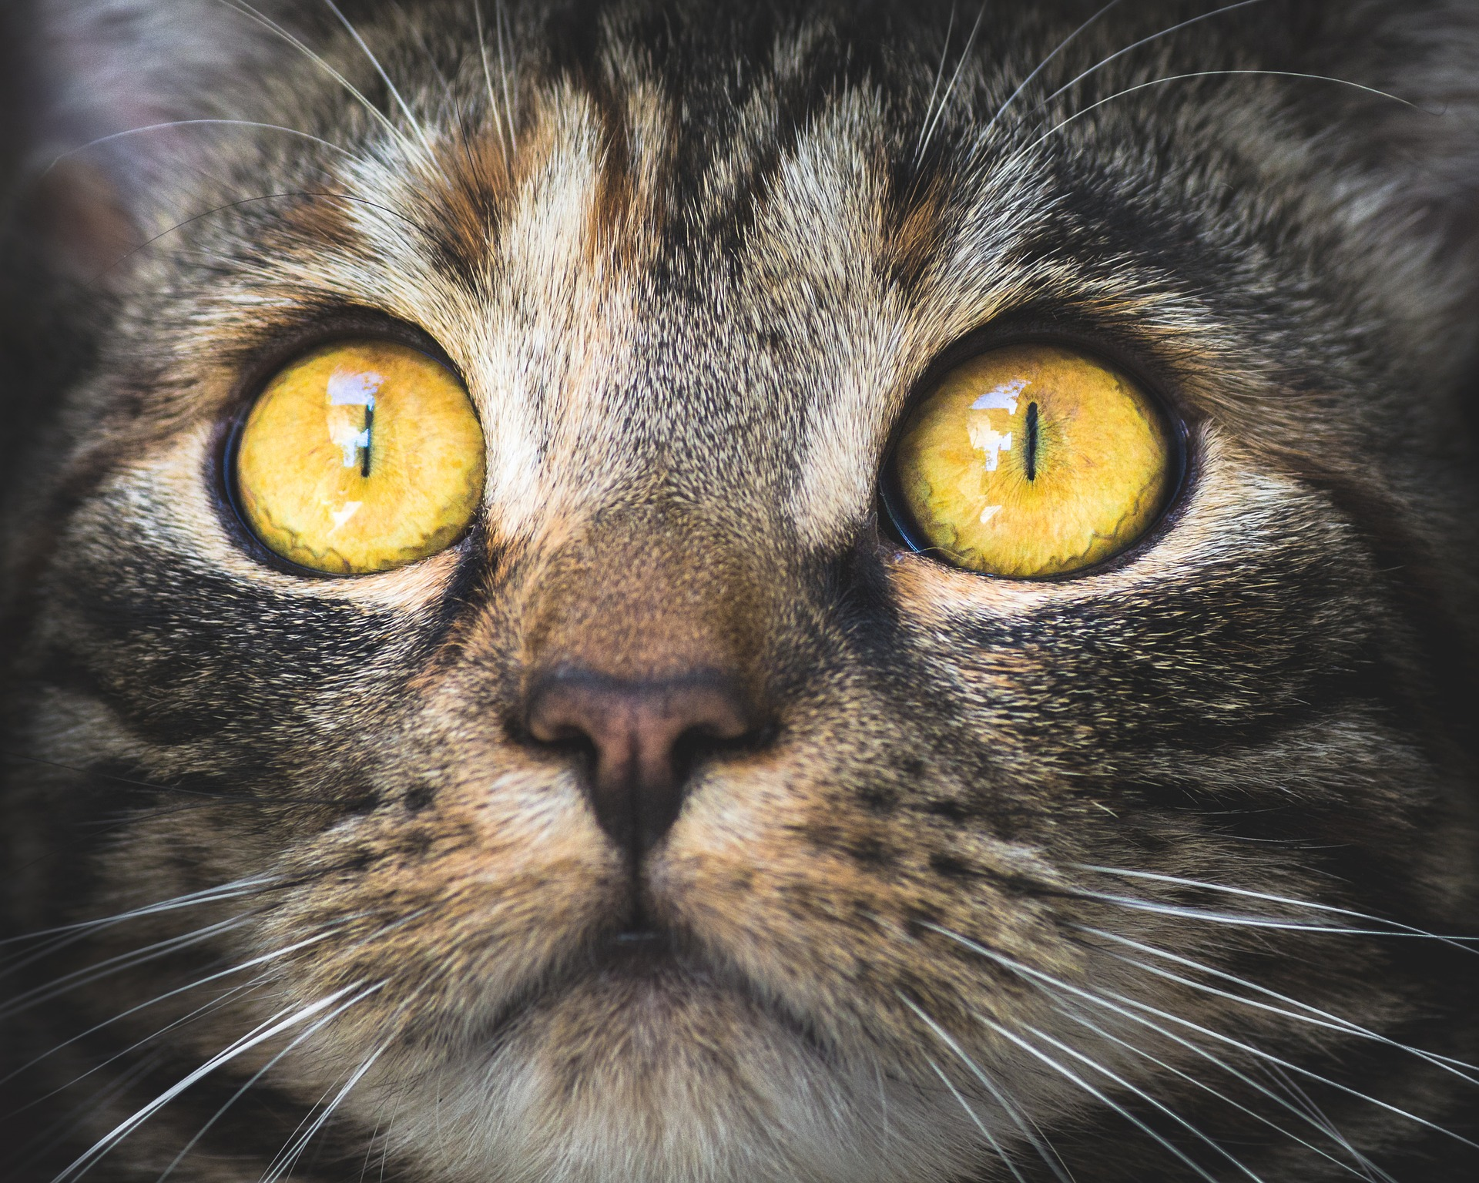
BASIC PRINCIPLES
3. You cannot circumvent a Technological Protection Measure (TPM) to use the content.
41.1 (1)
Screen capture can be considered picking a digital lock.

Slide 10
BASIC PRINCIPLES
4. Three key sections of the Copyright Act that apply to makerspace activities:
Fair dealing (s. 29)
Non-commercial user-generated content (s.29.21)
Format shifting exception (s.29.22)
(s. 29)

Slide 11
REVIEW
Basic principles to keep in mind:
Is this for personal use or commercial purposes?
2. Are you incorporating third-party content?
3. You cannot circumvent a technological protection to use the content.
4. Three key sections of the Copyright Act that apply to makerspaces:
Fair dealing
Non-commercial user-generated content
Format shifting exception

Slide 12
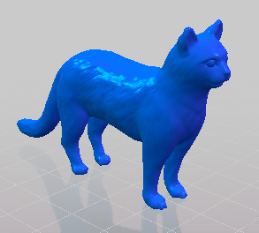
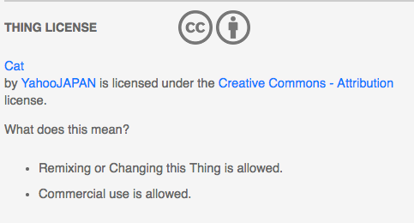
3D PRINTING

Slide 13
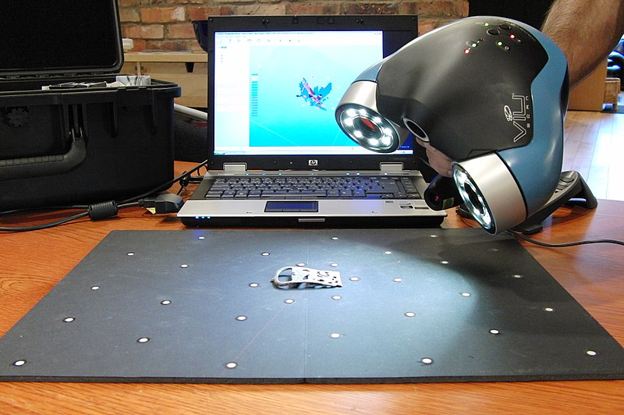
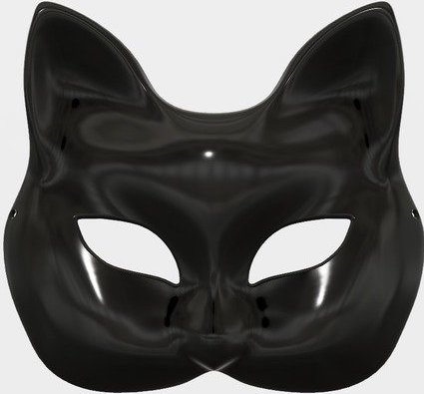
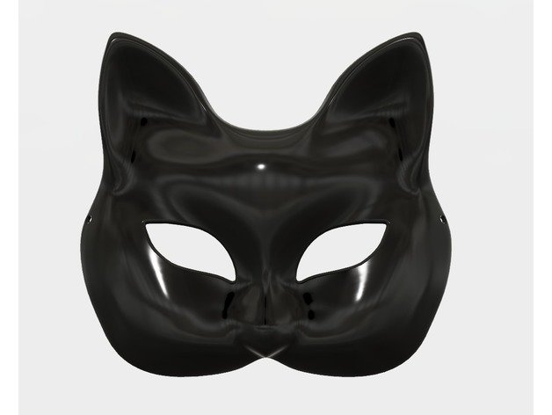
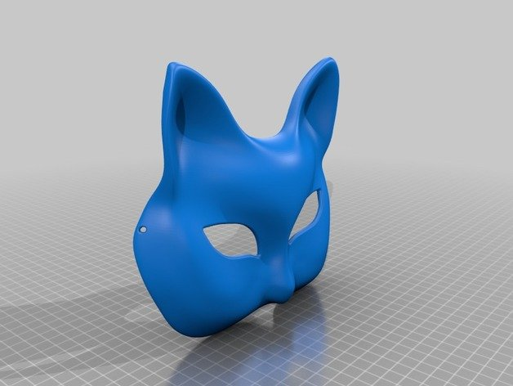
3D SCANNING
Scan
Print
©

Slide 14
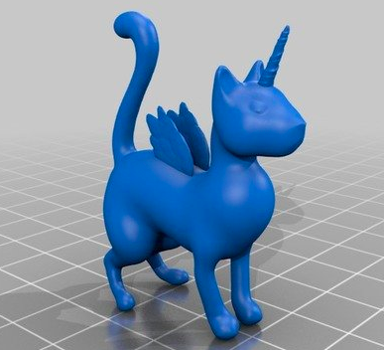
3D SCANNING AND PRINTING

Slide 15
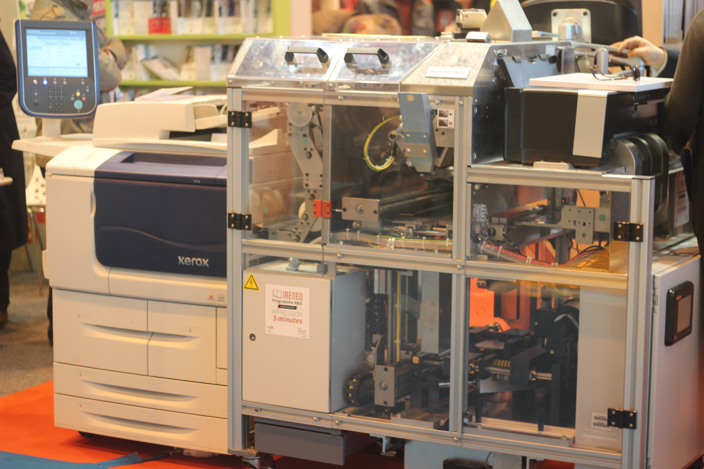
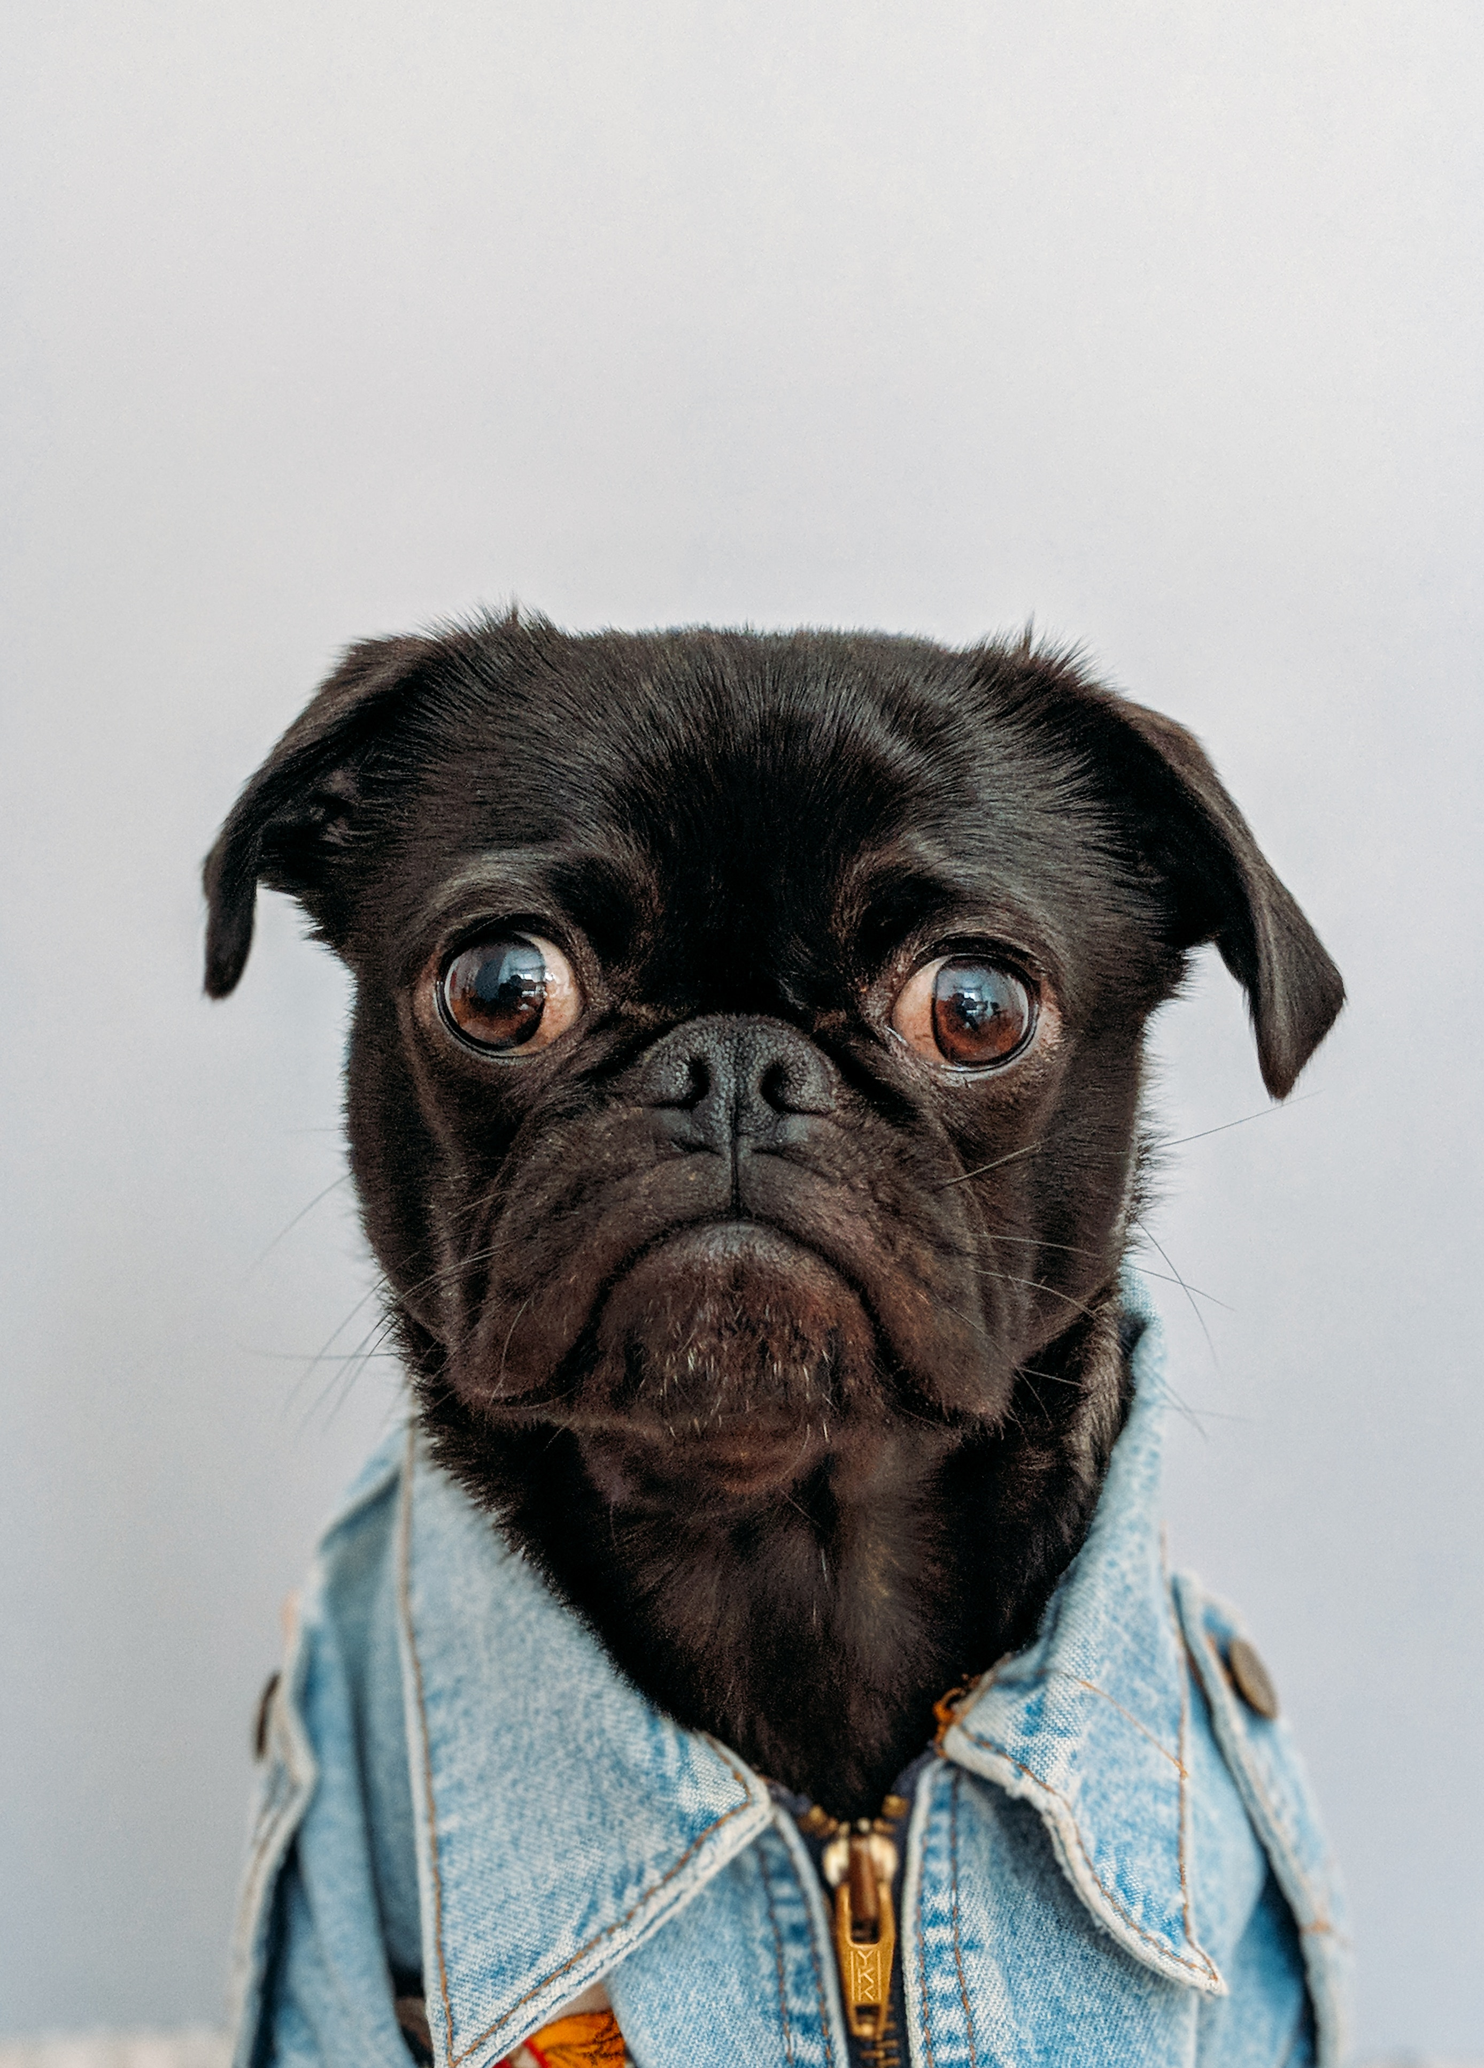
BOOK PRINTING
Sandy Jones
Being Sandy
I ❤️ Dogs
Harry Potter
↑ not for commercial purposes

Slide 16
FILM
I was pretty cute.
‘89 - BABY SANDY

Slide 17
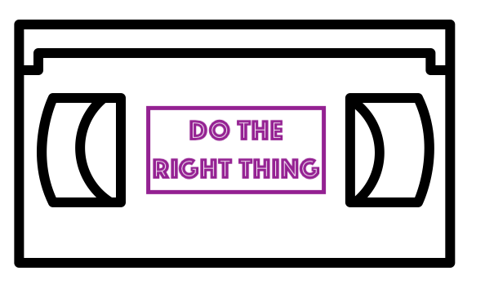
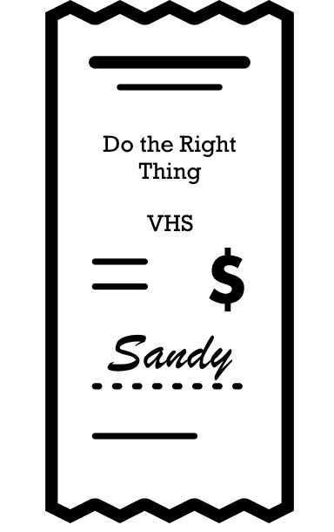
FILM
What? I just love that movie!
Do The Right Thing
s. 29.22
↑ for private use

Slide 18
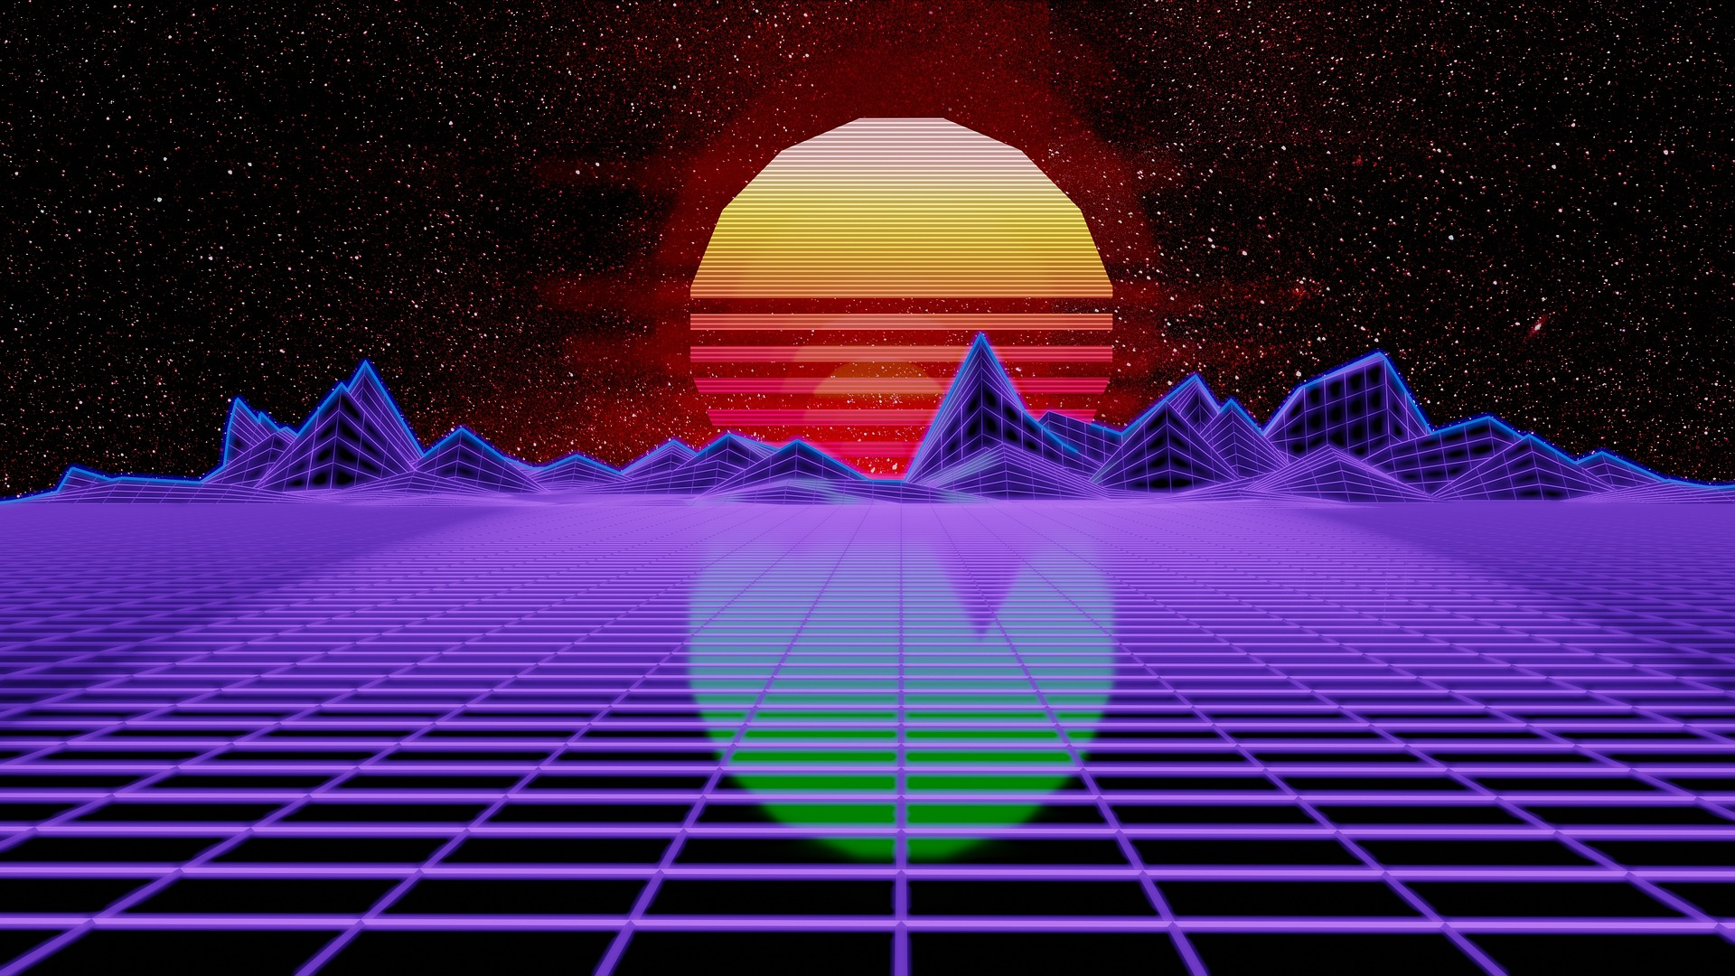
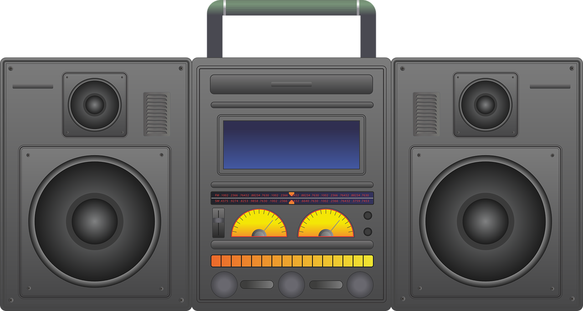
FILMMAKING
YA’LL CAN’T COPYRIGHT NO BEAT!
✓
?
s.29

Slide 19
NON-CANADIAN CONTEXTS
Copyright Act provisions, such as the User-generated Content exception, may not apply in non-Canadian contexts.
29.21 (1)

Slide 20
BEING SANDY
❤️

Slide 21
LEARNING OBJECTVES
You should now be able to:
Identify the four important considerations for dealing with copyright concerns in makerspaces
Understand the relevance of the non-commercial user-generated content exception to makerspace activity
Describe the limitations on creative activity in makerspaces imposed by digital locks (anti-circumvention protection for Technological Protection Measures)

Slide 22
THANK YOU FOR YOUR ATTENTION
Notes:
34. This has been the University of Alberta’s Opening Up Copyright Module on SOCAN v. Bell. Thank you for your attention. [C]

Slide 23
QUESTIONS
1. Which of the following is not a question you should ask yourself when using makerspaces:
a. Is this for personal use or commercial purposes?
b. Am I incorporating third-party content?
c. What is the best way pick a digital lock?
d. Is this covered under fair dealing?
2. According to the format-shifting exception in the Copyright Act you can convert media to a different format if:
a. You obtained the original legally, it is for personal use, and you circumvented a technological protection measure
b. You are making a copy for a friend, you obtained the original legally, you did not pick a digital lock
c. You obtained the original legally, it is for personal use, you did not circumvent a technological protection measure
d. You love this movie, selling copies of it could be your new side-hustle, and you screen captured it (the perfect crime)

Slide 24
QUESTIONS
3. Printing this many copies of an item using a 3D printer may implicate industrial design protection:
a.25 or more
b. 50 or more
c. 100 or more
d. 10 or more
4. You likely have reasonable grounds for believing the source material you want to use is not infringing copyright if:
a. You found it with a Google images search
b. It is labeled for reuse on the rights holder’s website
c. You got it off a DVD you picked out of the garbage
d. You couldn’t find a licence anywhere

Slide 25
QUESTIONS
5. The user-generated content exception applies to every country in the world. True or False.
6. Content Scrambling System that prevents copying of contents on DVDs or Blu Rays and download restrictions placed on video streaming services like Netflix are examples of technological protection measures. True or False.
7. Which of the following are requirements of the non-commercial user-generated content exception:
a. Non-commercial use and reasonable grounds that the source material you are using does not infringe copyright
b. You did not pick a digital lock and you intend to make money from this
c. It is solely for the purpose of education or private study
d. Non-commercial use and you are making more than 50 copies

Slide 26
IMAGES AND SOUND RECORDINGS
Images Credits (in order of appearance):
Free Clip Art. (n.d.). Meditating Cartoon Kid.[Baby Sandy] https://commons.wikimedia.org/wiki/File:Meditating_Cartoon_Kid.svg
Rainbow Art (n.d.). https://pixabay.com/illustrations/pink-splash-lines-paint-decor-1219285/
Pan (n.d.) https://pixabay.com/vectors/cooking-education-kitchen-pan-1300674/
Crock pot https://www.goodfreephotos.com/vector-images/crock-pot-vector-clipart.png.php
Karen Arnold. [crayons] https://www.publicdomainpictures.net/en/view-image.php?image=37304&picture=colorful-crayons-clipart
StockSnap [robot] https://pixabay.com/photos/danbo-sad-art-box-cardboard-robot-2601848/
Aaron. (n.d.). Lego mind storms robot guarding the #epl Makerspace Attribution 2.0 Generic (CC BY 2.0) https://www.flickr.com/photos/egoant/11424074956/in/photolist-vQy5zH-rTMNKu-rTMNU7-kmZ6xk-kn1dDy-kmYLN6-kn1c5S-kmYNMX-ipvntA-i5TLyU-rBmaH7
Mack male. (n.d.). [EPL Makerspace] https://www.flickr.com/photos/mastermaq/18962871653
Williams College (n.d.). “Makerspace 3D Printing” https://www.flickr.com/photos/williamscollege/16385633137/in/photolist-qXWDSa-rfnDWR-rfe3G4-rfe3hg-qimKEW-qXNN1d-qiyPo2-qXNLVh-qXMH3h-rd5ei9-qiyMun-qXMFTJ-rfdYaP-raH2Mx-r7Y7c3-qQArGc-qQArED-r849dR-r5KVrq-r5mhiZ-qMe1vE-q7hA8J-dQA47c-r3cZyD-r38d3d-qZUTsN-qKDty3-q6cra9-qKDtxS-qKMc5n-q6pZCF-r38cNA-r33Ypi-qKDti3-qKKojT-r33Ymn-rfnyWk-rfdXDt-qSSDPV-qR8YGz-qbybDo-qR8Yjv-qbybid-r79wbw-r5qnrC-r4juHH-qLBpQB-r3XeQW-qZUTss-r33YDg
Andrey Vasiliev. (n.d.) Film Projector. The Noun Project. CC BY. https://thenounproject.com/term/film-projector/336166
Fahmionline (n.d.). Book. The Noun Project. CC BY. https://thenounproject.com/search/?q=book&i=1299354
Corpus delicti (n.d.). Cat. The Noun Project. CC BY. https://thenounproject.com/search/?q=cat&i=564461

Slide 27
IMAGES AND SOUND RECORDINGS
Images Credits Cont. (in order of appearance):
Iconeu (n.d.). Snow. The Noun Project. CC BY. https://thenounproject.com/iconeu/uploads/?i=731799
Dheming. Ice Crack. https://freesound.org/people/dheming/sounds/268023/
Locad (n.d.). Beanie. The Noun Project. CC BY https://thenounproject.com/search/?q=beanie&i=1179357
James Christopher. (n.d). Patent. The Noun Project. CC BY. https://thenounproject.com/icon/4467
Effach. (n.d.) Sode Bottle. The Noun Project. CC BY. https://thenounproject.com/icon/715021
parkjisun. (n.d). Goblin. The Noun Project. CC BY https://thenounproject.com/icon/1005005
Kero (n.d.). Caution. The Noun Project. CC BY. https://thenounproject.com/search/?q=caution&i=674137
Shastry. (n.d.) DVD. The Noun Project. CC BY. https://thenounproject.com/term/dvd/2163746
Adrian Coquet. (n.d.) Unlock. The Noun Project. CC BY. https://thenounproject.com/term/unlock/1862800
Yi Chen. (n.d.). Film.The Noun Project. CC BY. https://thenounproject.com/search/?q=film&i=60788
KatinkavomWolfenmond. (n.d.) Cat. https://pixabay.com/photos/cat-portrait-animal-pet-3374422/
Yonaldi (n.d.). Computer..The Noun Project. CC BY. https://thenounproject.com/search/?q=computer&i=2281016
yahoo Japan (n.d.). Cat https://www.thingiverse.com/thing:182091/files
Creative Tools. [3D Scanner] https://commons.wikimedia.org/wiki/File:VIUscan_handheld_3D_scanner_in_use.jpg
Windjunkie. (n.d.).Cat mask. https://www.thingiverse.com/thing:2618474
MakerMace (n.d.).Caticorn (Test Model) https://www.thingiverse.com/thing:2617362

Slide 28
IMAGES AND SOUND RECORDINGS
Image Credits Cont. (in order of appearance)
Nikita Kozin. (n.d.). Starfish.The Noun Project. CC BY. https://thenounproject.com/search/?q=star%20fish&i=1178199
Laymik,(n.d.). Sea shell.The Noun Project. CC BY. https://thenounproject.com/search/?q=sea%20shell&i=1078155
ActuaLitté - Xerox PUF, impression à la demande - Salon du Livre de Paris 2015 [Book printing] CC BY-SA 2.0, https://commons.wikimedia.org/w/index.php?curid=39239340
Dogs https://unsplash.com/photos/K4mSJ7kc0As?utm_source=unsplash&utm_medium=referral&utm_content=creditCopyText Charles
Vitor Gurgel Siqueira (n.d.). Directors Chair. The Noun Project. CC BY. https://thenounproject.com/search/?q=directors%20chair&i=18550
Kristin Poncek.(n.d.). VHS Tape. The Noun Project. CC BY. https://thenounproject.com/search/?q=VHS&i=482433
Lil Squid.(n.d.). Reciept. The Noun Project. CC BY. https://thenounproject.com/search/?q=receipt&i=149995
Requasar. [boombox] https://pixabay.com/illustrations/boombox-ghetto-blaster-audio-player-2138198/
Iwybr [80s wallpaper] rhttps://pixabay.com/illustrations/synthwave-retrowave-synth-3941721/
Alexandr Cherkinsky. (n.d.).Sunglasses. The Noun Project. CC BY. https://thenounproject.com/search/?q=sunglasses&i=212418
Dbenbenn. (2008). Flag image of the United States. Wikimedia Commons. Public Domain. https://commons.wikimedia.org/w/index.php?curid=318418
Closing Slides Music: Rybak, Nazar. (n.d.). Corporate Inspired. HookSounds. CC BY. http://www.hooksounds.com/

Slide 29
LICENSING AND ATTRIBUTION
Suggested Citation:
University of Alberta. 2019. “Makerspaces and Copyright.” Opening Up Copyright Instructional Module. https://www.ualberta.ca/copyright/resources/opening-up-copyright-instructional-modules
For the project overview and complete list of modules please visit the project website at: https://www.ualberta.ca/copyright/resources/opening-up-copyright-instructional-modules
Questions, comments, and suggestions should be directed to the University of Alberta’s Copyright Office at: copyright@ualberta.ca
This module is made available and licensed under a Creative Commons Attribution 4.0 International Licence

Slide 30
CONTRIBUTORS
Copyright Office
Centre for Teaching and Learning
Technologies in Education
Adrian Sheppard
Amanda Wakaruk
Cosette Lemelin
Graeme Pate
Krysta McNutt
Anwen Burk
University of Alberta Libraries
School of Library and Information Studies
Michelle Brailey
Toby Grant
Julia Guy
Kris Joseph
Michael B. McNally

Slide 31
ACKNOWLEDGEMENT
Opening Up Copyright modules were initially funded through the University of Alberta, Centre for Teaching and Learning’s Teaching and Learning Enhancement Fund (TLEF) with in kind contributions from the Copyright Office and the School of Library and Information Studies.

