Slide 1

Copyright and Fair Dealing: Lessons Learned in
COVID-19 Quarantine
Dr. Carys Craig
Osgoode Hall Law School
email: ccraig@osgoode.yorku.ca;
Twitter: @craigcarys

Slide 2
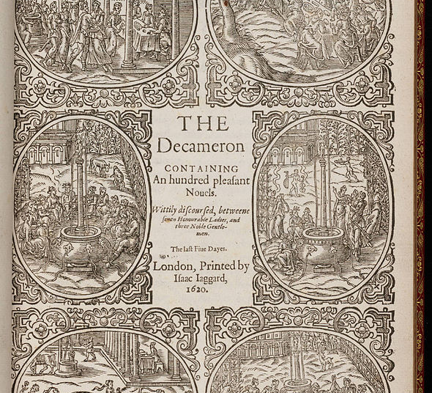
“‘An Hundred Stories in Ten Days”
COVID-19 Lessons for Culture, Learning and Copyright Law”
Carys Craig & Bob Tarantino
57:3 OHLJ 567 (2021) https://digitalcommons.osgoode.yorku.ca/ohlj/vol57/iss3/3/

Slide 3
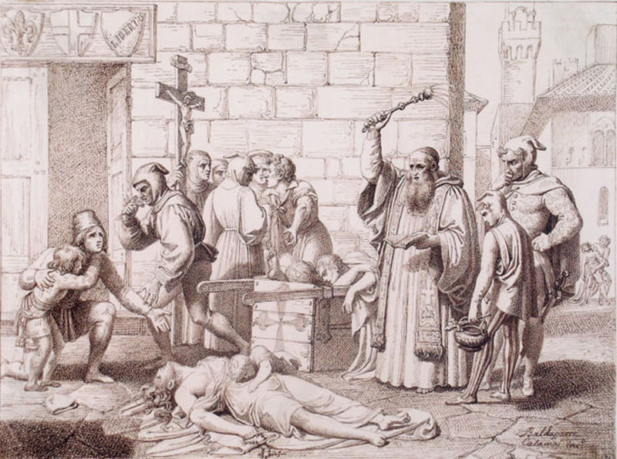
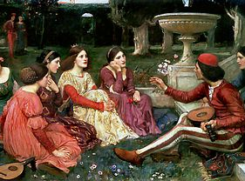
The Decameron (1471)
Giovanni Boccaccio
Beginneth here the book called Decameron, wherein are contained an hundred novels told in ten days by seven ladies and three young men.
In the illustrious city of Florence, there made its appearance that deadly pestilence which had had its origin before in the East when it had propagated itself without respite and so, calamitously, had spread into the West. …There was no medicine for the disease equal in efficiency to flight.
‘Tis my advice that we sojourn and in such a way of life continue until we see—if death not first overtake us—the end which Heaven reserves for these events.
If you take my advice you will find pastime in telling of stories which the invention of one may afford solace to all the company of his hearers. So…then, I ordain that we be free to discourse of such matters as most commend themselves, to each in turn.

Slide 4
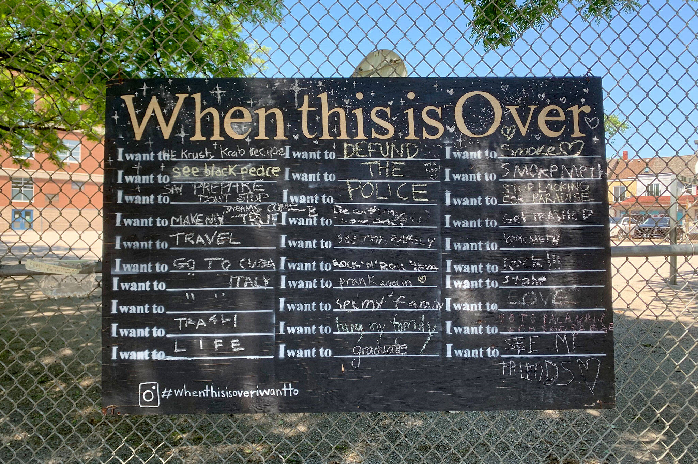
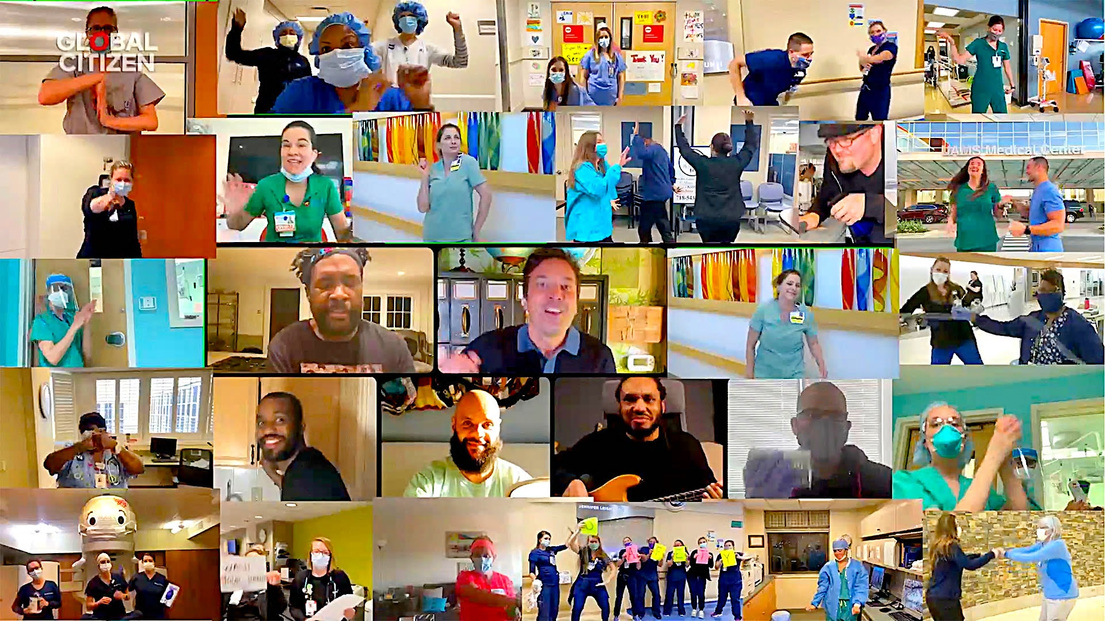
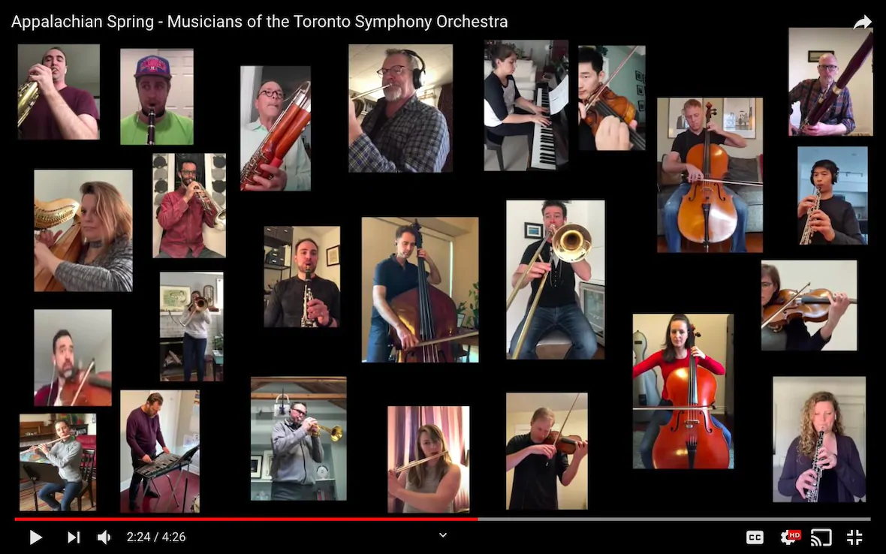
Copyright and Creative Engagement

Slide 5
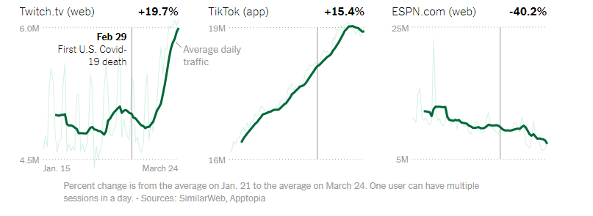
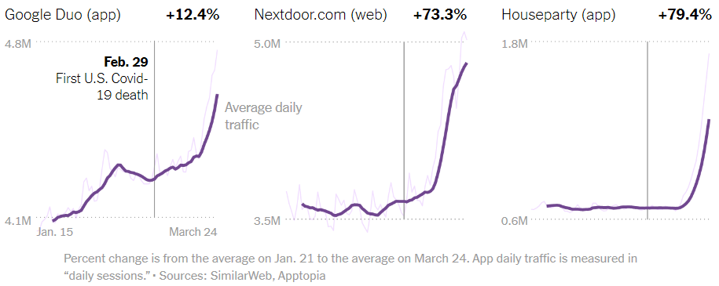
Surging Online Content Sharing Services

Slide 6
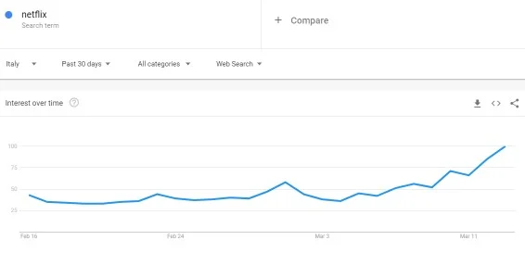
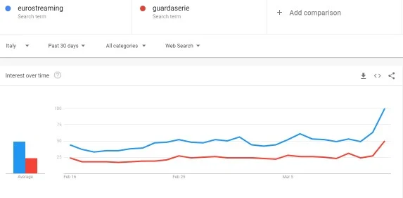
Surge in Streaming Services
“Despite the array of streaming options on offer—Netflix, Hulu, Amazon Prime, HBO, and Disney+ among them—Internet search trends reveal an increase in illegal download interest in areas that have been particularly affected by the COVID-19 pandemic. In Italy, which has recorded about a third of all coronavirus-induced deaths around the globe, Google searches for Netflix are up, according to the search company—as well as searches for local pirate sites”
“As coronavirus forces people home, interest in streaming services is surging. So is piracy.” By Aric Jenkins, Fortune March 29, 2020

Slide 7
Copyright’s Reach
Section 5 (works / originality)
  low bar: “almost anything written, drawn or expressed”
Sections 15, 18, 21 (performances, sound recordings, broadcast signals)
  Lower bar: don’t need fixation or originality
  Layering of rights and rightholders
Scope of exclusive rights is broad
  Reproduction: even ephemeral, transitory copies that no one sees or interacts with
  Communication: includes streaming, making available to members of the public at a time and place individually chosen by them

Slide 8

Protected
Infringing

Slide 9


Automated Copyright Enforcement
Our Community Guidelines enforcement today is based on a combination of people and technology… As a result of the new measures we’re taking, we will temporarily start relying more on technology to help with some of the work normally done by reviewers. This means automated systems will start removing some content without human review, so we can continue to act quickly to remove violative content and protect our ecosystem. As we do this, users and creators may see increased video removals, including some videos that may not violate policies.
We want to encourage musical expression on our platforms while also ensuring that we uphold our agreements with rights holders. These agreements help protect the artists, songwriters, and partners who are the cornerstone of the music community...
As part of our licensing agreements, there are limitations around the amount of recorded music that can be included in Live broadcasts or videos. While the specifics of our licensing agreements are confidential, today we’re sharing some general guidelines:
The greater the number of full-length recorded tracks in a video, the more likely it may be limited.

Slide 10
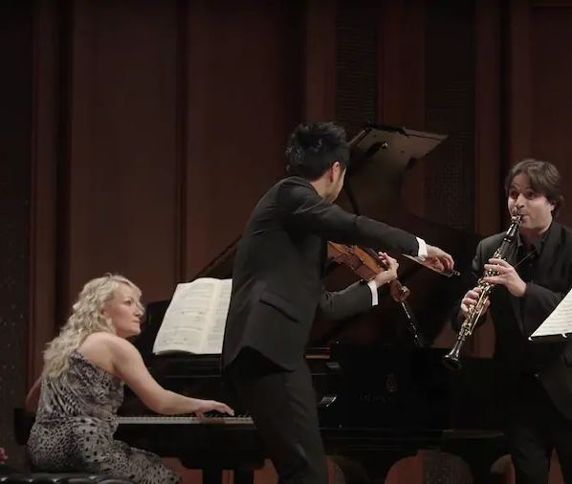
Copyright bots and classical musicians are fighting online. The bots are winning.
“What the hell is going on?” Spence recalls shouting to his son across the living room as the viewer count conspicuously dropped. Just minutes into the airing of the concert, Facebook issued Spence a notification that his video — an original performance of an hour-long piece composed by Mozart in 1786 — somehow contained one minute and 18 seconds of someone else’s work, in this case, “audio owned by Naxos of America.”
Washington Post, by Michael Andor Brodeaur,
May 21, 2020

Slide 11
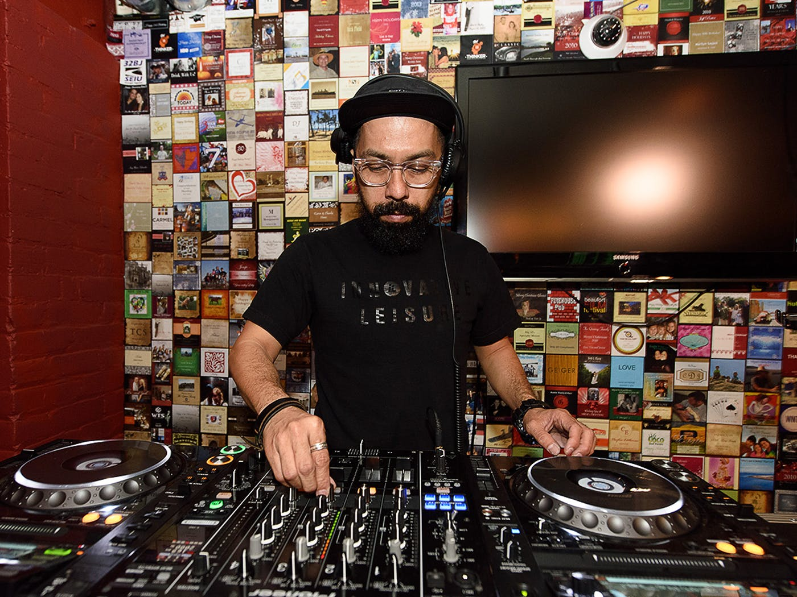
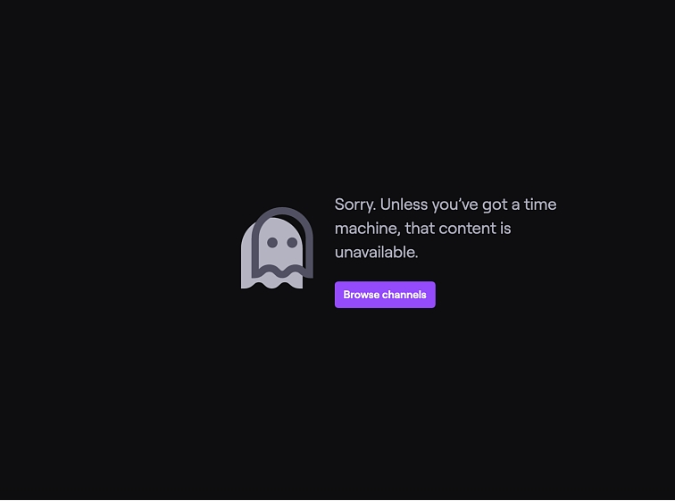
The implications
Enforcement first: Obstructing / pre-emptively silencing creative use/communication
  “Once access to materials posted online is blocked or removed, a story may not unfold.” (Elkin Koren & Perel)
Bypasses legal decision-making structures and processes
  Anointing platforms and online services as “circulation gatekeepers” (Edwards)
Reifying potentially erroneous or overly-expansive owner rights assertions
Changing the “social, legal, and creative default”
  The choices of creators and audiences are “informed, manufactured and ultimately distorted by the architecture of regulation” (Burk)

Slide 12
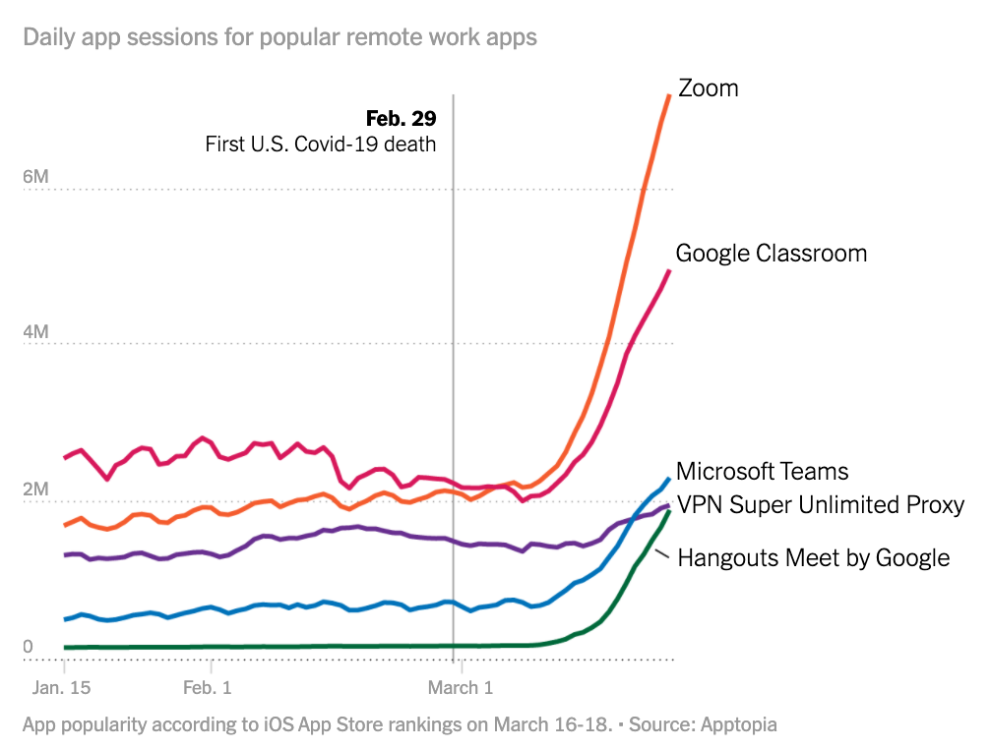

Copyright & Education: The shift to online learning

Slide 13
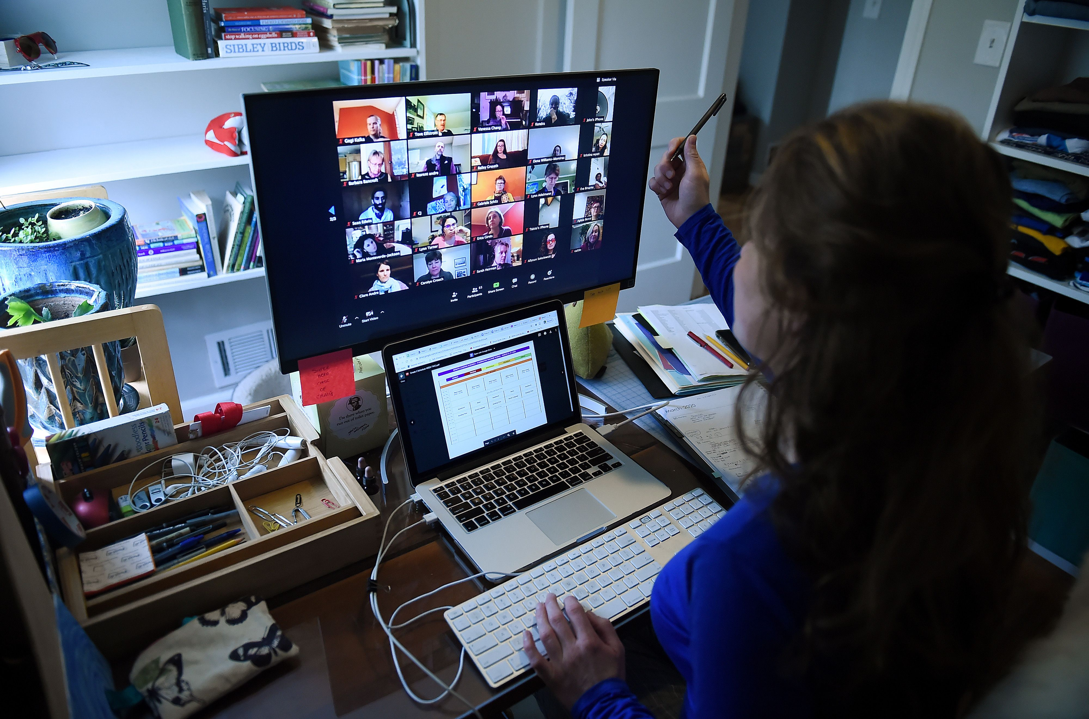

Copyright Challenges
Delivery of educational content online rather than in classroom
  Implicating copyright in routine lesson delivery: reproduction + communication
  Asynchronous delivery compounds issues with further copying, storing, sharing
  Platform terms of service often shift liability for copyright infringement onto teachers (Léo Pascault et al)
Accessing learning materials
  Libraries shut, schools closed, physical copies not reachable
  e-licenses not available or too expensive = no access
  Many publishers do not provide electronic purchasing options for libraries (representing 85% of existing textbook)
  Even if available, the budget for digital copies can purchase only a small fraction of the physical copies it would cover
Operating under a longstanding “clear for fear” culture
  Risk-averse institutions
  Onerous licensing obligations limiting digital uses
  Underregulated and litigious Copyright Collectives (Access © v York U)

Slide 14
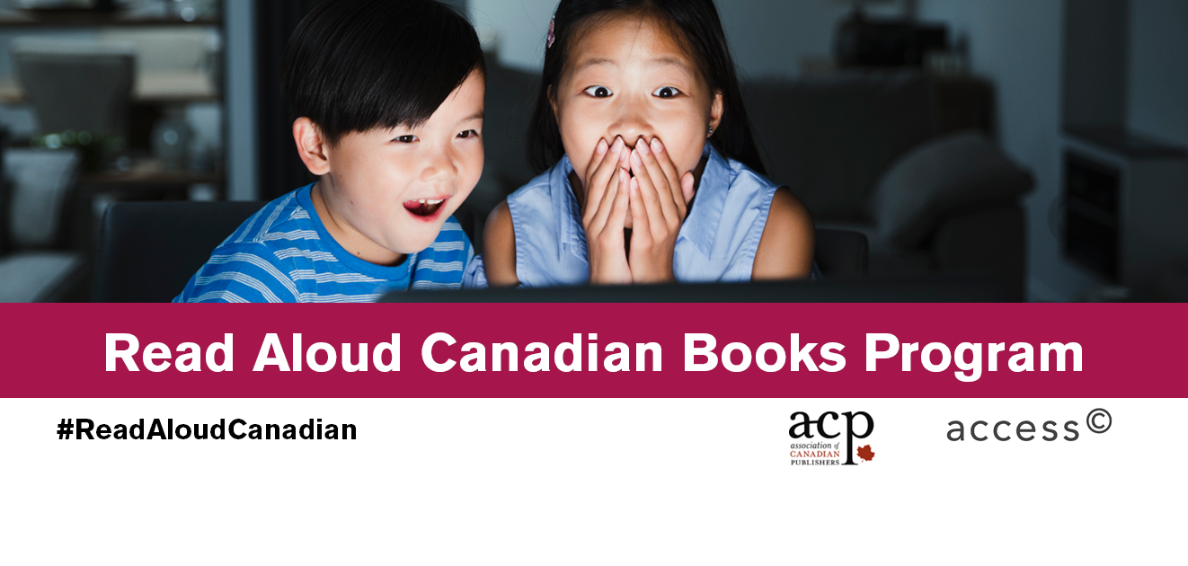
Temporary “Fixes”
Extraordinary measures on a “one-time, non-precedent setting basis”
COPIBEC: temporarily increased portion of materials that could be copied from 15% to 35%
Access Copyright’s “Read Aloud Canadian Books” Program
  Temporary waiver of licence fees for “online storytime”
  For select books only
  Submit request providing details, provide attribution, state that reading is occurring “with permission from Access Copyright on behalf of the publisher”
  Delete no later than June 30, 2020, no archiving or retaining.

Slide 15

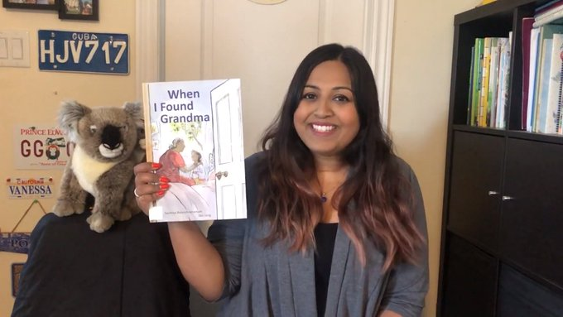

The Flaws of Temporary “Fixes” “Fixes”
Assuming that online reading is the publisher’s right to grant
Behaving as if a license would be required in the absence of this waiver paves the way for the adoption of overreaching licenses in the future—licenses that extract funds for uses that require no permission and for which no payment is due
Jim Gibson: The “practice of unneeded licensing… [results in] a steady, incremental, and unintended expansion of copyright….”

Slide 16
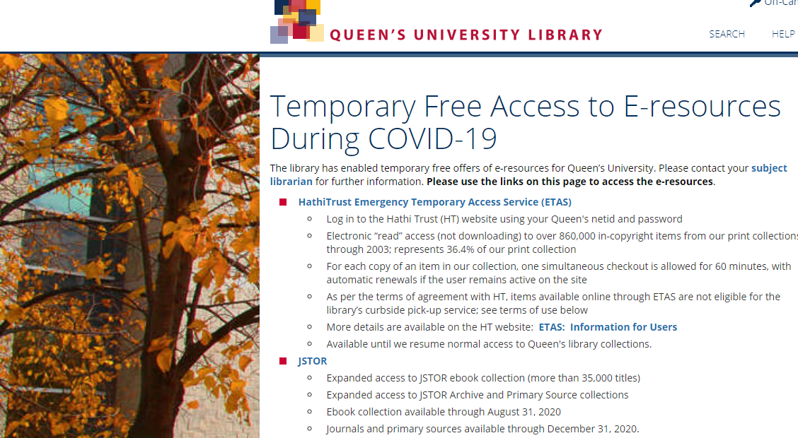
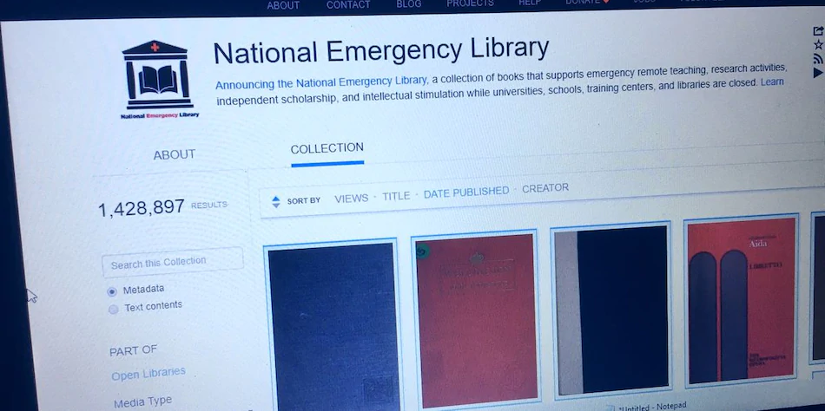
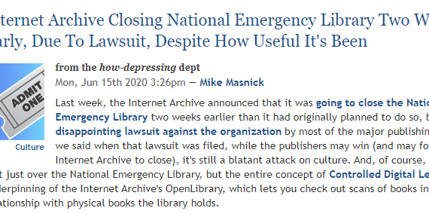
Emergency Measures
Missing the Mark
“the temporary measures taken by publishers in the face of this crisis seem lacklustre, and ultimately serve only to underscore long-standing problems that pervade commercial educational publishing”
“it seems clear that it will take more than the current crisis to move the dial on digital lending as accepted common practice. In the meantime, stringent copyright controls continue to hamper public access to lawfully acquired books.”

Slide 17

Existing “Solutions” in the law?
Specific exceptions for educational institutions and lessons
  s.29.4: Permits reproductions etc. in order to display works for “education or training” and for “a test or examination”;
  s.29.5 permits performances of works to student audiences “on the premises” (s.30.01deemed to extend to enrolled students);
  S.30.04 allows educational institutions to copy/communicate to students works available on the internet.
  → But “the ability of educators to comfortably rely on these exceptions for educational institutions is hampered by their stringent specificity, onerous conditionality and legal complexity.”
Non-commercial User-Generated Content
  S. 29.21: allows use of a work in the creation of a “new work”.
  → But/ must be “new work”; non-commercial; attribution if reasonable; no substantial adverse effect on market for existing work

Slide 18
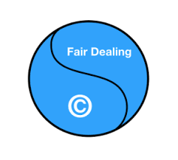
So What About Fair Dealing?
S. 29: Fair Dealing should cover many of the activities described
(Macklem & Trosow)
  Purpose: Education, private study or research (teacher/student)
  Fairness:
    Uses appropriate and reasonably necessary to achieve educational purpose (especially in a pandemic);
    Character of dealing usually limited to distribution to enrolled students;
    Often no equally effective alternatives and no substitution effect on the market
…But
  Requires a contextual case-by-case analysis;
  The conclusion may be uncertain;
  Reluctance to rely on fair dealing given threats or litigation/liability

Slide 19

The Limits of
Copyright Limits
Targeted exceptions often too narrowly drawn, complicated and subject to onerous conditions
Uncertainly means users and institutions often reluctant to rely on exceptions – produces a permission-first sensibility
Owners are unlikely to concede that exceptions apply
Licensing terms often or ostensibly supersede statutory user rights and impose more restrictions in exchange for certainty
Learning platforms shift risks onto educators
Algorithms monitor and impede uses without accounting for fair dealing analysis or other user rights

Slide 20
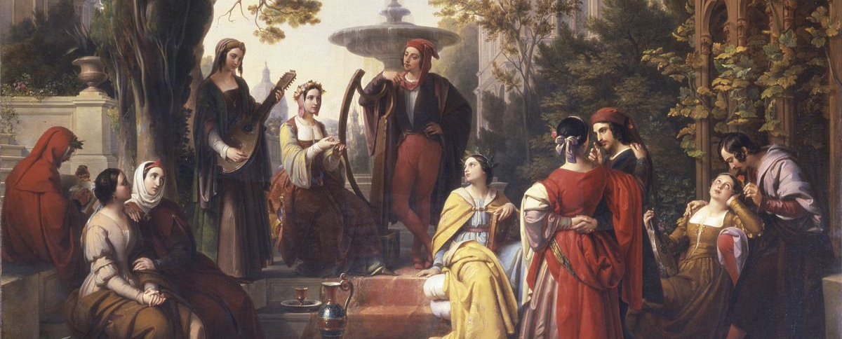
Copyright Lessons from Lockdown
“I acknowledge that the things of this world have no stability,
but are ever undergoing change.”

Slide 21
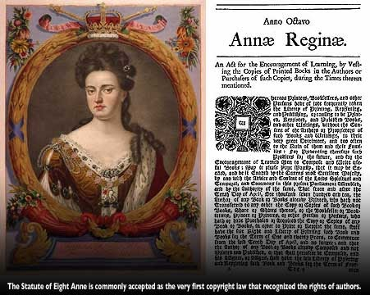
Copyright’s Origins and Purpose
“History is one distinctive kind of story-telling and [IP] is an area in need of many more critical historical stories.” (Drahos)
The Statute of Anne of 1710, “An Act for the Encouragement of Learning,” contained provisions to ensure accessibility of books and statutory duty for printers to deliver books to university libraries.
Ariel Katz (quoted by the Internet Archive):
“The historical precedence of libraries and the legal recognition of their public function cannot determine every contemporary copyright question, but this historical fact is not devoid of legal consequence… As long as the copyright ecosystem has a public purpose, then some of the functions that libraries perform are not only fundamental but also indispensable for attaining this purpose.”

Slide 22

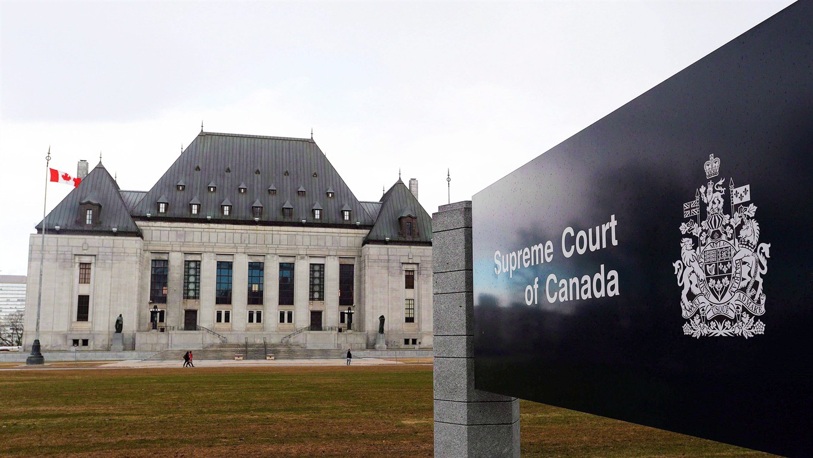
Copyright’s Purpose (Canadian version)
Copyright is “a balance between promoting the public interest in the encouragement and dissemination of works of the arts and intellect and obtaining a just reward for the creator”
Théberge v Galerie d’Art du Petit Champlain inc, 2002
“The proper balance among these and other public policy objectives lies not only in recognizing the creator’s rights but in giving due weight to their limited nature.” CCH Canadian Ltd. v LSUC, 2004
“Théberge focused attention on the importance copyright plays in promoting the public interest, and emphasized that the dissemination of artistic works is central to developing a robustly cultured and intellectual public domain. …[B]oth protection and access must be sensitively balanced in order to achieve this goal.” SOCAN v Bell, 2012

Slide 23


How Should Copyright Work?
Copyright is a state-constructed system of entitlements granted by law to:
- support communicative activity and a vibrant public domain
- by incentivizing and facilitating creativity and dissemination
Copyright should be instrumentalized to encourage creativity and learning
- without imposing unnecessary liability risks and technological constraints
- and without unduly impeding access, chilling creativity, or impairing free speech

Slide 24

Substantive Technological Neutrality
“The Copyright Act was designed to keep pace with technological developments to foster intellectual, artistic and cultural creativity. In applying the Copyright Act to a realm that includes the Internet…the public benefits of this digital universe should be kept prominently in view.…”
(Robertson v. Thomson, 2006 (diss.))
“[T]he traditional balance between authors and users should be preserved in the digital environment” (ESA v SOCAN, 2012)
Substantive technological neutrality: not technology blindness but steady pursuit of ©’s normative objectives, adjusting in the face of technological change.

Slide 25

Adjusting the Copyright Balance
if a primary goal of © is to maximize the distribution of intellectual works, we need to preserve/enable opportunities for digital distribution
if a primary goal of © is to encourage people to engage in creative expression, creative engagement should be allowed to flourish
If a primary goal of © is to encourage learning, it should not impede students’ access to vital educational resources
“That might mean giving greater weight to users’ rights of access than to owners’ rights to exclude when we find ourselves at a moment in history in which physical exclusion is inescapable and digital access is the only open door to creative engagement, education, and participatory democracy”

Slide 26
Restoring Copyright’s Equilibrium
analog world: even infringing activities were often irrelevant to overall functioning of the system and unlikely ever to be “caught” in what was an inherently “leaky” system
→ “leakiness” was a feature and not a bug of the copyright system—mitigated the consequences of copyright’s paradox.
but now: as our lives move online, technology is increasingly plugging these “leaks” and transitioning us towards a time of perfect content monitoring and automated control
→ We need to recalibrate the copyright system to restore its equilibrium in the digital environment, counterbalancing technical measures by building leaks and limits back into the system by design

Slide 27
Shoring Up User Rights
it is essential to copyright’s legitimacy that we find ways to better safeguard users’ rights in our online interactions
requires strong, flexible, technologically neutral, and readily comprehensible exceptions
requires positive user rights that can be enforced by users
algorithmic © monitoring and enforcement should be transparent, accountable, tailored to the limits of rights
Online architecture needs to enable users to interact with moderators and (human) decision-makers to assert rights

Slide 28
Rethinking Traditional Publishing Models
If physical books are increasingly inaccessible, we have to critically re-examine a system that locks institutions, libraries, students and educators into limited and unworkable options as captive audiences.
Rather than relying on expensive and restrictive licenses, libraries and users need the option of affordable openly licensed materials that actually facilitate online access
Educators and learners need to confidence to engage in fair dealing and lawful uses, and must be systematically safeguarded against threats of litigation and potential liability.
time for educational institutions, instructors, and faculty members to turn the page on proprietary textbooks and to commit instead to developing Open Educational Resources and Open Access publishing

Slide 29
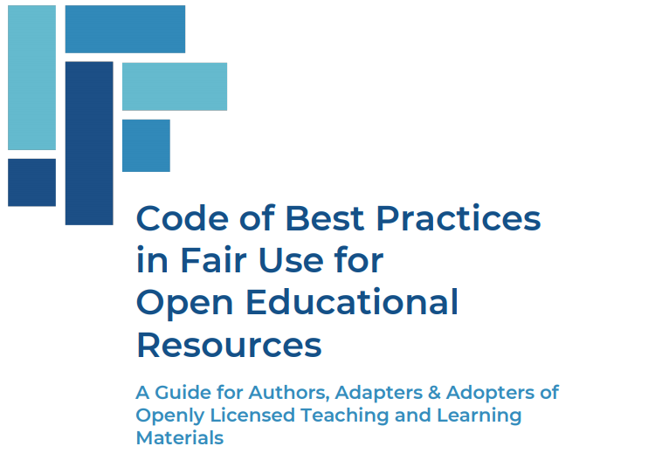
Best Practices in Fair Use for OER
“Educators should not be constrained to use only what commercial publishers choose to offer and the formats they choose to offer it in. When OER authors are able to understand and rely on fair use, it allows them to create materials that are compelling, impactful, and adaptable.
This Code is a tool for educators, librarians, and authors to evaluate common professional scenarios in which fair use can enable them to incorporate inserts, including those protected by copyright, to create OER.”
(See Appendix Three:
Educational Fair Dealing in Canada)
https://www.wcl.american.edu/impact/initiatives-programs/pijip/documents/code-of-best-practices-in-fair-use-for-open-educational-resources/

Slide 30
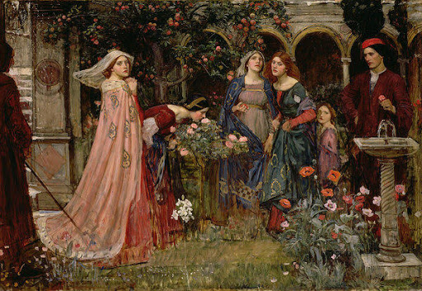
Conclusion
“The lessons to be taken from these tales are not limited to the current crisis but should inform our evolving copyright norms in whatever “new normal” emerges; they are lessons for how copyright should and should not work if it is to serve its policy objectives and consistently advance the public interest over the course of time and social change.”
“In truth, had it been honestly possible to guide you whither I would bring you by a road less rough than this will be,
I would gladly have done so.”

