Slide 1
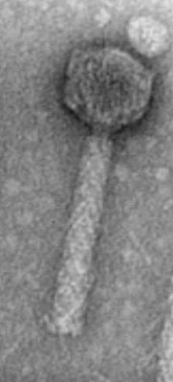
Development of an assay for the identification of campylobacter bacteriophage receptor binding proteins
Jessica Sacher
MSc Student
Szymanski Lab
University of Alberta
Notes:
THANK.
http://www.health-pic.com/campylobacter-jejuni-gastroenteritis/

Slide 2
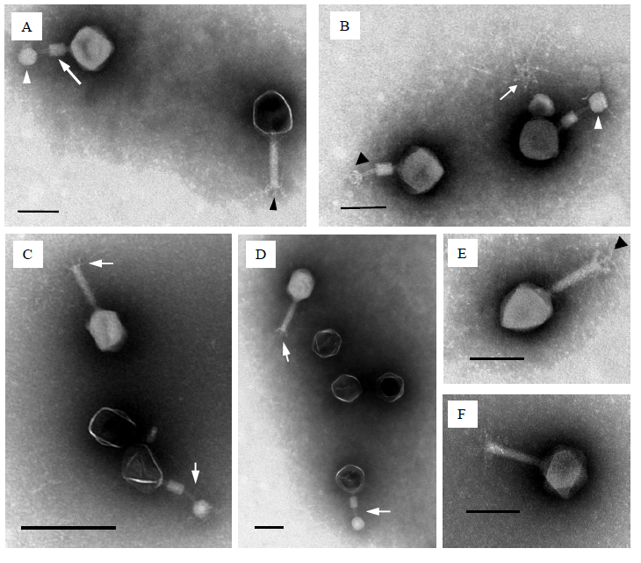
Bacteriophages
Bacteriophages are the most abundant life form on earth with estimated numbers up to 10³⁰ globally.
We have exploited billions of years of co-evolution to use the phage host-specific recognition proteins as “surrogate antibodies” for use as novel therapeutics and diagnostics.
(Kropinski et al. 2011, Appl. Environ. Microbiol.)

Slide 3
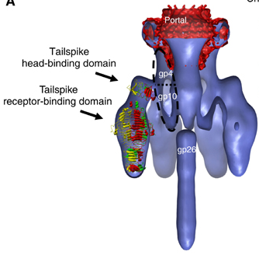
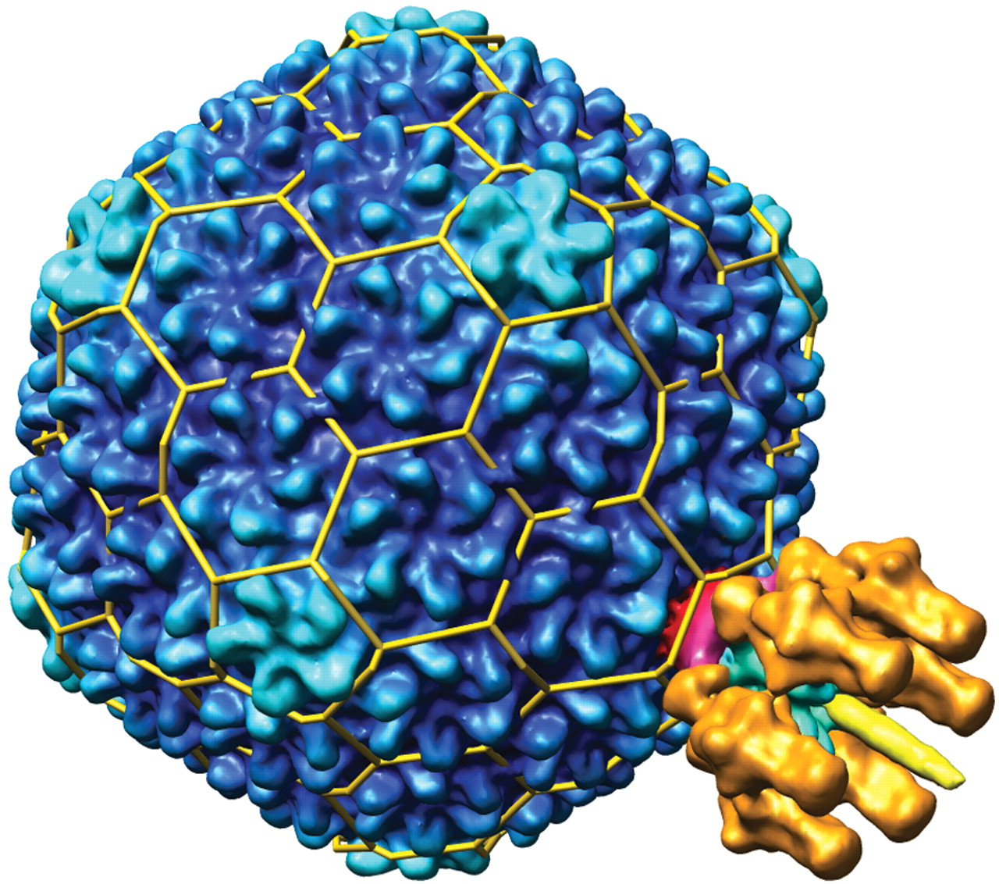
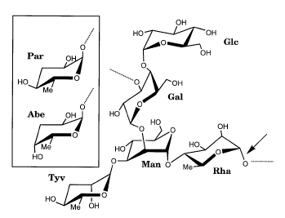
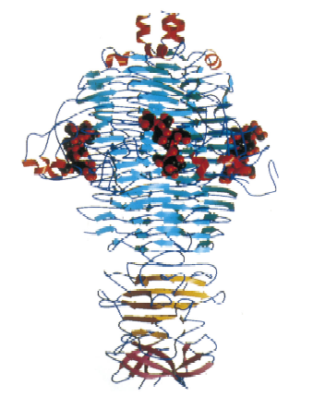
Receptor Binding Proteins (RBPs)
RBP: a phage-expressed protein with target organism-binding activity
Phages must contact their target bacterial cell surface in order to infect: usually coated with glycoconjugates
  Phage have evolved to express specific sugar-binding proteins
RBPs could be exploited as “surrogate antibodies” that predominantly recognize bacterial surface carbohydrates
Notes:
Alternative to antibodies, Christine, NRC, Dr. Tanha, Salm LPS, P22 model, crystal, FIX PICTURE

Slide 4
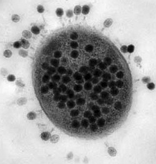
Phage therapy vs. RBP therapy
Non-toxic, robust and self-replicating medicine
Highly specific – will not disrupt normal flora
Evolve to combat bacterial resistance
No delivery of virulence genes to new organisms
Easy to express in E. coli for large-scale production and purification
Previously shown:
  Easily immobilized for efficient and specific bacterial cell capture
  Can reduce Salmonella colonization and spread to the liver and spleen in chickens
Notes:
Resistance – alternative antimicrobials – intact are attractive. Evoy, NINT, jamshid tanha, lead in with we wanted a campylo phage

Slide 5
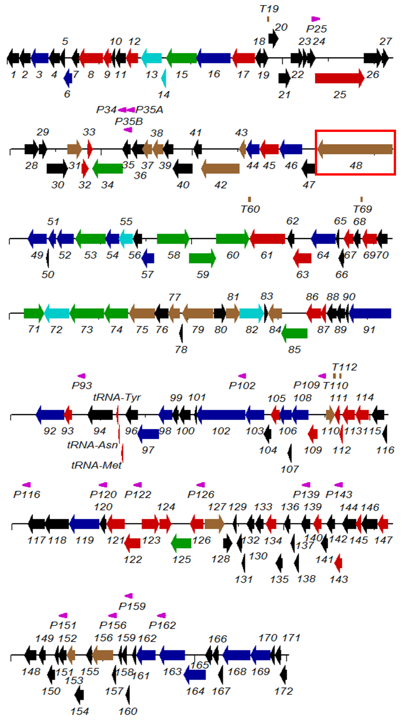
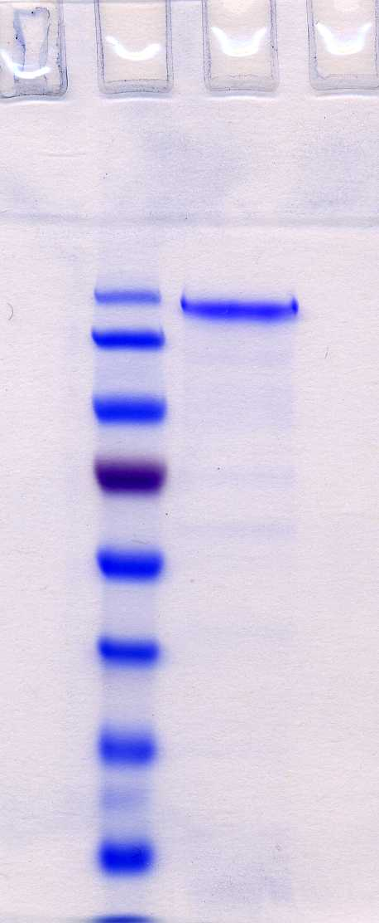
ID of Gp48, a C. jejuni phage RBP
Expressed by the Campylobacter jejuni-specific NCTC 12673 phage
170
Gp48
130
100
150 kDa
SDS-resistant trimers
135 kb
Notes:
Carbohydrate binding domains, cite Kropinski, we overexpressed this protein…interesting properties

Slide 6
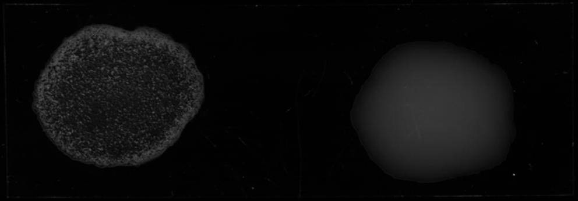
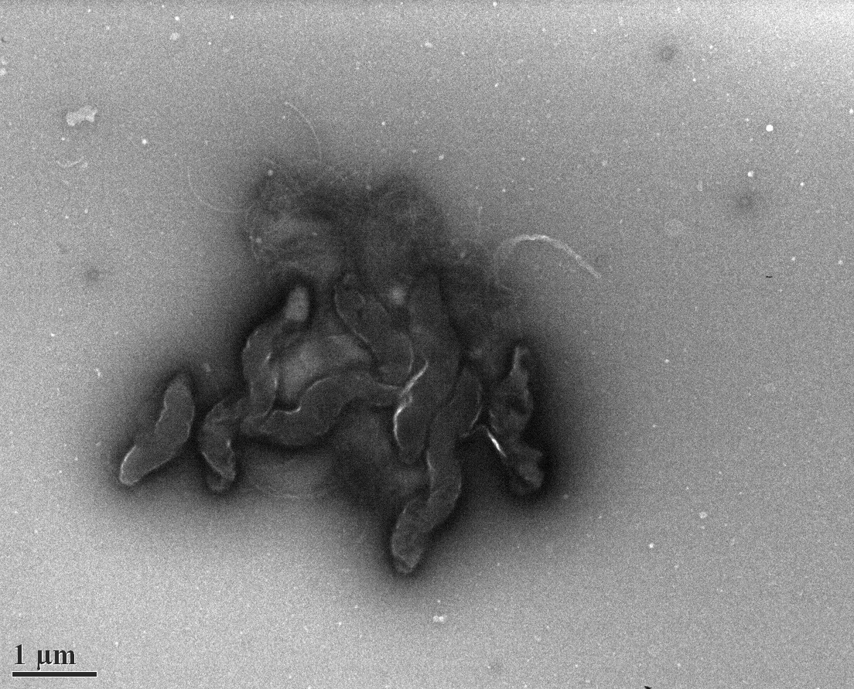
Agglutination of C. jejuni by Gp48
PBS
ccGp48
Notes:
Motility (not shown) – is it reduced? Significantly?

Slide 7
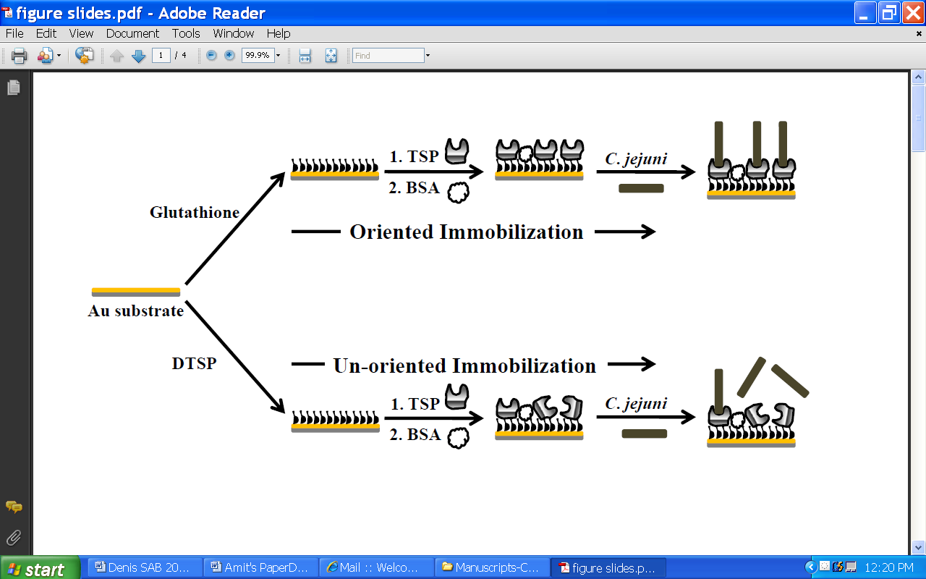
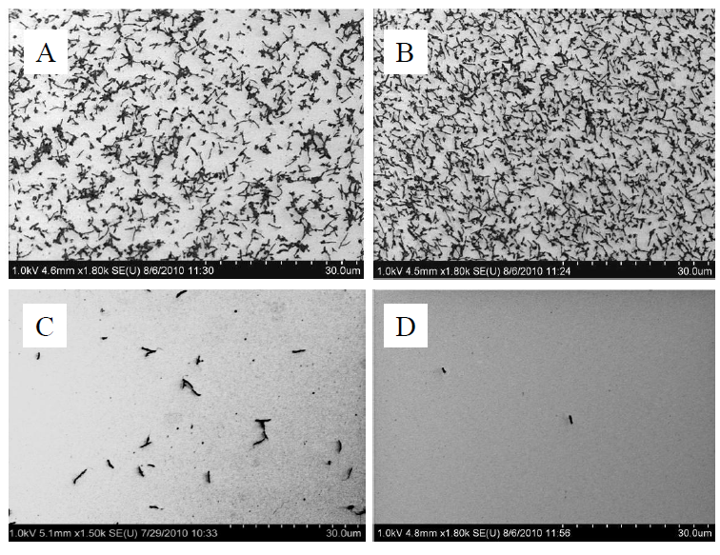
Immobilization of GST-Gp48
A) C. jejuni +
unoriented Gp48
B) C. jejuni + oriented Gp48
C) Salmonella Typhimurium
D) Nonspecific C. jejuni binding
Singh et al. 2011, Analyst
Notes:
C. jejuni (A, B and D) or Salmonella Typhimurium (C) bound to the treated gold surfaces. A – un-oriented, B and C – oriented immobilization of GST-Gp48; D – unspecific binding of C. jejuni to the BSA-treated gold surface. Cell suspensions of 10⁹ cfu/ml were used.

Slide 8
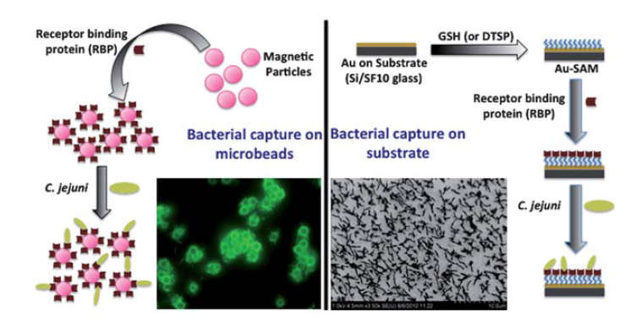
Fluorescence image of bacterial capture by Gp48-functionalized Dynabeads®
Singh et al. 2011, Analyst
Notes:
Pull out of suspen

Slide 9
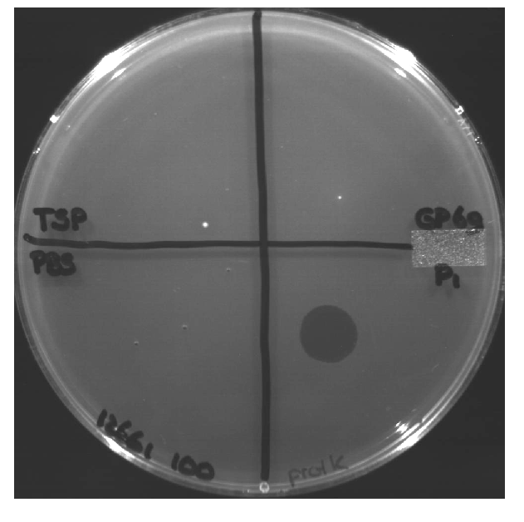
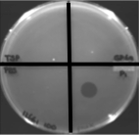
Bacterial growth clearing by Gp48
C. jejuni MP21
Gp48 Gp69
ProtKGp48 Gp69
PBS Phage
PBS Phage
Notes:
When I came into the lab I set out to follow up on an observation that had been made that Gp48 is actually able to clear C. jejuni growth on agar plates.

Slide 10
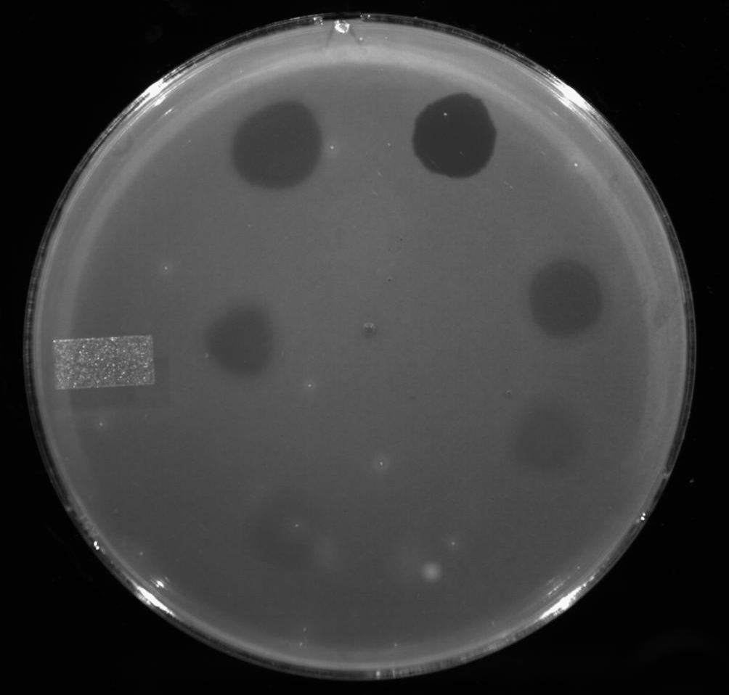
Dose-dependent clearing of MP21
1.3 µg
ccGp48
P1 Phage
0.9 µg
ccGp48
0.4 µg
ccGp48
0.2 µg
ccGp48
0.1 µg
ccGp48
Notes:
We wanted to investigate the mechanism of this clearing activity..

Slide 11
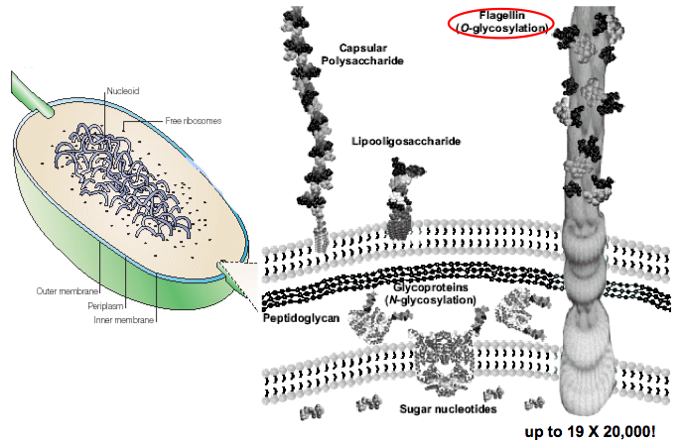
Gp48 binds to the Campylobacter jejuni
flagella O-linked glycans

Slide 12
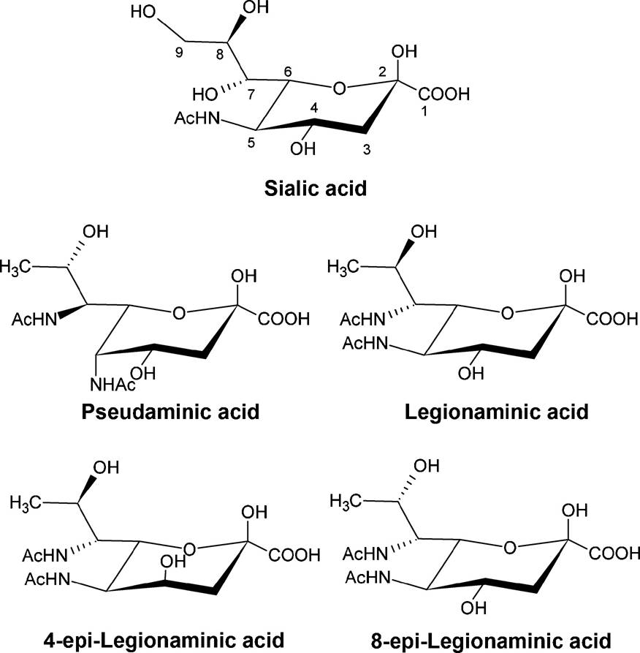
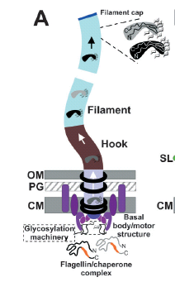
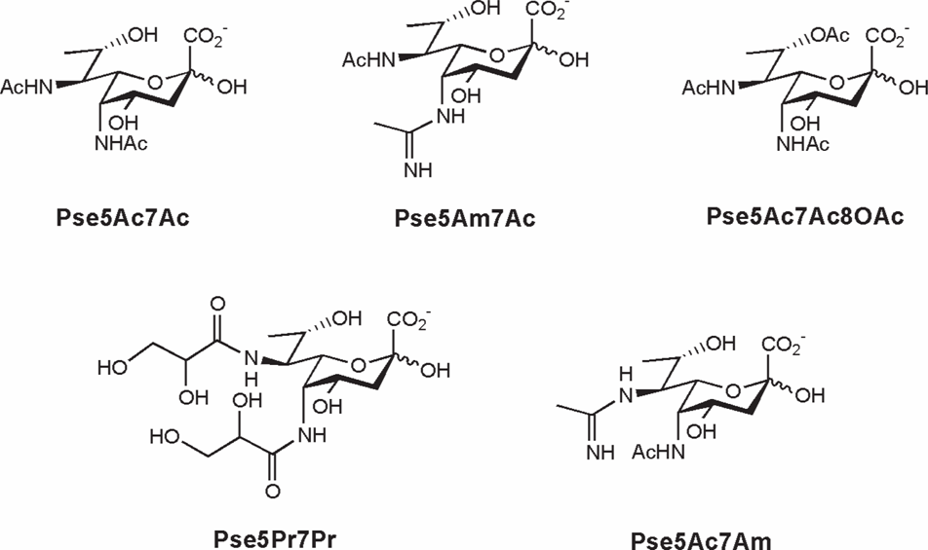
C. jejuni flagellin O-modification
with pseudaminic
and legionaminic acid derivatives
Logan,
Microbiology
(2006)
Galkin, Guerry et al.
Science (2008)
Notes:
Dr. Logan

Slide 13
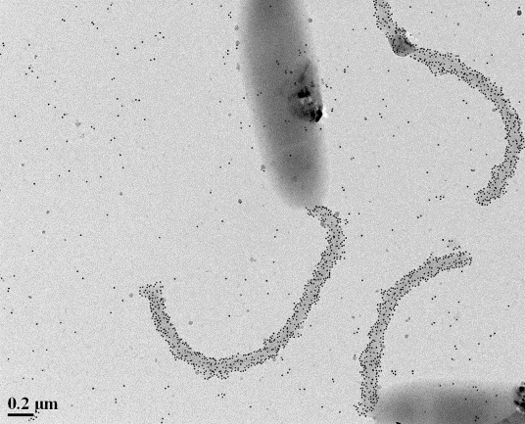
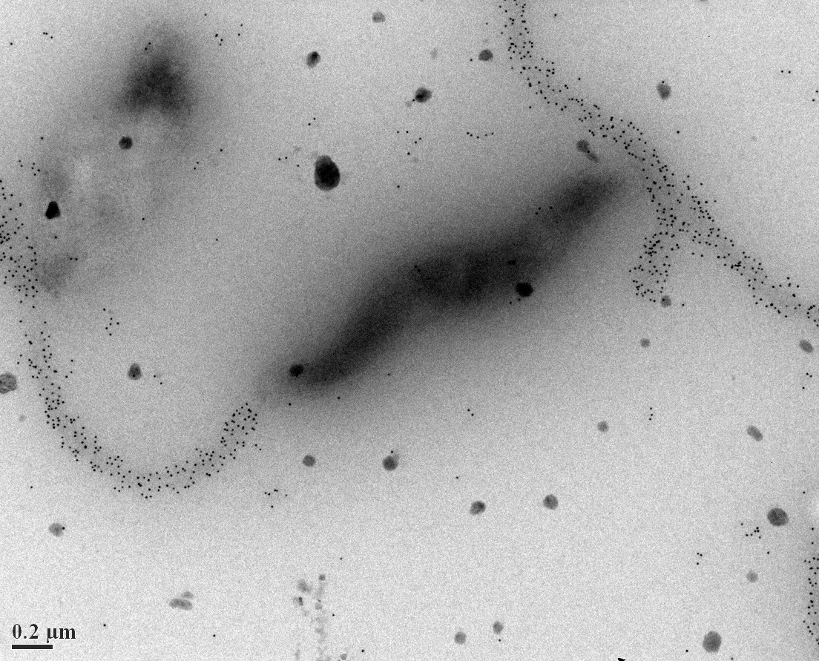
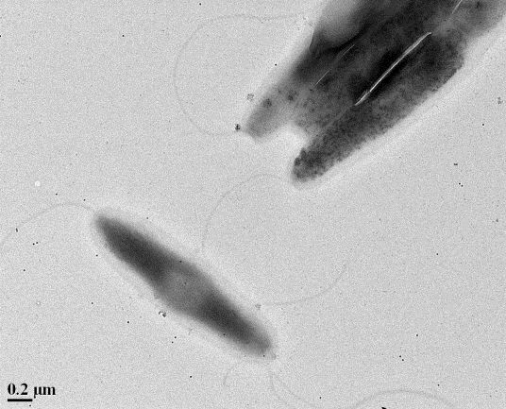
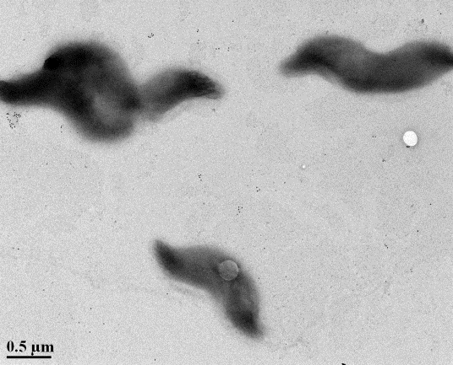
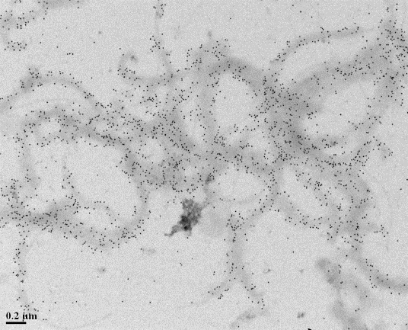
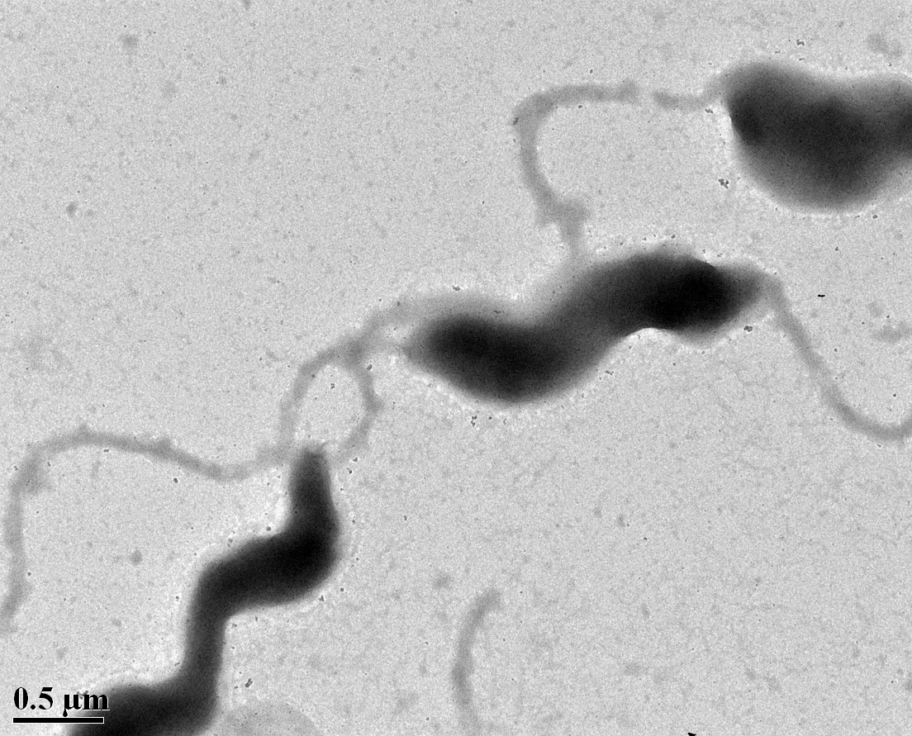
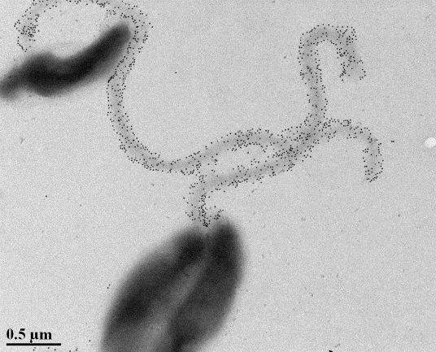
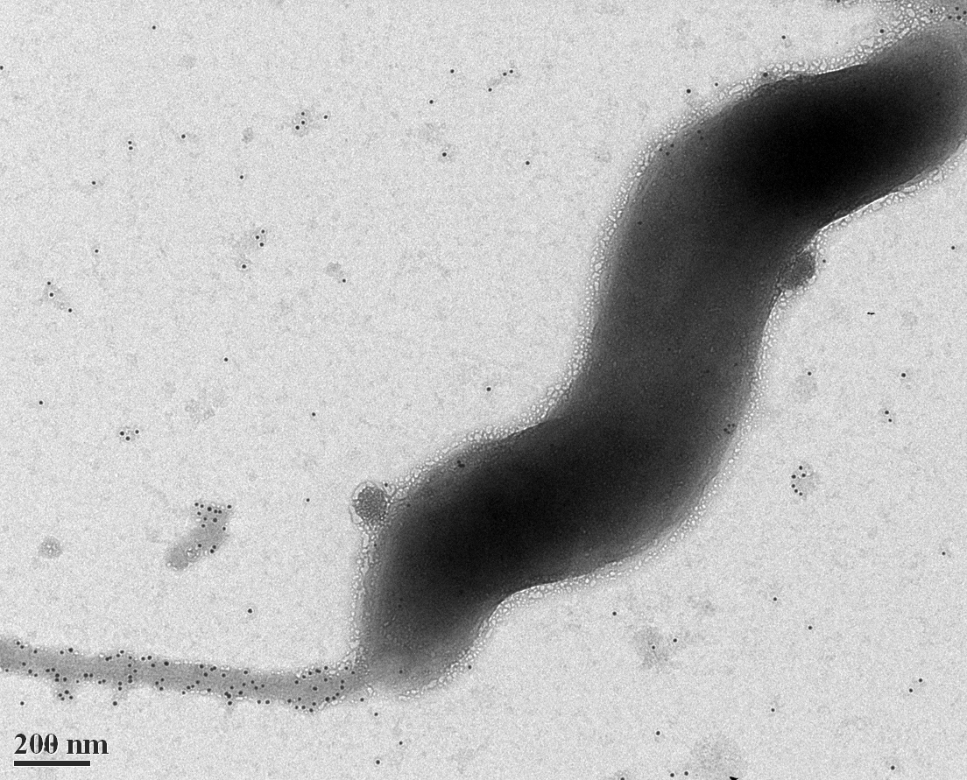
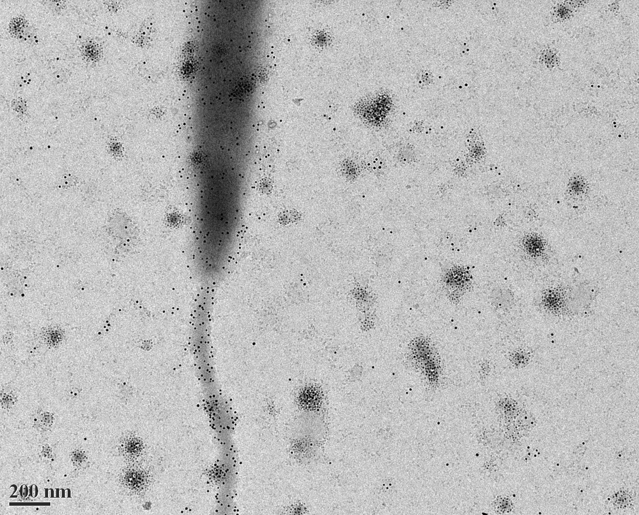
Immunogold labelling with Gp48
A.11168H WT
B. ccGp48 1:1000
C. ccGp48 1:4000
D. 11168ΔpseH
E. 11168 flagella (purfd.)
F. MP21 + ccGp48 + anti-Gp48
G. 81-176 WT
H. 11168ΔkpsM
I. α-Gp48 + Penner sera
Notes:
Electron microscopy images of C. jejuni 11168 (original isolate), 11168H (hypermotile variant of 11168), 81-176 strains, 11168ΔkpsM (capsule mutant), 11168ΔpseH (flagellum mutant) and 11168 purified flagella that were immuno-gold stained by exposing them to ccGp48 followed by rabbit anti-gp48 and goat anti-rabbit IgG secondary antibodies conjugated to gold particles. The purified recombinant ccGp48 (1.3 mg/ml) showed binding to C. jejuni flagellum in up to 1:3000 dilution. Like full length Gp48, ccGp48 forms multimers and binding of ccGp48 increases the thickness of C. jejuni flagellum even when purified flagellum was exposed to ccGp48 without exposure to anti-Gp48 and secondary antibodies (F). Flagellum binding of ccGp48 is independent of capsular polysaccharides, receptor of ccGp48 source phage NCTC12673 (H), ccGp48 did not show binding to C. jejuni cell body in immuno-gold labeling experiments, however, cell body was stained by gold particles when cells were exposed to Penner’s sera along with anti-Gp48 antibodies (I).
13

Slide 14
Gp48 is specific for C. jejuni & C. coli
 | Strains tested | Positive | Negative | % Positive
C. jejuni | 38 | 36 | 2 | 95%
C. coli | 19 | 17 | 2 | 90%
H. pylori | 2 | Nil | 2 | Nil
C. fetus fetus | 1 | Nil | 1 | Nil
C. fetus venerealis | 1 | Nil | 1 | Nil
C. upsaliensis | 1 | Nil | 1 | Nil
C. lari | 1 | Nil | 1 | Nil
C. concisus | 1 | Nil | 1 | Nil
E. coli | 2 | Nil | 2 | Nil
S. enterica | 1 | Nil | 1 | Nil
*
*

Slide 15
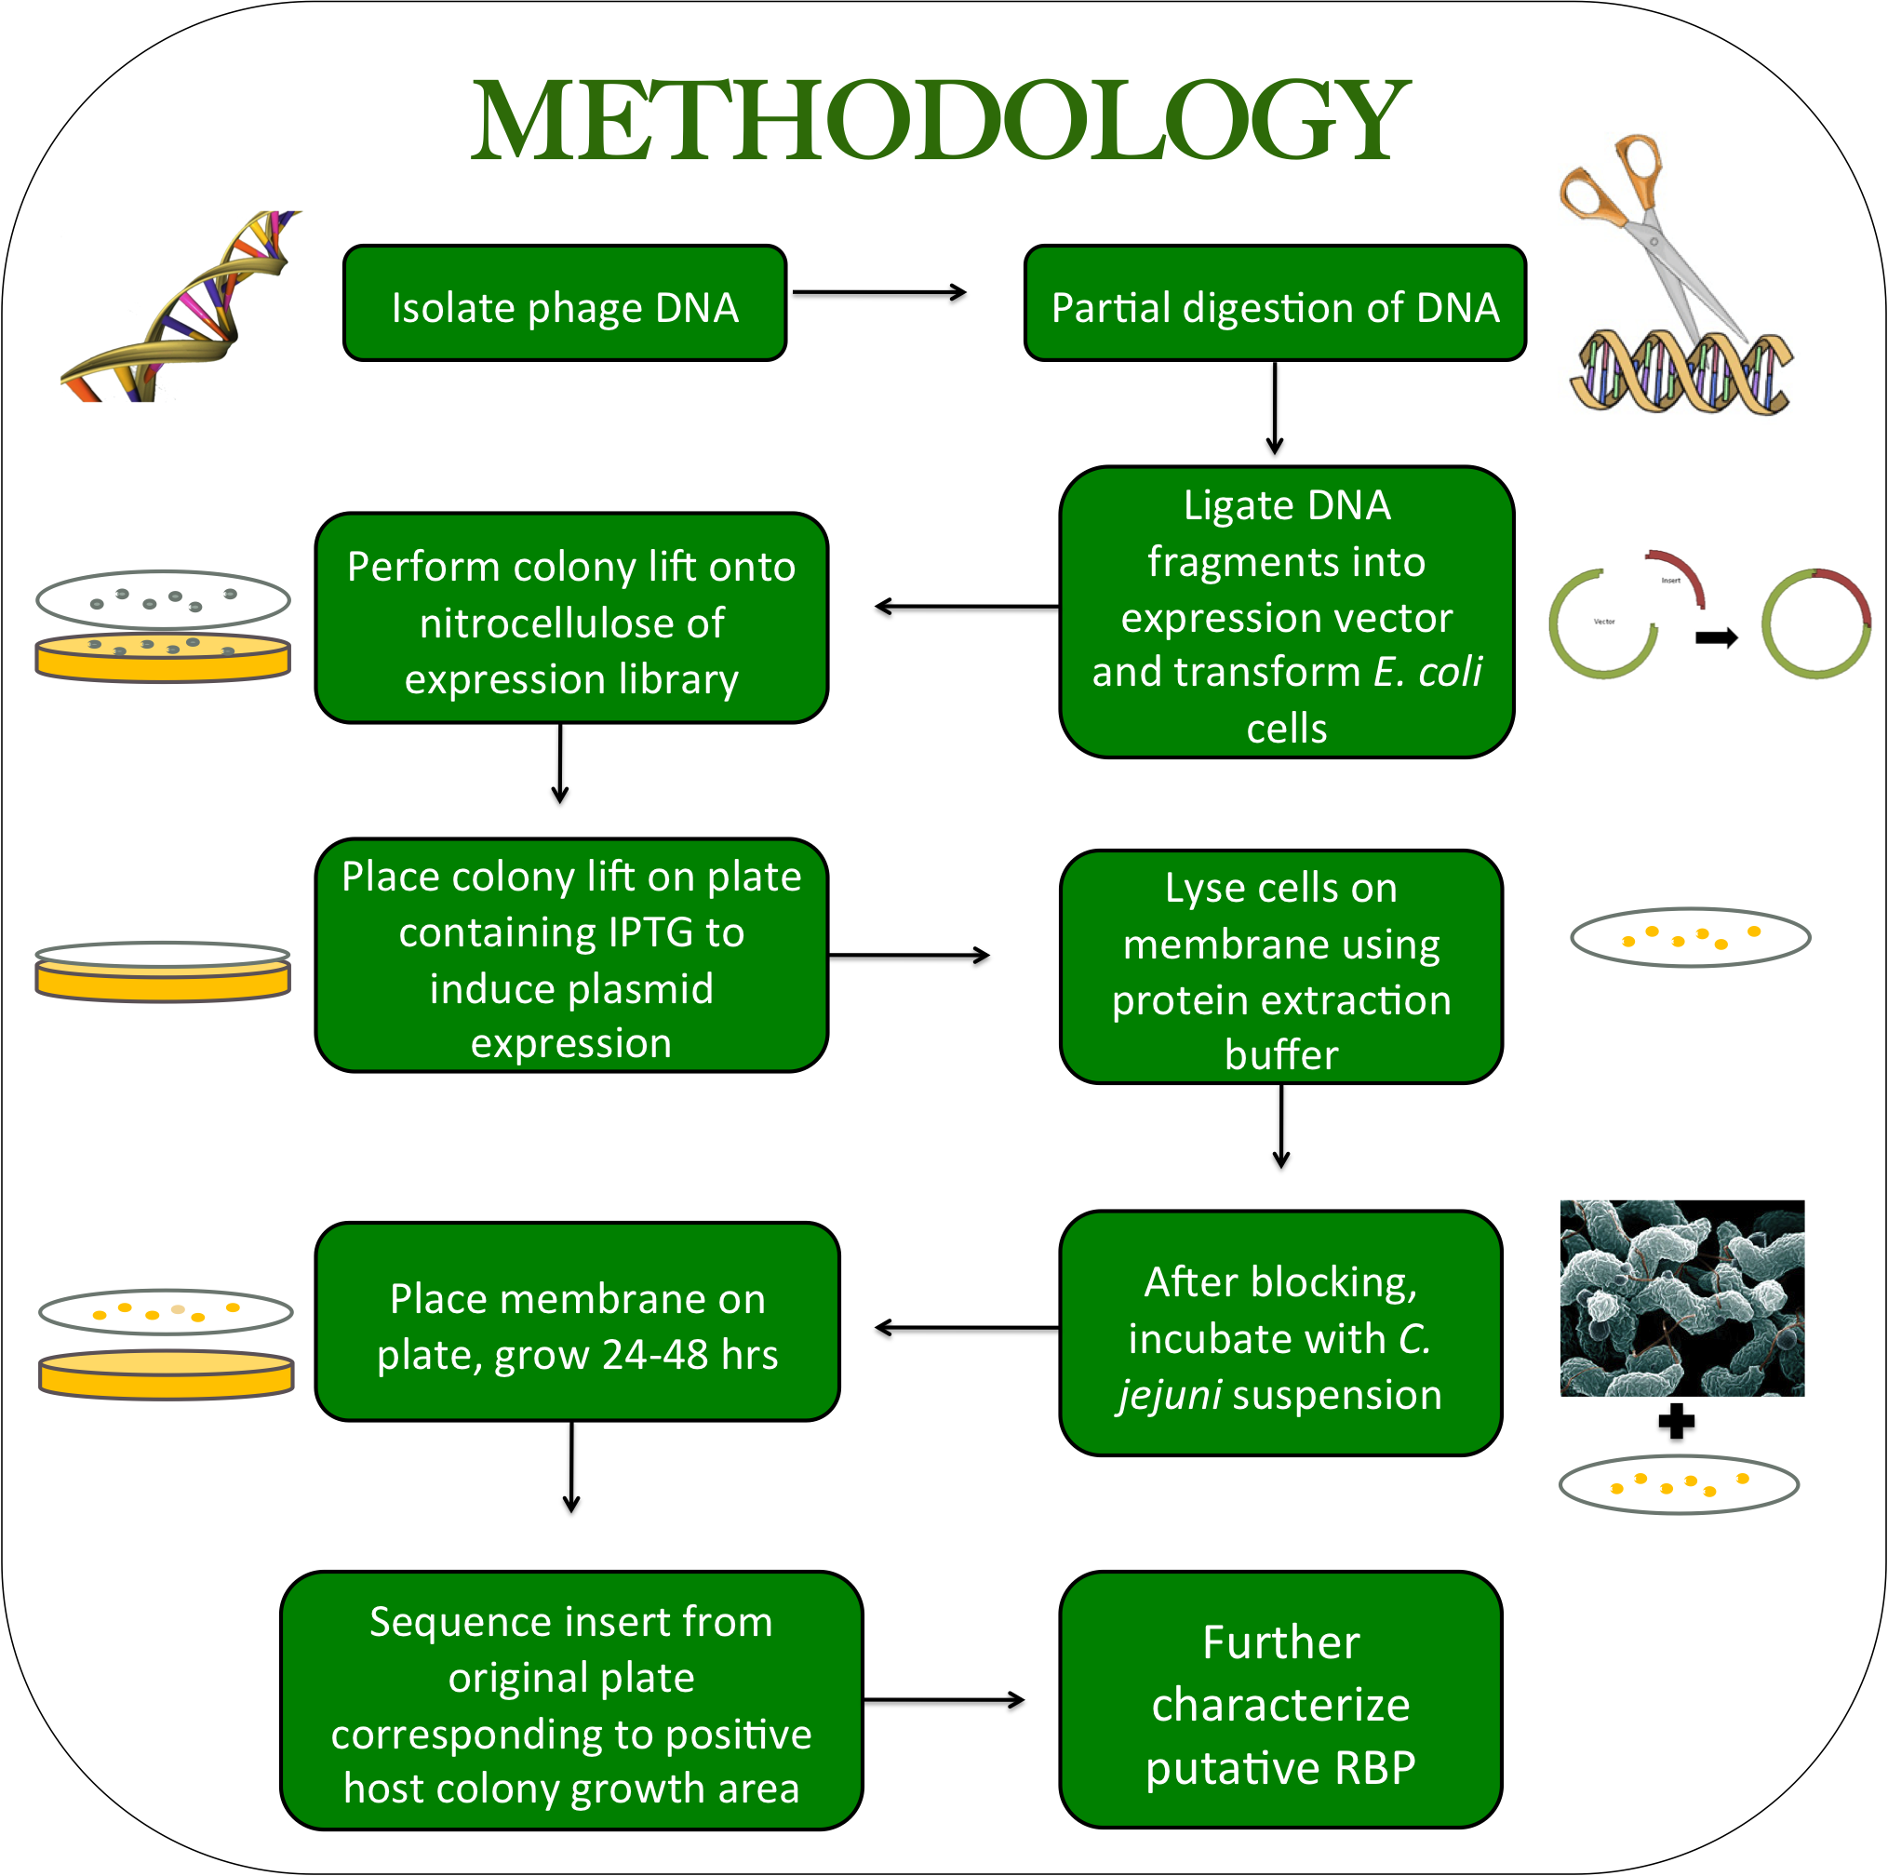
RBP Identification Method
Lack of homology between RBPs
Phage are difficult to sequence
Currently developing a high-throughput method to identify RBPs from unsequenced phage
Gp48/C. jejuni system as proof of principle
Notes:
Add slide from poster (already accomplished) – now general

Slide 16
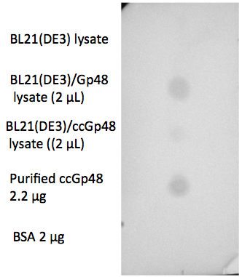
Detection of known C. jejuni phage RBP in
E. coli cell lysates
Spotted E. coli/Gp48 lysate shows clear spot indicative of C. jejuni binding
Now will move on to optimizing the full method:
  Detection of Gp48 among all genome fragments of NCTC 12673 phage

Slide 17




ACKNOWLEDGEMENTS
Christine Szymanski
David Simpson
Denis Arutyunov
Afzal Javed
Lieke van Alphen
Everyone in the Szymanski lab!
Notes:
As well as my funding…

Slide 19
Notes:
“Temperature” phages? … go through and make sure I’ve highlighted best ones

Slide 20


Infection by
new virions
Lysis of cells
Clumping
surrounding cells
by free Gp48s
Proposed biological role for Gp48
20

Slide 21
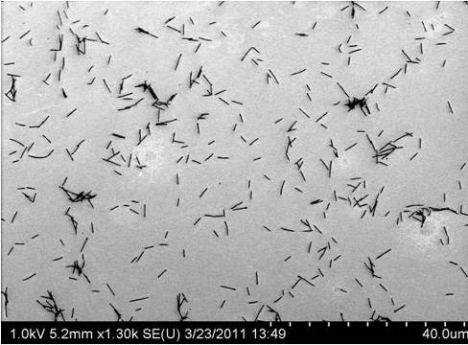
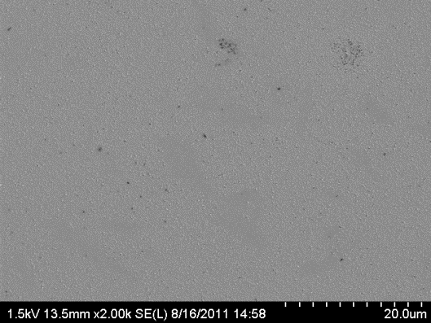
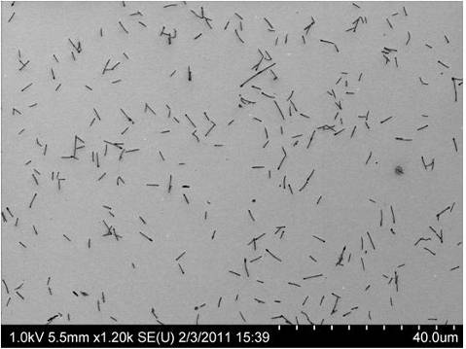
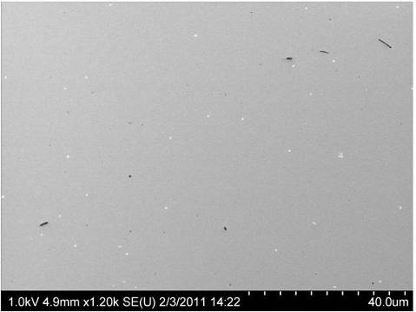
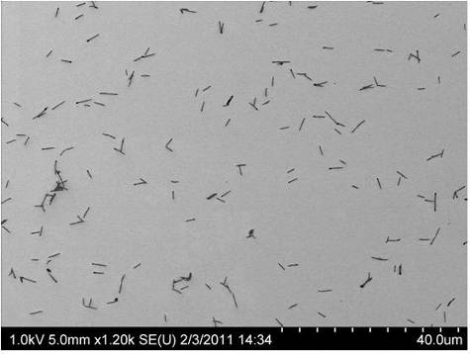
Gp48 binding site is at the C-terminus
A
B
GST
ncGp48
GST
ccGp48
36 kDa
36 kDa
GST
nGp48
GST
cGp48
76 kDa
76 kDa
N
Gp48
C
152 kDa
C
Gp48 full-length
ccGp48
nGp48
ncGp48
cGp48
Afzal, unpublished

Slide 22
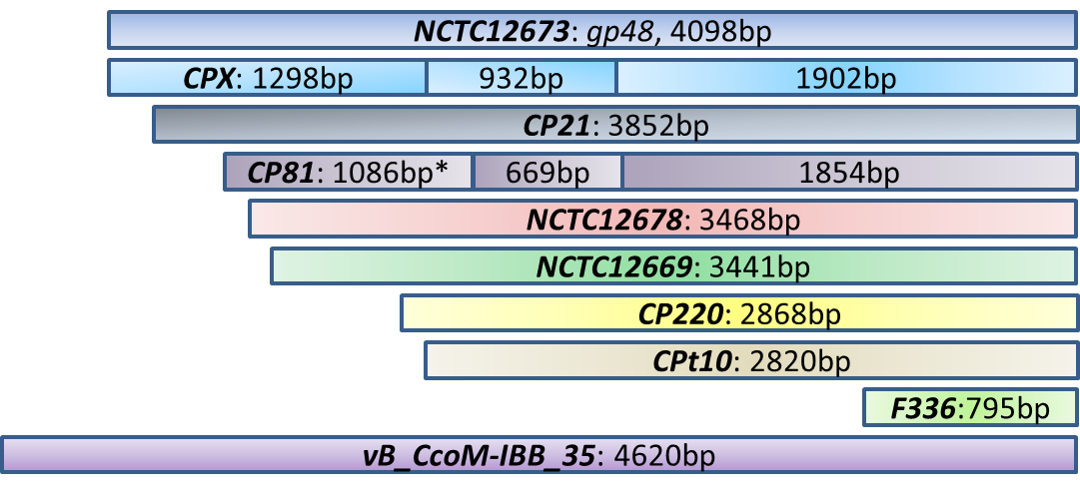
Gp48 homologues found in all Campylobacter jejuni bacteriophages sequenced to date

Slide 23
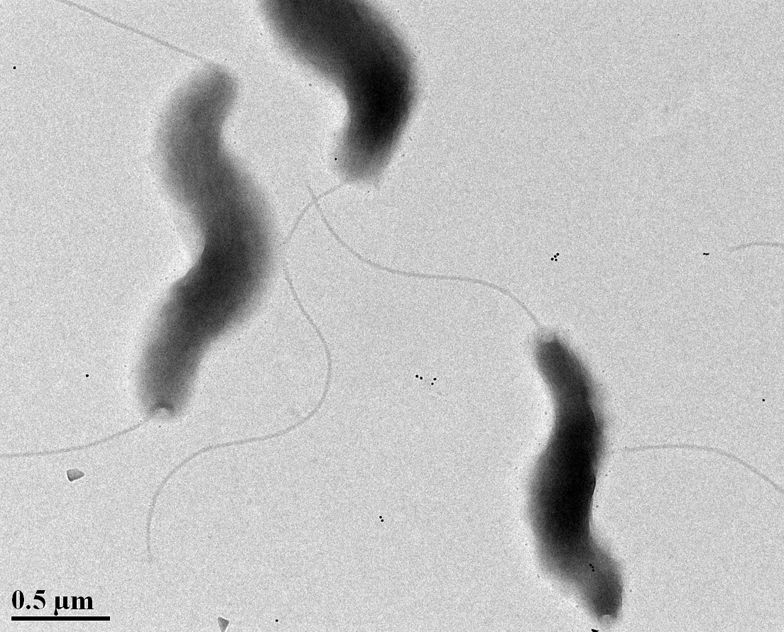
Gold labeling of MP21Δcj1316c
with ccGp48

Slide 24
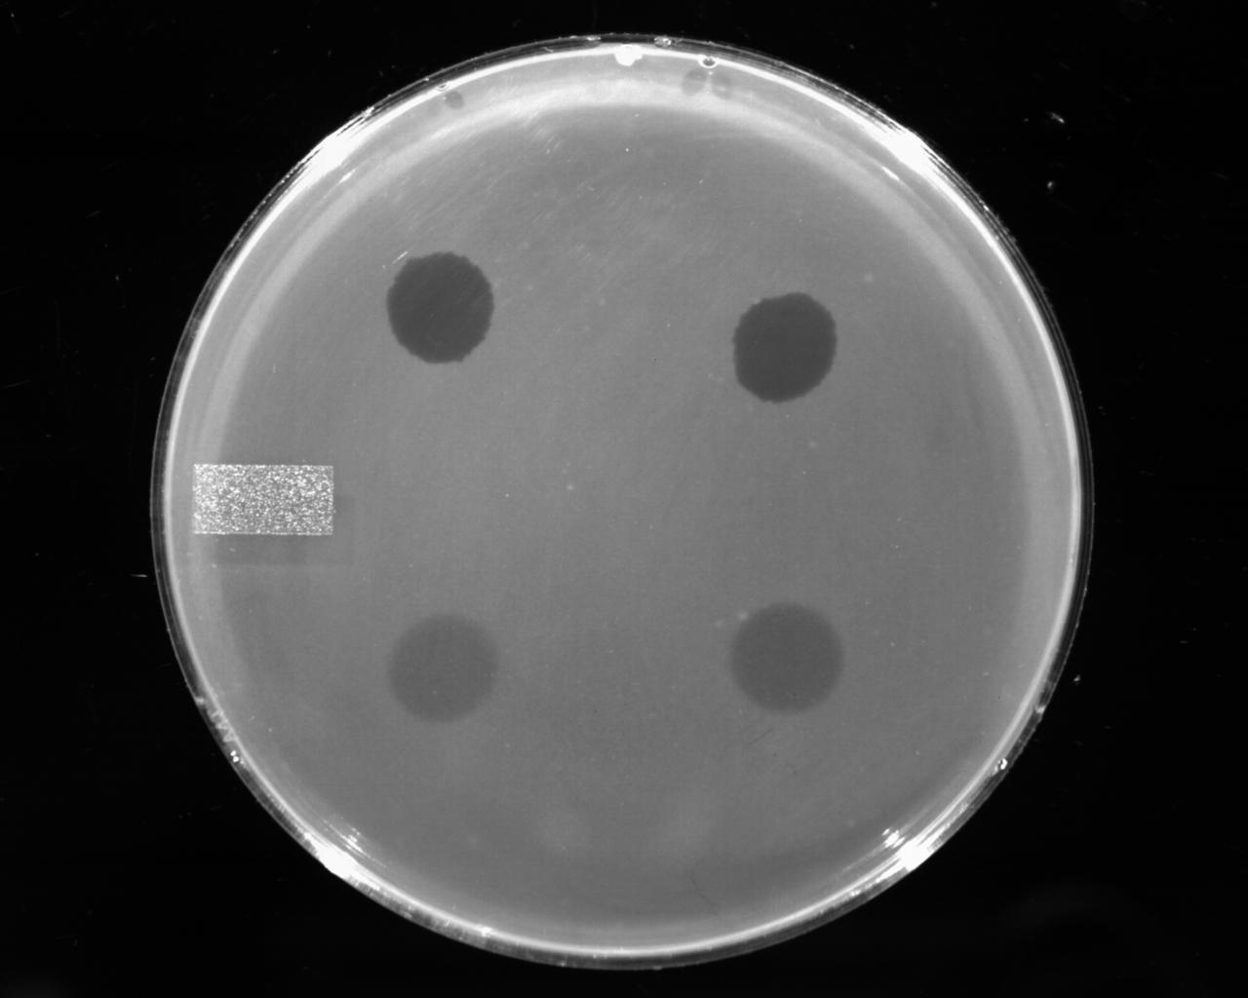
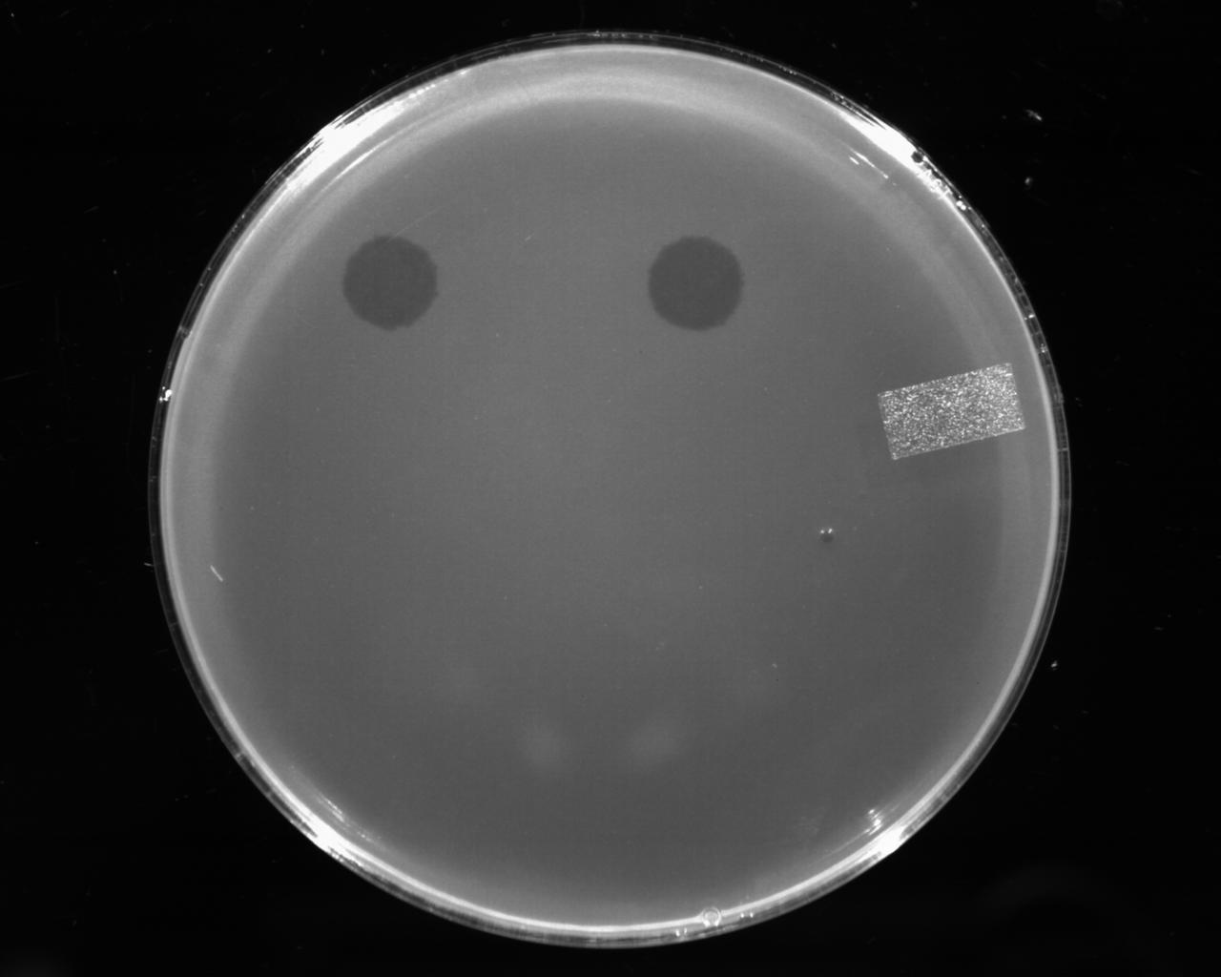
Clearing activity of ccGp48 in MP21Δcj1316c
Pseudaminic acid mutant cannot glycosylate its flagellin
ccGp48 activity abolished in mutant
Wildtype
cj1316c mutant
P1
P1
ccGp48
ccGp48
Notes:
Mutation of Cj1316c or pseA had been shown to result in loss of the acetamidino form of pseudaminic acid (PseAm).

