Slide 1
Moral Rights
*July 2019
Notes:
*Updated: November 2023
Hello, and welcome to the University of Alberta’s Opening Up Copyright instructional module on Moral Rights.

Slide 2
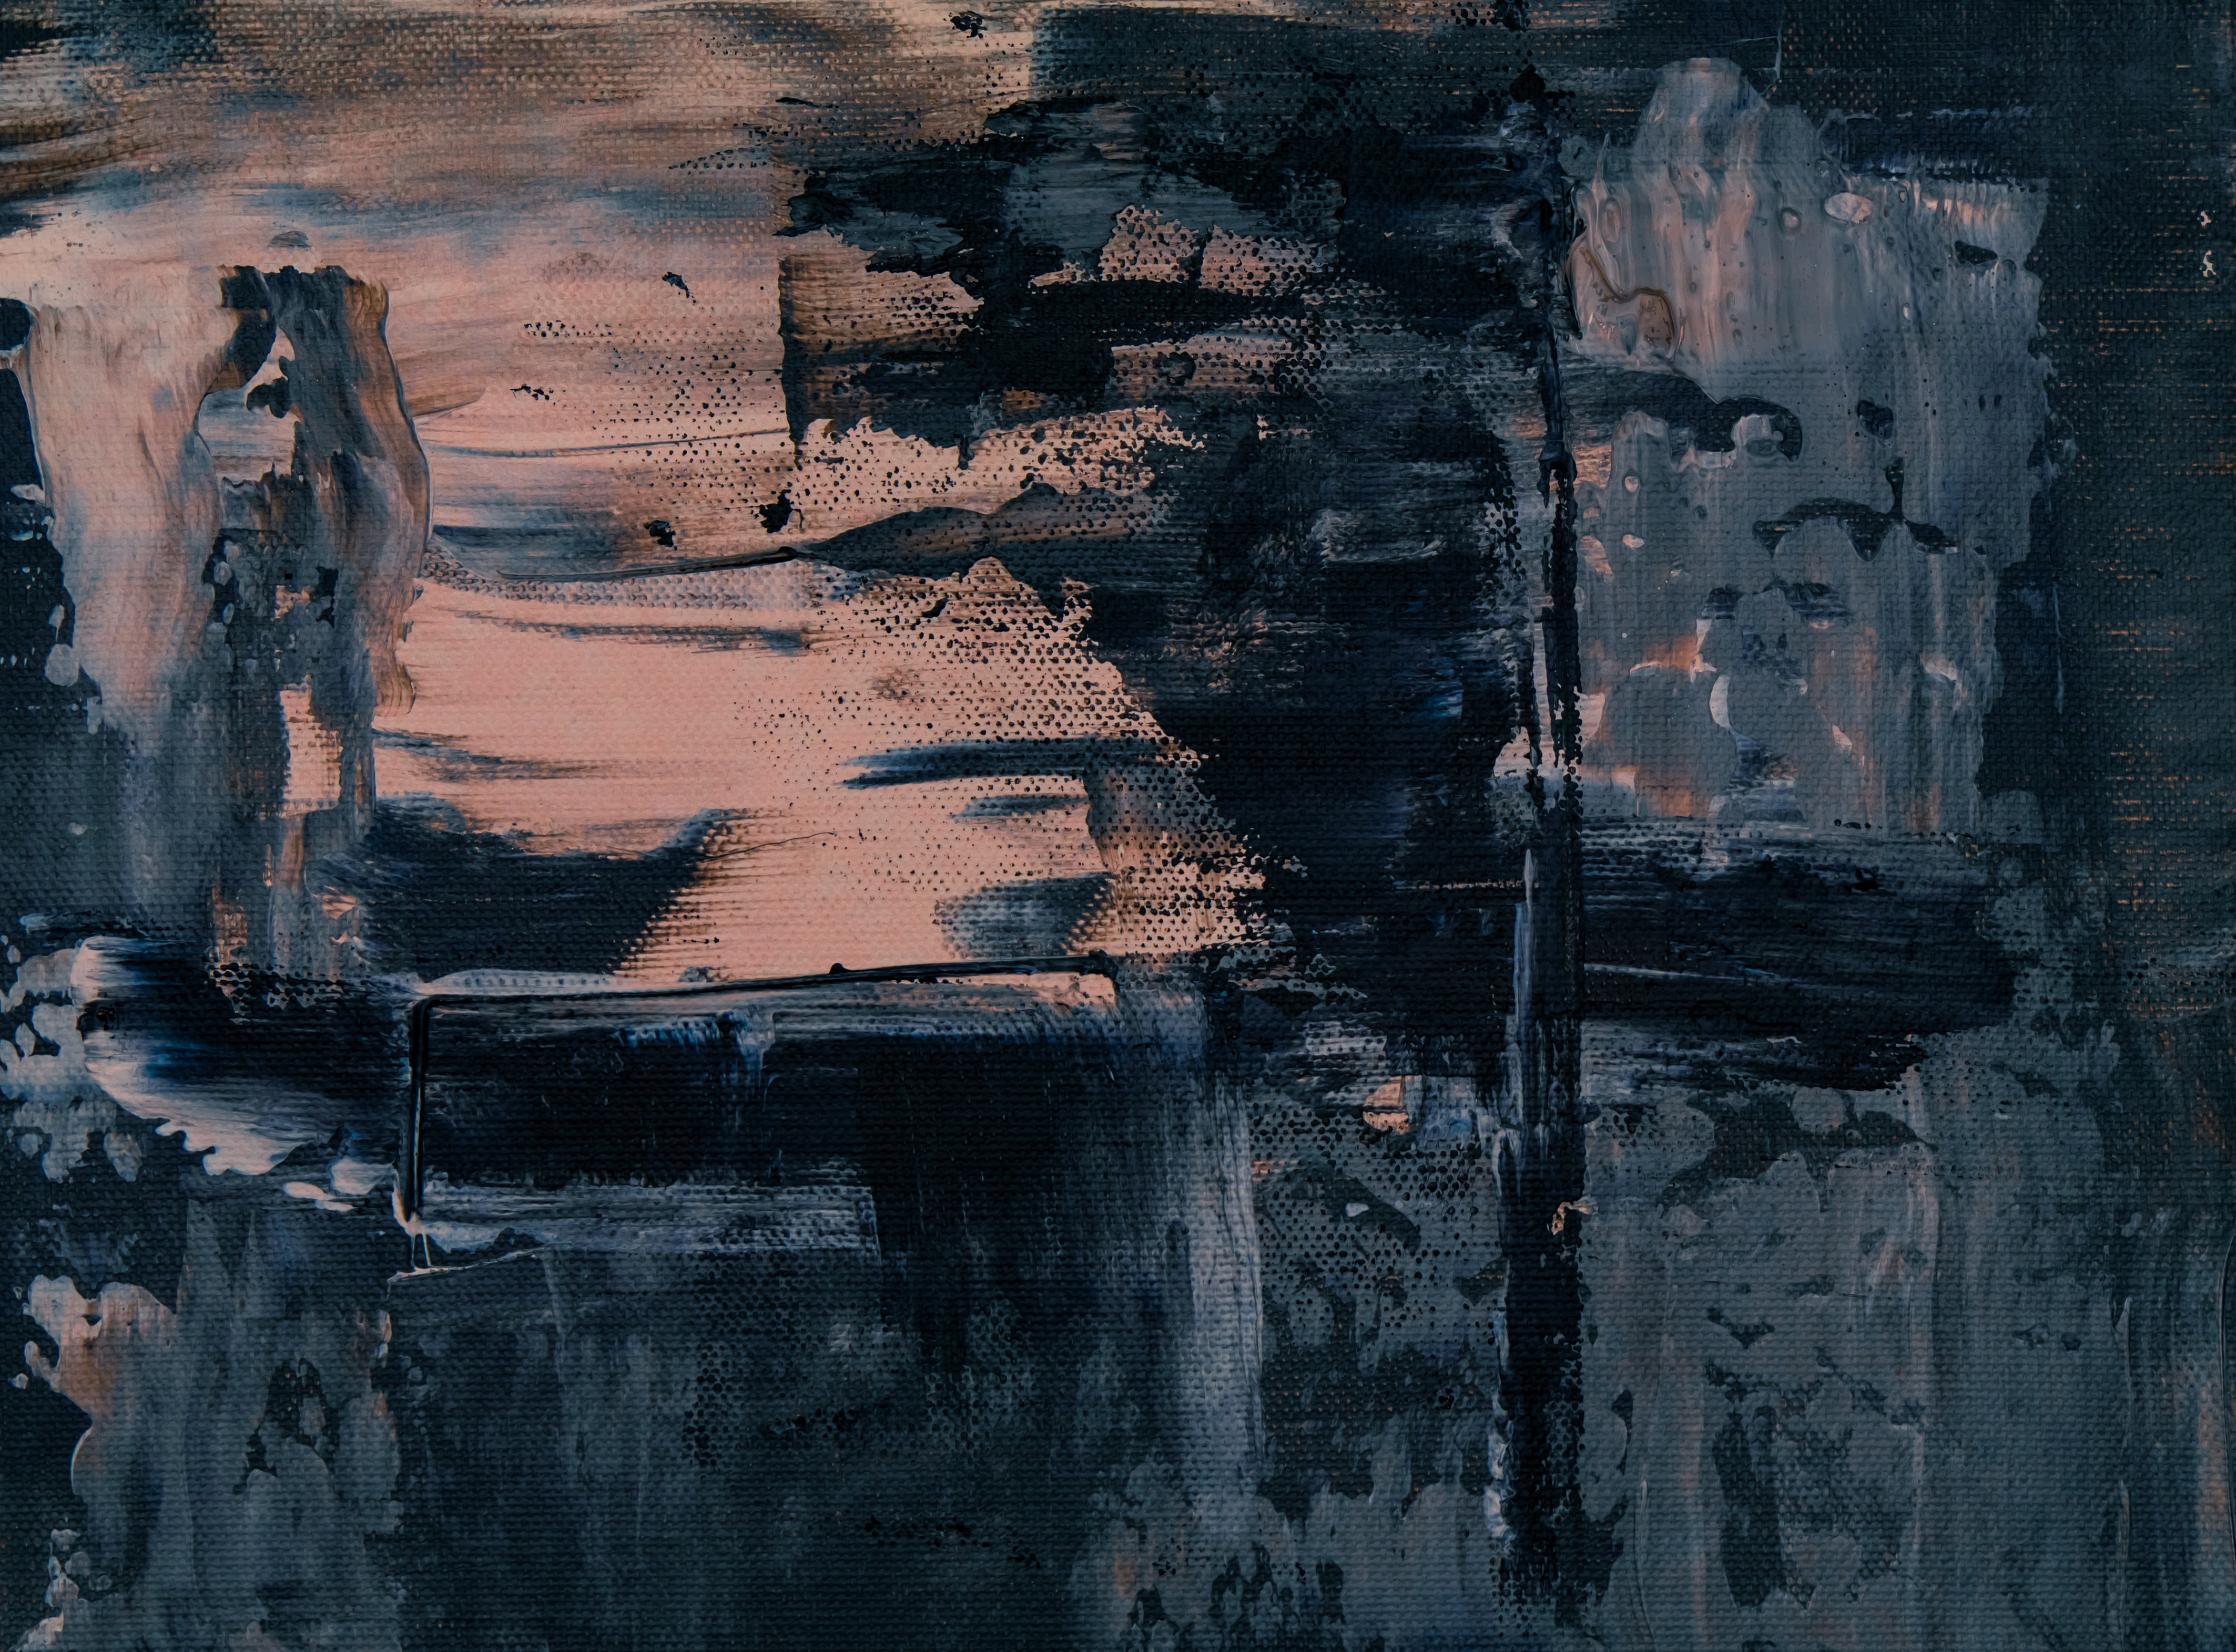




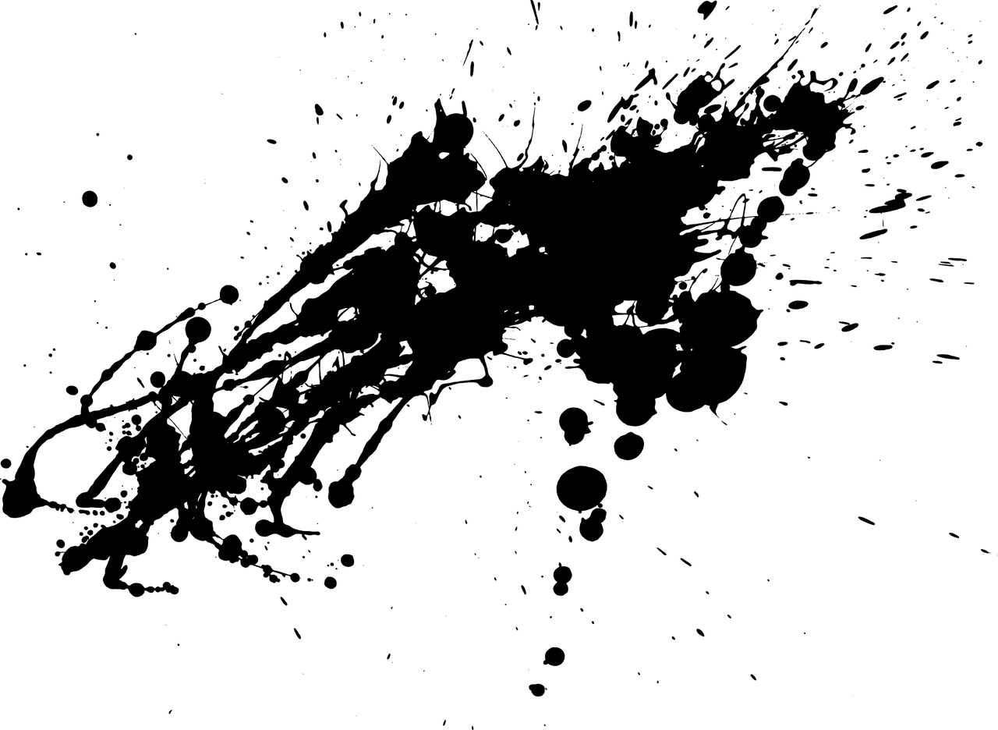
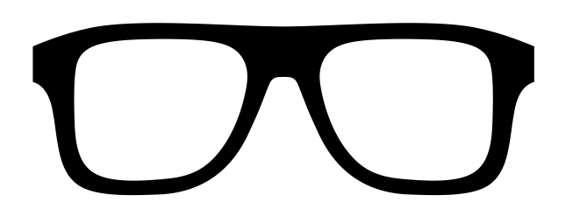
THIS IS ANDRÉ
I’M TRYIN TO MAKE A NAME FOR MYSELF AFTER ALL.
IT’S SUPER DARK.
I’M KILLIN IT!
A
WATERCOLOUR
MURDER
Notes:
This is André. André is an aspiring painter and author. Recently a film company asked to buy the rights to one of André’s short stories. Way to go, André! This is totally what he has always wanted – to be recognized for his work! But that’s the thing... André wants to make sure that he is recognised for his work and that the film version of his story doesn’t take on a new life of its own.

Slide 3




THIS IS SO NOT ANDRÉ
YA’LL CAN’T COPYRIGHT THIS FRIENDSHIP!
A
WATERCOLOUR
MURDER
ROMANCE
Notes:
André’s friend Sandy said he should look into something called moral rights.

Slide 4



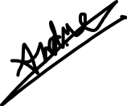
MORAL RIGHTS
MUAHHAHAHAHA!
©
Notes:
Moral rights are rights that exist separately from the economic rights we usually associate with copyright and are centred around the author or creator’s identity and reputation. These rights are rights that an author or creator of a work normally maintains even if the copyright associated with a work is transferred. Because of this, a licensee will not be able to purchase copyright to a work and then claim that they created that work. It will still be attributed to the original author because the moral rights, including the right of attribution cannot be transferred during the author’s lifetime.

Slide 5



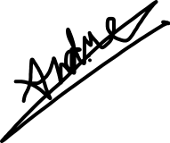
MORAL RIGHTS
TOLD YOU I WANNA MAKE A NAME FOR MYSELF!
…AND IT’S MY NAME!
=
Performer
Composer
Creator
“Author”
Filmmaker
“…where reasonable in the circumstances, to be associated with the work as its author by name or under a pseudonym and the right to remain anonymous”
1
The right to association
2
The right to integrity of the work
14.1 (1)
Notes:
Moral rights have two main components: The right of association – and that usually means attribution – and the right to the integrity of a work.
According to s. 14.1(1) of the Copyright Act, association is the “right, where reasonable in the circumstances, to be associated with the work as its author by name or under a pseudonym and the right to remain anonymous.” It is essentially the right to have credit (or not have credit) for the work. The moral rights outlined in the Copyright Act also allow an author to publish a work anonymously or under a pseudonym, but do not provide protection against the real identity of the author being exposed. By the way, the word “author” in the Copyright Act refers to writers but also to other artists, creators, composers, and, as of 2012, performers as well.

Slide 6

THE RIGHT TO INTEGRITY
2
The right to integrity of the work
“…is infringed only if the work or the performance is, to the prejudice of its author’s or performer’s honour or reputation, distorted, mutilated or otherwise modified; or used in association with a product, service, cause or institution.”
28.2 (1)
Notes:
The second component of moral rights is the right to the integrity of the work. This refers to an author's right for their work not to be used in a way that disadvantages the creator. Under s. 28.2 (1) of the Copyright Act this right “is infringed only if the work or the performance is, to the prejudice of its author’s or performer’s honour or reputation, distorted, mutilated or otherwise modified; or used in association with a product, service, cause or institution.” But how do you decide if a work has been distorted? Or what affect this has had, if any, on the author’s reputation?

Slide 7
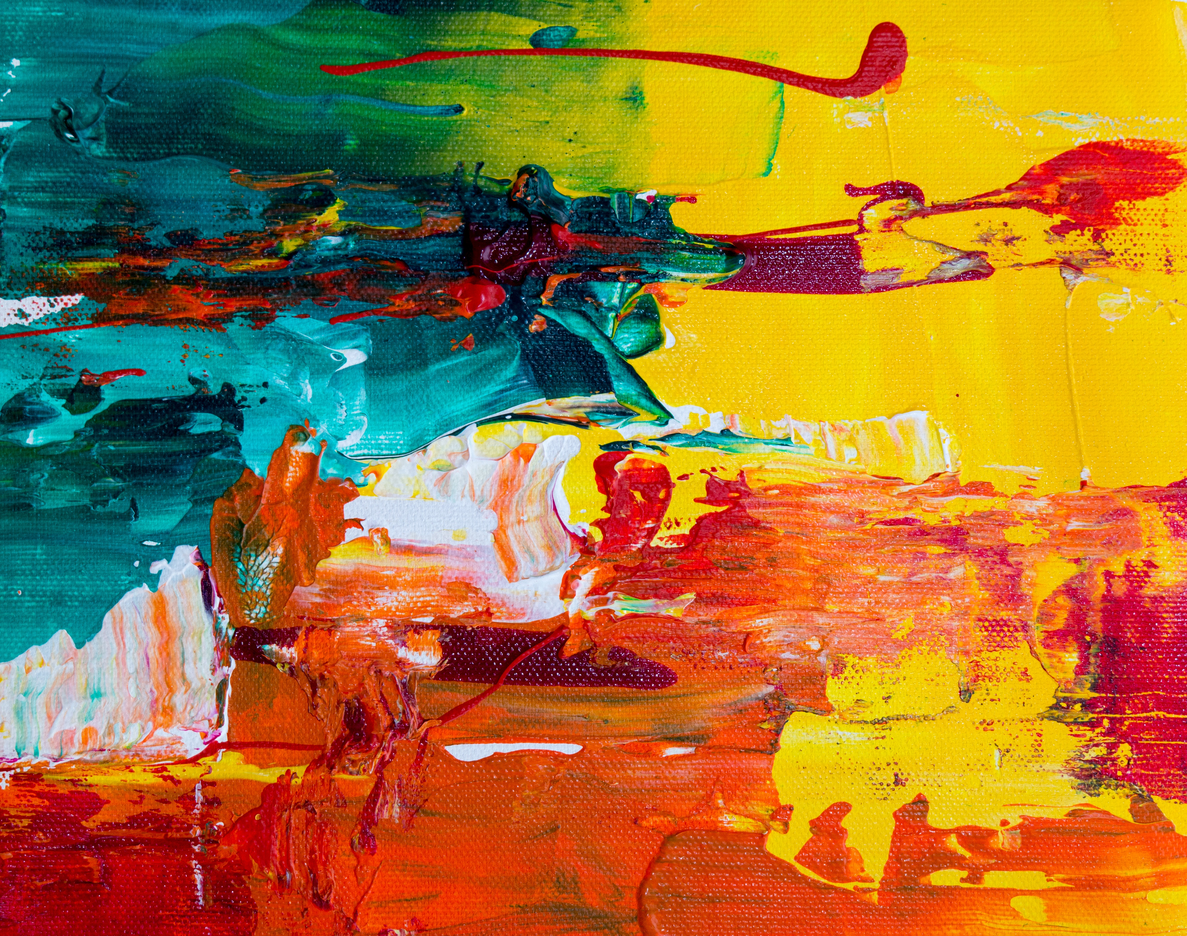
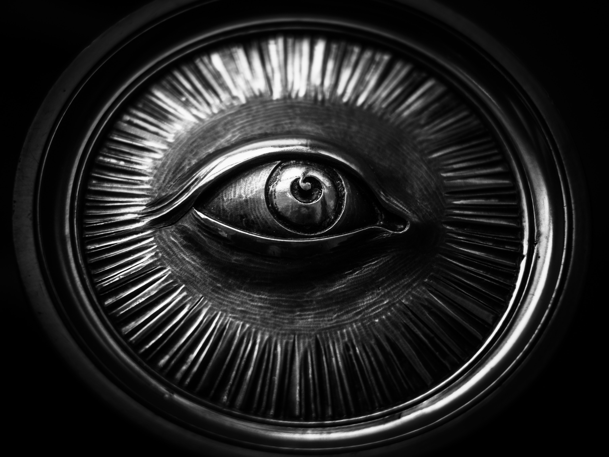
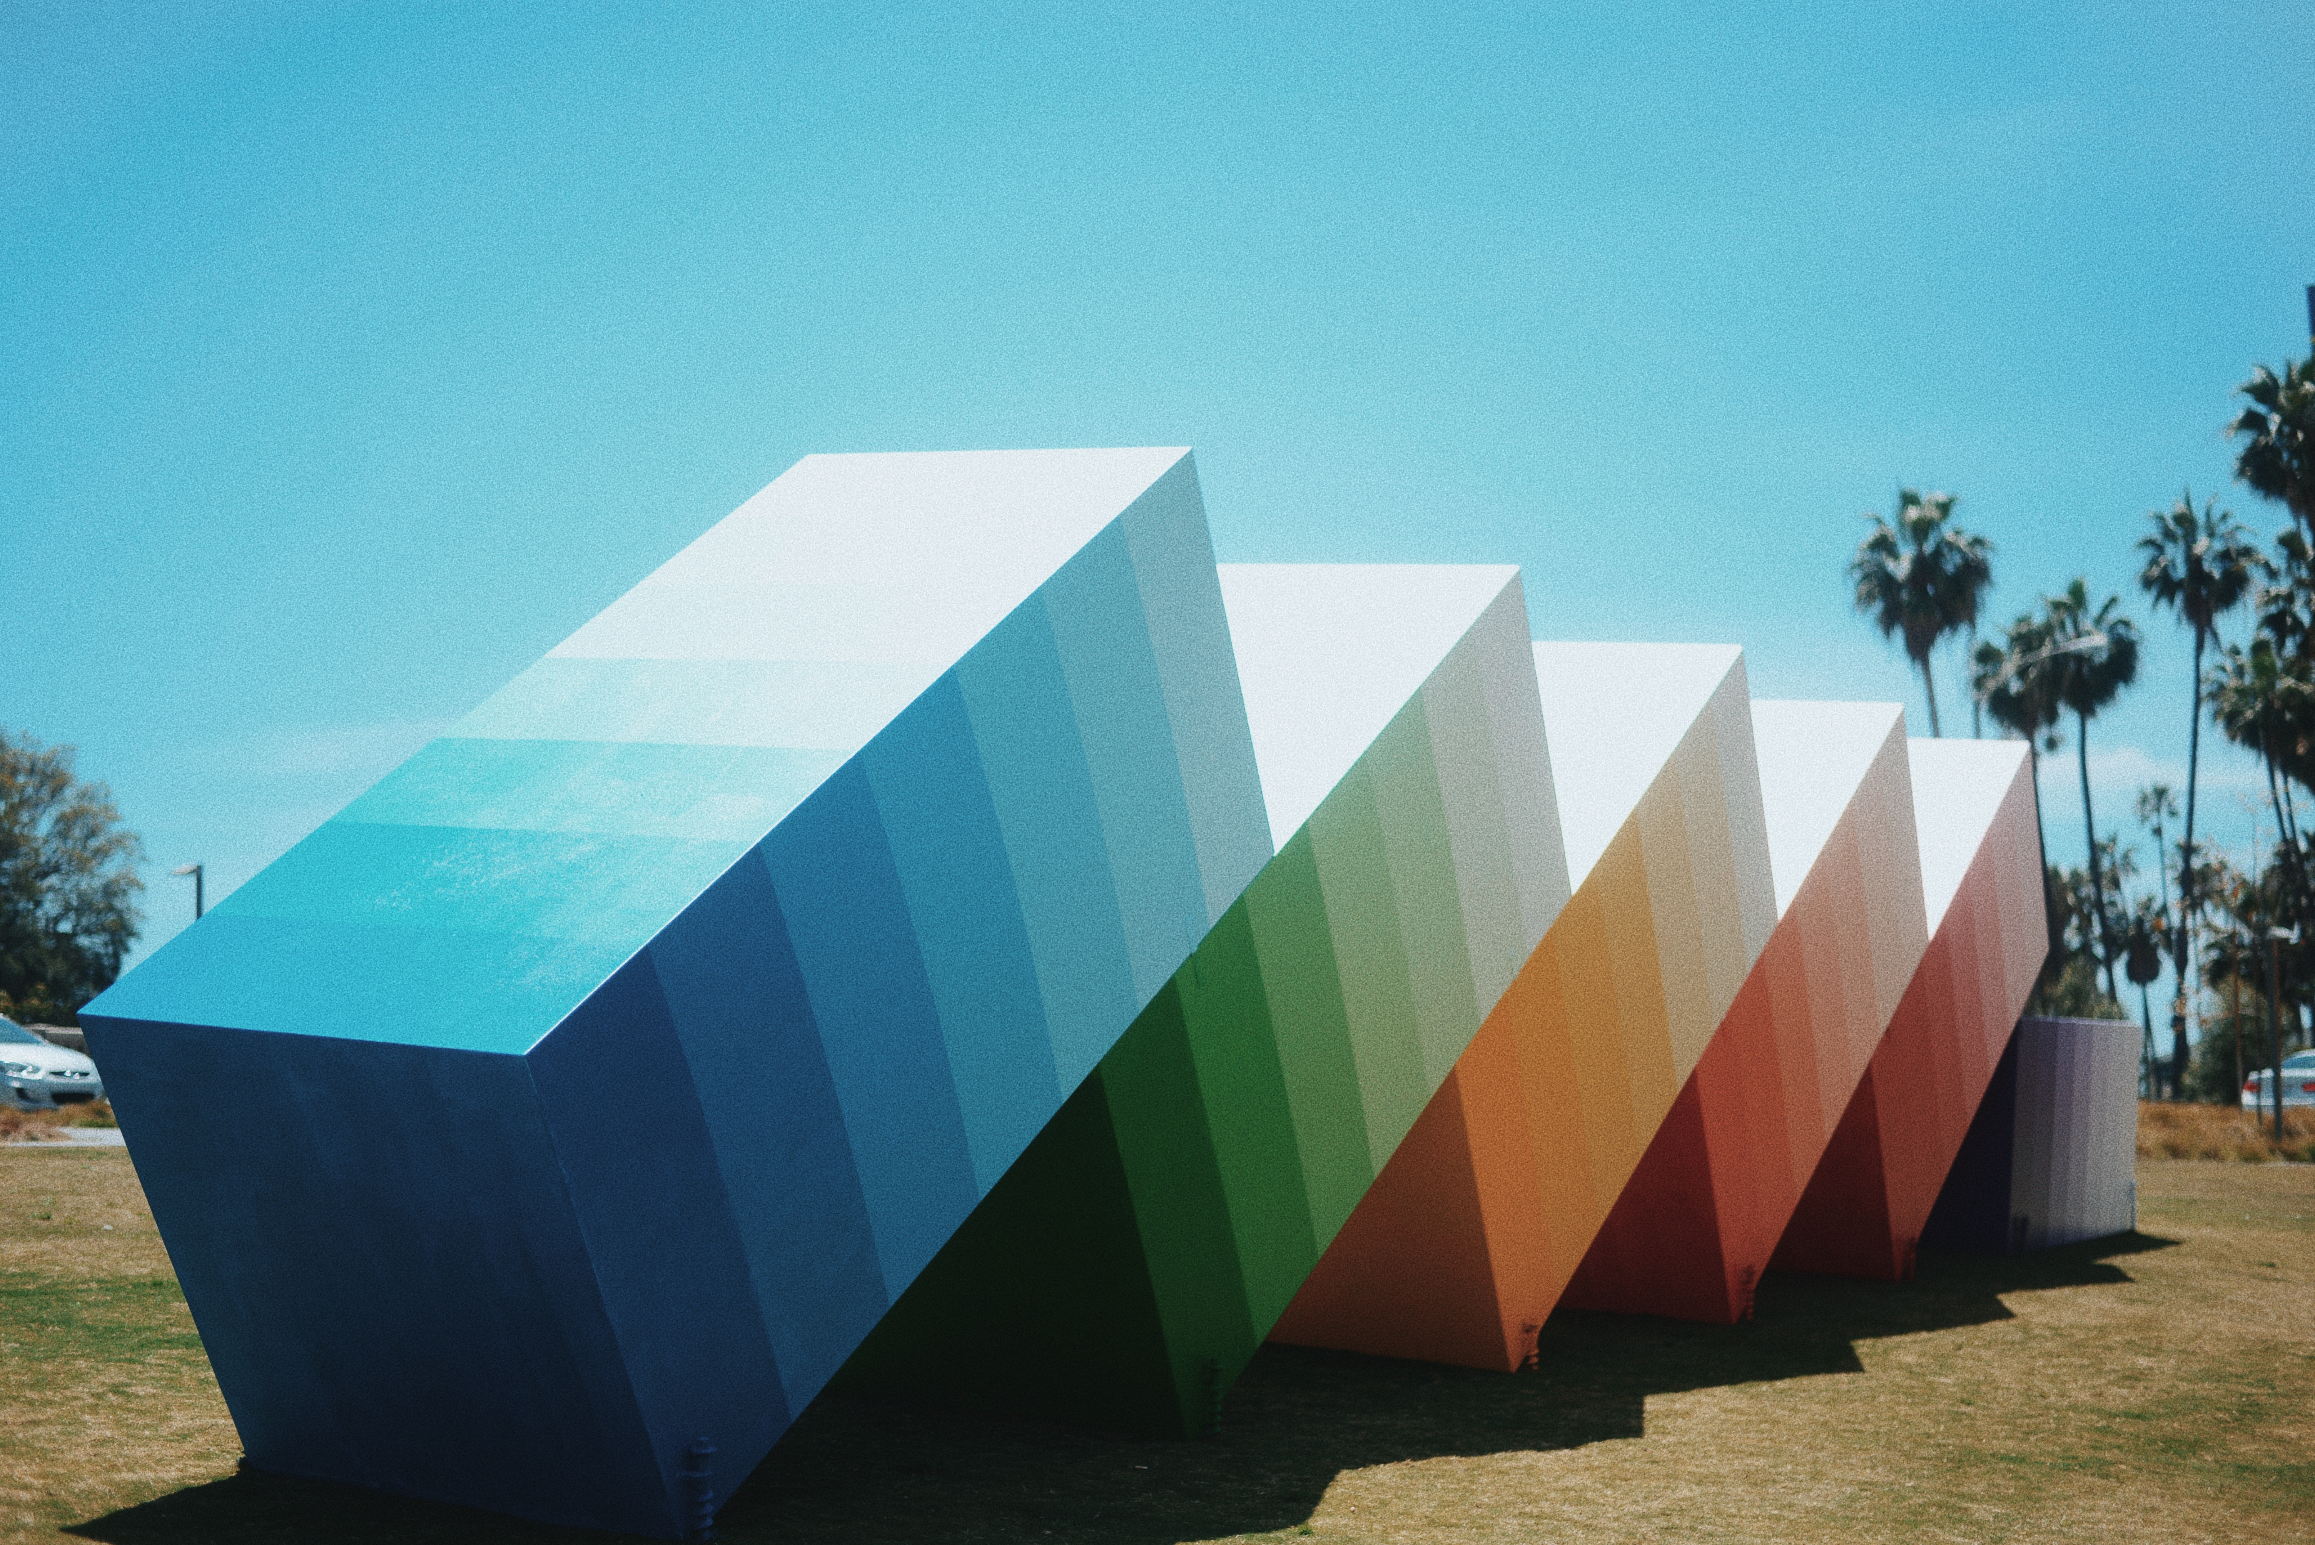
THE RIGHT TO INTEGRITY
NO TOUCHY
NO DUDE, WE COOL!
BACK OFF, OMBRÉ
ANDRÉ?
I’M WATCHING YOU
Notes:
In the case of a painting, an engraving, or a sculpture, any modification, distortion, or mutilation is considered a prejudice to the creator’s honour or reputation. This does not include steps taken to restore or preserve the work, relocate the work, or changes to the physical structure containing a work.

Slide 8
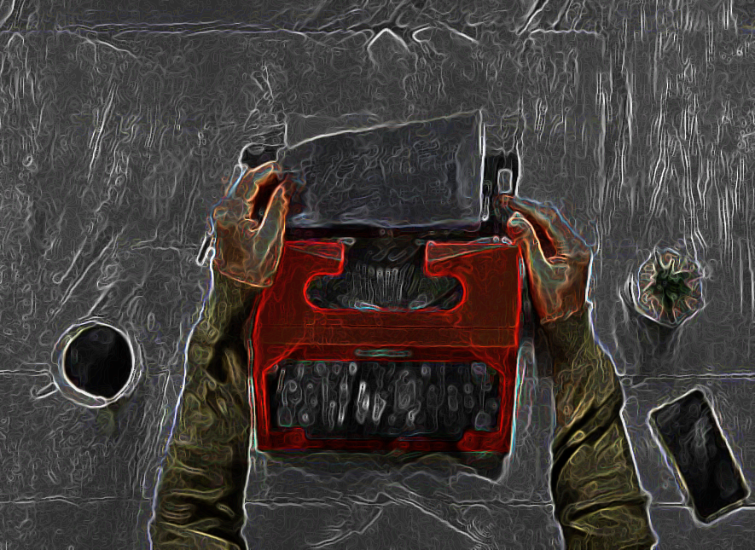

THE RIGHT TO INTEGRITY
Notes:
So if instead of selling the rights to one of his stories, Andre had sold the rights to one of his paintings or allowed it to be exhibited at a gallery, any modification of André’s painting could be infringing on his moral rights.

Slide 9
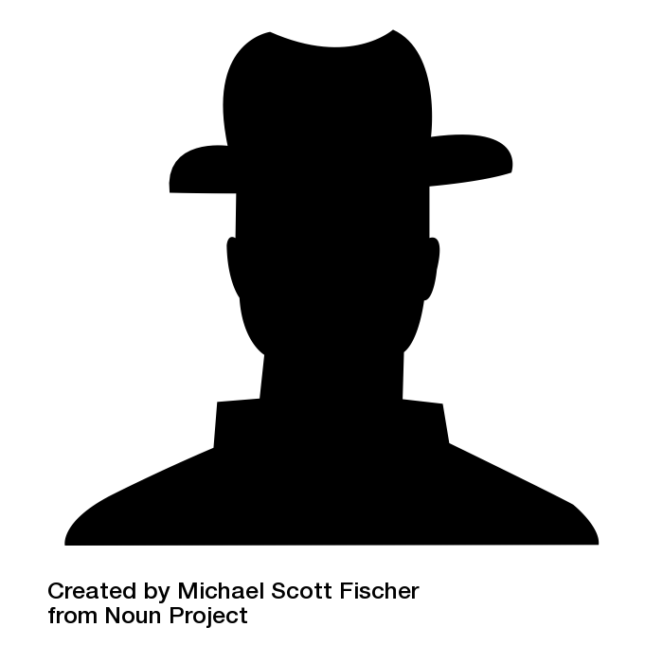
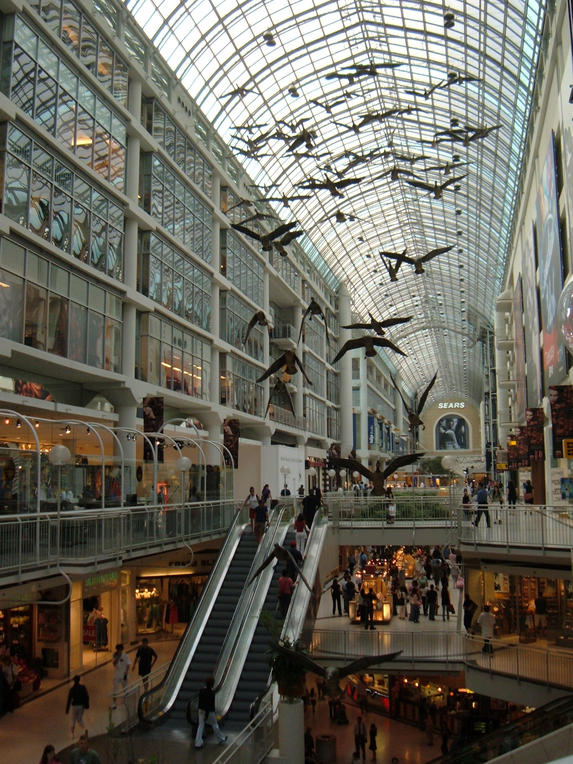

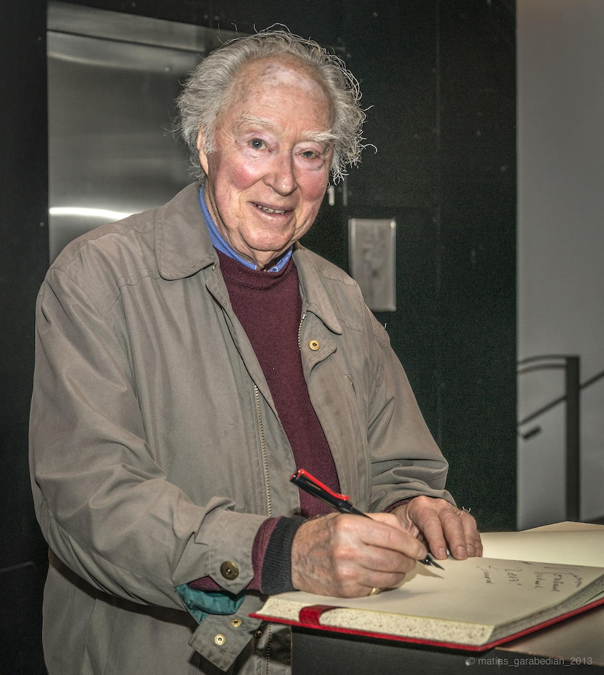

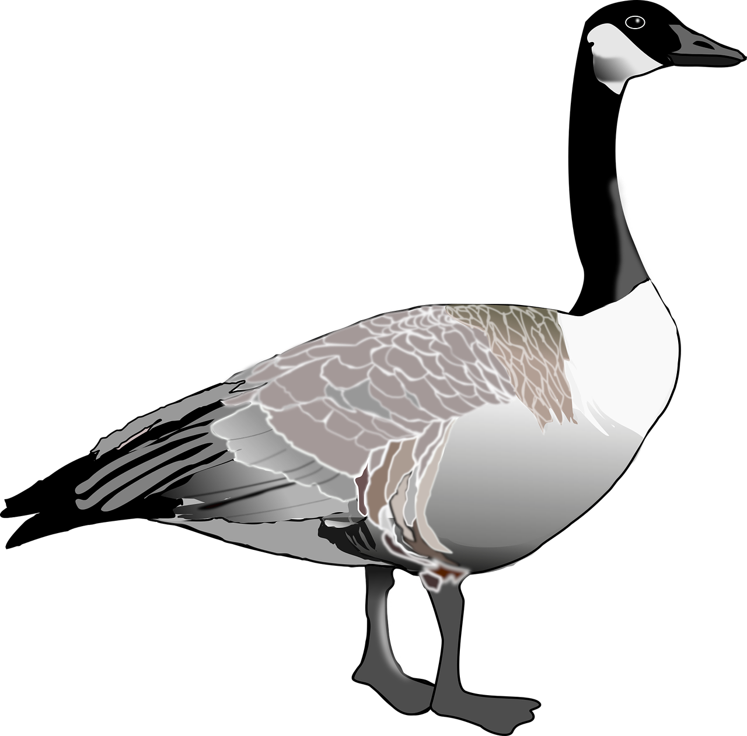
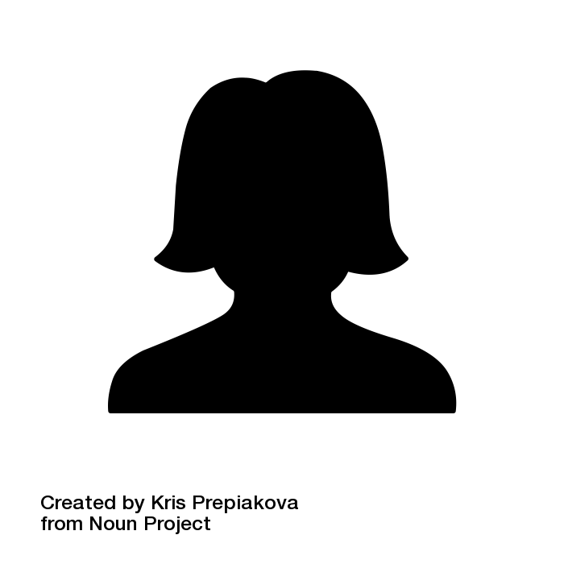

Snow v. The Eaton Centre Ltd.
Snow v. The Eaton Centre Ltd.
NOT COOL!
MINE HONOUR!!
YOU HAVE FOULED MY FOWL!
THIS IS QUACK!
THINE HONOUR!!
SUPER NOT COOL!
v.
JUST BOW WITH IT !
Notes:
One well-known example of this is the 1982 Snow v. The Eaton Centre Ltd. case. Sculptor Michael Snow sued the Eaton Centre Shopping mall in Toronto after they put red ribbons around the necks of the geese in his sculpture “Flight Stop” at Christmas time. The court took into account both Snow’s perceived damages to his reputation as well as the opinion of other artists in his field and ruled that the ribbons were in fact a violation of Snow’s moral rights because this modification was shown to prejudice the artist’s honour and reputation by others in his field. The ribbons were subsequently removed from the installation.

Slide 10
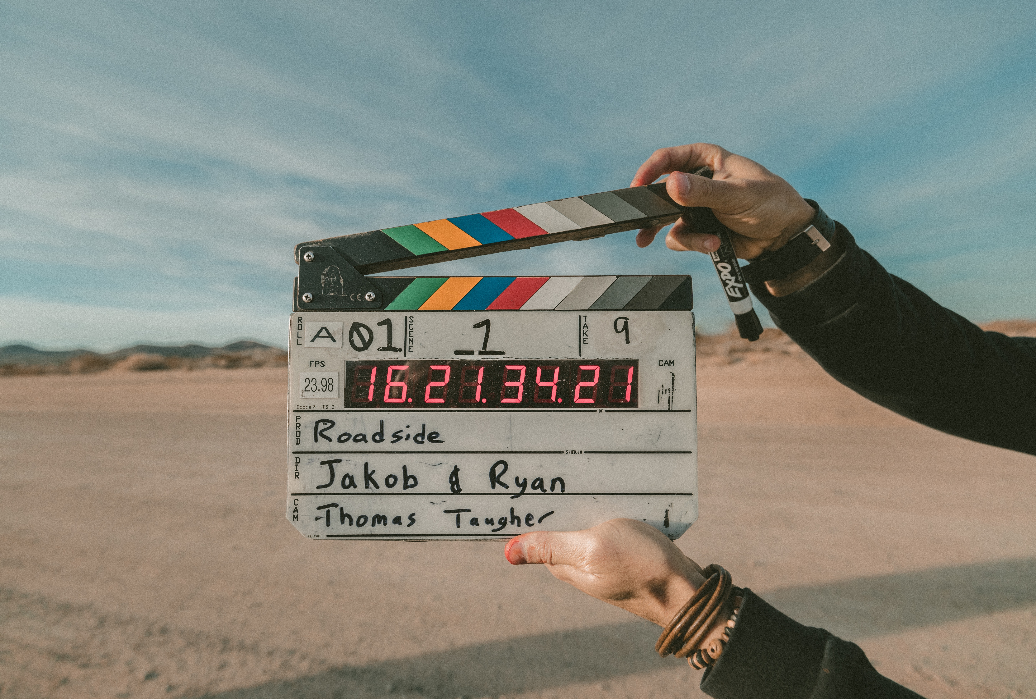
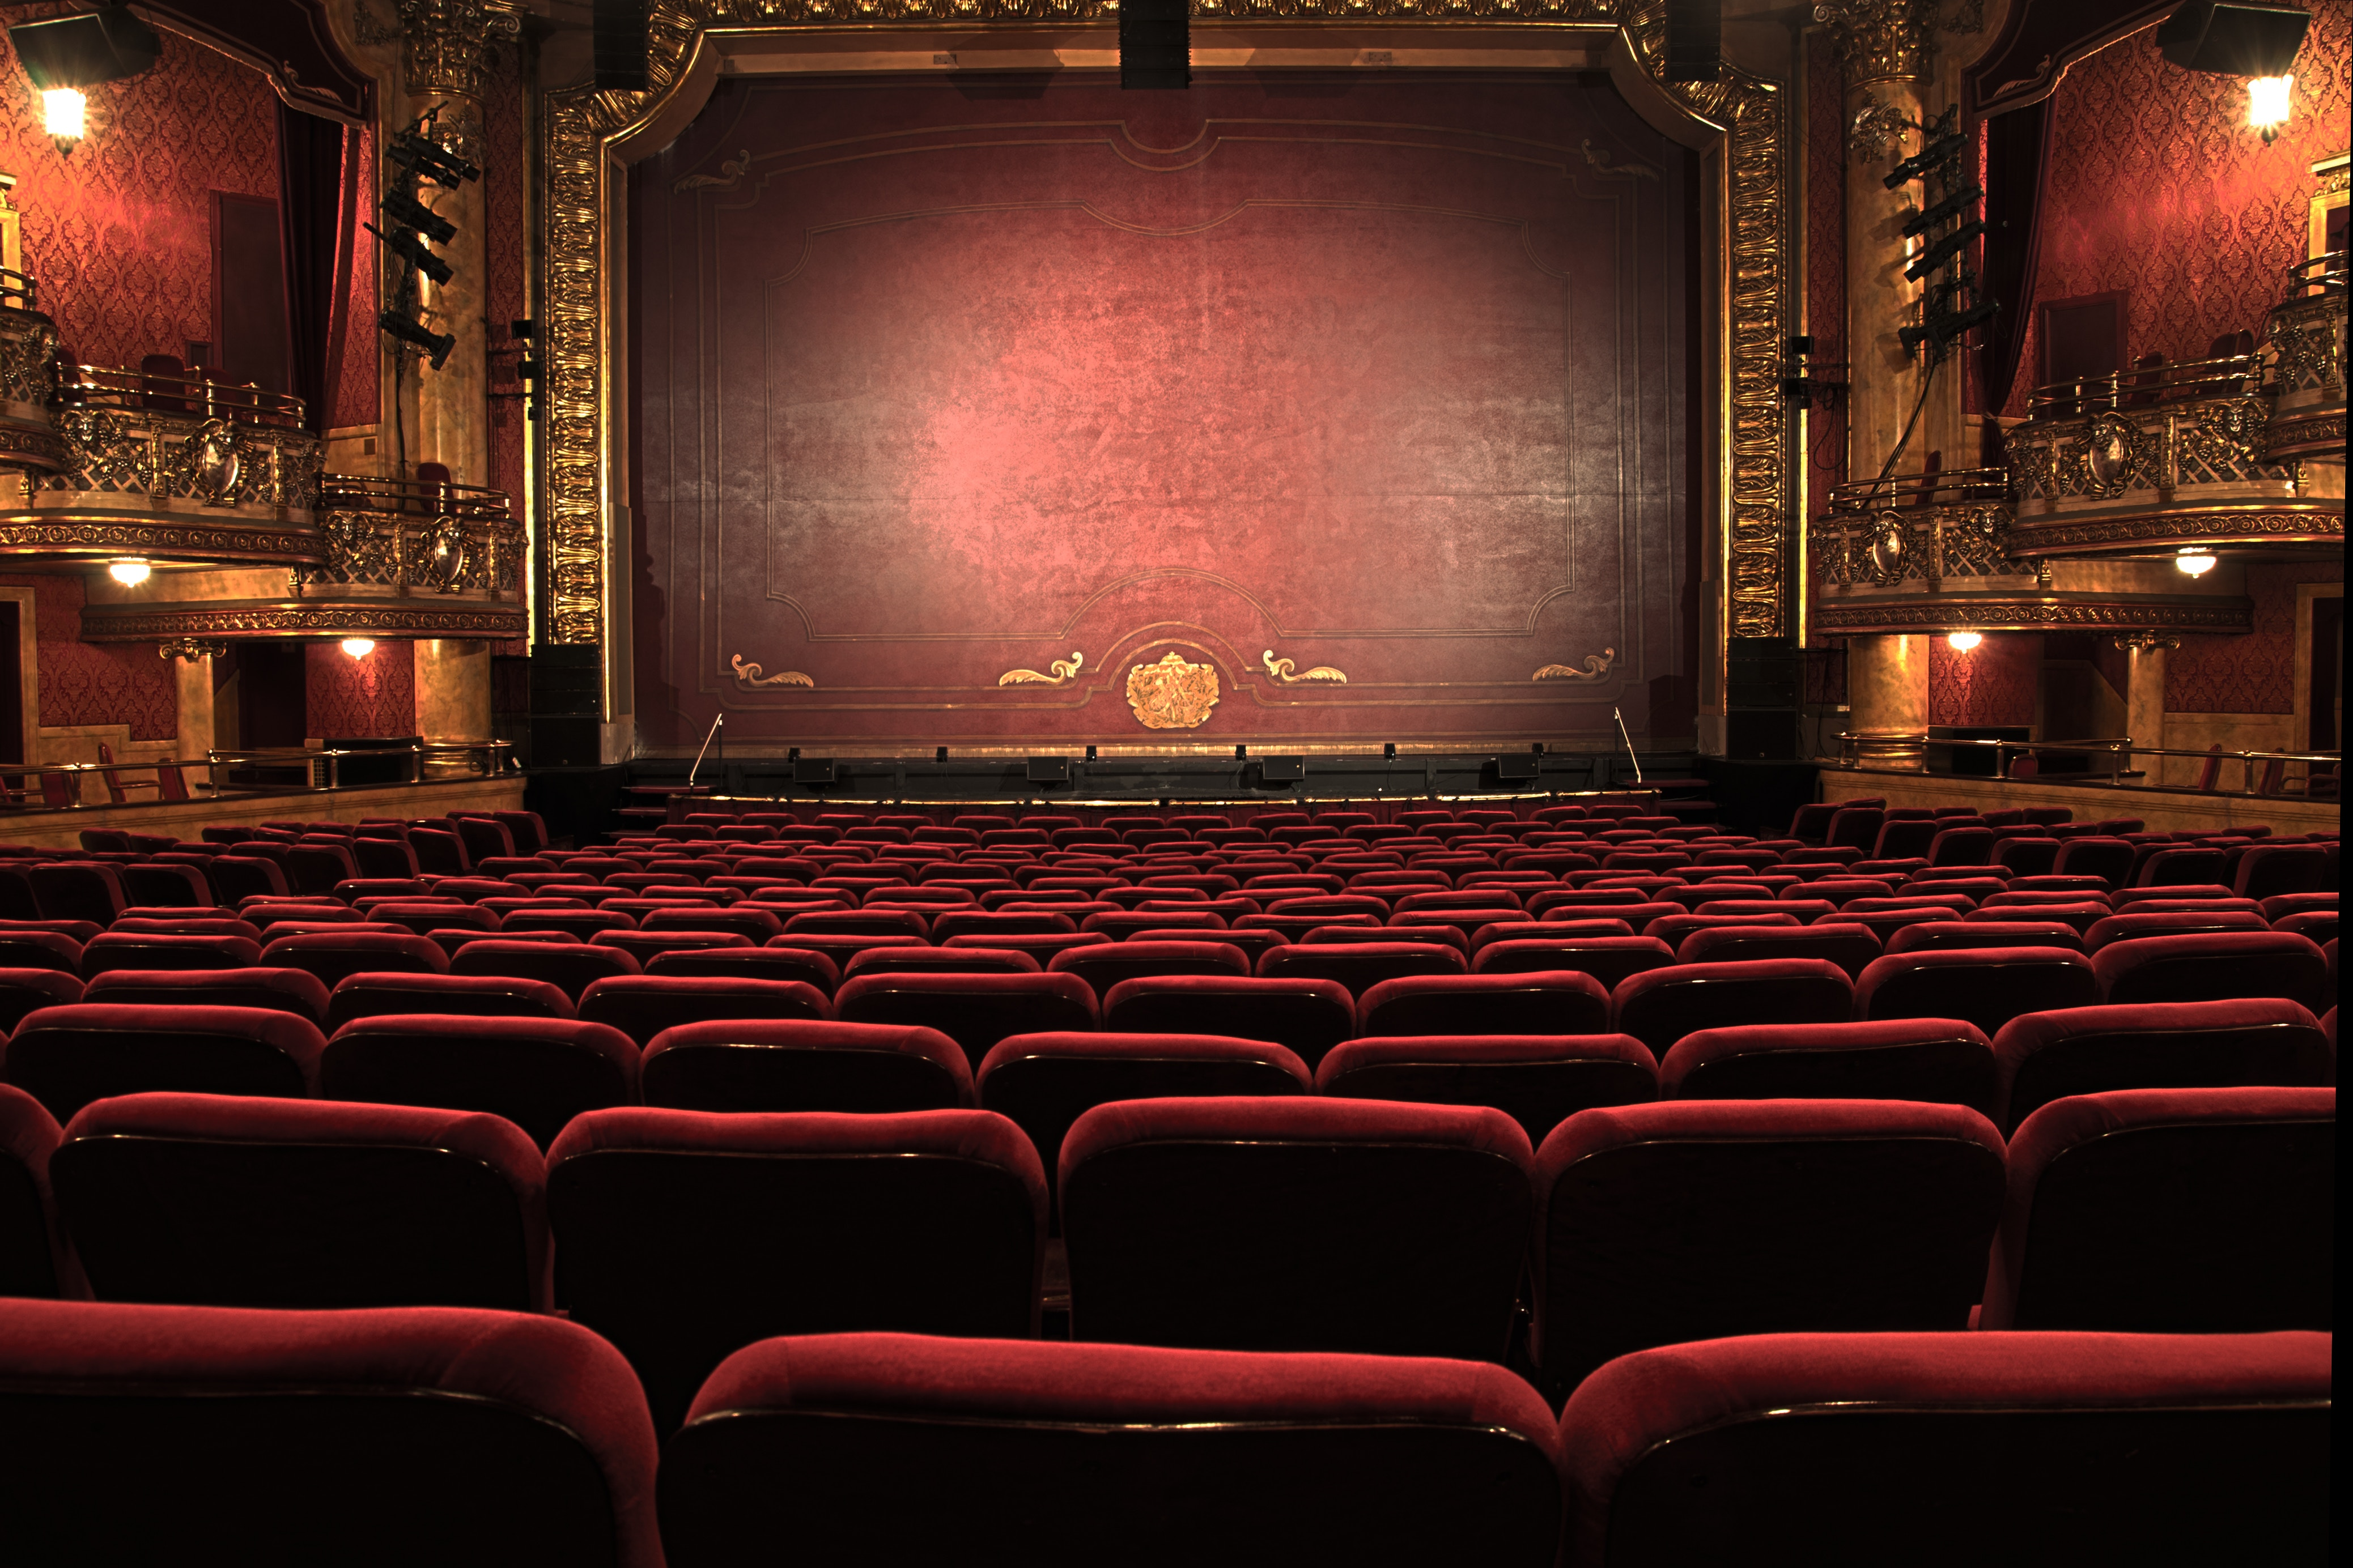


MODIFICATION & INFRINGEMENT
ANY MODIFICATION
=
INFRINGEMENT
MINE HONOUR!!!
THINE HONOUR!!
WHAT ABOUT WITH MY STORY?
“Don’t go breaking my art…”
28.2 (1)
Notes:
Since this case the Copyright Act now states in section 28.2(2) that with paintings, sculptures or engravings any distortion is considered infringement. So if this occurred today it would not be necessary for Snow, as a sculptor, to make a claim about damage to his honour or reputation.
For other kinds of works a modification or distortion of a work alone is not enough to prove an infringement of moral rights. In fact, some have suggested that the Snow case raised the bar for establishing infringement in other kinds of works such as books or in André’s case short stories. For these kinds of works the author must show that the modification is prejudicial to their honour or reputation.

Slide 11
MODIFICATION & INFRINGEMENT
I DON’T WANT ANOTHER STORY!
I WANNA KEEP MY STORY GORY!
I’D NEED TO PROVE THEY RUINED MY GORY STORY GLORY!
“CAN’T TOUCH THIS.”
=
ANY MODIFICATION
INFRINGEMENT
MINE HONOUR!!!
THINE HONOUR!!
A
WATERCOLOUR
MURDER
Notes:
In other words, if someone who purchased the rights to André’s painting had modified it – that is an automatic infringement, but if they modified his story... well that’s another ... story. André would have to make a claim that the modification has negatively affected his reputation. A claim that moral rights have been violated by modifying a work is more likely to succeed in court if it is backed up by evidence, such as an expert witness, that can link the modification of the work to damage to the creator’s reputation.

Slide 12
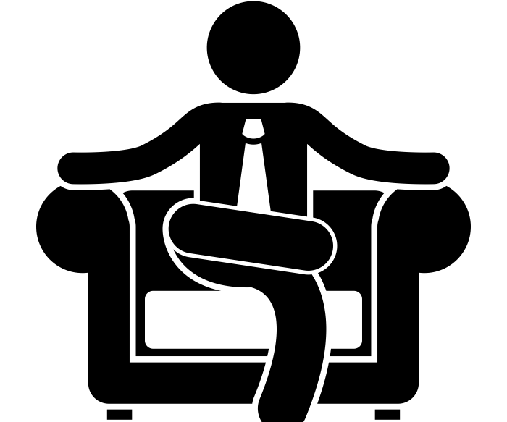

WAIVING MORAL RIGHTS
WHY WOULD I DO THAT?
”A WATERCOLOUR ROMANCE” NOT LOOKING SO BAD NOW, HUH?
YEAH NOT HAPPENING.
GO ON…
Notes:
Although moral rights cannot be transferred, they can be waived in whole or in part by the creator with a written agreement. One reason why an author might waive their moral rights is in order to negotiate a higher licensing fee. An author could charge a higher fee for allowing the licensee to use and modify the work more freely and, depending on the terms of the waiver, potentially avoid attributing the work to the original creator. An author might also be required by their employer to waive their moral rights to the work they produce in the course of their employment, although this doesn’t apply to André.

Slide 13



MORAL RIGHTS TERMS
Resize…
problems
70 years
50 years
PERPETUELLEMENT!
…Not really a thing.
Notes:
It should be noted that moral rights of an author also vary by country. For example, unlike in Canada, where the term for moral rights is the same as the term for copyright (50 years after the death of the creator or in the case of multiple authors, 50 years after the death of the last surviving author), in France moral rights are perpetual. The United States, on the other hand, has no moral rights provision in their copyright law outside of a visual arts context. Canada’s approach to moral rights falls somewhere in the middle of the spectrum.

Slide 14
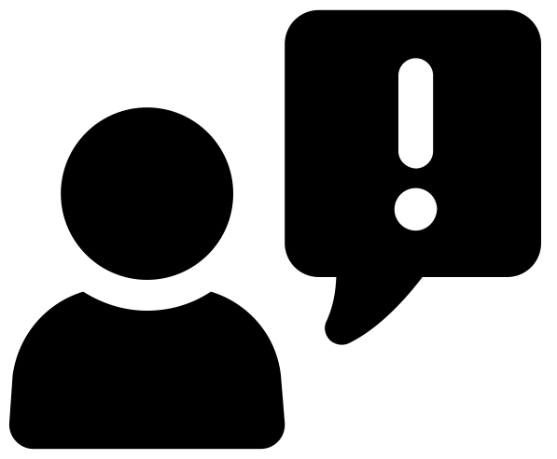
WELL, ACTUALLY…
We interrupt this instructional module
to bring you important information about the term of copyright protection in Canada.
On December 30, 2022, the 20-year extension to the general term of copyright protection in Canada, which was a requirement under the Canada-United States-Mexico Agreement (CUSMA), came into force.
The term of copyright protection was changed from life of the author plus 50 years ("Life + 50") to Life + 70. This 20-year extension does not apply retroactively to works already in the public domain in 2022.
Notes:
[Copied as an image to display via H5P.]

Slide 15
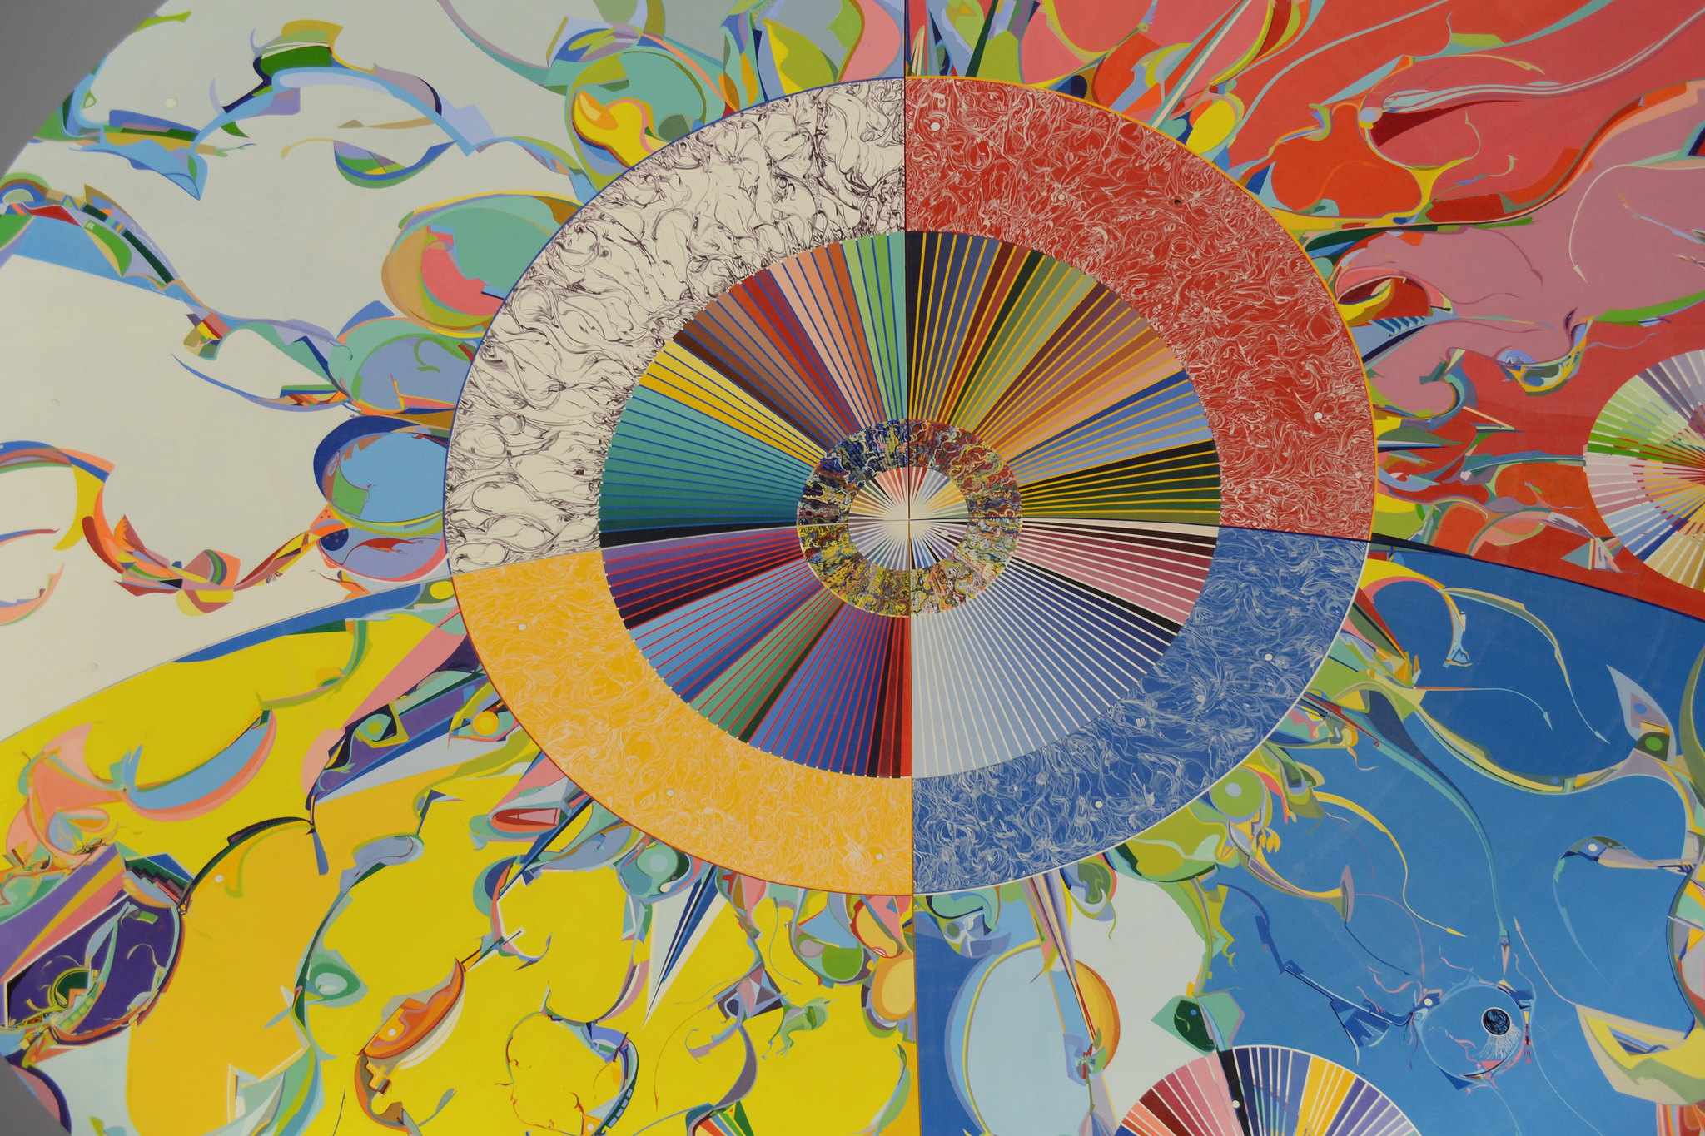
INDIGENOUS MORAL RIGHTS
”Morning Star” by Alex Janvier
“The painting is a commentary on the clash of cultures that took place after Europeans arrived in North America and encountered Native peoples” (“Morning Star,” n.d.)
Notes:
It is important to acknowledge that Canada’s approach to moral rights is based on western concepts of authorship and ownership. Because of this it can be difficult for Indigenous peoples, whose cultural and Traditional Knowledge has been developed collectively over generations, to protect the integrity of their works.

Slide 16
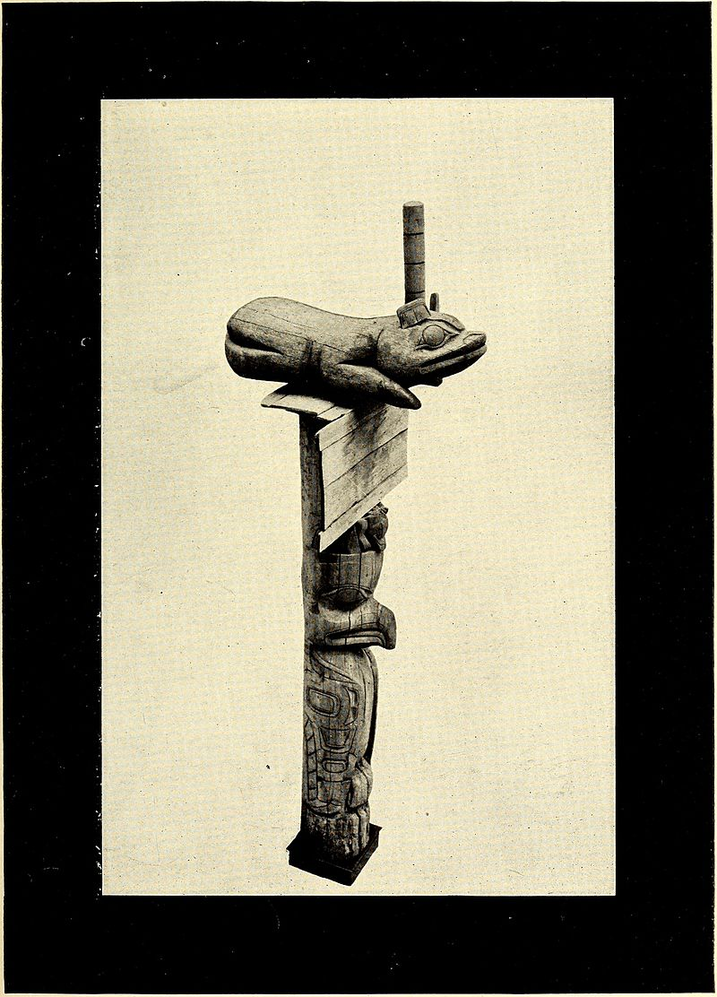
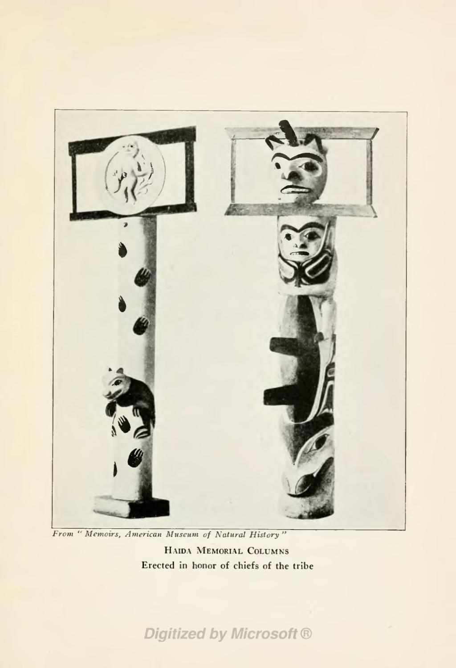
INDIGENOUS MORAL RIGHTS
Traditional Haida memorial columns
Notes:
Canadian copyright as it stands today cannot adequately cover the moral rights of many Indigenous works. This is for many reasons including that there is not always an identifiable, singular author and that the reputation or honour in these cases often refers to the honour of a clan, culture, or nation rather than a specific individual. According to Murray and Trosow, Indigenous ideas about cultural property illuminate a range of different cultural practices and contexts and function as a powerful critique of certain elements of copyright thinking in Canada.

Slide 17
LEARNING OBJECTIVES
You should now be able to:
Define the two key components of moral rights
Compare and contrast moral rights with economic rights in copyright
Recognize what constitutes an infringement of moral rights
Understand the limitations of the Canadian approach to moral rights for protecting Indigenous knowledge

Slide 18
Notes:
This has been the University of Alberta’s Opening Up Copyright Module on Moral Rights. Thank you for your attention.

Slide 19
QUESTIONS
  A claim that moral rights have been violated by modifying a work is more likely to succeed in court if it is backed up by evidence that the creator’s reputation has suffered as a result.
    True
    False
What are the two key components of moral rights:
  Association and affiliation
  Association and integrity
  Association and attribution
  Salvation and purgatory
The right to association also includes a right to use a pseudonym and the right to remain anonymous.
    True
    False

Slide 20
QUESTIONS
Moral rights (as opposed to economic rights) in copyright:
  Can be waived but not transferred
  Deal with reputation and honour of the creator
  Are not really a thing in the U.S.
  All of the above
Which feature is not common to both moral and economic rights in copyright in Canada:
  Term of protection
  Can be transferred during an author’s lifetime
  Can be negotiated between a licensee and creator
  Define author broadly (e.g. author = filmmaker, performer, etc.)
Currently, for sculptures, engravings and paintings, moral rights infringement occurs when:
  The work is moved to a new location
  There is a change to the structure containing the work
  The work is altered as part of preservation efforts
  There is any other kind of modification than those listed above
When will the Eaton’s Centre be able to put bows on Snow’s geese sculpture, “Flight Stop”:
  70 years after the death of Snow
  Never
  After the Eaton Centre successfully defeats Snow in a duel for honour
  They won’t be able to as Amazon will have put the mall out of business (RIP Eaton’s)

Slide 21
QUESTIONS
Changes to the Copyright Act since the Snow v. Eaton Centre Ltd. case mean that:
  All geese statues in Canada must wear bows
  Canadians are only allowed to do Christmas shopping through the Eaton’s catalogue
  It has been suggested that the bar has been raised for establishing moral rights infringement for works that are not sculptures, engravings or paintings
  Moral rights are only guaranteed if you paint an engraved sculpture
The current Canadian approach to moral rights is poorly suited for protecting Indigenous knowledge and cultural expression because:
  Moral rights are based on Western ideas of ownership and authorship
  There is not always an identifiable author
  Damages to reputation could impact a nation, community or culture rather than an individual
  All of the above

Slide 22
FURTHER READING
Adeney, E. (2008). Moral rights in Canada: A historical and comparative view. In Y. Gendreau (Ed.) Queen Mary Studies in Intellectual Property: An emerging intellectual property paradigm: Perspectives from Canada (163-196). Retrieved from: https://ssrn.com/abstract=2859316
Barraclough, E. (2018). Raging bull and fearless girl: Moral rights in copyright. WIPO Magazine. Retrieved from: https://www.wipo.int/wipo_magazine/en/2018/02/article_0003.html
Vaver, D. (1987). Authors’ moral rights: Reform proposals in Canada: Charter or barter of rights for creators? Osgoode Hall Law Journal, 25(4) 749-786. Retrieved from: http://digitalcommons.osgoode.yorku.ca/ohlj/vol25/iss4/4
Wilkinson, M.A. (2006). The public interest in moral rights protection. Michigan State Law Review 1, 193-234. Retrieved from: https://ir.lib.uwo.ca/lawpub/49
Wilkinson, M.A., & Gerolami, N. (2009). The author as agent of information policy: The relationship between economic and moral rights in copyright. Government Information Quarterly 26, 321- 332. Retrieved from: https://ir.lib.uwo.ca/lawpub/48

Slide 23
“Morning Star” (n.d.). Canadian museum of history [website]. https://www.historymuseum.ca/cmc/exhibitions/tresors/treasure/283eng.html
Murray, L.J., Trosow, S.E. (2013). Canadian copyright: A citizen’s guide. Between the Lines

Slide 24
IMAGE AND SOUND REFERENCES
Steve Johnson (n.d.). [painting- black]. Unsplash. https://unsplash.com/photos/8fnJThWFl6I
FreeCreativeStuff (n.d.). [paint splash video] Pixabay. https://pixabay.com/videos/splash-paint-splashing-ink-splat-23176/
CreatureSH (n.d.). [black paint splatter]. Pixabay. https://pixabay.com/vectors/paint-splatter-splash-ink-drop-2174689/
Basadev4 (n.d.). [Andre]. Pixabay. https://pixabay.com/illustrations/black-avatar-cute-cheerful-3025348/
Achille Bianchi (n.d.). Glasses. The Noun Project. CC BY. https://thenounproject.com/search/?q=glasses&i=240647
Prucanada (2018). A Short, high-pitch scream. Freesound. CC0. https://freesound.org/people/prucanada/sounds/415353/
OpenClipart-Vectors [book]. Pixabay. h https://pixabay.com/vectors/book-notebook-paper-text-textbook-2028349/
Clikr-Free-Vector-Images. [blood]. Pixabay. https://pixabay.com/vectors/splatter-blood-drops-paint-color-303569/
Clikr-Free-Vector-Images. [hearts]. Pixabay. https://pixabay.com/vectors/hearts-valentine-love-romance-37308/
OpenClipart-Vectors. [pink film]. Pixabay. https://pixabay.com/vectors/negatives-film-photography-plastic-155925/
Alexkandrel (2012). Royal sparkle woosh left to right. Freesound. CC0. https://freesound.org/people/alexkandrell/sounds/170522/
Eucalyp (n.d.). Moral. The Noun Project. CC BY. https://thenounproject.com/term/moral/901639
deleted_user_96253 (2016). Cha ching. Freesound. CC0. https://freesound.org/people/deleted_user_96253/sounds/351304/

Slide 25
IMAGE AND SOUND REFERENCES
AFY Studio (n.d.). Paint. The Noun Project. CC BY. https://thenounproject.com/search/?q=paint&i=839739
Gregor Cesnar (n.d.). Anonymous. The Noun Project. CC BY. https://thenounproject.com/search/?q=anonymous&i=441049
Maxime Kulikov (n.d.). Glasses. The Noun Project. CC BY. https://thenounproject.com/search/?q=glasses&i=2585978
VintageSnipsAndClips. [question mark]. Pixabay. https://pixabay.com/vectors/question-question-mark-punctuation-1243504/
Steve Johnson (n.d.). [abstract painting]. Unsplash. https://unsplash.com/photos/e5LdlAMpkEw
Samuel Zeller (n.d.). [engraving]. Unsplash. https://unsplash.com/photos/ZeKDTlXFWu8
Julian Howard (n.d.). [sculpture]. Unsplash. https://unsplash.com/photos/ZeKDTlXFWu8
Rawpixle (n.d.). [red typewriter]. Pixabay. https://pixabay.com/photos/technology-computer-business-man-3224644/
Matias-Garabedian (2013). Michael Snow. Wikiepedia. CC BY-SA 2.0. https://en.m.wikipedia.org/wiki/File:Michael_Snow_(9838260743).jpg
IYY (2005). Toronto Eaton centre facing north. CC BY-SA 3.0
Wikimedia Commons. https://en.wikipedia.org/wiki/Snow_v_Eaton_Centre_Ltd#/media/File:TorontoEatonCentre.jpg
OpenClipArt-Vectors (n.d.). Pixabay. [Canada goose]. https://pixabay.com/vectors/alphabet-word-images-animal-canada-1293059/

Slide 26
IMAGE AND SOUND REFERENCES
GDJ (n.d.) Pixabay. [red bow]. https://pixabay.com/vectors/red-ribbon-hair-accessory-clothing-1227873/
Iconnic (n.d.) Profile. The Noun Project. CC BY. https://thenounproject.com/search/?q=profile&i=2011988
Kris Prepiakova (n.d.). User. The Noun Project. CC BY. https://thenounproject.com/search/?q=SILHOUETTE&i=948793
Michael Scott Fischer (n.d.). Man. The Noun Project. CC BY https://thenounproject.com/search/?q=silhouette&i=10325
Bone666138 (2013). Medieval style fanfare using 3 trumpets. Freesound.CC0. https://freesound.org/people/bone666138/sounds/198874/
Jakob Owens (n.d.). [film]. Unsplash. https://unsplash.com/photos/2uwFEAGUm6E
AnnieSpratt (n.d.). [books]. Pixabay. https://pixabay.com/photos/books-library-jrr-tolkien-1246674/
Peter Lewicki ( n.d.). [theatre]. Unsplash. https://unsplash.com/photos/Wfh650C1OHU
BomSymbols (n.d.). Money. The Noun Project. CC BY. https://thenounproject.com/search/?q=MONEY&i=890872
Gan Khoon Lay (n.d.) Relaxing Boss. The Noun Project. CC BY. https://thenounproject.com/term/relaxing-boss/1587069
S. Shankar (2012). Dome in the Canadian museum of civilization [painting by Alex Javier]. CC BY 2.0.
https://www.flickr.com/photos/shankaronline/8348737742

Slide 27
IMAGE AND SOUND REFERENCES
[Haida memorial column- left] https://commons.wikimedia.org/wiki/File:Annual_report_of_the_Director_to_the_Board_of_Trustees_for_the_year_..._(1901)_(18433906051).jpg
[Haida memorial column – right] https://en.wikisource.org/wiki/Page:Myths_and_Legends_of_British_North_America.djvu/243
Unattributed materials are contributions from the Opening Up Copyright Project Team and placed in the Public Domain
Closing Slides Music: Rybak, Nazar. “Corporate Inspired.” HookSounds. n.d. http://www.hooksounds.com (used under a CC-BY 4.0 Licence)

Slide 28
LICENSING AND ATTRIBUTION
Suggested Citation:
  University of Alberta. (2019). Moral Rights. Opening Up Copyright Instructional Module. https://sites.library.ualberta.ca/copyright/
For the project overview and complete list of modules please visit the project website at: https://sites.library.ualberta.ca/copyright/
Questions, comments, and suggestions should be directed to: ouc@ualberta.ca
This module is made available and licensed under a Creative Commons Attribution 4.0 International Licence

