Slide 1
Remixing and Revising
Free Teaching Materials
Krysta McNutt, Centre for Teaching and Learning, University of Alberta, krystam@ualberta.ca Amanda Wakaruk, Copyright Librarian, Copyright Office, amanda.wakaruk@ualberta.ca
Unless otherwise noted, this work is licensed under a Creative Commons Attribution 4.0 International License.

Slide 2
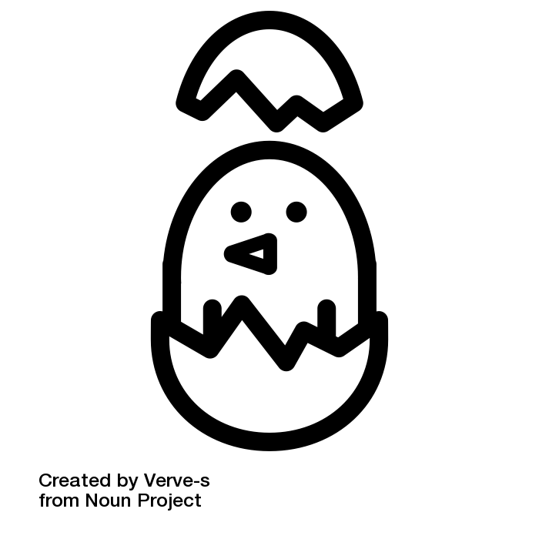
Is this resource
open or free?
Aren’t they
the same
thing?
What is Creative Commons?
Am I doing this right?
Unless otherwise noted, this work is licensed under a Creative Commons Attribution 4.0 International License.

Slide 3
Public benefit
& reuse
Save students money
Customized materials for teaching, activities, assignments, etc.
Unless otherwise noted, this work is licensed under a Creative Commons Attribution 4.0 International License.

Slide 4
UA OER Awards Applications
Funding for student support
Support from CTL & Libraries
UAL Digital Publishing Service
Pressbooks, Omeka, etc.
Copyright Office
Licensing Consultations
Unless otherwise noted, this work is licensed under a Creative Commons Attribution 4.0 International License.

Slide 5
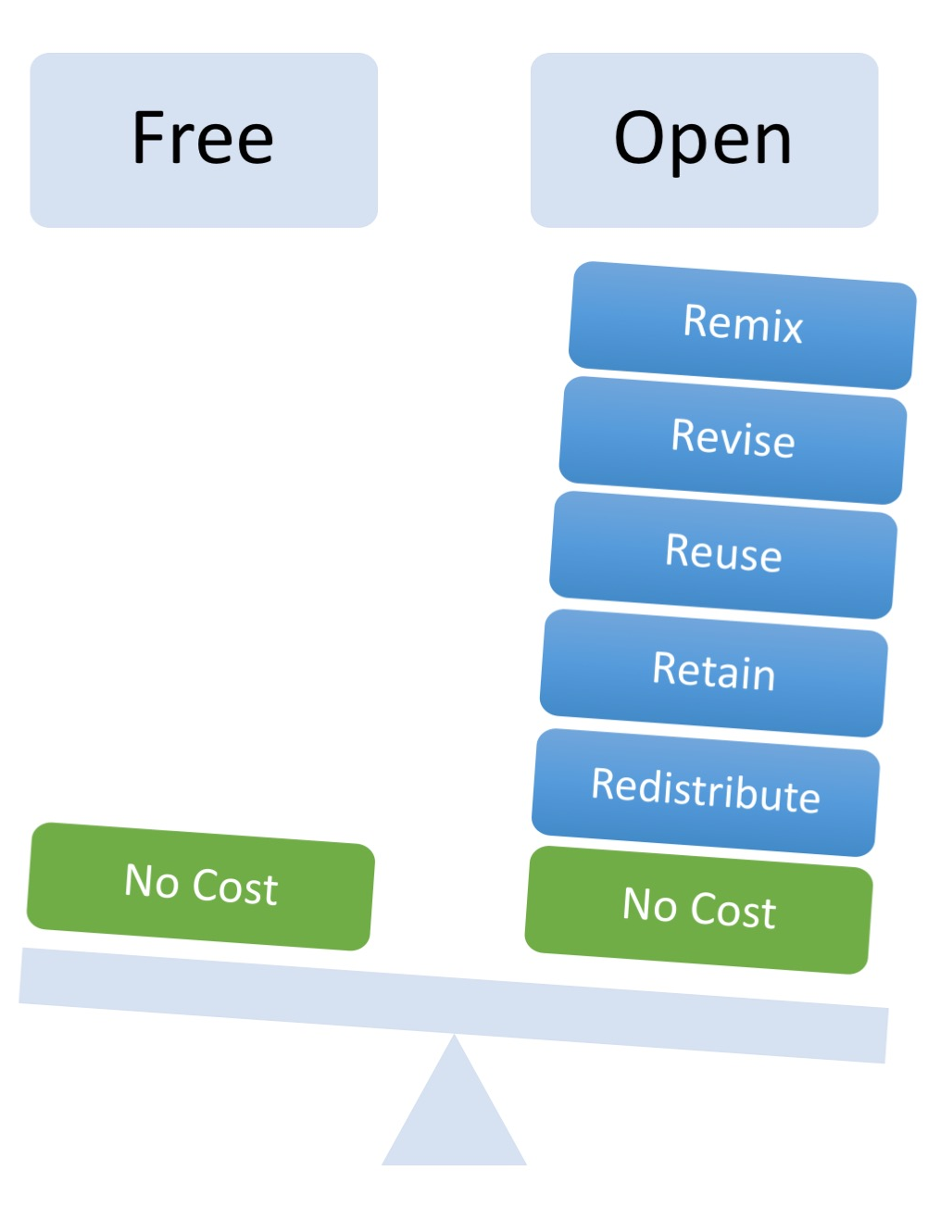
Combine two or more
Adapt, modify, and improve
Use in a wide range of ways
Make and keep a copy
Share with others
Image by Designers for Learning: Gain Experience for Good, Jennifer Maddrell, Director (CC, BY, NC, SA)
Unless otherwise noted, this work is licensed under a Creative Commons Attribution 4.0 International License.
Notes:
Krysta

Slide 6
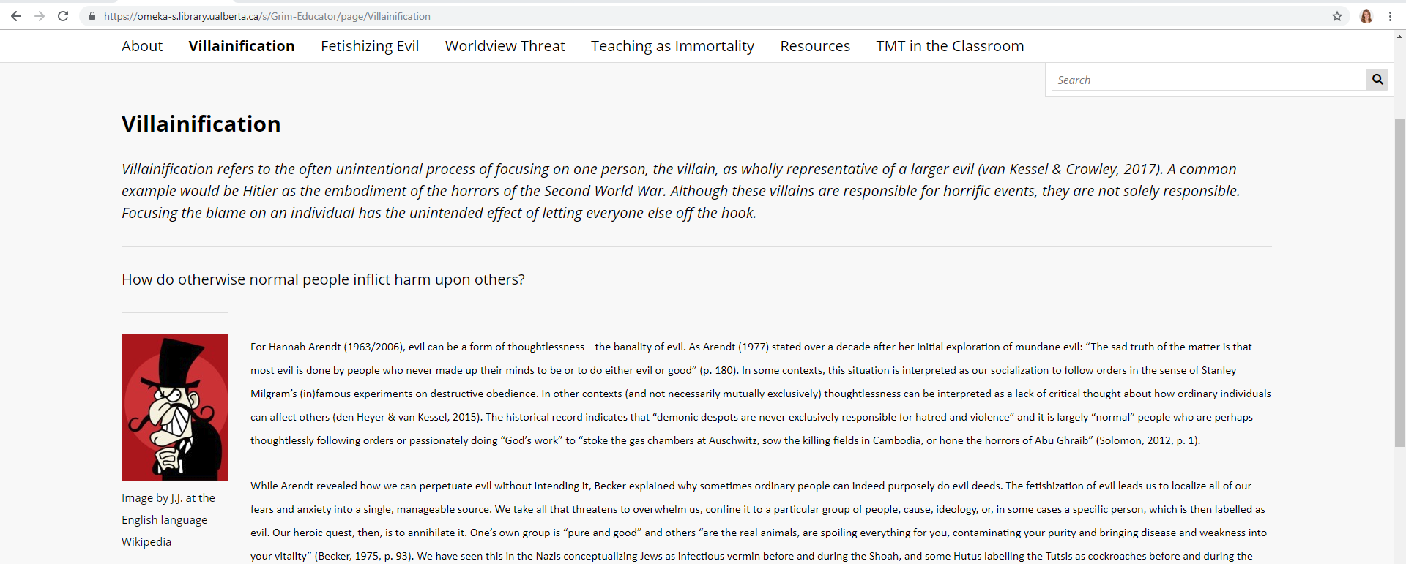
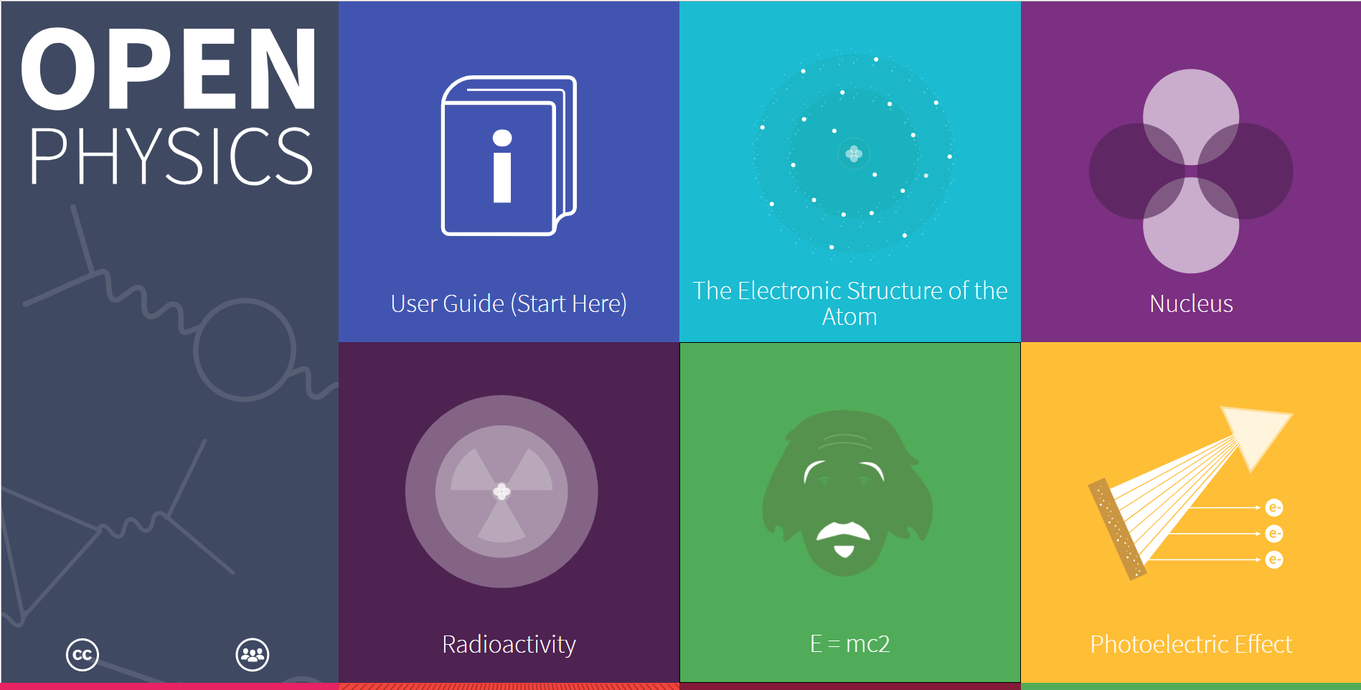
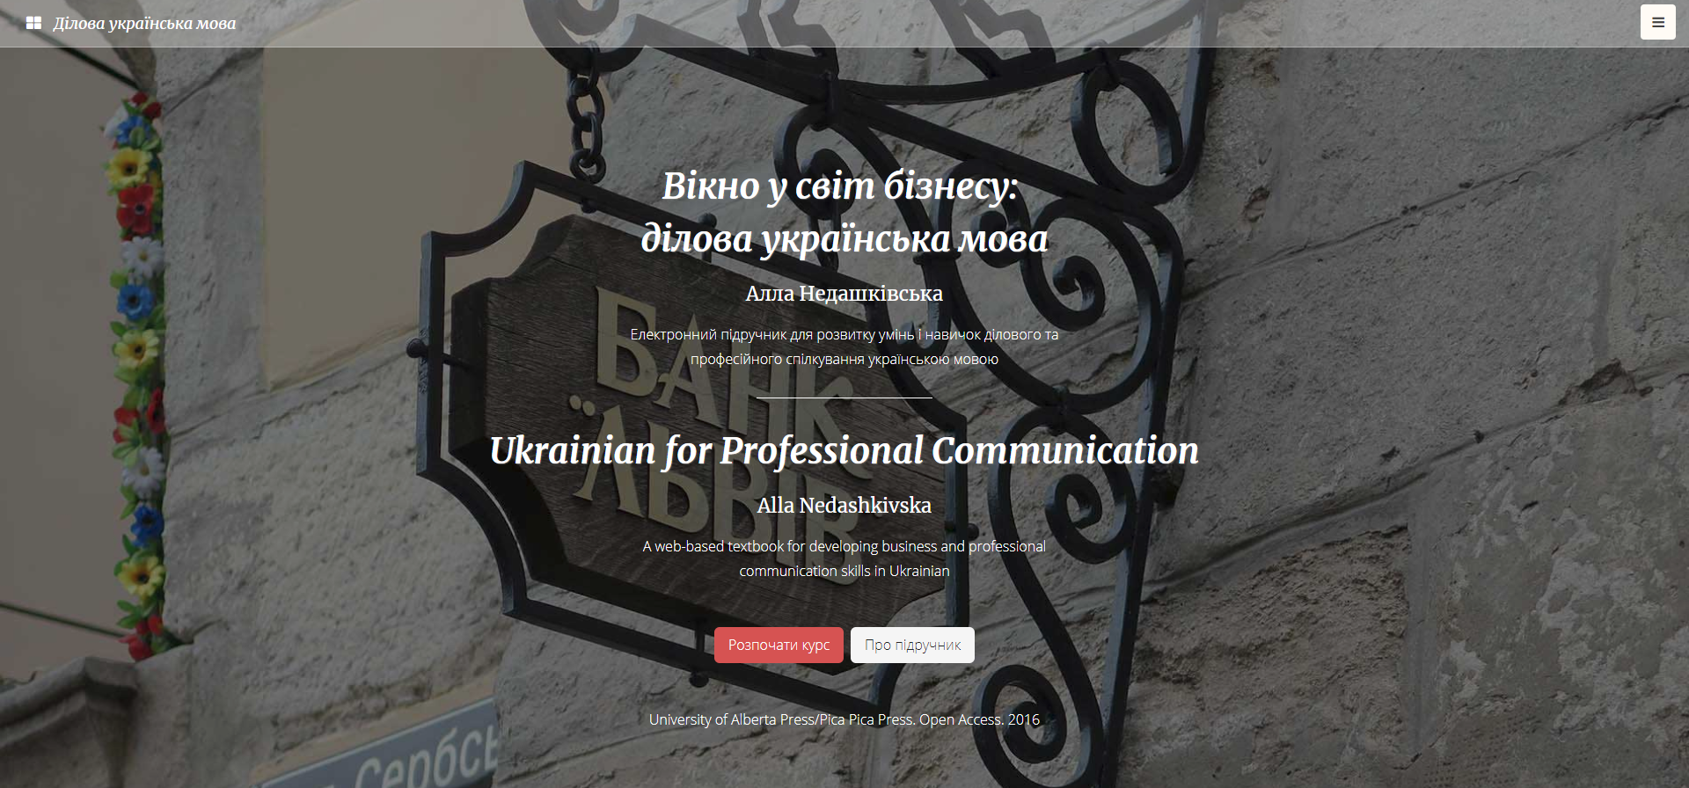
Course content on a public website.
https://omeka-s.library.ualberta.ca/s/Grim-Educator/
https://openphys.med.ualberta.ca/
https://businessukrainian.com/
Unless otherwise noted, this work is licensed under a Creative Commons Attribution 4.0 International License.
Notes:
Krysta

Slide 7
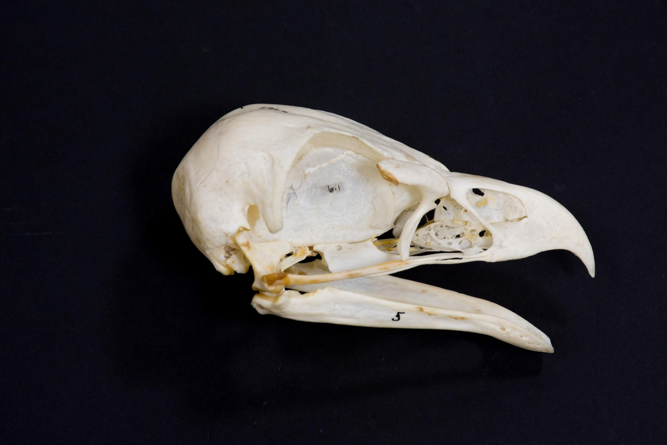
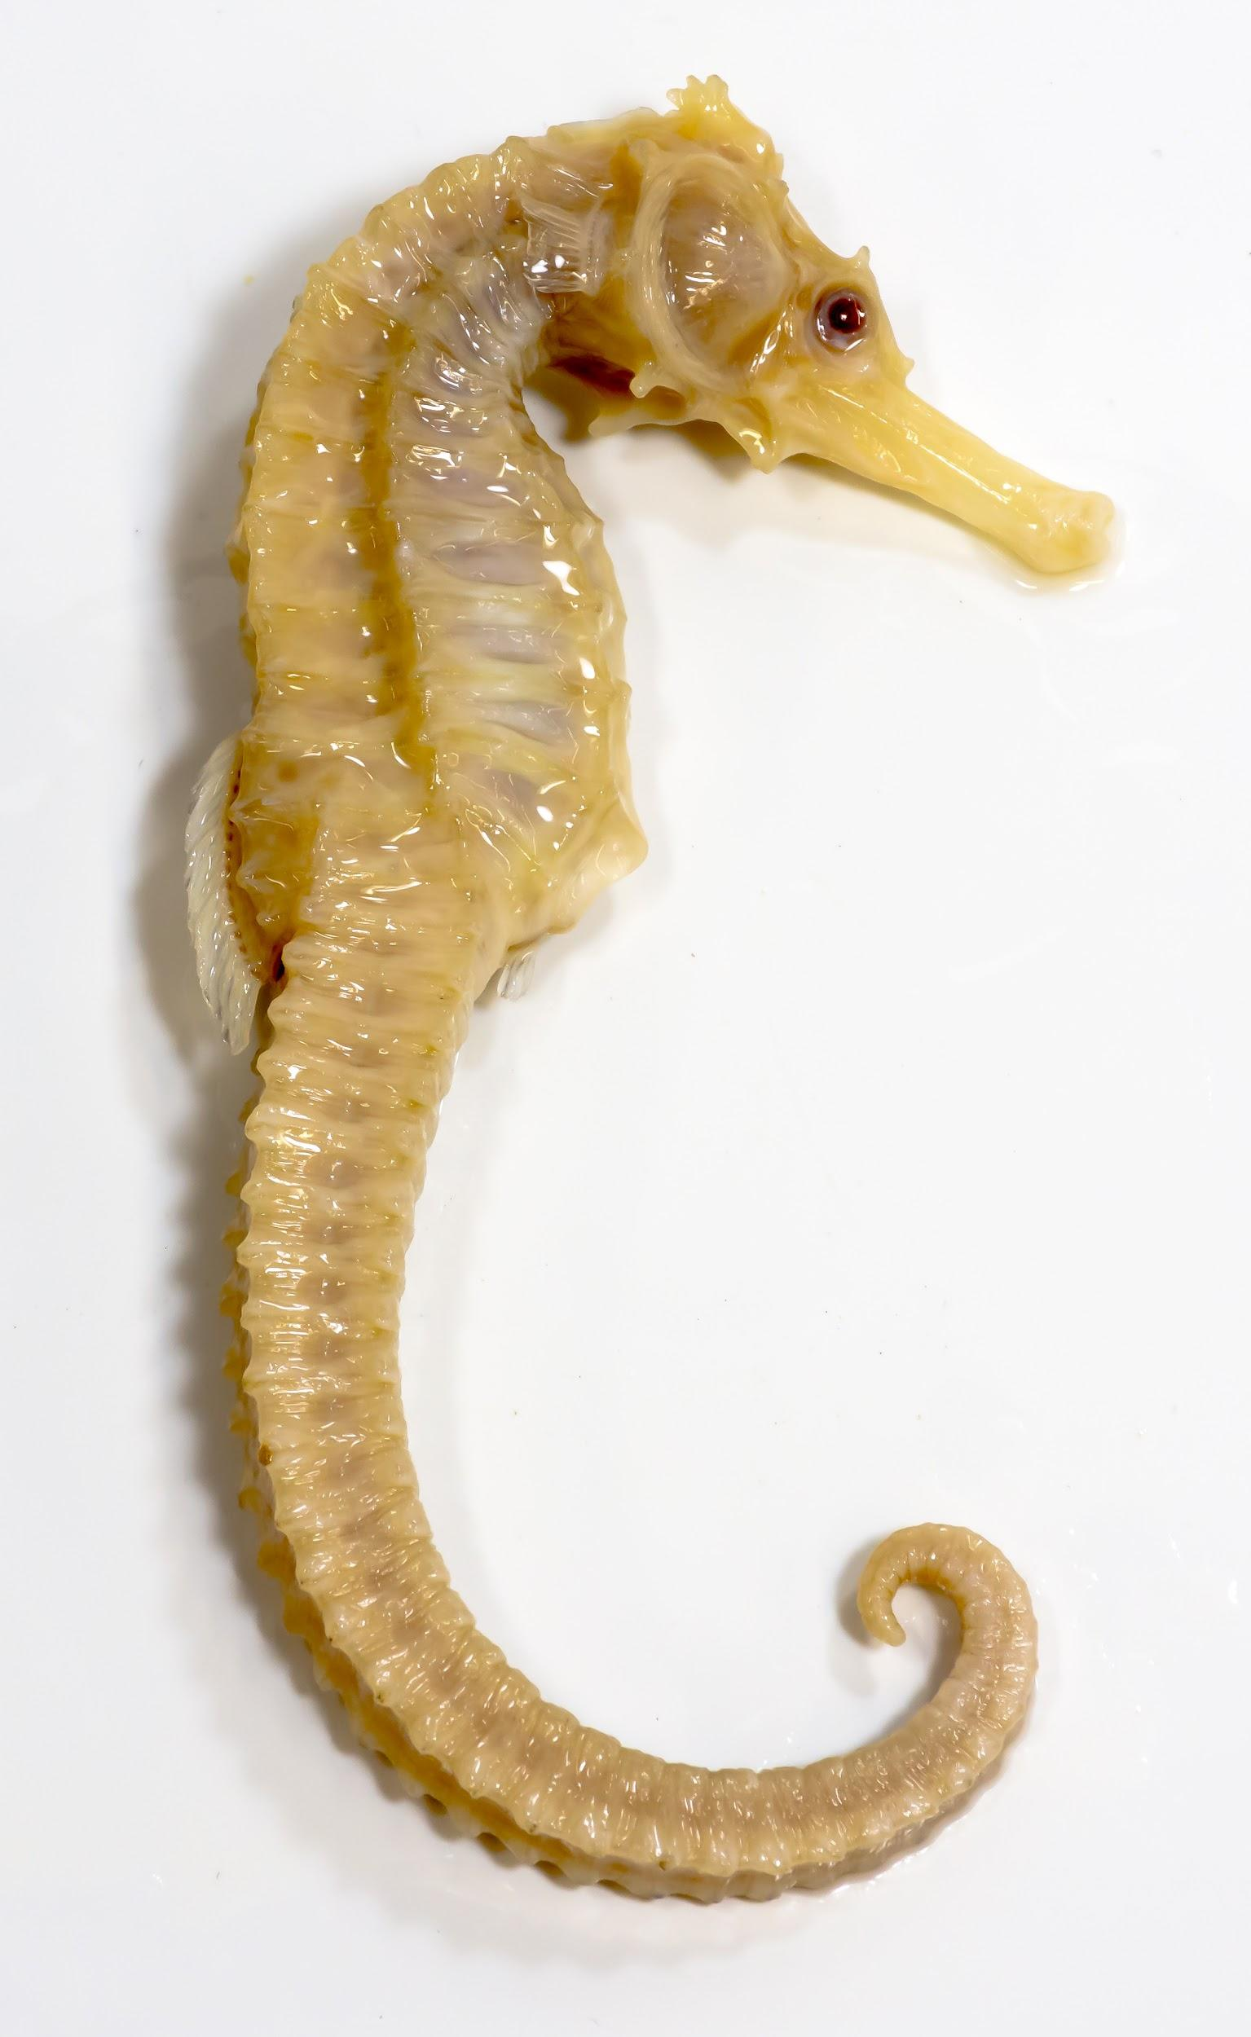
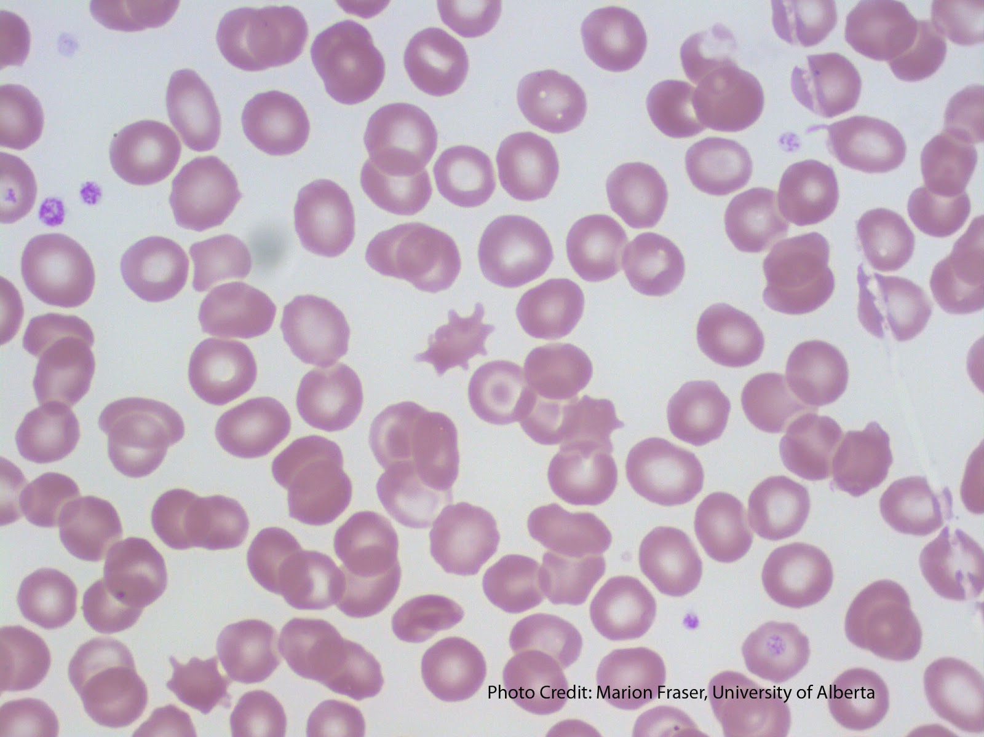
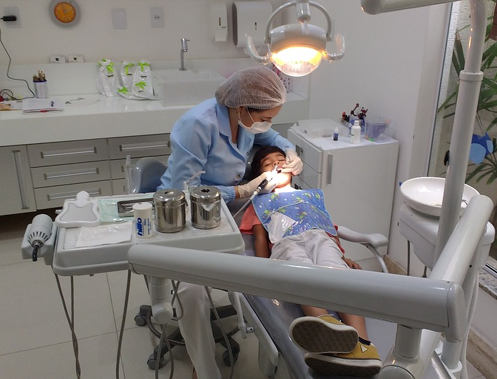
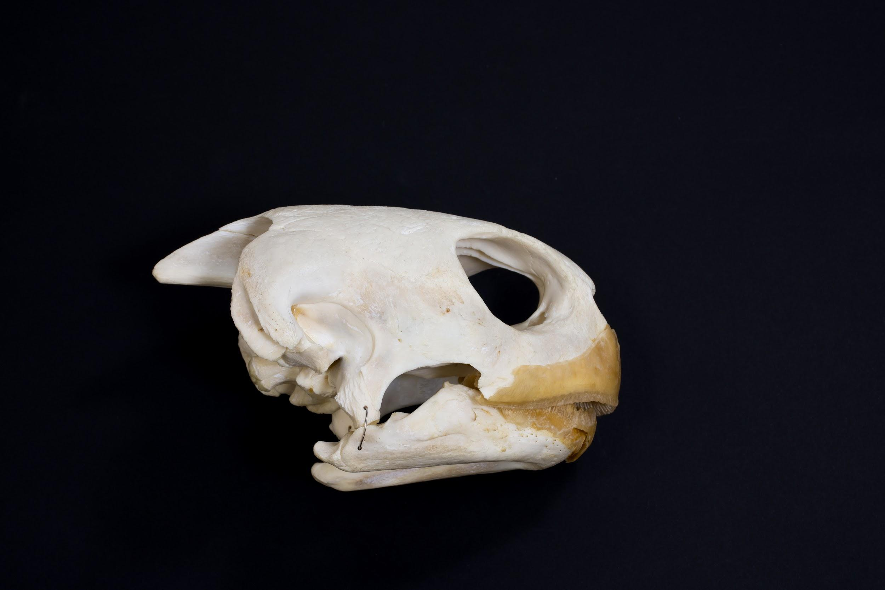
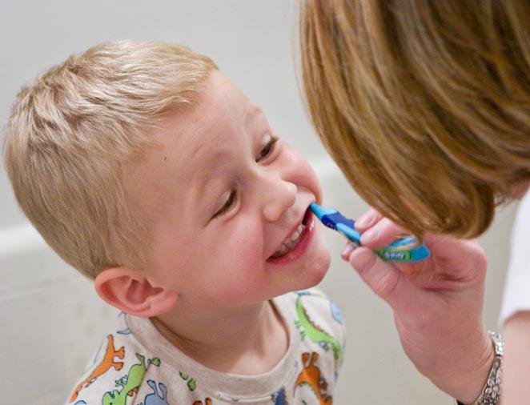
Image Collections
Image Sources: University of Alberta, Faculty of Medicine and Dentistry, School of Dentistry, Pediatric Dentistry Image Collection
Image Sources: University of Alberta, Faculty of Science, Department of Biological Sciences, Open Image Collection
Unless otherwise noted, this work is licensed under a Creative Commons Attribution 4.0 International License.
Notes:
Krysta

Slide 8
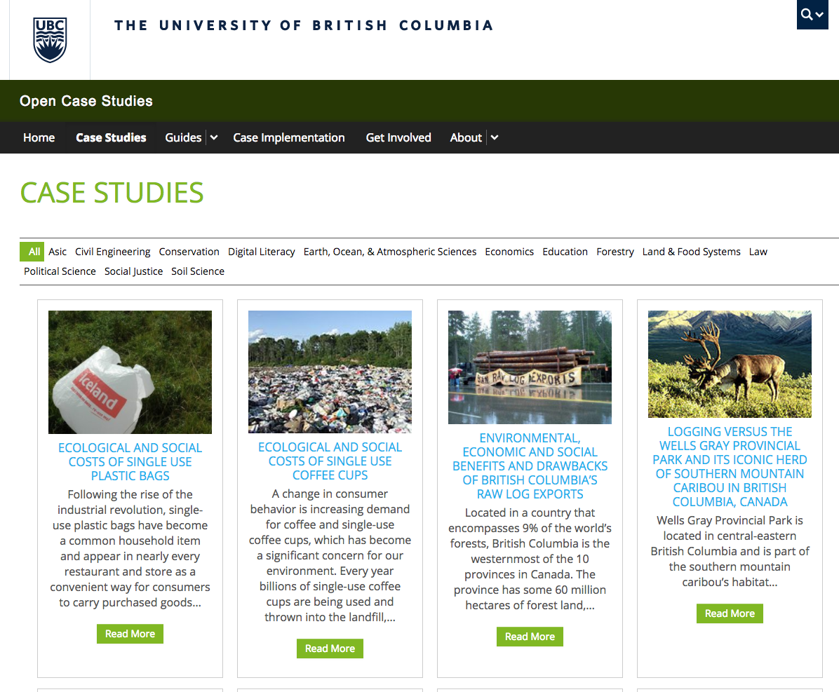
http://cases.open.ubc.ca
Unless otherwise noted, this work is licensed under a Creative Commons Attribution 4.0 International License.
Notes:
Krysta
CC-BY licensed educational content hosted online created for multidisciplinary use.

Slide 9
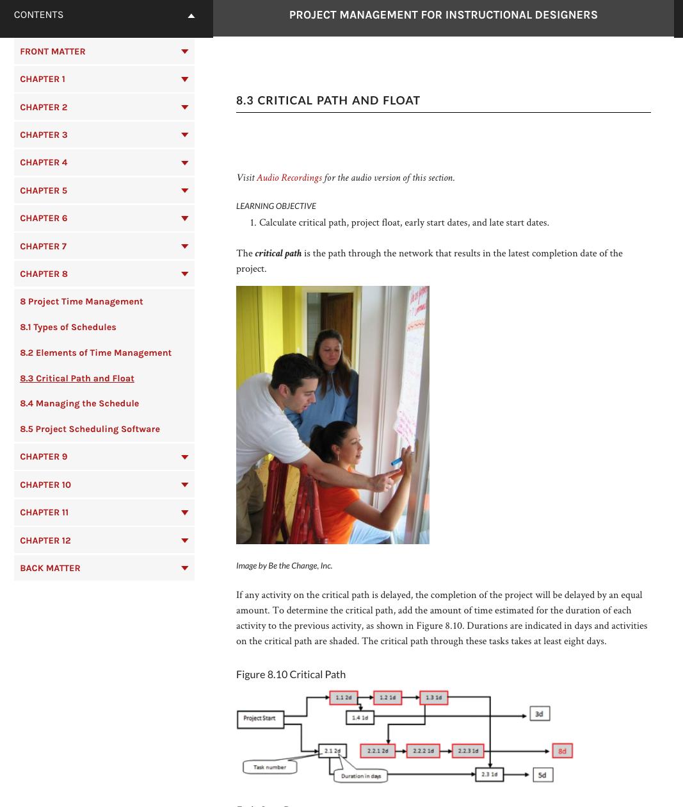
https://pm4id.org/
Project Management for Instructional Designers Wiley, et al.
Example Assignments:
Align each chapter with CAPM/PMP certification exam study requirements
Create industry-specific examples (e.g. cost and time estimating)
Capture industry-specific interviews to compliment each chapter
Update/modernize a section of the book
Create a glossary of key terms
Additional skill based Assignments:
Create text-to-speech audio recordings of each chapter
Replace copyright images with CC licensed images
Create an automated process for book conversion
Proofreading and editing
https://opencontent.org/blog/archives/2629
Unless otherwise noted, this work is licensed under a Creative Commons Attribution 4.0 International License.
Notes:
Krysta
CC-BY open textbook written by students with supervision of instructor across many terms. Most assignments contribute to further development of the textbook.

Slide 10
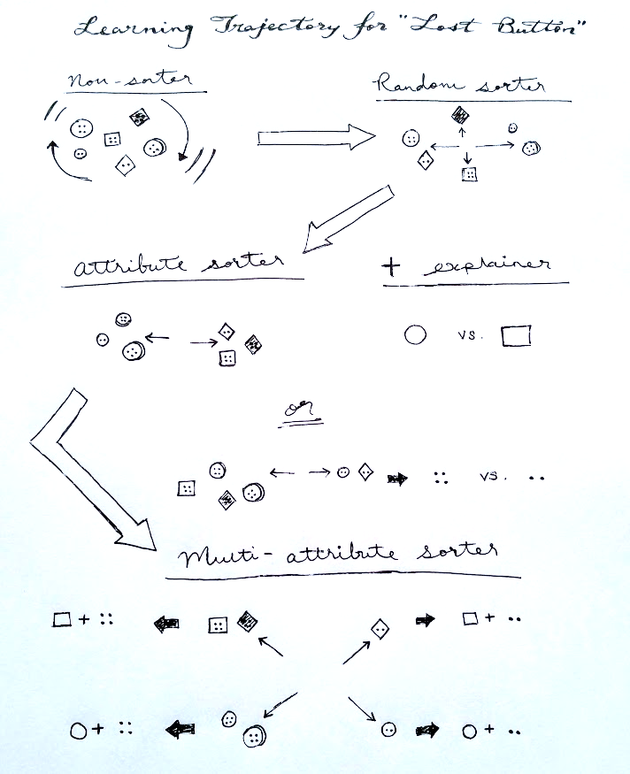
Free & Online
(access for free)
Class Textbook: https://search.library.ualberta.ca/catalog/7839930
Open Educational Resource
(adapt & redistribute) OER Textbook / Compilation
Lost Button Lesson Plan
Finger Counting Lesson Plan
Image Credit: Stenhouse Publishers
Images sourced from: OER Textbook / Compilation and Lesson Plans: Steven Khan
Unless otherwise noted, this work is licensed under a Creative Commons Attribution 4.0 International License.
Notes:
Krysta

Slide 11
Copyright, Creative Commons licences, etc.
Unless otherwise noted, this work is licensed under a Creative Commons Attribution 4.0 International License.
Notes:
Amanda

Slide 12
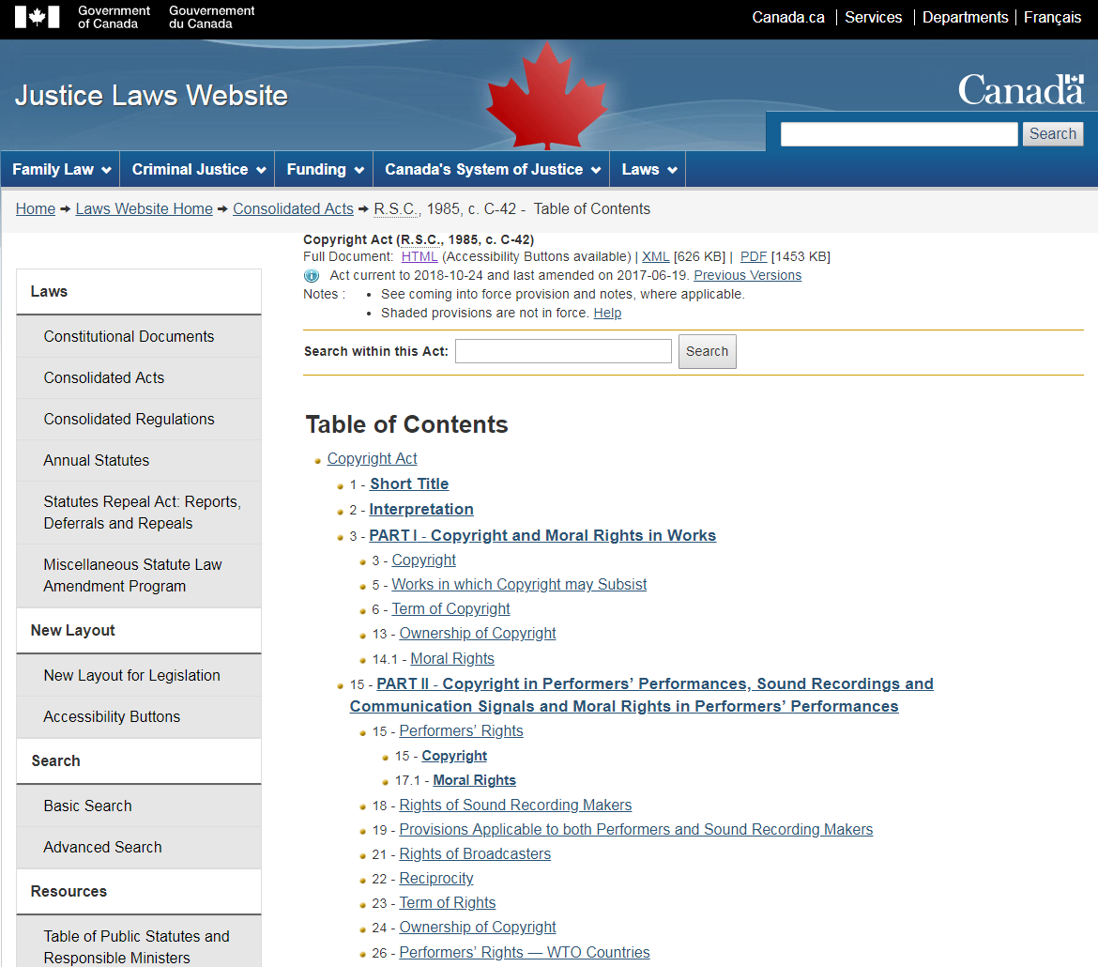
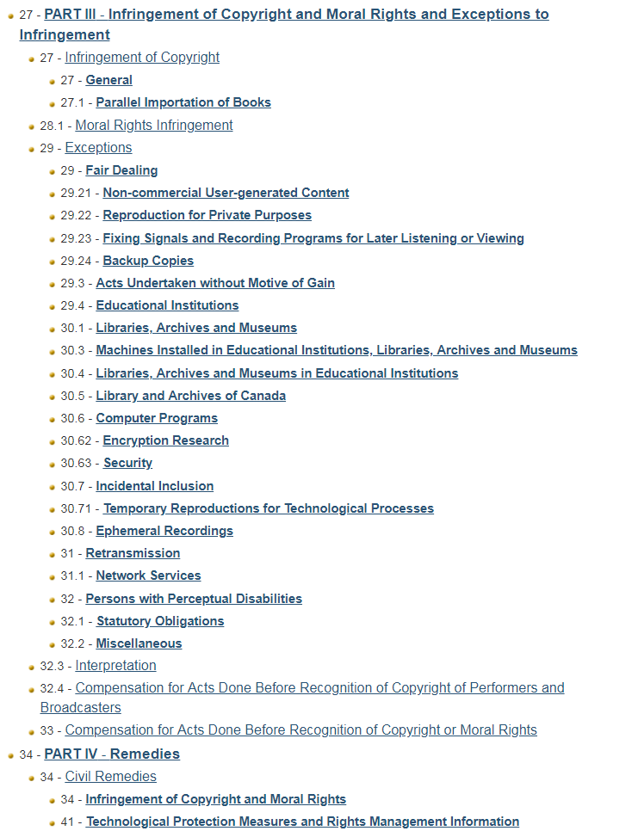
Copyright: one form of intellectual property protection
Copyright Act gives rights holders the sole right to produce, reproduce, perform, or publish a work.
Initial copyright is held by the employer (unless there’s an agreement to the contrary) or creator. AASUA contract is an agreement to the contrary.
Rights are immediate and time limited. Economic rights are transferable. Moral rights can be waived.
Copyright Act includes exceptions that give users the right to deal fairly with these works.
Unless otherwise noted, this work is licensed under a Creative Commons Attribution 4.0 International License.
Notes:
Copyright is relevant to OER because it’s the policy mechanism through which rights are granted to share, reproduce and reuse materials. As instructors, you are both creators and users of copyright-protected works.
Know your rights as an instructor
Understand the relationship between IP, copyright, public domain and Creative Commons
Navigate Creative Commons licence options

Slide 13
Rights holders choose what others can do with their works:
Default (do nothing): all rights reserved. Use by others is limited to fair dealing and other exceptions to infringement.
Assign specific terms of use. “Small print” on some websites, click-through agreements including social media, etc., inform others how the works can be used.
Assign an open licence. Creative Commons (CC) licences allow for relatively flexible use of the work by others. Most CC licences are OER-compatible.
Waive rights before copyright term expires. Creative Commons 0 (CC0) or other public domain designation.
Unless otherwise noted, this work is licensed under a Creative Commons Attribution 4.0 International License.
Notes:
Assume that all rights are reserved if you see nothing to the contrary (includes content on open web). Note that we have no case law supporting the use of fair dealing for OER remixing.
Some terms of use support OER, some do not.
One way to think of open licences is as an agreement between the rights holders and the world at large.
Public domain will happen eventually - waiving rights speeds it up.

Slide 14
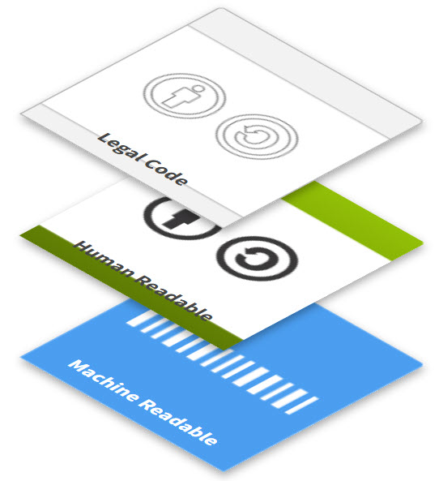
Creative Commons licence elements:
licence layers
attribution
share alike
non-commercial
no derivatives
nitty gritty legalities
modifications shared under same licence
modifications cannot be shared
must credit the creator
commercial use not ok
summary of main points
optimizes tech access and searchability
ALL OER
no (copy)rights reserved
CC LICENSED WORKS
= NOT OER COMPATIBLE
Unless otherwise noted, this work is licensed under a Creative Commons Attribution 4.0 International License.
Notes:
CC licence elements make up the four OER-compatible licences. Licences with an ND element are not OER-compatible.

Slide 15
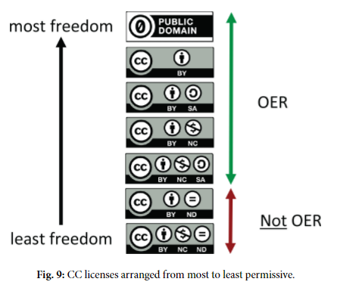
Copyright, Open Licensing, and OER
Creative Commons licences are the most common OER open licences.
Choose a licence https://creativecommons.org/choose/
Mark the work with the CC icon https://wiki.creativecommons.org/wiki/Marking_your_work_with_a_CC_license
Link icon to licence deed.
Include a statement.
by Cable Green is licensed under CC-BY 4.0
Unless otherwise noted, this work is licensed under a Creative Commons Attribution 4.0 International License.

Slide 16
Summary: copyright and OER
Copyright is a set of limited rights established by law. It is immediate, time limited, and transferrable.
AASUA members retain the copyright in the course materials they create and can assign an OER-compatible licence.
Open licensing is a core infrastructural element of OER.
Copyright status does not change when a standard open licence is assigned.
works in the public domain
term length expired OR
rights holder placed work in public domain (e.g., CC0) OR
work never qualified for copyright protection
works protected by copyright
openly licensed works
Open licences grant permission to use a copyright-protected work with few or no restrictions.
OER
Unless otherwise noted, this work is licensed under a Creative Commons Attribution 4.0 International License.

Slide 17
Resources noted during session on April 23, 2019:
Best practices for attribution -- Creative Commons (TASL = title, author, source, licence) https://wiki.creativecommons.org/wiki/best_practices_for_attribution
Permissions template for including third party content in your OER -- prepared by the Copyright Office https://www.ualberta.ca/copyright/resources/forms-and-templates
Wikipedia licence information (CC BY SA) and related resources on right panel of this page: https://en.wikipedia.org/wiki/Wikipedia:Text_of_Creative_Commons_Attribution-ShareAlike_3.0_Unported_License
Creative Commons search https://search.creativecommons.org/ and Google Advanced Search https://www.google.ca/advanced_search (or select “Tools” after conducting a Google image search).
Unless otherwise noted, this work is licensed under a Creative Commons Attribution 4.0 International License.

Slide 18
Q&A
Unless otherwise noted, this work is licensed under a Creative Commons Attribution 4.0 International License.
Notes:
Krysta --- Q&A or activity, depending on response

Slide 19
Wiley’s 5Rs and Creative Commons Licensing
 | Retain | Reuse | Revise | Remix | Redistribute
 | Make and own a copy | Use in a wide range of ways | Adapt, modify, and improve | Combine two or more | Share with others
Public Domain
CC-BY
CC-BY-SA |  |  | same license | same license
CC-BY-NC |  |  |  |  | non-commercial
CC-BY-NC-SA |  |  | same license | same license | non-commercial
CC-BY-ND |  |  | personal use only | personal use only
CC-BY-NC-ND |  |  | personal use only | personal use only | non-commercial
OER
Not OER
Give appropriate credit, provide a link to the license, and indicate if changes were made.
Unless otherwise noted, this work is licensed under a Creative Commons Attribution 4.0 International License.
Notes:
https://docs.google.com/presentation/d/1Tk9sBhdIAKvhzxqjR9SeYn_dfctl7wXRfvcHZgj4sQo/edit?usp=sharing

Slide 20
1. Jenny took a photo and wants to allow others to download it from her website and use it, even for commercial purposes, as long as they attribute her and do not alter the photo.
This slide is an adaptation of “Choosing & Using Sources, Creative Commons Licensing” from The Ohio State University, University Libraries which is licensed under a Creative Commons Attribution 4.0 International License.
Unless otherwise noted, this work is licensed under a Creative Commons Attribution 4.0 International License.

Slide 21
2. Thomas recorded an original song with the intention to allow others to use it for non-commercial purposes. He doesn’t mind if others remix the recording.
This slide is an adaptation of “Choosing & Using Sources, Creative Commons Licensing” from The Ohio State University, University Libraries which is licensed under a Creative Commons Attribution 4.0 International License.
Unless otherwise noted, this work is licensed under a Creative Commons Attribution 4.0 International License.

Slide 22
3. Roger posted a video he took of a political speech to YouTube. He wants others to use it freely, as long as they do so under the same CC license and give him credit.
This slide is an adaptation of “Choosing & Using Sources, Creative Commons Licensing” from The Ohio State University, University Libraries which is licensed under a Creative Commons Attribution 4.0 International License.
Unless otherwise noted, this work is licensed under a Creative Commons Attribution 4.0 International License.

Slide 23
4. Alice wrote a poem and posted it to her blog. She doesn’t really care what others do with it, but wants credit for the original.
This slide is an adaptation of “Choosing & Using Sources, Creative Commons Licensing” from The Ohio State University, University Libraries which is licensed under a Creative Commons Attribution 4.0 International License.
Unless otherwise noted, this work is licensed under a Creative Commons Attribution 4.0 International License.

Slide 24
5. Kris created a web comic and wants to allow others to share it freely as long as they give proper attribution, use it for non-commercial purpose, and do not make any changes.
This slide is an adaptation of “Choosing & Using Sources, Creative Commons Licensing” from The Ohio State University, University Libraries which is licensed under a Creative Commons Attribution 4.0 International License.
Unless otherwise noted, this work is licensed under a Creative Commons Attribution 4.0 International License.

Slide 25
6. Michael made an audio recording of an interview he conducted with a famous author. He’s fine with people using the recording however they want, except for commercial purposes, as long as they give him credit for the original and publish using the same CC license.
This slide is an adaptation of “Choosing & Using Sources, Creative Commons Licensing” from The Ohio State University, University Libraries which is licensed under a Creative Commons Attribution 4.0 International License.
Unless otherwise noted, this work is licensed under a Creative Commons Attribution 4.0 International License.

