Slide 1
Broadcasting Policy
LIS 598 – Information Policy – Winter 2017
Mar. 31, 2017

Slide 2
Outline
A. Broadcasting Policy History
B. Four Factors Shaping Broadcasting Policy
C. CBC and “Let’s Talk TV”
D. Information Policy in a time of Statutory Change

Slide 3
A-I. Broadcasting Policy History
First broadcasting legislation is the Wireless Telegraphy Act (1905)
1928 Royal Commission on Radio Broadcasting (Aird Commission)
Proposed creation of national broadcaster
Canadian Radio Broadcasting Act of 1932
Established the creation of the Canadian Radio Broadcasting Commission (CRBC), forerunner to the CBC
CRBC was both broadcaster and regulator
Canadian Radio Broadcasting Act of 1936
Formally created the CBC modelled on the BBC in Britain
Department of Transport becomes responsible for telecommunications

Slide 4
A-I(ii). Broadcasting Policy History
1949 Royal Commission on National Development in the Arts, Letters and Sciences (Massey Commission)
Give CBC take lead in developing a national television system
No private TV stations until the CBC national network is put in place
CBC to avoid excessive commercialization and promote Canadian content and talent
1955 Royal Commission on Broadcasting (Fowler Commission)
Recommends separation of the regulatory and broadcast functions of the CBC
Broadcasting Act of 1958
Creates new regulatory agency - Board of Broadcast Governors (BBG)
BBG introduces Canadian content requirements for private broadcasters

Slide 5
A-I(iii). Broadcasting Policy History
Broadcasting Act of 1968
Formally created the Canadian Radio-television Commission (replacing the BBG)
Unlike its predecessors, CRTC (not Parliament) had power to issue broadcast licenses
Declares radio frequencies (spectrum signals) as public property
Canadian ownership and control regulations
Canadian Radio-television and Telecommunications Act of 1976
Transformed Canadian Radio-television Commission into Canadian Radio-television and Telecommunications Commission
Added telecommunication regulation to CRTC (taken over from the Canadian Transport Commission (1967-76), and before that the Board of Transport Commissioners (1937-67))
Broadcasting Act of 1991
Current governing legislation

Slide 6
A-III. Broadcasting Policy for Canada
Like the Canadian Telecommunications Policy, the Broadcasting Policy for Canada is explicit in the relevant legislation
Telecommunications Act, s. 7; Broadcasting Act, s. 3
Notable subsections:
3(a) – Canadian ownership and control
3(b) – broadcasting should contribute to national identity and cultural sovereignty
3(c) – English and French broadcasting are distinct
3(e) – promote Canadian content creation
3(l) – the CBC should inform, enlighten and entertain
3(o) and (p) – programming for Aboriginal and disabled Canadians, “as resources become available”

Slide 7
B-I. Four Factors Shaping Broadcasting Policy (CRTC 2010, 2011)
Regulatory bifurcation
Technological convergence
Corporate consolidation
Audience fragmentation

Slide 8
B-II. Corporate Consolidation
Two kinds of corporate convergence
Horizontal – consolidation within an industry
Bell purchase of CHUM stations in 2007
Vertical – integration of broadcasting and telecom functions
Rogers purchase of City TV stations in 2007
Content owners see benefit in owning the means of distribution
Pattern repeated globally and across media (CRTC 2016-110)

Slide 9
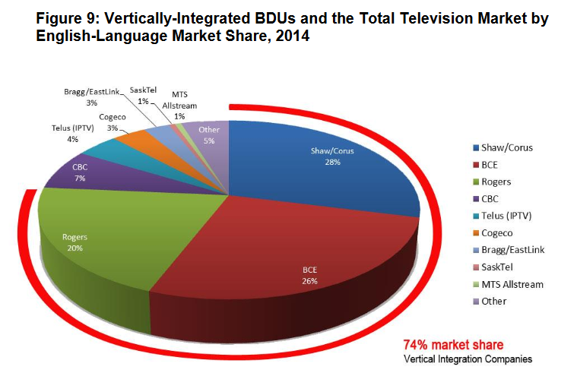
B-II(ii). Corporate Consolidation
Canadian Media Concentration Research Project. 2015. Growth and Concentration Trends in the English-Language Network Media Economy in Canada, 2000-2014: Report. p. 20.

Slide 10
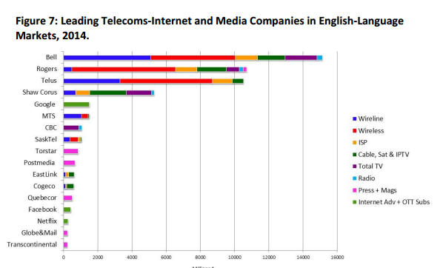
B-II(iii). Corporate Consolidation
Canadian Media Concentration Research Project. 2015. Growth and Concentration Trends in the English-Language Network Media Economy in Canada, 2000-2014: Report. p. 16.

Slide 11
B-III. Audience Fragmentation
Despite corporate consolidation and technological convergence, audiences are fragmenting
Fragmentation occurring both across platforms and within platforms
CRTC (2010) suggests fragmentation creates opportunity for Canadian content to thrive on a global scale

Slide 12
C-I. Canadian Broadcasting Corporation
Mandate defined is s. 3 of the Broadcasting Act
(l) the Canadian Broadcasting Corporation, as the national public broadcaster, should provide radio and television services incorporating a wide range of programming that informs, enlightens and entertains;
(m) the programming provided by the Corporation should
(i) be predominantly and distinctively Canadian,
(ii) reflect Canada and its regions to national and regional audiences, while serving the special needs of those regions,
(iii) actively contribute to the flow and exchange of cultural expression,
(iv) be in English and in French, reflecting the different needs and circumstances of each official language community, including the particular needs and circumstances of English and French linguistic minorities,
(v) strive to be of equivalent quality in English and in French,
(vi) contribute to shared national consciousness and identity,
(vii) be made available throughout Canada by the most appropriate and efficient means and as resources become available for the purpose, and
(viii) reflect the multicultural and multiracial nature of Canada;

Slide 13
C-I(ii). CBC
Operates four major broadcasting undertakings
French and English, radio and TV
Funding and revenue continue to be key issues
CBC Revenue and Expenses (in millions) (CBC, 2016, p. 5)
Radio service did have commercials until 1974
 | 2014-15 | 2015-16
Self-generated Revenue | $ 600 | $ 528
Government Revenue | $ 1,036 | $ 1,027
Expenses | $ 1,620 | $ 1,722
Revenue less Expenses | $ 16 | $ -167

Slide 14
C-II. “Let’s Talk TV”
In 2013 CRTC initiated a fairly comprehensive, multi-phase review of Canadian TV broadcasting (the “Let’s Talk TV”) consultation (CRTC 2013-563)
2014 (CRTC 2014-190) consultation notice had 80 questions on a range of topics
Three most salient issues were “sim-sub,” “skinny basic” and “pick and pay”
Series of decisions resulted:
Broadcasting Regulatory Policy CRTC 2015-25 brought a end to some “sim-sub” including the 2017 Super Bowl (reaffirmed in CRTC 2016-334 and CRTC 2016-335)
“Skinny basic” and “pick and pay” introduced by Broadcasting Regulatory Policy CRTC 2015-96 (reaffirmed in CRTC 2015-514 and CRTC 2016-59)
However, complaints over “skinny basic” options has resulted in another consultation (CRTC 2016-197)

Slide 15
D-I. A New Communication Era
Budget 2017 (Canada, 2017, p. 106):
“The Government also recognizes that Canada’s media industries, and the systems that allow for broadcasting, distribution and the exchange of ideas, are fundamentally changing in the digital age.
To ensure that Canadians continue to benefit from an open and innovative Internet, the Government proposes to review and modernize the Broadcasting Act and Telecommunications Act.
In this review, the Government will look to examine issues such as telecommunications and content creation in the digital age, net neutrality and cultural diversity, and how to strengthen the future of Canadian media and Canadian content creation. Further details on the review will be announced in the coming months.”

Slide 16
D-II. Information Policy in Flux
Access to Information Act under (delayed) review (Bronskill, 2017)
Copyright Act statutorily mandated review to begin in November 2017
Telecommunications and Broadcasting Acts now to be reviewed an modernized
What role can/should the LIS community play in this time of flux and who will listen?

Slide 17
Discussion Questions
What role can/should the LIS community play in this time of flux and who will listen?
Copyright is an obvious area of concern, but what role can/should the LIS community play in regards to the other major legislative reviews? How can meaningful (i.e. impactful) participation be ensured?
Tinker or blow it all up – what approach would you rather see for the telecom and broadcast reviews?
Create a new Communications Act and end the bifurcation?
Remove foreign investment restrictions and open up the Canadian market?
Privatize and defund the CBC or reinvigorate and expand the CBC?
Expand or constrict the CRTC’s regulatory purview?
What else?

Slide 18
Thank You

Slide 19
Sources:
Bronskill, Jim. 2017. “Liberal Government Postpones Initial Access to Information Reforms.” Global News. 21 Mar. 2017. http://globalnews.ca/news/3323656/ottawa-postpone-initial-access-to-information-reforms/
Canada. 2017. Building a Strong Middle Class: Budget 2017. http://www.budget.gc.ca/2017/docs/plan/budget-2017-en.pdf
Canadian Broadcasting Corporation (CBC). 2016. Canada’s Public Space: 2015-2016 Annual Report. http://www.cbc.radio-canada.ca/site/annual-reports/2015-2016/_documents/cbc-radio-canada-2015-2016-annual-report.pdf
Canadian Media Concentration Research Project. 2015. Growth and Concentration Trends in the English-Language Network Media Economy in Canada, 2000-2014: Report. http://www.cmcrp.org/wp-content/uploads/2015/12/English_Media_Econ_Concentration_2000-2014.pdf
Canadian Radio-Television and Telecommunications Commission (CRTC). 2010. Navigating Convergence: Charting Canadian Communications Change and Regulatory Implications. http://www.crtc.gc.ca/eng/publications/reports/rp1002.pdf
CRTC. 2011. Navigating Convergence II: Charting Canadian Communications Change and Regulatory Implications. http://www.crtc.gc.ca/eng/publications/reports/rp1108.pdf
CRTC. 2013. Broadcasting Notice of Invitation CRTC 2013-563. http://www.crtc.gc.ca/eng/archive/2013/2013-563.htm#bm1
CRTC. 2014. Broadcasting Notice of Consultation CRTC 2014-190. http://www.crtc.gc.ca/eng/archive/2014/2014-190.htm
CRTC. 2015. Broadcasting Regulatory Policy CRTC 2015-25. http://www.crtc.gc.ca/eng/archive/2015/2015-25.htm
CRTC. 2015. Broadcasting Regulatory Policy CRTC 2015-96. http://www.crtc.gc.ca/eng/archive/2015/2015-96.htm
CRTC. 2015. Broadcasting Regulatory Policy CRTC 2015-514. http://www.crtc.gc.ca/eng/archive/2015/2015-514.htm
CRTC. 2016. Broadcasting Decision CRTC 2016-110. http://www.crtc.gc.ca/eng/archive/2016/2016-110.htm
CRTC. 2016. Broadcasting Information Bulletin CRTC 2016-59. http://www.crtc.gc.ca/eng/archive/2016/2016-59.htm
CRTC. 2016. Broadcasting Notice of Consultation CRTC 2016-197. http://www.crtc.gc.ca/eng/archive/2016/2016-197.htm
CRTC. 2016. Broadcasting Regulatory Policy CRTC 2016-334 and Broadcasting Order CRTC 2016-335. http://www.crtc.gc.ca/eng/archive/2016/2016-334.htm

Slide 20
Comments and Critique
Comments and critique on this presentation and any other material for LIS 598 Information Policy – Winter 2017 can be sent to Michael B. McNally at: mmcnally@ualberta.ca
Comments and critique will be used to improve future iterations of these materials

