Slide 1


A Program to Support the Adaptation, Creation, and Use of OER at a Research-Intensive Institution
What We’ve Learned So far
Krysta McNutt, Open Education Program Lead, University of Alberta
Michelle Brailey, Digital Initiatives Projects Librarian, University of Alberta
Annual Conference of the Society for Teaching and Learning in Higher Education (STLHE)
June 12, 2019
Unless otherwise noted, this work is licensed under a Creative Commons Attribution 4.0 International License.
Notes:
Add name of conference + year, my name & Michelle

Slide 2
What is an OER?

Slide 3
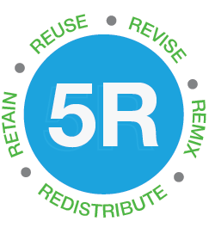


Slide 4
GERM 111, 112, PSYCHO 403, BIO 107/108/207/208, EDEL 316, EDEL 335, SCI 101
Finding and Using OER
open textbooks
course packs
class assignments
interactive resources
media collections
EAS 233, CELL 201, DDS 545-2, ENG 423
Developing existing OER

Slide 5
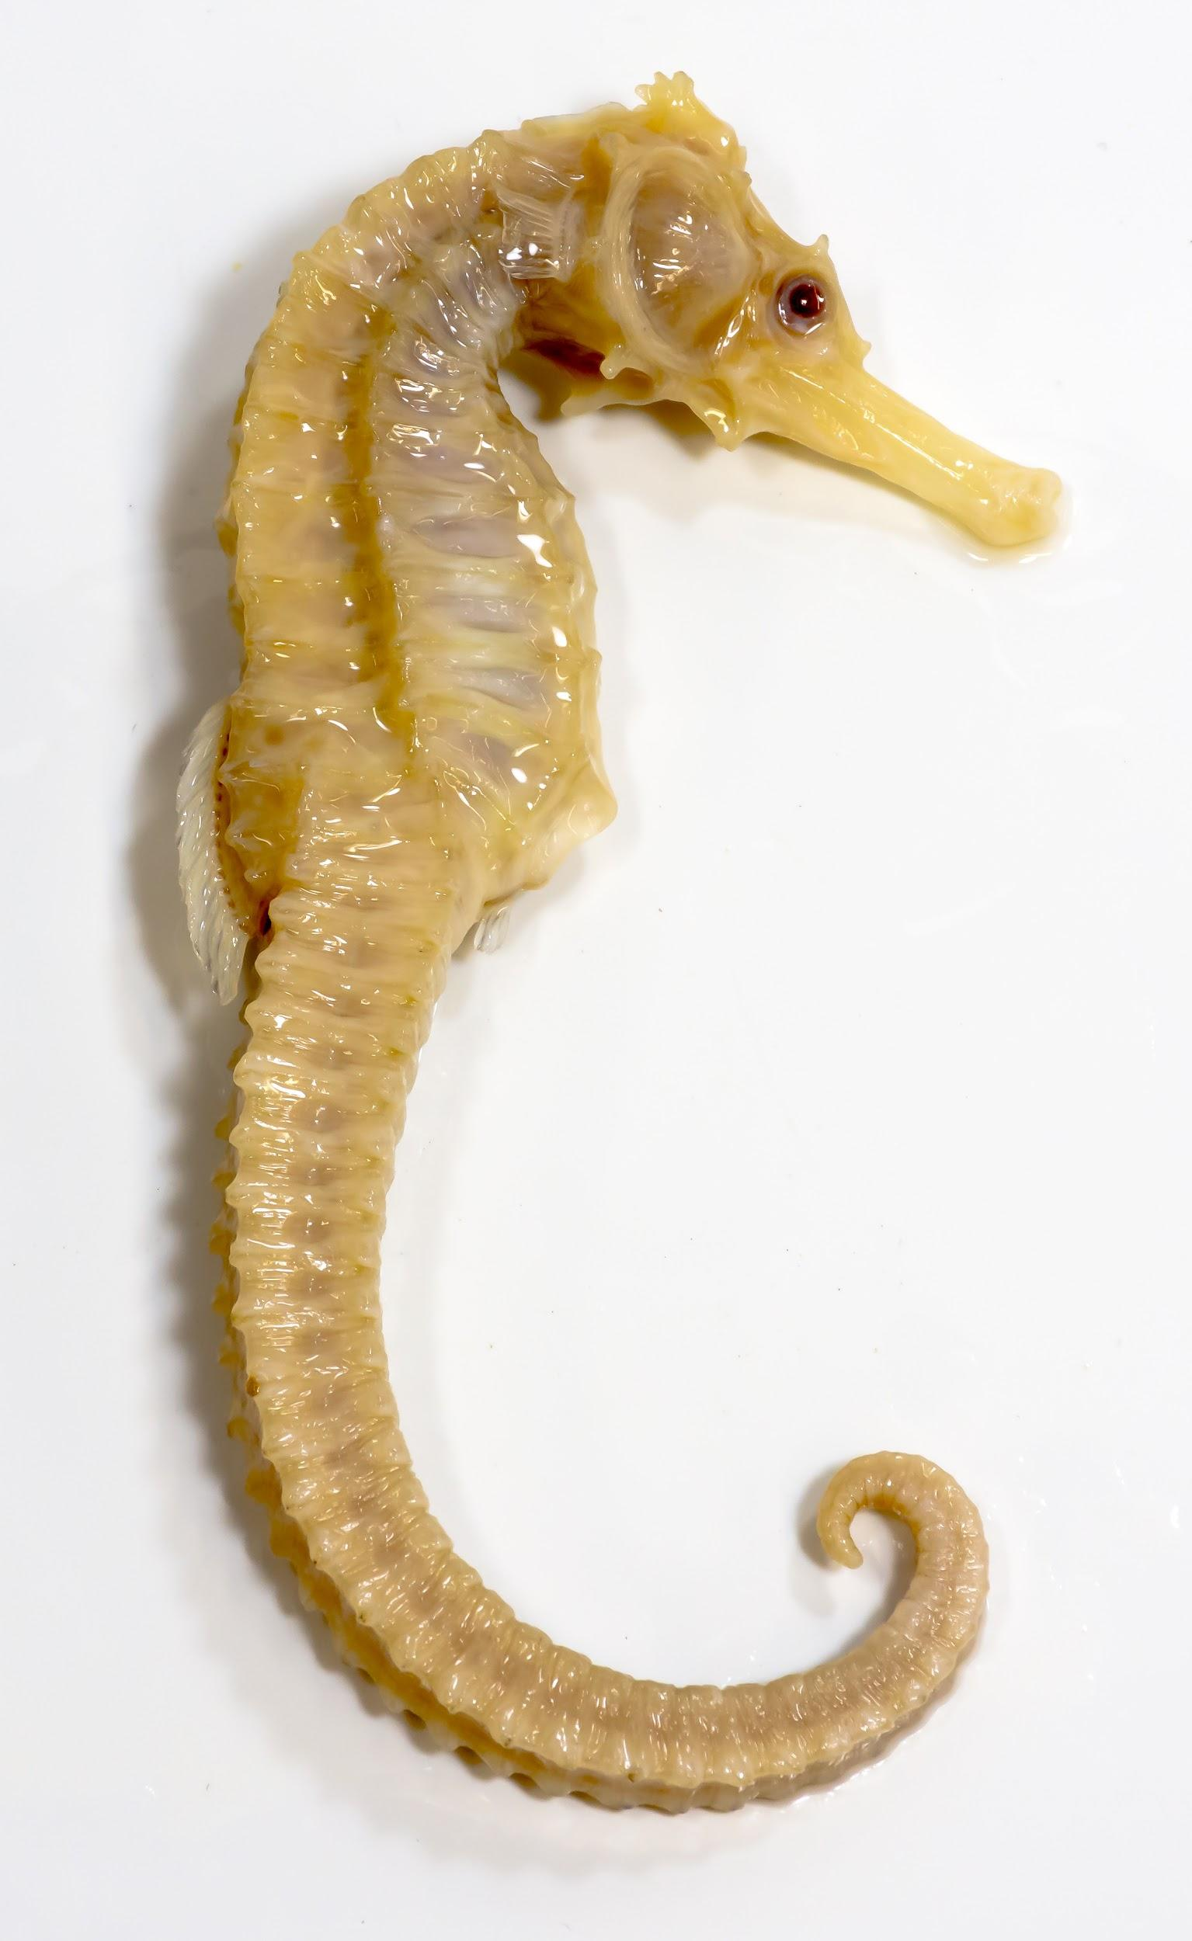
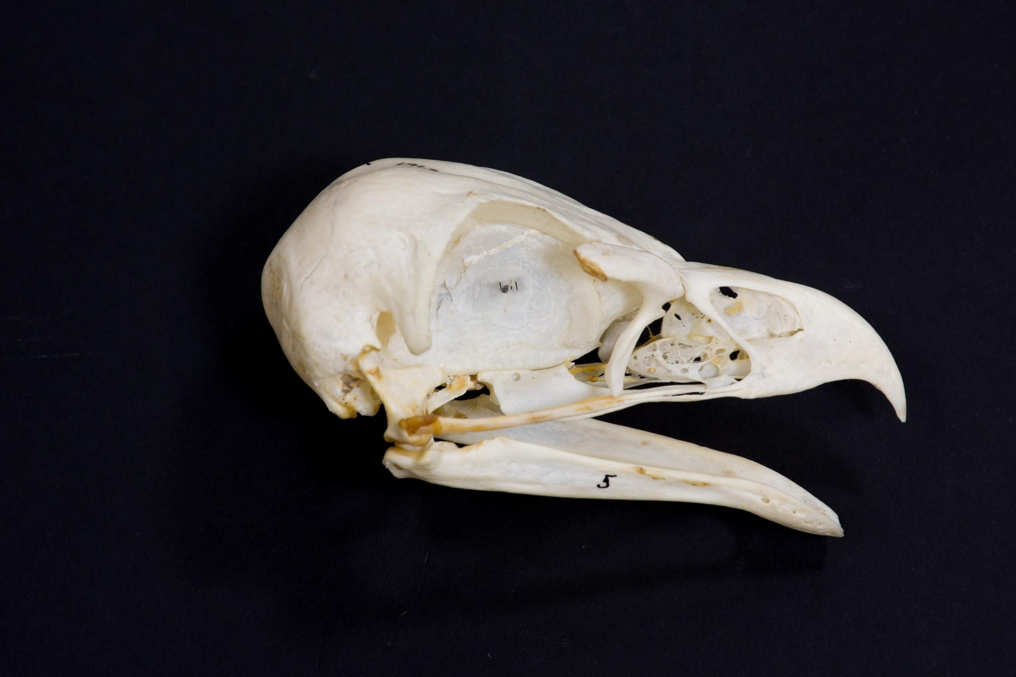
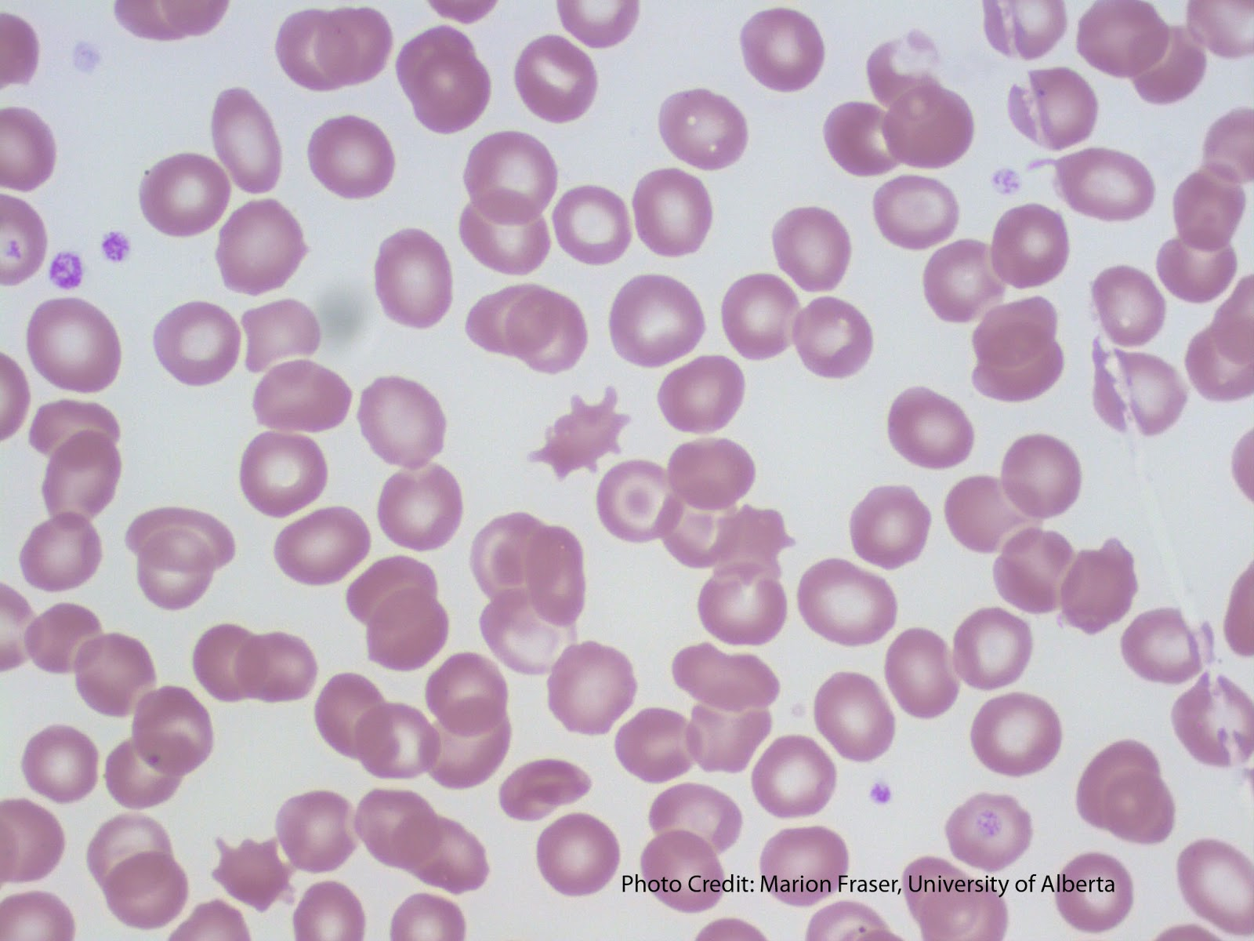
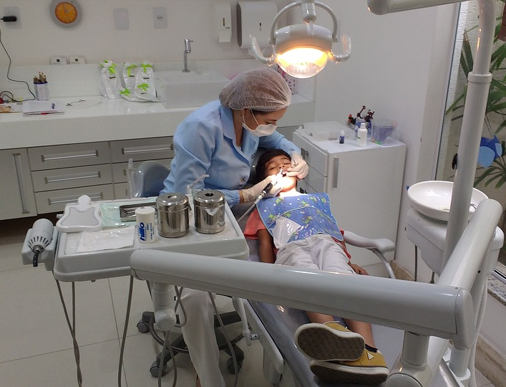
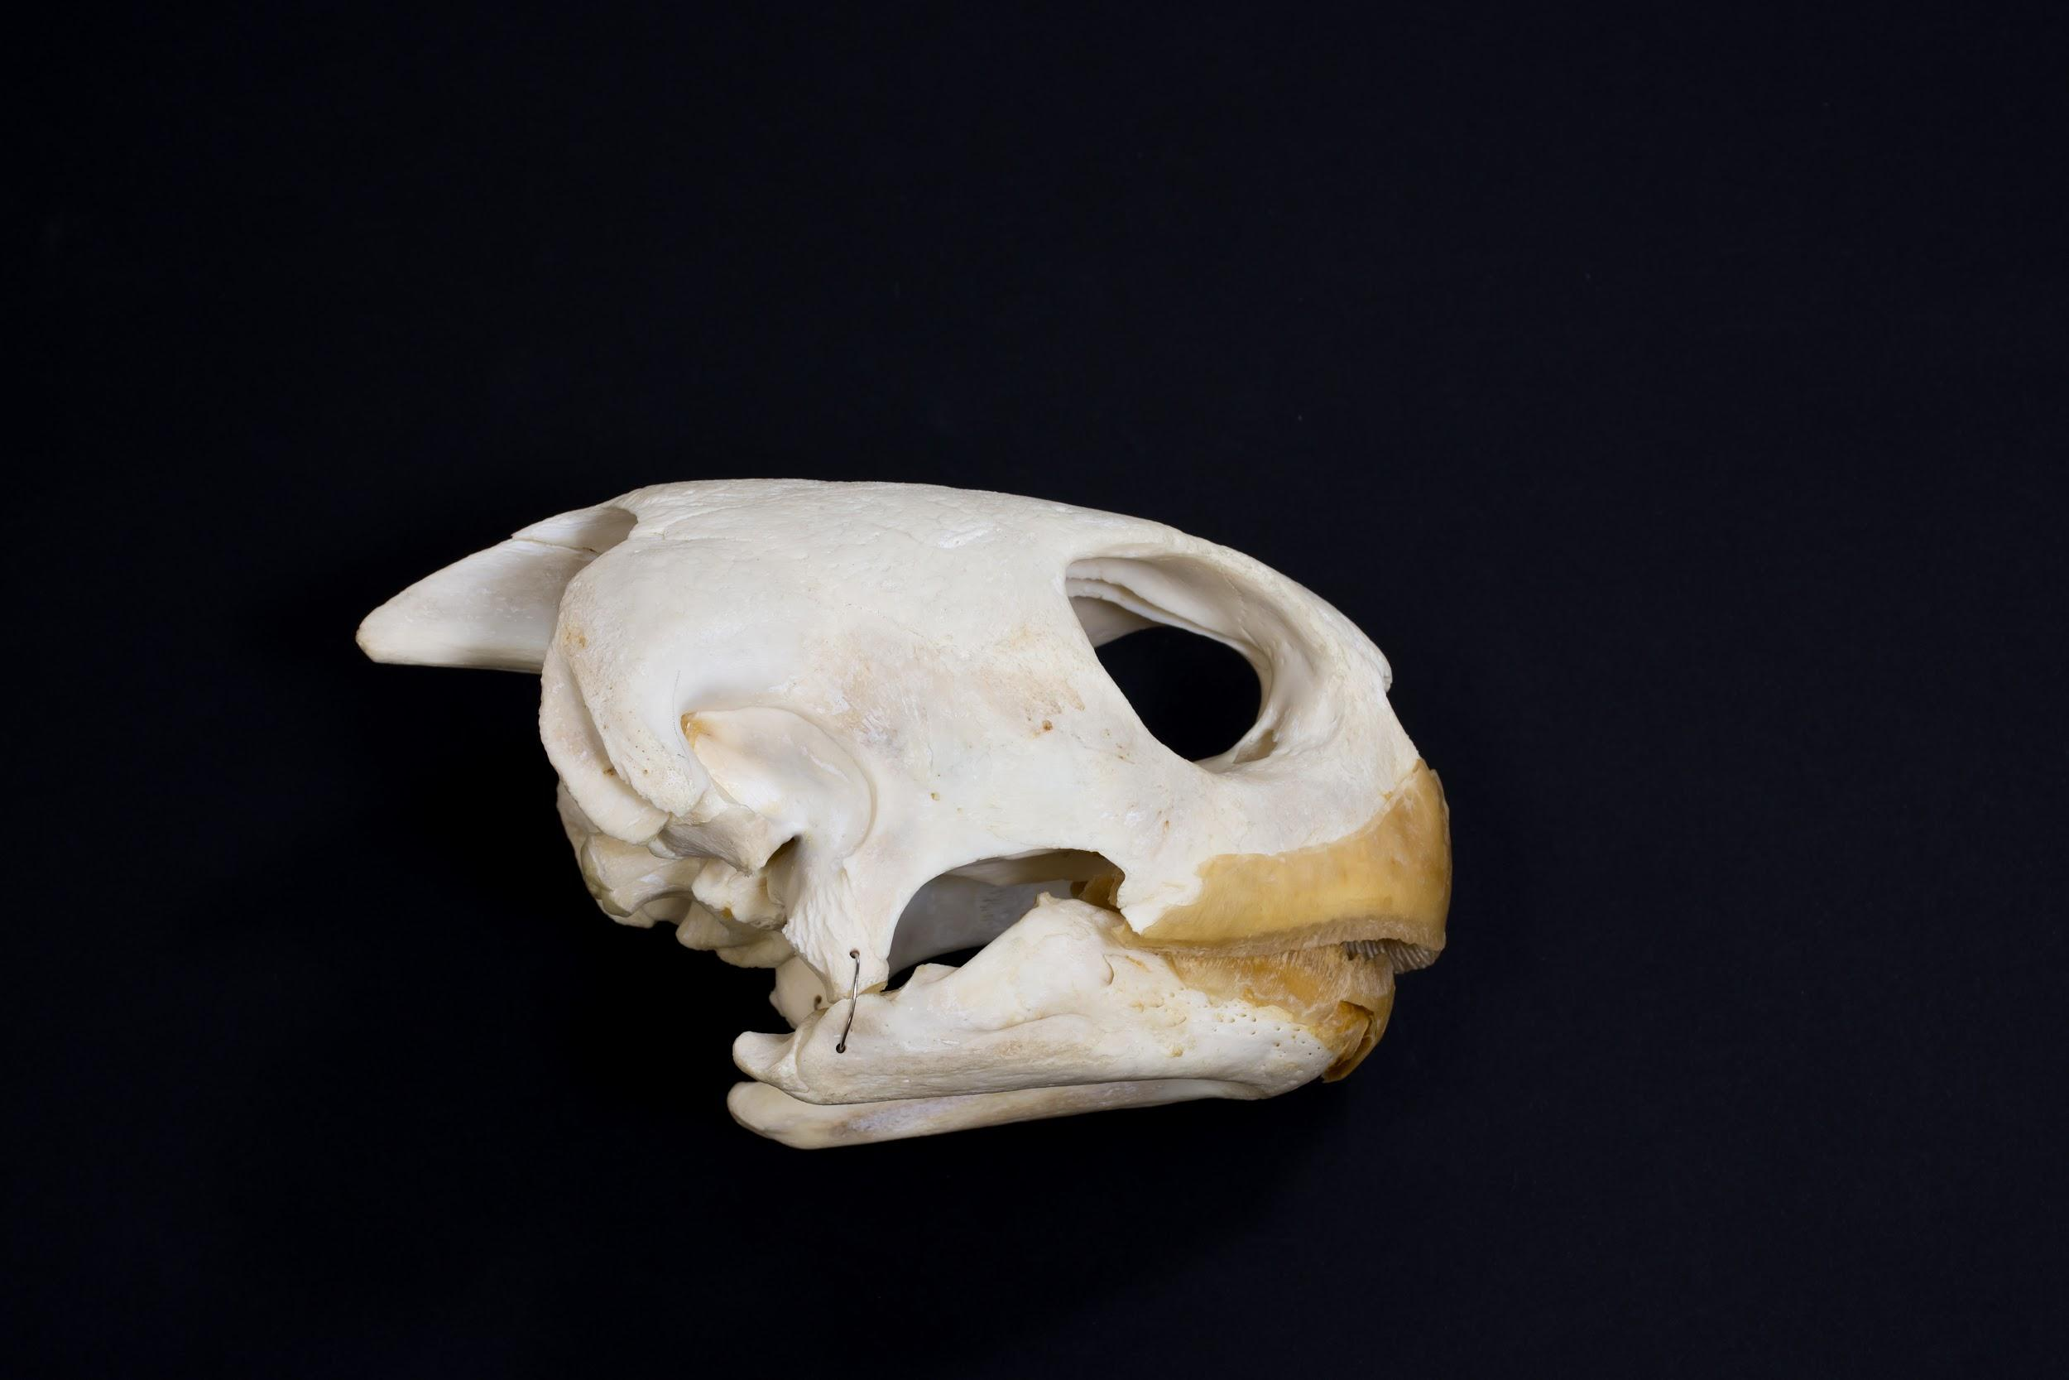
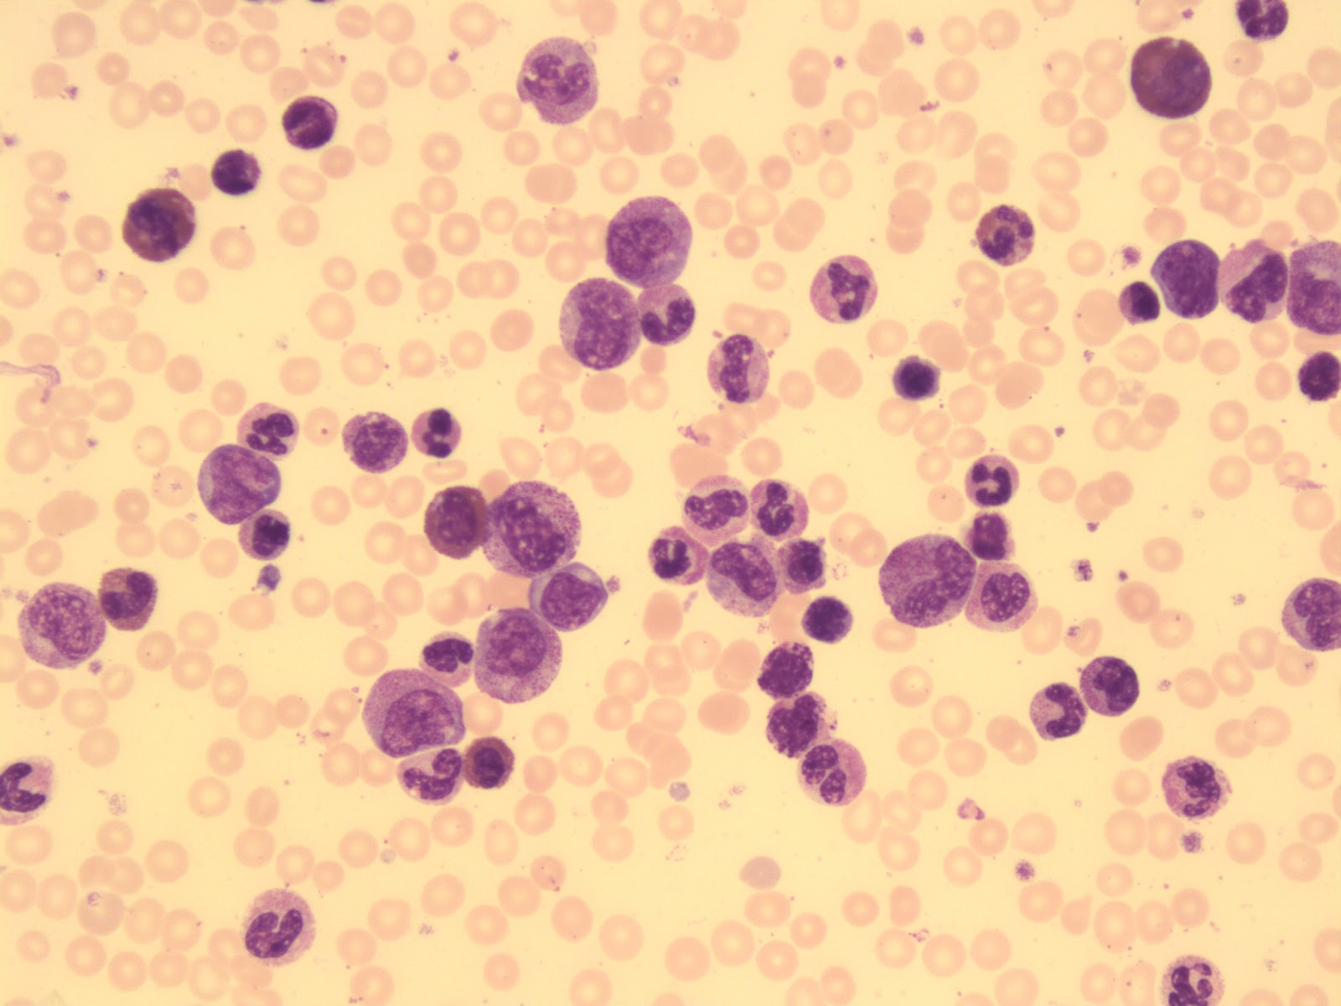
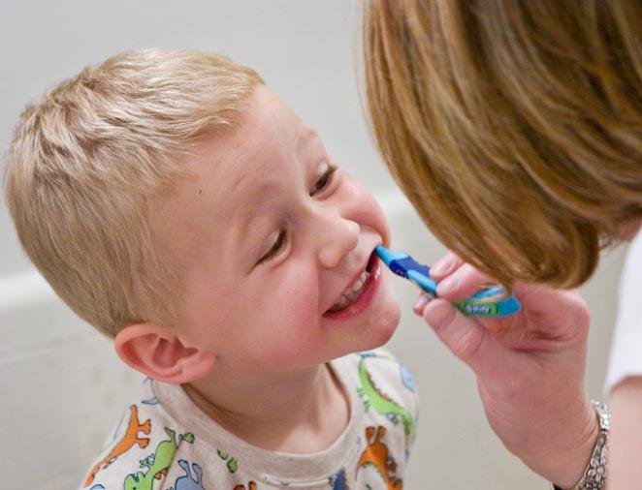
Media Collections
Image Sources: University of Alberta, Faculty of Medicine and Dentistry, School of Dentistry, Pediatric Dentistry Image Collection
Image Sources: University of Alberta, Faculty of Science, Department of Biological Sciences, Open Image Collection

Slide 6
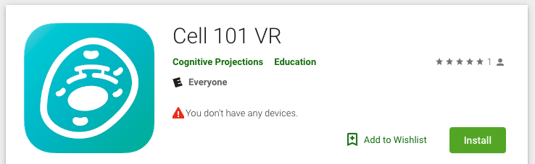


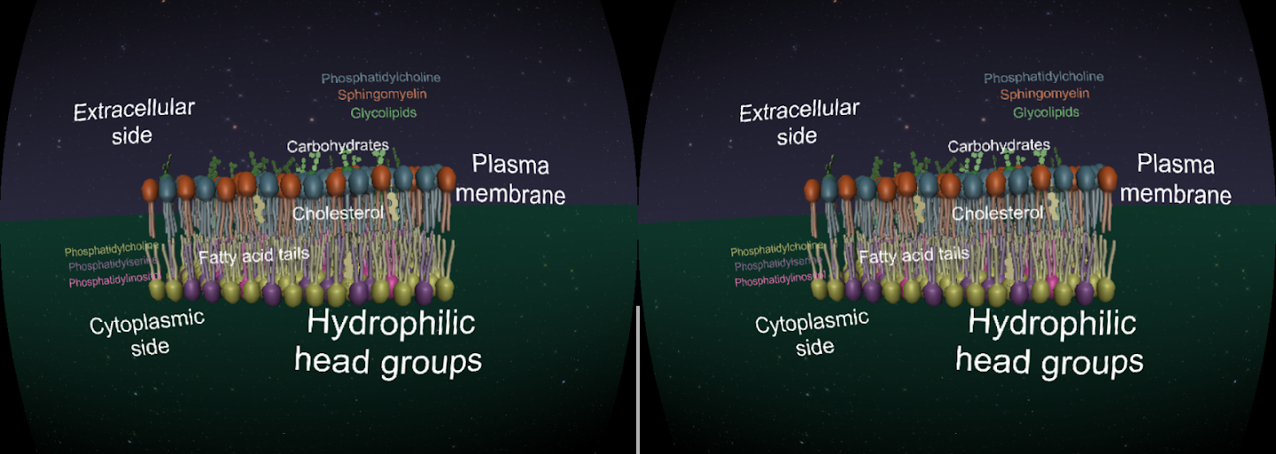
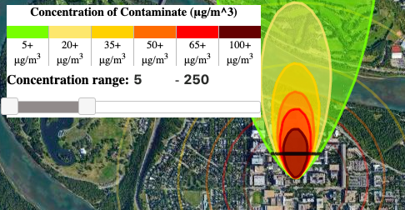
Interactive Resources
Open Textbooks
Interactive overlays
Image Sources: https://cognitiveprojections.ca/
Image Source: https://falon3.github.io/oer_visualTools/plume.html#top

Slide 7
UA OER Awards Program

Slide 8
Course Enhancement
Find, customize, and use open educational resources. Pilot use of new resources in class. | Replace traditional textbooks and other paid resources with open educational resources. Pilot use of new resources in class. | Utilize OER in classroom activities to leverage open licensing by enabling students to modify and redistribute OER.
OER Development
Engage students, other educators, and/or the community in the development of open teaching resources. | Solicit feedback and pilot the use of OER. Validate alignment of the resource with stakeholder needs beyond the classroom. | Develop version 2.0 of your existing OER by publishing on Pressbooks or other platforms to enhance engagement.

Slide 9
Faculty
Copyright Office
Student
Governance
Co-chairs:
Vice Provost Learning Initiatives
Vice Provost Learning Services / Chief Librarian
Bookstore
CTL
Libraries

Slide 10
Evaluation Criteria
Exploration
Class size & frequency
Student Engagement
Student
Impact
Cost Savings to Students
Transfer-
ability
Potential beyond UofA
Existing resource costs

Slide 11

Project Agreements
Evaluations | Institutional Repository
Student Teams
OERs are stored in the
UA Educational Research Archive (ERA)
Course outlines, project team interviews
Funding stays in CTL, staffed by students
CC-BY, CC-BY-SA, CC-BY-NC, or CC-BY-NC-SA

Slide 12
OER Project
Cycle

Slide 13
OER
Project
Cycle
Pilot
Find
Customize

Slide 14
Shared vision for student learning
Dedicated student support
----
Google Advanced & CC Search
----
CC license training at the outset
Setting an open licensing intent
Capturing usage rights along the way
Find
OER Project Cycle
Common challenges: time, how-to, organizing information

Slide 15
Iterative development
Collaborative testing
(student, instructor, & other)
Capturing changes along the way
---
Early consults with Copyright Office
Find
OER Project Cycle
Customize
Common challenges: choosing the cut, usage rights, versioning, designing “open”

Slide 16
content
“I’m trying something new”
Feedback loop
In-class reflection
Educate about OER / open licenses
learning
Pilot
Find
OER Project Cycle
Customize
Common challenges: articulating usage rights, change

Slide 17
Questions?
oer@ualberta.ca
Krysta McNutt, Open Education Program Lead, University of Alberta
Unless otherwise noted, this work is licensed under a Creative Commons Attribution 4.0 International License.
Notes:
Add name of conference + year, my name & Michelle

