Slide 1


Section 13: Copyright Ownership
Opening Up Copyright Instructional Module
December 2018
Notes:
Hello and welcome to the University of Alberta’s Opening Up Copyright Instructional Module on Ownership of Copyright (Section 13).

Slide 2



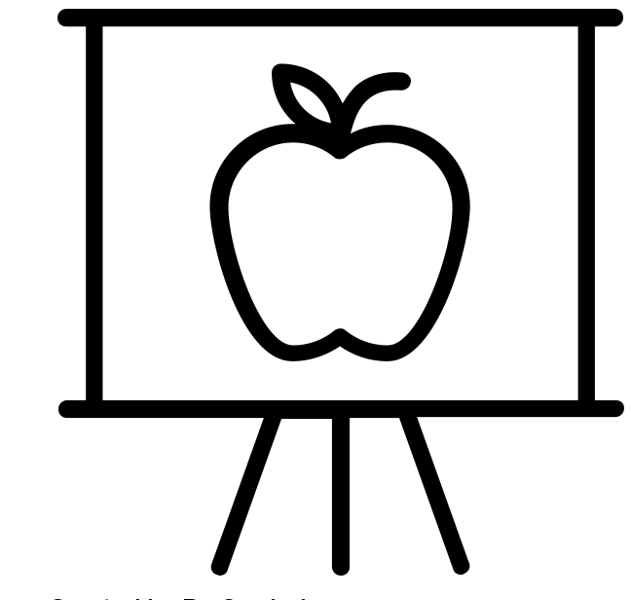
COPYRIGHT OWNERSHIP
?
Notes:
2. Copyright provides rights holders with a lot of control over the way works can be used and re-used. Have you ever wondered who owns the copyright for works that you create? What if you write a report, design an image or compose a jingle while at work? Have you ever wondered whether you own the copyright in works you created in the course of your employment?

Slide 3

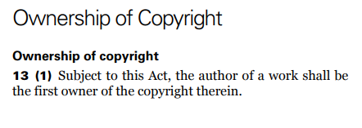
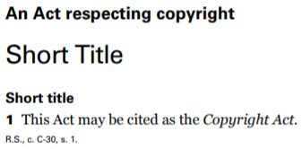
OWNERSHIP OF COPYRIGHT
Notes:
3. Ownership of copyright is covered in section 13 of Canada’s Copyright Act. Section 13(1) makes it clear that the author of a work is the first owner of the copyright in that work. However, there can be exceptions to this general rule.

Slide 4



EMPLOYMENT AND COPYRIGHT
“…but where the work is an article or other contribution to a newspaper, magazine or similar periodical…be reserved to the author a right to restrain the publication of the work…” s.13 (3)
Notes:
4. Section 13(3), explicitly states that the employer owns the copyright for works produced by someone who is employed under a contract or apprenticeship, and where those works are made in the course of employment, unless there is an agreement to the contrary.
This does not apply in the same way to all types of employment, however. Section 13(3) also specifies that, for contributions to newspapers, magazines and similar periodicals, the author retains a right to restrain the publication of the work otherwise than as part of a newspaper, magazine or similar periodical.
https://pixabay.com/en/girl-read-reading-newspaper-791231/

Slide 5
APPLYING SECTION 13
?
Application of section 13
Notes:
While the application of section 13 can seem straightforward, there can be cases where application of this section is less clear.

Slide 6
EXTRA-CURRICULAR ACTIVITIES
Technical manual based on your work
Work Computer
vs.
vs.
Home Computer
Novel about witchy seahorses
Notes:
6. For example, if you are an employee and you create something outside the course of your employment but you used the employer’s equipment, then the employer may have a claim to the copyright in that work. Similarly, if you create a work outside of regular working hours, but the work is directly related to or stemming from your duties as an employee, again, the employer may have a claim to the copyright. If such extra-curricular activities are anticipated, it is important to discuss copyright ownership issues with your employer upfront, and, where possible, to address these in a contract or via amendments to a collective agreement.

Slide 7



COPYRIGHT IN ACADEMIA
©
Notes:
7. In some sectors, such as academia, employment contracts or collective agreements often allow academic staff members to retain copyright in works created in the course of their employment. For example, it’s typical for faculty members at a university to own the copyright on the articles they write, even though these works are created in the course of their employment. However, it is important to note that for other kinds of materials (e.g. administrative documents) and for certain academic staff (e.g. contract sessional instructors or academics working at many colleges) copyright in such works might be retained by the employer.

Slide 8
FREELANCE
✓
Notes:
8. Employment status is another issue related to copyright ownership. Section 13 covers employees, but it does not extend to freelancers. However, determining the line between a freelancer and an employee can be complicated. As stated earlier, it is always important to discuss ownership of copyright upfront and have it clarified in writing.

Slide 9

EMPLOYMENT WITH THE GOVERNMENT
Notes:
9. Governments are another large employer in Canada. Copyright in works produced by government employees in the course of their employment is normally owned by the employer.
https://www.canada.ca/en.html

Slide 10
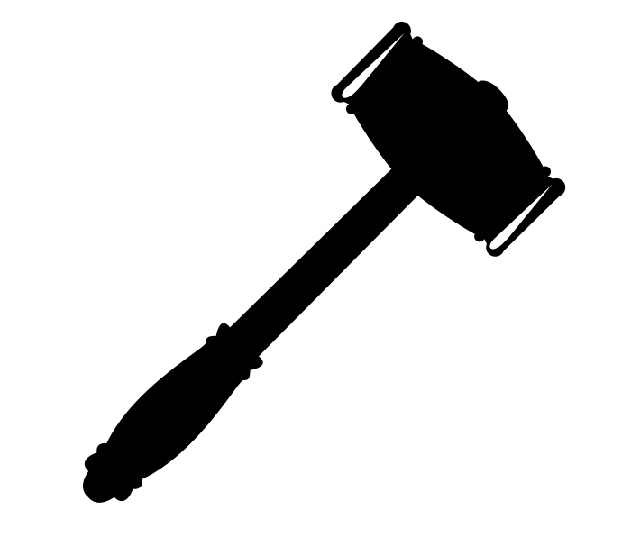
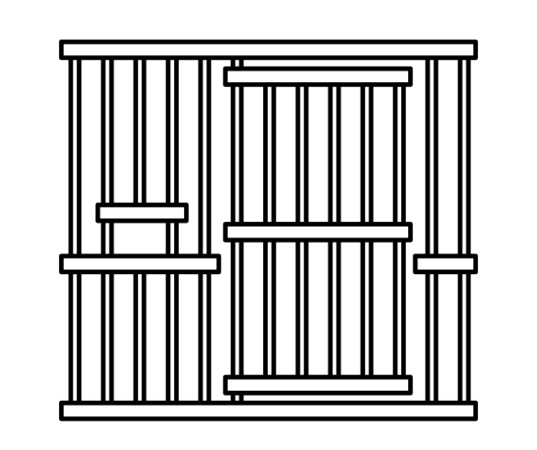
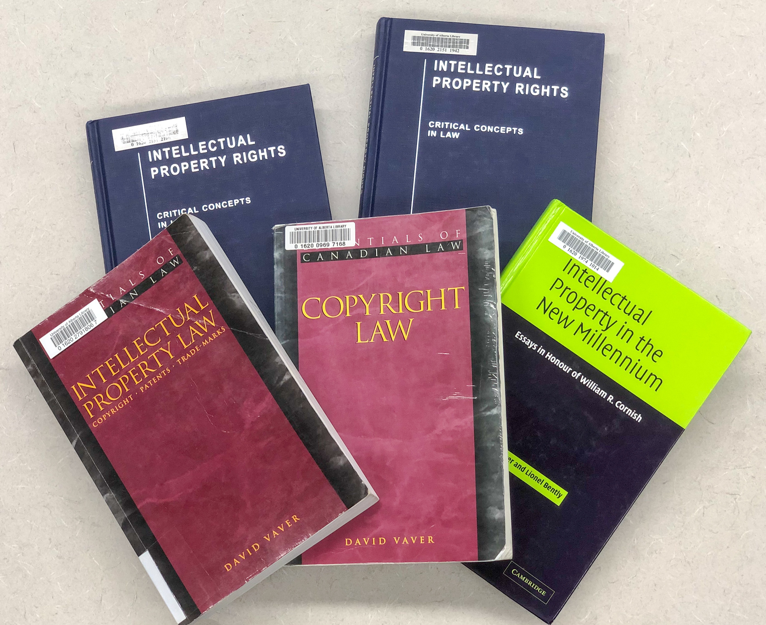
INCARCERATION AND EMPLOYMENT
To what extent is someone who is incarcerated a government employee?
…no provisions in the Act that address copyright held by incarcerated persons…
Notes:
10. The definition of a government employee, however, can be broader than you might think. For example, to what extent is someone who is incarcerated a government employee? What works produced by an inmate would be considered works created in the course of that employment? While there are no provisions in the Act that address copyright held by incarcerated persons, esteemed Canadian legal scholar David Vaver notes a judicial precedent that vests copyright with the Crown for a painting produced by a federal inmate as part of their rehabilitation. Court decisions like this one help us better understand the relationship between statutory provisions and their interpretation in real world scenarios.
https://www.11southsquare.com/barristers/professor-david-vaver/

Slide 11
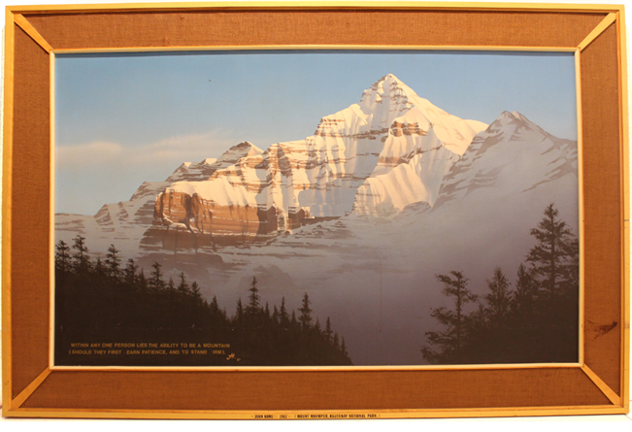
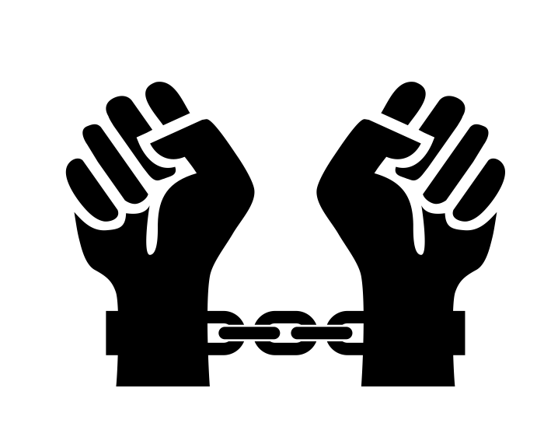
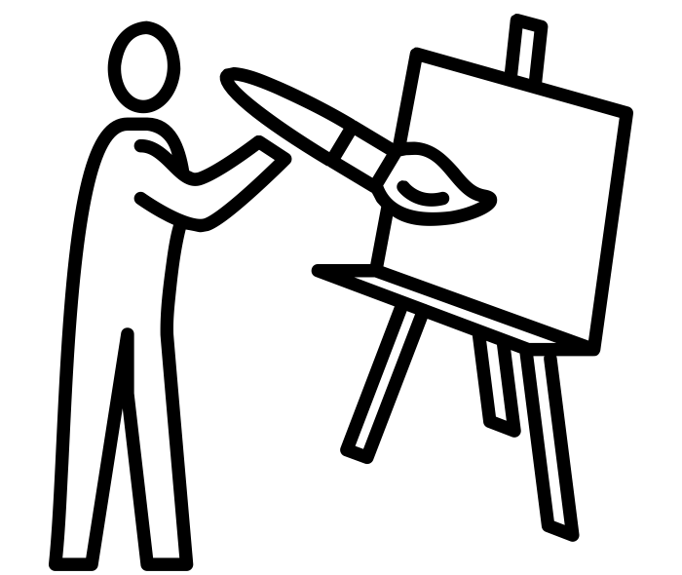

HAWLEY V. CANADA
“gainfully employed” para 60
$6/day
Frontenac Institution
Copyright of the painting owned by the Crown
©
Notes:
11. In Hawley v. Canada, the plaintiff, artist John Hawley, while incarcerated at Frontenac Institution, a minimum security facility in Kingston Ontario, was assigned to do a large mural for the institution’s common room as part of his work programme. All inmates at Frontenac Institution were “gainfully employed” through their participation in a work programme [para. 60]. By agreement, the mural became a large painting for the dining room. The painting was completed and Hawley was later released and claimed ownership of the painting and copyright in the painting. The case was brought before the Federal Court Trial Division (Hawley v. Canada, [1990] F.C.J. No. 337), where it was decided that the painting, and the copyright in the painting, was owned by the Crown.

Slide 12

HAWLEY V. CANADA
“I should first of all find that all inmates at Frontenac Institution had to be gainfully employed. The gain might only be in the neighbourhood of $6 per diem but it was employment nevertheless.” para 60
“…in dealing with a literary work or a work of art made or created by an inmate in a penal environment, there is no reason to apply different criteria or to depart from normal rules.” para 65
Product of labour during work hours rather than during leisure hours.
Notes:
12. Given that the work was found to have been created by Hawley during the course of his employment as an inmate, the Court found that “in dealing with a literary work or a work of art made or created by an inmate in a penal environment, there is no reason to apply different criteria or to depart from normal rules.” [para. 65] The judge in this case determined that the painting was a product of an inmate’s labour during work hours, rather than during leisure hours, therefore it was decided the copyright in the painting was owned by the employer, which in this case was the Government of Canada.

Slide 13


TRANSFER OF RIGHTS
©
©
Notes:
When a work is created in the course of employment, the employer becomes the “first owner” of the copyright in the work. However, section 13 also deals with the assignment or licensing, in whole or in part, of rights by the copyright holder. Section 13(4) makes it explicit that no assignment or grant of a license is valid unless it is in writing and signed by the rights-holder or an authorized representative. In other words, any transfer of rights will require a written agreement.

Slide 14
CONTRACTS AND COLLECTIVE AGREEMENTS
It is important to fully understand contracts and collective agreements.
Notes:
13. Regardless of your employer, It is always important to ensure that you fully understand contracts and collective agreements that might specify how copyright ownership in various types of works is determined.

Slide 15
LEARNING OBJECTIVES
You should now be able to:
Understand how section 13 governs the ownership of copyright for works created in the scope of employment
Recognize certain employment situations where ownership of copyright may be unclear
Describe the importance of having copyright ownership covered in contracts or collective agreements
Notes:
You should now be able to:
Understand how section 13 governs the ownership of copyright for works created in the scope of employment
Recognize certain employment situations where ownership of copyright may be unclear
Describe the importance of having copyright ownership covered in contracts or collective agreements

Slide 16
TEST QUESTIONS
According to Section 13, who is the first owner of the copyright for a work created?
It is generally the author of the work, though there are some important exceptions.
It is the person who purchases the work.
It immediately enters the public domain.
It is generally the employer of the author of the work, though there are some important exceptions.
Section 13(3) explicitly states that the employer owns the copyright for works produced by someone who is employed under contract or apprenticeship, and where those works are made in the course of employment…
Unless the employee purchases the copyright.
Unless the employee is casual staff.
Unless there is an agreement to the contrary.
Unless the employer says differently.

Slide 17
TEST QUESTIONS
You definitely own the copyright of the novel you wrote even if you used your employer’s computer.
True
False
It is typical for all staff at an academic institution to own the copyright on the works they create.
True
False

Slide 18
TEST QUESTIONS
It is important to read and ensure that you understand any collective agreement or contract that you sign.
True
False
In Hawley v. Canada, the court decided the copyright was owned by the Crown because:
The warden wanted the painting.
His $6/day pay had been fair compensation.
The work was produced during his work hours instead of his leisure hours.
Inmates have no leisure time so all work produced is owned by the Crown.

Slide 19
REFERENCES AND RESOURCES
Ginsburg, J. C. (2003). The concept of authorship in comparative copyright law. DePaul Law Review. 52(4). 1063-1092
Lametti, D. (2001). Publish and profit?: Justifying the ownership of copyright in the academic setting. Queen’s Law Journal. 26. 497-568
Monotti, A.L. & Rickeston, S. (2003). Universities and intellectual property: Ownership and exploitation. Oxford: Oxford University Press.
Tomkowicz, R.J. (2013). Copyright in ideas: Equitable ownership of copyright. Canadian Intellectual Property Review. 29(1). 75-98
Vaver, D. (2011) Intellectual property law: Copyright, patents and trade-marks. 2nd Ed. Toronto: Irwin Law

Slide 20
CASES AND LEGISLATION
Hawley v. Canada, 1990 CanLII 8024 (FC). http://canlii.ca/t/gbw0q

Slide 21
IMAGE AND SOUND REFERENCES
Image Credit (in order of appearance):
rawpixel. (2017). Typerwriter. Pixabay. CC0 https://pixabay.com/en/typewriter-old-alphabet-typing-2242164/
Enshia. (n.d.). Book. The Noun Project. CC BY https://thenounproject.com/icon/1787402/
ProSymbols. (n.d.). Art. The Noun Project. CC BY. https://thenounproject.com/icon/1976897
Atif Arshad. (n.d). Gramophone. The Noun Project. CC0. https://thenounproject.com/icon/1306170/
kaboompics. (2015).Girl Reading. Pixabay. CC0 https://pixabay.com/en/girl-read-reading-newspaper-791231/
Adrian Coquet. (n.d.) Worker. The Noun Project. CC BY. https://thenounproject.com/icon/1772869/
Vladimir Belochkin. (n.d). contract. The Noun Project. CC BY. https://thenounproject.com/icon/869929
Template. (n.d.) professor. The Noun Project. CC BY. https://thenounproject.com/icon/2041323/
Ghan Koon Lay. (n.d.) PhD Student. The Noun Project. CC BY. https://thenounproject.com/icon/1248191/
Orin zuu. (n.d.) memo. The Noun Project. CC BY. https://thenounproject.com/icon/1169851/
Daniel Turner. (n.d.) Crown. The Noun Project. CC BY. https://thenounproject.com/icon/26903/
Jolan Soens. (n.d.) Prison. The Noun Project. CC BY. https://thenounproject.com/icon/567031/
JAW. (n.d.) Gavel. The Noun Project. CC BY. https://thenounproject.com/icon/23174/

Slide 22
IMAGE AND SOUND REFERENCES
Image Credit (in order of appearance):
corpus delicti.(n.d.) Prisoner. The Noun Project. CC BY. https://thenounproject.com/icon/1250858/
Bjorn Andersson. (n.d.) Judge. The Noun Project. CC BY. https://thenounproject.com/icon/1017231/
Hawley, J. (n.d). Government of Canada. Mount Whymper [Painting]. Retrieved from http://www.centrevox.ca/en/conference/the-radical-imaginary-the-social-contract-assembly-performance/
Chris Homan. (n.d).painter. The Noun Project. CC0. https://thenounproject.com/icon/620855
Ghan Koon Lay. (n.d). Boss. The Noun Project. CC0. https://thenounproject.com/icon/1587076
Unattributed materials are contributions from the Opening Up Copyright Project Team and placed in the Public Domain
Closing Slides Music: Rybak, Nazar. “Corporate Inspired.” HookSounds. N.d. http://www.hooksounds.com (used under a CC-BY 4.0 Licence)

Slide 23
LICENSING AND ATTRIBUTION
Suggested Citation:
  University of Alberta. 2018. “Section 13: Copyright Ownership.” Opening Up Copyright Instructional Module. https://www.ualberta.ca/copyright/resources/opening-up-copyright-instructional-modules
For the project overview and complete list of modules please visit the project website at: https://www.ualberta.ca/copyright/resources/opening-up-copyright-instructional-modules
Questions, comments, and suggestions should be directed to the University of Alberta’s Copyright Office at: copyright@ualberta.ca
This module is made available and licensed under a Creative Commons Attribution 4.0 International Licence

Slide 24
CONTRIBUTORS
Copyright Office
Centre for Teaching and Learning
Technologies in Education
Adrian Sheppard
Amanda Wakaruk
Cosette Lemelin
Graeme Pate
Krysta McNutt
Anwen Burk
Jamie Stewart
Matt Cheung
University of Alberta Libraries
School of Library and Information Studies
Michelle Brailey
Jesse Carson
Toby Grant
Kris Joseph
Michael B. McNally

Slide 25

ACKNOWLEDGEMENT
Opening Up Copyright modules were initially funded through the University of Alberta, Centre for Teaching and Learning’s Teaching and Learning Enhancement Fund (TLEF) with in kind contributions from the Copyright Office and the School of Library and Information Studies.

