Slide 1
A post-truth existence for fair dealing?
Dr. Meera Nair, Copyright Officer
26 February 2020

Slide 2
(I fixed it)
All rights reserved. The use of any part of this publication reproduced, transmitted, in any form or by any means, electronic, mechanical, photocopying, recording, or otherwise, or stored in a retrieval system, without prior consent of the publishers, -- or in the case of photocopying or other reprographic copying, a license from the Canadian Copyright Licensing Agency – is an infringement of copyright law.
Consider instead substantiality, user rights, and CCH’s pointed remark that licenses have no bearing on fair dealing.

Slide 3
Mistaken histories
Zamacois v. Douville and Marchand (1943)
Boudreau v. Lin (1997)
CCH Canadian Ltd. v. Law Society of Upper Canada (2004)
Some conduits of post-truth
Sifting truth
Toronto Star v. Allen (1997)
CCH in its entirety (1997-2004)
Warman v. Fournier (2012)

Slide 4
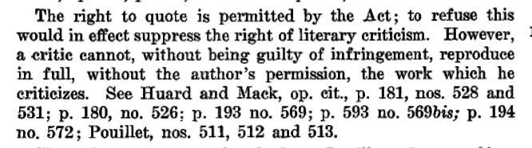
Zamacois v. Douville and Marchand (1943).
See also Meera Nair, “a miscast legacy,” Fair Duty 3 September 2019.

Slide 5
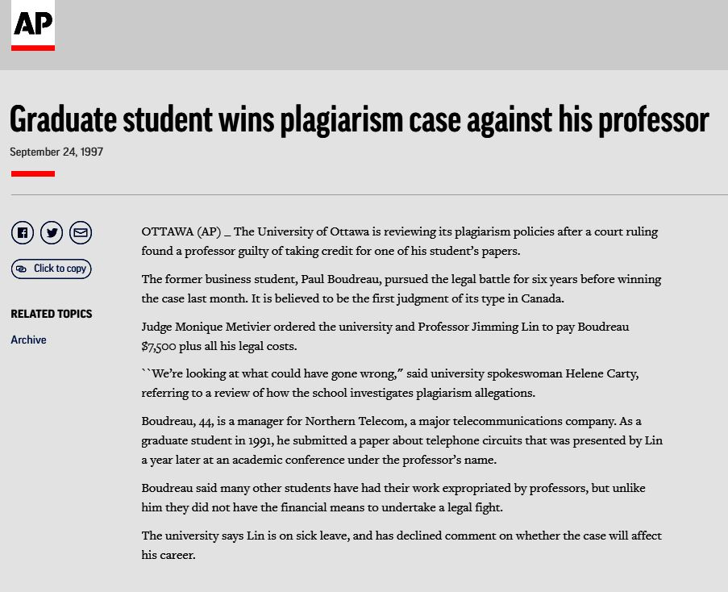
Boudreau v. Lin (1997)

Slide 6
“The fair dealing exception is perhaps more properly understood as an integral part of the Copyright Act … . Any act falling within the fair dealing exception will not be an infringement of copyright.”
CCH Canadian Ltd. v. Law Society of Upper Canada, 2004 SCC 13, para 48-49.
Laura Murray, “Copyright Talk.” In the Public Interest… ed. Michael Geist (2005).
Meera Nair, “Fair Dealing at a Crossroads,” Radical Extremism…, ed. Michael Geist (2010).

Slide 7
“In CCH, the Court relied on general assumption which led it to state that it was permissible for the entire legal community to broadly reproduce a legal monograph owing to the fact that general practice established by the Great Library allowed the photocopying for research purposes.”
Normand Tamaro, The 2012 Annotated Copyright Act (Carswell, 2012) 587. Repeated throughout subsequent editions including 2020.

Slide 8
“… the copying from Forensic Evidence in Canada amounted to the copying of the whole of a 32-page monograph within a 713-page textbook, which amounted to 13 percent of the whole of the textbook.
…
In the case of the textbook Economic Negligence, which is 306 pages in length, 69 pages were copied amounting to 93 percent of one chapter and 21 percent of the pages of the textbook.”
CCH Canadian Ltd. v. Law Society of Upper Canada (1999)

Slide 9
“The fair dealing provision [originated] in the Canadian Copyright Act of 1921, at a time when reproducing copyright materials meant copying out by hand. … Fair dealing is a defense to a claim of unauthorized use of copyright materials… A 1995 court case held that the reproduction of a magazine cover by a newspaper where a photograph on the cover was predominant was not fair dealing of the photograph.”
Lesley Ellen Harris, Canadian Copyright Law 4th Edition (Wiley, 2014) 163-168.
See instead Isabella Alexander, Copyright Law and the Public Interest in the Nineteenth Century, 283-285, and, Ariel Katz, “Fair Use 2.0 -- Rebirth of Fair Dealing in Canada” in the Pentalogy Book, 93-156,
and, CCH (2004), and Toronto Star v. Allen (1997).

Slide 10
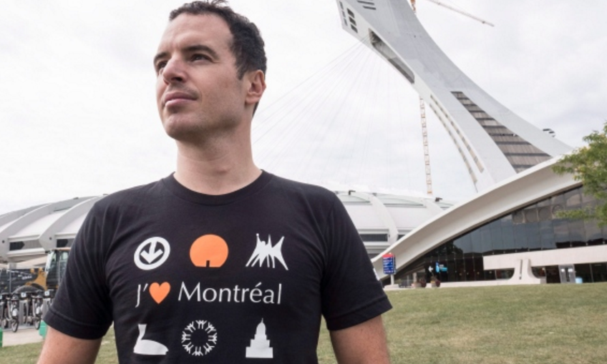
Olympic Stadium T-shirt violates copyright laws
Paul Chiasson/The Canadian Press via CBC, 25 September 2016
See instead Copyright Act (R.S.C., 1985, c. C-42), Miscellaneous Permitted Acts: S32.2(1)b; See also Isabella Alexander.

Slide 11
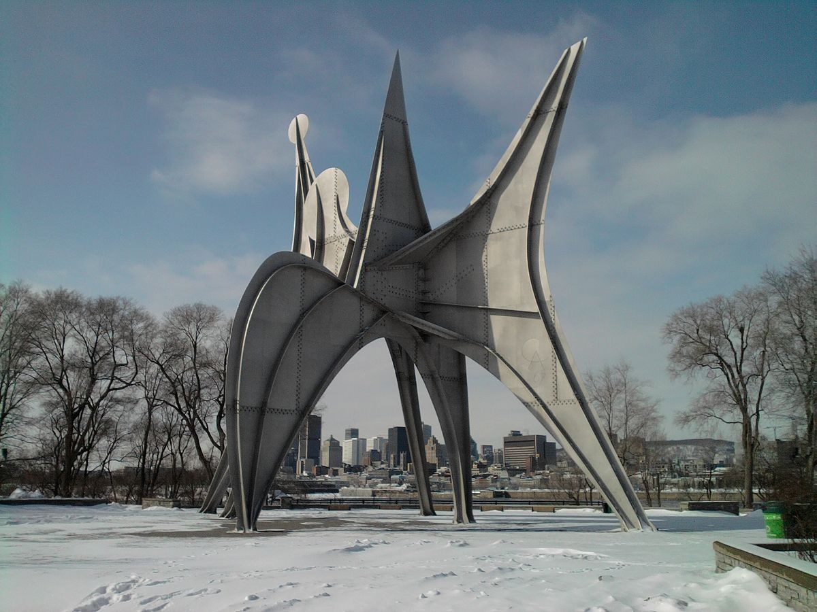
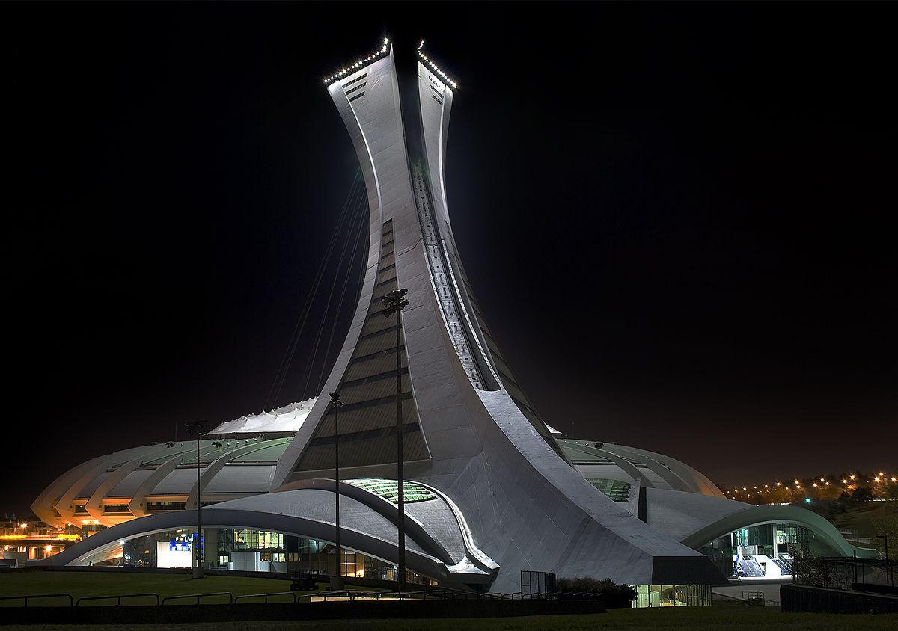
Man (l’Homme), Artist: Alexander Calder
Photographer: Idej Elixe CC-BY-SA
Le Stade Olympique de Montréal, Architect: R. Taillibert
Photographer: Alain Carpentier CC-BY

Slide 12
Contemporary instructions to undergraduate students
“Respect the copyright of others and abide by all copyright notices and regulations when using the computing facilities provided for your course of study. No material on the Internet or World Wide Web may be reproduced or distributed in any material form or in any medium, without permission from copyright holders or their assignees.”
Provided by a Canadian student in 2019.
Consider instead: Public Domain material OR substantiality (S3.1) OR Fair Dealing (S29) OR NonComm UGC (S29.21) OR – wait for it –WORK AVAILABLE THROUGH INTERNET (S30.04 ).
See also CCH Canadian Ltd. v. Law Society of Upper Canada, 2004 SCC 13, paras. 43-45.

Slide 13
Contemporary instructions to graduate students
“When copying copyrighted works for use in a thesis, such copying is primarily for the purpose of research. As understood in the context of the fair dealing exception, the research purpose does not contemplate distribution to the public (i.e., publication of your research). …. Because the University requires you to submit your thesis to [the online repository] and also to submit your thesis to [LAC] the fair dealing exception is not available. …. Since you will typically be using the whole of the copyrighted image (as opposed to a small portion of the image), you should be particularly careful to obtain permission before including it in your thesis.”
University of British Columbia, and the University of Northern BC, and ?
See instead Sara Bannerman, International Copyright and Access to Knowledge, (Cambridge University Press, 2016) 34-40
and David Vaver, Copyright Law (2000), 196.

Slide 14

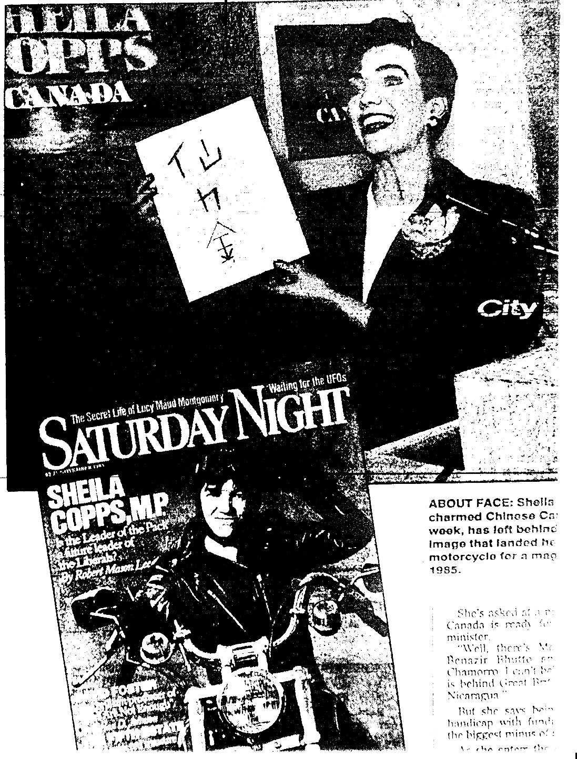
Toronto Star v. Allen (1997)

Slide 15
  “The use of [the cover] was related to the then news; the leadership aspirations of Ms. Copps…. It was apt for the newspaper to contrast the image she was willing to project in 1985. The change in her image was the thrust of the article.
  … The cover was reproduced in a reduced form. The news story and the accompanying photo received no special prominence in the newspaper. They appeared on an inside page on an inside section. These factors are indications that the purpose of the reproduction of the cover was to aid in the presentation of a news story, not to gain an unfair competitive advantage over Allen or Saturday Night.”
Toronto Star v. Allen (1997), para 37-38.

Slide 16
“As an integral part of the scheme of copyright law, the s. 29 fair dealing exception is always available. ”
“Research must be given a large and liberal interpretation…”
“The availability of a licence is not relevant to deciding whether a dealing has been fair.”
Commerciality is not a bar to fair dealing.
No liability to institutions for what students might do.
Contextual analysis should adapt to each situation
And more….
CCH Canadian Ltd. v. Law Society of Upper Canada, 2004 SCC 13.
See also Meera Nair, “six factors if necessary,” Fair Duty 24 February 2017.

Slide 17
“Quantitatively, the reproduction constitutes less than half of the work. The [Work] itself consists of a headline and eleven paragraphs. The reproduction [of excerpts] included the headline, three complete paragraphs and part of a fourth. Qualitatively, the portions reproduced are the opening ‘hook’ of the article, and the summary of the facts on which the article was based. Most of the commentary and original thought expressed by the author is not reproduced.”
Warman v. Fournier (2012) para 25.

Slide 18
“Some of the factors weigh less strongly in favour of a finding of fair dealing: there was arguably an alternative to the dealing, namely providing a summary of the Kay Work instead of reproducing excerpts. Also, the character of the dealing does not strongly support a finding of fair dealing. The excerpts are widely distributed on the internet as opposed to the making of a private copy. However, balancing all the factors together, I find that the reproduction of the Kay Work falls within the fair dealing exception for the purposes of news reporting.”
Warman v. Fournier (2012), para 34, emphasis mine .

Slide 19
I titled this submission as an enquiry though, because it is not clear at this time if fair dealing is doomed to be permanently mired in a post-truth existence. Much depends on each institution’s capacity to understand fair dealing’s actual legal history, as compared to the perceived history encouraged by notable authorities. Effort will also be needed to resist the temptation of subsuming individual activity within the ambit of the institution’s responsibility.
These tasks become easier with some historical knowledge.

Slide 20
_{Thank you}
Dr. Meera Nair - meeran@nait.ca - 1.780.491.3048
26 February 2020

