Slide 1

Best Practices for OER in Canada: A Fresh Look at Fair Dealing for Educational Use
Dr. Carys Craig
Osgoode Hall Law School
ccraig@osgoode.yorku.ca
@craigcarys
Notes:
https://copyrightliteracy.org/2021/06/06/building-copyright-literacy-for-a-global-community-of-open-educators-with-the-code-of-best-practice-in-fair-use-for-oer/

Slide 2

Code of Best Practices in Fair Use for OER
Facilitators & Authors:
Meredith Jacob American University Washington College of Law
Peter Jaszi American University Washington College of Law
Prudence S. Adler American University Washington College of Law
William Cross NC State University Libraries
The panel of external reviewers
Prof. Carys J. Craig, Osgoode Hall Law School, York University
Associate University Librarian Sharon E. Farb, UCLA
Prof. Michael J. Madison University of Pittsburgh School of Law
General Counsel Steven J. McDonald, Rhode Island School of Design
Dean of Libraries Kevin L. Smith, University of Kansas
Prof. Rebecca Tushnet, Harvard Law School
Copyright and Information Policy Librarian Laura Quilter, University of Massachusetts, Amherst

Slide 3
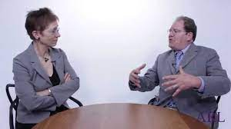
Fair Use and Best Practices: Surprising Success
“The viability of fair use—legitimate, unauthorized use of copyrighted material under certain circumstances—has come into question, both with aggressive policing of copyright by large media holders and with changing digital practices. And yet fair use is arguably the most important feature that maintains copyright law’s constitutionality…
The creation of the Documentary Filmmakers’ Statement of Best Practices in Fair Use demonstrates that in fact fair use is a vital and functional part of copyright law, when its terms are well-understood by a particular creative community.”
BY PAT AUFDERHEIDE
AND PETER JASZI

Slide 4
The role of “Best Practices”
Proliferation of Best Practices documents over the last 16 years
The missions of participating communities have benefitted -- doc films, libraries, etc.
The community we hope will benefit is OER creators, who should have access to a wide range of inserts -- illustrations and examples in all media to support teaching and learning -- not just those with open licenses or PD status.
Among other things, this will promote the accessibility and durability of OER -- creating resources that are self-contained
Notes:
Put it into practice
https://cmsimpact.org/report-list/codes/

Slide 5
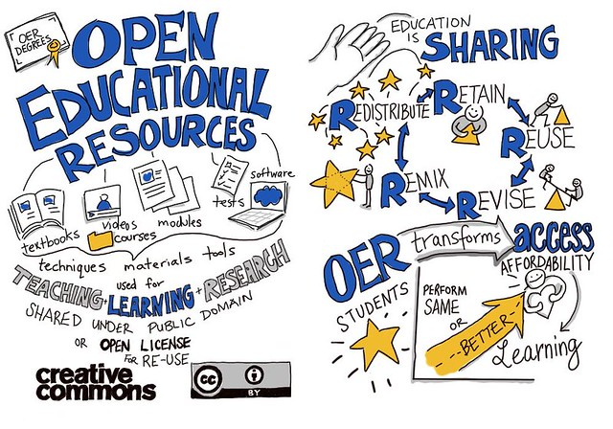
https://brocku.ca/pedagogical-innovation/resources/open-educational-resources/

Slide 6
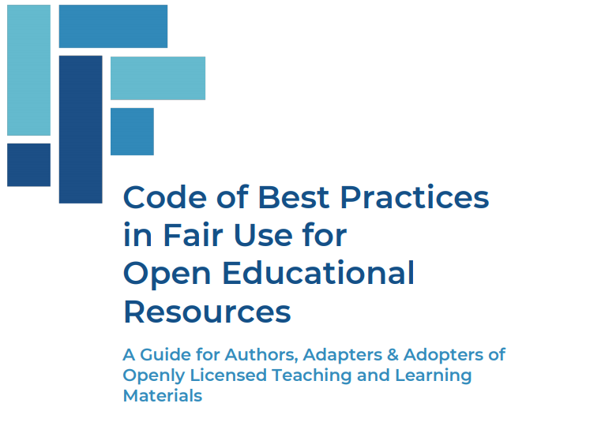
Best Practices in Fair Use for OER
“Educators should not be constrained to use only what commercial publishers choose to offer and the formats they choose to offer it in. When OER authors are able to understand and rely on fair use, it allows them to create materials that are compelling, impactful, and adaptable.
This Code is a tool for educators, librarians, and authors to evaluate common professional scenarios in which fair use can enable them to incorporate inserts, including those protected by copyright, to create OER.”
https://www.wcl.american.edu/impact/initiatives-programs/pijip/documents/code-of-best-practices-in-fair-use-for-open-educational-resources/

Slide 7
Are you doing something new or different (something “transformative”) with the material?
AND
2. Is the amount you are using – whether a part or the whole – appropriate?
→ If yes to both, it’s unlikely that you’ll be providing a “substitute” for the copyright work in its intended market - which is the only pocketbook issue relevant to fair use.
Fair use: Two core questions
Notes:
Exceptional exception
Long history in common law, added to statute in the 76 act w 4 factors
Checked history from the 8os and some hangover
We could spend all day, but the quick version is that most questions Gail down to this formulation

Slide 8

What the Code Is, and What It Is Not

Slide 9
How to use the Code of Best Practices for Fair Use in OER
As a tool for institutional and individual copyright education
As a guide to reasoning about how to apply fair use to particular projects, including in recurrent situations
As a vehicle for talking about fair use with colleagues, including so-called “gatekeepers”
As a way of attracting new makers to the OER project and enabling new projects

Slide 10
What the Code is not!
Because it keeps a tight focus on fair use and inserts into OER, it doesn’t address fair use in course reserves, classroom work, etc.
Because it addresses fair use, it isn’t a handbook on how to get the most out of open licensing.
Because it describes a way of thinking about fair use, it doesn’t provide metrics, rules of thumb, etc.
  Just as well, since these have proven to be some of the most consistently mischievous features of the copyright knowledge system.

Slide 11
The Code is a consensus-based centrist document,
…not a radical manifesto!
The Code is not a “far out” effort to push fair use in OER to (or past) conventionally understood limits. Rather, it represents an approach to fair use that reflects
broadly held views of the OER community, as evinced in hundreds of individual interviews in individual and group settings, as
captured by the project’s expert team of facilitators; and
critically vetted by a panel of independent copyright experts, both academics and practitioners.
MJ

Slide 12
Applying the Code
WC

Slide 13

How the principles in the Code are structured
Use case
Statement of principle
Considerations for use
Hard cases - as an outer limit

Slide 14
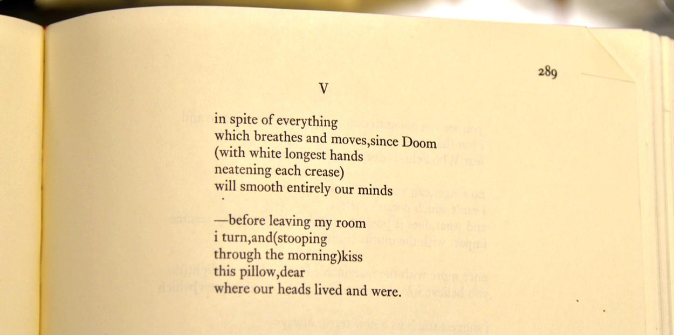
Using inserts as objects of criticism and commentary
WC
in spite of everything by ee cummings is included on the basis of fair use as described in the Code of Best Practices in Fair Use for Open Education
Notes:
Coalesce around a center of gravity
Common and happily easy question about using images text, video etc. in a way that directly comments on or engages in critique.
From poetry textbook looking at trends to film studies doing close reading.
Sometimes teacher designed explicitly offered the commentary and sometimes students were asked to do so.

Slide 15
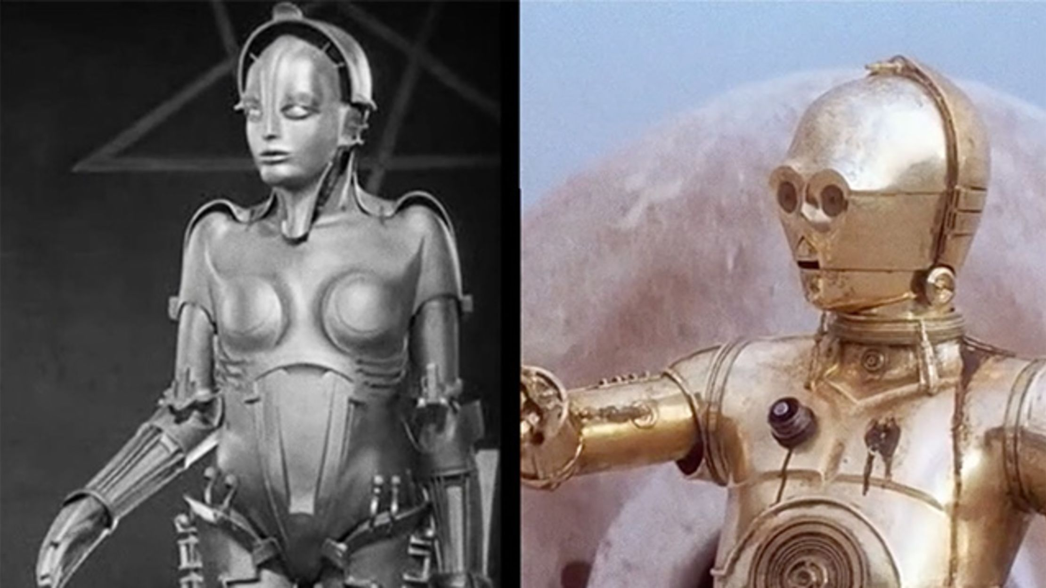
Including inserts for the purpose of illustration
WC
Images from Metropolis (1927) and Star Wars (1977) included on the basis of fair use as described in the Code of Best Practices in Fair Use for Open Education
Notes:
Similar question: using images, video, music, etc. as a way not to critique but illustrate an idea, a trend, etc. So, example here is using images from a series of films to illustrate the way hollywood presents robots.
iconic news image may galvanize students’ interest in the 1960’s Civil Rights Movement, or clips from a series of Hollywood movies can support an educator’s generalizations about how cultural attitudes toward working women have changed over decades

Slide 16
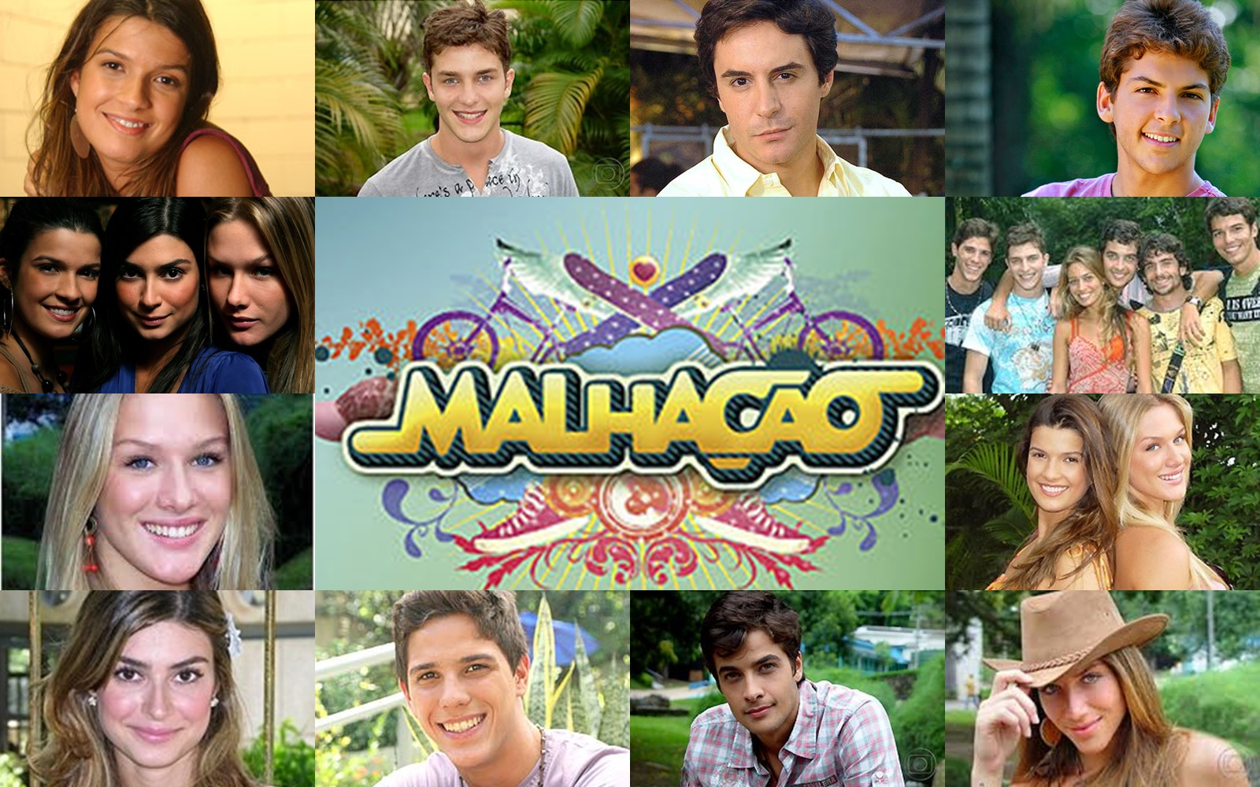
Incorporating content as learning resource materials
WC
Poster for Brazillian telenovella Malhacao is included on the basis of fair use as described in the Code of Best Practices in Fair Use for Open Education
Notes:
Third example is not about commentary or illustration but practice: inserts are used to build analytical skills, familiarity, or fluency
This image is from a telenovella being used to immerse students in the way spanish is actually spoken, rather than the formal version seen in a textbook
political science course may be enriched if students are exposed to the ways theoretical issues are mirrored in newspaper editorials and op-eds
essential opportunities to practice their skills and deepen their insights
Something they all had in common - Not created for educational uses

Slide 17
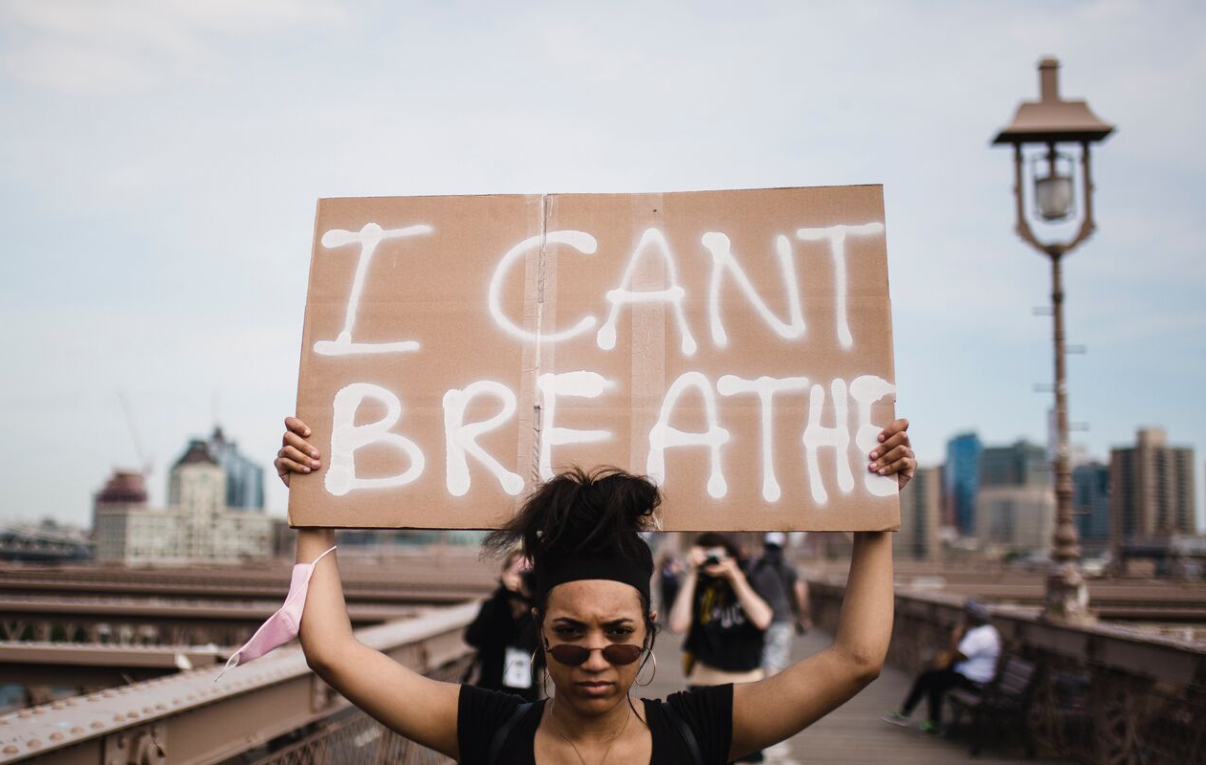
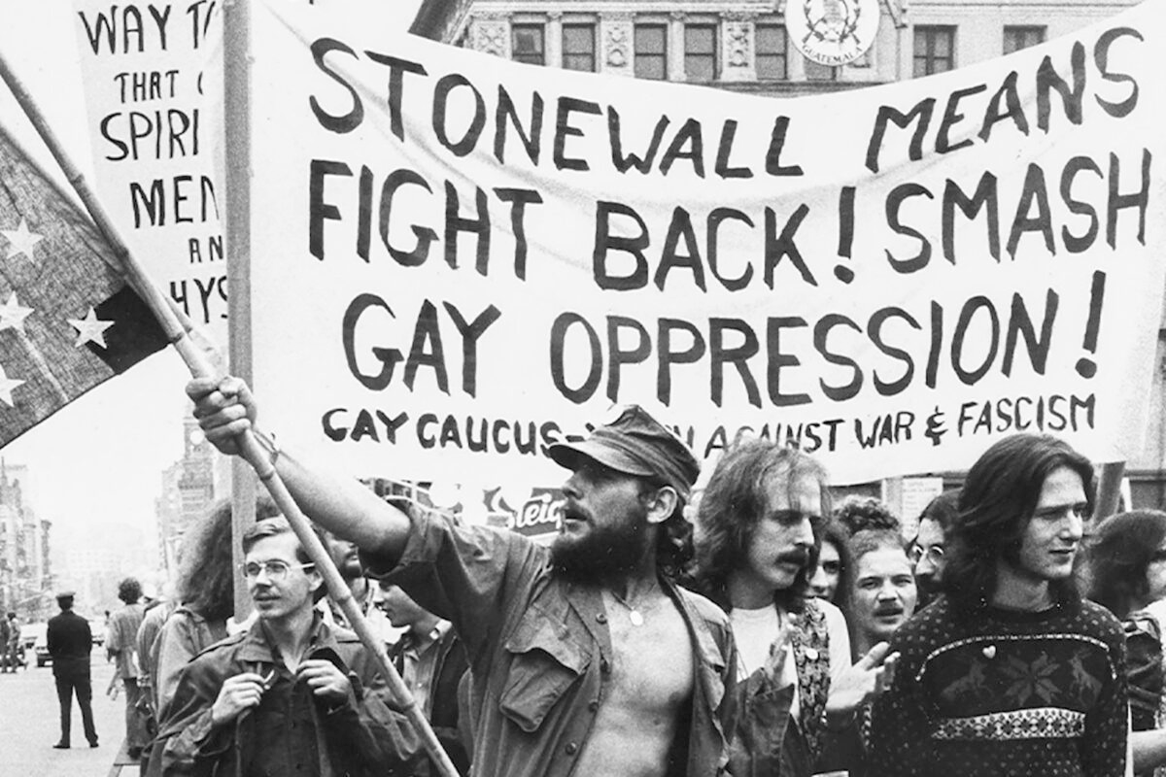
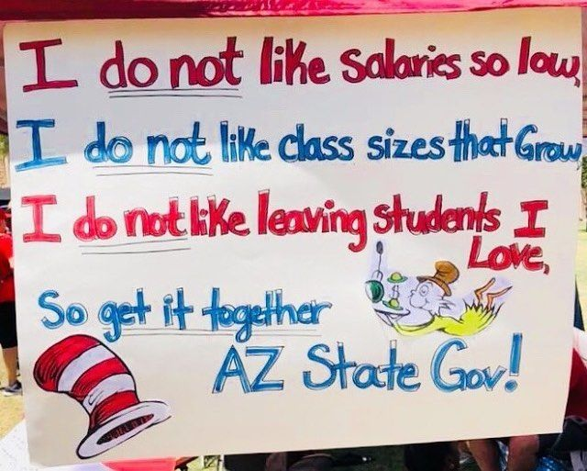
Case study: Teaching about protest
Analysis of Protest Strategies
Illustration of Historical Moments of Protest
Engaging with Authentic Protest Materials
Images of protest are used under fair use as described in the Code of Best Practice in Fair Use for OER.
All

Slide 18
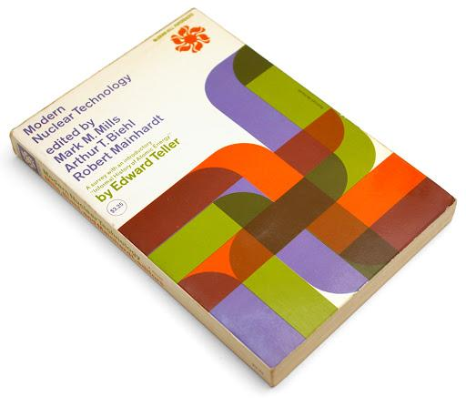
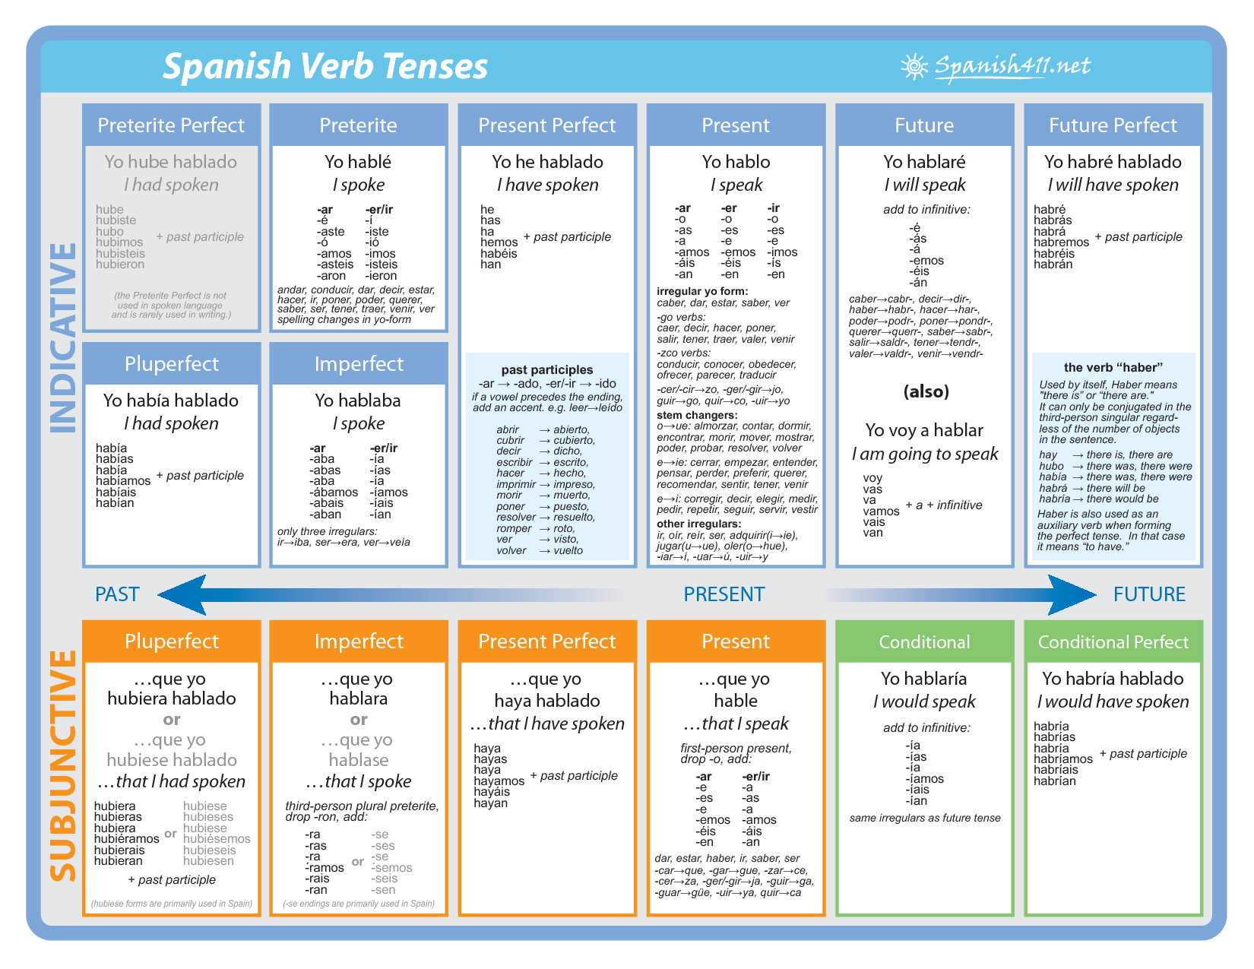
Repurposing pedagogical content from existing educational materials
WC
Verb Conjugation Chart and image of Modern Nuclear Technology included on the basis of fair use as described in the Code of Best Practices in Fair Use for Open Education
Notes:
Don’t reinvent the wheel!
outlived their useful commercial lives but remain protected under copyright law.
Here, fair use factors such as the amount of copyrighted material involved and the impact on the market for the original work may come into prominent play.
Authors of a new OER biology textbook may want to reproduce the structure of a once-popular predecessor’s chapter on cell-level metabolism, along with only a few specifics of the discussion itself. Or the author of an OER general math book may want to borrow and modify a problem set from an out-of-print algebra text

Slide 19
Core values throughout the Code
Attribution of sources and clear marking of fair use inclusions
Fair use as a tool for equity
Fair use as a tool for accessibility
Linking out and alternatives as an inadequate approach

Slide 20
Options for marking fair use in OERs
1. Indirect acknowledgement. It is already a best practice to label individual inserts that are included pursuant to licenses (as is required by the attribution clause in Creative Commons licenses). It also is desirable (and relatively straightforward) to mark “public domain” inserts as such. Reliance on fair use could then be signaled by way of a notice in the front matter of the OER to the effect that “Unless otherwise indicated, third-party texts, images, and other materials quoted in these materials are included on the basis of fair use as described in the Code of Best Practices for Fair Use in Open Education.”
2. Direct acknowledgement. Where OER authors are in doubt about whether the indirect approach will be enough to put downstream adopters and adapters on notice, they could label inserts included on the basis of fair use affirmatively, either with a short narrative text (e.g., “this illustration, from [SOURCE] is included on the basis of fair use”) or a conventional symbol (e.g., [F in a circle]).
3. Hybrid acknowledgement. In this mode, OER authors could use indirect acknowledgement in general, while singling out individual items as to which adopters and adapters might benefit from a more specific notice, perhaps including some indication of the fair use rationale involved, perhaps by reference to the categories of fair uses presented in this Best Practices document.
WC

Slide 21
The Code recommends marking instances of fair use
-- Participants agreed that marking could offer a big potential benefit to downstream adapters of OER
-- Of course, all determinations about inserts made by OER authors (including CC and public domain status) are potentially open to revision
-- But because fair use determinations are highly predictable in context, many reuses of inserts by adapters (e.g. from a college text to one for high schools) can be presumed to be valid
-- Where the reuse is in a new context, reanalysis (guided by the Code) is in order
WC

Slide 22

Core values throughout the Code
Attribution of sources and clear marking of fair use inclusions
Fair use as a tool for equity
Fair use as a tool for accessibility
Linking out and alternatives as an inadequate approach

Slide 23
The Appendices -- well worth your attention!
One -- a summary of what the project team found about OER and copyright in our conversations (starting in 2018-19) with leaders in the field
Two -- a concise account of fair use law in the U.S., including its history and the current state of the case law
Three -- a discussion of copyright exceptions that function similarly to fair use in other countries of the world (including educational exceptions and the quotation right), suggesting that the laws of the world have more in common than might first be imagined.
Four -- a specific illustration of the preceding point, focused on the Canadian law of “fair dealing”.
Five -- a run-through of other IP doctrines that might limit OER making, reaching the happy conclusion that most of them actually don’t.
WC

Slide 24
Applying the Code
for Canadian Educators
CC

Slide 25

The main takeaways
The fair dealing doctrine in Canada is remarkably similar, in purpose and scope, to the US fair use doctrine.
Fair dealing in Canada is now a broad and flexible user right that enables the fair use of copyrighted materials for educational and learning purposes.
If a use falls within a permitted fair dealing purpose, it can reasonably be assumed that a “fair use” in the US will be a “fair dealing” in Canada.
Terminology and framing may vary slightly, but the Best Practices in the Code are appropriate for cross-border and Canadian OER.
CC

Slide 26
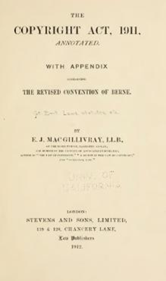
The shared origins of fair use / dealing
“Fair use” evolved in the UK courts as an equitable doctrine.
UK’s Copyright Act 1911, s.2(1)(i)
Canada’s Copyright Act 1921, s. 16(1)(i)
“Any fair dealing with any work for the purposes of private study, research, criticism, review or newspaper summary” shall not constitute an infringement of copyright.”
Statutory fair dealing was interpreted restrictively by courts to mean that a use has to fall within an enumerated purpose to qualify, and fairness was “strictly construed.”

Slide 27
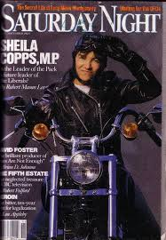
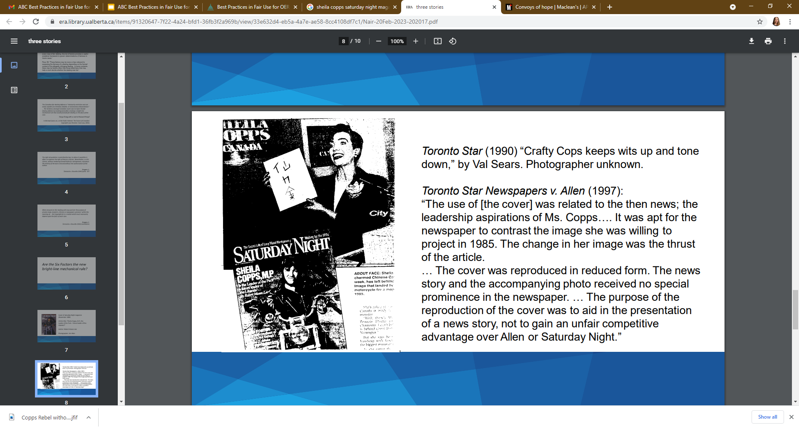
Toronto Star Newspapers v. Allen (1997)
Cover of Saturday Night magazine (November 1985)
Photographer: Jim Allen
Toronto Star (1990) “Crafty Cops keeps wits up and tone down,” by Val Sears. Photographer unknown.
Images from “Saturday Night magazine” and The Toronto Star, are used under fair use as described in the Code of Best Practice in Fair Use for OER.

Slide 28
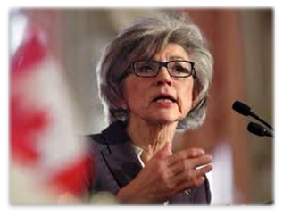
Fair dealing recognized as a “user right”
CCH v. Law Society of Upper Canada, SCC 2004
“[T]he fair dealing exception, like other exceptions in the CRA, is a user’s right. In order to maintain the proper balance… it must not be interpreted restrictively... User rights are not just loopholes. Both owner rights and user rights should therefore be given the fair and balanced reading that befits remedial legislation.”
“Under s. 29 of the CRA, fair dealing for the purpose of research or private study does not infringe copyright. ‘Research’ must be given a large and liberal interpretation in order to ensure that users’ rights are not unduly constrained.”
“Copyright Pentalogy” SCC 2012: SOCAN v. Bell; Alberta v. Access CR: Supreme Court confirms that “fair dealing is a ‘user’s right’”
CC

Slide 29
Fair dealing for research, private study, education
Alberta v. Access Copyright: “[T]he teacher’s purpose in providing copies is to enable the students to have the material they need for the purpose of studying. The teacher/copier therefore shares a symbiotic purpose with the student/user who is engaging in research or private study....”
SOCAN v. Bell: “In mandating a generous interpretation of the fair dealing purposes, ...CCH created a relatively low threshold for the first step so that the analytical heavy-hitting is done in determining whether the dealing was fair.
Copyright Modernization Act 2012: “Fair dealing for the purpose of research, private study, education, parody or satire does not infringe copyright” (s. 29)
Geist: “Canada now has a fair use provision in everything but name only.”

Slide 30
US-Canada: Similarities in OER Best Practices
The addition of “education” as an enumerated purpose enables OER uses to easily proceed over the first fair dealing hurdle.
When a dealing is for the purpose of “education” or “private study and research,” the only additional requirement is that the use is “fair.”
Fairness in Canada is established through a contextual, multi-factor analysis very similar to the US fair use analysis (so likely to produce the same result).
Transformative uses in Non-commercial OER may also benefit from Canada’s User-Generated Non-Commercial Content exception for “new works.”
Specific exceptions are available for educational institutions & those acting under their authority (including for works available through the Internet).
CC

Slide 31

The Pendulum Swings?
York University v. Canadian Copyright Licensing Agency
(Access Copyright), 2021 SCC 32

Slide 32
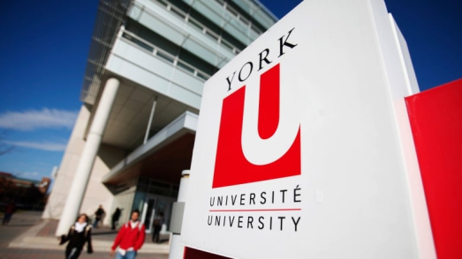

Access Copyright v. York University (FCTD)
"The fact that the guidelines could allow for copying of up to 100 per cent of the work of a particular author…indicates that the guidelines are arbitrary and are not soundly based in principle."
"York has not satisfied the fairness aspect of the quantitative amount of the dealing. There is no explanation why 10 per cent or a single article or any other limitation is fair."
"It is evident that York created the guidelines and operated under them primarily to obtain for free that which they had previously paid for."
Justice Phelan, Federal Court (Trial Division)

Slide 33
Unanimous Affirmation of User Rights in Education
Abella J: “There are some significant jurisprudential problems with those aspects of the [FC and FCA] judgments [on fair dealing] that warrant comment.”
“The main problem…was that they approached the fairness analysis exclusively from the institutional perspective…the nature of fair dealing as a user’s right was overlooked and the fairness assessment was over before it began.”
“In the educational context, instructors are facilitating the education of each of their individual students who have fair dealing rights”
“Funds “saved” by proper exercise of the fair dealing right go to the University’s core objective of education, not to some ulterior commercial purpose”
“Since fair dealing is a ‘user’s’ right, the ‘amount of the dealing’ factor should be assessed based on the individual use” (citing SOCAN).

Slide 34
Minor differences & additional considerations
Purpose Inquiry: Use of © material in OER must (genuinely) be for the purposes of education, facilitating private study/research, criticism or review.
There is no broad recognition of a transformative use doctrine as such.
There is one added fairness factor: availability of alternatives (consider whether materials would be equally effective without use; license irrelevant)
Uses for purposes of criticism, review and new reporting (not education/private study) require acknowledgement of source/author.
Canada provides greater protection for authors’ Moral Rights - right to attribution of authorship where reasonable; protection of integrity (avoid modifications/associations that could harm an author’s reputation).
Crown Copyright: Government works are protected by copyright.
CC

Slide 35
Summary: Harmony between fair use and fair dealing
The general Principles and Best Practices set out in the Code are intended to be equally appropriate for US and Canadian-based OER makers/materials.
Fair dealing is a positive user right that is integral to Canada’s copyright system, its purpose, and balance (CCH v. LSUC, Alberta, SOCAN v Bell, York U v Access)
Enumerated purposes in Canada’s Copyright Act are to be liberally interpreted.
The addition of “education” to s. 29 removed the purpose hurdle for OER.
The “analytical heavy-hitting” is done in determining whether use is “fair.”
“Fairness” is determined using a multifactor test very similar to US fair use.
Additional considerations? Available alternatives; attribution/moral rights.
Can assume “fair use” for an educational purpose = a “fair dealing” in Canada.

Slide 36
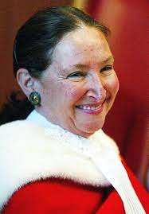
User Rights Resonating with the Reasons of Abella J.
“Increasing public access to and dissemination of artistic and intellectual works, which enrich society and often provide users with the tools and inspiration to generate works of their own, is a primary goal of copyright.”
“At the end of the day, the question in a case involving a university’s fair dealing practices is whether those practices actualize the students’ right to receive course material for educational purposes in a fair manner, consistent with the underlying balance between users’ rights and creators’ rights in the Act.”

Slide 37

Questions and Discussion
https://www.wcl.american.edu/impact/initiatives-programs/pijip/documents/code-of-best-practices-in-fair-use-for-open-educational-resources/

