Slide 1
Broadband 101 An Introductory Presentation in Support of the Consultations for Getting Started – Building a Broadband Consensus
Michael B. McNally, PhD – mmcnally@ualberta.ca
Assistant Professor, School of Library and Information Studies
University of Alberta
Version 1.1 - Prepared June 8, 2016

Slide 2
Presentation Content
Broadband Benefits
Policy and Regulatory Background
Technological Background
Other Considerations
Getting Started – Building a Broadband Consensus

Slide 3
Broadband Benefits
Broadband, specifically rural and remote broadband, is crucial for:
Economic development/preventing economic stagnation
Economic diversification
Distance learning
Tele-health and tele-presence medicine
Government services
Youth retention
Quality of life
Source: Screenshots from, Intelligent Community Forum’s, “The New Connected Countryside”

Slide 4
Policy Environment
Two key federal departments/agencies:
Innovation, Science and Economic Development (ISED) (formerly Industry Canada)
Canadian Radio-television and Telecommunications Commission (CRTC)
Federal Cabinet also has ability to provide policy direction to the CRTC
One key policy objective for Canadian telecom is:
“to render reliable and affordable telecommunications services of high quality accessible to Canadians in both urban and rural areas in all regions of Canada;”
Telecommunications Act, section 7(b)

Slide 5
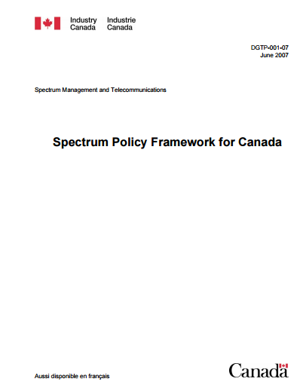
Innovation, Science and Economic Development
ISED has primarily policy related responsibilities, though also has some regulatory functions for wireless telecommunication
Oversees federal broadband initiatives
Broadband Canada (2009-12)
Connecting Canadians (2014-17)
New $500M Program (???)
Governs both licensed and unlicensed uses of radio-spectrum
Spectrum Policy Framework for Canada (3rd Ed., 2007) governs spectrum policy in Canada

Slide 6
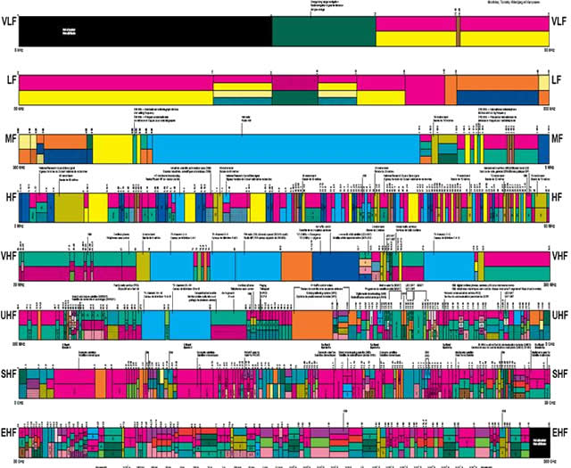
ISED and Wireless Policy
Wireless policy governed by Spectrum Policy Framework for Canada (2007)
Policy Objective: To maximize the economic and social benefits that Canadians derive from the use of the radio frequency spectrum resource.
First enabling guideline: “Market forces should be relied upon to the maximum extent feasible.”
Radio Spectrum Allocations in Canada illustrates the 20 different uses (e.g. broadcasting, mobile, radio astronomy) for spectrum in Canada at different radio frequencies

Slide 7
Canadian Radio-television and Telecommunications Commission
CRTC is an arm’s length, quasi-judicial regulator
CRTC has regulatory authority over Canadian telecommunications system
Most telecommunication services are forborne (not regulated)
The CRTC notes its role as:
“We are dedicated to ensuring that Canadians—as citizens, creators and consumers—have access to a world-class communication system that promotes innovation and enriches their lives.”

Slide 8
CRTC Basic Services Objective Review
First established in 1999, the obligation to serve requires incumbents to:
provide touch-tone telephone service,
low speed Internet access at local rates,
access to long distance calling,
voicemail, enhanced calling features
….and a copy of the phonebook upon request.
In order to do this in high cost service areas, incumbents (and only incumbents) have access to the National Contribution Fund.

Slide 9
CRTC Basic Services Objective Review
Last BSO Review was 2010/11, and culminated in CRTC Telecom Regulatory Policy 2011-291
“In the Commission’s view, market forces and targeted government funding will continue to drive the rollout and improvement of broadband Internet access services in rural and remote areas.” (para. 63)
“the Commission considers that the appropriate target speeds for broadband Internet access service are a minimum of 5 Mbps download and 1 Mbps upload.” (para. 76)
“With respect to the date for achieving the target speeds, the Commission considers that, based on the record of this proceeding, the end of 2015 is appropriate.” (para. 79)

Slide 10
CRTC Basic Services Objective Review
The BSO Review asks which basic telecommunications services Canadians “require to participate meaningfully in the digital economy?”
Should broadband be considered a basic telecommunications service?
If so, what constitutes a broadband connection? What should the speed target be and why?
What constitutes “meaningful participation?”
At the public hearing in Ottawa on Apr 18, 2016, Chaiman Blais noted, “Today in Canada, broadband is vital.”
CRTC Chairman Jean-Pierre Blais (photo source: Toronto Star)

Slide 11
CRTC Basic Services Objective Review
One key theme of BSO has been rural and remote connectivity
Wide suggestion of proposals put forward
CRTC also called for intervenors to comment on what elements might constitute a national broadband strategy (though the CRTC itself cannot implement a strategy)
Timelines for decision and implementation of any changes unclear

Slide 12
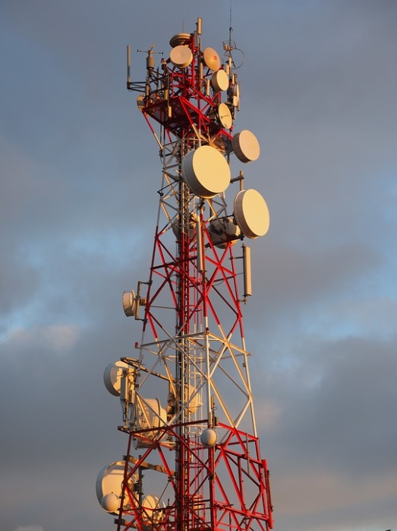
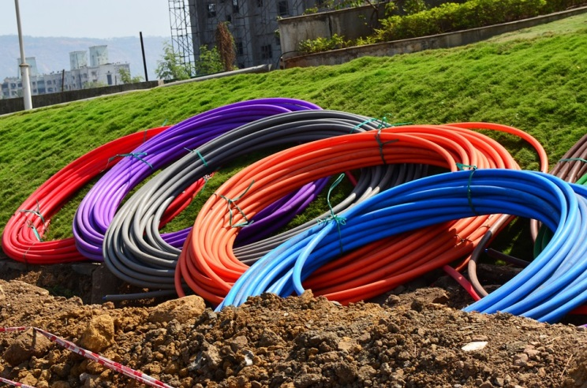
Broadband Technologies
Two major means of connection – wired and wireless
Two types of connections to consider:
How is the community connected to transport/backhaul infrastructure?
How are the households and businesses connected within a community?
Wired Connections:
Fibre – the gold standard in broadband
Allows speeds of 1000 Mbps/1Gbps or greater
Legacy Connections
Copper/DSL
Coaxial cable

Slide 13
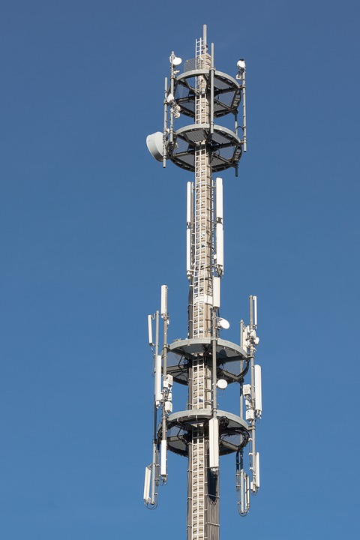
Broadband Technologies
Wireless Connections:
Satellite
Useful for very remote regions (‘satellite dependent’)
Connection speeds are slowest and suffers from problems related to latency
Fixed Wireless
Provides middle range speeds, but not comparable to fibre
Requires tower infrastructure and fibre backbone/backhaul connections
Can be done on unlicensed or first come first serve spectrum
Mobile Wireless
Requires licensed spectrum and infrastructure (towers)
Services only available through major service providers

Slide 14
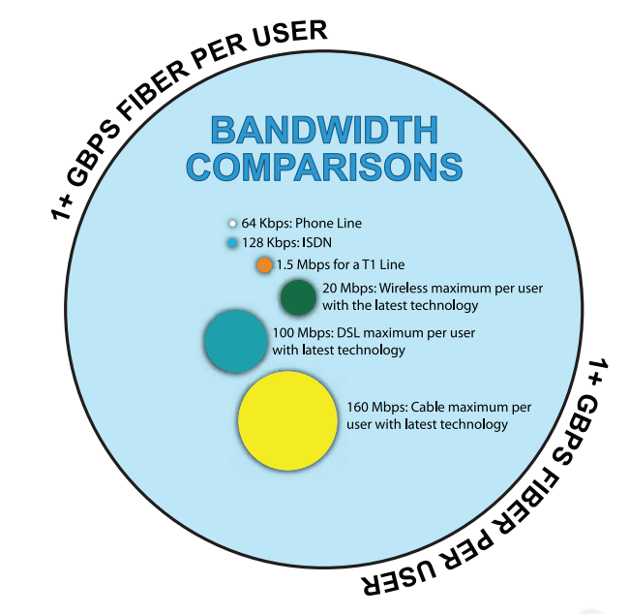
Comparing Connection Types
Fibre is a future-proof solution offering capacity to address the next generation of broadband needs
Planning for the future may involve not going directly to fibre, but using best practices, such as a ‘dig once’ policy to help prepare a community for a future fibre network
Source: New York Broadband Program Office, New York State Broadband Strategy Development Toolkit, p. 11

Slide 15
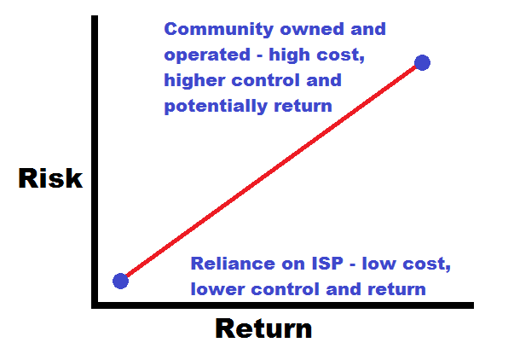
Business Models
Options for deployment range from completely community/government built, owned and operated (Olds, AB), to entire reliance on the private sector (Vulcan, AB)
Several options in between
Greater community involvement increases risk and cost, but also control and return

Slide 16
Beyond Infrastructure
A successful project requires considering more than infrastructure
Several community broadband projects have revealed “if you build it, they won’t come”
Need to have strategy for citizen engagement
Cultivate a ‘culture of use’

Slide 17
Getting Started – Building a Broadband Consensus
Development team from U of A:
Drs. Michael McNally, Rob McMahon and Dinesh Rathi
Advisory Review Team includes individuals from:
Calgary Regional Partnership,
City of Calgary,
Alberta Southwest Regional Alliance,
cci Wireless, and
Cybera
Completion date: October, 2016

Slide 18
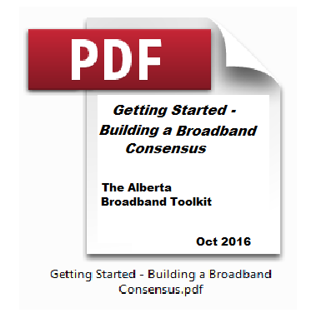
Getting Started – Building a Broadband Consensus
Content will include:
Broadband Basics and Background
Broadband Benefits
Rural and Community Aspects
Community Engagement
Challenges
Best Practices
Technology Background
Policy and Regulatory Background
Broadband Business Models
Further Resources

Slide 19
Notes on Images
Images used on slides 3, 5, 6, 10 and 14 are from the sources provided
Images on slides 8, 11, 12, 13, and 16 are Public Domain images from https://pixabay.com/
Images on slides 15 and 18, are creations of Michael McNally

