Slide 1
Open Enough?
Eight Factors to Consider when Transitioning from Closed to Open Resources and Courses: A Conceptual Framework

Slide 2

About Us
Erik G. Christiansen
Assistant Professor/Librarian at Mount Royal University, Calgary, Canada
Michael B. McNally
Associate Professor, School of Library and Information Studies, University of Alberta, Edmonton, Canada

Slide 3
HOW THIS PROJECT STARTED
1

Slide 4

It started with a
NAPKIN
Notes:
Michael and I began talking about this project in November 2016.
Like all good projects, the basic idea of our framework was outlined on a napkin over a workshop lunch. At the workshop I was discussing some of the challenges of OERs, and Michael was in the process of thinking about how best to transition his graduate course into an OER.
Methodological considerations
Phenomenological self-reflection (Colaizi, 1973)
close analysis of the literature.
Contribution to the literature
We envision the contribution of this paper as theorizing the tradeoffs that exist when moving to OER, and looking for a practical threshold of openness that can provide guidance to educators.

Slide 5
OUR RESEARCH QUESTIONS
What factors do educators need to consider when transitioning to OER?
If each of these factors could be placed on a conceptual scale from “closed” to “most open”, what would be the implications?
Notes:
We had two research questions we wanted to answer.
What are the primary factors that educators need to consider when transitioning to OER?
If each of these factors could be placed on a conceptual scale from “most closed” to “most open”, what would be the implications?

Slide 6
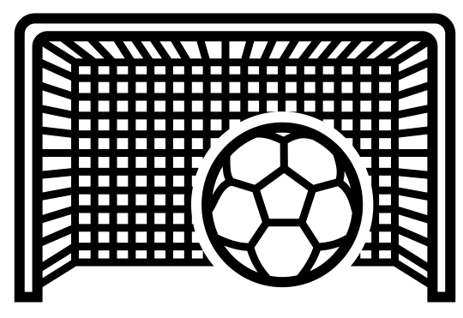
GOALS WITH THIS PROJECT
We want to create a framework that helps educators conceptualize OCW/OER projects
Determine what is ‘open enough’
Determine if maximizing openness, in certain instances, could be problematic
Notes:
From the beginning, we wanted this project to serve as a guide for educators. Therefore…
We wanted to create a framework that helps educators conceptualize OER/OEP projects
Determine what is ‘open enough’
What are reasonable expectations for educators?
Determine when maximizing openness is potentially problematic

Slide 7
LITERATURE – Conceptualizing Openness
OPEN EDUCAITONAL RESOURCES
Have been several cycles of openness going back centuries (Peter and Deimann , 2013, p. 12).
Hegarty (2015) proposes eight attributes of open pedagogy, only one of which involves OER (p. 5)
Pomerantz and Peek (2016) reviewed 50 kinds of ‘open’ and identified several approaches to open. Authors warn of ‘open washing.’
Nasccimbeni et al. (2016) argue that becoming an ‘open educator’ is transitional process involving multiple steps.
OPEN EDUCAITONAL PRACTICES
OPEN PEDAGOGY
Christiansen & McNally, 2017
Notes:
Having had previously read a considerable amount of literature on openness in education, we observed some trends, identified some well-established criticisms of openness, and identified some gaps that this project could potentially address.
There are a number of key papers that outline the historical impact of open education or that try to identify what ‘openness’ means.
Have been several cycles of openness going back centuries.
Peter and Deimann (2013) noted a tendency for periods of contractions in openness to follow those where openness expands (p. 12).
Openness in education is not a ‘new’ phenomenon.
Hegarty (2015) proposes eight attributes of open pedagogy, only one of which involves OER (p. 5).
There are conflated definitions of openness.
Pomerantz and Peek (2016) in their review of over 50 different kinds of ‘opens’, found several approaches to open including rights, access, use, transparent, participatory, enabling, etc.
The authors also warn of ‘openwashing,’ to highlight that the term is becoming increasingly ambiguous.
Nasccimbeni et al. (2016) define the ‘open educator’ as a transitional process involving multiple steps.

Slide 8

LITERATURE – Gaps and Criticisms
Lack of theorization around the concepts of openness (Knox, 2013, p. 822).
  Weller (2014) highlights vagueness of the term makes it open to being meaningless (p. 28).
Ehlers (2011, p. 2) argues that access issues have been over emphasized at the expense of discussions around quality and innovation in teaching and learning.
All the concepts around openness tend toward learner centrism. Openness in education should focus on improving student learning (Pierce, 2016, p. 11).
CC photo by Ben White
On Unsplash
Notes:
In the literature, there are a number of papers that criticize, and outline the challenges of, openness in education.
Knox (2013) argues that there is a general lack of theorization around the concepts of openness
Weller (2014) notes the vagueness of the term makes it open to being meaningless (p. 28)
Open educational practices (OEP) literature has many insights regarding approach, but a there is a gap around choices and consequences of open design.
OER literature has a disproportionate number of institutional case studies that focus on cost saving to students.
Ehlers (2011, p. 2) argues that access issues have been over emphasized at the expense of discussions around quality and innovation in teaching and learning.
Pierce (2016) notes that what all the concepts around openness tend toward learner centrism. Openness in education should focus on improving student learning.

Slide 9
FRAMEWORK OVERVIEW
2

Slide 10
STEP 1
Copyright / Open Licensing
1. Choose Elements to Address
2. Effort and Willingness
3. Skill/Knowledge Required
Which of the OER elements do you need to consider to create your OER?
How much work is required to create your OER?
What skills do you need to create your OER?
Will you require outside expertise?
What aspects are you willing to rework?
Accessibility / Usability Formatting
Language
Support Costs
Assessment
Digital Distribution
File Format
Cultural Considerations
Christiansen & McNally, 2017
Notes:
This flow chart represents our framework from a macro view:
We have identified eight factors (on the left) that educators must consider when undertaking OER projects.
The framework is comprised of three steps
Choose elements to address – Educator must decide which of the eight OER factors need to be addressed for a given project.
Effort and willingness – How much effort or willingness the educator is willing to expend to undertake the project. We differentiate between effort and willingness (explained on slide 14).
Skill/knowledge required – The skills/knowledge the educator has, or doesn’t have, to undertake a given OER project.

Slide 11
THREE HYPOTHETICAL SCENARIOS
1. Choose Elements to Address
2. Effort and Willingness
3. Skill/Knowledge Required
Eight OER Factors
Closed
Mixed
Most Open
Notes:
Each of the steps in our framework can be broken down into a series of decision matrices for conceptualizing openness.
At each step in the framework, we have attempted to conceptualize what each of the eight factors look like under three hypothetical scenarios:
Closed
Mixed
Most open
Keep in mind, that this framework was developed primarily with OCW in mind (ie full courses), but the framework can be applied to discrete resources

Slide 12
CONCEPTUAL SCALES
3
Visualizing openness

Slide 13
STEP 1
Decision Factors Scale
OER Factors | Closed | Mixed | Most Open
Copyright/Open Licensing Frameworks | Copyright/all rights reserved | Less Open CC License Terms (NC/ND and arguably SA) | CC-BY License/ Public Domain
Accessibility/Usability Formatting | Not formatted for accessibility | Some accessibility formatting (e.g. closed captioning) | Fully accessibility (e.g. compliance w/ US HHS 508 Compliant)
Language | Single Language (usually English) | Bi-lingual or includes guides/steps for translation | Multi-Lingual or includes guides/steps for translation and is bilingual
Support Costs | Paid resources | Licensed library resources | Openly Licensed Resources
Assessment | No assessment available | Assessments made available | Assessments tailored for self-assessment
Digital Distribution | Closed/available only to insiders (e.g. via LMS) | Open but low discoverability (e.g. institutional repository) | Open and high discoverability (e.g. YouTube or broadly available repository (e.g. Merlot, BCcampus)
File Format | PDF or other non-editable format | Editable format but proprietary software (e.g. Word) | Fully open format (e.g. html)
Cultural Considerations | No consideration for outside cultural users/includes culturally specific materials/content | Some considerations for outside cultural users | Generally devoid of culturally specific material
Notes:
Step 1 is the primary reference scale
This provides an overview of what each of the eight factors look like under each of the hypothetical scenarios we’ve proposed.
We envision that this would be the primary scale of reference for educators, as it gives the best overview of how openness can be conceptualized.

Slide 14
STEP 2
Effort and Willingness
OER Factors | Closed | Mixed | Most Open
Copyright/Open Licensing Frameworks | Closed by default | Minimal willingness / effort | Some willingness
 |  |  | Minimal effort
Accessibility/Usability Formatting | Closed by default | Some willingness / effort | More willingness / effort
Language | Closed by default | More willingness / effort | More willingness / effort
Support Costs | No willingness | Some willingness / effort | More willingness / effort
 | Minimal effort
Assessment | Closed by default | Some willingness / effort | More willingness / effort
Digital Distribution | No willingness | Some willingness / effort | Some willingness / effort
 | Minimal effort
File Format | No willingness | Minimal willingness / effort | Minimal willingness / effort
 | Minimal effort
Cultural Considerations | Closed by default | Some willingness / effort | More willingness / effort
most open
most open
Notes:
Step 2 looks at the effort and willingness required to make each factor open.
We conceptualize openness in this scale through the qualifiers none/no, minimal, some, more.
What is most important about Step 2 in the framework is the divergence of effort and willingness. Also, for some of the factors the increase in effort/willingness is gradual while for other factors it spikes quickly.

Slide 15
STEP 3
Skill / Knowledge Scale
OER Factors | Closed | Mixed | Most Open
Copyright/Open Licensing Frameworks | None | Some skill / knowledge | Some skill / knowledge
Accessibility/Usability Formatting | None | More skill / knowledge | More skill / knowledge
Language | None | More skill / knowledge | More skill / knowledge
Support Costs | None (an awareness problem; still need to pick resources regardless of cost) | Some skill / knowledge | More skill / knowledge
Assessment | None | Some skill / knowledge | More skill / knowledge
Digital Distribution | None | Some skill / knowledge | Some skill / knowledge
File Format | None | Some skill / knowledge | Some skill / knowledge
Cultural Considerations | None | More skill / knowledge | More skill / knowledge
most open
most open
Notes:
Step 3 conceptualized the knowledge and skill required for each factor.
Some factors require a great deal of skill/knowledge even under the mixed scenario, while other factors present a more gradual increase of skill/knowledge.
Of the eight factors accessibility/usability formatting, language, and cultural considerations present the greatest potential challenge for educators when maximizing openness. Conversely, factors like file format, digital distribution, and copyright/open licensing frameworks are easier to maximize for openness.

Slide 16
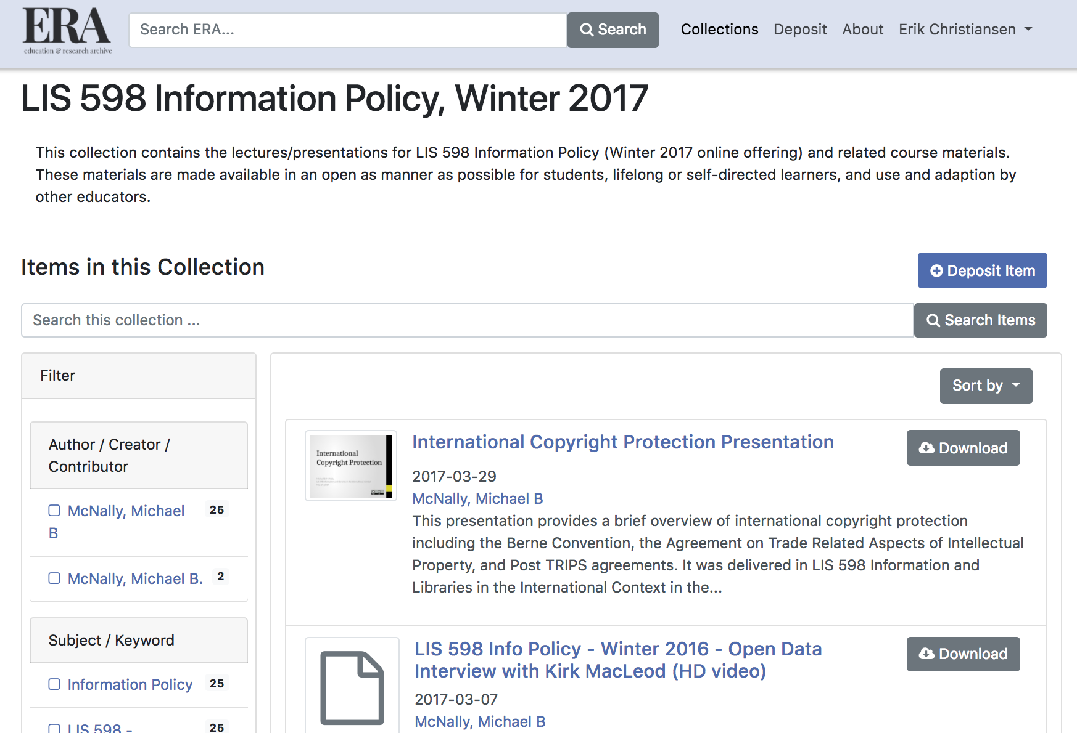
EXAMPLE COURSE: LIS 598 INFORMATION POLICY
I ran Michael’s graduate course through our framework to determine its level of ‘openness’
Screenshot taken from the ERA Repository, University of Alberta
Notes:
While testing our framework is a future project we have planned, I wanted to demonstrate how such a framework could be used to conceptualize openness.
I ran my collaborator Michael’s graduate course through our framework. Michael’s course can be found in the University of Alberta’s Education & Research Archive – the institution’s digital repository. As I mentioned at the start of this presentation, Michael had already started thinking about making his course an OER when we first discussed this project, so the example is fitting.
The course has its own collection and is comprised of lecture PowerPoints with voiceover, audio files, video files, etc.

Slide 17
EXAMPLE COURSE
Lis 598 Information Policy: How open is it?
OER Factors | Closed | Mixed | Most Open
Copyright/Open Licensing Frameworks | Copyright/all rights reserved | Less Open CC License Terms (NC/ND and arguably SA) | CC-BY License/ Public Domain
Accessibility/Usability Formatting | Not formatted for accessibility | Some accessibility formatting (e.g. closed captioning) | Fully accessibility (e.g. compliance w/ US HHS 508 Compliant)
Language | Single Language (usually English) | Bi-lingual or includes guides/steps for translation | Multi-Lingual or includes guides/steps for translation and is bilingual
Support Costs | Paid resources | Licensed library resources | Openly Licensed Resources
Assessment | No assessment available | Self-assessment, but not meaningful (questions only) | Meaningful self assessment (questions and answers)
Digital Distribution | Closed/available only to insiders (e.g. via LMS) | Open but low discoverability (e.g. institutional repository) | Open and high discoverability (e.g. YouTube or broadly available repository (e.g. Merlot, BCcampus)
File Format | PDF or other non-editable format | Editable format but proprietary software (e.g. Word) | Fully open format (e.g. html)
Cultural Considerations | No consideration for outside cultural users/includes culturally specific materials/content | Some considerations for outside cultural users | Generally devoid of culturally specific material
Notes:
Openness is only maximized under the copyright and cultural considerations factors, while all other factors fall under the closed or mixed scenarios.
One factor which Michael actively chose to keep mixed was the support costs. Students are required to read works by Anthony Giddens which he felt could not be substituted. While these materials were available through the university library, they were not open access readings.
Assessments – being a graduate course – are essay style and are not made available so that factor remains closed.
All lectures were accompanied with video options and transcripts which is a considerable amount of work. Still, to be ‘most open’ Michael would have to make his course fully compliant with one of the accessibility standards (not an insignificant task). This might require reviewing fonts, colours, etc; this would tie into the file format factor as course materials are only available in editable proprietary formats.

Slide 18
INSIGHTS
4
What we can to do to guide educators

Slide 19
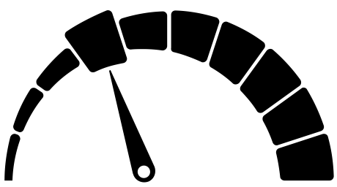

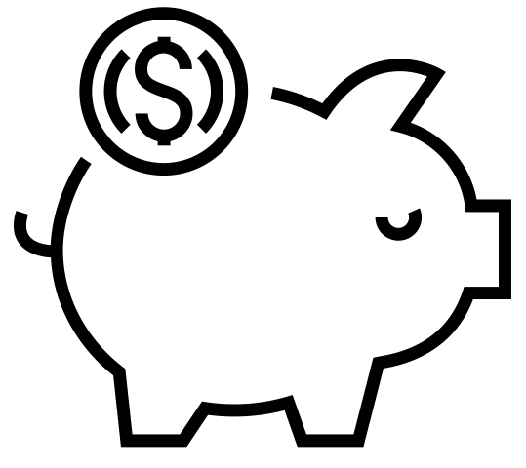
INSIGHTS
Huge range in difficulty among the eight factors when maximizing openness
Copyright is the most critical factor and the easiest open
Support costs can be approached in different ways
Notes:
Huge range in difficulty among the eight factors when maximizing openness
For some factors it’s very difficulty to maximize openness, while it’s easy for others.
Not all the steps in the framework manifest themselves in the same way.
Also, the factors are not mutually exclusive – with some being inherently linked to others (eg. Accessibility/usability formatting and File Format).
Copyright
The most critical factor
Maximizing openness through an open license is trivially easy – regardless of the chosen license
CC-BY or equivalently open license is highly recommended, to facilitate broader distribution and editability
Without open licensing, OERs are a non-starter
Language and cultural considerations
Translating works into multiple languages or providing translation guidelines is a monumental amount of work
Some courses simply won’t be applicable to all cultures

Slide 20
The ‘most open’ scenario can be pedagogically problematic and can place unreasonable expectations on the educator

Slide 21
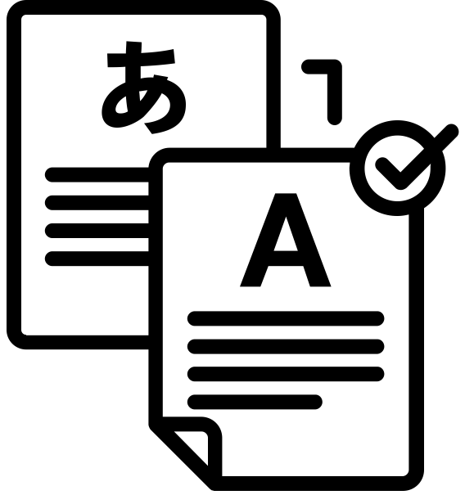
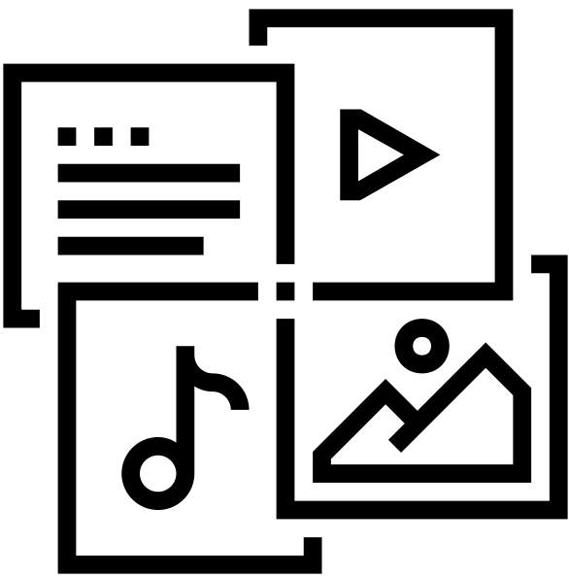

INSIGHTS
Openness has pedagogical tradeoffs for assessment
Maximizing openness for multiple languages and cultures is very difficult and unrealistic
Maximizing openness for file format isn’t clear cut
Notes:
Assessment
Self-assessment (in the most open scenario) has a pedagogical tradeoff, as it limits the possible assessment mechanisms to objective approaches including multiple choice, true/false, and matching.
Rich critical thinking exercises are lost
Maximizing openness for language and culture
Huge undertaking on behalf of the educator and can drastically increase production time
We recommend just designing an OER for one intended language
Cultural considerations are not always clear cut. For example, are the images in this presentation universally understood/representative? Our cultural blind spots are not always obvious.
Multimedia files
We recommend distributing documents in as many open file formats as possible.
What is a more or less editable video or audio file format? Will these file formats always be relevant?
What matters is the quality (resolution or bit rate) of the file.
Highlights the challenge of discussing formats generally, as these are likely to change based on the evolution of technology. Ten years from now we might be more concerned about editable augmented reality or virtual reality environments.
File format is tightly linked to the Accessibility/Usability factor
It will be up to educators to keep up with technology. What will usability look like for file formats we haven’t seen yet?

Slide 22
FUTURE RESEARCH
5
Where do we go from here?

Slide 23
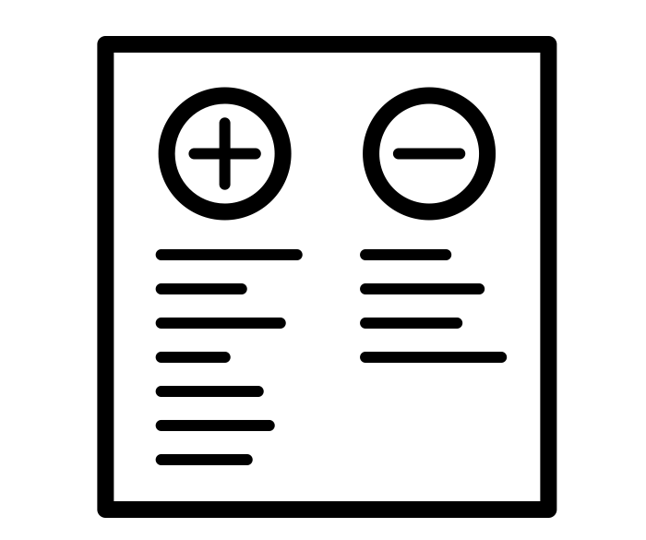

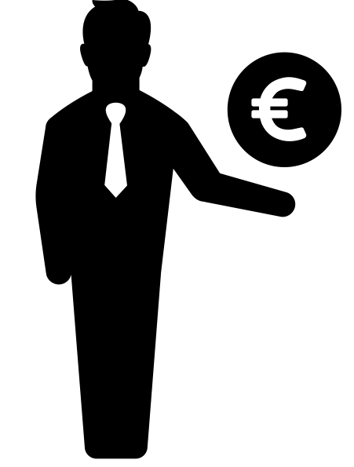
FUTURE RESEARCH AND RECOMMENDATIONS
1) Empirical testing of this framework
2) Interactive online resource to
Generate of OER project plans
3) Financial funding for translation of resources
Notes:
1) Future Research - Empirical testing. We could like to run a variety of open courses through this framework to see the courses fare, and to see where our framework can be adjusted
2) Future Research - Interactive online resource, so educators can generate project plans for OCW/OER projects
3) Suggestion - OER funding bodies should require an open license and funds should be available to translate resources that are most likely to be beneficial to an international audience.

Slide 24
Thanks for attending
Any questions?
Erik G. Christiansen
Website: erikchristiansen.net
Twitter: @eriksation
Email: info@erikchristiansen.net
Michael B. McNally
Website: bit.ly/MMcNally
Email: mmcnally@ualberta.ca

Slide 25
FURTHER READING
Christiansen, Erik. G., & McNally, Michael. B. (2017, October 12). Open enough? Choices and consequences when transitioning from closed to open resources and courses. Poster session presented at the International Society for the Scholarship of Teaching and Learning, 2017 Conference, Calgary, Alberta. Retrieved from http://hdl.handle.net/11205/352
Colaizzi, Paul Francis. 1973. Reflection and Research in Psychology: A Phenomenological Study of Learning. Dubque, IA: Kendall/Hunt.
Cronin, Catherine. 2017. “Openness and Praxis: Exploring the Use of Open Educational Practices in Higher Education.” International Review of Research in Open and Distributed Learning, 18(5): http://www.irrodl.org/index.php/irrodl/article/view/3096/4263
Ehlers, Ulf-Daniel. 2011. “Extending the Territory: From Open Educational Resources to Open Educational Practice.” Journal of Open, Flexible, and Distance Learning, 15(2): http://www.jofdl.nz/index.php/JOFDL/article/view/64/46
Hegarty, Bronwyn. 2015. “Attributes of Open Pedagogy: A Model for Using Open Educational Resources.” Educational Technology, July-August 2015: https://upload.wikimedia.org/wikipedia/commons/c/ca/Ed_Tech_Hegarty_2015_article_attributes_of_open_pedagogy.pdf
Hendricks, Christina. 2015. “Teaching and Learning Philosophy in the Open.” AAPT Studies in Pedagogy, 1: 17-32.

Slide 26
REFERENCES
Knox, Jeremy. 2013. “Five Critiques of the Open Educational Resources Movement.” Teaching in Higher Education: 18(8): 821-832.
Lane, Andy. 2009. “The Impact of Openness on Bridging the Educational Digital Divides.” International Review of Research in Open and Distance Learning, 10(5): http://www.irrodl.org/index.php/irrodl/article/view/637/1408
Lane, Andy and McAndrew, Patrick. 2010. “Are Open Educational Resources Systematic or Systemic Change Agents for Teaching Practice.” British Journal of Educational Technology: 41(6): 952-692.
McNally, Michael B. (2017). LIS 598: Information policy. Education & Research Archive. Retrieved from https://era.library.ualberta.ca/communities/b9bce94a-c976-43b0-853d-58b48797b3d1/collections/6478a049-7b92-4736-b02b-2153ad5db9d8
McNally, M. B. (2017, May 11). Open educational resources (OER) benefit analysis. Presented at the ABOER Summit, University of Alberta, Edmonton, Alberta. Retrieved from https://era.library.ualberta.ca/files/gx41mm630
McNally, M., & Christiansen, Erik. (2016, December 7). Choices and consequences in transitioning from closed to open resources and courses. Presented at the Open Education in Action Conference, Maskwacis Cultural College, Maskwacis, AB. Invited. Retrieved from http://hdl.handle.net/11205/307
Nasccimbeni, Fabio and Burgos, Daniel. (2016). “In search for the open educator: Proposal of a definition and framework to increase openness adoption among university educators.” International Review of Research in Open and Distributed Learning, 17(6): 1-17.

Slide 27
REFERENCES
Paskevicius, Michael. 2017. “Conceptualizing Open Educational Practices through the Lens of Constructive Alignment.” Open Praxis, 9(2): 125-140.
Pierce, Matthew. 2016. “Looking at OER with a Critical Eye: Strengthening OER Initiatives by Focusing on Student Learning.” Community & Junior College Libraries, 22(1-2): 11-17.
Polkinghorne, Donald E. 1989. “Phenomenological Research Methods.” p. 41-60. In Existential-Phenomenological Perspectives in Psychology. Ronald S. Valle and Steen Halling (Eds.). New York: Plenum Press.
Pomerantz, Jeffrey, and Peek, Robin. 2016. “Fifty Shades of Open.” First Monday, 21(5): http://firstmonday.org/article/view/6360/5460
Richter, Thomas, and McPherson, Maggie. 2012. “Open Educational Resources: Education for the World?” Distance Education, 33(2): 201-209.
Stacey, Paul. 2007. “Open Educational Resources in a Global Content.” First Monday, 12(4): http://firstmonday.org/ojs/index.php/fm/article/view/1769/1649
Stagg, Adrian. 2014. “OER Adoption: A Continuum for Practice.” RUSC: Universities and Knowledge Society Journal, 11(3); 152-165.
Weller, Martin. 2014. The Battle for Open: How Openness Won and Why It Doesn’t Feel Like Victory. London: Ubiquity Press. DOI: https://doi.org/10.5334/bam

Slide 28
CC ICON CREDITS
Accessibility by Alfonso Melolonta Urbán from the Noun Project
Compare by Bernar Novalyi from the Noun Project
Computer by Daily icons from the Noun Project
Cost Saving by Vector Bakery from the Noun Project
Difficulty Gauge by Thanh Nguyen from the Noun Project
File by icon 54 from the Noun Project
Funding by Gregor Cresnar from the Noun Project
Goal by Nikita Kozin from the Noun Project
Important Document by Designify.me from the Noun Project
Internet by Vectors Market from the Noun Project
Multimedia by Maxim Basinski from the Noun Project
Survey by Ann Fandrey from the Noun Project
Translation by costantino montanri from the Noun Project

Slide 29
CREDITS
Special thanks to all the people who made and released these awesome resources for free:
Presentation template by SlidesCarnival
Photographs by Startup Stock Photos

Slide 30
PRESENTATION DESIGN
This presentation uses the following typographies and colors:
Titles: Roboto Condensed
Body copy: Roboto Condensed
You can download the fonts on this page:
https://material.io/guidelines/resources/roboto-noto-fonts.html
Navy #3f5378 · Dark navy #263248 · Yellow #ff9800
You don’t need to keep this slide in your presentation. It’s only here to serve you as a design guide if you need to create new slides or download the fonts to edit the presentation in PowerPoint®

Slide 31
SlidesCarnival icons are editable shapes.
This means that you can:
Resize them without losing quality.
Change line color, width and style.
Isn’t that nice? :)
Examples:

