Slide 1
International Copyright Protection
Michael B. McNally
LIS 598 Information and Libraries in the International Context
Mar. 29, 2017

Slide 2
Outline
The Berne Convention and International Copyright Protection
TRIPS and International Copyright Protection
Post TRIPS

Slide 3
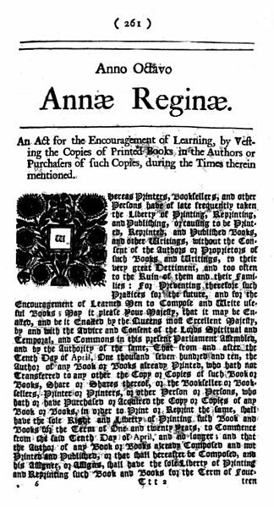
A-I. Birth of Domestic Intellectual Property (IP) Protection
First modern intellectual property (IP) mechanism was a 1474 statute from Venice providing patent protection
1624 Parliament of England provides patent protection via the Statute of Monopolies
1710 Parliament of Great Britain passes Statute of Anne providing copyright protection
1787 U.S. Constitution empowers Congress to provide IP protection
1790 US passes both Patent Act and Copyright Act

Slide 4
A-II. Paris Convention for the Protection of Industrial Property (1883)
First international IP treaty was the Paris Convention for the Protection of Industrial Property (1883)
Paris Convention’s origins lie in concerns patent protection in advance of 1873 World’s Fair in Vienna
U.S. despite joining the Paris Convention in 1887, was instrumental in pushing for international system of patent protection (McNally, 2009)
Pro free trade (and anti-patent) Germany under Bismarck did not sign (later accession in 1903)
Key principle was ‘national treatment’ – contracting states have to provide the same protection for foreign nationals of contracting states as its own nationals

Slide 5
A-III. Berne Convention for the Protection of Literary and Artistic Works (1886)
Paris Convention talks spurred discussion around a similar, international copyright treaty
1884 conference in Berne led to draft Convention
U.S. response to the Berne Convention:
“The Government of the United States is in principle disposed to accept the rule that the author of a literary or artistic work… must be protected everywhere as a national. In practice, however, the Government sees great obstacles to accommodating all countries within one and same Convention.” (WIPO 1986, 83).
1886 Berne Convention for the Protection of Literary and Artistic Works formalized
Original signatories – Belgium, France, Germany, Italy, Spain, Switzerland, Tunisia, and the United Kingdom

Slide 6
A-III(ii). Berne Convention for the Protection of Literary and Artistic Works (1886)
Employs principle of national treatment (Article 3)
Provides a term of protection for life of the author plus 50 years after their death (Article 7)
Three step test for copyright exceptions (Article 9(2))
“It shall be a matter for legislation in the countries of the Union to permit the reproduction of such works in certain special cases, provided that such reproduction does not conflict with a normal exploitation of the work and does not unreasonably prejudice the legitimate interests of the author.”
Protection of moral rights added in 1928 version of the Convention (Article 6bis)

Slide 7
A-IV. United States and the Berne Convention
In 1800s U.S. was a ‘pirate’ nation
In 1842 Charles Dickens toured the U.S., and a key theme of his tour was a call for international copyright (Houtchens, 1941)
Following the Berne Convention, Mark Twain provided testimony at the U.S. Senate on the need for international copyright protection (McNally, 2009)
1891 U.S. passes domestic legislation providing international copyright
However, to qualify books had to printed in the United States
1908 revisions to the Berne Convention expressly prohibited formalities such as domestic printing requirements
U.S. only formally accedes to the Berne Convention in 1989

Slide 8
A-V. Universal Copyright Convention
1952 UNESCO developed Universal Copyright Convention (UCC) becomes the second major international copyright agreement
Unlike the Berne Convention which specifically forbid formalities (restrictions) around copyright protection, UCC allowed such restrictions
UCC also included a special provision (Article XVII) designed to ensure that Berne Convention signatories could participate, and that they would be penalized if they renounced the Berne Convention

Slide 9
B-I. Growth in Number of Berne Convention Signatories
Number of Berne Convention Signatories by Year (Source: WIPO, n.d.)

Slide 10
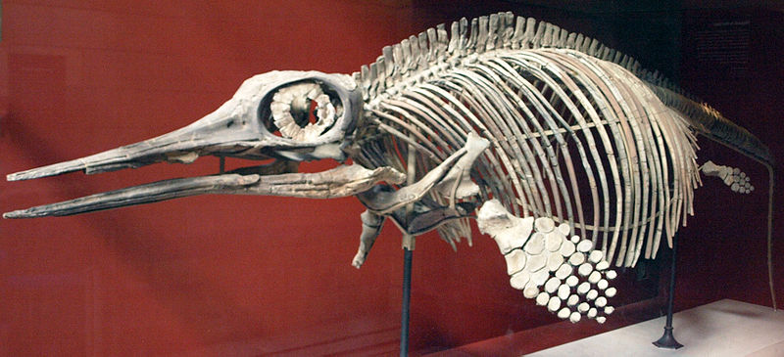
B-II. Berne’s Growing Pains
Berne Convention revised many times from 1886 to 1979
Revisions in 1896, 1908, 1914, 1928, 1948, 1967, 1971 and 1979
1967 UN based World Intellectual Property Organization (WIPO) formed
Forerunner was BIRPI (Bureaux Internationaux Réunis pour la Protection de la Propriété Intellectuelle) which administered Berne and Paris Conventions
Two main problems with Berne
By 1980 with 70 signatories revising the agreement increasingly complicated
Berne had no mechanism to punish signatories who didn’t meet obligations (it was toothless)

Slide 11
B-III. Uruguay Round and Teeth
Through 1970s U.S. economy was changing
Rise of IP based industries
U.S. IP lobbies convince U.S. Trade Representative of the need for strong IP protection globally (Drahos and Braithwaite, 2002; May, 2010)
In turn U.S. convinces Europeans, Japanese and Canadians to include IP protection as part of Uruguay Round trade talks
Brazil and India lead resistance; however, Uruguay Round concludes with creation of new global IP treaty
‘Teeth’ achieved in the form of the World
Trade Organization (WTO)

Slide 12
B-IV. Agreement on Trade Related Aspects of Intellectual Property (TRIPS)
Uruguay Round concludes in 1994 – three main agreements
General Agreement on Trade and Tariffs (GATT) (1947)
General Agreement on Trade in Services (GATS) (1994)
Agreement on Trade Related Aspects of Intellectual Property (TRIPS) (1994)
World Trade Organization (WTO) established
Dispute Settlement mechanism gives all three treaties teeth
TRIPS incorporates texts (and obligations) of Berne (and other international IP treaties), but specifically excludes Article 6bis (moral rights protection (TRIPS Article 9)
Developing nations signed because of lack of expertise around IP implications and desire for access to U.S. agricultural market (Drahos and Braithwaite)

Slide 13
C-I. TRIPS+ (WCT and WPPT)
Even before TRIPS was concluded U.S. was already looking to ratchet up global copyright protection beyond TRIPS (Samuleson, 1997)
Rather than pursue discussion in the Uruguay Round, Clinton administration strategy was made to create new agreements at WIPO
Result was two new agreements:
WIPO Copyright Treaty (WCT) (1996)
WIPO Performances and Phonograms Treaty (WPPT) (1996)
WCT introduced new range of protections including anti-circumvention of technological protection measures

Slide 14
C-II. Bilateral Trade Agreements and Copyright
U.S. has also used bilateral (and small multilateral) trade agreements to further strengthen IP protection
Blue print for this approach was North American Free Trade Agreement (NAFTA) Chapter 17
Between 2000 and 2007 U.S. concluded 11 bilateral agreements, each with an IP chapter, plus a 2004 septilateral trade agreement in Central America
Korea – U.S. Free Trade Agreement required 169 changes to Korean law, including IP changes, and 0 changes to U.S. law (Dinwoodie, 2007)
Bilateral trade agreements ensured the WCT and WPPT entered into force

Slide 15
C-III. Retreat of the Expansionary Regime?
2011 Anti-Counterfeiting Trade Agreement has failed to enter into force because of European Parliament opposition
Trans-Pacific Partnership (TPP) appears dead because of Trump
Conversely, 2013 Marrakesh Treaty, with a focus on exceptions for the benefit of the blind, visually impaired and otherwise print disabled (VIPs) has entered into force
Well recent developments suggest a turn away from an expansionary IP regime, the record of the last ~50 years (1970 onward) is a marked expansion in all forms of IP

Slide 16
Citations
Dinwoodie, Graeme. 2007. “The International Intellectual Property System: Treaties, Norms, National Courts and Private Ordering.” In Intellectual Property, Trade and Development: Strategies to Optimize Economic Development in a TRIPS-Plus Era. Daniel J. Gervais, (Ed.), New York: Oxford University Press, 2007: 61-114.
Drahos, Peter and John Braithwaite. 2002. Information Feudalism: Who Owns the Knowledge Economy? New York: New Press.
Houtchens, Lawrence H. 1941. “Charles Dickens and International Copyright.” American Literature, 13(1): 18-28.
May, Christopher. 2010. The Global Political Economy of Intellectual Property Rights: The New Enclosures.” 2nd Ed. New York: Routledge.
McNally, Michael B. 2009. “The Influence of Washington’s Farewell Address on the American Intellectual Property Debate in the Late 19th Century.” Proceedings of the Annual Conference of CAIS. Ottawa, ON. https://journals.library.ualberta.ca/ojs.cais-acsi.ca/index.php/cais-asci/article/view/781
Samuelson, Pamela. 1997. “The U.S. Digital Agenda at WIPO.” Virginia Journal of International Law, 37: 369-440.
World Intellectual Property Organization (WIPO). 1986. Berne Convention centenary. Geneva: WIPO.
WIPO. N.d. “WIPO-Administered Treaties Contracting Parties > Berne Convention (Total Contracting Parties: 173).” http://www.wipo.int/treaties/en/ShowResults.jsp?treaty_id=15

Slide 17
Treaties and Agreements
Agreement on Trade-Related Aspects of Intellectual Property Rights (1994) [Annex 1C of the Marrakesh Agreement]. https://www.wto.org/english/docs_e/legal_e/27-trips.pdf
Berne Convention for the Protection of Literary and Artistic Works (1979). http://www.wipo.int/wipolex/en/treaties/text.jsp?file_id=283698
Marrakesh Treaty to Facilitate Access to Published Works for Persons Who Are Blind, Visually Impaired, or Otherwise Print Disabled (2013). http://www.wipo.int/wipolex/en/treaties/text.jsp?file_id=301016
North American Free Trade Agreement – Chapter 17 Intellectual Property (1994). http://www.sice.oas.org/trade/nafta/chap-171.asp
Paris Convention for the Protection of Industrial Property (1979). http://www.wipo.int/treaties/en/text.jsp?file_id=288514
Universal Copyright Convention (1952). http://portal.unesco.org/en/ev.php-URL_ID=15381&URL_DO=DO_TOPIC&URL_SECTION=201.html
WIPO Copyright Treaty (1996). http://www.wipo.int/wipolex/en/treaties/text.jsp?file_id=295166
WIPO Performances and Phonograms Treaty (1996). http://www.wipo.int/wipolex/en/treaties/text.jsp?file_id=295578

Slide 18
Image Sources
Slide A-I. “Statute of Anne.” British Government. 1709. PD. https://commons.wikimedia.org/wiki/File:Statute_of_anne.jpg
Slide B-II. “Ophthalamosaurus.” Captmondo. 2008. GNU GFDL v. 1.2/CC-BY-SA 2.5/CC-BY 3.0. https://commons.wikimedia.org/wiki/File:OphthalmosaurusIcenius-NaturalHistoryMuseum-August23-08.jpg
Slide B-III. “Tyrannosaurs Rex.” David Monniaux. 2005. GNU GFDL v. 1.2/CC-BY 3.0. https://commons.wikimedia.org/wiki/File:Palais_de_la_Decouverte_Tyrannosaurus_rex_p1050042.jpg
Slide C-III. “Stop ACTA Octopus.” Piratenpartei Schweitz. 2012 CC-BY-SA 3.0. https://commons.wikimedia.org/wiki/File:Stop_ACTA_Octupus.jpg

