Slide 1
Educational Institutions’ Policies and Practices
*September 2020
Notes:
*Updated: March 2024
Hello and welcome to the University of Alberta’s Opening Up Copyright instructional module on Educational Institutions’ Policies and Practices.

Slide 2
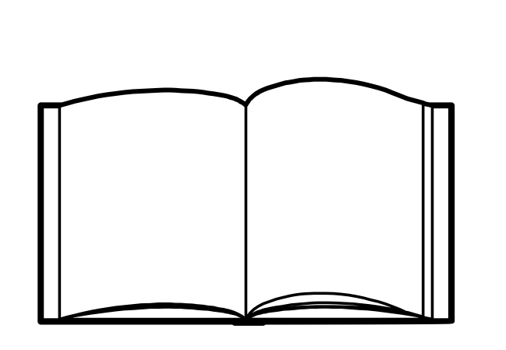






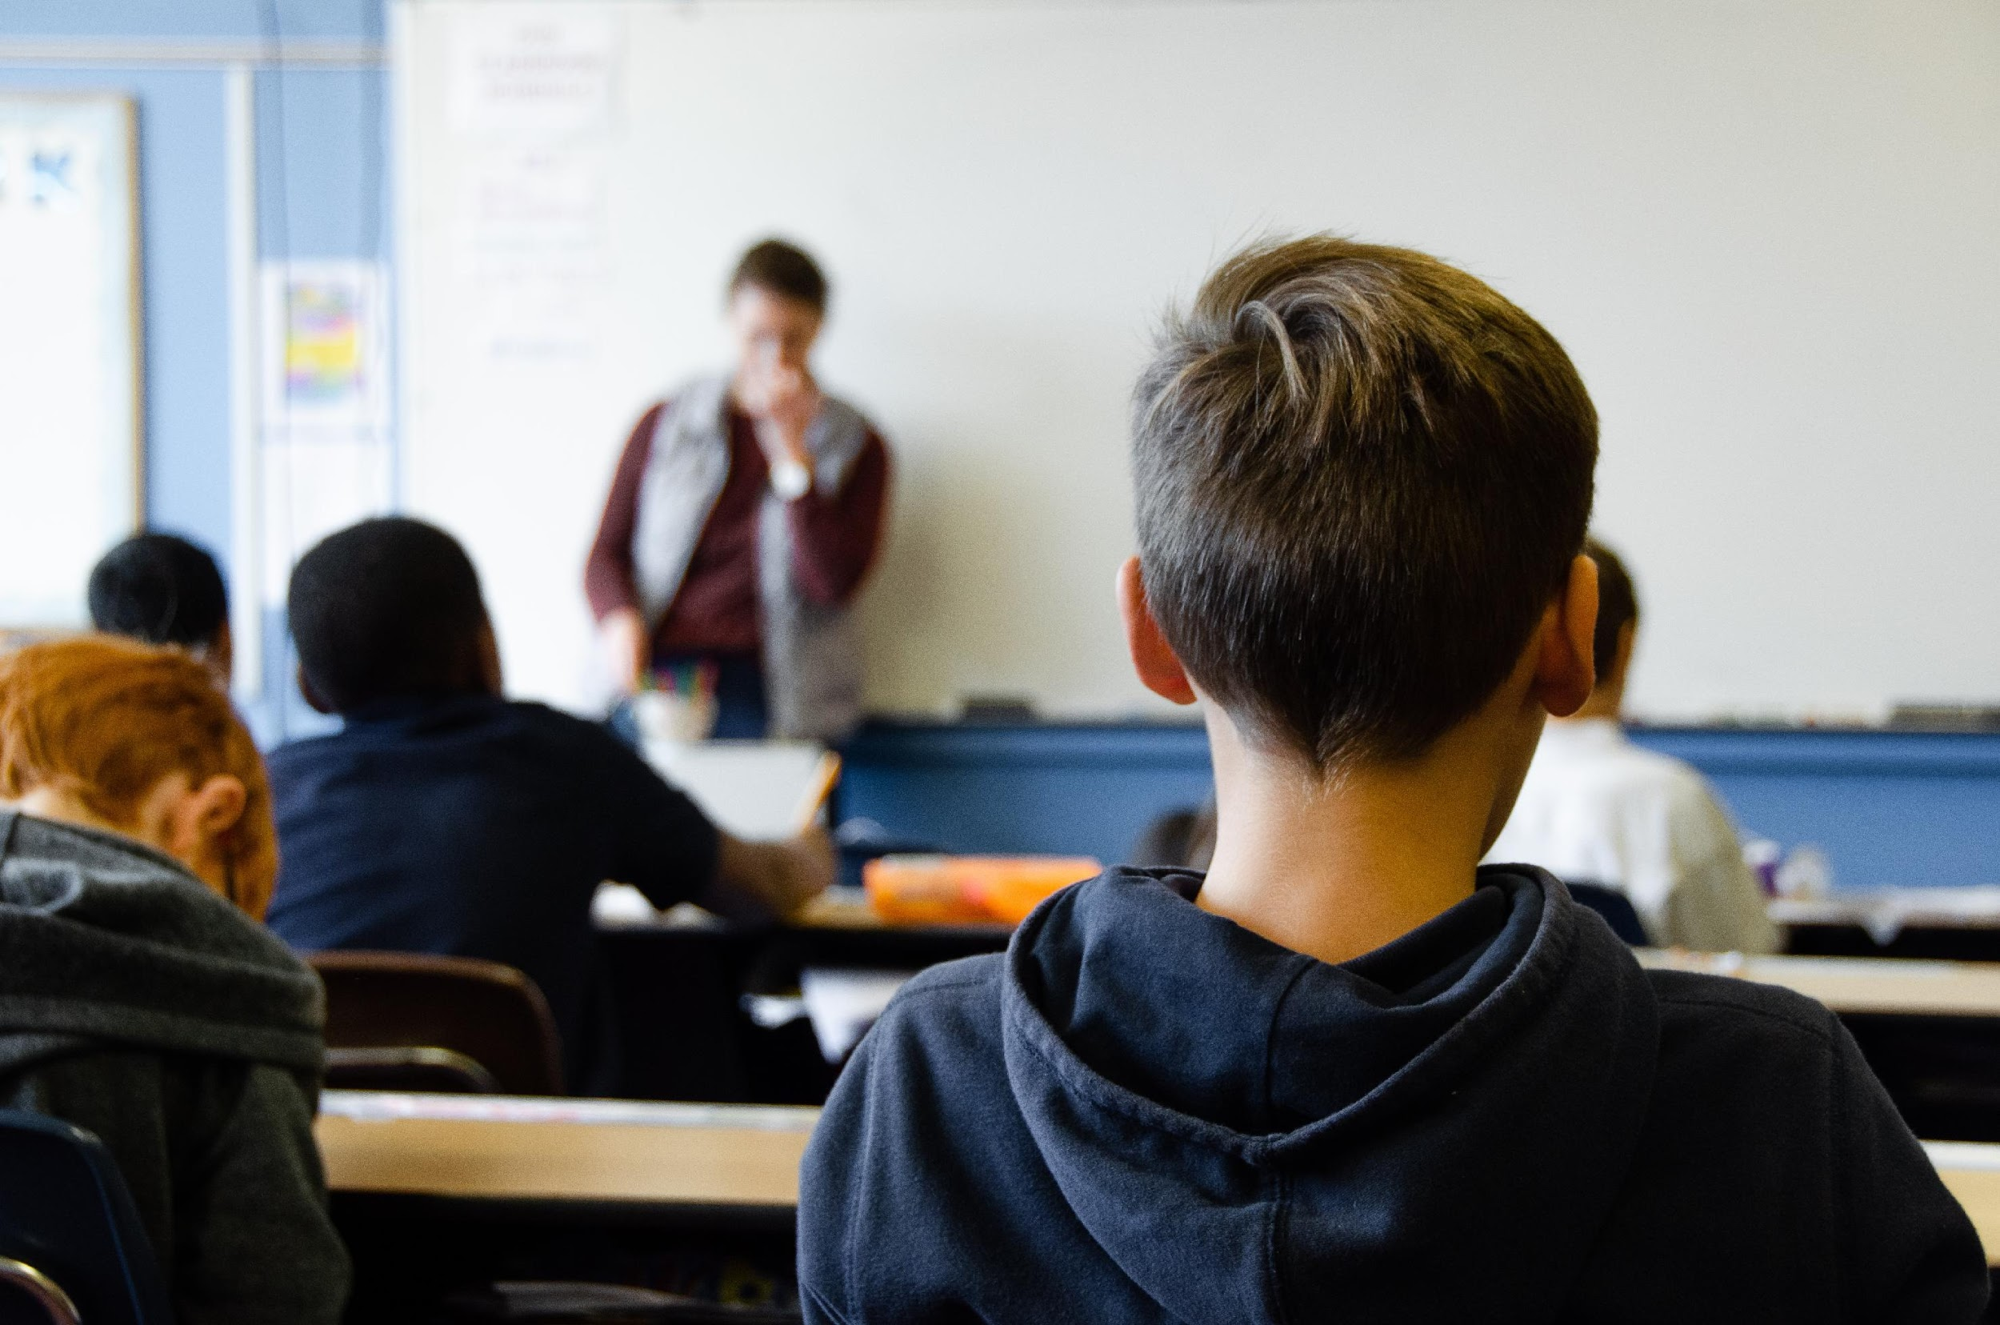
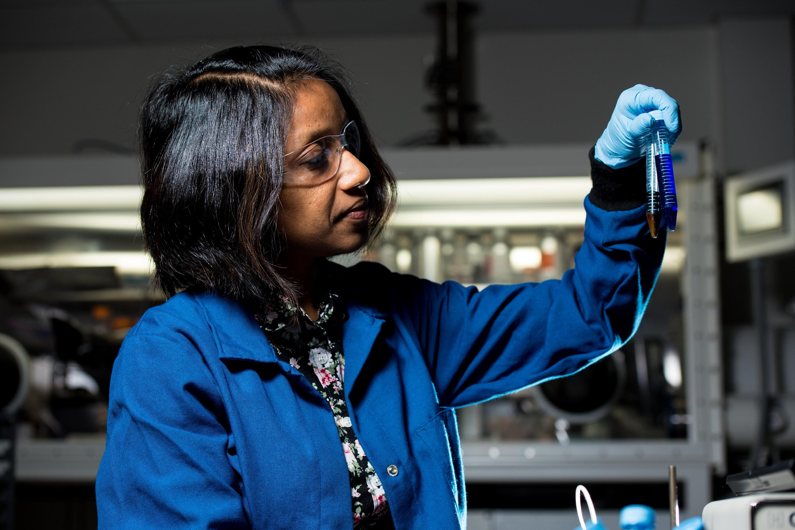

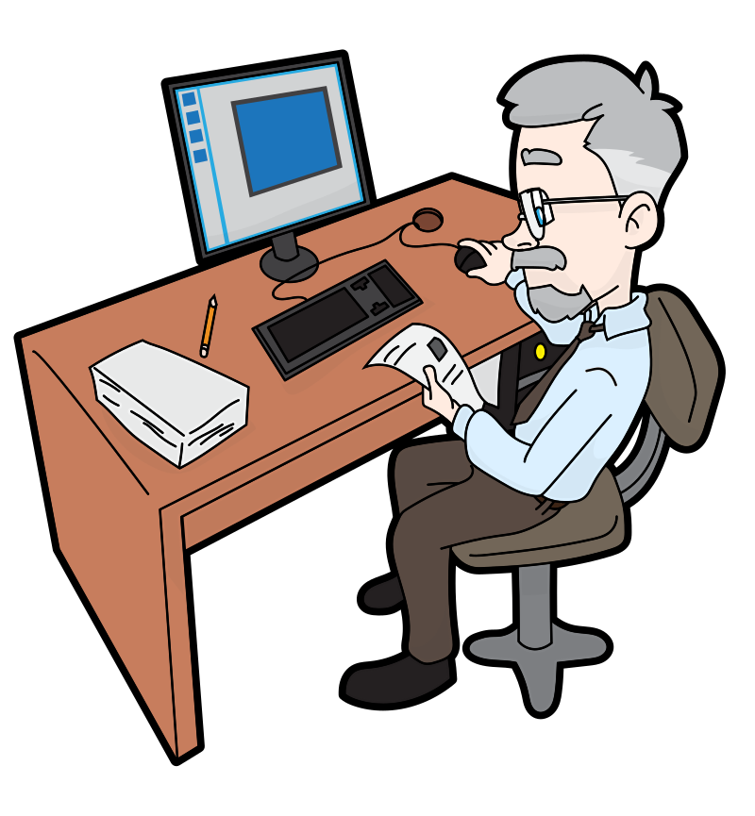




COPYRIGHT AND EDUCATION
‘Educational Institutions’ in the Copyright Act include:
K-12 Schools
Notes:
In order to effectively learn, teach, and research we must be able to access and build off the work of others. It is therefore no surprise that teachers and students use, consult, and share so many materials in educational institutions. And while the Copyright Act has a very specific definition of what counts as an ‘educational institution’ the term covers both K-12 and post-secondary education. There are many different kinds of copying done in education. A few examples are institutional copying, such as copying done by professors as part of their research; copying done by teachers and professors for students in order to enrich their learning experience; and copying done by the students themselves, both as part of their formal education or for personal study. With all that copying and distribution going on, it is no wonder that educational policy and practice is one of the most hotly contested areas of copyright.

Slide 3
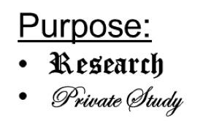
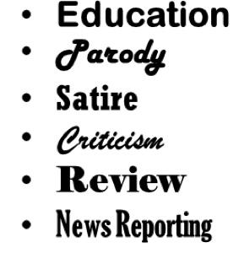




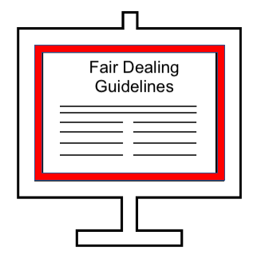


COPYRIGHT LAWSUITS
Alberta (Education) v. Access Copyright
Access Copyright v. York University
Tariff
s. 29
Notes:
Major copyright lawsuits have arisen because of differing viewpoints around the fairness of the copying done by staff in educational institutions. The 2012 Alberta (Education) v. Access Copyright case is an example. This case went to the Supreme Court and eventually determined that the teachers’ copying of short excerpts of printed works, and distributing those copies to their students, was fair. Also in 2012, the Copyright Modernization Act came into force, which added “education” as a distinct purpose under fair dealing in the Copyright Act.
Disagreements about the interpretation of the fair dealing exceptions in the Copyright Act are often at the heart of lawsuits like Alberta (Education) v. Access Copyright and Access Copyright v. York University, another court case this time involving a post-secondary institution. The main issues of this case revolved around whether tariffs approved by the Copyright Board are mandatory and whether the copyright fair dealing guidelines used by York University were fair.

Slide 4

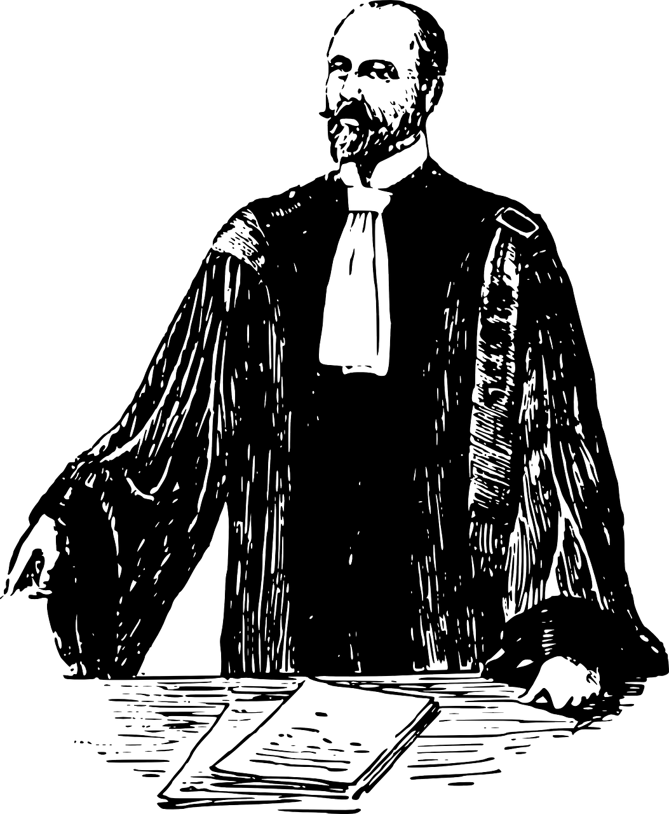
COPYRIGHT COLLECTIVES
Access Copyright v. York University
Alberta (Education) v. Access Copyright
DID SOMEONE SAY LAWYER?!
Access
Copyright
COPIBEC
Notes:
You may have noticed that both of these cases involved Access Copyright. Access Copyright is a copyright collective that manages the rights of literary works and licenses the photocopying of those works in educational institutions in exchange for fees. However in Quebec, Copibec is the responsible collective. And speaking of lawsuits, Copibec brought a class action suit against Université Laval in 2017 which was settled in 2018.
With so much controversy around educational copying and the high cost of litigation, it is natural for people who work in education to want to be cautious. However, we need to be careful that ongoing legal action on the part of collectives does not impede or discourage the legitimate uses of copyrighted material by students or educational institutions covered under fair dealing.

Slide 5
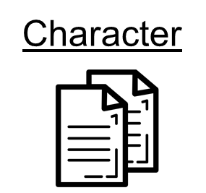
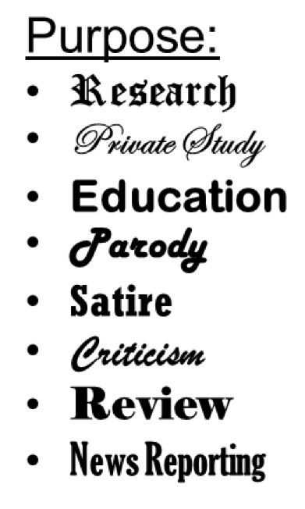
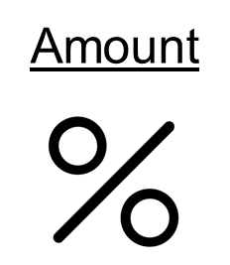





FAIR DEALING
Purpose
s. 29
Notes:
Fair dealing is outlined in s. 29 of the Copyright Act and involves a ‘Two-Step Test’ for determining whether a particular use of a copyrighted material is fair. The first step is assessing the purpose of the use. The list of acceptable purposes includes education as well as research and private study. However, just meeting one of the purposes in the first step doesn’t mean that the use is fair. It depends on the outcome of the second step, the ‘six-factor test’. This second step involves assessing six key factors for determining whether the use of the work can be reasonably considered fair.

Slide 6
FAIR DEALING RESOURCES
Opening Up Copyright Modules:
Other Resources:
Notes:
There are many good resources that can help us understand if our use of a material falls under the fair dealing exception. These include other Opening Up Copyright Modules, resources from the Universities of Alberta, Ottawa and Toronto, as well as CAUT’s copyright guidelines.

Slide 7

EDUCATIONAL EXCEPTIONS
s. 29.4–30.03
K-12 Schools
Post-secondary Institutions
Notes:
In addition to the fair dealing exception, the Copyright Act also outlines other exceptions to infringement for educational contexts. Sections 29.4 to 30.03 describe the exceptions to infringement that apply specifically to educational institutions and staff. However, these exceptions are not relied on very often, in part because they are cumbersome to say the least, and are thus not as relevant as the fair dealing exception which is commonly relied on in different educational contexts.

Slide 8
K-12 SECTOR AND CMEC
CMEC
ouncil of
inisters of
CMEC Copyright Consortium Resources:
  Fair Dealing Guidelines
  Fair Dealing Decision Tool
ducation,
K-12 Schools
anada
Notes:
In the K-12 context, the Council of Ministers of Education, Canada plays a leading role. The CMEC Copyright Consortium has developed and published Fair Dealing Guidelines to help teachers and school administrators understand how to use copyright-protected works appropriately. They have also developed other resources like a Fair Dealing Decision Tool that allows teachers to determine whether their copying requires copyright permission or can be done without permission because it falls within its fair dealing guidelines. Individual school boards may also adopt their own guidelines.

Slide 9

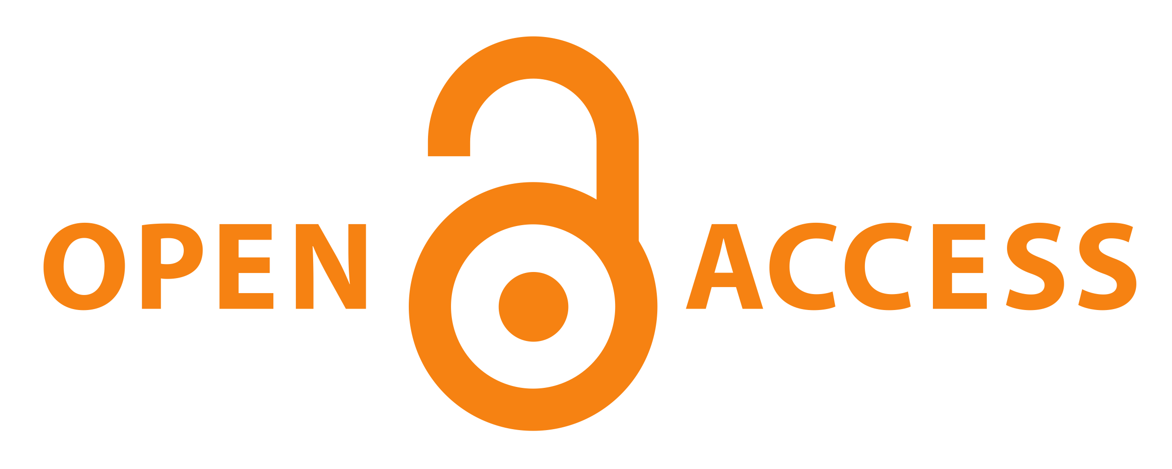



POST-SECONDARY POLICIES
AND PRACTICES
Access
Copyright
s. 29
Notes:
Before 2011 post-secondary institutions would almost always have licence agreements with Access Copyright or Copibec to cover routine copying in their institutions. In recent years this has given way to institutions employing a variety of different approaches to remaining copyright compliant, in part, by relying on fair dealing exceptions.

Slide 10
POST-SECONDARY POLICIES
AND PRACTICES
Guidelines are not intended as a replacement for a full fair dealing assessment
Notes:
Like CMEC, many post-secondary institutions have developed their own institutional Fair Dealing Guidelines in order to provide a simple and straightforward approach to determine if the Fair Dealing exception applies in particular circumstances. For both post-secondary and K-12 contexts, these fair dealing guidelines are not intended to be a replacement for the full analysis outlined by the Supreme Court of Canada, but, if followed, the guidelines are expected to yield a result consistent with such a full analysis in the vast majority of applicable cases.

Slide 11
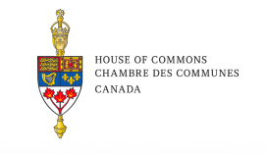

GOING FORWARD
(2019)
That the Government of Canada consider establishing facilitation between the educational sector and the copyright collectives to build consensus towards the future of educational fair dealing in Canada. (Recommendation 16)
That the House of Commons Standing Committee on Industry, Science and Technology resume its review of the implementation of educational fair dealing in the Canadian educational sector within three years, based on new and authoritative information as well as new legal developments. (Recommendation 17)
Notes:
The future of copyright policies and practices in educational institutions is up in the air. The 2019 INDU Statutory Review of the Copyright Act acknowledged the ongoing tension between copyright collectives and educational institutions. It also recommended that the implementation of educational fair dealing continue to be reviewed (Recommendations 16 and 17).
While copyright battles in the education sector may continue, it is also important to note that the rise of open content such as open access scholarly publication and open educational resources, like this, offer one way to resolve the tension.

Slide 12
LEARNING OBJECTIVES
You should now be able to:
Recognize that educational institutions can rely on both fair dealing and educational exceptions outlined in the Copyright Act
Understand and be able to explain the role of fair dealing guidelines in an educational context
Notes:
You should now be able to:
Recognize that educational institutions can rely on both fair dealing and educational exceptions outlined in the Copyright Act
Understand and be able to explain the role of fair dealing guidelines in an educational context

Slide 13
Notes:
This has been the University of Alberta’s Opening Up Copyright instructional module on Educational Institutions’ Policies and Practices. Thank you for your attention.

Slide 14
QUESTIONS
Which of the following institutions or organizations has created fair dealing guidelines and resources you can reference?
  Council of Ministers of Education, Canada (CMEC)
  Universities of Alberta, Ottawa and Toronto
  Canadian Association of University Teachers (CAUT)
  All of the above
An institution’s fair dealing guidelines, if followed, are:
  Expected to yield a result consistent with a full fair dealing analysis as outlined by the Supreme Court of Canada in the vast majority of cases, but are not a replacement
  Like seasonal tires and should be changed every six months
  A replacement for the full fair dealing analysis outlined by by the Supreme Court of Canada”
Educational staff and teachers can refer to both the fair dealing exception to infringement and the specific educational exceptions in the Copyright Act.
  True
  False

Slide 15
Canadian Association of University Teachers. (2013). CAUT guidelines for the use of copyrighted material. https://www.caut.ca/docs/default-source/copyright/revised-caut-guidelines-for-the-use-of-copyrighted-material-(feb-2013).pdf
Council of Ministers of Education, Canada. (n.d.). Copyright information for teachers. Retrieved 2020, from https://www.cmec.ca/466/Copyright_Information_for_Teachers.html
Council of Ministers of Education, Canada. (n.d.). Available copyright resources for teachers. Retrieved March 7, 2024 from https://www.cmec.ca/739/Available_copyright_resources_for_teachers.html
Murray, L. J., & Trosow, S. E. (2013). Canadian copyright: A citizen’s guide (2nd ed.). Between the Lines.
University of Alberta Copyright Office. (n.d.). Fair dealing. Retrieved 2020, from https://www.ualberta.ca/faculty-and-staff/copyright/intro-to-copyright-law/fair-dealing/index.html
University of Toronto Libraries. (n.d.). Copyright basics and FAQs. Retrieved 2020, from https://onesearch.library.utoronto.ca/sites/default/files/copyright/basicsfaqs_092018.pdf
University of Toronto Libraries. (n.d.). Copyright Resources at U of T. Retrieved March 7, 2024 from https://onesearch.library.utoronto.ca/copyright/copyright-resources-u-t#Copyright%20Basics

Slide 16
Canadian Copyright Licensing Agency (Access Copyright) v. York University, 2017 FCC 669. https://decisions.fct-cf.gc.ca/fc-cf/decisions/en/item/232727/index.do
Alberta (Education) v. Canadian Copyright Licensing Agency (Access Copyright), 2012 SCC 37, [2012] 2 SCR 345. https://scc-csc.lexum.com/scc-csc/scc-csc/en/item/9997/index.do
York University v. Canadian Copyright Licensing Agency (Access Copyright), 2020 FCA 77. https://decisions.fca-caf.gc.ca/fca-caf/decisions/en/item/469654/index.do
York University v. Canadian Copyright Licensing Agency (Access Copyright), 2021 SCC 32. https://decisions.scc-csc.ca/scc-csc/scc-csc/en/item/18972/index.do

Slide 17
Christina@wocintechchat.com. (n.d.). [Teach]. Unsplash. https://unsplash.com/photos/c-mgSuxqpzA
Taylor Wilcox. (n.d.). [Learn]. Unsplash. https://unsplash.com/photos/4nKOEAQaTgA
Science in HD. (n.d.). [Research]. Unsplash. https://unsplash.com/photos/37-obwmRiAI
Lluisa Iborra. (n.d.). Open book. The Noun Project. https://thenounproject.com/search/?q=open%20book&i=991011
Dawid Sobolewski. (n.d.). Mockup article. The Noun Project. CC BY. https://thenounproject.com/search/?q=article%20mockup&i=244221
Joko Mistari. (n.d.). File. The Noun Project. CC BY. https://thenounproject.com/search/?q=file%20sound&i=2728070
Bieu Tuong. (n.d.). School. The Noun Project. CC BY. https://thenounproject.com/search/?q=school&i=1983588
Crosswell, Rob. (n.d.). Library. The Noun Project. CC BY. https://thenounproject.com/crosswellrob/uploads/?i=1122689

Slide 18
Vectortoons. (n.d.). [Sam the teacher at desk]. Wikimedia Commons. CC BY SA. https://commons.wikimedia.org/wiki/File:Senior_Guy_At_The_Office_Cartoon.svg
chrystalizabeth. (n.d.). [Professor Pam]. Pixabay. https://pixabay.com/en/teacher-bookworm-glasses-professor-359311/
Rawpixel. (n.d.). [Isabelle]. Pixabay. https://pixabay.com/illustrations/cartoon-casual-character-drawing-3685566/
Saishradd. (n.d.). Highlight. The Noun Project. CC BY. https://thenounproject.com/search/?q=highlight%20document&i=241534
Marie Van den Broeck. (n.d.). Kids. The Noun Project. CC BY. https://thenounproject.com/search/?q=kids&i=235684
Creaticca Creative Angencyy. (n.d.). Printer. The Noun Project. CC BY. https://thenounproject.com/search/?q=photocopier&i=1127745
Designs by MB. (n.d.). Paper money. The Noun Project. CC BY. https://thenounproject.com/search/?q=paper%20money&i=3360185

Slide 19
Till Teenck. (n.d.). Accept Payment. The Noun Project. CC BY. https://thenounproject.com/tillt/collection/money-money/?i=402474
Kick. (n.d.). Scales. The Noun Project. CC BY. https://thenounproject.com/search/?q=scale&i=1320645
Guilherme Fertado. (n.d.). Sign. The Noun Project. CC BY. https://thenounproject.com/search/?q=sign&i=1859815
Star and Anchor Designs. (n.d.). Building. The Noun Project. https://thenounproject.com/search/?q=building&i=164596
DigestContent. (2018). Woosh punch. Freesound. CC BY NC. https://freesound.org/people/DigestContent/sounds/442755/
Dezign, Ruslan. (n.d.). Target. The Noun Project. CC BY. https://thenounproject.com/icon/1005058/
ATOM, TH. (n.d.). Copy. The Noun Project. CC BY. https://thenounproject.com/search/?q=copy&i=1474212
Тимур Минвалеев, RU. (n.d.). Percent. The Noun Project. CC BY. https://thenounproject.com/search/?q=percent&i=397874

Slide 20
Farais, B, CL. (n.d.). Decision. The Noun Project. CC BY. https://thenounproject.com/search/?q=alternatives&i=1074053
AFY Studio, ID. (n.d.). Leaf. The Noun Project. CC BY. https://thenounproject.com/AFYstudio/uploads/?i=1737325
Cresnar, Gregor. (n.d.). Dollar sign. The Noun Project. CC BY. https://thenounproject.com/search/?q=dollar%20sign&i=171145
DesignNex. (n.d.). Document. The Noun Project. CC BY. https://thenounproject.com/search/?q=copyright&i=93928
Vector Market. (n.d.). Content sharing. The Noun Project. CC BY. https://thenounproject.com/search/?q=content%20management&i=1575870
Edwin PM. (n.d.). Agreement. The Noun Project. CC BY. https://thenounproject.com/search/?q=agreement%20company&i=3373812

Slide 21
onathasmello. (2012). Global Open Educational Resources Logo. Wikimedia Commons. CC BY. https://commons.wikimedia.org/wiki/File:Global_Open_Educational_Resources_Logo.svg\
Guilherme Fertado. (n.d.). Sign. The Noun Project. CC BY. https://thenounproject.com/search/?q=sign&i=1859815
Closing Slides Music: Rybak, Nazar. (n.d.). Corporate Inspired. HookSounds. CC BY. http://www.hooksounds.com
Unattributed materials are contributions from the Opening Up Copyright Project Team and placed in the Public Domain.

Slide 22
University of Alberta. (2020). Educational Institutions’ Policies and Practices. Opening Up Copyright Instructional Module. https://sites.library.ualberta.ca/copyright/

