Slide 1

Race, Discrimination, and Trust in Police: Insights from Black Canadians
ISMAIL AYATULLAH NASIRUDEEN,
MA, Department of Sociology,
University of Alberta

Slide 2
Presentation Outline
Background
Research question
Why this study is important
Theoretical framework
Methodology
Results
Preliminary findings
Implications & final takeaways
References

Slide 3
Background
For any democratic government to be legitimate, trust in police is crucial (Staubli, 2017).
One of many factors that influence public trust is the discrimination experienced by people.
Visible minorities remain a unique population whose perspectives of police are important (Cao, 2014; Sprott & Doob, 2014).
The historical relationship between Black Canadians and the police is fraught with tension (Wortley & Owusu-Bempah, 2022).
Around half of Black Canadians reported discrimination nearly 3 X higher than that of the non-Indigenous, non-visible minority population within the past five years; and 4 X higher when interacting with the police (Ibrahim, 2020).

Slide 4

Research Question
How does discrimination experienced by Black Canadians during interactions with police affect their trust in the police?

Slide 5
Why this study is important
Within the Canadian context, there is a lack of studies examining the relationship between trust in police and experiences of discrimination.
Studies in Canada do not consider discrimination experiences when measuring trust in police among Black Canadians.
Only few empirical studies target Black Canadians when discussing this relationship (e.g. Wortley & Owusu-Bempah, 2022).
Walter and Mayer (2024) highlight an unresolved question regarding the effects of general experiences of discrimination on trust in police. Given that discrimination is a common aspect of contemporary societies, particularly impacting racial minorities such as the Black population, studying its effect on trust in police is highly important.

Slide 6
Theoretical framework
Procedural justice theory
Fairness
Respect
The argument for procedural justice suggests that, generally speaking, people's main concerns regarding the police revolve around whether officers act and treat them fairly, acknowledge citizens' rights, show respect, and take individuals' concerns seriously (Tyler, 2001; 2003; 2017).
Voice
Transparency
Legitimacy
Tyler (2001; 2003; 2017)

Slide 7
Methodology
  Does NOT include the interview component.
  Rely on the Impacts of COVID-19 on Canadians: Experiences of Discrimination, 2020 dataset.
  Conducted by Statistics Canada in August 2020. Total cases: 36,674
  Analysis sample:
  Visible minorities (5203 cases). Black Canadians included as visible minorities
  Sample techniques:
  Crowdsourcing (Non-probability). Not generalizable
  Variables:
  Dependent variable (Trust in police);
  Independent variable (Experience of discrimination)
  Mediating variables (Race-based discrimination & police-interaction-based discrimination)
  Statistical Approach:
  Descriptive Statistics, Bivariate Regression, & Multiple Linear Regression Models

Slide 8
Focal relationship
MODERATING VARIABLES
Race/skin color
Police interactions
Before
COVID-19
Experience of
Trust in police
discrimination
Since
COVID-19

Slide 9
Results

Slide 10

Descriptive Statistics, Impacts of COVID-19 on Canadians: Experience of Discrimination, 2020 Crowdsourcing
About 29.3% expressed moderate trust in police
(1) Before COVID-19
67.6% reported experiencing discrimination
69.9% based on race/skin color
14.3% during police interactions
(2) Since COVID-19
49.5% reported experiencing discrimination
73.3% based on race/skin color
8.1% during police interactions
Variables | Frequency | Mean or % | SD (Var) | Range
Trust in Police 1.00 - Zero trust 2.00 - Low trust 3.00 - Moderate trust 4.00 - High trust 5.00 - Complete trust | 701 1380 1524 1035 563 | 2.8806 13.5% 26.5% 29.3% 19.9% 10.8% | 1.19245 (1.422) | 1-5
BEFORE COVID-19 Experienced Discrimination 0.00 - No 1.00 - Yes (a) Discrimination based on race/skin color 0.00 - No 1.00 - Yes (2461 out of 3519) = 69.9% (b) Discrimination while interacting with police 0.00 - No 1.00 - Yes (504 out of 3519) = 14.3% | 1684 3519 2742 2461 4699 504 | .6763 32.4% 67.6% .4730 52.7% 47.3% .0969 90.3% 9.7% | .46792 (.219) .49932 (.249) .29581 (.088) | 0-1 0-1 0-1
SINCE COVID-19 Experienced Discrimination 0.00 - No 1.00 - Yes (a) Discrimination based on race/skin color 0.00 - No 1.00 - Yes (1888 out of 2576) = 73.3% (b) Discrimination while interacting with police 0.00 - No 1.00 - Yes (209 out of 2576) = 8.1% | 2627 2576 3315 1888 4994 209 | .4951 50.5% 49.5% .3629 63.7% 36.3% .0402 96.0% 4.0% | .50002 (.250) .48087 (.231) .19637 (.039) | 0-1 0-1 0-1
40.0%
30.7%
N = 5203

Slide 11

Bivariate Regression Statistics for all Variables with Trust in Police, Impacts of COVID-19 on Canadians: Experience of Discrimination, 2020 Crowdsourcing
The analysis revealed a weak positive correlation between experience of discrimination and trust in police, both before and since COVID-19.
Specifically:
- Before the pandemic: Correlation coefficient of 0.323
- Since the pandemic: Correlation coefficient of 0.284
Variable | Mean | Standard deviation | Variance | Range | Correlation with trust in police
Trust in police | 2.8806 | 1.19245 | 1.422 | 1-5 | ---
BEFORE COVID-19
Experienced discrimination | .6763 | .46792 | .219 | 0-1 | .323**
Race/Skin color | .4730 | .49932 | .249 | 0-1 | .337**
Interacting with Police | .0969 | .29581 | .088 | 0-1 | .331**
SINCE COVID-19
Experienced discrimination | .4951 | .50002 | .250 | 0-1 | .284**
Race/Skin color | .3629 | .48087 | .231 | 0-1 | .285**
Interacting with Police | .0402 | .19637 | .039 | 0-1 | .251**
N = 5203

Slide 12

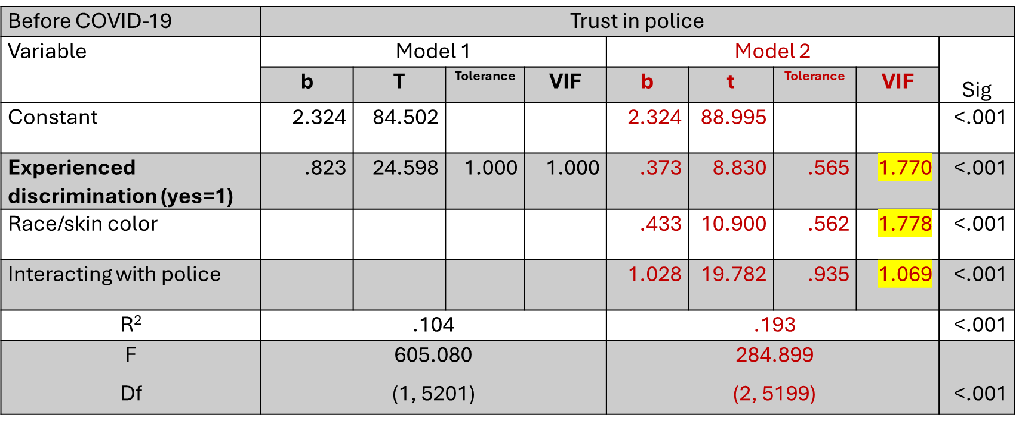



Predicting trust in police by experience of discrimination BEFORE COVID-19, Impacts of COVID-19 on Canadians: Experience of Discrimination, 2020 Crowdsourcing
Model 1 shows a strong positive relationship between experienced discrimination and trust in police (b = .823)
Model 2 adds control variables for race-based discrimination and police-interaction-based discrimination. The results show that police-interaction-based discrimination (b = 1.028) has a stronger effect on trust than race-based discrimination (b = .433).
N = 5203

Slide 13

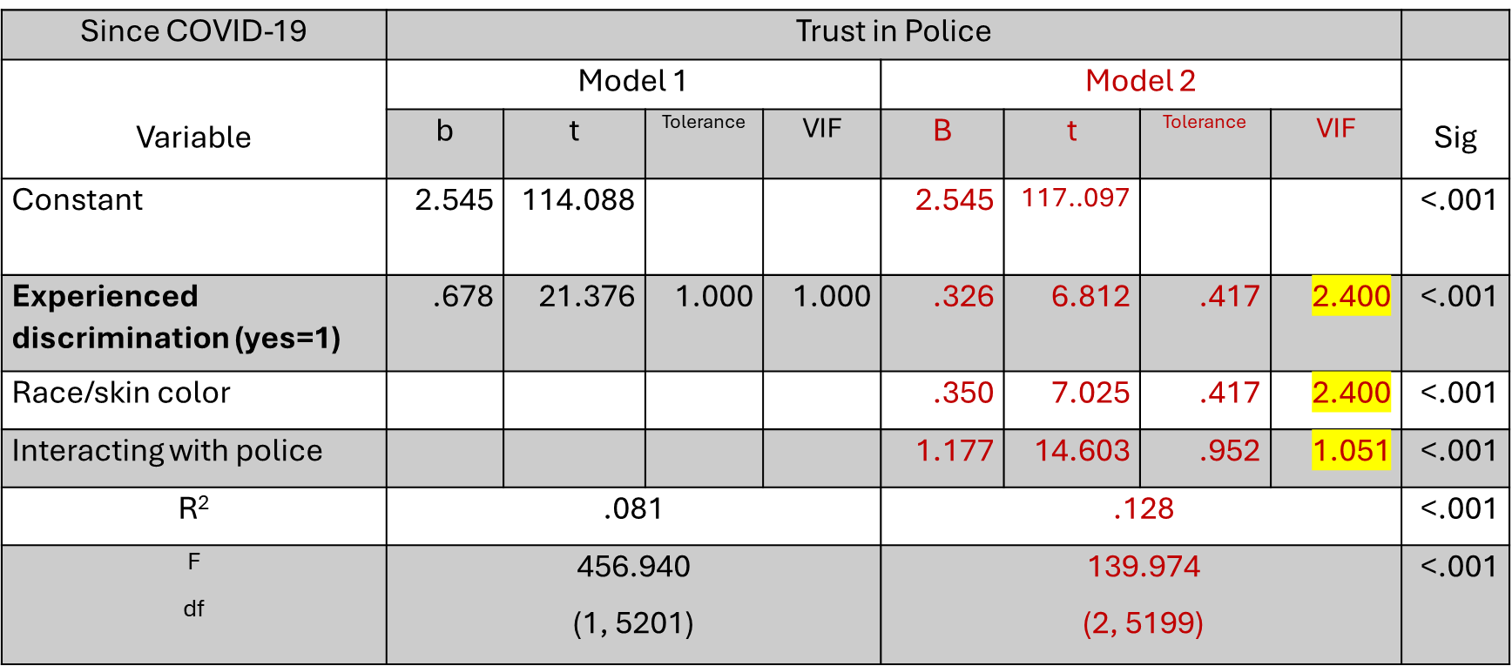



Predicting trust in police by experience of discrimination since COVID-19, Impacts of COVID-19 on Canadians: Experience of Discrimination, 2020 Crowdsourcing
Model 1 shows a positive correlation (b = .678) between discrimination and trust in police.
- Model 2 introduces control variables and reveals that race-based discrimination (b = .350) and police-interaction-based discrimination (b = 1.177) still has a significant impact on trust in police, but the correlation weakens slightly (b = .326).
N = 5203

Slide 14
Preliminary findings
Visible minorities experienced heightened levels of discrimination prior to the COVID-19 pandemic compared to the period following the pandemic's onset.
The discrimination experienced by visible minorities has a significant impact on their trust in police.
This finding corroborates the basic assumptions of PJT: personal interactions shape public trust in police; and that trust diminishes when individuals perceive bias, discrimination, or unfair treatment, such as racial profiling, within the police force.
There is a positive correlation between experiences of discrimination among visible minorities and trust in police.
This positive correlation was stronger and persists even after controlling for race-based and discrimination stemming from interactions with the police.

Slide 15
Implications & final takeaways
There is a pressing need for a comprehensive and reliable nationwide database in Canada that accurately tracks instances of discriminatory treatment by police officers, including the use of force.
The importance of incorporating experiences of discrimination in surveys and studies focusing on trust in police.
Initiatives aimed at fostering trust between police and visible minority communities (including Blacks) should consider some specific experiences and perceptions of discrimination.
The impact of discrimination experiences on this trust is a critical area of study that can guide policy and practice.
Future research should delve deeper into the specific forms of discrimination that visible minorities encounter during interactions with police officers.
Future studies should also break down questions beyond experiences of discrimination during these interactions.

Slide 16
References
Cao, L. (2014). Aboriginal people and confidence in the police. Canadian Journal of Criminology and Criminal Justice, 56(5), 499-526. https://doi.org/10.3138/CJCCJ.2013.E05.
Farren, D., Hough, M., Murray, K., & McVie, S. (2018). Trust in the police and police legitimacy through the eyes of teenagers. In: S. Roché, & M. Hough (eds), Minority Youth and Social Integration (pp. 167-. Springer, Cham. https://doi.org/10.1007/978-3-319-89462-1_7.
Ibrahim, D. (2020, November 25). “Public perceptions of the police in Canada’s provinces, 2019.” Statistics Canada. https://www150.statcan.gc.ca/n1/pub/85-002-x/2020001/article/00014-eng.htm.
Tyler, T. R. (2001). Public trust and confidence in legal authorities: What do majority and minority group members want from the law and legal institutions?. Behavioral sciences & the law, 19(2), 215-235. https://doi.org/10.1002/bsl.438.
Tyler, T.R. (2003). Procedural Justice, Legitimacy, and the Effective Rule of Law. Crime and Justice, 30, 283–357. http://www.jstor.org/stable/1147701.
Tyler, T.R. (2017). Procedural Justice and Policing: A Rush to Judgment? Annual Review of Law and Social Science, 13, 29-53. http://dx.doi.org/10.1146/annurev-lawsocsci-110316-113318.
Sprott, J. B., & Doob, A. N. (2014). Confidence in the police: Variation across groups classified as visible minorities. Canadian Journal of Criminology and Criminal Justice, 56(3), 367-379. https://doi.org/10.3138/CJCCJ.2013.E10.
Statistics Canada (2023a). Impacts of COVID-19 on Canadians – Experiences of Discrimination, 2020: Crowdsource file [Dataset]. Retrieved from: https://doi-org.login.ezproxy.library.ualberta.ca/10.5683/SP3/NIOE4A.
Staubli, S. (2017). Trusting the police: Comparisons across Eastern and Western Europe. Kultur und soziale Praxis. https://doi.org/10.14361/9783839437827.
Walter, L., & Mayer, S. J. (2024, March 29). “Discrimination Experiences and Trust in the Police – Evidence from the DeZIM.panel.” https://doi.org/10.31235/osf.io/d4k97.
Wortley, S., & Owusu-Bempah, A. (2022). Race, police stops, and perceptions of anti-Black police discrimination in Toronto, Canada over a quarter century. Policing: An International Journal, 45(4), 570-585. https://doi.org/10.1108/PIJPSM-11-2021-0157.

Slide 17
Thank you
ISMAIL AYATULLAH NASIRUDEEN
MA, Department of Sociology,
University of Alberta
780-263-7635
nasirude@ualberta.ca

