Slide 1
albertaoer.com
Notes:
Who am I

Slide 2
Background and Goals
Notes:
the background and intent, scope of the toolkits, date these were created.

Slide 3
OER Championship
Notes:
What we used as a template to desk the Championship Toolkit

Slide 4
Know Your Audience
Who are your stakeholders?
OER Championship
Faculty
Librarians & Instructional Designers
Students, Leadership, & Government

Slide 5
Know Your Audience
Academic | Instructional Support | Leadership
OER Championship
Students
Faculty
Leadership
Institutional Leadership
Professors
Librarians
Copyright
Officers
Educational Technology Units
Instructional Designers

Slide 6
Mindset of a Champion
OER Championship
FOCUS ON WHY | MAINTAIN OBJECTIVITY
ENGAGE THE OPEN | REINFORCE CHANGE

Slide 7
Mindset of Your Audience
OER Championship
the individual’s change journey
Prosci ADKAR® Model

Slide 8
Mindset of Your Audience
OER Championship
Awareness
the individual’s change journey
Desire
Prosci ADKAR® Model

Slide 9
Mindset of Your Audience
OER Championship
Awareness
the individual’s change journey
Desire
Knowledge
Prosci ADKAR® Model

Slide 10
Mindset of Your Audience
OER Championship
Awareness
the individual’s change journey
Ability
Desire
Knowledge
Prosci ADKAR® Model

Slide 11
Mindset of Your Audience
OER Championship
Reinforcement
Awareness
the individual’s change journey
Ability
Desire
Knowledge
Prosci ADKAR® Model
Notes:
update as citation

Slide 12
Mindset of Your Audience
OER Championship
Why
What
the individual’s change journey
How
Why
How

Slide 13
Mindset of Your Audience
OER Championship
Why
What
Remind
Educate
How
Equip
Attract
Why
Teach
How

Slide 14
Engagement Strategies
OER Championship
Formal Presentation
Informal Presentation
Special Interest Groups
Facilitated Group Discussion
Modeling / Exemplars
Collaboration
Embedded Championship
Educational Sessions | Individual Discussions | Conference Presentations | E-mail Announcements
Posters & Multimedia | Collaborative Projects | Public Forum / Panels | Web & Social Media

Slide 15
Know Your Audience
Academic | Instructional Support | Leadership
OER Championship
Cost
Quality
Awareness & Discovery

Slide 16
Know Your Audience
Academic | Instructional Support | Leadership
OER Championship // Adjusted from McNally, M.B. (2016)
Government
Students
Cost
Leadership
Quality
Awareness & Discovery
Faculty
Library

Slide 17
Engagement Strategies
OER Championship
Your Why
Faculty
Librarians, Instructional Designers
Their Why
Students, Leadership, Government
Notes:
Add what is important to each stakeholder group.

Slide 18
Engagement Strategies
OER Championship
Your Why
Faculty
Librarians, Instructional Designers
Their Way
Their Why
Students, Leadership, Government

Slide 19
OER Starter Kit
Notes:
The Starter Kit provides a strategies for using and adapting OER
The goal of the Starter Kit was...
to educate users on what creating and adopting and OER entails
fundamentals of open copyright systems
and usability and accessibility.
The toolkit has a focus on adoption and reuse rather than creating from scratch because the immediate goal was to encourage faculty to use resources that save students money.
Didn’t have a lot of experience creating “toolkits” prior to the project
Reviewed other toolkits and found some commonalities
Text heavy
Often not very visual
All encompassing

Slide 20
CC0 Image
Notes:
We didn’t want our starter kit to look like this...

Slide 21
CC BY 4.0 icons
OER Starter Kit
Notes:
Like the Champion’s Toolkit, the Starter Kit had to fit the spirit of OER by being a simple and modular document that could be used in any format
Further, the toolkit would…
provide a brief introduction to OER and act as a directory to other resources
divided into three main sections

Slide 22
1 - Considerations for Users
CC BY 4.0 icons
OER Starter Kit
Does the
OER Exist?
Who is your
Audience?
Expertise
Required?
Notes:
Goal was to inform people about what’s required when creating and adopting OER
Does the OER you want already exist? Get thinking about reuse and repurposing. Don’t want to recreate the wheel
Who is your audience?
What expertise is required (major barrier to OER as noted by faculty)

Slide 23
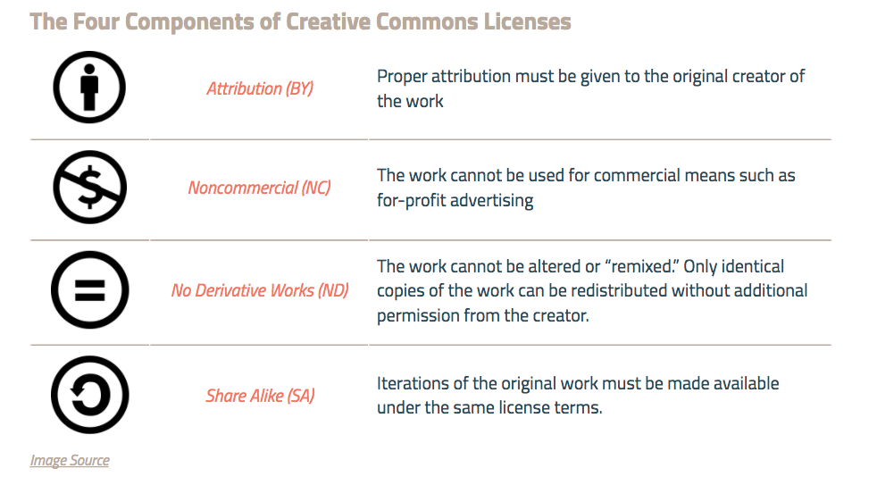
2. Copyright and Licensing
CC BY NC 4.0 screenshot
OER Starter Kit
Notes:
Copyright and licensing
Introduce open copyright systems such as CC, MIT, GNU
Goal was to educate about open licensing and where to find openly licensed content
Breakdown of the CC license elements

Slide 24
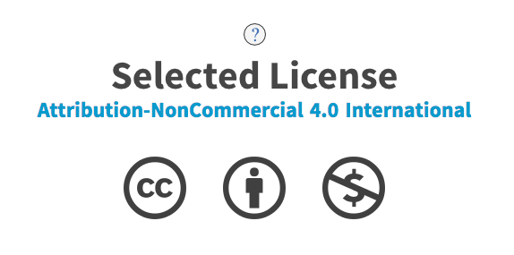
2. Copyright and Licensing
OER Starter Kit
CC BY 4.0 screenshot
Image Source

Slide 25
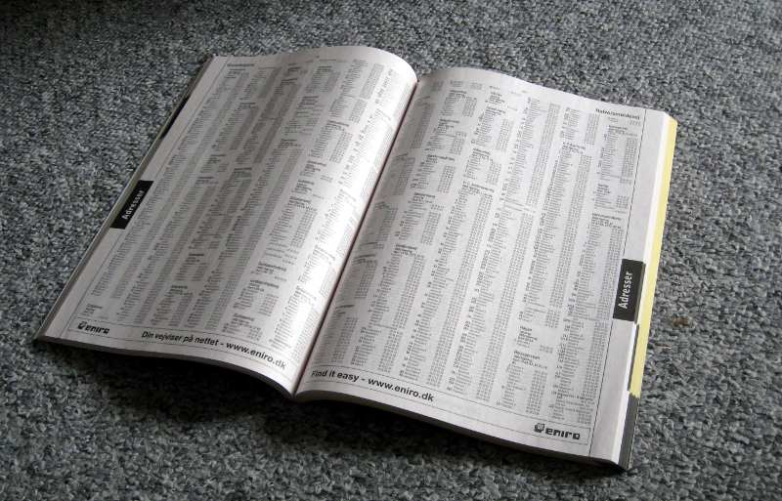
2. Copyright and Licensing
CC BY 3.0 image
OER Starter Kit
Notes:
In addition to awareness, finding OER content is a huge barrier.
The Starter Kit acts like a directory to many other resources including...
The BC Campus Open Textbook Project
OER Commons
Open Stax
MIT Open Courseware, etc

Slide 26
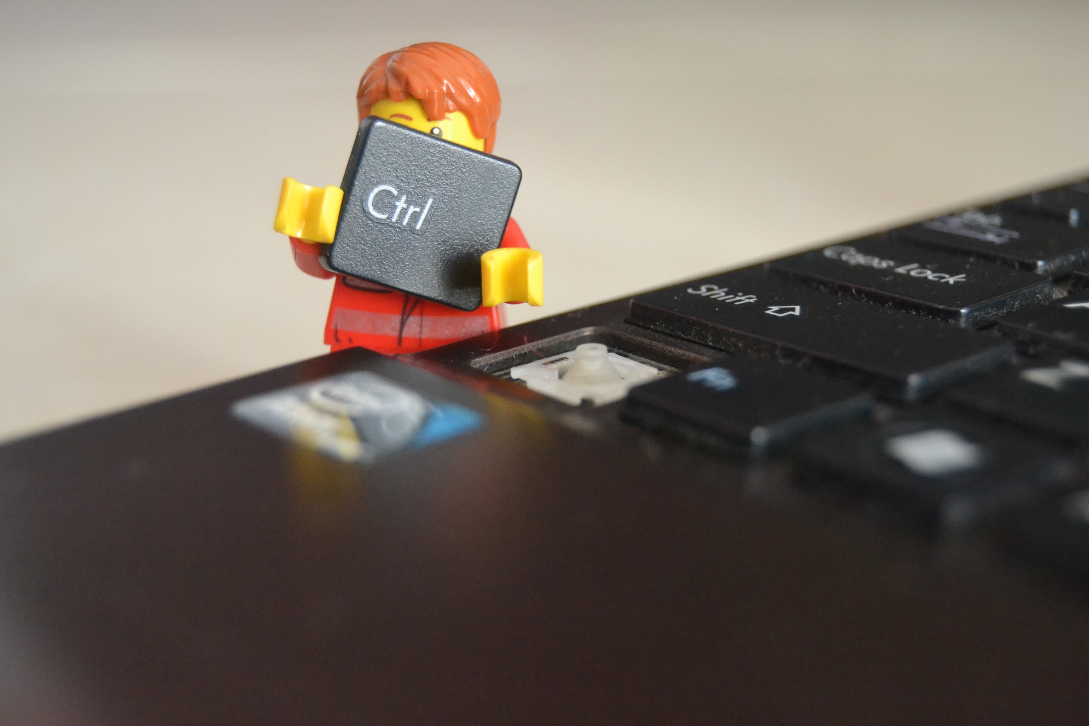
3. Accessibility and Usability
CC0 Image
OER Starter Kit

Slide 27
3. Accessibility and Usability
CC0 Image
CC0 Image
CC0 Image
OER Starter Kit
Notes:
The absence of copy protection and digital rights management (DRM) allows learners…
Download resources onto any device
Highlight and make notes freely
Print without restrictions
Use greyscale options
Edit and modify resources using a variety of applications

Slide 28
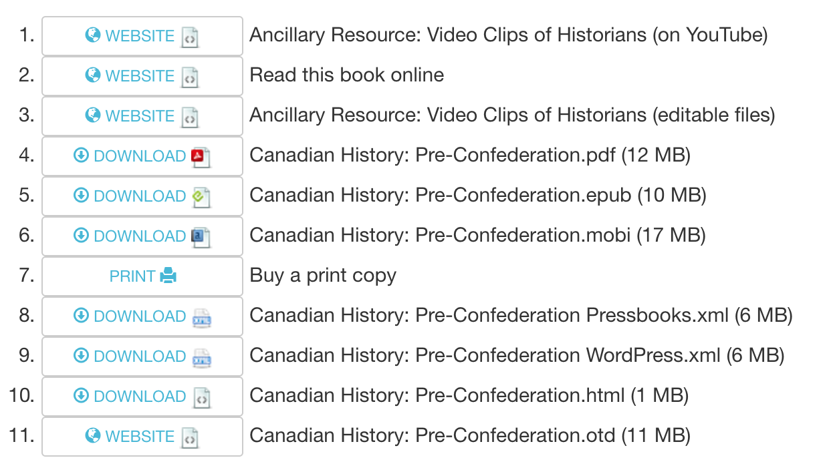
3. Accessibility and Usability
CC BY NC 4.0 screenshot
OER Starter Kit

Slide 29
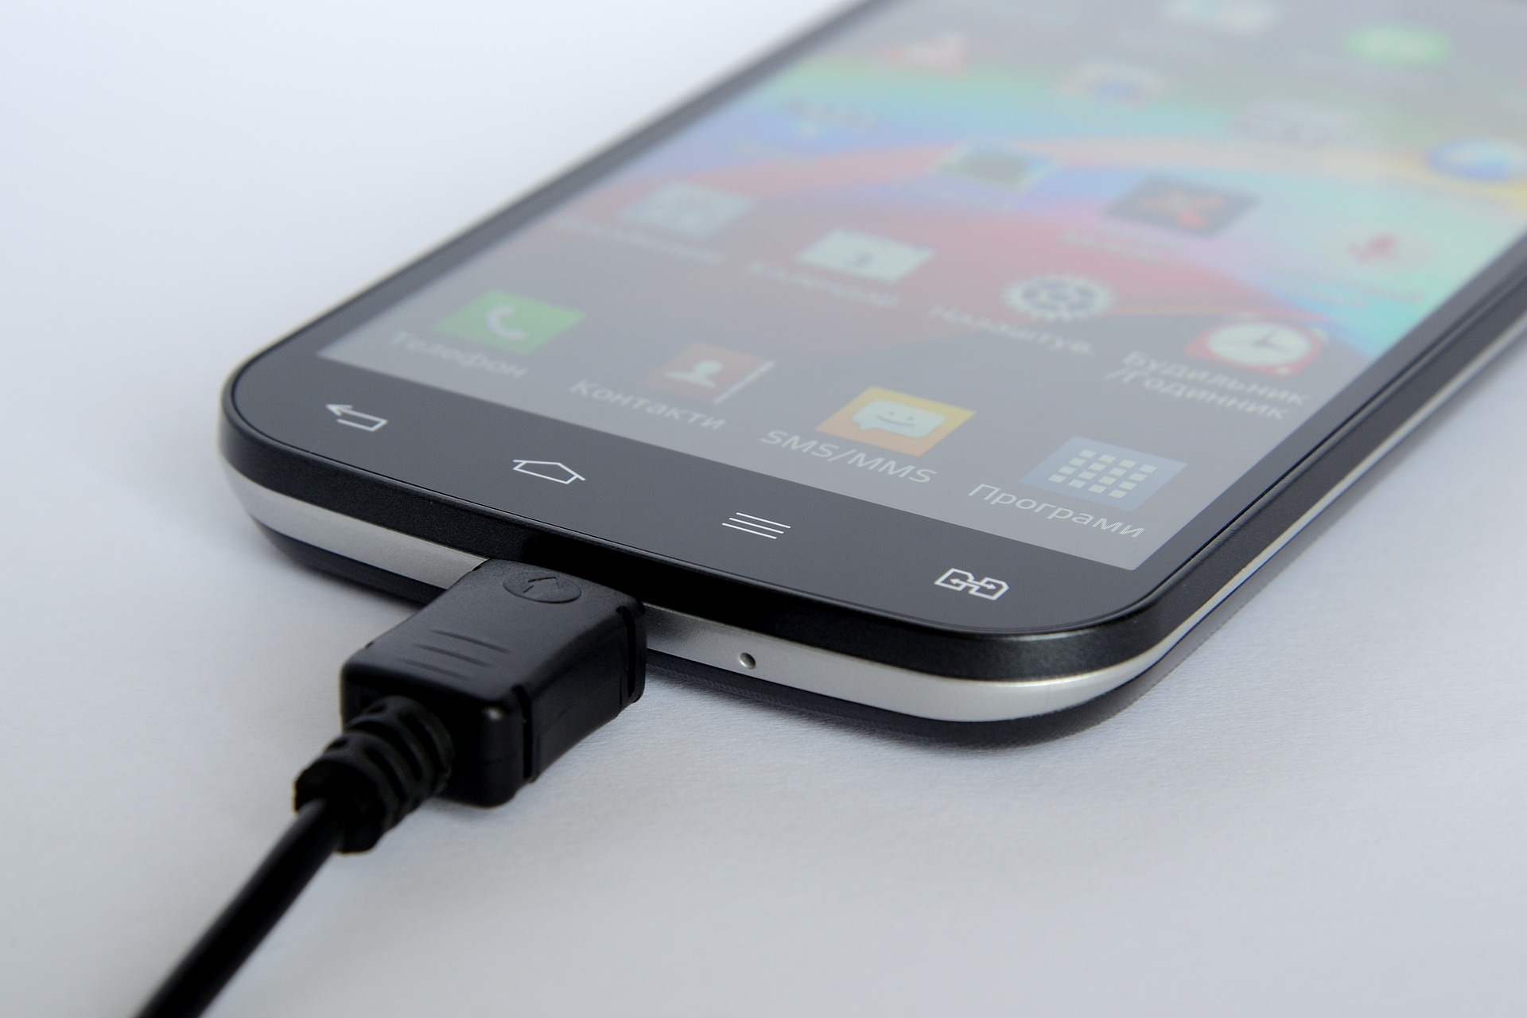
3. Accessibility and Usability
Toolkits are available in
Word (.docx)
Open Doc Format (.odt)
Rich Text Format (.rtf)
PDF (.pdf)
Plain text (.txt)
Web Page (.html)
ePub (.epub)
CC0 Image
OER Starter Kit

Slide 30
albertaoer.com

Slide 31
References
Christiansen, E., McNally M., Lock, J., Welch, J., Sou, L. (2016). The starter kit. Retrieved from http://albertaoer.com/content/resources
Hiatt, Jeffrey M. (2006). Adkar: A model for change in business, government and our community. Loveland, CO: Prosci Research.
McNally, M.B. (2016). Open educational resources (OER): Background and some considerations [PowerPoint slides]. Retrieved from https://era.library.ualberta.ca/files/b5q47rn818#.WCS79S0rL4Y
McNutt, K., Christiansen, E., Welch, J., Sou, L. (2016). The champions toolkit. Retrieved from http://albertaoer.com/content/resources

