Slide 1
OER Inside and Outside the Classroom
Athabasca University - Learning Café - Feb. 28, 2020
Krysta McNutt
Open Education Program Lead
Centre for Teaching and Learning, University of Alberta
Michael B. McNally - Associate Professor
Faculty of Education,
University of Alberta
Except some images as noted
Notes:
MM

Slide 2
Outline
Definitions
Background, history and trends
OER in the classroom
Tensions
Reflections
Notes:
MM

Slide 3
Learning Objectives
By the end of this presentation and discussion, you should be able to:
????
In the spirit of open educational practices and pedagogy, we aren’t going to tell you what you are going to learn - we’ll co-create the learning objectives (and this might fail)
Notes:
MM

Slide 4
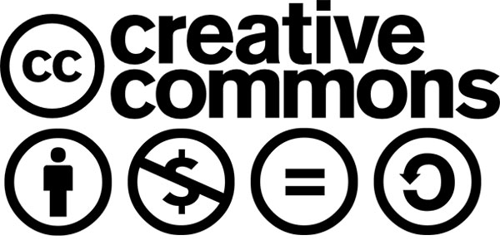
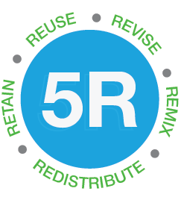
What is OER?
Notes:
KM

Slide 5
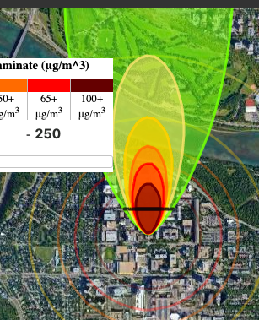
open textbooks | course packs | class assignments interactive resources | media collections
Pressbooks.library. ualberta.ca/mlsci
Zaher Hashisho
cell101.arvr.ca
openphys.med.ualberta.ca
Notes:
KM

Slide 6
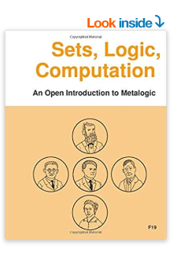
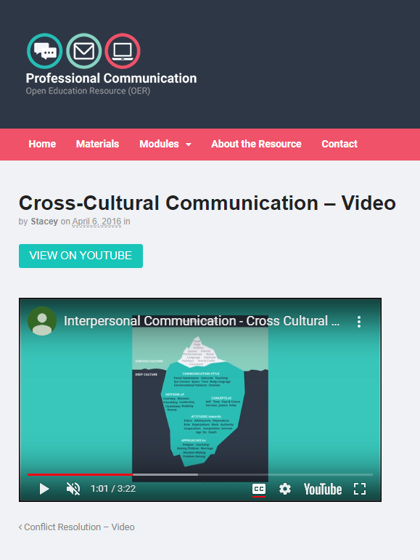
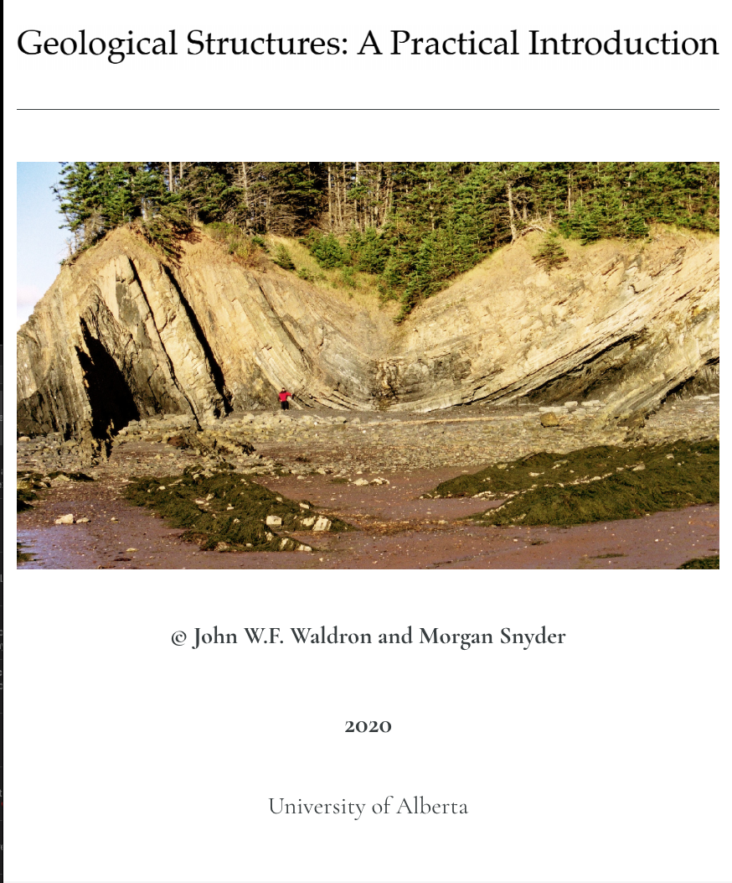
open textbooks | course packs | class assignments interactive resources | media collections
albertaoer.com
Dr. Mike Sosteric
Procomoer.org
Bow Valley, GPRC,
EAS 233
openlogicproject.org
Notes:
KM

Slide 7
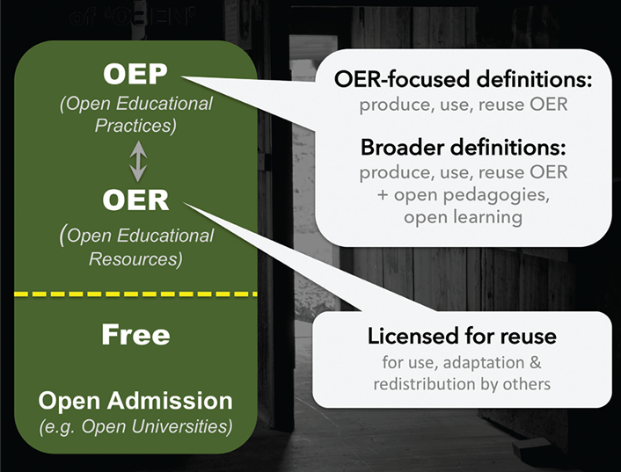
What is OE/OEP
OEP (1) - “Open educational practices”
OEP (2) - “Open education(al) pedagogy”
OE - “Open education”
Can you do OEP without OER?
Figure 2. Interpretations of "Open" (Credit: Image by Catherine Cronin. CC BY-SA)
Notes:
MM

Slide 8
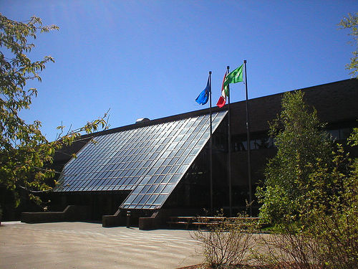
OE The Long History
OER/OEP most recent trend in OE
Historically there have been periods of openness and closedness in post-secondaries, going back centuries
Before the OER/P phase, next most recent wave was “open education” in the 1960s
Open University in the U.K. founded 1969
Athabasca University founded 1970
How is 1960’s OE different from OE/R/P today?
Addison, S. (2007). “Athabasca University.” Wikimedia Commons. CC-BY-SA.
For more on cycles in openness in education see: Sandra Peter and Markus Deimann. 2013. “On the Role of Openness in Education: A HIstorical Reconstruction.” Open Praxis, 5(1): 7-14
Notes:
MM

Slide 9
MIT launches its Open CourseWare Initiative
Cape Town OER Declaration
International Milestones
UNESCO OER Recommendation
2002
2012
2001
2007
UNESCO OER Definition
First Open Education Week / UNESCO Paris OER Definition
BC Open Textbook Project (now BCcampus)
Federal Finance Committee Recommends $8m OER pilot (not adopted)
2015
Canadian Developments
2012
2017
eCampus Ontario Launched
eCampus Alberta (terminated)
ABOER (terminated)
ABOER Summit (UofA)
eCampus Alberta (launched)
Alberta Initiatives
ABOER Summit (Norquest)
2014
2018
2020
2002
2017
2019
ABOER Program (launched)
ABOER Summit (MRU)
ABOER Summit (UofA)
Open Education Interest Group (launches)
Open Education Advocacy Committee (launches)
Open Education Interest Group (ends)
2017
UofA Activity
2015
2018
Office of Open Education ???
Open Education Advocacy Group (launches)
OER Awards Program (begins)
Notes:
MM

Slide 10
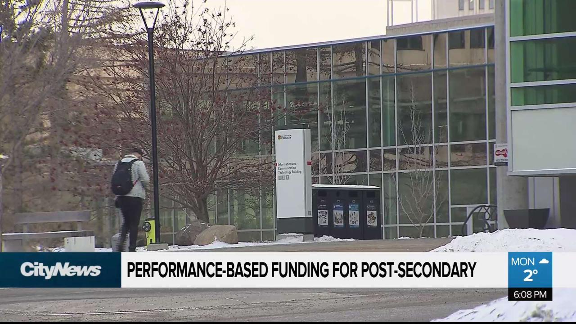
OE/OER/OEP Trends
Image Source: “Post-secondary schools react to performance-based funding model” Retrieved from: https://edmonton.citynews.ca/2020/01/21/post-secondary-schools-react-to-performance-based-funding-model/
Notes:
MM

Slide 11
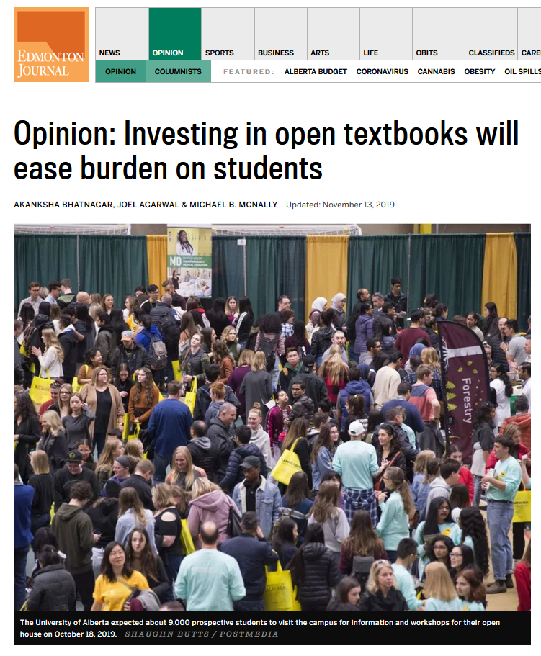
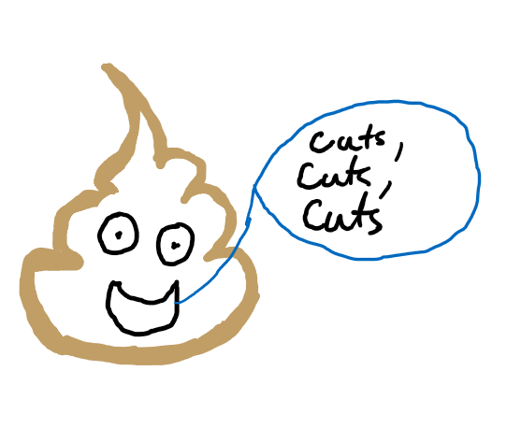
OE/OER/OEP Trends
Edmonton Journal: Nov 13, 2019
Alberta Budget: Feb 27, 2020
FYI: Technically the Poop Emoji is under copyright
Notes:
MM

Slide 12
OE/OER/OEP Trends
Notes:
KM http://bolt.athabascau.ca/index.php/oer/multiply-k-12-alberta-oer-project/oer-podcasts/

Slide 13
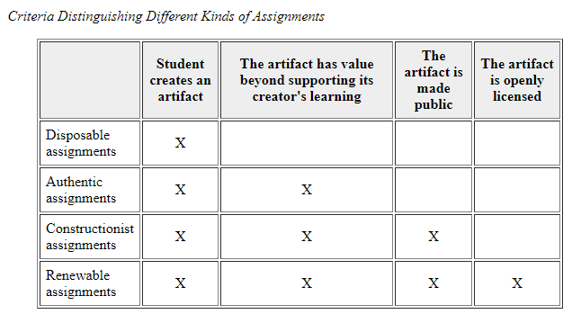
More on “OEP”- Wiley and Hilton (2018)
Notes:
KM ‘Defining OER-Enabled Pedagogy” http://www.irrodl.org/index.php/irrodl/article/view/3601/4724

Slide 14
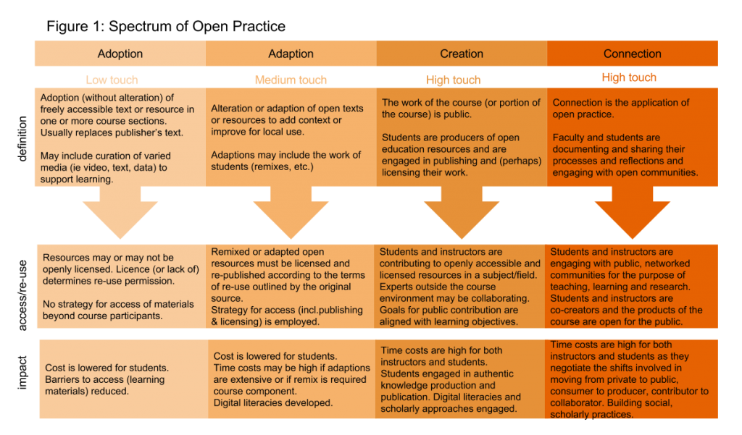
Spectrum of Open Practice, by Cindy Underhill, licensed CC BY-SA 3.0
Notes:
KM http://blogs.ubc.ca/chendricks/2017/05/22/navigating-open-pedagogy-pt1/

Slide 15
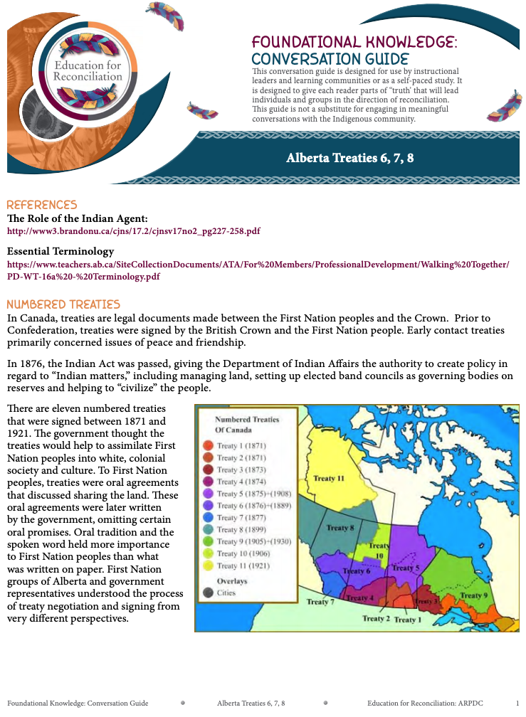
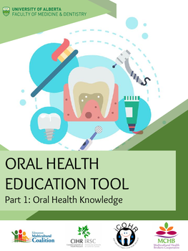
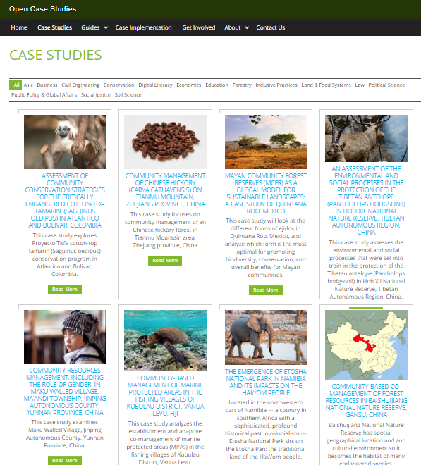
open textbooks
EDEL 335
Oral Health Toolkit
UBC Open Case Studies
Notes:
KM
Adoption - open textbooks adopted to reduce costs to students (or the institution), combined with supplementary reading materials and ppts that may or may not be openly licensed. Purpose is to meet the needs of the students in the classroom, not beyond.
Adaptation - e.g. EDEL 335, students adapt conversation guides which were created by the Alberta Regional Consortia as educational tools for practicing teachers. The students create lesson plans surrounding these conversation guides and may modify the conversation guide to meet their needs. A strategy for open licensing the lesson plans and modified resource is employed to redistribute to practicing teachers and fellow pre-service teachers (students). Because this occurs within the University of Alberta, the open licensing is optional for students and therefore is of very little control by the instructor. Slow progress to redistribute and requires continual support by the Library to preserve created materials in partnership with the instructor.
Creation - students are engaged in

Slide 16
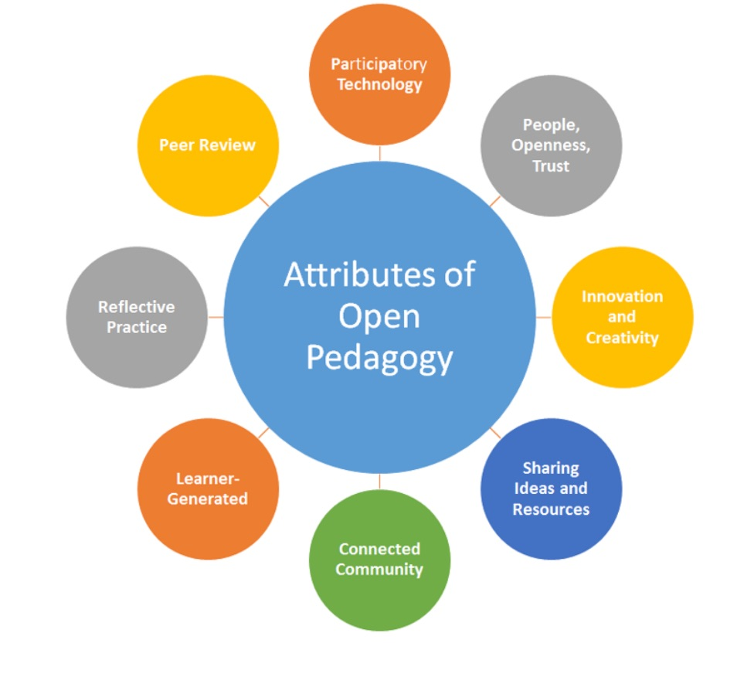
More on “OEP”- Hegarty (2015)
Hegarty. Bronwyn. "Attributes of Open Pedagogy: A Model for Using Open Educational Resources." Educational Technology, July-August 2015, pp. 3-13.
Image: © Bronwyn Hegarty, 2015
Notes:
MM https://upload.wikimedia.org/wikipedia/commons/c/ca/Ed_Tech_Hegarty_2015_article_attributes_of_open_pedagogy.pdf

Slide 17
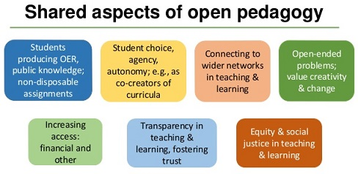
More on “OEP”- Hegarty (2015)
C. "Shared Aspects of Open Pedagogy" (visual from SlideShare)
Hegarty. Bronwyn. "Attributes of Open Pedagogy: A Model for Using Open Educational Resources." Educational Technology, July-August 2015, pp. 3-13.
Notes:
MM https://upload.wikimedia.org/wikipedia/commons/c/ca/Ed_Tech_Hegarty_2015_article_attributes_of_open_pedagogy.pdf

Slide 18
OEP Limitations
Resistance Fear Time Autonomy
X
Prado (n.d.). “Resist.” Noun Project. CC-BY
Anis (n.d.). “Ghost.” Noun Project. CC-BY
Iastspark (N.d.). “Time”. Noun Project. CC-BY
Aisyah, (N.d.). “Pac-Man” Noun Project. CC-BY.
Notes:
MM

Slide 19
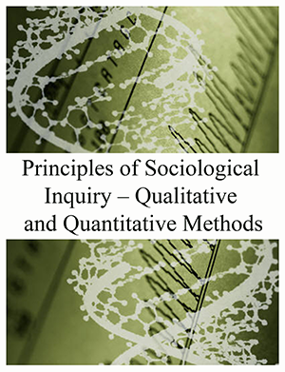
LIS 505 - Trying (and failing) on an Open Textbook
Student Work
+
+
=
Complicating factors:
Large class (50 students)
Not a very straight forward approach
Online class and ‘cooling off period’ following grade submission created ‘distance’ (both in relation to people and the work)
Notes:
MM
Blackstone (2012). Principles of Sociological Inquiry. https://open.umn.edu/opentextbooks/textbooks/principles-of-sociological-inquiry-qualitative-and-quantitative-methods
Bhattacherjee (2012). Social Science Research: Principles, Methods and Practice. https://open.umn.edu/opentextbooks/textbooks/social-science-research-principles-methods-and-practices

Slide 20
Notes:
Mapping the spectrum of practice to your work. What is possible? What would be the opportunities & challenges?

Slide 21
Applying Underhill
Consider the following four elements of a course:
Textbook/readings
Course content (e.g. lectures)
Assignments
Engagement with the learners/pedagogy
Where are OER/P already present?
For each element think through what would be required to use (adopt), adapt, create and connect (Underhill model). What barriers or challenges exist? Does embracing ‘Connection’ for any/all elements make sense?

Slide 22
Tensions
McNally’s recent work focuses on tensions on OER design
Factors influencing openness - McNally and Christiansen (2019) “Open Enough?” First Monday
Role of proprietary software in OER - Joseph, Guy and McNally (2020f) “Toward a Critical Approach for OER” Open Praxis
Trade-offs among precision, reusability and engagement - Joseph, Guy, Wakaruk, Sheppard and McNally (2019) “Know Your Audience(s)” IJOER

Slide 23
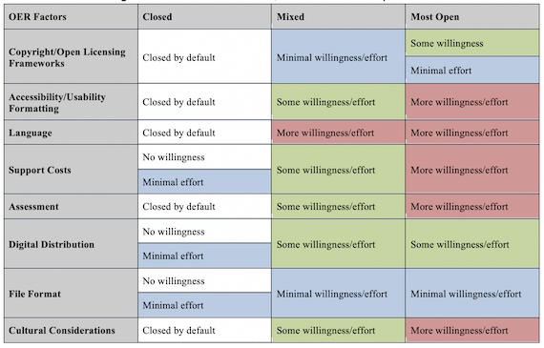
Openness - Not Just a Licence
Licensing just one factor of openness:
E.g.: Is a PDF open?
Effort and willingness vary among factors
Some factors require an active choice to make ‘closed’
McNally and Christiansen (2019)

Slide 24
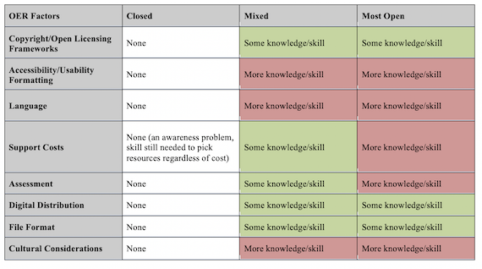
Considering Effort, Willingness, Skill and Knowledge
Licence, file format and distribution/dissemination all relatively simple to increase openness
Language, cultural considerations and accessibility/usability all considerably more challenging to open up
McNally and Christiansen (2019)

Slide 25
OER and OSS
How feasible is it to create OER using only OSS?
Findings (using Opening Up Copyright as case study):
Hard to remove both Microsoft and Apple for hardware and operating systems
Avoiding Google and Amazon (specifically AWS) very challenging
Full removal of all ‘Big 5’ borders impossible

Slide 26
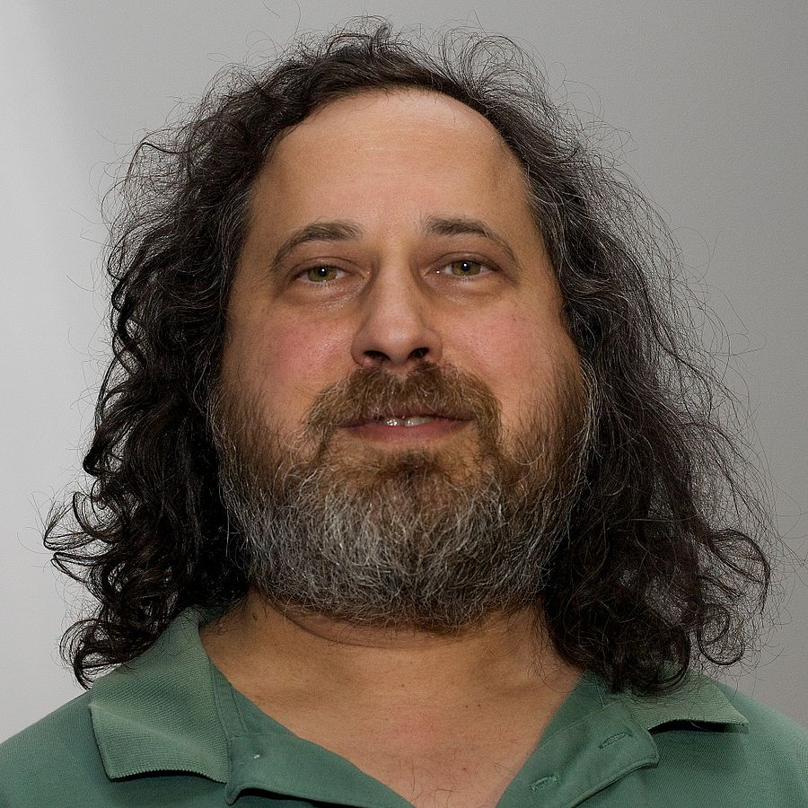
OER and OSS
For Richard Stallman (early champion of Free Software) proprietary software wasn’t only less pragmatic than free/open source software, it was immoral
So,
Does only using Open Source Software (OSS) in OER make the resulting OER more ‘pure’?
NicoBZH (2008). “Richard Stallman.” Wikimedia Commons. CC-BY-SA

Slide 27
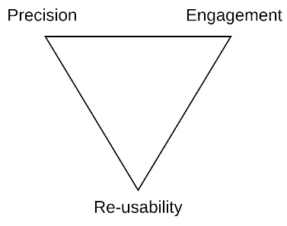
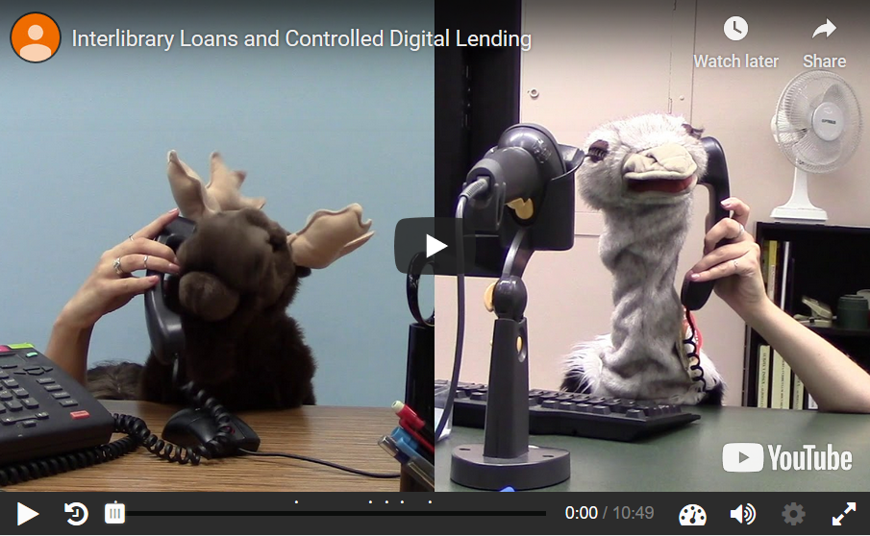
Tension in Design
“Iron Triangle” of OER developed from project management
Joseph et al. (2019)
Findings:
No optimal solution - balance all three over maximize any one
Address each facet in each layer of a resource
In OUC’s case: script, video, add-on content (H5P)
OUC Module: Interlibrary Loan and Controlled Digital Lending
Notes:
Is this an Iron Triangle of OER - do all OER projects face this

Slide 28
Reflections
Notes:
Co create with learners? Did we meet our objectives, are there learning objectives we “accidentally” achieved today? Do you have new learning objectives.

Slide 29
Reminders!
May 20, 2020 - next Alberta OER Summit at UofA
Info & Registration - CTL,University of Alberta
--
Recently launched provincial open textbook publishing platform hosted by University of Alberta for all Alberta post secondary institutions (wow!)
pressbooks.library.ualberta.ca/
Notes:
Co create with learners? Did we meet our objectives, are there learning objectives we “accidentally” achieved today? Do you have new learning objectives.

