Slide 1
Participatory Research Methods
LIS 505 – Introduction to Research in Library and Information Services
Michael B. McNally
Arp. 5, 2017

Slide 2
Outline
Participatory Approaches
Participation and Challenges
Community Informatics and Participatory Research at SLIS and MACT

Slide 3
A-I. What is Participatory Research
Fundamentally, participatory research is about the reallocation of power from researcher(s) to participants (Carroll and Rosson, 2007; Hayward et al. 2004; Cornwall and Jewkes, 1995)
Particularly useful for studying marginalized groups and those who lack social inclusion (Denison and Stillman, 2012; Balcazar et al., 2004)
Strong normative/moral element (Balcazar et al., 2004; Carroll and Rosson, 2007)
Academic origins can be traced to Scandinavian work on information system design (Carroll and Rosson, 2007)

Slide 4
A-I(ii). What is Participatory Research
Participatory approaches aim to both develop new knowledge and benefit the community of participants (Denison and Stillman, 2012)
Benefits may differ by participant type (Denison and Stillman, 2012)
Benefits may be an improvement in processes/efficiency or a contestation of social oppression (Balcazar et al., 2004)
Participants are treated as research partners rather than passive subjects (Denison and Stillman, 2012)
Research designs should be flexible, iterative and reflexive (Cornwall and Jewkes, 1995)

Slide 5
A-II. Participatory Research Approaches
Participatory approaches tend to be derived and use qualitative methods (Denison and Stillman, 2012; Bergold and Thomas, 2013)
Interviews and focus groups are the most common methods (Bergold and Thomas, 2013)
Uptake is expanding across disciplines (Hayward et al., 2003)
Tend not to use research literature (and its gaps) as the source of identification of problems (Whyte et al., 1989)
Participatory Action Research (PAR) tends to be the dominant participatory approach, though others exist (e.g. Participatory Rural Appraisal)
Not all participatory research is action focused (Bergold and Thomas, 2013)

Slide 6
B-I. Participation
Participation can be included at all stages of design (Carroll and Rosson, 2007; Whyte et al. 1989)
Trust is a key element of participatory research that must be cultivated (Denison and Stillman, 2012)
Participation can range from low (e.g. advisory groups) to high (e.g. control over the professional research team), though many projects have a middle ground where professional researchers retain some key decision making power (Balcazar et al., 2004)

Slide 7
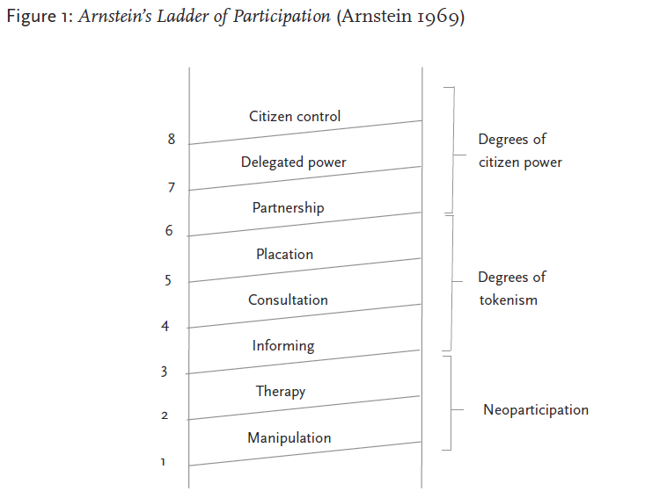
B-I(ii). Participation
Arnstein’s Ladder of Participation (Arnstein, 1969) from Hayward et al., 2004, p. 99

Slide 8
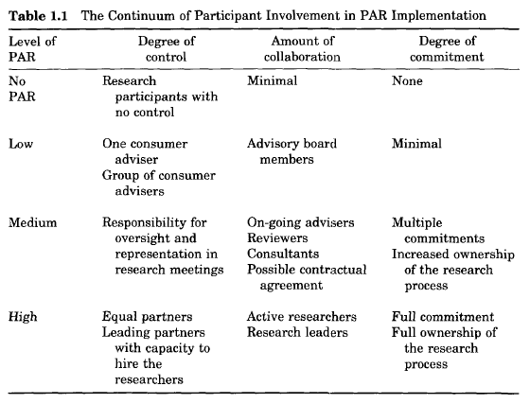
B-I(iii). Participation
Balcazar et al., 2004, p. 19

Slide 9
B-I(iv). Participation
Inclusion of leaders of particular communities/stakeholder groups may undermine consensus decision making (Denison and Stillman, 2012; Cornwall and Jewkes, 1995)
Danger that community representation may not be diverse enough, or that communities may be treated as overly homogenous (Denison and Stillman, 2012; Hayward et al. 2004; Cornwall and Jewkes, 1995)
Researchers must be reflexive at the outset about what constitutes a community (Denison and Stillman, 2012)
Failure to do so may propagate existing socio-political relationships and power relations (Hayward et al. 2004)

Slide 10
B-II. Challenges with Participatory Approaches
Participatory approaches may be harder to get funding
Funding agencies want specific methods and research questions defined in proposals (Denison and Stillman, 2012; Bergold and Thomas, 2013)
Participatory methods may exploit the free labour of participants (Denison and Stillman, 2012; Corwnall and Jewkes, 1995)
Remuneration is one solution, but may inhibit funding (Bergold and Thomas, 2013)
Participants may suffer from consultation fatigue (Denison and Stillman, 2012; Hayward et al., 2004; Cornwall and Jewkes, 1995)
Issues of data ownership and confidentiality may be obscured (Denison and Stillman, 2012)

Slide 11
B-II(ii). Challenges with Participatory Approaches
Participatory approaches are often more time consuming and demanding of researchers (Bergold and Thomas, 2012)
Highly contextual nature of participatory research may impede re-use and reinterpretation of data and results by others (Denison and Stillman, 2012)
Participatory approaches mythologize the benefits of emancipation and empowerment (Hayward et al., 2003)
Extollation of ‘democratic’ nature of participatory research may be a form of western imperialism (Cornwall and Jewkes, 1995)
Continued concerns in academic community over reliability, credibility and rigour (Corwnall and Jewkes, 1995)
Danger that ‘participation’ is used to simply recruit participants (Bergold and Thomas, 2013; Bergold and Thomas, 2013)

Slide 12
C-I. Community Informatics
Community Informatics (CI) projects aim to have communities develop their own information and communications technologies (ICTs) systems and infrastructures
The primary (though note sole) mode of LIS participatory research
Community informatics stresses the inclusion of the community because they tend to lack sufficient resources to develop solutions on their own (Carroll and Rosson, 2007)
Tends to avoid ‘us vs. them’ dichotomization (Carroll and Rosson, 2007)

Slide 13
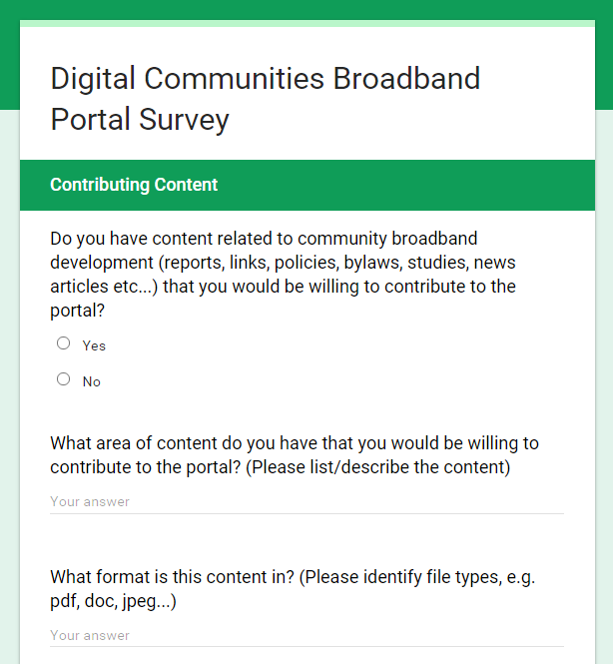
C-II. Community Informatics at the University of Alberta
Digital Library North Project (https://www.ualberta.ca/~dln/)
First Mile Connectivity Consortium (see Rob McMahon’s SLIS Research Colloquium): https://drive.google.com/file/d/0B2Rz4U8adiH3MHNOdDVuSEl1S2c/view?usp=sharing)
Mobile Applications for Research Support (MARS) Lab project (http://www.marslab.ca/)
Digital Communities Broadband Portal (https://sites.ualberta.ca/~digicom/)
Understanding Community Broadband: The Alberta Broadband Toolkit (https://era.library.ualberta.ca/files/c247dw24x#.WOQTcm8rJaQ)

Slide 14
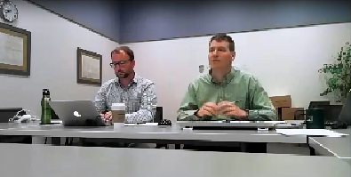
C-III. Understanding Community Broadband and Participatory Design
Broadband toolkit funded by Government of Alberta
Summer 2016 – 8 regional focus groups: hybrid in-person / remote (WebEx)
Blended public outreach and research
Challenges:
Technology
Heterogeneity of participants
Blurred roles
Some oversized focus groups

Slide 15
Sources:
Balcazar, Fabricio, Renee R. Taylor, Gary W. Kielhofner, Karen Tamley, Tom Benziger, Nancy Carlin, and Sabrina Johnson. 2004. “Participatory Action Research: General Principles and a Study with a Chronic Health Condition.” In Participatory Community Research. Washington: American Psychological Association. p. 17-35.
Bergold, Jarg, and Stefan Thomas. 2012. “Participatory Research Methods: A Methodological Approach in Motion.” FQS, 13(1): http://www.qualitative-research.net/index.php/fqs/article/view/1801/3334
Carroll, John M. and Mary Beth Rosson. 2007. “Participatory design in community informatics.” Design Studies, 28: 243-261.
Cornwall, Andrea, and Rachel Jewkes. (1995). “What is Participatory Research?” Social Science and Medicine, 41(12): 1667-1676.
Denison, Tom and Larry Stillman. 2012. “Academic and ethical challenges in participatory models of community research.” Information, Communication and Society, 15(7): 1037-1054.
Hayward, Chris, Lyn Simpson, and Leanne Wood. 2004. “Still left out in the cold: Prolematising Participatory Research and Development.” Sociologia Ruralis, 44(1): 95-108.
Whyte, William Foote, Davydd J. Greenwood, and Peter Lazes. 1989. “Participatory Action Research.” American Behavioural Scientist, 32(5): 513-551.

