Slide 1
Colour Our Collections
Using adult colouring as outreach in a health science library rare books collection
Laura Hamonic & Liz DennetT

Slide 2
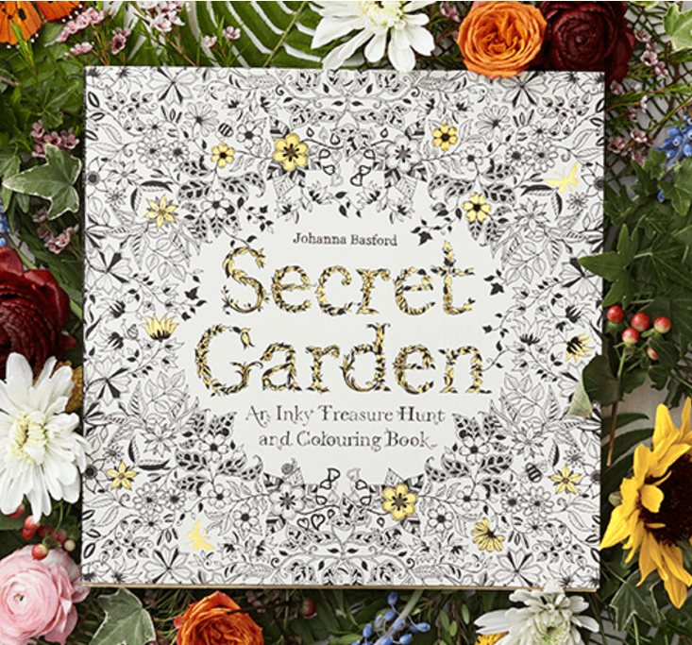
Adult colouring Trend
Increased sales of colouring books & colouring supplies (Begley, 2016; Euromonitor International, 2016)
Global Trend (Euromonitor International, 2016)
(Basford, 2016)

Slide 3
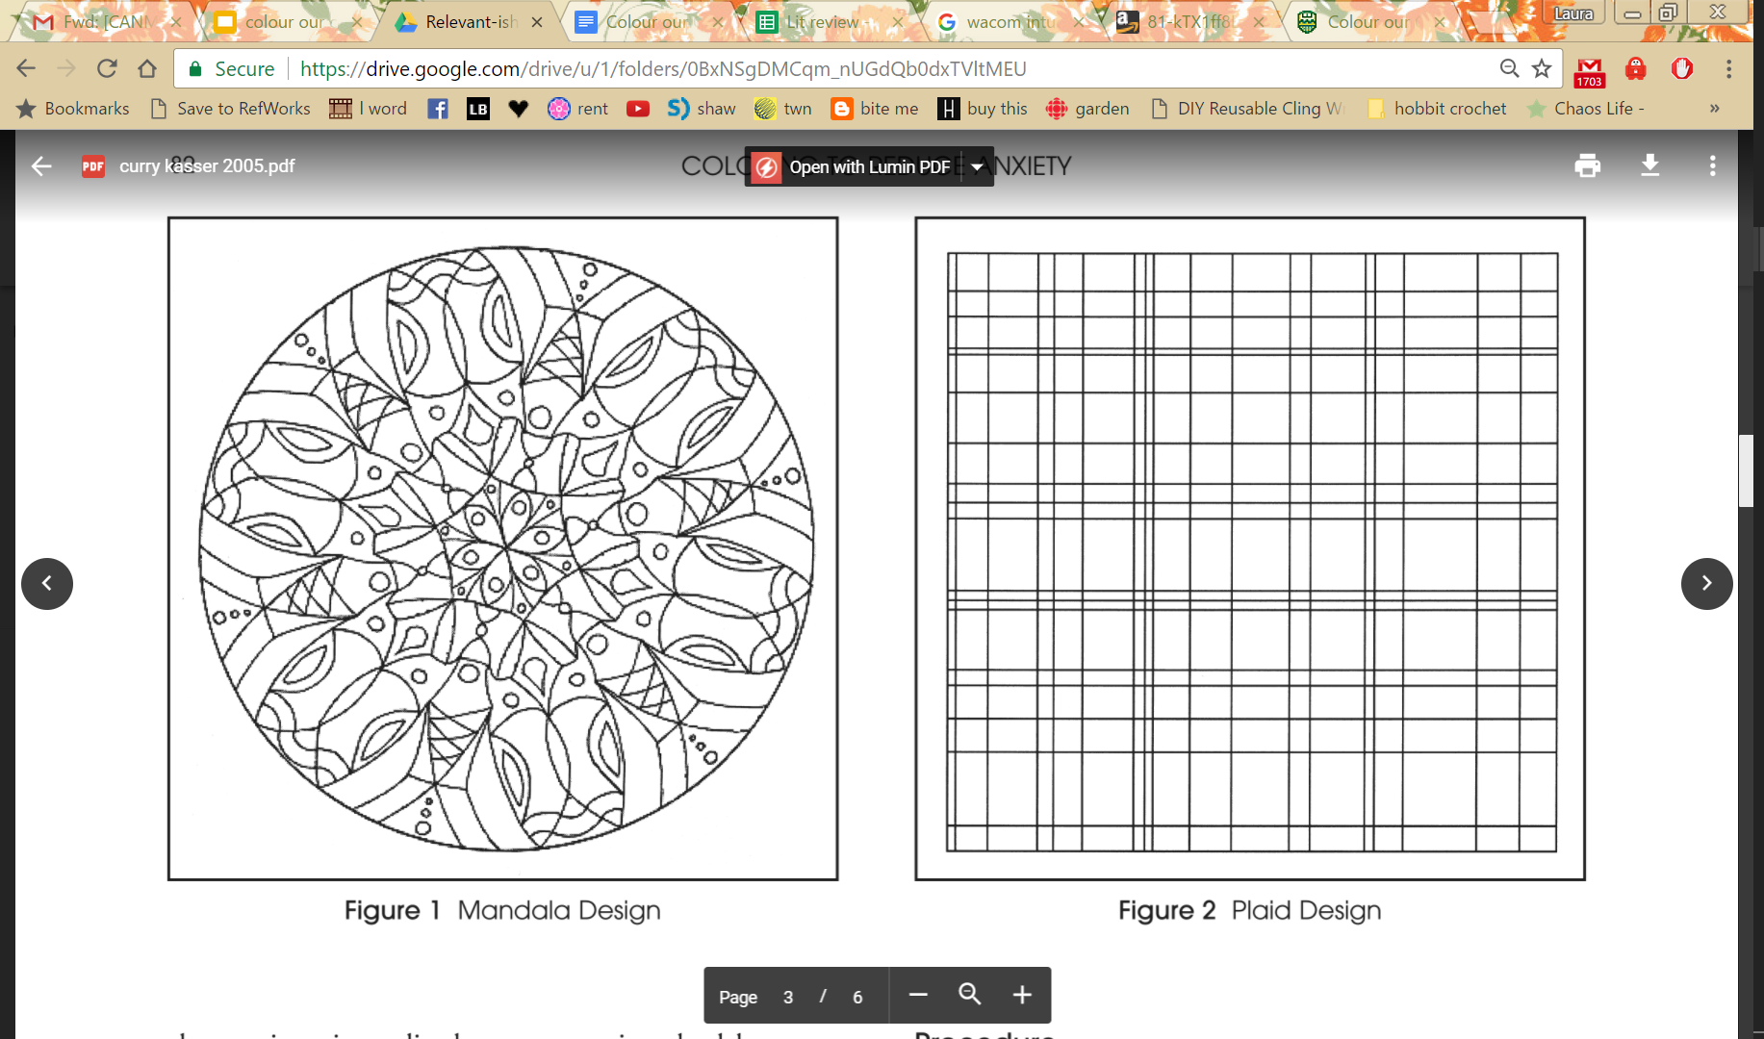
Benefits of Colouring
Reduce anxiety, improve mindfulness & mood (Barret, 2015; Curry & Kasser, 2005; Eaton & Tieber, 2017)
Complexity, structure, and direction are needed (Curry & Kasser, 2005; Eaton & Tieber, 2017)
Relaxing for cancer patients (Rigby & Taubert, 2016)
(Curry & Kasser, 2005)

Slide 4
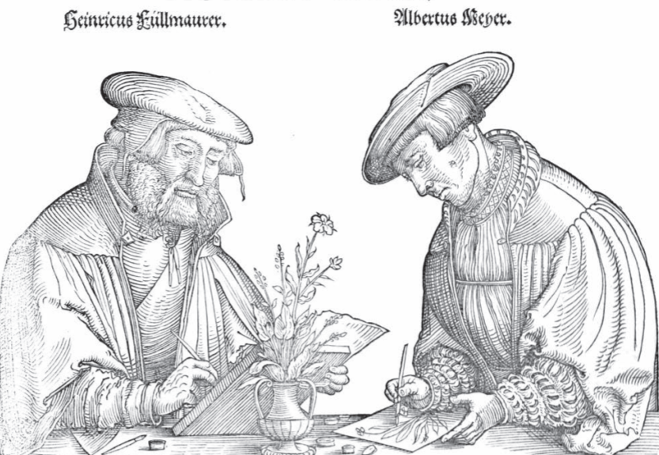
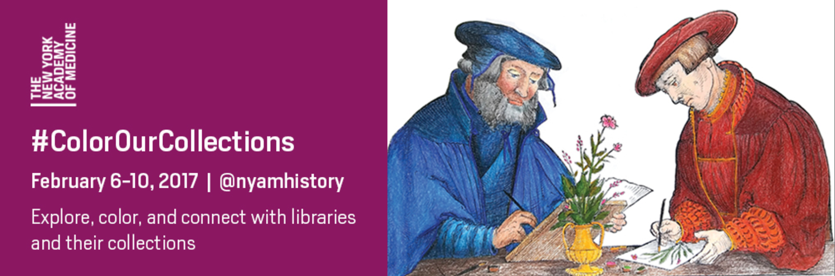
#ColorOurCollection Movement
New York Academy of Medicine week-long colouring social media event (Garner, Goldberg & Pou, 2016)
211 participating organizations
(New York Academy of Medicine, 2017)

Slide 5
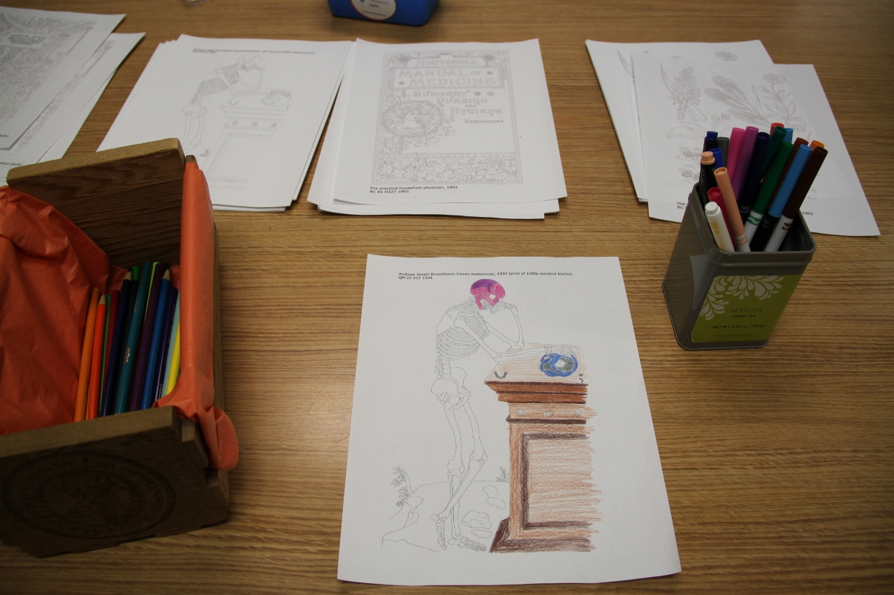
Goals of the project
Student Engagement (Snavely, 2012)
  Just For Fun
  Whole Person
  Collection Based
Outreach for special collection

Slide 6
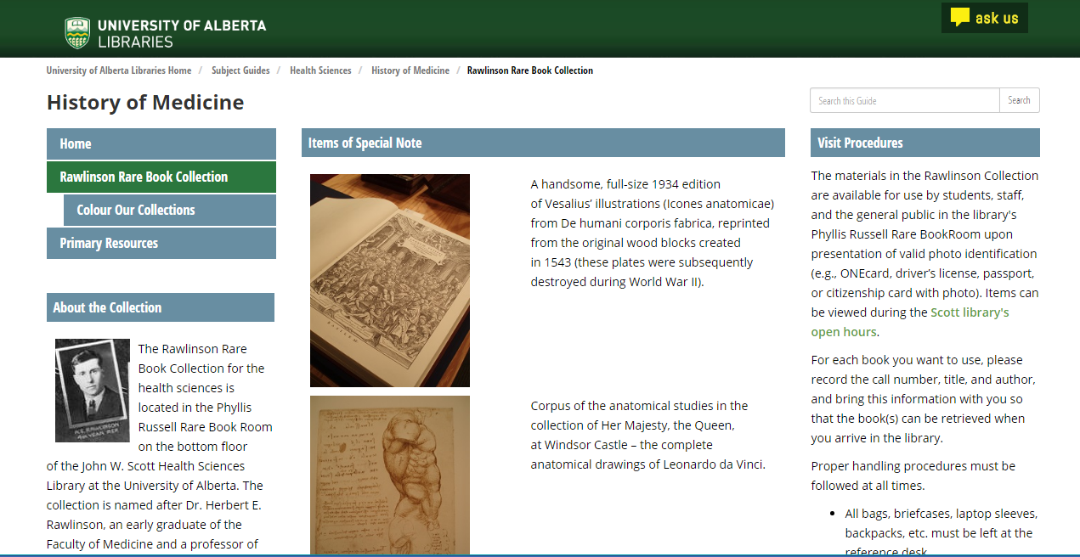
Rawlinson Rare Book Collection

Slide 7
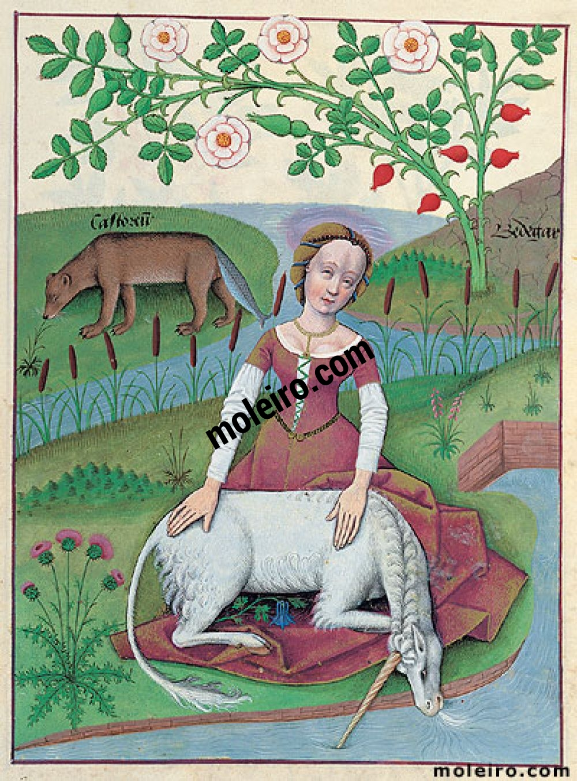
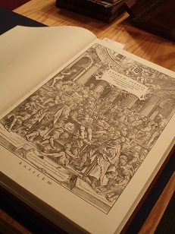
Creating the Colouring Pages
Selecting Images
  Size?
  Copyright?
Tracing images
  Digitally?
  Software?
(Moleiro, 2017)

Slide 8
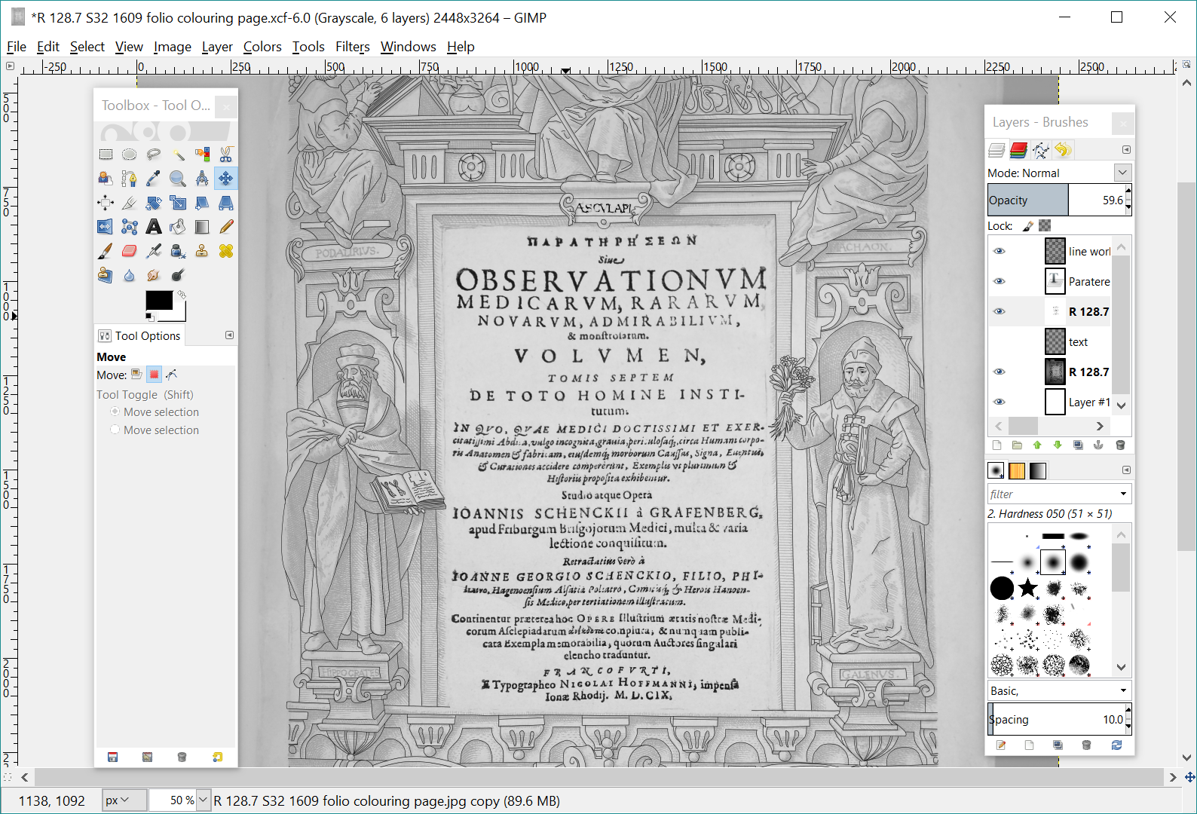

Slide 9
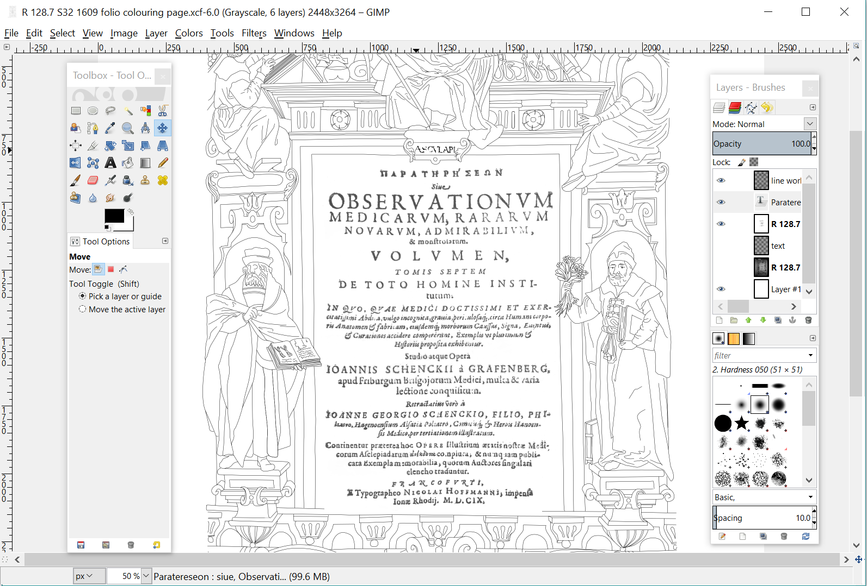

Slide 10
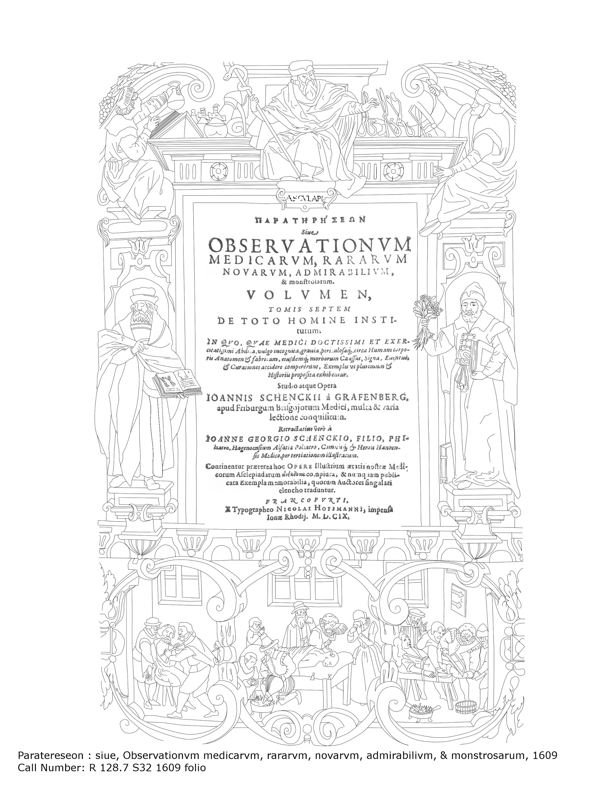
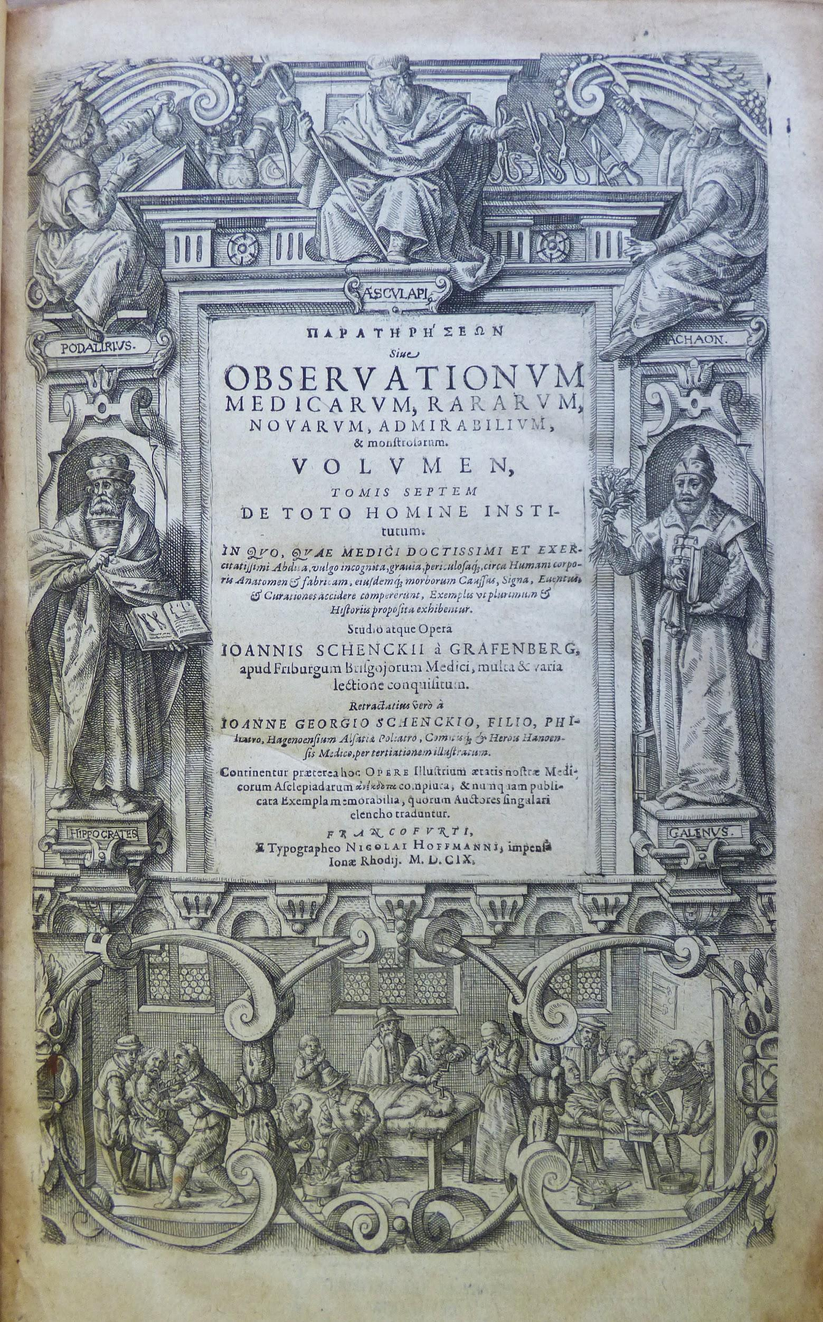

Slide 11
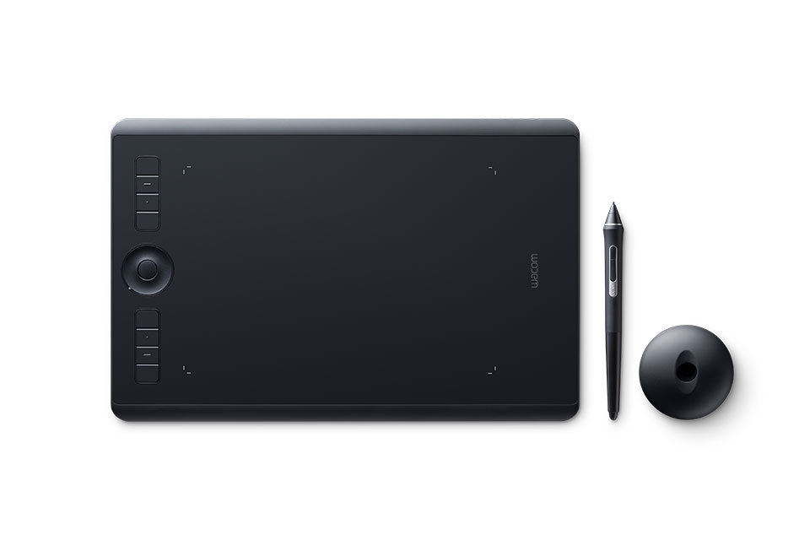
(Wacom, 2017)

Slide 12
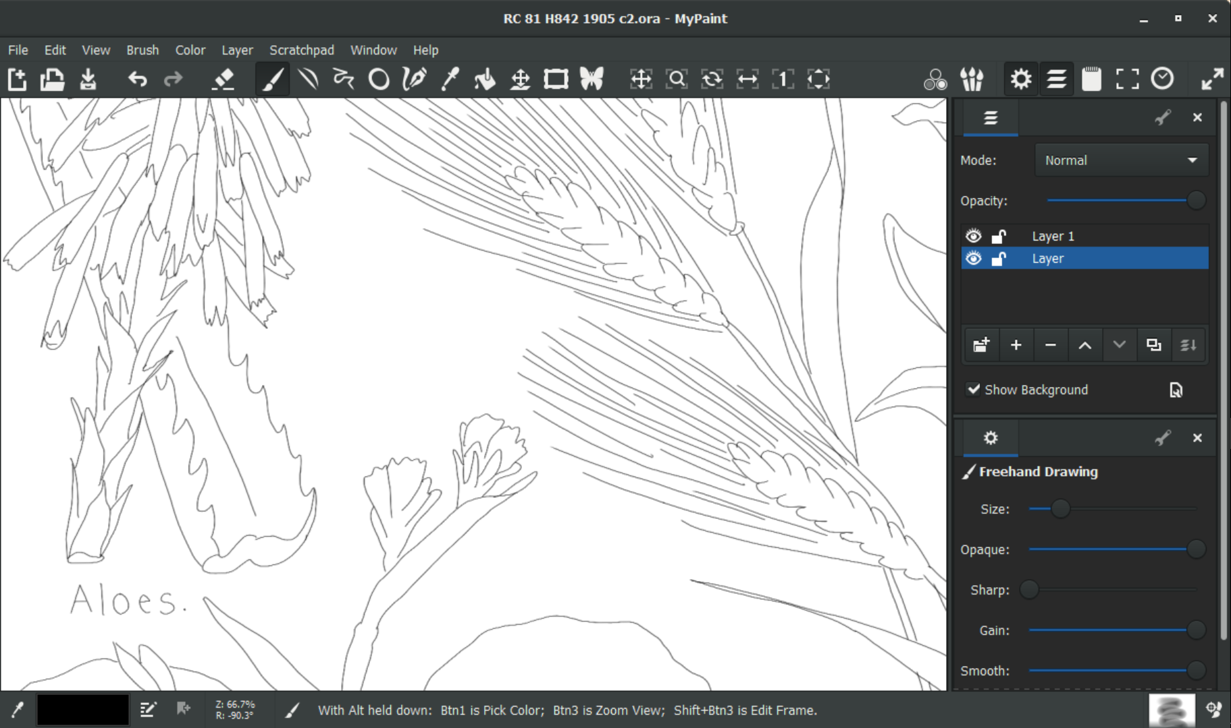

Slide 13
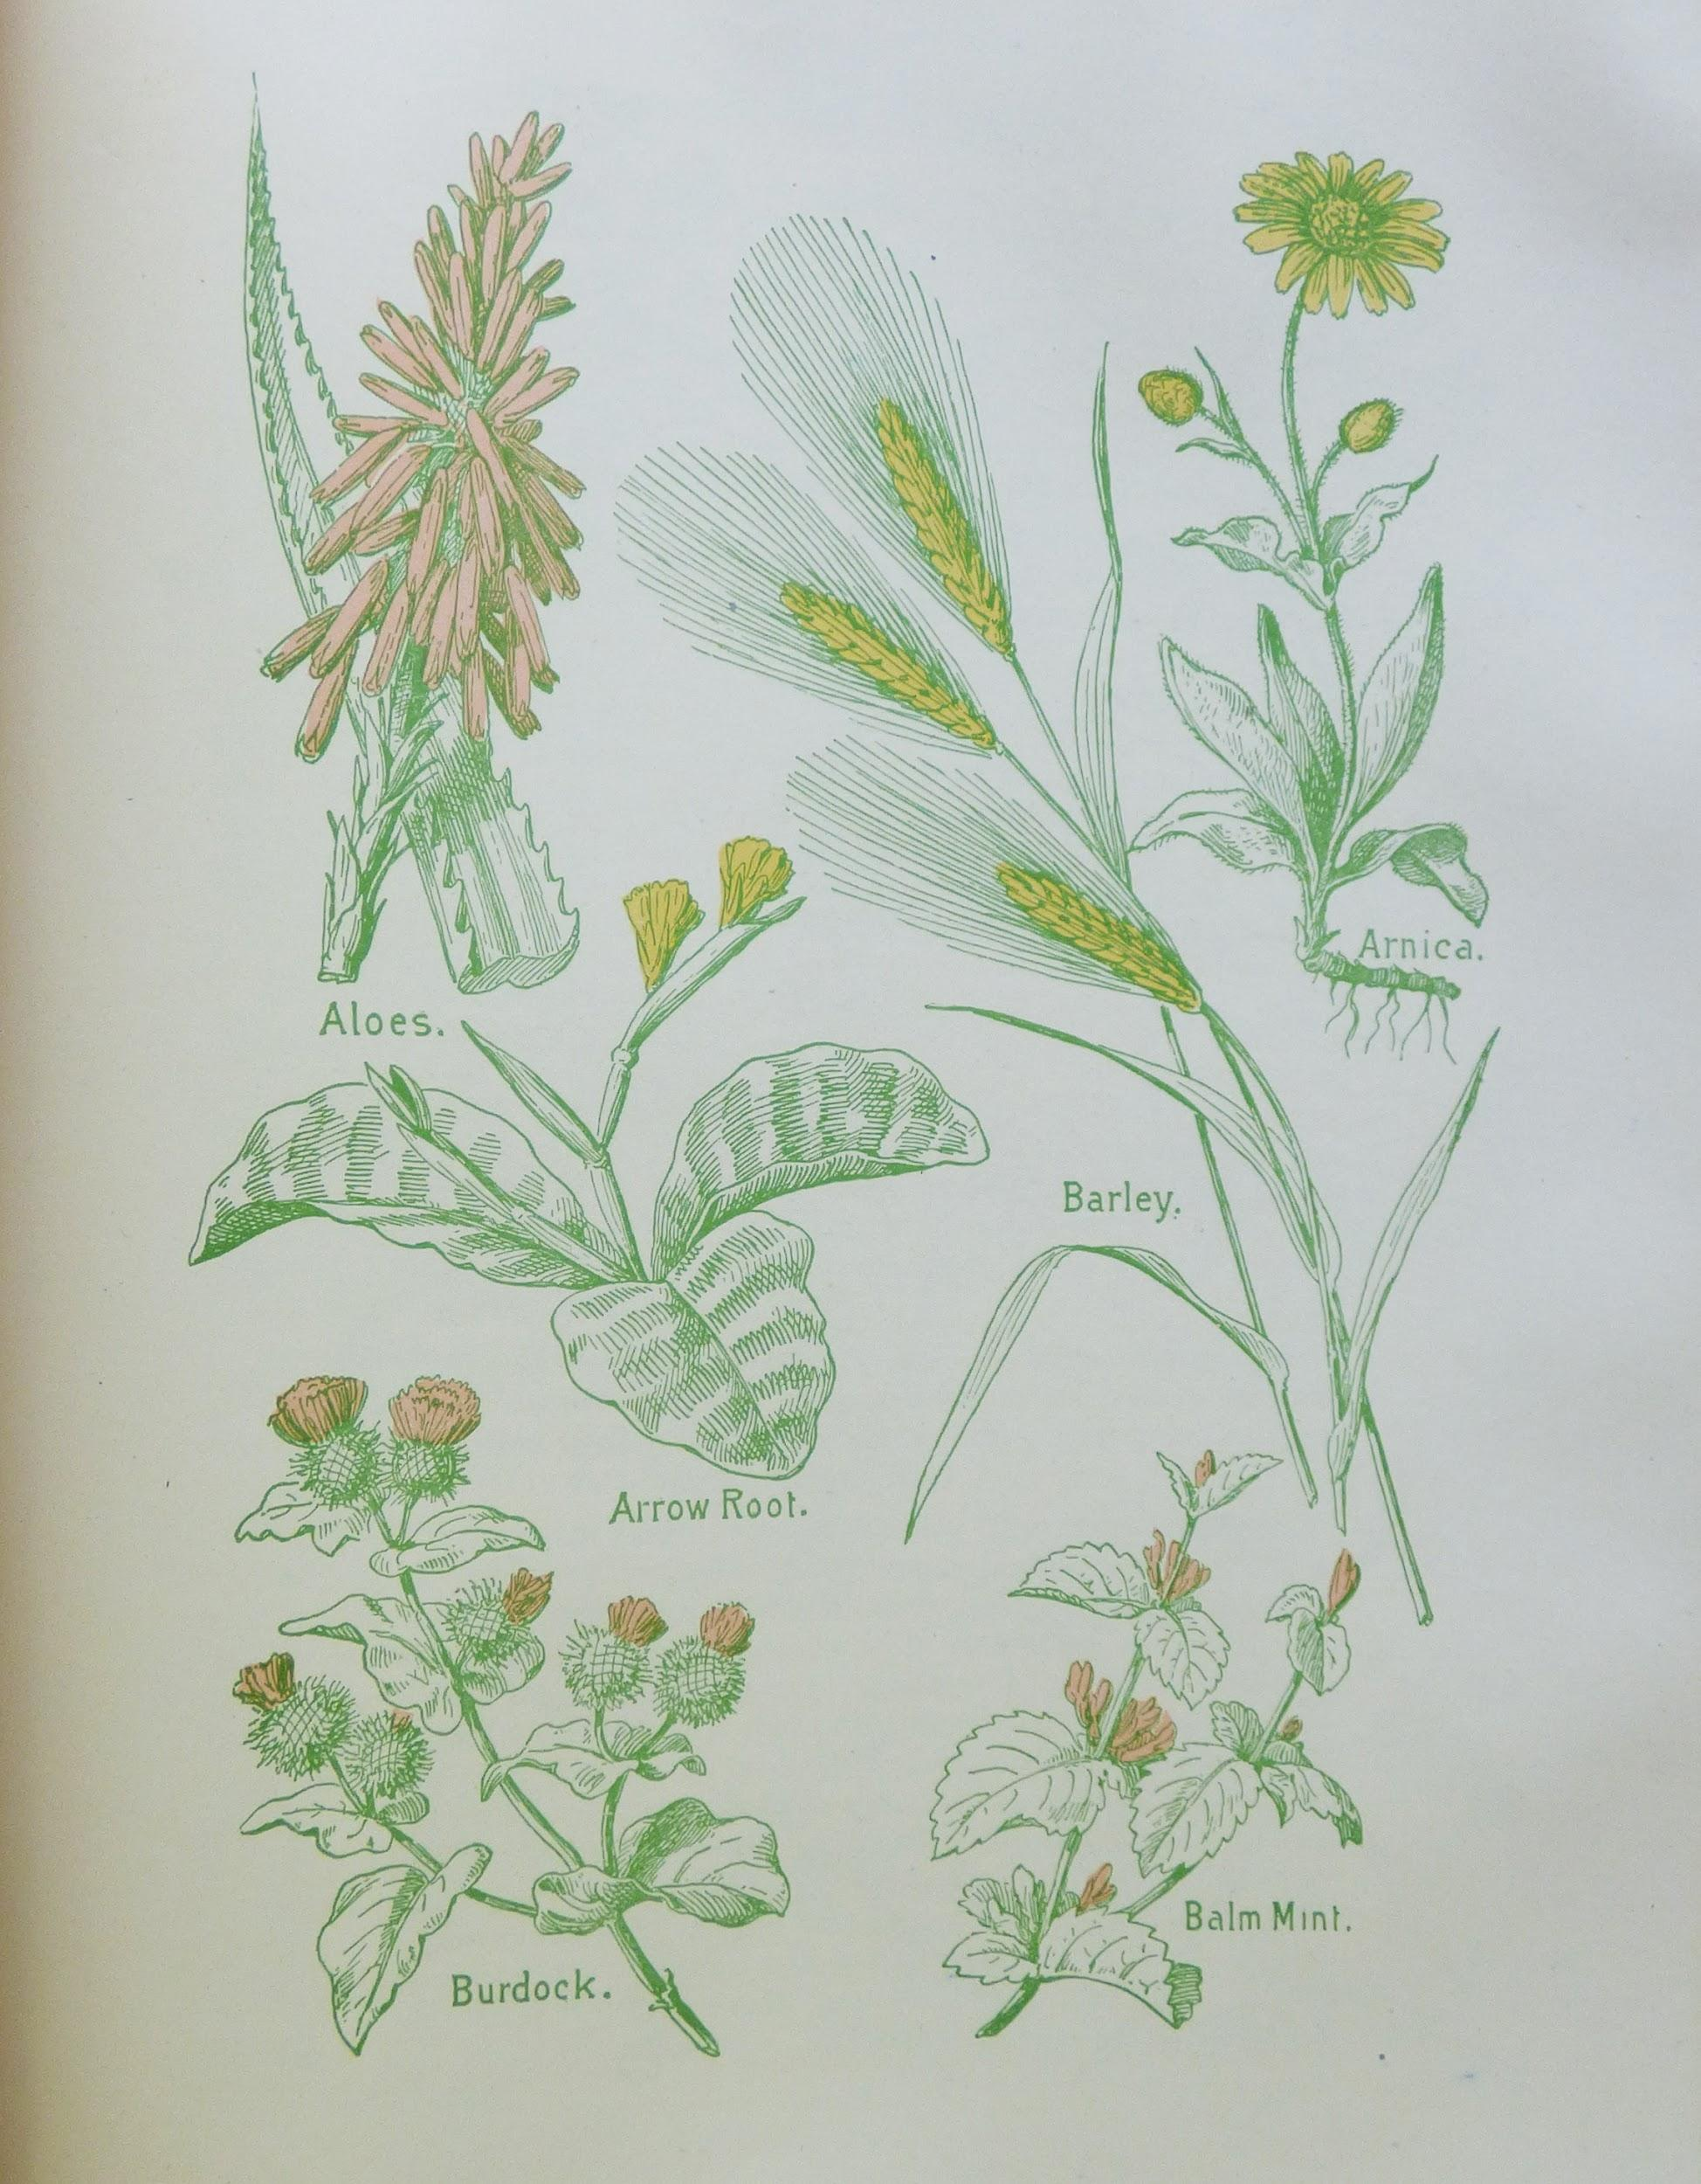
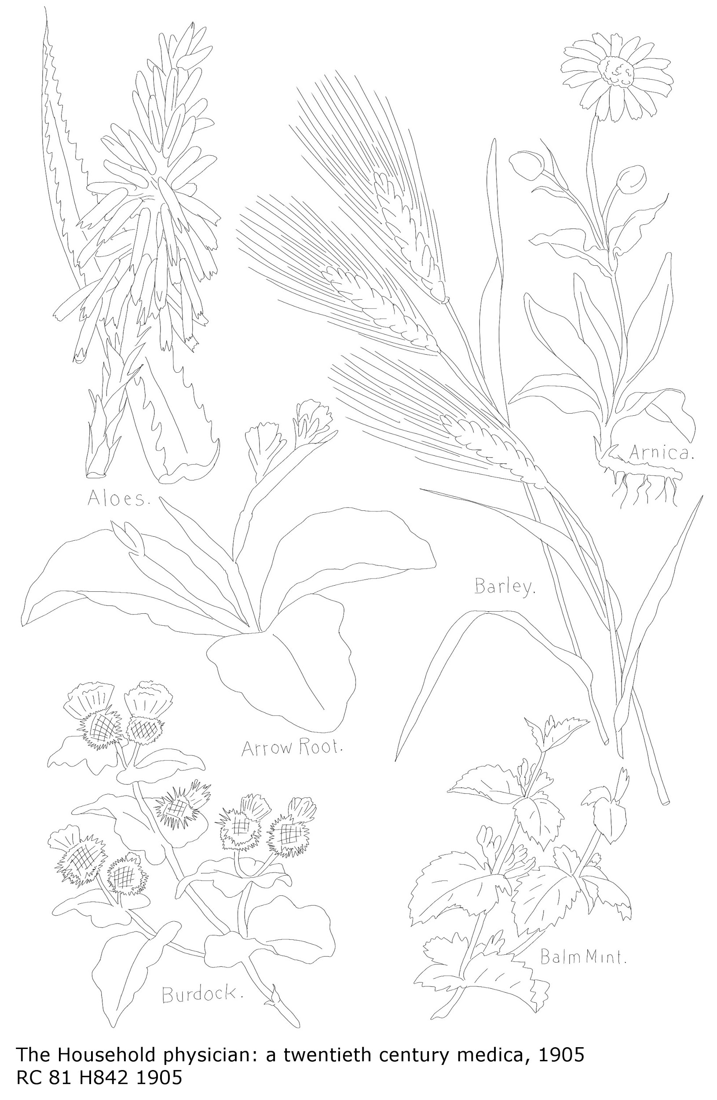

Slide 14
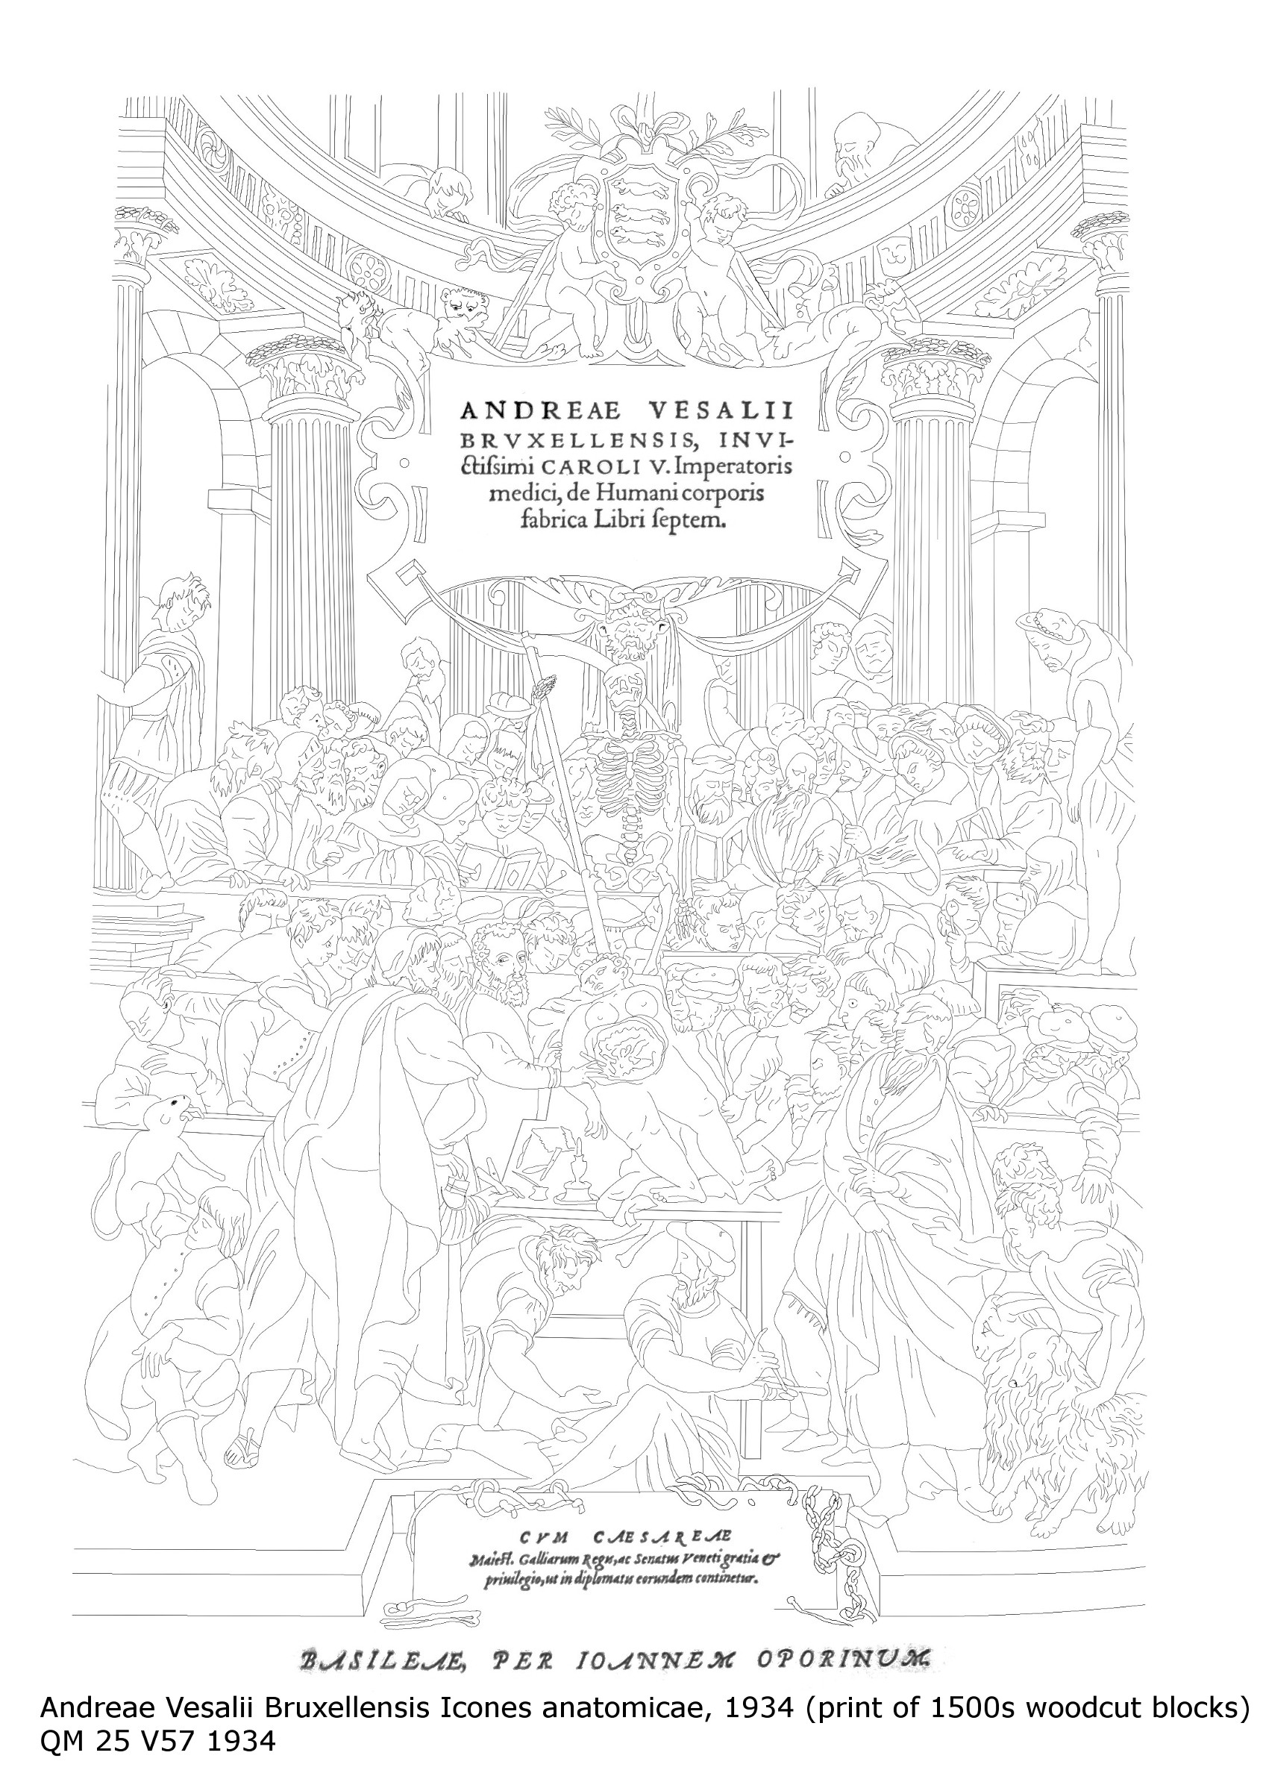
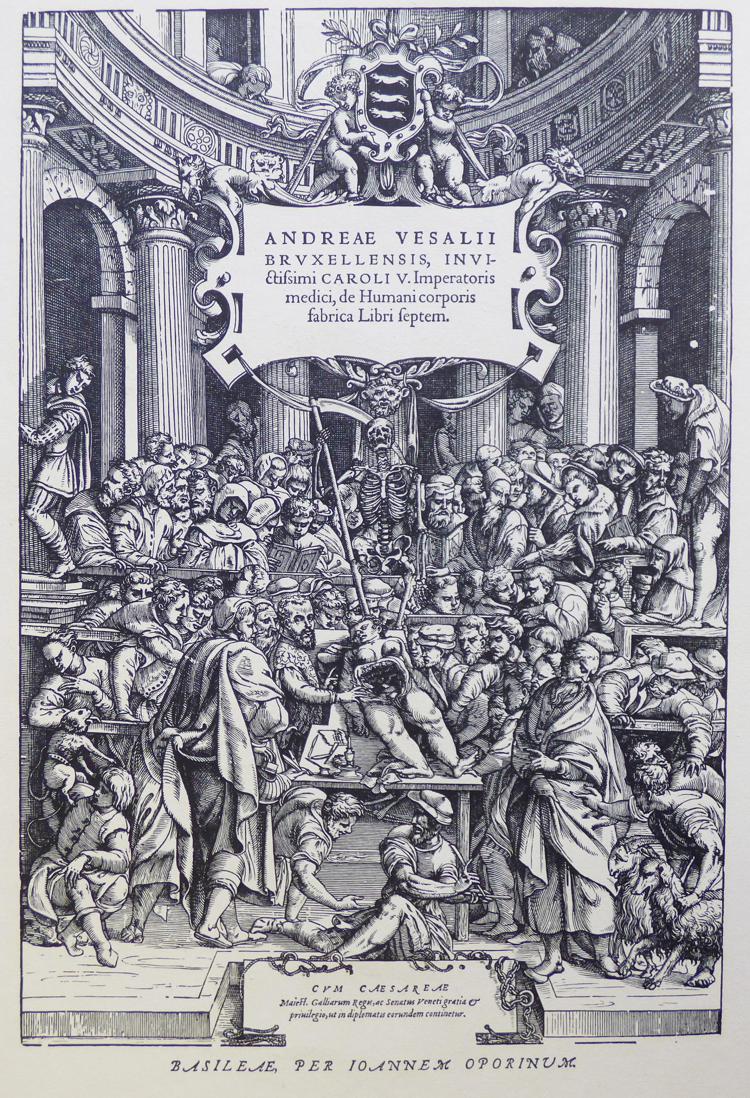

Slide 15
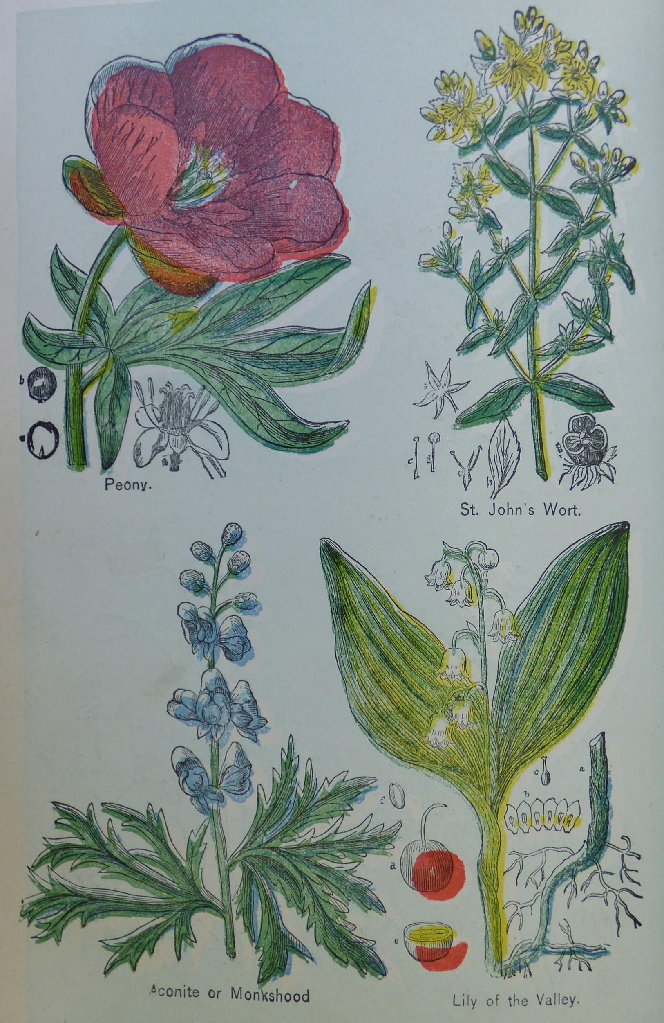
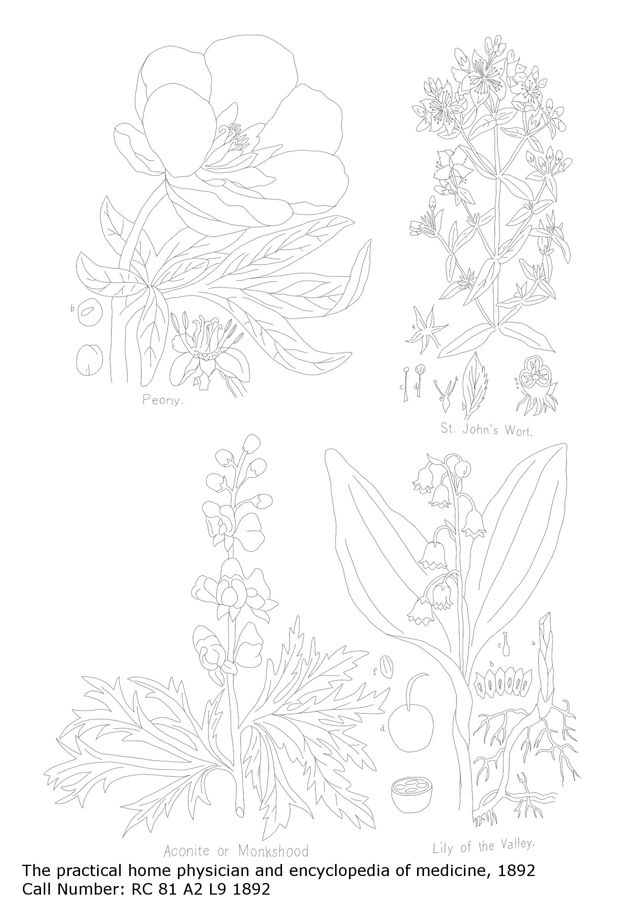

Slide 16
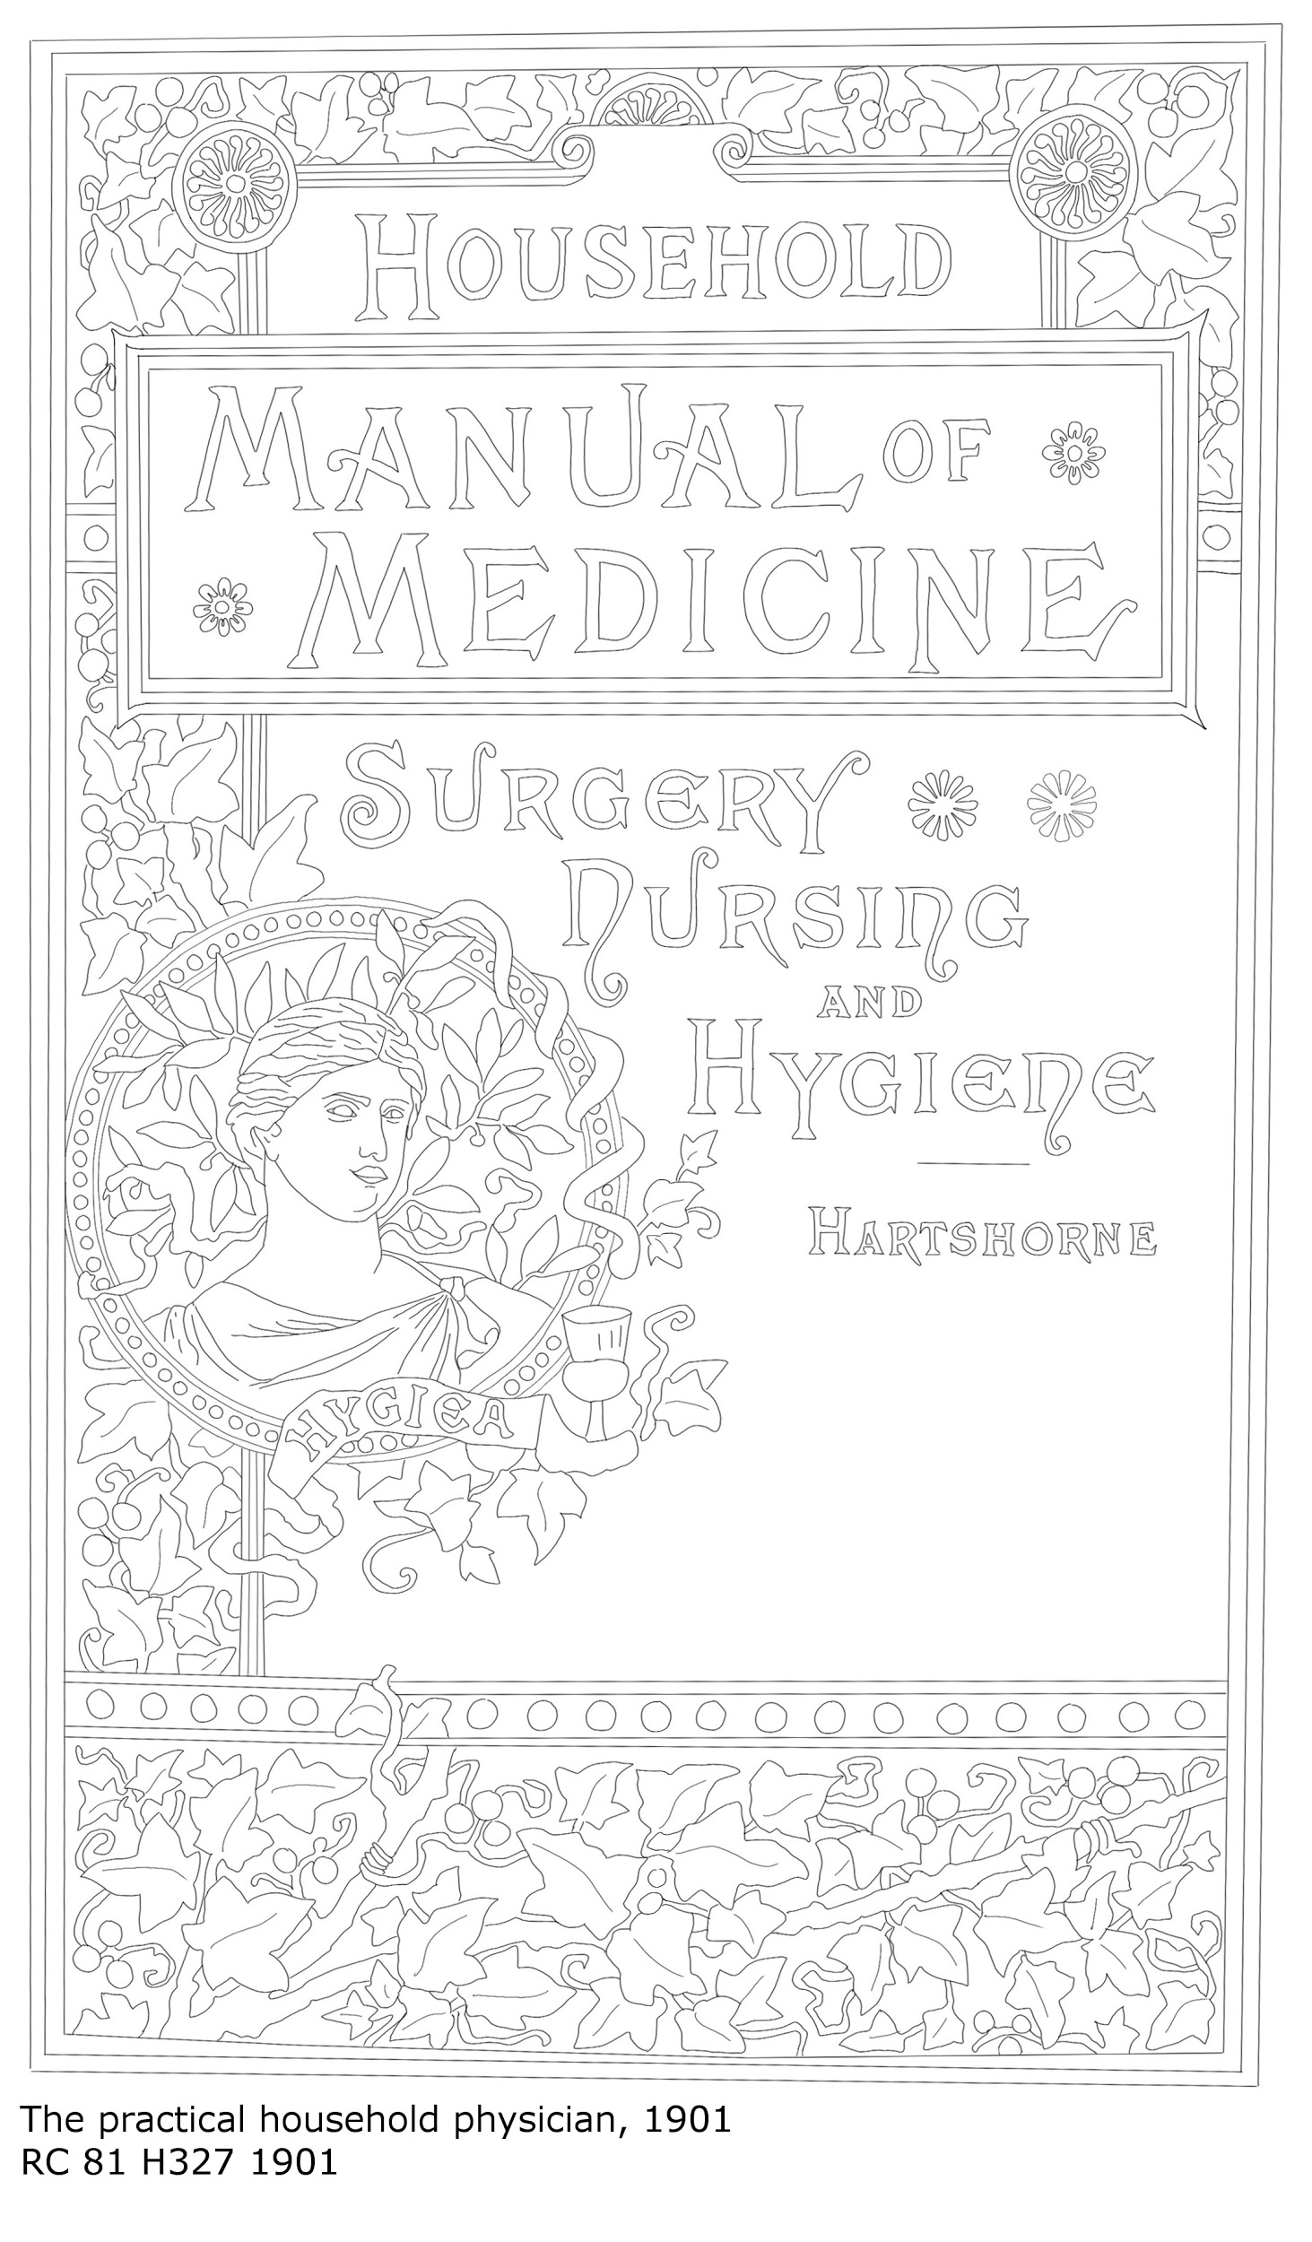
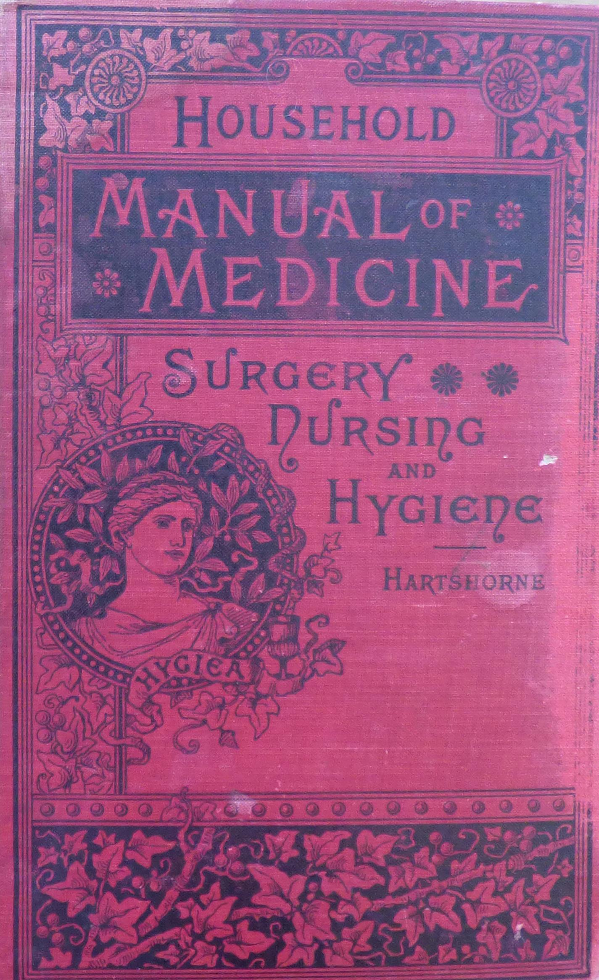

Slide 17
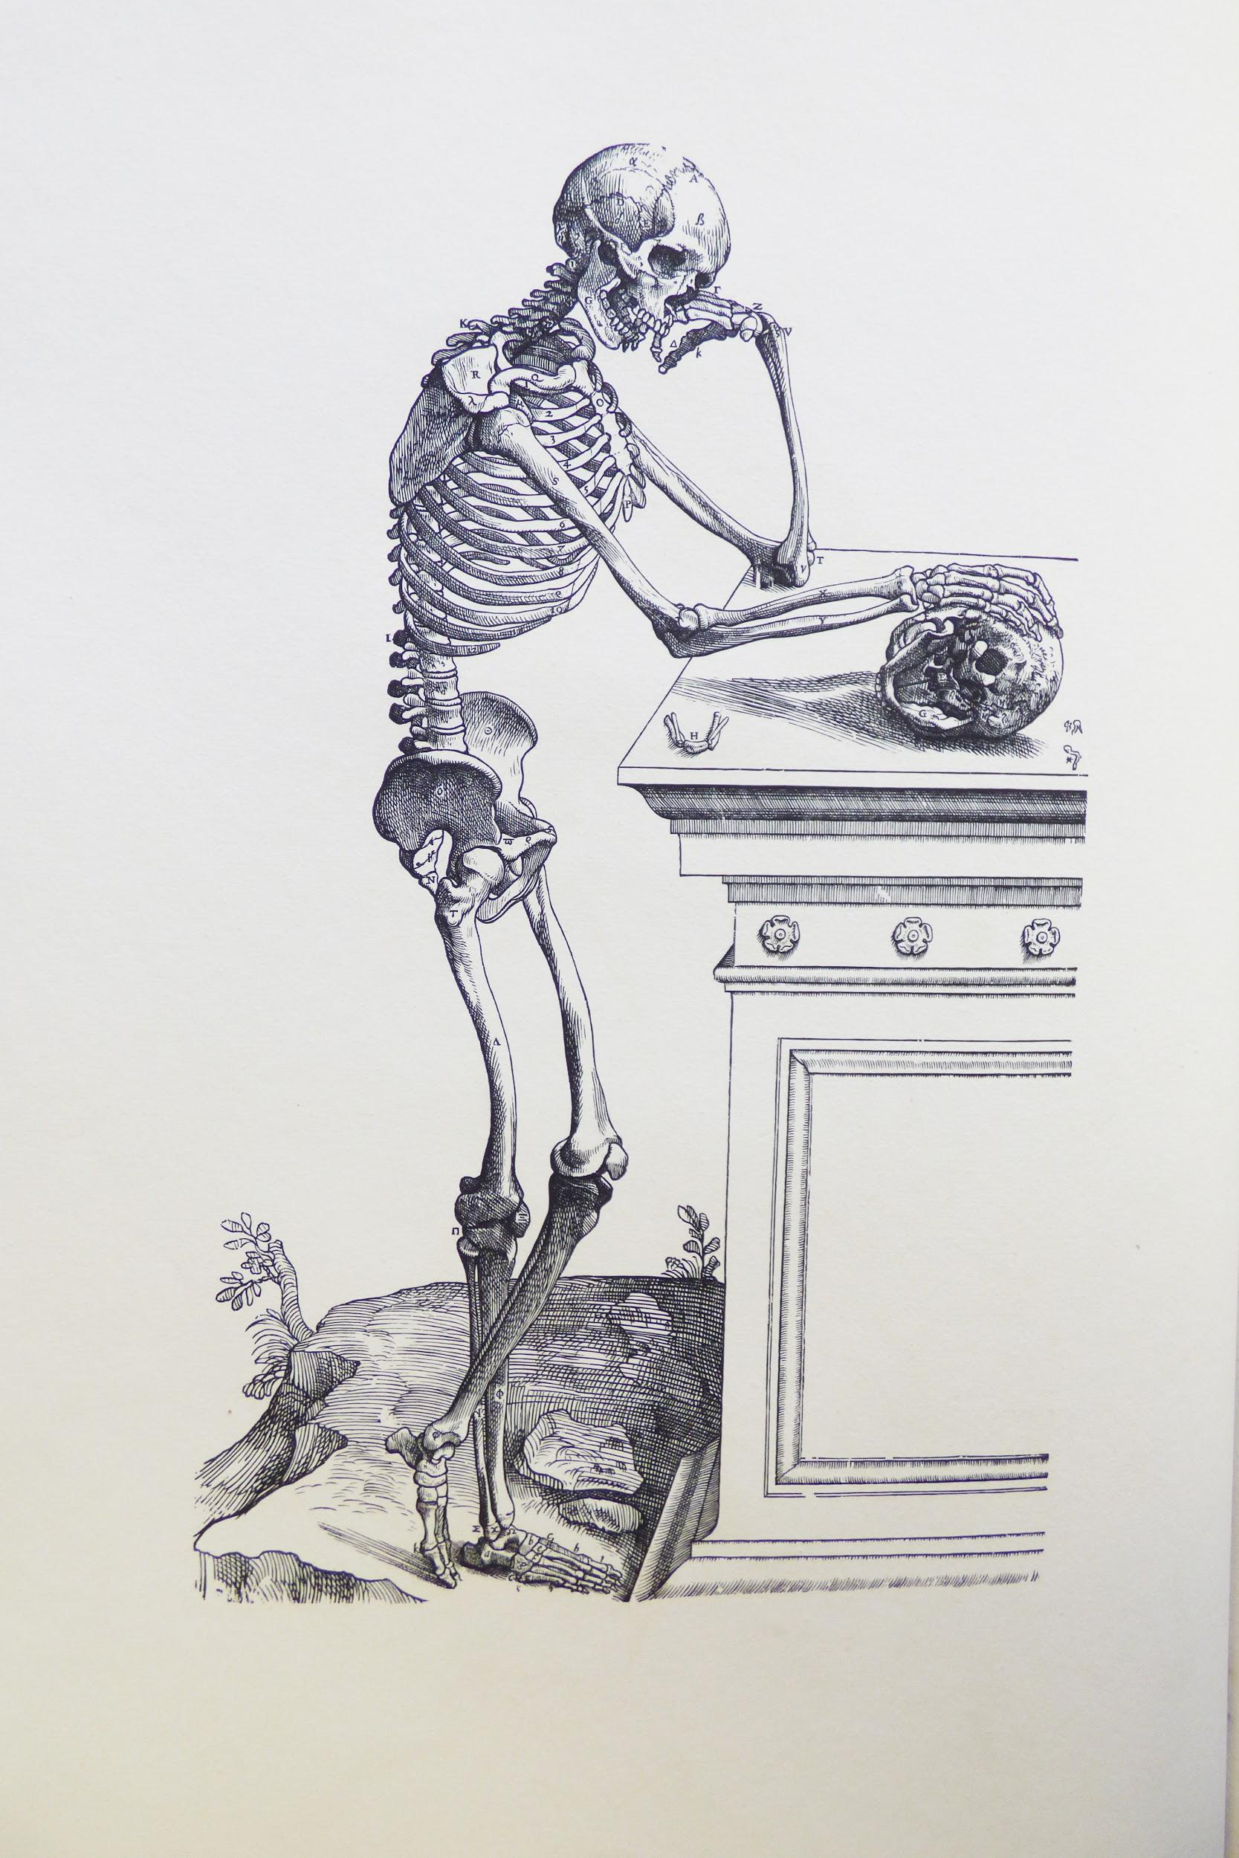
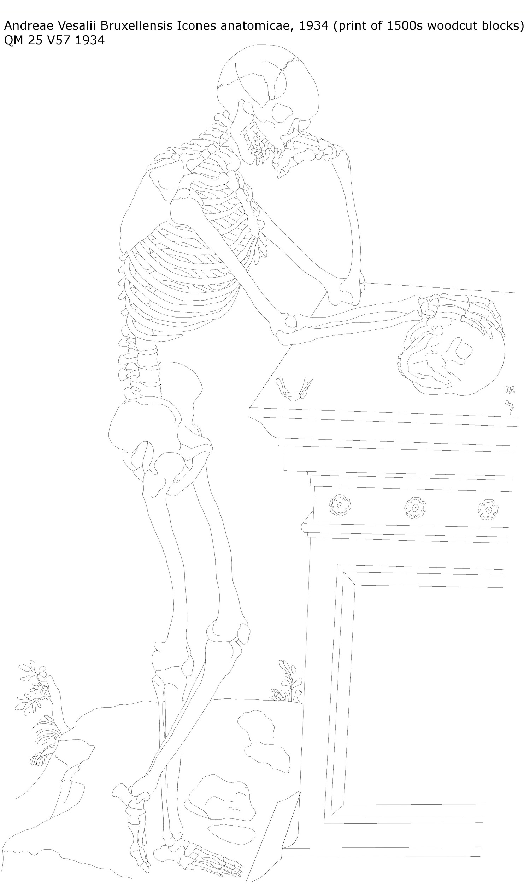

Slide 18
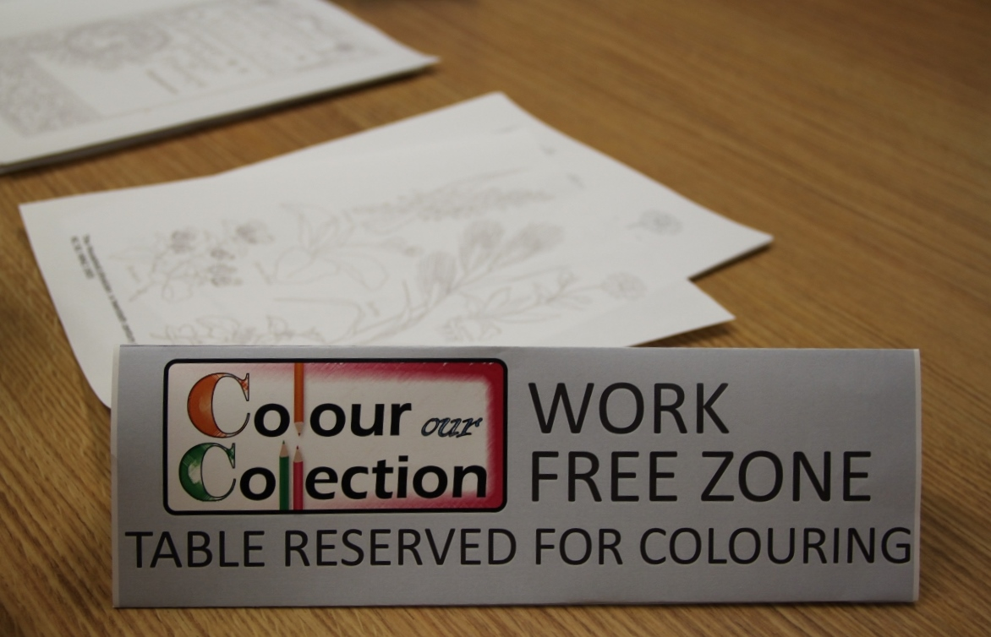
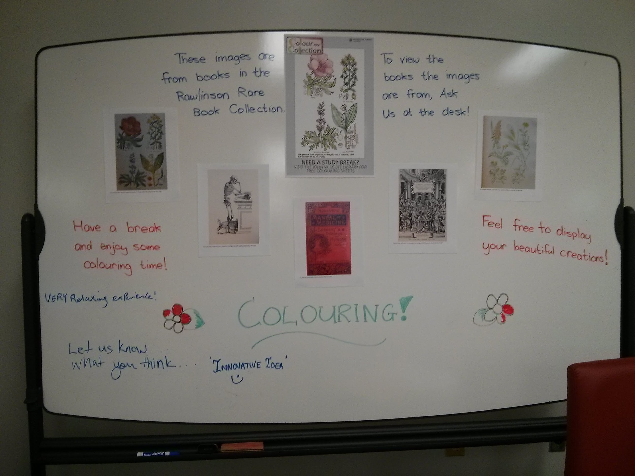
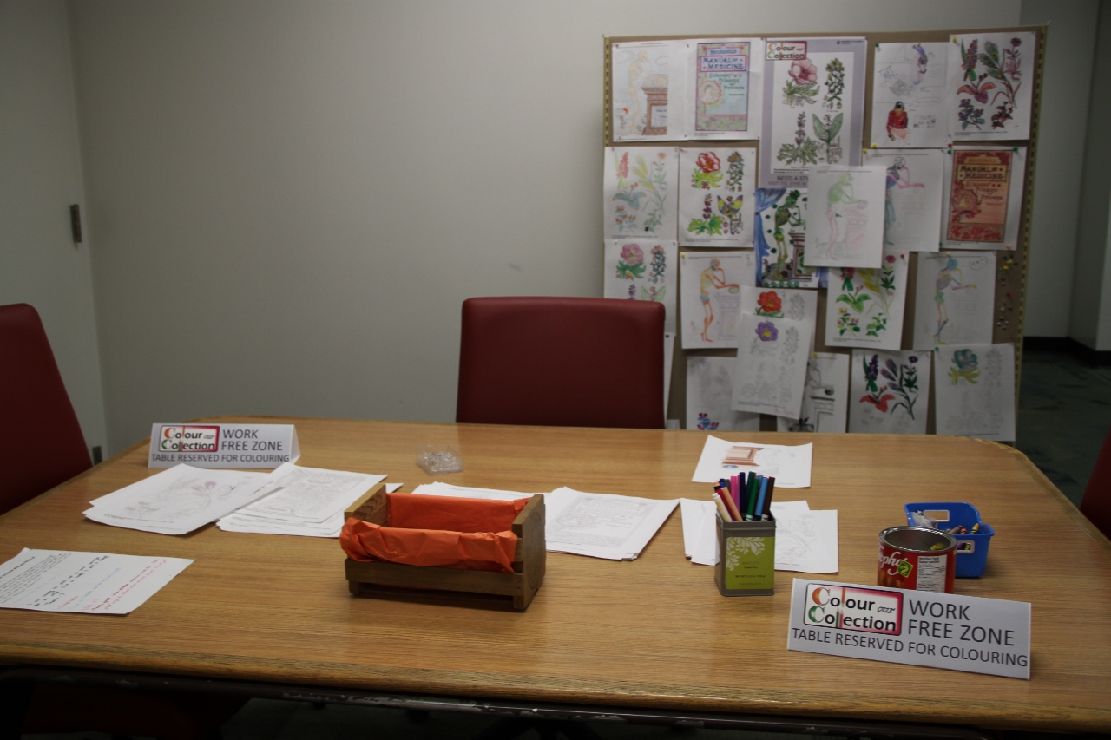

Slide 19
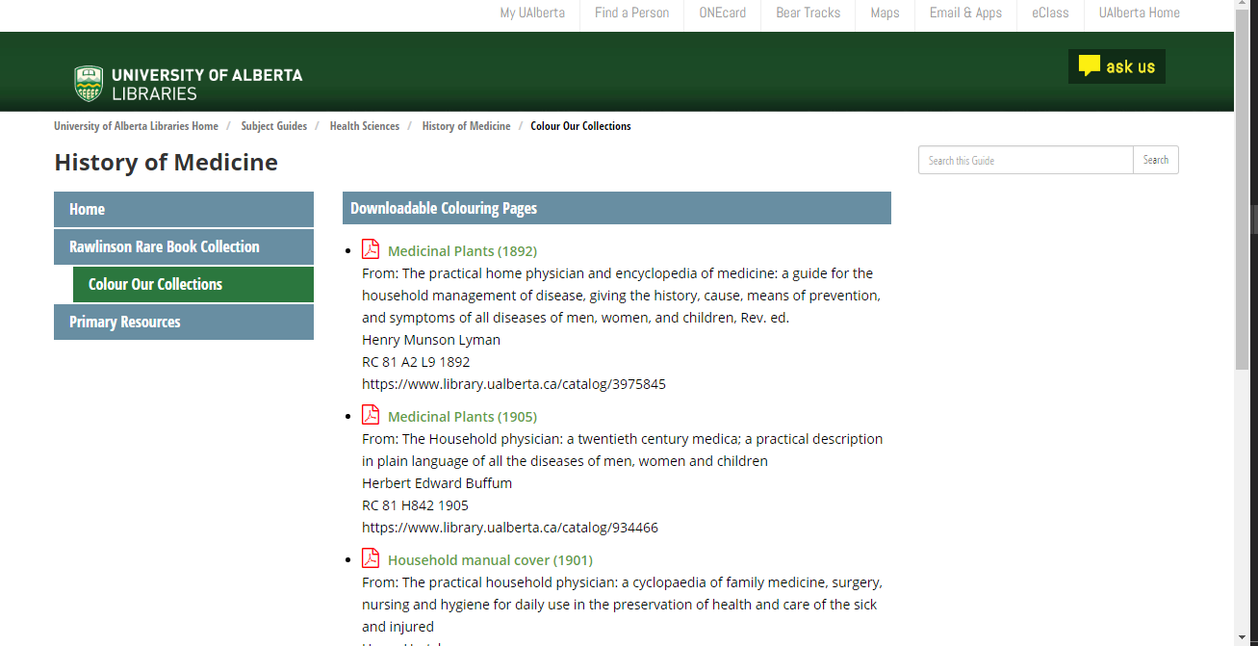

Slide 20
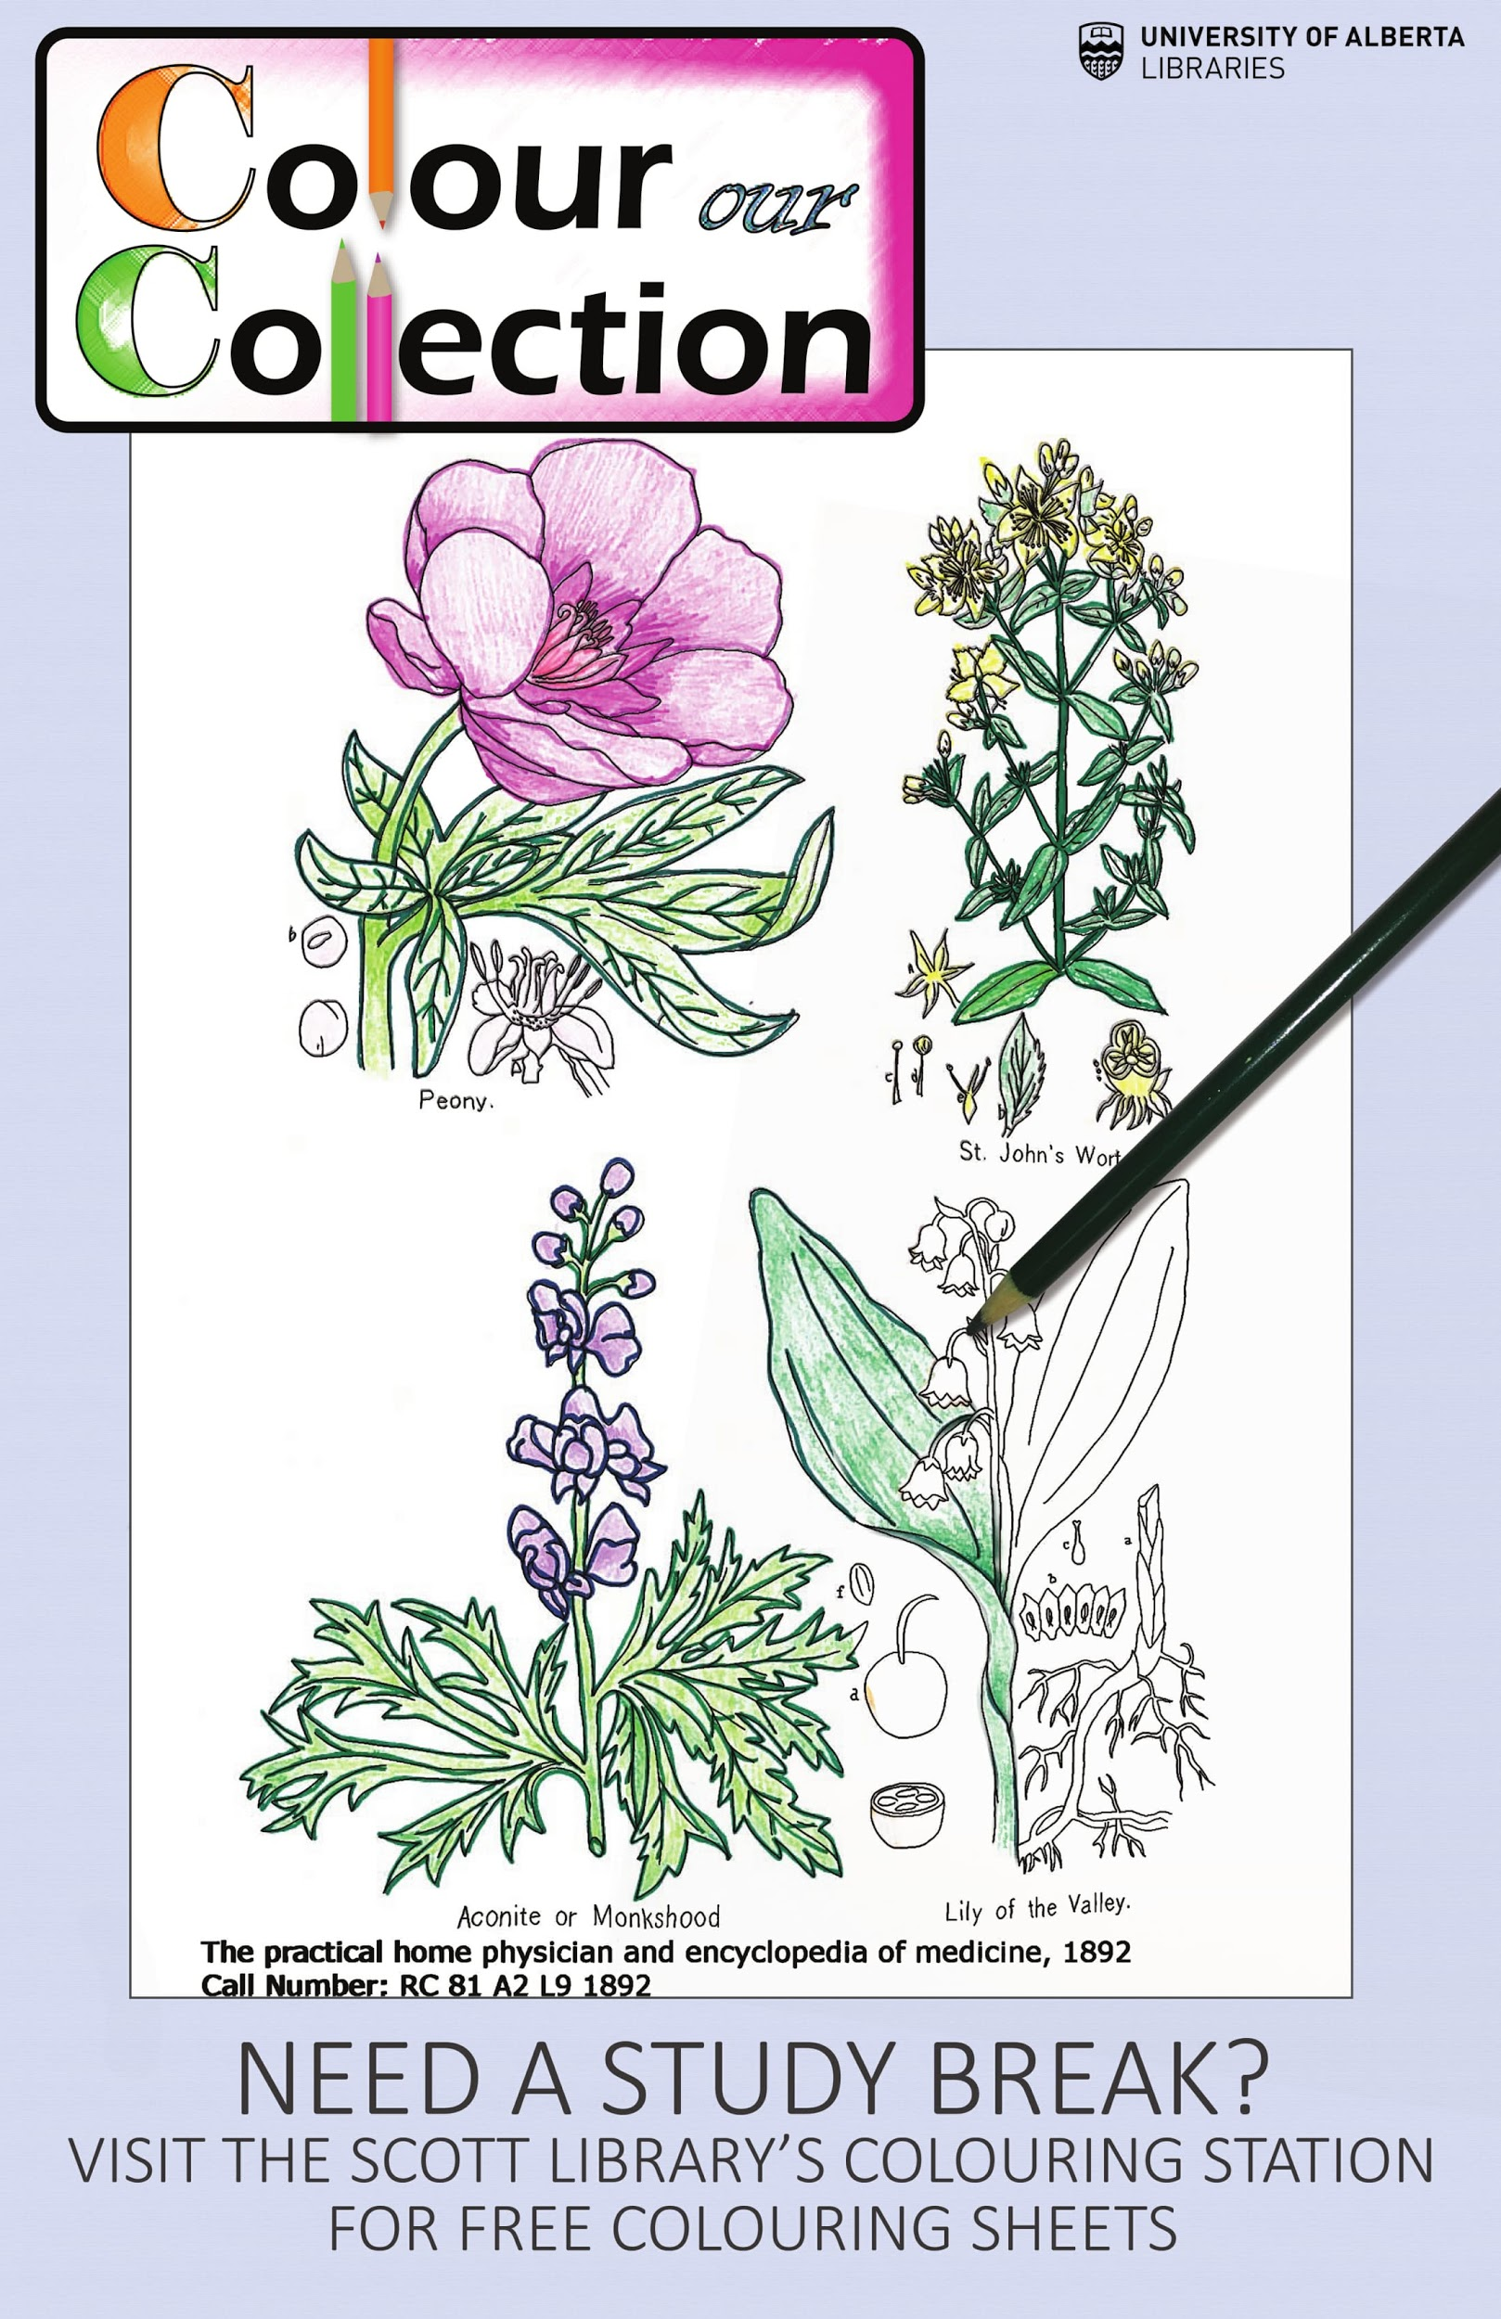
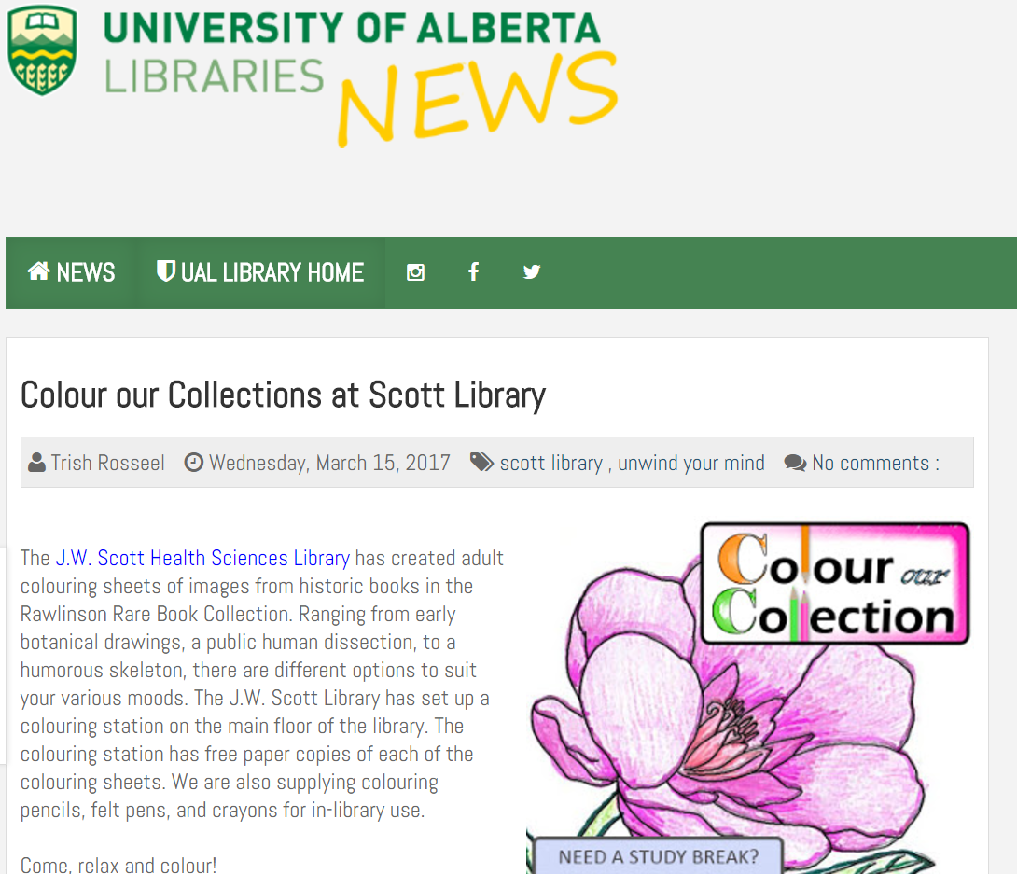

Slide 21
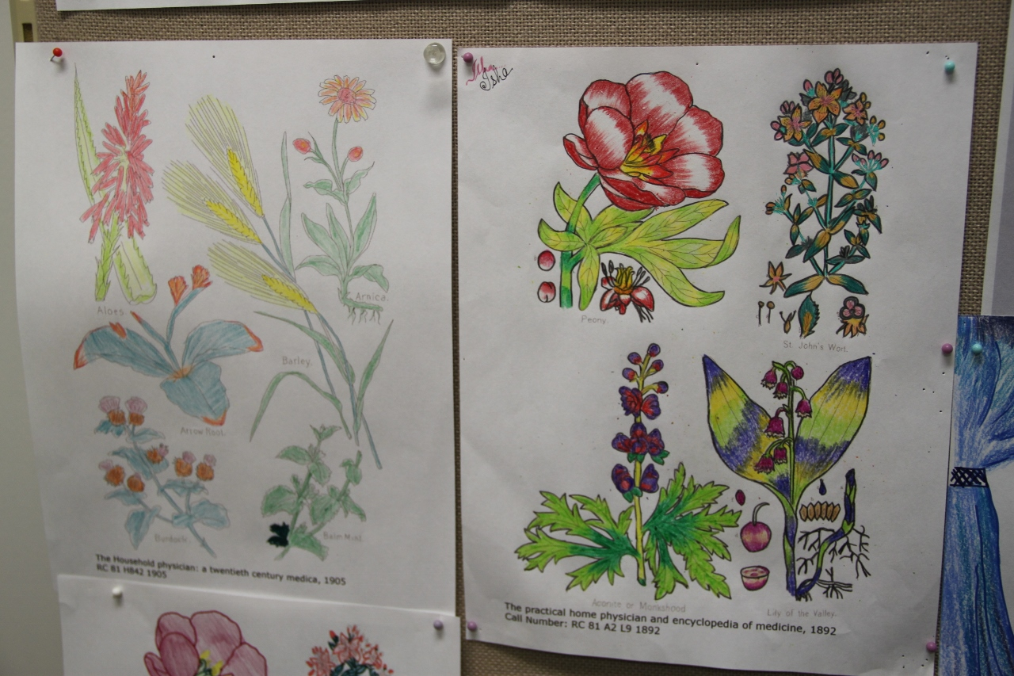
Outcomes
185 sheets taken in person
1251 total downloads of pages online

Slide 22
57 printed sheets
307 downloads
44 printed sheets
260 downloads
41 printed sheets
188 downloads

Slide 23
29 printed sheets
231 downloads
14 printed sheets
265 downloads

Slide 24
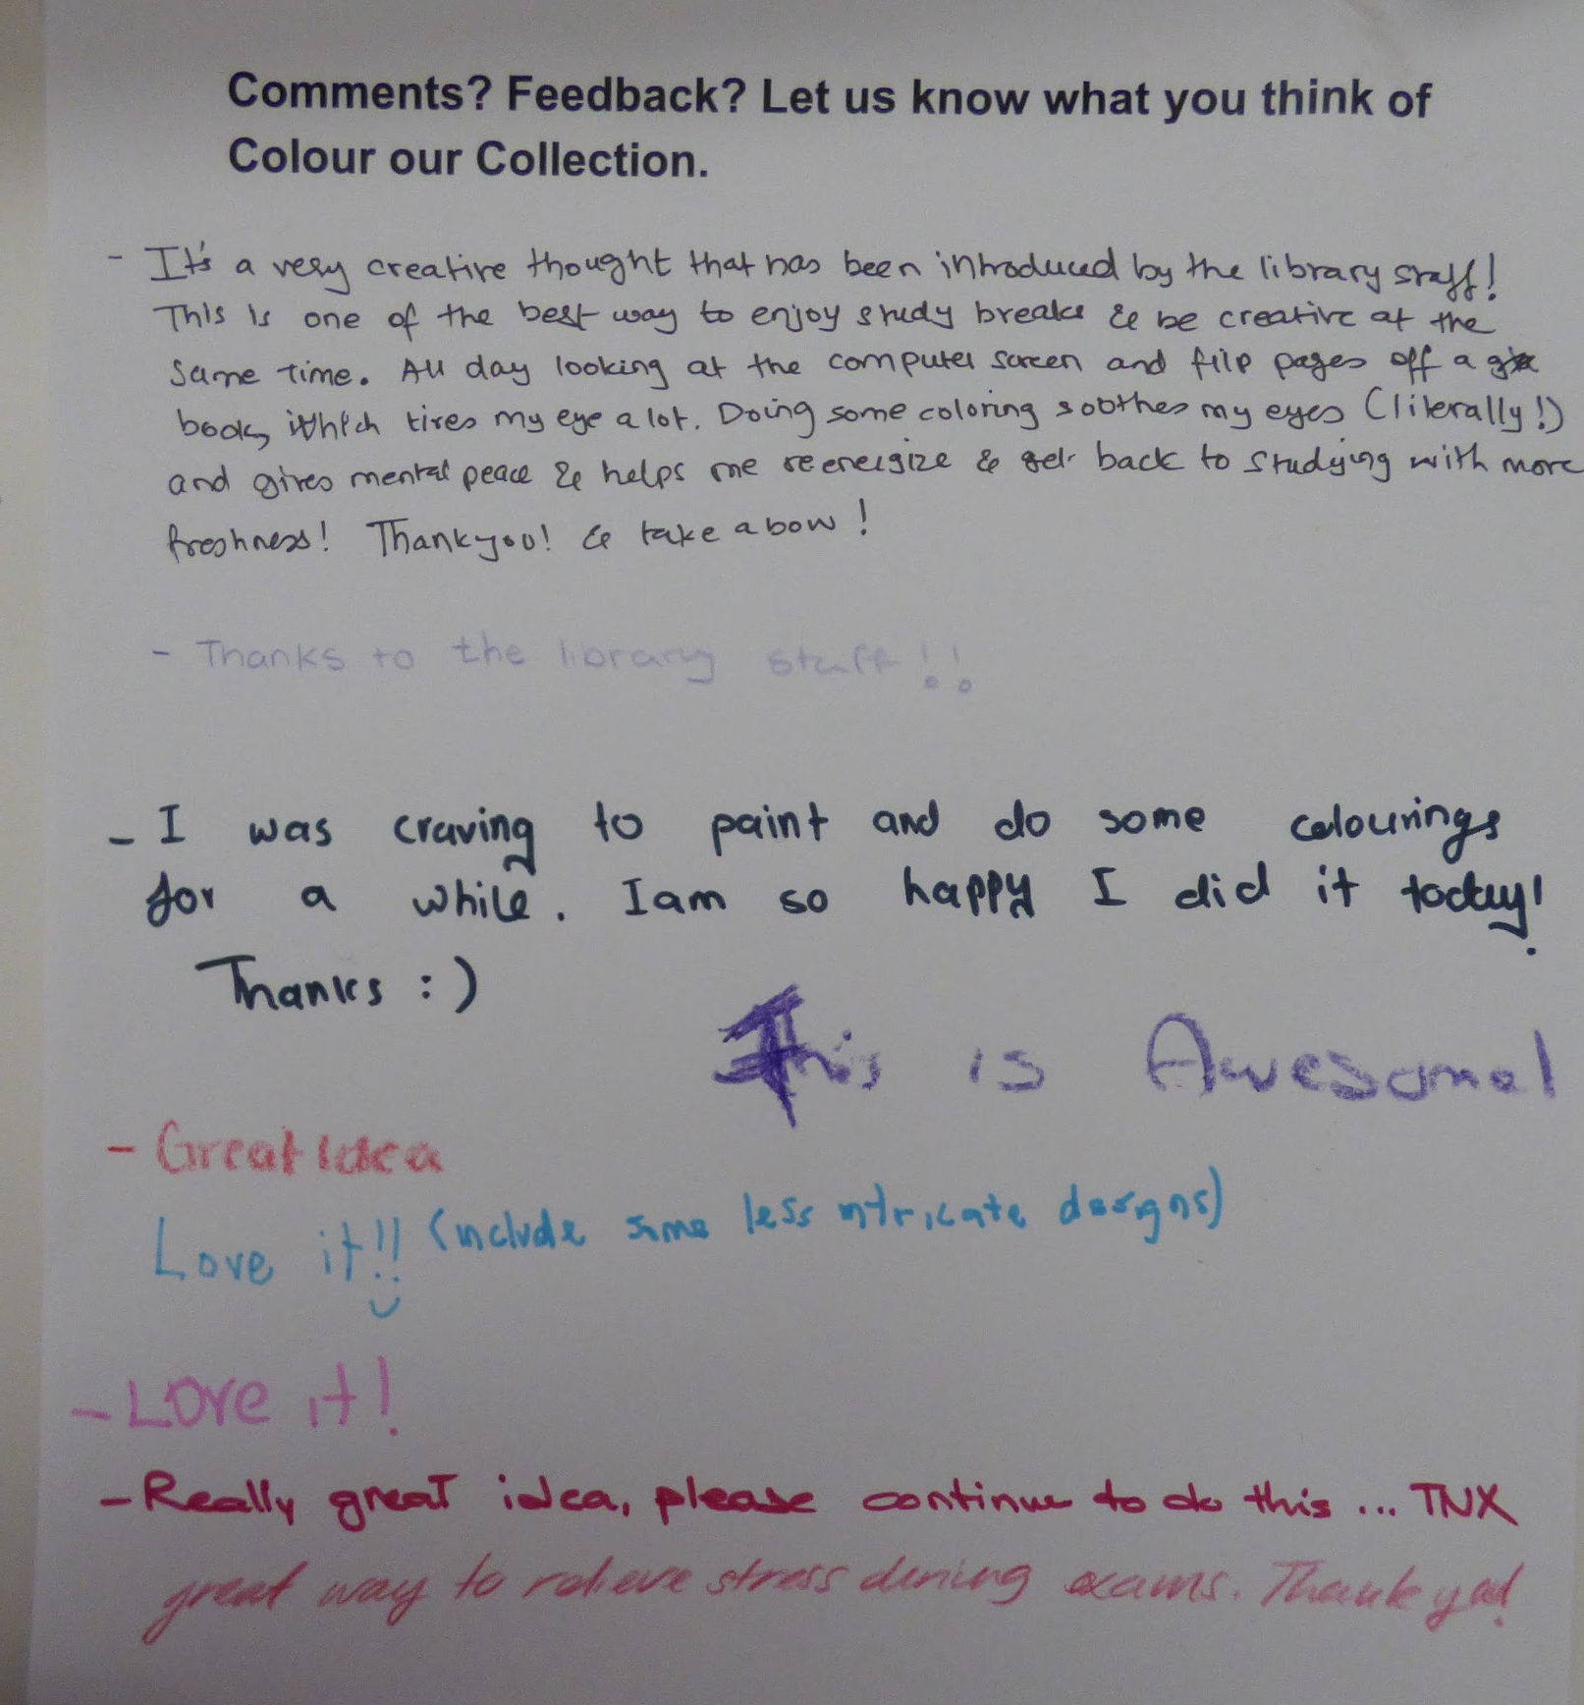
Final Thoughts
Successful in student engagement
  Positive Feedback
  Artwork displayed
No increase in Rawlinson Collection Traffic
Low cost: $161.36 total
Low theft of supplies
Easy to use again next year

Slide 25
Acknowledgements
Thank you to Liz Dennett, Erin Sanderman and all the other librarians and public service assistants at the john w. Scott library at the university of Alberta

Slide 26
Works Cited
Barrett, C. (2015). Adult Coloring Books: Patterns for Stress Relief. Phi Kappa Phi Forum, 95(4), 27.
Begley, S. (2016, Mar 2). How Colouring Inside the Lines Came Into Fashion. Time Magazine, 58-59. Retrieved from http://time.com/4246079/coloring-books-for-adults/
Curry, N., & Kasser, T. (2005). Can coloring mandalas reduce anxiety? Art Therapy, 22(2), 81-85. doi:10.1080/07421656.2005.10129441
Eaton, J., & Tieber, C. (2017). The Effects of Coloring on Anxiety, Mood, and Perseverance. Art Therapy, 34(1), 42-46. doi:10.1080/07421656.2016.1277113
Euromonitor International. (2016, July). Writing Instruments in Canada. Passport Database.
Garner, A., Goldberg, J., & Pou, R. (2016). Collaborative Social Media Campaigns and Special Collections: A Case Study on #ColorOurCollections. RBM: A Journal of Rare Books, Manuscripts and Cultural Heritage, 17(2), 100-117.
Snavely, L. (2012). Student engagement and the academic library. Santa Barbara, CA: Libraries Unlimited.
Rigby, M., & Taubert, M. (2016). Art of Medicine: Colouring books for adults on the cancer ward. The BMJ, 352. doi:10.1136/bmj.h6795

Slide 27
Image Sources
Basford, J. (2016). Secret Garden. Retrieved from https://www.johannabasford.com/book/secret-garden/
Moleiro. (2017). The Book of Simple Medicines: National Library of Russia, St Petersburg. Retrieved from http://www.moleiro.com/en/books-of-medicine/the-book-of-simple-medicines.html
New York Academy of Medicine. (2017). #ColorOurCollections. Retrieved from http://library.nyam.org/colorourcollections/
Wacom. (2017). Wacom Intuos Pro. Retrieved from http://www.wacom.com/en-gb/products/pen-tablets/intuos-pro

