Slide 1
Educational Institution Exceptions
September 2020
Notes:
Hello and welcome to the University of Alberta’s Opening Up Copyright instructional module on Educational Institution exceptions of the Copyright Act.

Slide 2
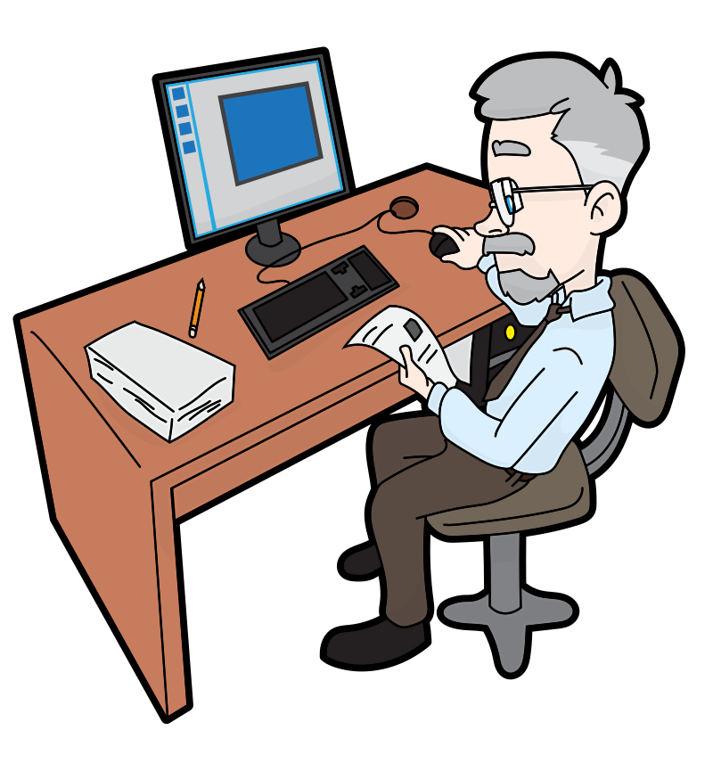
EDUCATIONAL EXCEPTIONS TO INFRINGEMENT
Exceptions
Fair Dealing
Research, private study, etc.
29 Fair dealing for the purpose of research, private study, education, parody or satire does not infringe copyright. R.S., 1985, c.
Criticism or review
29.1 Fair dealing for the purpose of criticism or review does not infringe copyright if the following are mentioned: …
News reporting
29.2 Fair dealing for the purpose of news reporting does not infringe copyright if the following are mentioned: …
s. 29.4–30.03
s. 29.4–30.03
Notes:
The Copyright Act outlines certain circumstances where users can copy or use copyright-protected works without infringing on the rights of the copyright owners. Section 29.4 to 30.03 of the Act describe the exceptions to infringement that apply specifically to educational institutions and staff. That said, it is critical for people who work in education to understand that in addition to these exceptions, they can also rely on the fair dealing exception, which is discussed further in other modules. In most cases, it is better to look at fair dealing exceptions first, as they provide more flexibility than the exceptions we will be discussing here.
The exceptions that apply specifically to educational institutions or people acting under their authority can be a little bewildering to be honest. Let’s go through them in order.

Slide 3
CLASSROOM DISPLAYS
If work commercially available
(3) Except in the case of manual reproduction, the exemption from copyright infringement provided by subsections (1) and (2) does not apply if the work or other subject-matter is commercially available
Reproduction for instruction
29.4 (1) It is not an infringement of copyright for an educational institution or a person acting under its authority for the purposes of education or training on its premises to reproduce a work, or do any other necessary act, in order to display it.
HUH?
Notes:
Starting with displaying works in classrooms.
It is not infringing copyright to copy a work, or take another necessary action, in order to display it in a classroom but this has to be done for educational purposes and it can only be displayed on school premises. Sounds great right? Except there is a limitation, which is the work cannot be reasonably ‘commercially available So it is okay for you to make a copy of something in order to display it in your classroom, as long as it is not reasonably possible for you to buy a copy in the right format for you to display in your classroom. Although, arguably this hinges on what you consider ‘reasonable.’
You can also reproduce things in order to include them in exams but again only if that thing is not commercially available in the appropriate medium.

Slide 4
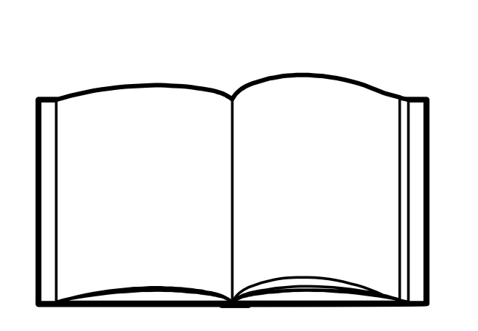
CLASSROOM DISPLAYS
✓
HUH?
(If image not reasonably available commercially in the displayable format)
Notes:
Starting with displaying works in classrooms.
It is not infringing copyright to copy a work, or take another necessary action, in order to display it in a classroom but this has to be done for educational purposes and it can only be displayed on school premises. Sounds great right? Except there is a limitation, which is the work cannot be reasonably ‘commercially available.’ So it is okay for you to make a copy of something in order to display it in your classroom, as long as it is not reasonably possible for you to buy a copy in the right format for you to display in your classroom. Although, arguably this hinges on what you consider ‘reasonable.’
You can also reproduce things in order to include them in exams but again only if that thing is not commercially available in the appropriate medium.

Slide 5
PUBLIC PERFORMANCES
Performances
29.5 It is not an infringement of copyright for an educational institution or a person acting under its authority to do the following acts if they are done on the premises of an educational institution for educational or training purposes and not for profit before an audience consisting primarily of students of the educational institution
(a) the live performance in public, primarily by students of the educational institution, of a work;
Notes:
Section 29.5 covers certain public performances of things like plays or music in educational institutions. This is allowed as long as it is held on the premises of the institution, the audience is composed primarily of students and educators,and the performance is done primarily by students.

Slide 6
SOUNDS, FILMS, AND BROADCASTS
Audience = Students
Notes:
Similarly, educational institutions can play sounds, films, or broadcasts made by others as long as the audience is primarily composed of students and educators and the copy was acquired in a way that is not infringing copyright. This exception makes it possible for teachers to include a variety of different kinds of works and media into their lessons.

Slide 7
SOUNDS, FILMS, AND BROADCASTS
UNCOOL.
30 days
If the recording is of a news broadcast
you can save it for future use.
If the recording is of a documentary or non-news broadcast
it must be destroyed after 30 days
Notes:
.
Teachers can also make a single copy of a broadcast for use in a classroom. If the recording is of a news program it can be kept for subsequent classroom use, but if the copy is of a documentary or of a non-news broadcast, the copy must be destroyed or royalties must be paid after thirty days. So if you are a teacher or instructor and you see a documentary that might be useful in a few months or next semester… I guess you don’t bother recording it or, or just consider whether you may be able to rely on fair dealing.

Slide 8
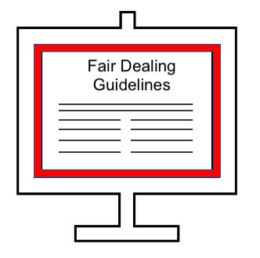
TELECOMMUNICATION AND RECORDING
WHO HAS TIME FOR THAT?
Communication by telecommunication
30.01 (3) Subject to subsection (6), it is not an infringement of copyright for an educational institution or a person acting under its authority
(a) to communicate a lesson to the public by telecommunication for educational or training purposes, if that public consists only of students who are enrolled in a course of which the lesson forms a part or of other persons acting under the authority of the educational institution;
(b) to make a fixation of the lesson for the purpose of the act referred to in paragraph (a); or
Like a recording or screen recording
Notes:
If you thought that was useful, just consider some of the s.30 exceptions. It is not infringing copyright to use materials in a telecommunication in order to deliver a lesson, test or examination to students who are enrolled in a course, even if they are not physically on the school premises (s. 30.01). You can also make a fixation (such as a screen recording) of that telecommunication or do any other action that is necessary. A student can also make a reproduction of it in order to listen or view the lesson at a more convenient time. Both the students and the educators are required to destroy a reproduction within 30 days after students receive their final course evaluations for the class that the lesson was a part of. This is a controversial condition because educators would usually want to encourage students to revisit their training and lessons in the future. Not only that, but institutions and teachers don’t usually have the time or money to go to the trouble of preparing a lesson only to destroy it at the end of the term (Murray & Trosow, p. 192). Having students and teachers destroy their lessons after courses are over kind of undermines the whole goal of education It is also unclear how these rules would be enforced. For distance education or online learning it is perhaps better to reference the educational institution’s fair dealing guidelines and rely on those exceptions instead.

Slide 9
REPROGRAPHIC REPRODUCTION
Exception — digital reproduction of works
30.02 (1) Subject to subsections (3) to (5), it is not an infringement of copyright for an educational institution that has a reprographic reproduction licence under which the institution is authorized to make reprographic reproductions of works in a collective society’s repertoire for an educational or training purpose
(a) to make a digital reproduction — of the same general nature and extent as the reprographic reproduction authorized under the licence — of a paper form of any of those works;
(b) to communicate the digital reproduction by telecommunication for an educational or training purpose to persons acting under the authority of the institution; or
WHAAAAA…
Notes:
As s. 30.02 attempts to explain, we think -- as there is no case law on this point, it is also not an infringement of copyright to make a digital reproduction of a reprographic reproduction in order to include it in a telecommunication of a lesson as long as you have a reprographic reproduction licence with a collective licencing agency. Did we lose you? Honestly, I think I lost myself, so no worries… Essentially, if you have entered into a specific digital reproduction licence agreement with a collective you must follow those terms and conditions when making a digital reproduction or copy, otherwise you can comply with the licence terms and conditions applicable in your reprographic reproduction licence to the extent that they are reasonably applicable to a digital reproduction. If an institution has been paying royalties to a collective voluntarily under an interim tariff and then that institution enters into a digital reproduction licence agreement with that collective, or if a tariff that applies to the digital copies being made is approved at a new royalty rate - there may be a difference in the amount of royalties that the institution owes the collective for digital copies going forward. If the institution is required to pay a greater amount in royalties under the new conditions than they had previously paid, they must pay that higher fee going forward and pay the difference in back-payments for the copies starting from the day in which the institution first made the first digital reproduction. If they are required to pay less than they had previously been paying for digital copies, the collective must reimburse the difference in fees back to the institution from the day in which the institution made the first digital reproduction. When we said these exceptions are bewildering ... we were not kidding. Have we mentioned fair dealing exceptions?? Those are looking pretty good right about now.

Slide 10
REPROGRAPHIC REPRODUCTION
Copyright
Collective
If your institution has a specific digital reproduction licence,
comply with those terms.
If it doesn’t,
apply the terms of your reprographic licence to the digital reproduction.
I’M GONNA GO LOOK AT THOSE INSTEAD
Notes:
As s. 30.02 attempts to explain, we think -- as there is no case law on this point, it is also not an infringement of copyright to make a digital reproduction of a reprographic reproduction in order to include it in a telecommunication of a lesson as long as you have a reprographic reproduction licence with a collective licencing agency. Did we lose you? Honestly, I think I lost myself, so no worries… Essentially, if you have entered into a specific digital reproduction licence agreement with a collective you must follow those terms and conditions when making a digital reproduction or copy, otherwise you can comply with the licence terms and conditions applicable in your reprographic reproduction licence to the extent that they are reasonably applicable to a digital reproduction. If an institution has been paying royalties to a collective voluntarily under an interim tariff and then that institution enters into a digital reproduction licence agreement with that collective, or if a tariff that applies to the digital copies being made is approved at a new royalty rate - there may be a difference in the amount of royalties that the institution owes the collective for digital copies going forward. When we said these exceptions are bewildering ... we were not kidding. Have we mentioned fair dealing exceptions?? Those are looking pretty good right about now.

Slide 11
PUBLICLY AVAILABLE MATERIALS
30.04 (1) Subject to subsections (2) to (5), it is not an infringement of copyright for an educational institution…to do any of the following acts for educational or training purposes in respect of a work or other subject-matter that is available through the Internet:
(a) reproduce it;
(b) communicate it to the public by telecommunication, if that public primarily consists of students…
(c) perform it in public, if that public primarily consists of students…
eClass
THAT’S ME!
TPM
Notes:
Now let's talk about PAM. Not professor pam who you might recognize from other modules, but the Publicly Available Materials on the Internet provision in the Copyright Act! As s. 30.04 states, if something is available through common uses of the internet it is not infringement for that thing to be reproduced, or communicated through telecommunication or performed for educational or training purposes. This is not the case if it is protected by a Technological Protection Measure or TPM, or if the owner explicitly posts otherwise. It is important to remember that reproducing for educational purposes does not mean distributing on the open web. A common interpretation of the conditions of this section is to make these resources available in a restricted environment, like an online portal that requires student and staff authentication to access.

Slide 12
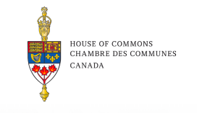
COPYRIGHT ACT REVIEW
(2019)
That the Government of Canada simplify the wording and the structure of the Copyright Act. (Recommendation 2)
Educational exceptions (s. 29.4–30.03) were not mentioned at all.
Notes:
These educational exceptions did not specifically come up at all during the INDU committee’s statutory review of the Copyright Act in 2019. This might speak to the fact that these exceptions are not relied on very often and are thus not as relevant as the fair dealing exception. However, we like to think that the second recommendation calling for the wording of the act to be simplified may be especially useful for these sections.

Slide 13
LEARNING OBJECTIVES
You should now be able to:
Understand the educational exceptions in s. 29.4 to s. 30.03 of the Copyright Act
Describe the publicly available materials on the internet exception
Recognize that the use of copyright protected materials for educational purposes may also fall under the fair dealing exception and that educators need not always rely on s. 29.4 to 30.03
Notes:
You should now be able to:
Understand the educational exceptions in s.29.4 to s.30.03 of the Copyright Act… well that is if anyone can even understand these sections
Describe the publically available on the internet exception (whatever that is)
Recognize that the use of copyright protected materials for educational purposes may also fall under a fair dealing exception and that educators need not always rely on s. 29.4 to 30.03 alone
Basically, don’t even watch this module again, and just rely on fair dealing when you can or find OER (whispered)

Slide 14
THANK YOU FOR YOUR ATTENTION
Notes:
This has been the University of Alberta’s Opening Up Copyright instructional module on s. 29.4 to s. 30.03 of the Copyright Act. Thank you for your attention.

Slide 15
QUESTIONS
According to section 29.4, it is not an infringement of copyright for a teacher to make a copy of a work in order to display it in their classroom as long as:
The work is not reasonably commercially available in the appropriate format
It is only displayed on the school premises
It is done for educational purposes
All of these must be true
According to section 31, you can telecommunicate a screen-recording of a lesson in order to watch it later but, 30 days after students have received their final grade:
The student must destroy the copy
The educator must destroy the copy
The student and the educator must destroy the copy
The student must forget what they were taught

Slide 16
QUESTIONS
According to this provision, if something is available through common uses of the internet it is not infringement for that thing to be reproduced, communicated through telecommunication, or performed for educational or training purposes:
Publicly Available Materials provision (PAM)
Supposedly Publicly Available Materials provision (SPAM)
Hardly Available Materials Provision (HAM)
Copyright Act Madness provision (CAM)
A common interpretation of the conditions of this section is to make these resources available in a restricted environment, like an online portal. True or False?
When trying to determine if you can copy of protected materials for educational purposes it is best to start with:
Section 29 of the Copyright Act, the Fair Dealing exception
Section 29.4- 30.03, the education exceptions
Section 44.12, Court ordered detention
Many institutions have fair dealing guidelines that are good to reference rather than trying to interpret the education-specific exceptions in the Copyright Act. True or False?

Slide 17
Murray, L.J., & Trosow, S. E. (2013). Canadian copyright: A citizen’s guide (2nd ed.). Between the Lines

Slide 18
[Sam the teacher at desk] (n.d.). https://commons.wikimedia.org/w/index.php?title=Special:Search&limit=50&offset=500&profile=default&search=man+cartoon&advancedSearch-current={%22namespaces%22:[6,12,14,100,106,0]}#/media/File:Senior_Guy_At_The_Office_Cartoon.svg
[Professor Pam] https://pixabay.com/illustrations/teacher-bookworm-glasses-professor-359311/
Wichai Wi (n.d.). Governent agency. The Noun Project. CC BY. Retrieved from: https://thenounproject.com/search/?q=ministry%20&i=3191240
Crosswell, Rob. (n.d.). Library. The Noun Project. CC BY. https://thenounproject.com/crosswellrob/uploads/?i=1122689
Qubodup (2008). Whoosh. Freesound. CC0. Retrieved from: https://freesound.org/people/qubodup/sounds/60013/
Tatyana RU (n.d.). Question Mark and Exclamation Mark. The Noun Project. CC BY. https://thenounproject.com/tanyasolo1986/uploads/?i=2460596
Creaticca Creative Angencyy. (n.d.).Printer. The Noun Project. CC BY. https://thenounproject.com/search/?q=photocopier&i=1127745
Krishna (N.D.). Presentation. The Noun Project. CC BY. Retrieved from:https://thenounproject.com/search/?q=PRESENTATION&i=1278944

Slide 19
[Hanging poems on a cherry tree]. Woodcut by Ishikawa Toyonobu, [1741, printed later]. Library of Congress Prints & Photographs Division. Retrieved from: https://unsplash.com/photos/027pkQs_6dU
Lluisa Iborra (n.d.). Open book. The Noun Project. Retrieved from: https://thenounproject.com/search/?q=open%20book&i=991011
Icon 54 (n.d.). Sound.The Noun Project. Retrieved from:https://thenounproject.com/search/?q=sound&i=208568
Andrey Vasiliev. (n.d.) Film Projector. The Noun Project. CC BY. Retrieved from. https://thenounproject.com/term/film-projector/336166/
Montu Yadav (n.d.). Broadcast. The Noun Project. CC BY Retrieved from. https://thenounproject.com/search/?q=broadcast&i=201837
Joko Mistari (n.d.). File. The Noun Project. CC BY. Retrieved from: https://thenounproject.com/search/?q=file%20sound&i=2728070
Geralt. (2017) Atomic bomb. Pixabay. CC0. https://pixabay.com/photos/atomic-bomb-nuclear-weapons-2621291/
Deleted_user_5405837 (2017). Freesound. CC BY, Retrieved from: https://freesound.org/people/deleted_user_5405837/sounds/399303/
Rawpixel. (n.d.). [Isabelle]. Pixabay. https://pixabay.com/illustrations/cartoon-casual-character-drawing-3685566/
https://commons.wikimedia.org/wiki/File:ITunes_logo.svg#/media/File:ITunes_12.2_logo.png

Slide 20
Mohamad_Hassan(n.d.). [Student] Pixabay. https://pixabay.com/vectors/programmer-computer-woman-support-3607627/
Guilherme Fertado (n.d.). Sign. The Noun Prohect. CC BY. Retrieved from: https://thenounproject.com/search/?q=sign&i=1859815
Dawid Sobolewski (n.d.). Mockup article. The Noun Project. CC BY. https://thenounproject.com/search/?q=article%20mockup&i=244221
deleted_user_96253 (2016).Cha ching. Freesound. CC0. https://freesound.org/people/deleted_user_96253/sounds/351304/
Aust_paul (2007). Bullet ricochet. Freesound. CC 0. https://freesound.org/people/aust_paul/sounds/30932/
Tafsir Jalalain (n.d.). Computer. The Noun Project. CC BY. https://thenounproject.com/search/?q=computer&i=2387560
Closing Slides Music: Rybak, Nazar. (n.d.). Corporate Inspired. HookSounds. CC BY. http://www.hooksounds.com/
Unattributed materials are contributions from the Opening Up Copyright Project Team and placed in the Public Domain.

Slide 21
University of Alberta. 2020. “Educational Institution Exceptions.” Opening Up Copyright Instructional Module. https://sites.library.ualberta.ca/copyright/

