Slide 1
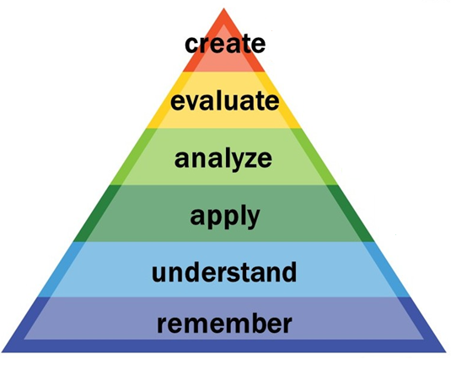
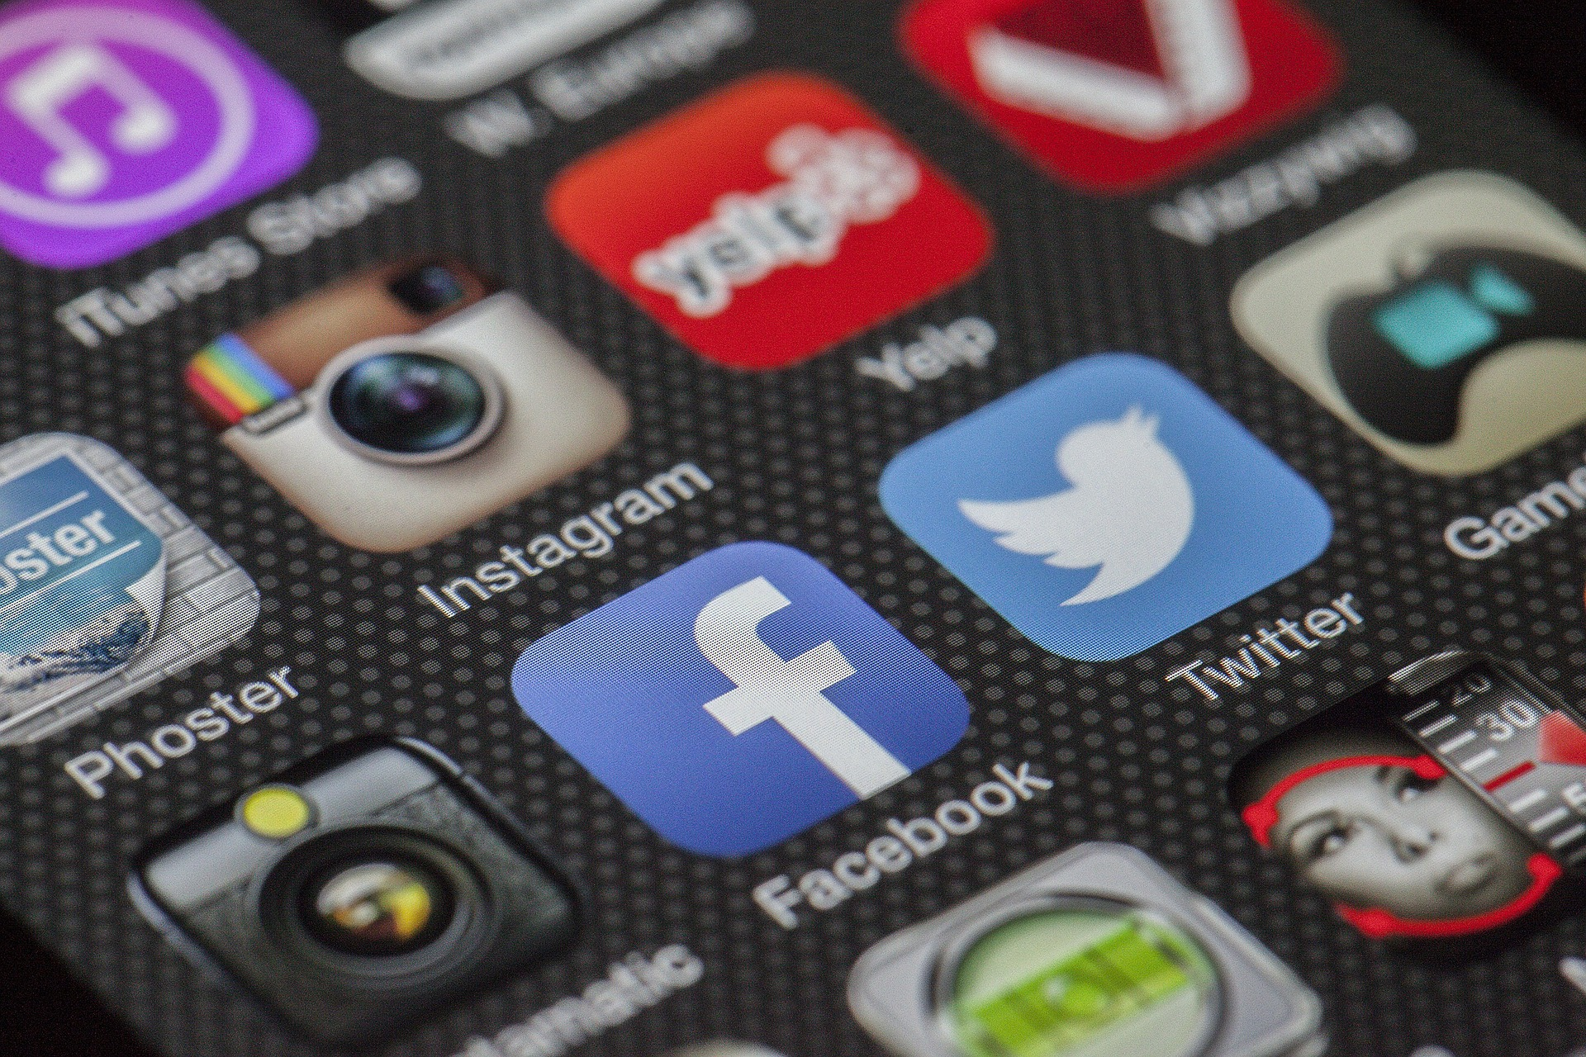
Tweets to put Students in the Driver’s Seat: A Systematic Review of Twitter in Medical Education
How is Twitter used in Medical Education?
Thane Chambers and Janice Kung
University of Alberta, John W. Scott Health Sciences Library
WHY IS THIS IMPORTANT?
METHOD
Twitter appears to have a lot of potential for medical education. It can:
A comprehensive literature search was conducted on Sept 5, 2016 to identify Twitter’s use in medical education. A data extraction form identified the categories listed below. The level of instruction was categorized by Bloom’s Taxonomy, a model that demonstrates different levels of thinking in educational, training, and learning processes [1]. Each level requires a higher level of abstraction and analytical thinking than the one below. The review only focused on articles that integrated Twitter into curriculum-based teaching.
Facilitate active participation
Build community among disparate members
Work well for asynchronous learning
Provide students and instructors with real-time feedback and communication
But what is its current state of use among educators? How can its potential be harnessed by educators? Is it an effective tool for learning and building knowledge?
Bloom’s Taxonomy
PRISMA Flow Diagram
RESULTS
772 articles identified
Geographic Location
Canada | 1
USA | 12
UK | 5
Type of Medical Students
UGME | 11
PGME | 5
Unknown | 2
Bloom’s Taxonomy
Apply | 3
Understand | 6
Remember | 1
N/A | 8
432 duplicates excluded
340 potentially relevant titles and abstracts reviewed
248 excluded based on title
and abstract review
Intervention
Information distribution (e.g. summary of lessons, daily clinical vignettes, distribution of resources, grand rounds presentations, announcements) | 9
Generate discussion | 5
Question and Answer (e.g. question posted on Twitter to which students were encouraged to respond) | 3
Used as a formal evaluation tool (e.g. Faculty members used direct messages to provide feedback to residents) | 1
Subject Areas
Emergency | 4
Surgery/Anaesthesia | 5
Anatomy | 1
Internal Medicine | 2
Electives | 2
Dermatology | 1
General Medicine | 3
92 selected for full-text review
74 articles excluded
18 articles included in review
RESULTS
RECOMMENDATIONS
Based on the 18 articles that underwent full-text review, Twitter is often used passively as a way to disseminate information to students and is not used to develop learning communities.
It is not clear if Twitter, as a medium, can facilitate community communication. Perhaps the issue is that the activities are not well designed for community building and communication.
Twitter is used primarily as a supplementary learning activity and is usually not used in classroom activities. It is also not used as a required instructional activity.
This “secondary-ness” may mean that students are less engaged.
Learning outcomes were rarely measured in studies.
Primary outcome was usage, but usage is not tied to learning or understanding according to Bloom’s Taxonomy.
Due to the passive nature of how Twitter is used, the studies were relatively low on the levels indicated on Bloom’s Taxonomy.
Twitter is most effective as a medium to provide feedback to students because it’s quick and easy to use (does not get buried in emails). Twitter can also be used as a way for students to provide feedback to instructors. An example of this may be having students use the hashtag, #iamconfused, to inform faculty if they are still struggling with a concept. This could be a quick way for instructors to identify problem areas.
Careful planning is necessary because it may not be an effective use of time for administrators and instructors. Educators should be encouraged to use some form of assessment to determine if Twitter is an effective tool. Simple questions such as Is the Twitter activity linked to the learning outcomes of this class or is it a distraction, may help. Considering the low usage of Twitter activity by those aged 18-29 (estimated to be around 36%)², it may not be the best use of educational time if instructors need to explain how to use Twitter.
This medium can be overwhelming to those who are unfamiliar with it. Due to the lack of higher level thinking and limited conversation, Twitter may not be the best tool for community building or support. Based on the studies reviewed, Twitter can useful in the following ways:
Disseminate formal evaluations from faculty members. This was especially successful for residency programs.
Deliver questions to learners. They have 24 hours to reply before the answer is posted.
REFERENCES
https://goo.gl/T0uAHv
2. http://www.pewinternet.org/fact-sheet/social-media/
Images should be between
150-200 ppi

