Slide 1
Surveillance
LIS 598 – Information Policy – Winter 2017
Feb. 10, 2017

Slide 2
Outline
A. Surveillance
B. Surveillance in Canada
C. Surveillance in U.S.

Slide 3
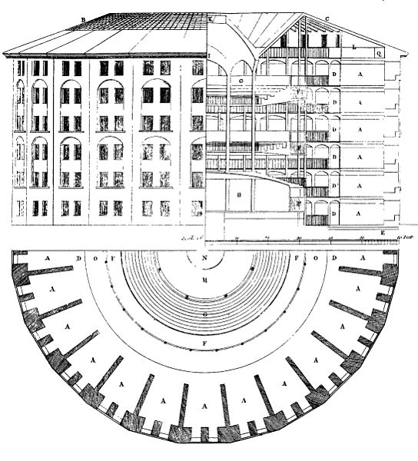
A-I. Bentham and Panopticon
An early influential piece on surveillance is Bentham’s (1787) Panopticon
The Panopticon was a design for a prison which allowed an observer to observe all prisoners without the prisoners knowing if they were being observed
Internalization of surveillance by the watched results behaviour modification

Slide 4
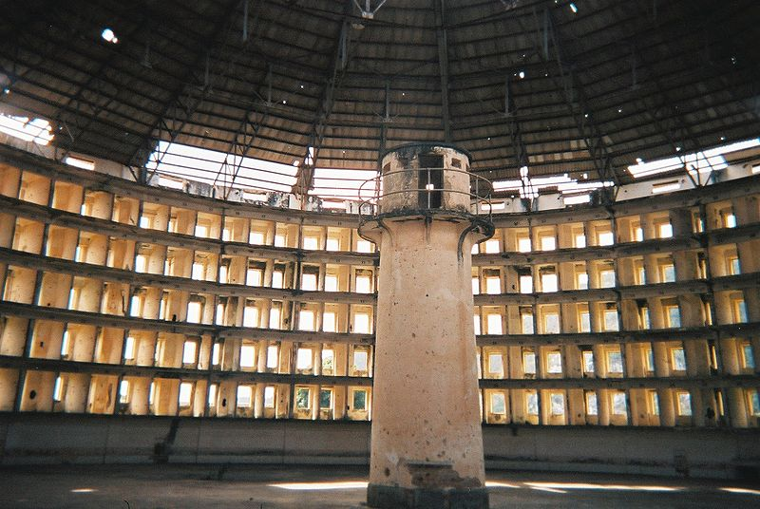
A-II. Panopticon and Presidio Modelo
Presidio Modelo in Cuba is one of many examples of a panoptic prison

Slide 5
A-III. Foucault (1979) and Panopticon
Panoptic surveillance creates discipline, specifically self discipline and the possibility of surveillance becomes internalized
Internalization makes surveillance redundant
Panoptic power and discipline is not limited to prison, but found in schools and hospitals
Panoptic discipline eliminates the need for more explicit methods of domination
However, the Panopticon as a surveillance concepts, has been critiques as overused (Lyon, 2007)

Slide 6
A-IV. Surveillance and Modernity
Surveillance is an inescapable element of modernity (Lyon, 2007; Giddens, 1990)
Over time surveillance has moved from focusing on animals to prisoners, then criminal suspects, non-citizens, the ill and children, and eventually all society (Marx, 2008)
Almost all of us are carrying at least one device that permits an incredible amount of surveillance
Giddens (1990) argues that surveillance is a key aspect of modernity and necessary to ensure efficiency in a complex society
He saw two kinds of surveillance (1987)
Accumulation of coded information used to administer activities of individuals about whom it is gathered
Direct supervision of the activities of some individuals by others who have power over those they supervise

Slide 7
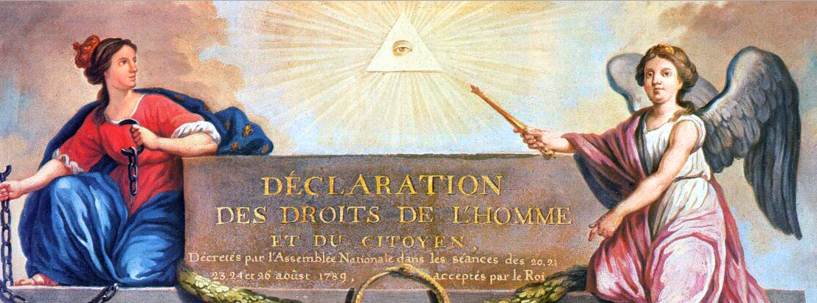
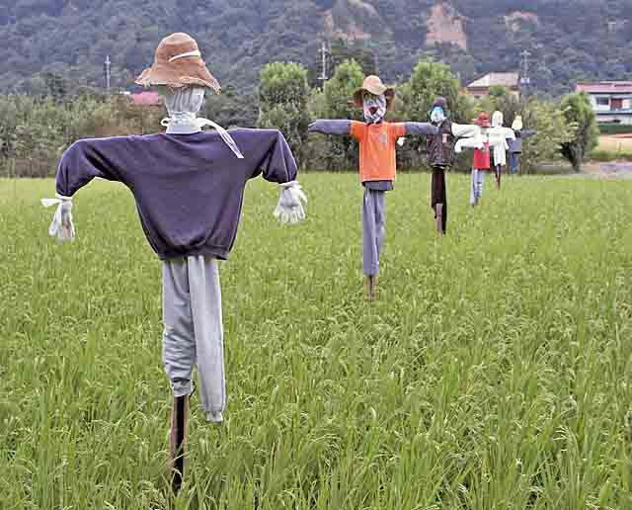
A-V. Seen/Seeing Dyad
Panoptic design breaks the seen/seeing dyad
Conceptually related to the Eye of Providence
The potentially observed cannot take comfort in the fact that they cannot see anyone observing them
Knowledge or lack of knowledge about surveillance has important implications for the effectiveness of surveillance

Slide 8
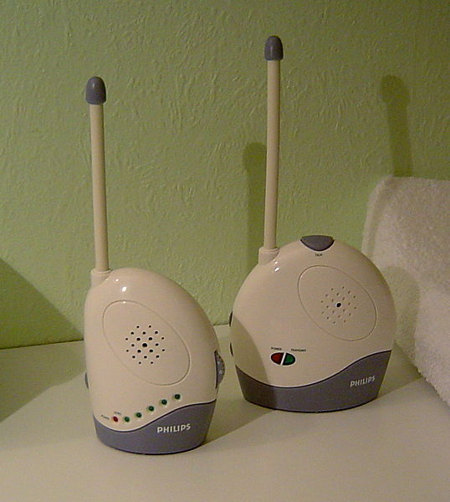
A-VI. Surveillance with a Friendly Face
Surveillance can motivated by care
Lifeguard and baby monitor are
two classic examples
However, even care based surveillance may have behavioural implications

Slide 9
A-VII. State and Military Surveillance
Historically, surveillance by the state associated with shadowy intelligence operatives (e.g. CIA, KGB) and totalitarian states in particular
According to Koehler (1999 p.9):
Soviet Union had 1 full time KGB agent for every 5,830 citizens
Gestapo (Nazi Germany) had 1 officer for every 2,000 citizens
Stasi (East Germany) had 1 secret policeman for every 166 citizens
Including full and partime Stasi informers the ratio rises to 1 for every 6.5 citizens
UK is one example of a democracy with extensive video surveillance
Estimated to have between 4 and 5.9 million CCTV cameras (BBC, 2015)
Surveillance by state authorities can range from local police to national intelligence agencies
Watch the following video for an example of local (police) surveillance in Florida http://www.youtube.com/watch?v=WA5Gy32aqdo

Slide 10
A-VIII. Worker Surveillance
Marx placed great emphasis on surveillance of workers by owners (Lyon, 2007), and Weber noted that bureaucracies have strong tendencies to engage in surveillance (Lyon, 2010)
Taylorism and its critiques (notably Braverman (1998)) also highlighted the role of surveillance in labour processes
Introduction of ICTs into workplaces has greatly expanded the surveillance power of employees
For example Enterprise Content Management systems:
“incorporate sophisticated systems for surveilling workers while on the job and advanced auditing capabilities for analyzing performance. They facilitate the creation of an intellectual assembly line, while providing management panoptic surveillance over each employee and piece of work.” McNally, 2010, p. 357-58

Slide 11
A-XI. Consumer Surveillance
In addition to surveillance by the state, an other major area of recent concern is surveillance by corporations
Variety of mechanisms for doing so
IP addresses and cookies on the internet
Loyalty cards
RFID tags and in store surveillance
Collection of personal information at the checkout
Wi-fi based tracking of customers in stores (see Euclid Analytics)
Primary aim is to predict consumer behaviour; however consumer information is also a valuable commodity even if it is de-individualized

Slide 12
A-XI(ii). Consumer Surveillance
As consumers we are highly conscious of surveillance efforts to prevent shoplifting/theft
Watch: http://www.youtube.com/watch?v=eob532iEpqk
However, we are much less cognizant of behaviour surveillance
Watch: https://www.youtube.com/watch?v=MV-_12bRenw
Surveillance is now also become a marketable feature of some products
Watch: https://www.youtube.com/watch?v=orc5fBf14vs
Watch the video at the top of the following story: http://www.cbc.ca/news/business/car-tracking-device-could-lower-premiums-insurers-claim-1.1364666

Slide 13
A-X. Library Surveillance
The library has a long history as an area for surveillance
In the current context one of the primary issues is the impact of the Uniting and Strengthening America by Providing Appropriate Tools Required to Intercept and Obstruct Terrorism Act (USA PATRIOT Act)
During the Cold War the FBI ran the Library Awareness Program with three main objectives (Foerstel, 1991)
Halt Soviet access to unclassified technical information
Recruit librarians as FBI informants
Prevent the KGB from recruiting librarians

Slide 14
A-XI. Surveillance and Data
Automated surveillance of data (dataveillance) is now the principal means of surveillance
Aggregation of communications metadata and contents is at the centre of the PRISM program, including a strong emphasis on metadata mapping
Because of the volume of surveillance, data surveillance is particular effective because it facilitates automated data mining and knowledge discovery in databases (KDD) (Vedder, 1999) and the use of predictive analytics (see for example: Andrejevic, 2013)

Slide 15
B-I. Canada’s Surveillance Regime
Provincial and national surveillance by RCMP, OPP (Ontario Provincial Police) and SDQ (Sûreté du Québec)
Major focus includes organized crime and terrorism
Canadian Security Intelligence Service (CSIS) conducts intelligence gathering operations in relation to national security
Mandate is outlined in the Canadian Security Intelligence Service Act (R.S.C., 1985, c. C-23)
Communications Security Establishment (CSE) collects a) foreign signals intelligence, b) protects government information and information infrastructure, and c) provides technical assistance to federal law enforcement and security agencies
Mandate outlined in the National Defence Act (R.S.C., 1985, c. N-5) and was revised in response to 9/11

Slide 16
B-II. Surveillance Oversight
Both CSIS and CSE are subject to review by independent oversight bodies
CSE Commissioner for the CSE
Security Intelligence Review Committee for CSIS
There has been considerable interest in the CSE’s bulk collection of metadata
CSE Commissioner had found bulk metadata collection not in compliance with the law in 2015 (CSE Commissioner, 2016)
However, more recent CSE Commissioner report notes, “This past year, all of the CSE activities reviewed complied with the law.” (CSE Commissioner, 2016, p. 13)
The 2015 concerns were the first time the CSE has been found non-compliant by the CSE Commissioner

Slide 17
B-III. CSE and International Cooperation
CSE has a well known history of collaborating as part of the ‘five eyes’ partnership
US – National Security Agency
UK – Government Communications Headquarters
Australia – Defence Signals Directorate
New Zealand – Government Communications Security Bureau
CSE is legally prohibited from asking its partners to conduct surveillance of Canadians

Slide 18
B-IV. Lawful Access Legislation
Between Oct. 29 and Nov. 1 2010, the Conservative government introduced three bills to expand surveillance over telecommunications
C-50 Improving Access to Investigate Tools for Serious Crime Act
C-51 Investigative Powers of the 21st Century Act
C-52 Investigating and Preventing Criminal Electronic Communications Act
None of the bills moved beyond first reading

Slide 19
B-IV(ii). Lawful Access Legislation
In 2012 the Conservatives introduced C-30 Protecting Children from Internet Predators Act
Bill fell victim to Public Safety Minister Vic Toews ill-conceived view of those who didn’t support the bill
http://www.youtube.com/watch?v=X-eeP6IVlLU
Bill C-13 in 2014 ultimately introduced lawful access legislation
Did so by attaching it to a bill about cyber-bullying
Key issue with lawful access is the Form 5.001 that allows police and peace officers to make preservation demands for computer data without a warrant

Slide 20
B-V. Expanding Surveillance in Canada
Bennet et al. (ed.) (2014) identify several factors leading to expanding surveillance in Canada:
Increased technological potential
Growing personal information economy
Neoliberalism
Ascendency of risk management
National security concerns
Public perceptions
New laws

Slide 21
C-I. USA PATRIOT Act
The USA PATRIOT Act was passed in October (26th) 2001 in wake of the 9/11 attacks
It’s a far reaching piece of legislation dealing with a range of issues including:
Surveillance and intelligence
Anti-money laundering
Border security
The PATRIOT Act weakens privacy rights by expanding surveillance
The act has also been strongly condemned by most librarians and library associations as it turns the library into a place of government surveillance (again)

Slide 22
C-I(ii). USA PATRIOT Act
There are several impacts of the PATRIOT Act on privacy:
Search warrants granted under the act do not require reasonable cause, they simply need to be “relevant” to an ongoing investigation
Search warrants no longer have to name individuals to be searched
Individuals subject to search warrants no longer have to be presented with the warrant and informed of the search
Search warrants no longer have to be specific with respect to location, and in the case of communications equipment used by the public all users can be searched
Finally for trails resulting from investigations under the act the evidence being used against the accused does not need to be provided to him/her
In Canada the Security Certificate system has many similar features

Slide 23
C-II. The PATRIOT Act and the ALA
Section 215 of the PATRIOT Act has been hotly contested by the library community
s. 215 allows access to records under the Foreign Intelligence Surveillance Act including library records
The ALA has taken a strong stand against the PATRIOT Act and has many resources about the act on its website
In the original act the s. 215 powers had a sunset (expiry) date
PATRIOT Act s. 215 finally expired on June 1, 2015

Slide 24
C-III. ECHELON, Total Information Awareness and PRISM
ECHECLON was Cold War surveillance program run jointly by the US, UK, Canada, Australia and New Zealand
Total Information Awareness was a program that grew out of the post 9/11 environment, though it was extremely short lived
Watch: http://tv.msnbc.com/2013/07/02/before-prism-there-was-total-information-awareness/
PRISM is the latest major surveillance project revealed by leaks from Edward Snowden

Slide 25
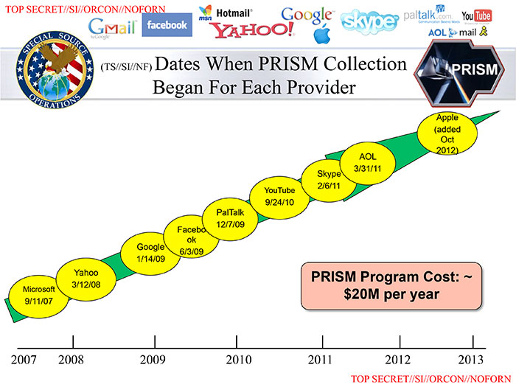
C-IV. PRISM and In-Q-Tel
Notably, private enterprise has been essential to PRISM
Since 1999 the CIA has been actively involved in financing surveillance technologies through In-Q-Tel

Slide 26
Discussion and Activity
Should we be more concerned with surveillance by governments or corporations – why? What can or should be done, if anything?
Activity – go somewhere (preferably not a library or your place of work) and examine the technologies of surveillance
What kinds of surveillance technologies are there?
How visible are they?
How clear is the information about the surveillance activities going on?
Report on what you find
But, don’t do something that will get you arrested

Slide 27
Next Week
Feb 20-26 Reading Week – No class, lecture or discussion
Feb 27 to Mar 5 – Copyright
Read CCH Case, Nair, Owen
Note: Paper outlines are due Feb. 27 by 23:55 MST (the Feb. 26 date in the syllabus is incorrect)

Slide 28
Sources
Bennett, Colin J., Kevin D. Haggerty, David Lyon, and Valerie Steeves (Eds.). Transparent Lives: Surveillance in Canada. Edmonton, AB: Athabasca University Press.
Bentham, Jeremy. 1787. Panopticon: Or the Inspection-House. Dublin: Thomas Bryne.
Braverman, Harry. 1998. Labor and Monopoly Capital. 25th Anniv. Ed. New York: Monthly Review Press.
BBC. 2015. “Too Many Cameras Useless, Warns Surveillance Watchdog Tony Porter.” 26 Jan. 2015. http://www.bbc.com/news/uk-30978995
Canada – Office of the Communications Security Establishment Commissioner. 2016. Annual Report 2015-2016. https://www.ocsec-bccst.gc.ca/s21/s68/eng/2015-2016-annual-report
Foerstel, Herbert N. 1991. Surveillance in the Stacks: The FBI’s Library Awareness Program. New York: Greenwood.
Foucault, Michel. 1979. Discipline and Punish: The Birth of the Prison. New York: Vintage Books.
Giddens, Anthony. 1987. The Nation-State and Violence. Berkeley, CA: University of California Press.
Giddens, Anthony. 1990. The Consequences of Modernity. Stanford, CA: Stanford University Press.
Lyon, David. 2007. Surveillance Studies: An Overview. Cambridge, UK: Polity.
Lyon, David. 2010. “Surveillance, Privacy, and the Globalization of Personal Information: Introduction.” In Surveillance, Privacy and the Globalization of Personal Information: International Comparisons. Elia Zureik, L. Lynda Harling Stalker, Emily Smith, David Lyon and Yolande E. Chan (Eds). Montreal, QC: McGill-Queen’s University Press. 1-4.
Marx, Gary T. 2008. “Surveillance and Technology: Contexts and Distinctions.” In Information Technology and Librarianship: New Critical Approaches. Gloria J. Leckie and John E. Buschman (Eds.). Westport, CN: Libraries Unlimited. 47-59.
McNally, Michael B. 2010. “Enterprise Content Management Systems and the Application of Taylorism and Fordism to Intellectual Labour.” Ephemera: Theory and Politics in Organization, 10(3/4): 357-373.
Vedder, Anton. 1999. “KDD: The Challenge to Individualism.” Ethics and Information Technology, 1: 275-281.

Slide 29
Image Sources
Slide A-I. – “Plan of the Panipticon.” Jeremy Bentham. 1843. https://commons.wikimedia.org/wiki/File:Panopticon.jpg
Slide A-II. – “Presidio Modelo.” Friman. 2005. CC-BY-3.0. https://commons.wikimedia.org/wiki/File:Presidio-modelo2.JPG
Slide A-V. – “Declaration of the Rights of Man and of the Citizen [cropped].” Jean-Jacques-Francois Le Barbier. 1789. https://commons.wikimedia.org/wiki/File:Declaration_of_the_Rights_of_Man_and_of_the_Citizen_in_1789.jpg
Slide A-V. – “U.S. 1 Dollar Bill [cropped]/Pyramid with an all-seeing eye.” Benutzer:Verwustung. 2009. PD. https://commons.wikimedia.org/wiki/File:Dollarnote_siegel_hq.jpg
Slide A-V. “Scarecrow.” Unknown. 2005. PD. https://commons.wikimedia.org/wiki/File:Kakashi2.jpg
Slide A-VI. “Lifeguard Jumping into Action in Ocean City, Maryland.” Unknown. 2007. CC-BY-2.0. https://commons.wikimedia.org/wiki/File:Lifeguard_jumping_into_action,_Ocean_City,_June_27_,2007.jpg
Slide A-VI. “Baby Monitor.” Joris. 2006. PD. https://commons.wikimedia.org/wiki/File:Babymonitor.JPG
Slide C-IV. “PRISM.” United States National Security Agency. 2013. PD. https://commons.wikimedia.org/wiki/File:Prism_slide_5.jpg

Slide 30
Comments and Critique
Comments and critique on this presentation and any other material for LIS 598 Information Policy – Winter 2017 can be sent to Michael B. McNally at: mmcnally@ualberta.ca
Comments and critique will be used to improve future iterations of these materials

