Slide 1
Introduction to Systematic Review Searching
Sandy Campbell, Liz Dennett and Janice Kung
John W. Scott Health Sciences Library

Slide 2
Conflict of Interest Statement
I/we have no financial interests or other personal interests in any of the information products or other products that will be discussed in this class. Specifically I have no financial interests in any pharmaceutical companies.

Slide 3
How are Systematic Reviews Different from Other Reviews?
High quality systematic reviews seek to:
Identify all relevant published and unpublished evidence
Select studies or reports for inclusion
Assess the quality of each study or report
Synthesis the findings from individual studies or reports in an unbiased way
Interpret the findings and present a balanced and
impartial summary of the findings with due consideration of any flaws in the evidence.
Hemingway, Pippa and Nic Brereton. “What is a Systematic Review?” Evidence Based Medicine, 2nd Ed., 2009. http://www.medicine.ox.ac.uk/bandolier/painres/download/whatis/Syst-review.pdf. Accessed Feb. 16, 2012

Slide 4
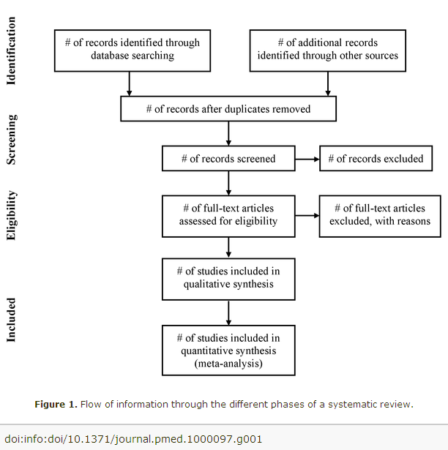

Slide 5
Sample Question:
In undergraduate medical education, does the use of clicker technology in the classroom improve learning outcomes?

Slide 6
PICOS – Well Built Clinical Query
PICOS | Ask yourself: | Example:
Population (patient) | How would I describe a group of patients similar to mine?
Intervention (drug, procedure, etc.) | Which main intervention, am I considering?
Comparison (optional) | What is the main alternative to compare with the intervention?
Outcome | What can I hope to accomplish, measure, improve or affect?
Study design | What study design would provide the best level of evidence for this question?
Notes:
Ask one question at a time
Define precisely what group, what condition, you are asking about (P)
Define intervention/exposure and comparison (I, C)
Have in mind clear, concrete outcomes (0)

Slide 7
Identify Major Concepts
Audience Response Systems
Health Professionals
SET 1
SET 2
Improved Educational Outcomes
SET 3

Slide 8
Identify Synonyms/Keywords
Audience Response Systems
Health Professionals
SET 1
Medical students
Clickers
SET 2
Electronic voting systems
Improved Educational Outcomes
Learning Outcomes
SET 3

Slide 9
Doing a better search
Things to think about:
Subject headings/controlled vocabulary
Alternate spellings - analyze/analyse, fetus/foetus
Alternate endings - learner/learns/learning/etc
Synonyms – doctor/physician/clinician
Trade names/generics –
iClicker/audience response system
Antonyms – success/failure, increase/decrease
Homonyms -same word - different meanings –
patient educators (patients who educate doctors)
patient educators (people who educate patients)
Acronyms – task-based learning or TBL

Slide 10
How to combine concepts
Use OR to create a large set of synonyms Use AND to find articles containing all three of your concepts
Use NOT to remove a known undesired concept or set OR = More (doctors OR physicians OR residents) AND = Less (clickers AND learning)
NOT = Less (clickers NOT bedside) ( Set 1 NOT Set 2)

Slide 11
Audience Response Systems
Health Professionals
OR
SET 1
Medical students
OR
Clickers
SET 2
AND
Electronic voting systems
Improved Educational Outcomes
Learning Outcomes
OR
SET 3
OR = More (clickers OR electronic voting systems) AND = Less (clickers AND learning outcomes)

Slide 12
Build your own search
The “health” concept can be excluded because the records in the database should be about health.

Slide 13
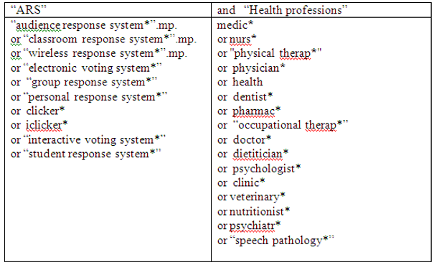
Education Databases
“eductation” concept does not need to be included because most of the materials in the database will be education-related

Slide 14
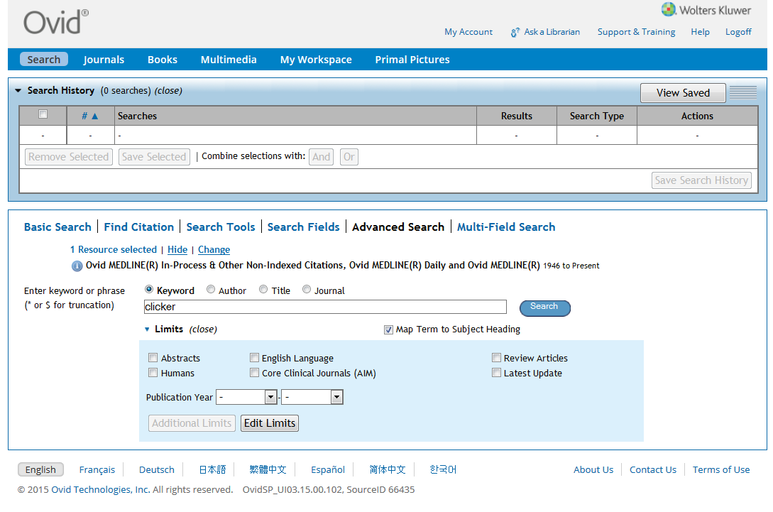

Slide 15
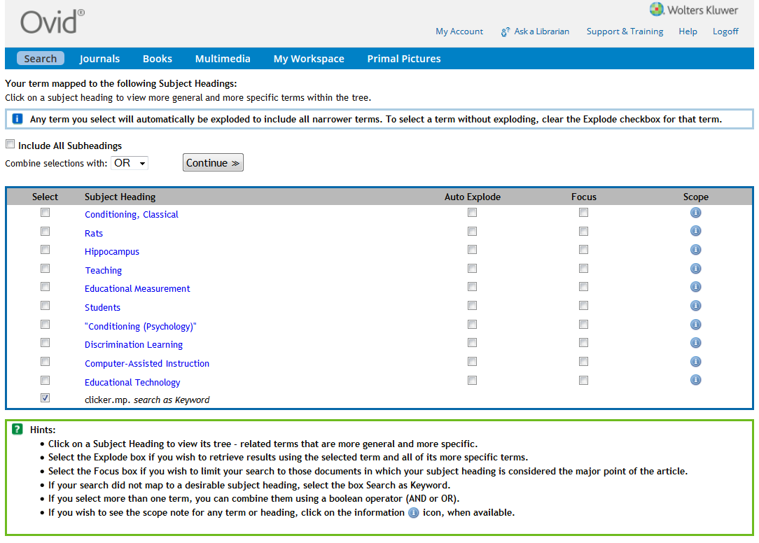

Slide 16
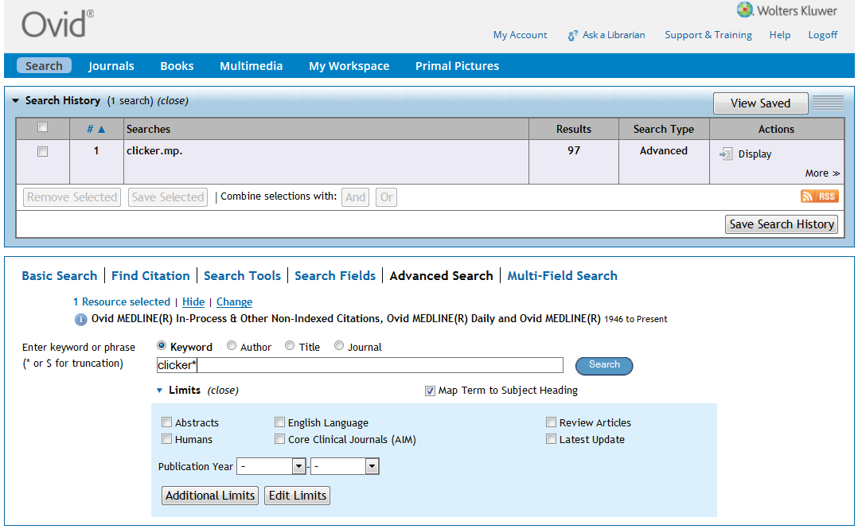

Slide 17
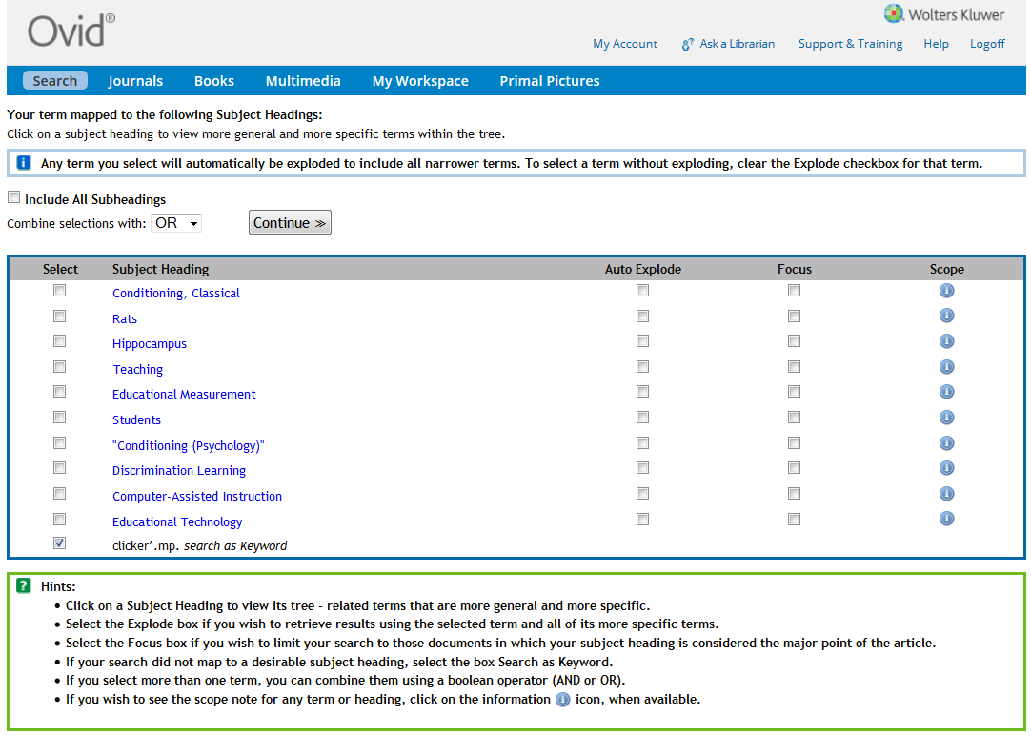

Slide 18
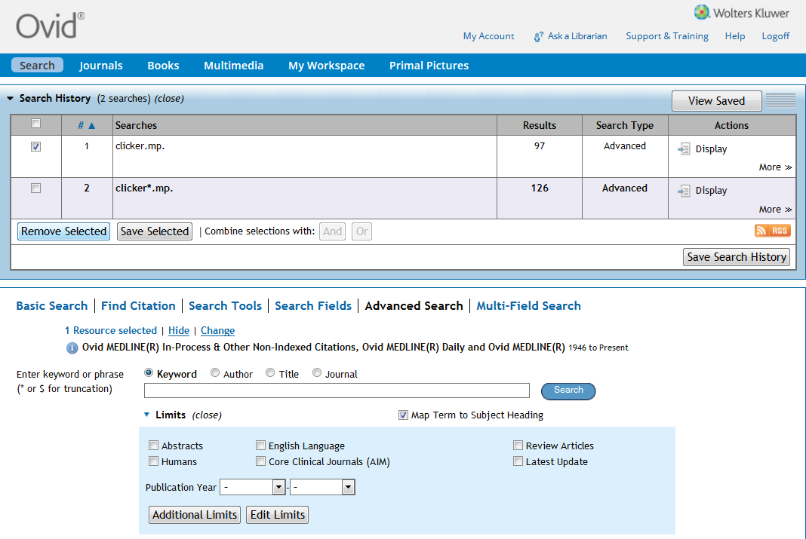

Slide 19
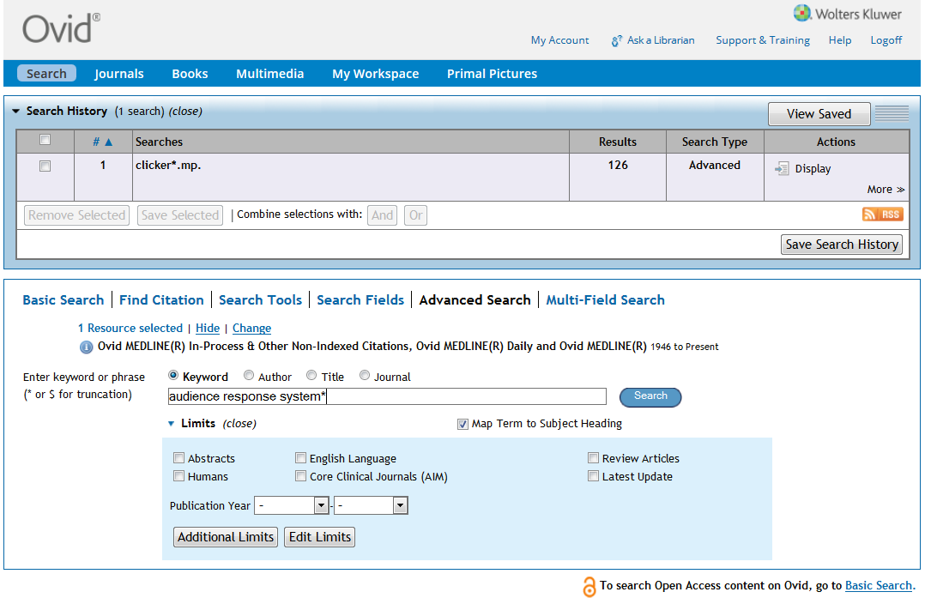

Slide 20
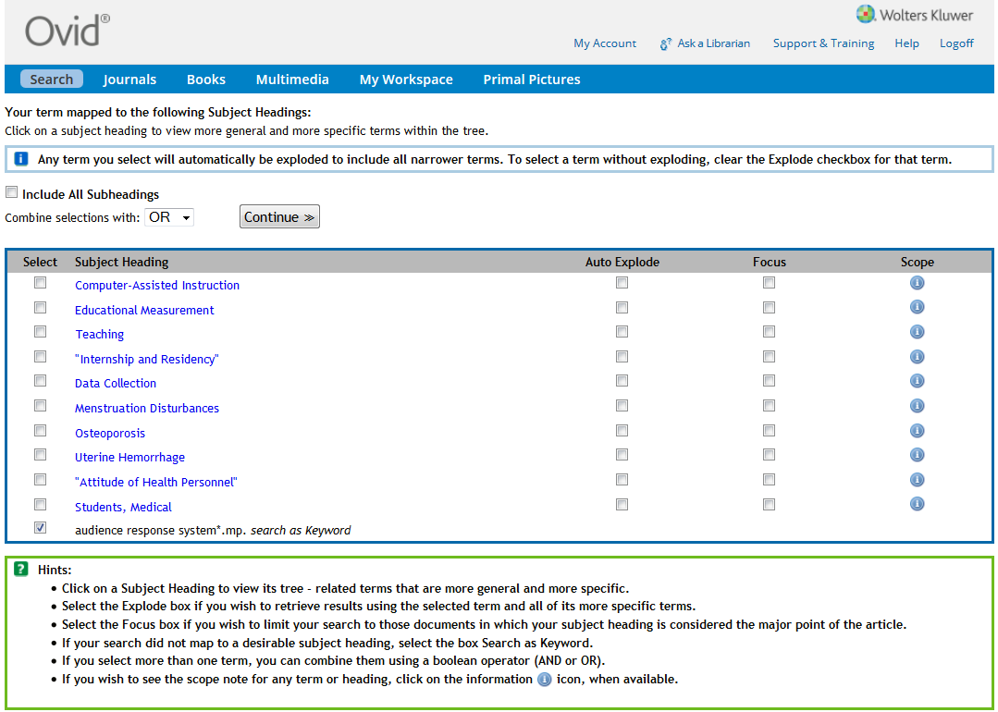

Slide 21
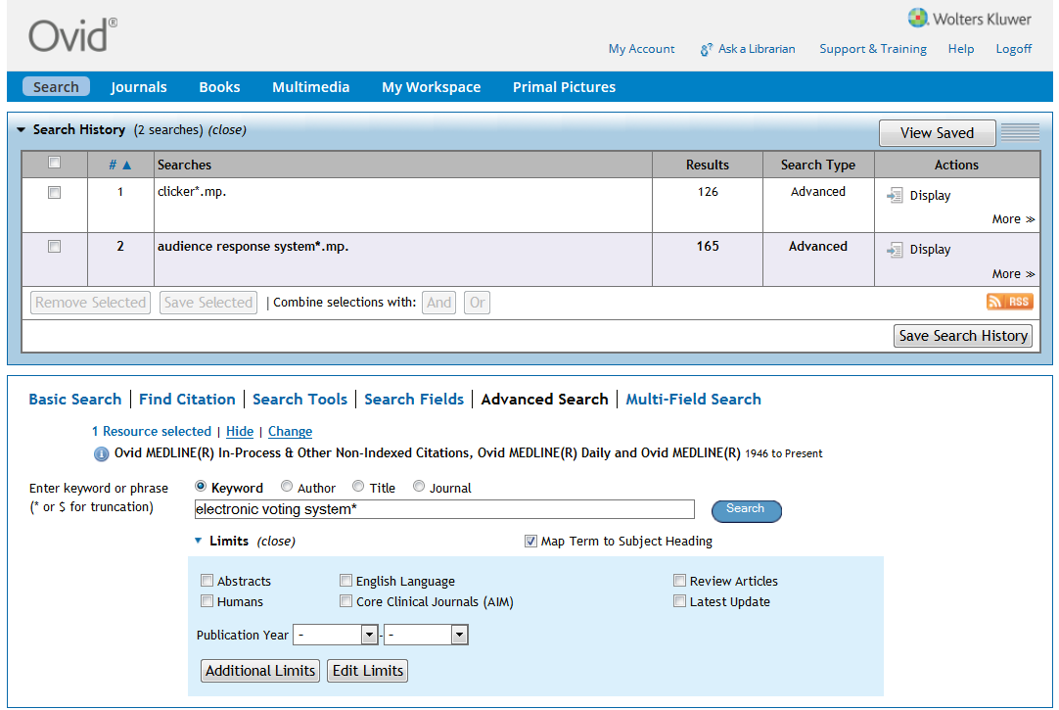

Slide 22
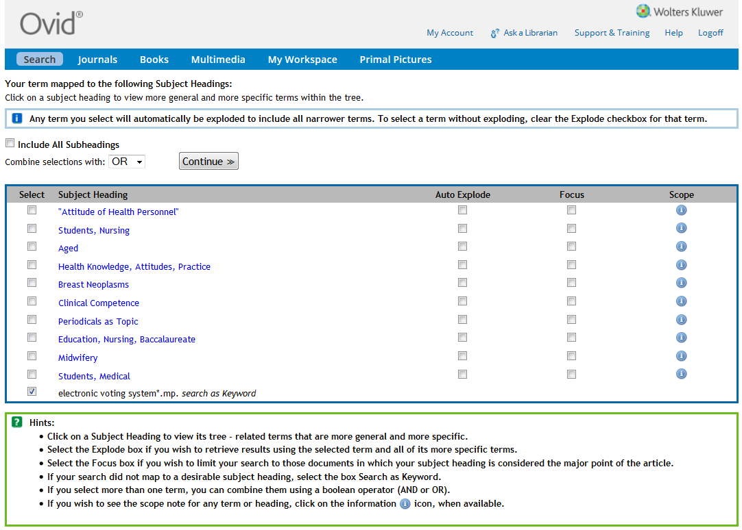

Slide 23
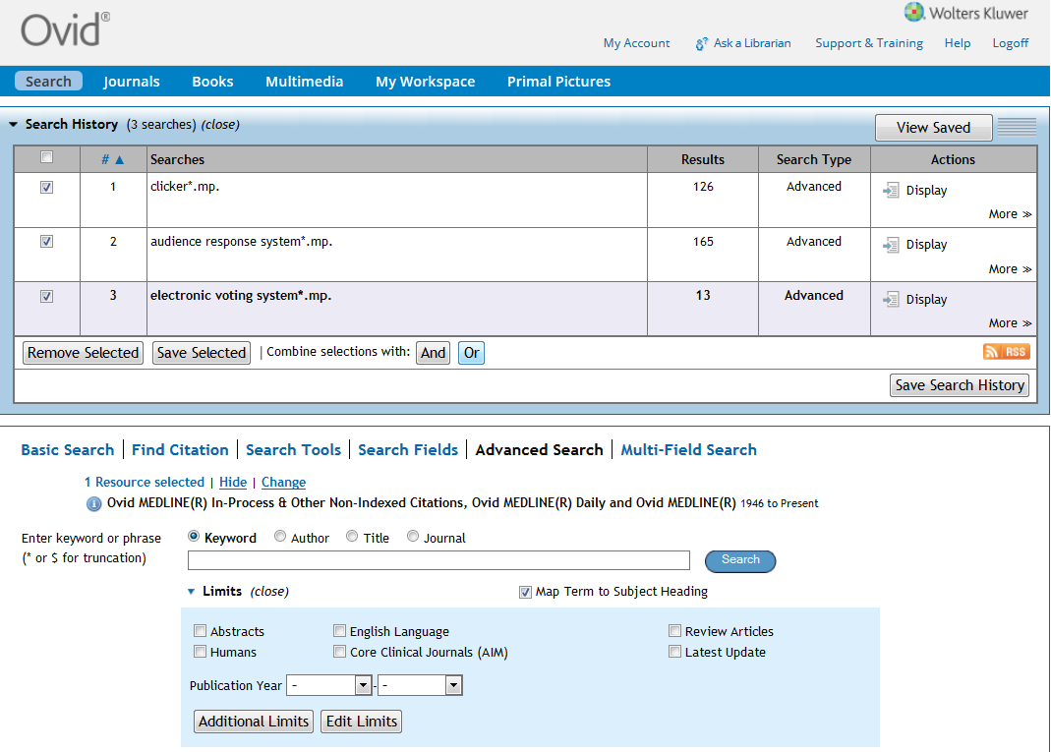

Slide 24
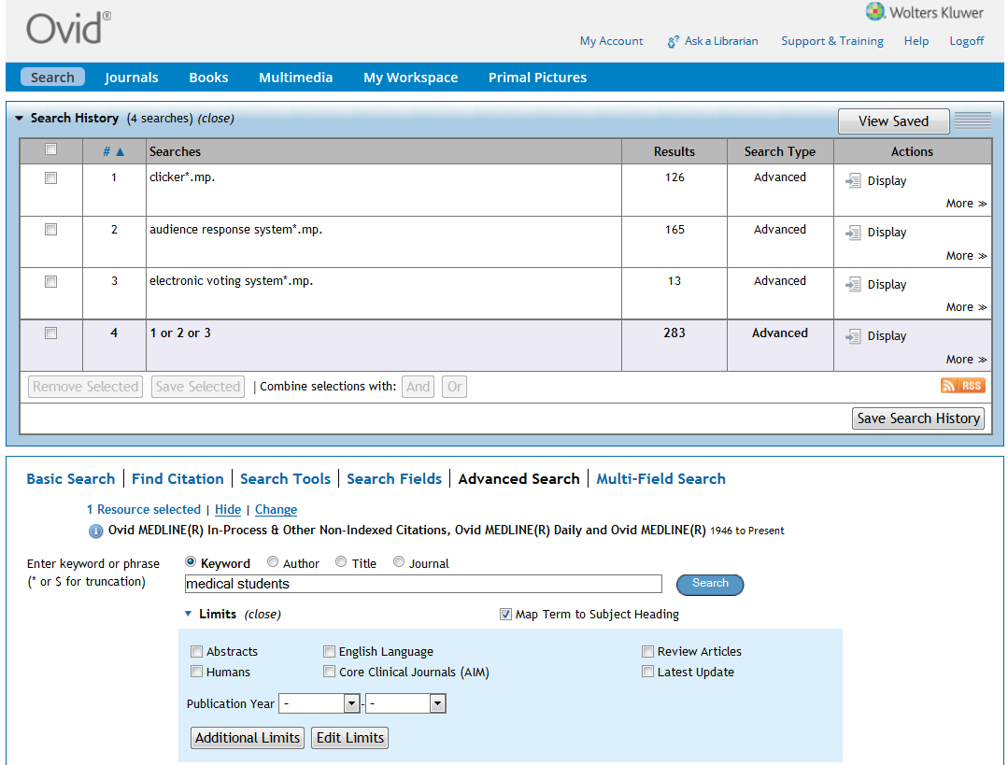

Slide 25
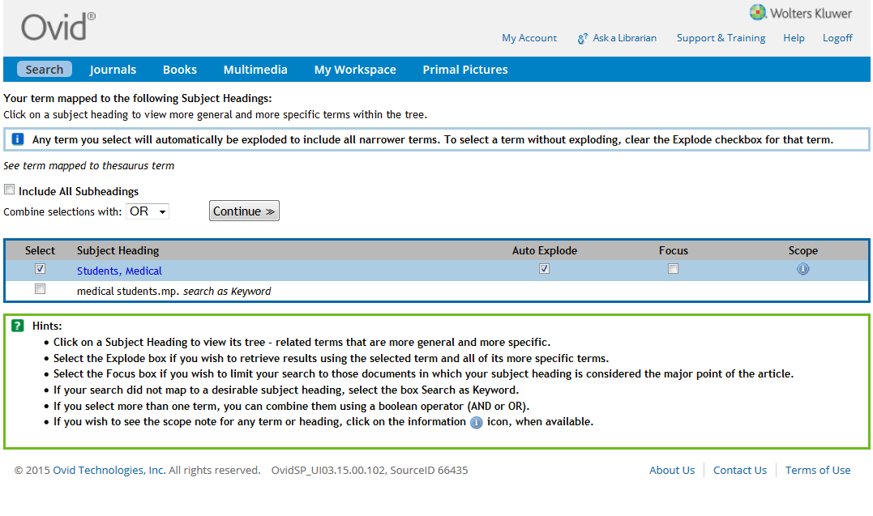

Slide 26
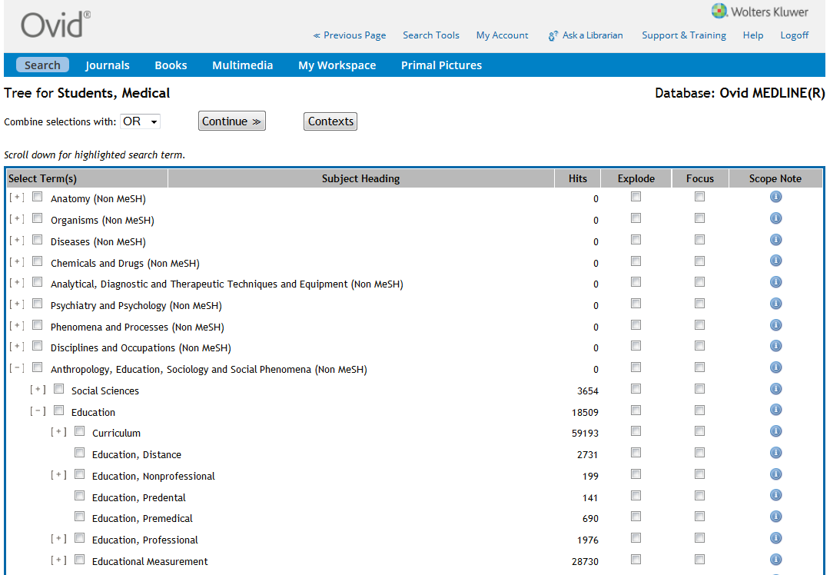
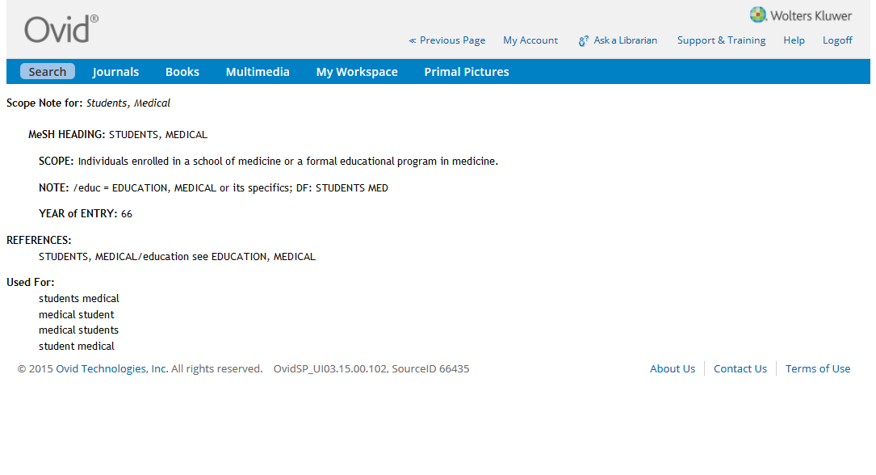
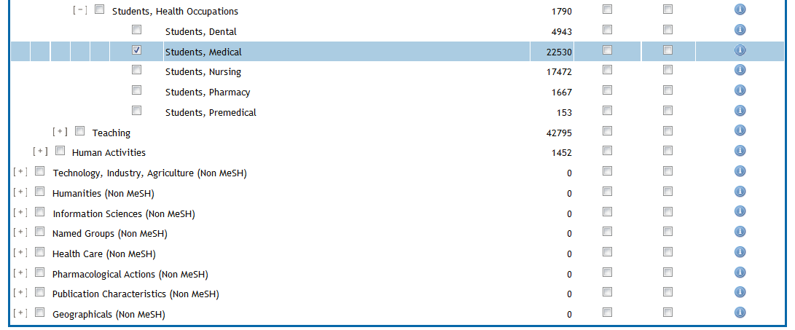

Slide 28
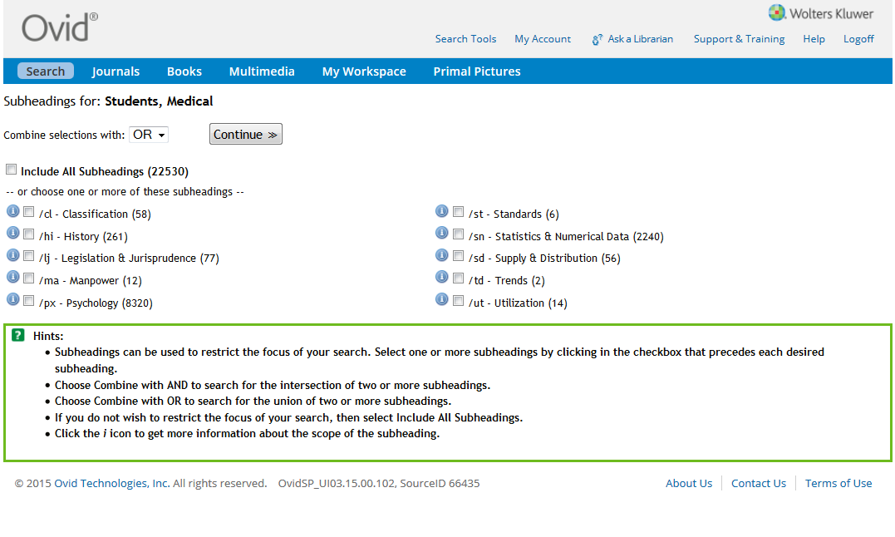

Slide 29
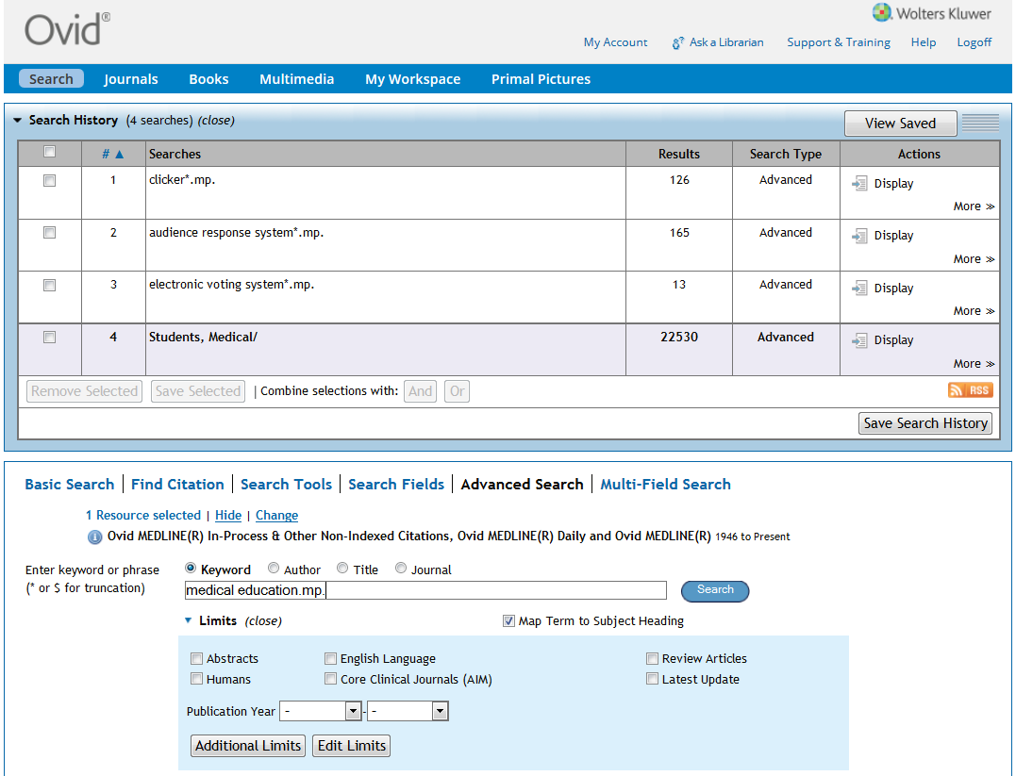

Slide 30
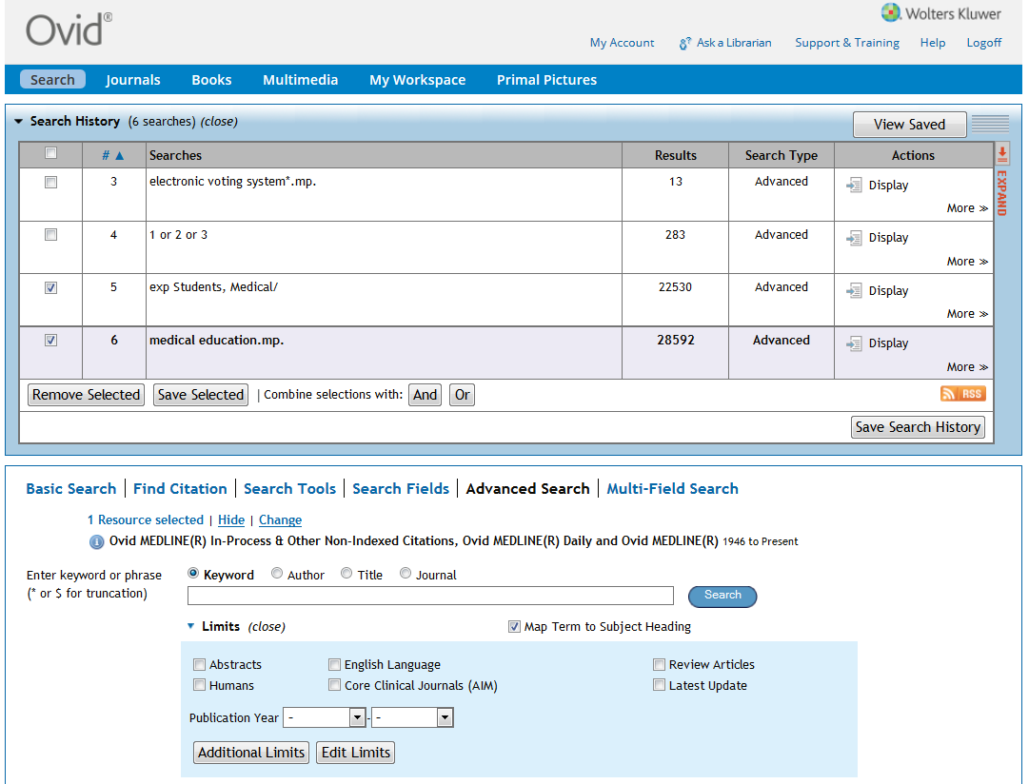

Slide 31
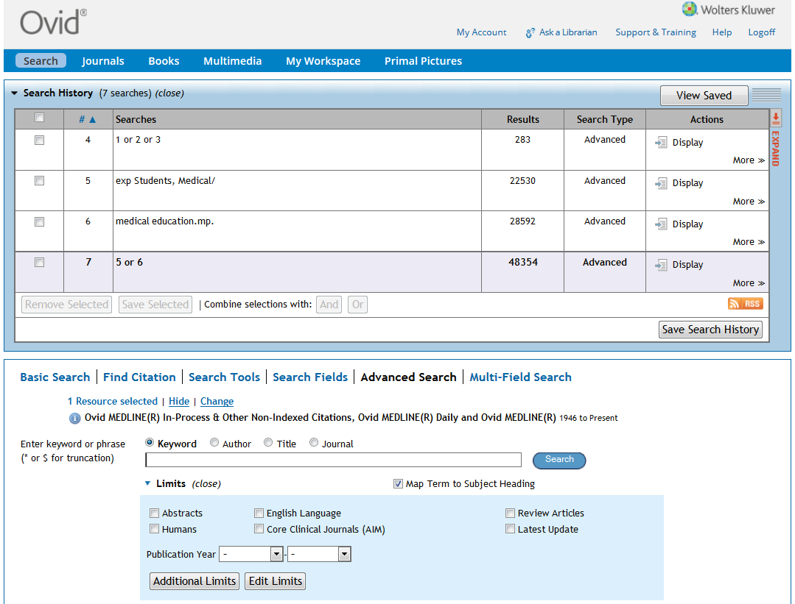

Slide 32
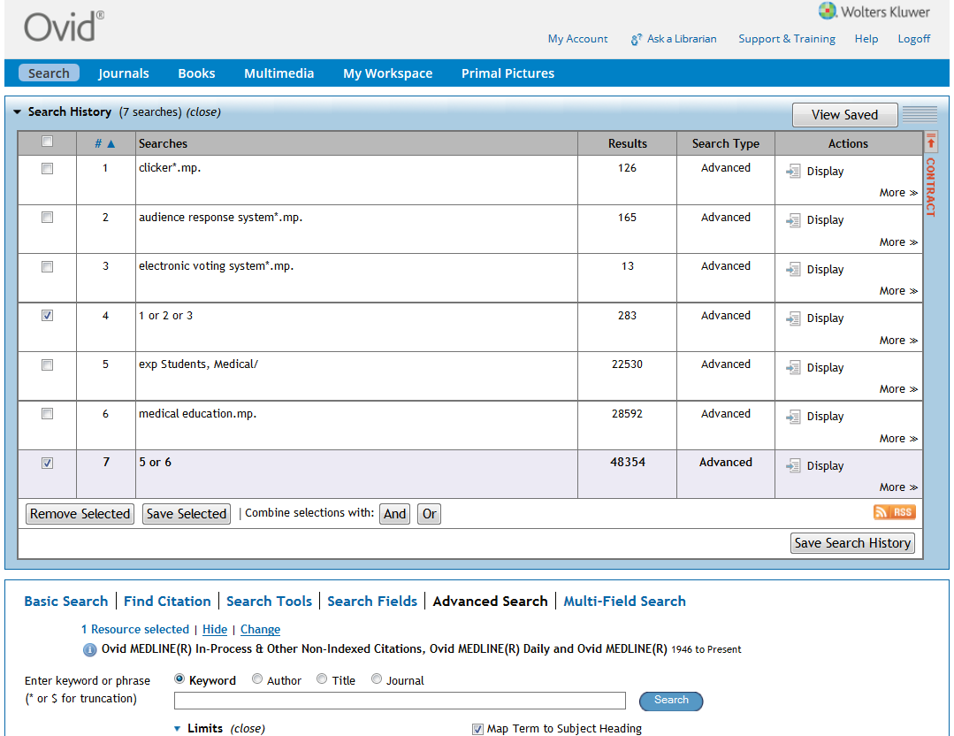

Slide 33
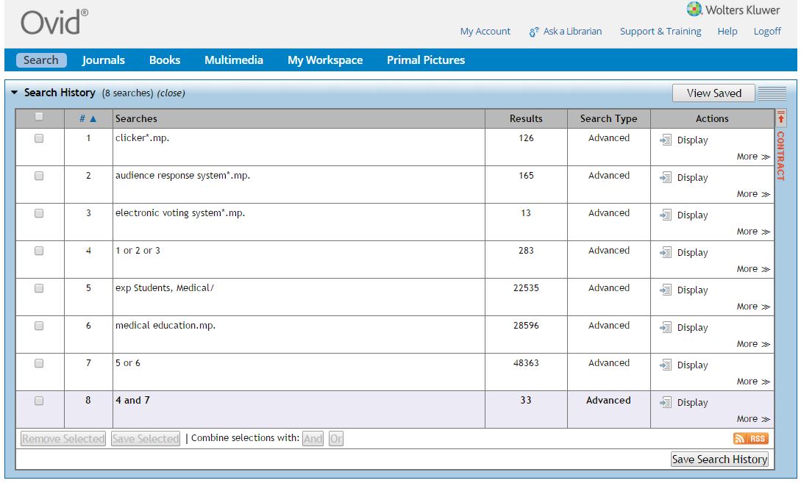

Slide 34
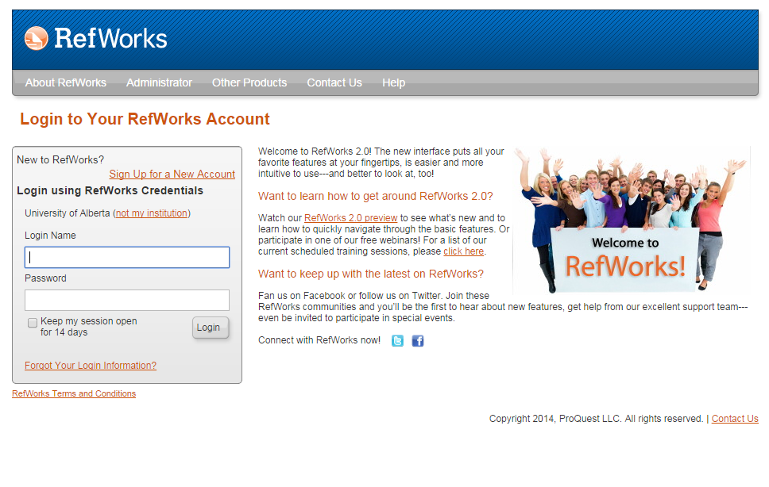

Slide 35
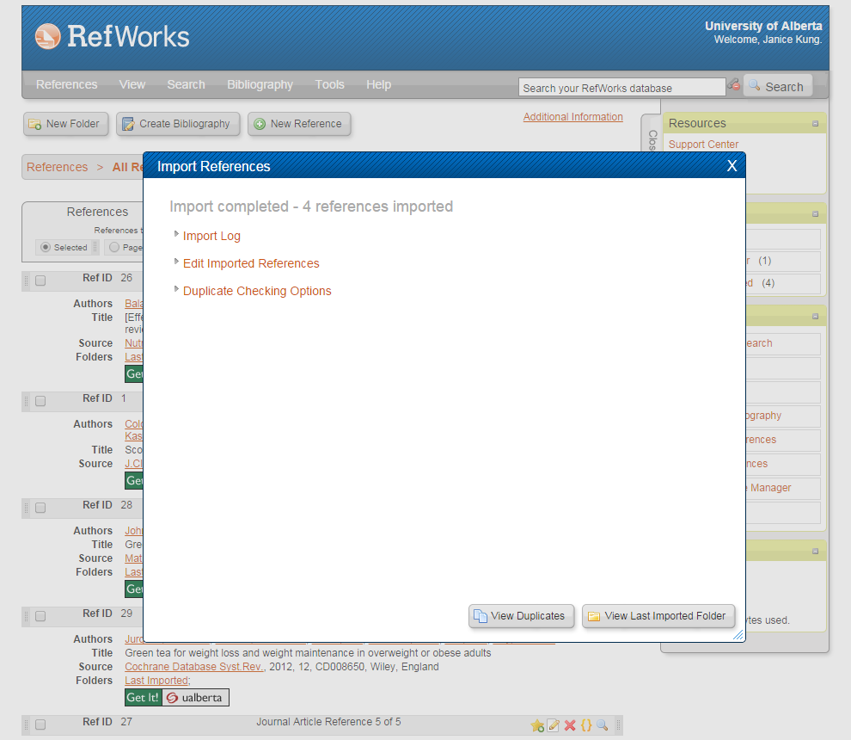

Slide 36
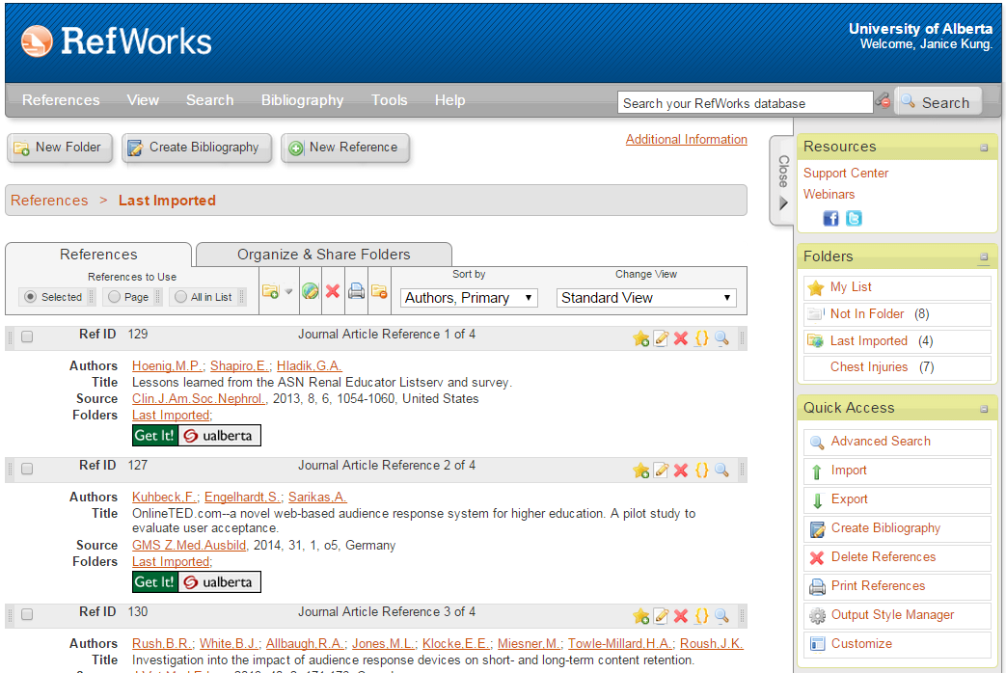

Slide 37
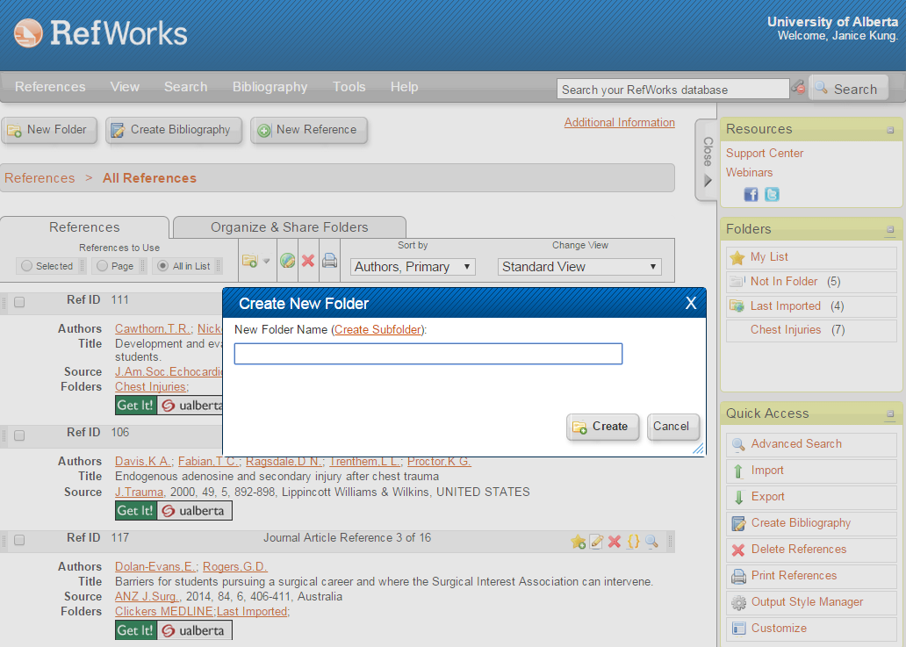
Clickers MEDLINE

Slide 38
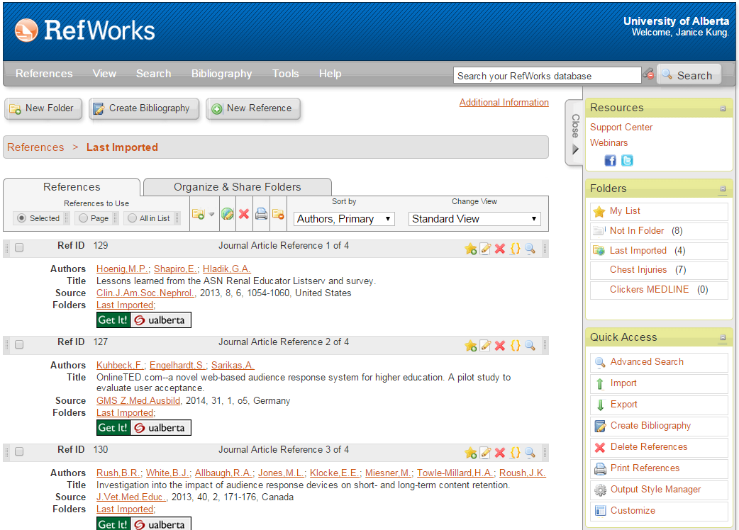

Slide 40
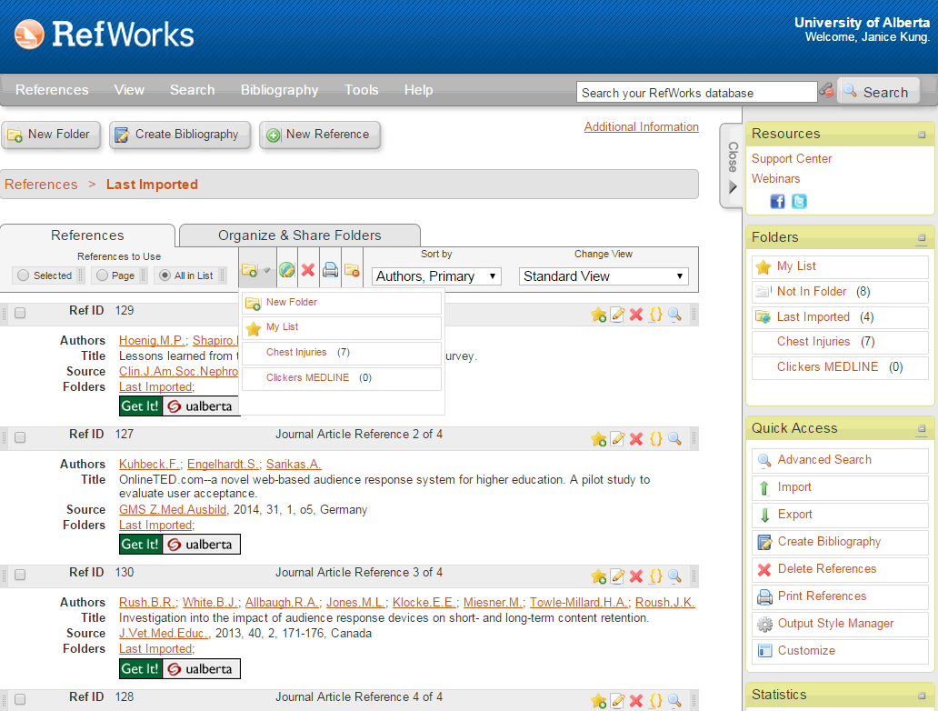

Slide 41
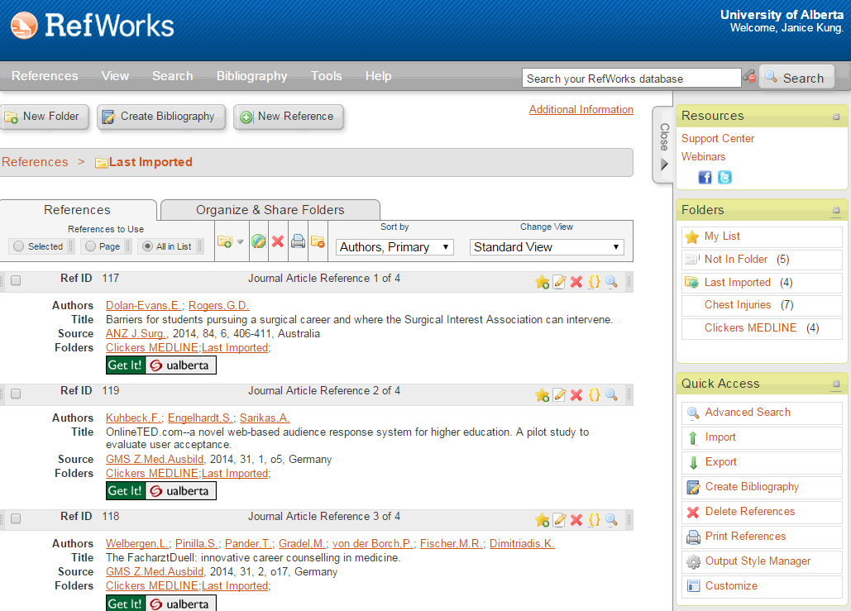

Slide 42
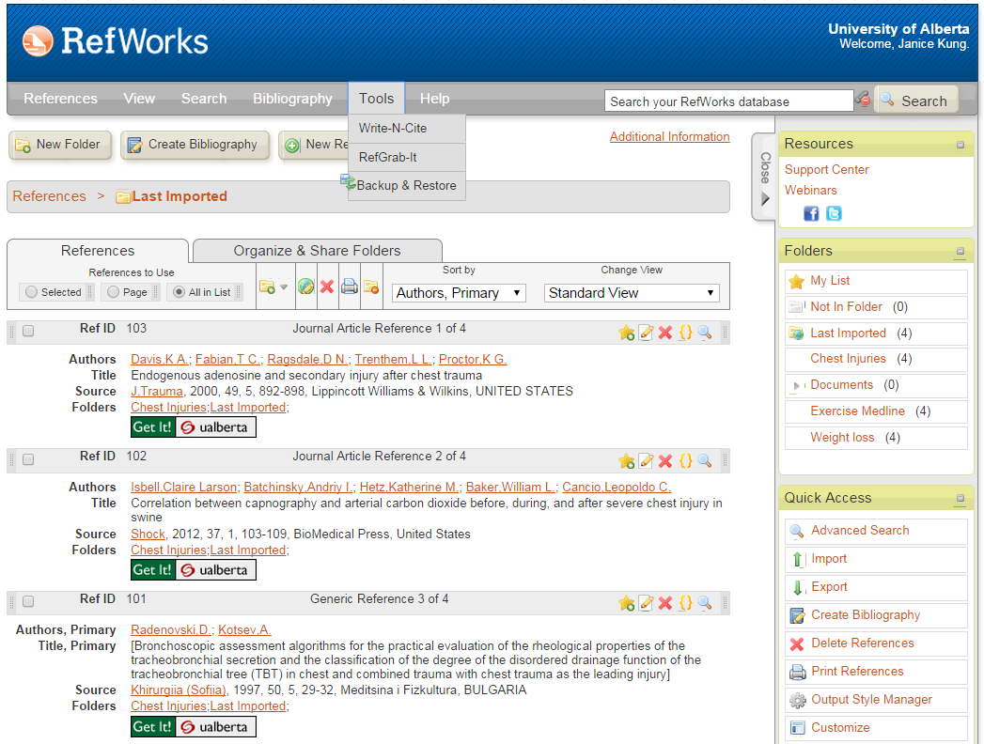

Slide 43
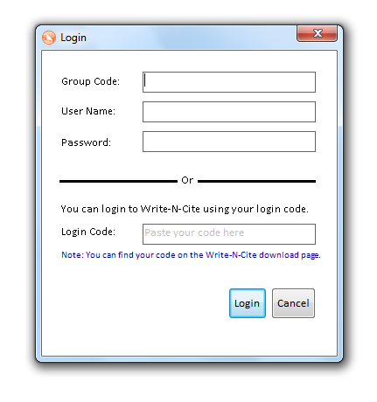
Using Write-n-Cite in Word

Slide 44
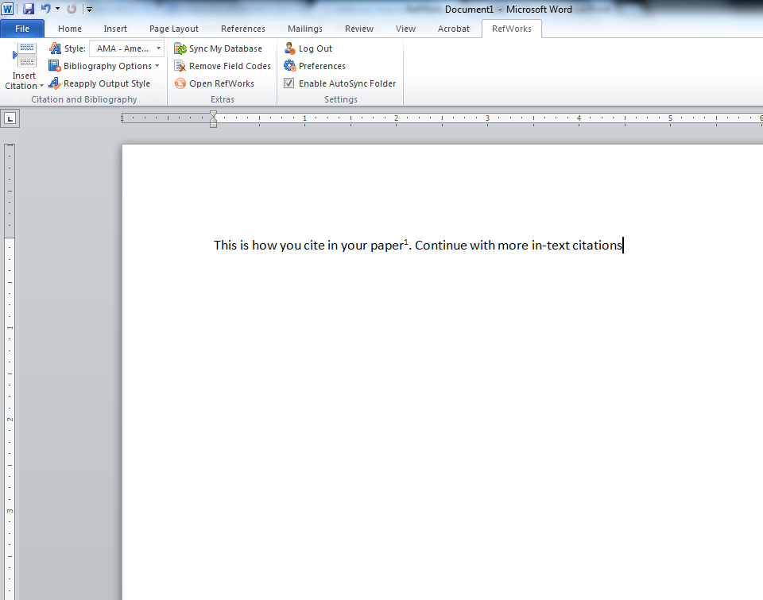

Slide 45
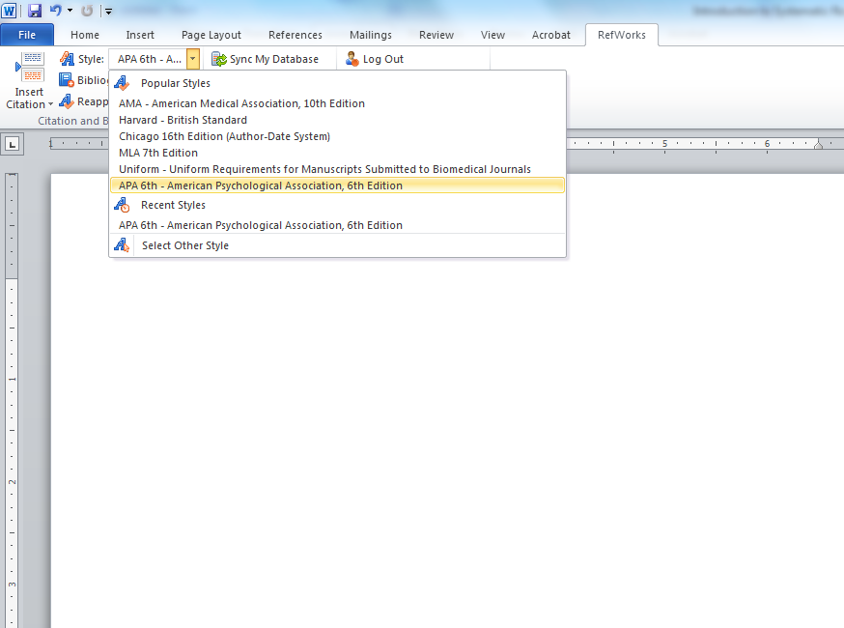

Slide 46
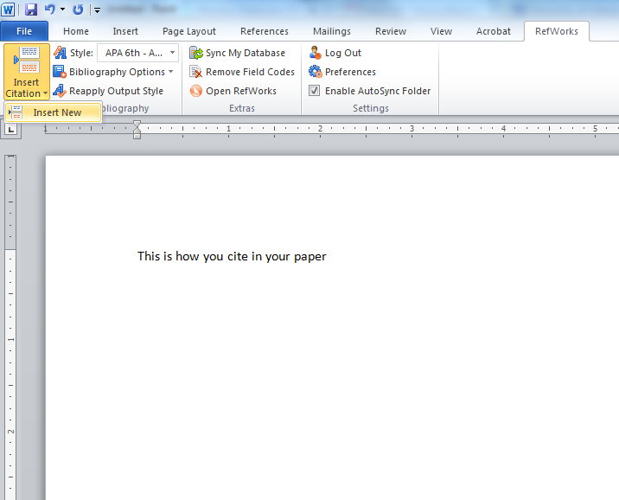
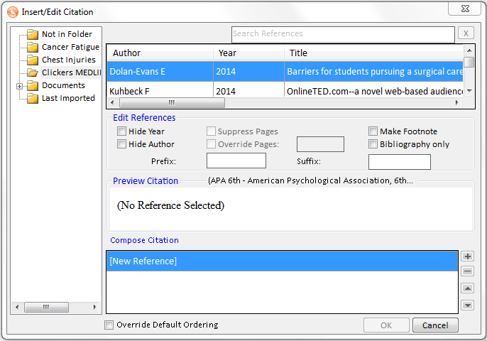

Slide 47
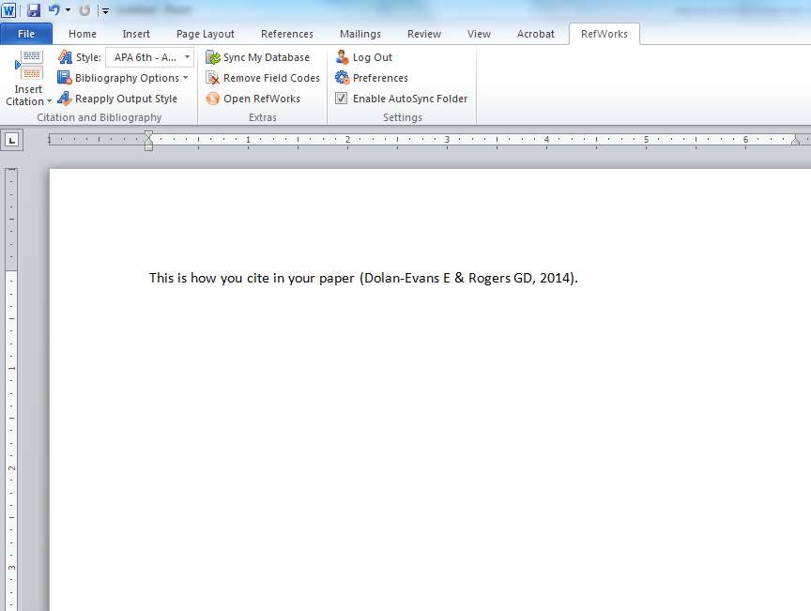

Slide 48
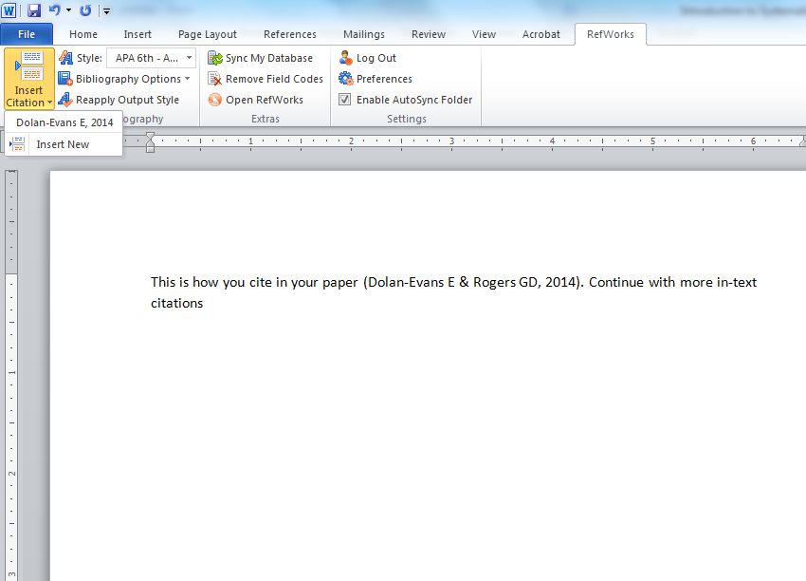
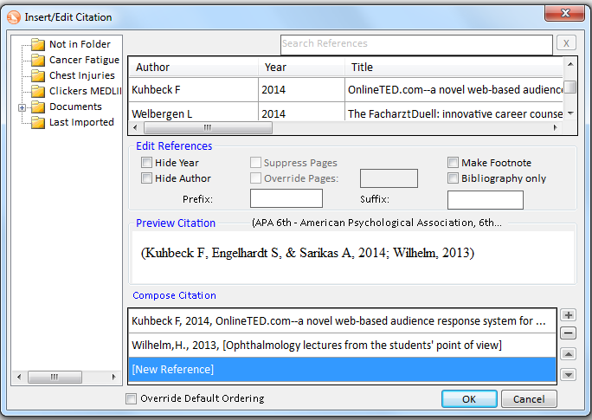

Slide 49
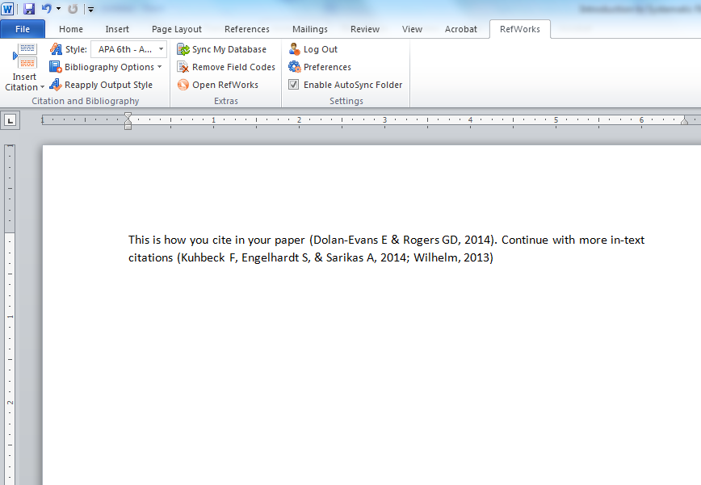

Slide 50
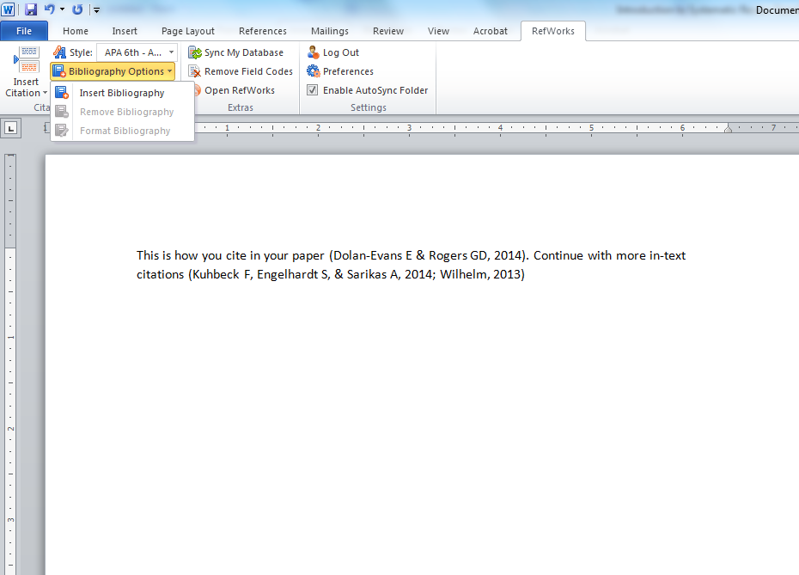

Slide 51
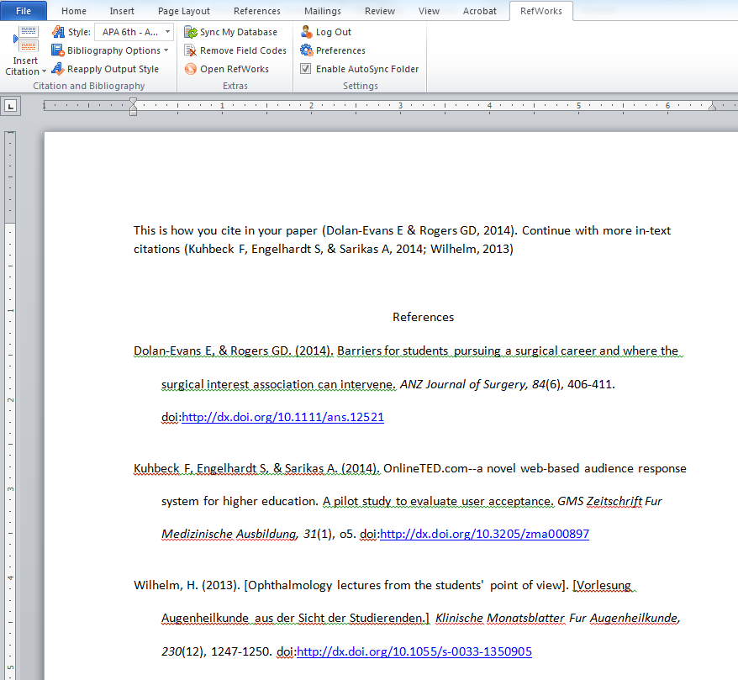

Slide 52
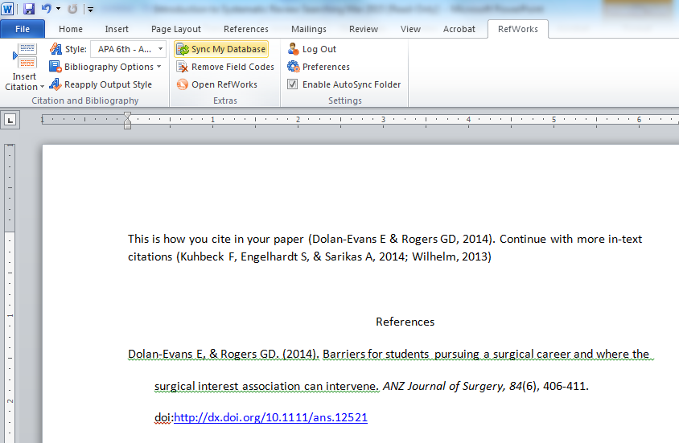
Don’t Forget to “Sync My Database”

Slide 53
What Kinds of Resources Must be Searched for a Systematic Review?
Systematic Review and Clinical Trial Databases
PROSPERO
Standard Bibliographic Databases
Grey Literature (Google)
Conference proceedings
Theses
Citation lists from the most relevant articles
Publication lists for the most important authors in the field
Conversations with experts in the field

Slide 54
Applying Limits
Date
Language
Study type (eg: randomized controlled trials, etc.)
Population (eg: aged, pediatric, adolescent)

Slide 55
Biomedical Databases
Cochrane Library
includes systematic reviews and trials
PubMed/MEDLINE
EMBASE
Specializes in drug literature (safety, toxicology, adverse reactions, and pharmacology)

Slide 56
Specialized Databases
CINAHL
Nursing and Allied Health
Essential for health services topics
Global Health
Combination of the Public Health and Tropical Medicine database and human health information from CAB Abstracts
Communicable diseases, tropical diseases, human nutrition, and community health

Slide 57
Specialized Databases
PsycINFO
Psychology
ERIC
Education
Health Policy Reference Centre, PAIS International, Social Policy and Practice
Public and social policy
Sport Discus, Physical Education Index
Physical Education and Sports Medicine
CAB, Pollution Abstracts, Environment Complete
Environmental Health

Slide 58
Large Interdisciplinary Databases
Include citation data:
Web of Science (1899-present)
Scopus (1996-present)
Google Scholar (?)

Slide 59
Grey Literature
Clinical trials registers
www.clinicaltrials.gov
Theses
ProQuest Dissertations and Theses Global
Conference Proceedings
Conferences in your field
Web of Science Conference Proceedings Index, OCLC PapersFirst
Google & Google Scholar
Other resources as necessary

Slide 60
Where to find filters
ISSG Search Filters Resource http://www.york.ac.uk/inst/crd/intertasc/rct.htm
McMaster University. Health Information Research Unit. Hedges http://hiru.mcmaster.ca/hiru/HIRU_Hedges_home.aspx
John W. Scott Library. Health Sciences Search Filters http://guides.library.ualberta.ca/content.php?pid=448005&sid=3671216
Look at the searches described in similar published systematic reviews

Slide 61
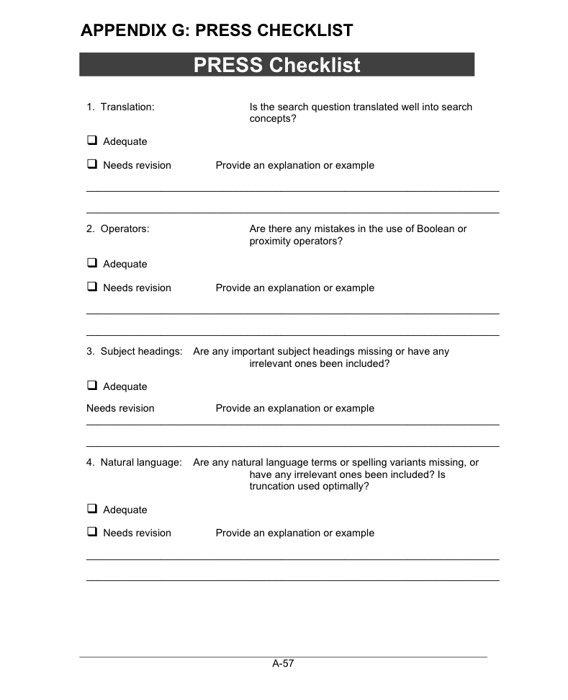
Peer Review of Searches
PRESS Form

Slide 62
Sample Search Description
Luz Maria De-Regil^{1,*}, Parminder S Suchdev²,
Gunn E Vist³, Silke Walleser⁴, Juan Pablo Peña-Rosas¹
Home fortification of foods with multiple micronutrient powders for health and nutrition in children under two years of age
September 2011 The Cochrane Library
DOI: 10.1002/14651858.CD008959.pub2

Slide 63
Describing Your Search in the Systematic Review
Search methods for identification of studies
Electronic searches
We searched the following electronic databases.
Cochrane Central Register of Controlled Trials (CENTRAL) (The Cochrane Library). Searched 18 February 2011. MEDLINE (1948 to week 2 February 2011). Searched 18 February 2011. EMBASE (1980 to Week 6 2011). Searched 18 February 2011. African Index Medicus. Searched 23 February 2011. CINAHL (1937 to current). Searched 20 February 2011. Conference Proceedings Citation Index - Science (1990 to 19 February 2011). Searched 21 February 2011. LILACS. Searched 21 February 2011. POPLINE. Searched 21 February 2011. Science Citation Index (1970 to 19 February 2011). Searched 21 February 2011. WHO International Clinical Trials Registry Platform (ICTRP). Searched 23 February 2011. metaRegister of Clinical Trials. Searched 23 February 2011. ClinicalTrials.gov. Searched 23 February 2011.
The search strategies for each database are in Appendix 1.
We did not apply any date or language restrictions, and no translation of relevant data was necessary.

Slide 64
Describing Your Search
Searching other resources
We searched through the bibliographies of included studies and asked authors of included studies for lists of other studies that should be considered for inclusion. For assistance in identifying ongoing or unpublished studies, on 25 January 2011 we contacted the Sprinkles Global Health Initiative, the Home Fortification Technical Advisory Group, the nutrition section of the United Nations Children's Fund (UNICEF), the World Food Programme (WFP), the Micronutrient Initiative (MI), the Global Alliance for Improved Nutrition (GAIN), Helen Keller International (HKI), Sight and Life Foundation, the Departments of Nutrition for Health and Development from the World Health Organization (WHO) and the U.S. Centers for Disease Control and Prevention (CDC).
The International Clinical Trials Registry Platform (ICTRP) was also searched for any ongoing or planned trials (24 January 2011). We did not apply any language restrictions.

Slide 65
Non-authorial Contributions
Examples
acquisition of funding
general supervision of a research group
general administrative support
writing assistance
technical editing
language editing
proofreading
International Committee of Medical Journal Editors. Defining the Role of Authors and Contributors http://www.icmje.org/recommendations/browse/roles-and-responsibilities/defining-the-role-of-authors-and-contributors.html
Accessed 9/4/2015

Slide 66
Librarian Support for Systematic Review Searching
J.W. Scott Librarians are available to assist with systematic review searches:
-for review of search strategies
-as team members (as required by some granting agencies)
Contact Info:
Sandy Campbell
J.W.Scott Library
780-492-7915
sandy.campbell@ualberta.ca

Slide 67
Thank You

