Slide 1
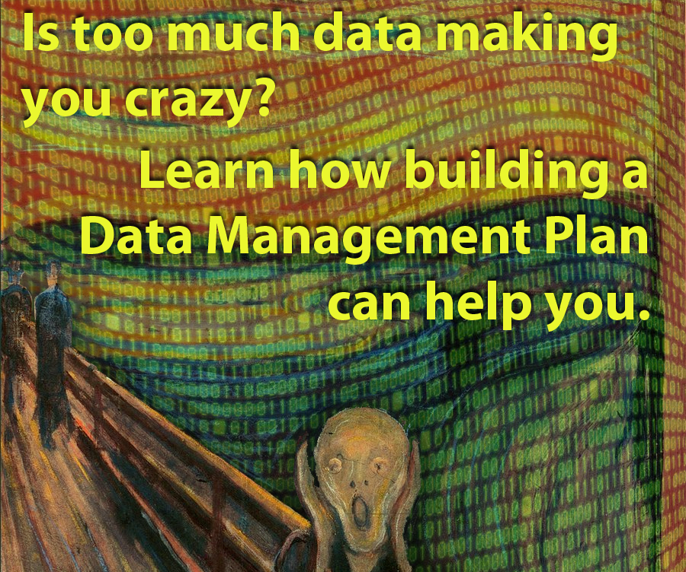

Slide 2
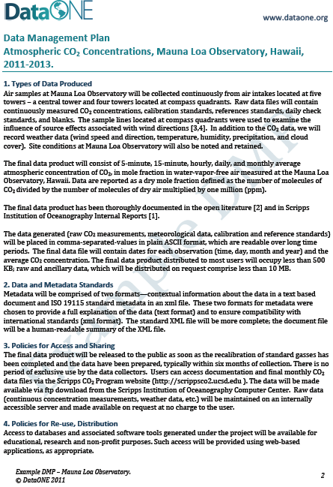
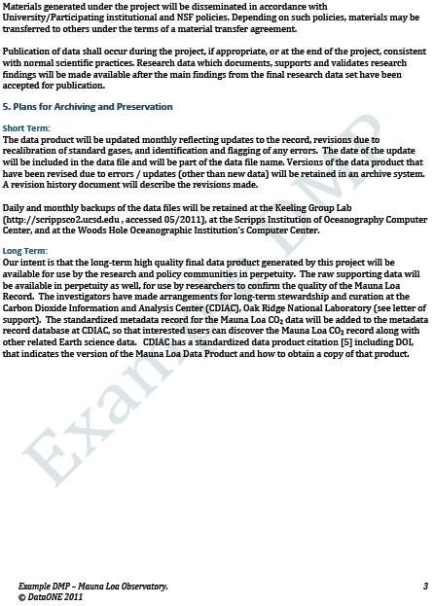

Slide 3
Crash course in data management plans
Coming soon to a granting agency near you!

Slide 4
Overview
The data life cycle and data management plans
Benefits of data management plans
How to share data
Tri-council intentions/consultations

Slide 5
Data Management Plan
Starts with the Data Life Cycle
Enables efficient application of the elements of the Data Life Cycle

Slide 6
Data Life Cycle Source: DataOne → Resources → Best Practices
Plan
Analyze
Collect
Data Life Cycle
Assure
Integrate
Discover
Describe
Preserve

Slide 7
What is a Data Management Plan?
Goal of Data Management
produce readily available self-describing data sets.
Can a user locate, access, understand and effectively and properly use your data.

Slide 8
What is a Data Management Plan?
Formalization of processes to:
collect
document
organize
manage
preserve

Slide 9
Importance - Timing
Develop DMP at the outset of a project
provides:
guidance
organization
detail
integration

Slide 10
Importance - Scale
Large Data (e.g. remote sensing, weather)
obliges sophisticated DMP
may be self directing
Small Data (typical of most efforts)
may function in absence of DMP
may limit data reuse, collaboration, preservation

Slide 11
Importance - Primary Purpose
Maintain Focus of DMP on the potential benefits
more time for research
data reuse
exposure and visibility of data
improve understanding
Focus can become compliance of your data management with accountability obligations of funders

Slide 12
Importance –Appropriate Data Use
Purpose:
To preserve open access benefits
When to use:
data type, collection, transformation are appropriate
When not to make available:
risks to sensitive features/values
ethical
privacy
cautions/guidelines/restrictions

Slide 13
Primary Importance
Maximize ability of users to find and utilize data
Preserve Data and Metadata

Slide 14
Benefits of DMPs
1. Data preservation
Storage over time
Reduce out of context use or theft
Data centres lend credibility to data

Slide 15
Benefits of DMPs
2. Citation and credit
Think benefit, not compliance
Increase profile of researcher and the research

Slide 16
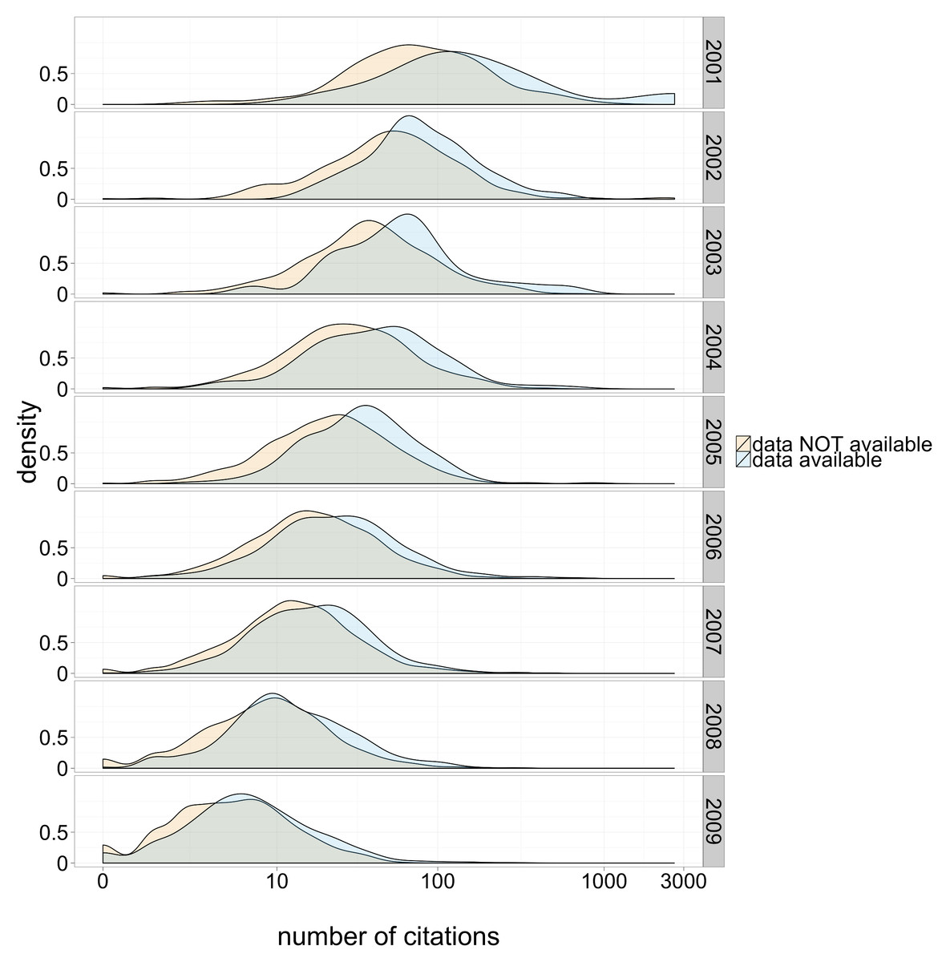
DOI: 10.7717/peerj.175/fig-1

Slide 17
Benefits of DMPs
3. Sharing
Verification of published results
Increase original data scrutiny for analysis
Prevent research duplication, speeding progression
Exploration of new questions
Potential for greater collaboration

Slide 18
Benefits of DMPs
4. Meta-analysis
Difficult to get data from authors through request
Archiving and sharing facilitates use
Allows for even larger analysis

Slide 19
Challenges of Implementation
Storage
Need suitable repositories
Difficult to find but directories exist (e.g., Databib)
Funding
Not often budgeted for initially
Costs often low (e.g., $80 dollars for one-time submission to DRYAD, free at ERA)
Require long-term and consistent funds
Notes:
In order to receive all these benefits there needs to be a change in the culture surrounding the use, re-use, and sharing of data.
Finding suitable data repositories and obtaining consistent funding to allow for archiving poses a potential problem
Many data repositories are very specific to the type of data they hold (i.e., GenBank)
This makes finding them more difficult though there are tools to find appropriate ones such as databib
Funding will become an issue for those that do not dedicate any funds currently to this
However, costs are fairly low (e.g., 80 dollars for a one-time submission to Dryad, zero for ERA)
Many data repositories are funded by larger agencies but still require long-term funding to prevent data degradation
Citation, which is probably the best incentive for researchers to share data, is not the norm within the scientific community
Typically, when data is being re-used it is acknowledged but not included as a formal citation
First, an appropriate citation method needs to be developed which is comparable across data centres
One option would be to create a unique digital object identifier for each dataset, which could be easily used to give credit within research papers
This change in procedure would be a main hurdle to jump before the benefits of data management and sharing become apparent
The culture around sharing needs to be shifted from data hoarding and eventual loss to one of mutual use, benefit, and preservation
The reluctance to share data quite often evolves from a fear of being beaten to a publication or potentially because researchers fear additional scrutiny in light of evolving analysis techniques
Embargoes could be put into place on datasets for a period of time allowing the metadata associated with these to be searchable while preventing access
These measures would ensure time for publication production by the original researcher while allowing the community to see what is happening and potentially request data for unrelated reasons
In addition to embargoes, some exceptions should be applied to the sharing of datasets
These would likely be rare but could include data on indigenous knowledge, location data for endangered or at risk wildlife, or data involving the personal information of research subjects
Even without thinking about these challenges with sharing and data preservation, the base knowledge of how you would go about these tasks is typically unknown to most researchers
So, I’d like to give the floor to Donna to talk about the tools of data preservation and storage

Slide 20
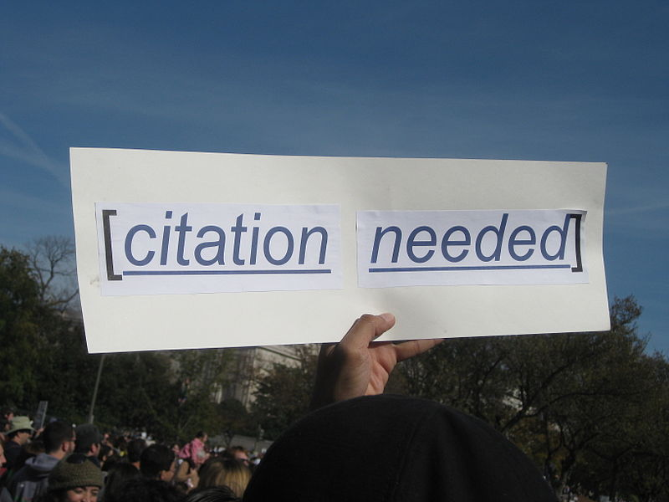
Challenges of Implementation
Citation
Best incentive but not practiced
Need appropriate citation method
e.g., Unique digital object identifier (DOI) to cite
Main hurdle before benefits are realized

Slide 21
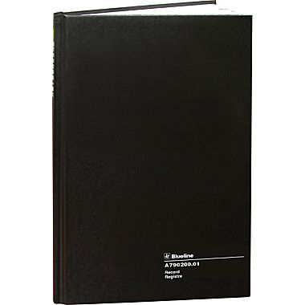
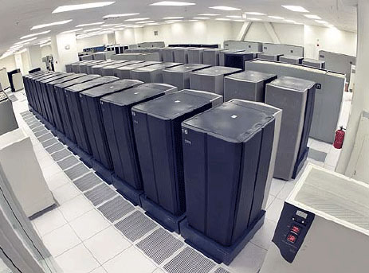
Challenges of Implementation
Sharing
Current focus on data hoarding and loss
Shift to mutual benefit and preservation
Reluctance on part of researchers

Slide 22
Data Sharing
How we share (or don’t share) data.

Slide 23
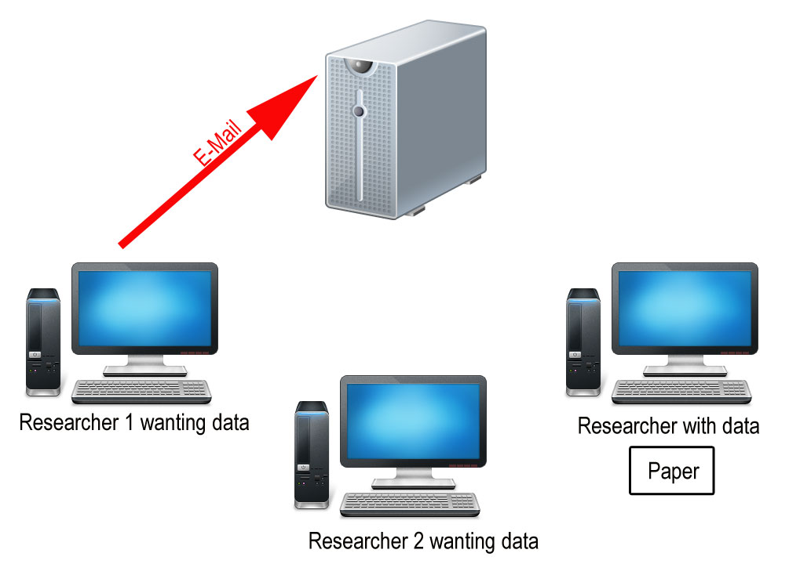
Data Sharing by Email
Sharing by e-mail in a perfect world: researcher requests data.

Slide 24
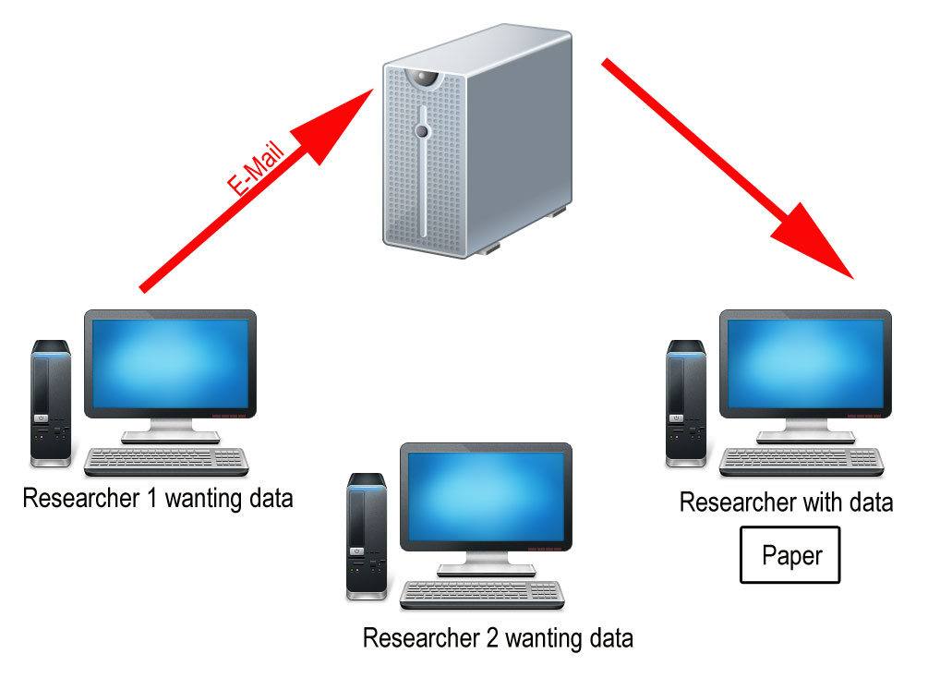
Data Sharing by Email
Email passes through a server and goes to the published researcher.

Slide 25
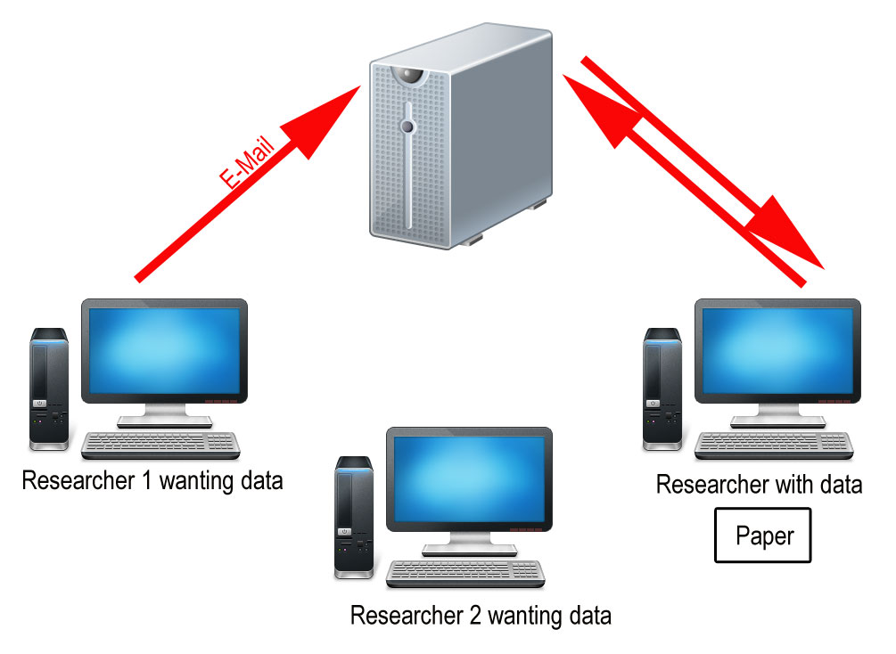
Data Sharing by Email
Published researcher emails colleague through a server

Slide 26
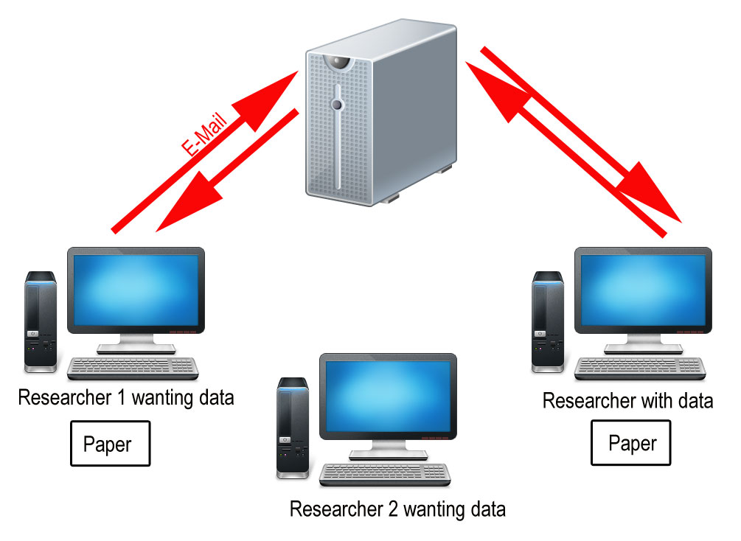
Data Sharing by Email
Email received, paper published.

Slide 27
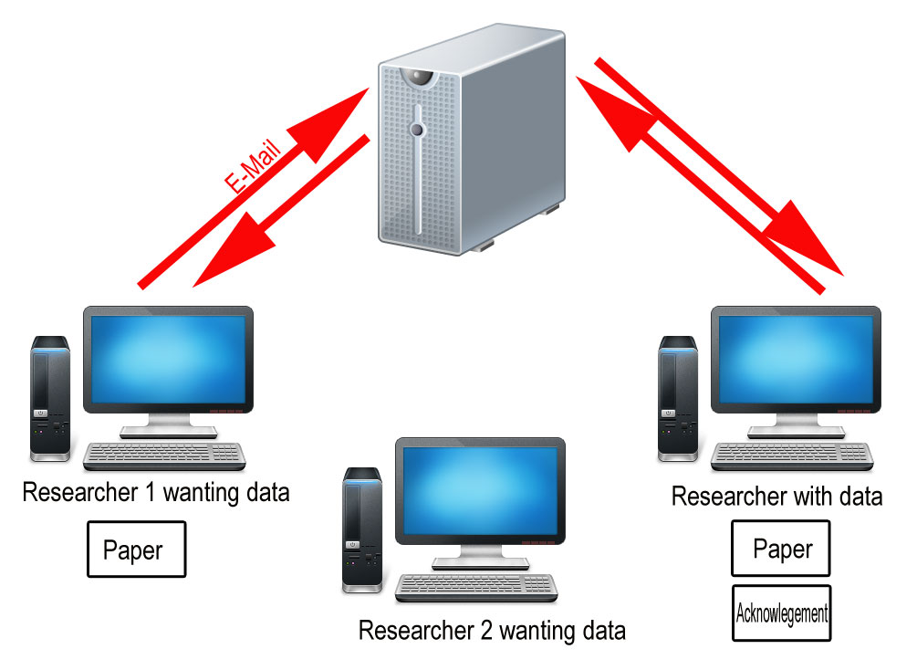
Data Sharing by Email
Researcher acknowledged. End of ideal world.

Slide 28
Data Sharing by Email
Another researcher contacts the data holder by sending an email through a server.

Slide 29
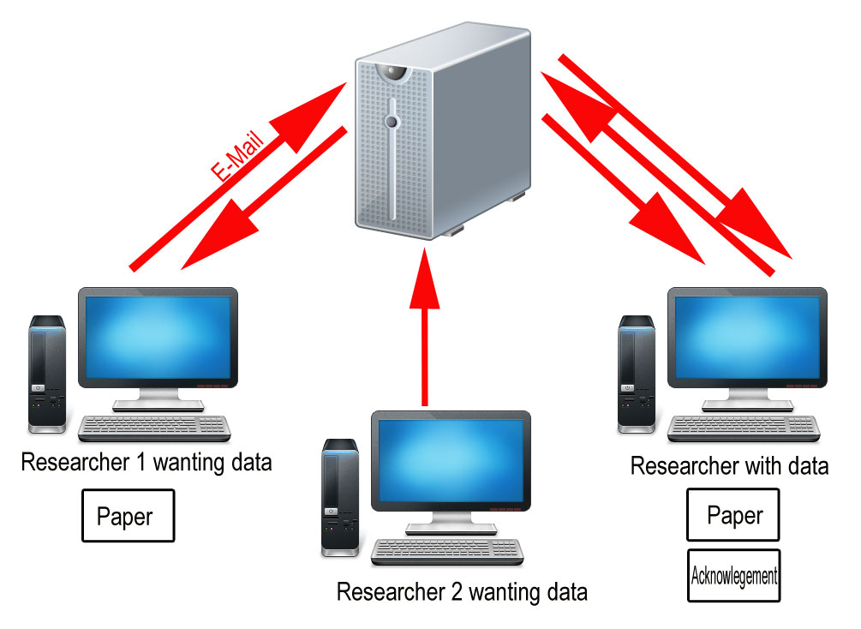
Data Sharing by Email
The data holding researcher receives the e-mail.

Slide 30
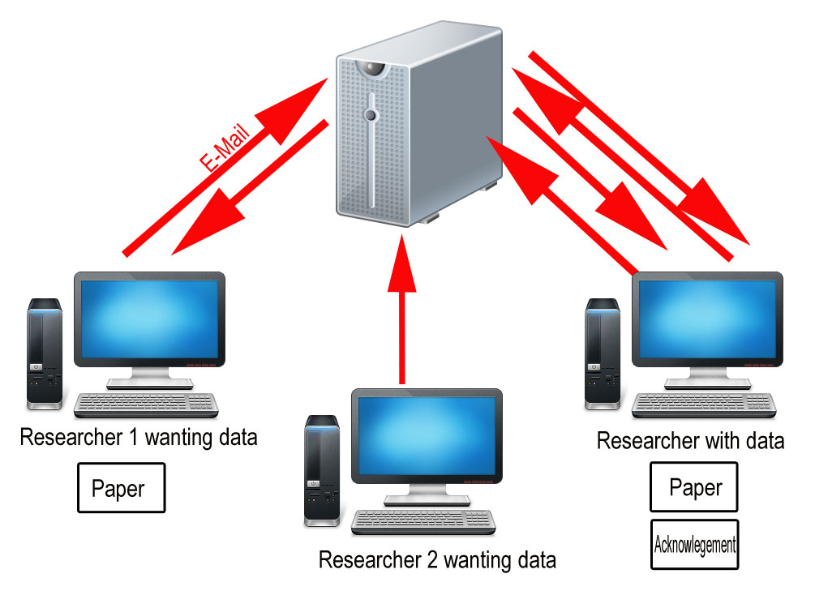
Data Sharing by Email
The dataset is sent by e-mail from the original researcher.

Slide 31
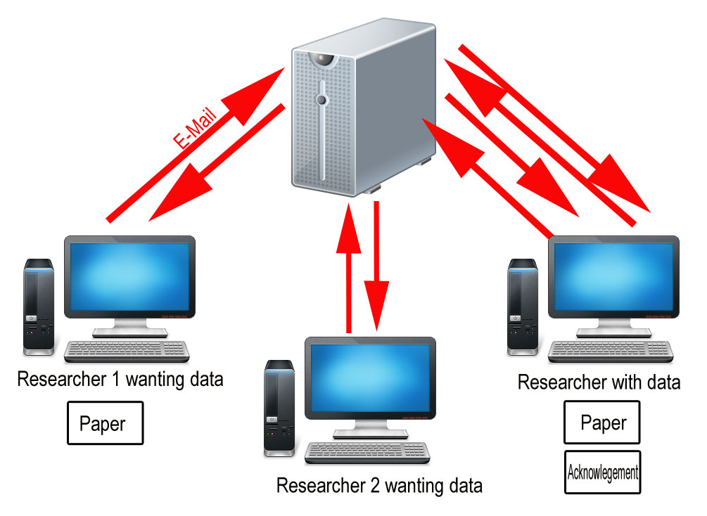
Data Sharing by Email
The second researcher receives the data, but does not publish.

Slide 32
Data Sharing by Email
The second researcher receives the data, but does not publish.

Slide 33
Data Sharing in the Real World
Even when sharing data is a requirement of publishing, a study by Savage and Vickers showed that only one author out of ten complied.
Savage CJ, Vickers AJ (2009) Empirical study of data sharing by authors publishing in PLoS journals. PLoS ONE 4: e7078. doi:10.1371/journal.pone.0007078.

Slide 34
Data Sharing in the Real World
Even when sharing data is a requirement of publishing, a study by Savage and Vickers showed that only one author out of ten complied.
Savage CJ, Vickers AJ (2009) Empirical study of data sharing by authors publishing in PLoS journals. PLoS ONE 4: e7078. doi:10.1371/journal.pone.0007078.

Slide 35
Data Sharing in the Real World
Even when sharing data is a requirement of publishing, a study by Savage and Vickers showed that only one author out of ten complied.
Savage CJ, Vickers AJ (2009) Empirical study of data sharing by authors publishing in PLoS journals. PLoS ONE 4: e7078. doi:10.1371/journal.pone.0007078.

Slide 36
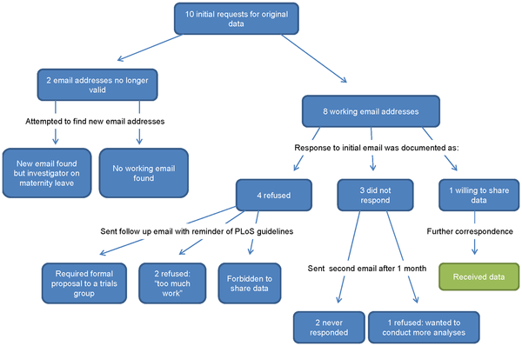
Data Sharing in the Real World

Slide 37
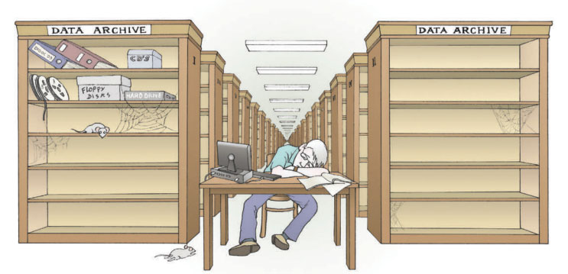
Researchers’ Opinions on Data Sharing
“Most researchers agree that open access to data is the scientific ideal, so what is stopping it happening?” Nelson, B. (2009). Data sharing: Empty archives. Nature, 461(7261), 160-163.

Slide 38
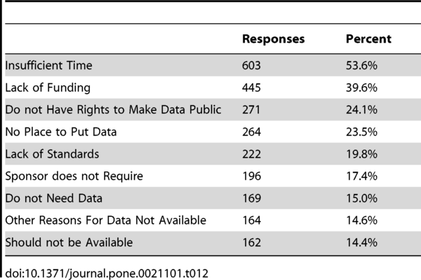
Research on Data Sharing
Reasons for not making data electronically available:
Tenopir C, Allard S, Douglass K, Aydinoglu AU, et al. (2011) Data Sharing by Scientists: Practices and Perceptions. PLoS ONE 6(6): e21101. doi:10.1371/journal.pone.0021101
http://www.plosone.org/article/info:doi/10.1371/journal.pone.0021101

Slide 39
Data Sharing by Email
Time-consuming, little reward.

Slide 40
A Better Way?
It all goes to a server – whether by e-mail or upload.

Slide 41
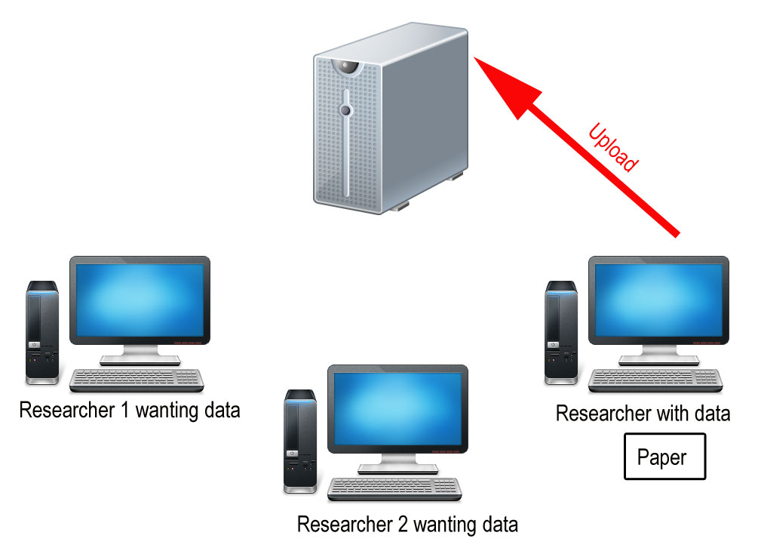
Data Sharing by Archive
Researcher uploads data to an archive, dataset receives Digital Object Identifier (DOI).

Slide 42
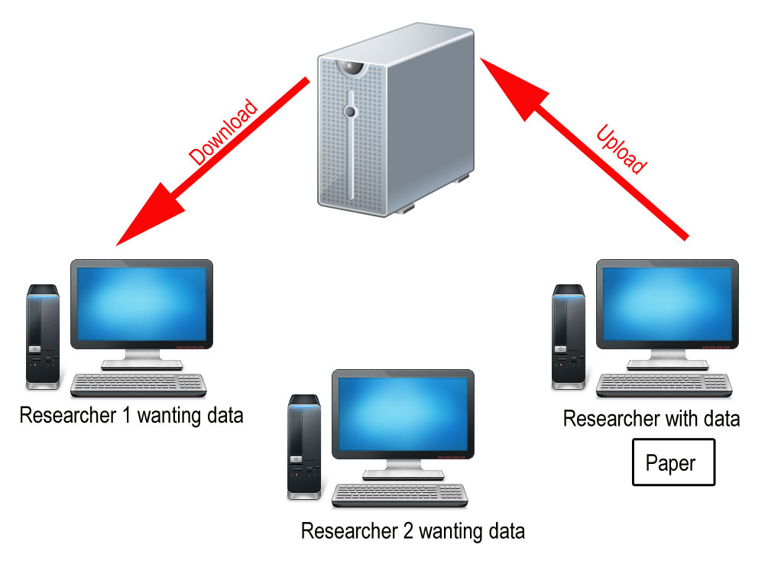
Data Sharing by Archive
Second researcher downloads data.

Slide 43
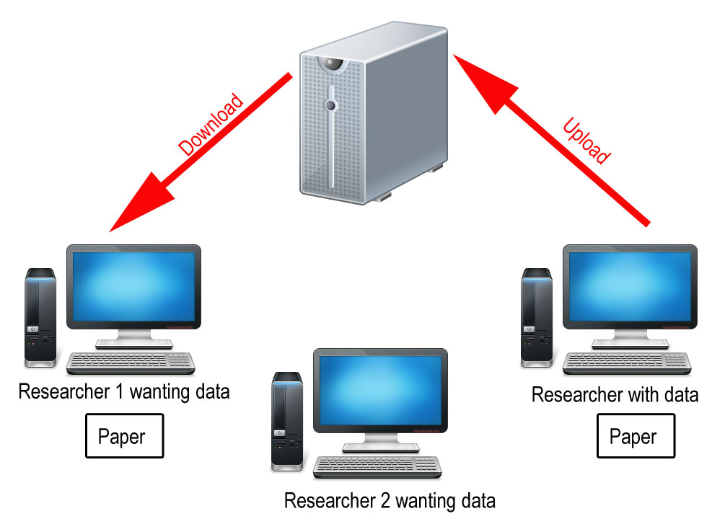
Data Sharing by Archive
Second researcher publishes using the dataset.

Slide 44
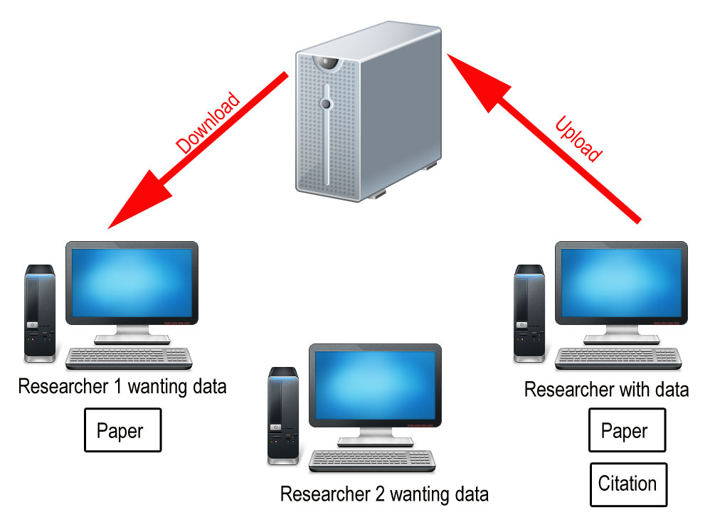
Data Sharing by Archive
Original researcher’s data is cited by DOI.

Slide 45
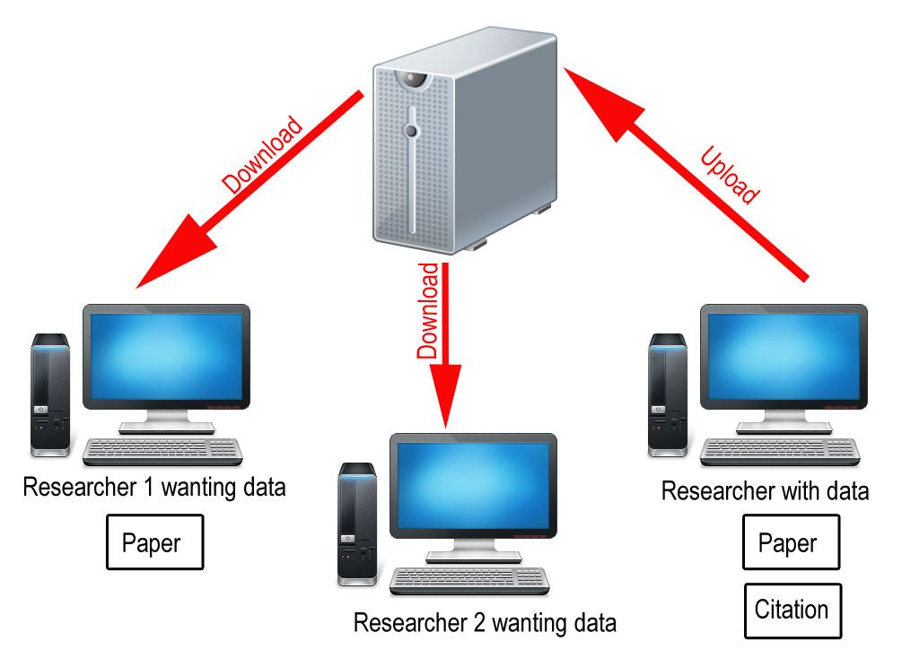
Data Sharing by Archive
Another researcher downloads data, but never publishes. No time is lost by the original researcher.

Slide 46
Places to Upload Your Data: General
Search for a data repository that suits you. Search for datasets similar to your own on:
Databib - lists 594 data repositories
Dataverse - researcher controlled research data web application
Thomson & Reuters' Data Citation Index - integrated with Web of Knowledge
Dryad - integrated data submission for numerous journals
ZENODO - highly customizable uploads, with DropBox integration
Figshare - 1 gigabyte of private storage, accepts negative results

Slide 47
Places to Upload Your Data: Specific
Hundreds of data repositories specialize in archiving datasets for specific research areas.
Example: DataOne - Data Observation Network for Earth. Funded by a $20-million NSF grant, offers a global repository for ecological and environmental data, and provides numerous tools for data management and best practices.
Example: ERA: Education and Research Archive at the University of Alberta. “A digital repository to collect, disseminate, and preserve the intellectual output of the University of Alberta.”

Slide 48
Tri-council
requirements
Currently, of the Tri-Council, which includes:
the Natural Sciences and Engineering Research Council of Canada (NSERC)
the Canadian Institutes of Health Research (CIHR)
the Social Sciences and Humanities Research Council (SSHRC)
CIHR has the strongest guidelines related to data sharing... for now.

Slide 49
Why funding agencies are getting involved...
to maximize the efficiency of research dollars
the current research climate: other large international research funding agencies in Australia, the United States, the EU, and the UK all have similar policies already in place

Slide 50
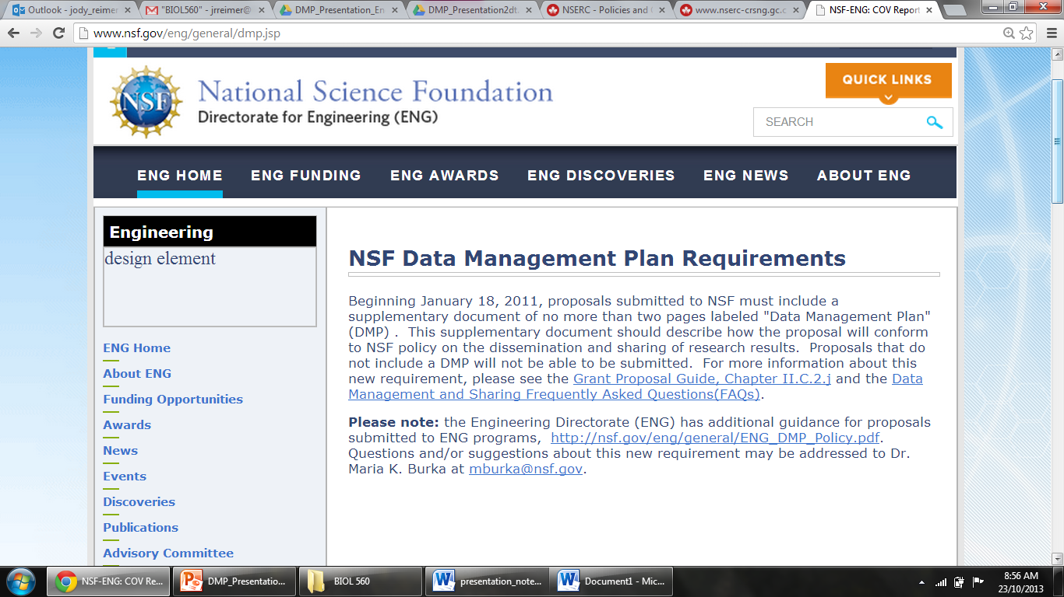
e.g. The National Science Foundation (NSF) ...

Slide 51
Why funding agencies are getting involved...
to maximize the efficiency of research dollars
the current research climate: other large international research funding agencies in Australia, the United States, the EU, and the UK all have similar policies already in place
Why you, as a researcher, should care…
It is important that the research community helps guide these requirements rather than waiting for them to be imposed.
This will ensure that they achieve the outcomes desired both by the granting agencies as well as the research communities

Slide 52
Consultation on the draft Tri-Agency Open Access Policy
http://www.nserc-crsng.gc.ca/NSERC-CRSNG/policies-politiques/OpenAccess-LibreAcces_eng.asp
considering a policy that would require federally funded peer-reviewed journal publications to be made freely available within one year of publication.
When: October 15-December 13; proposed to be implemented for NSERC and SSHRC on Sept. 1st, 2014
Send responses to openaccess@nserc-crsng.gc.ca

Slide 53
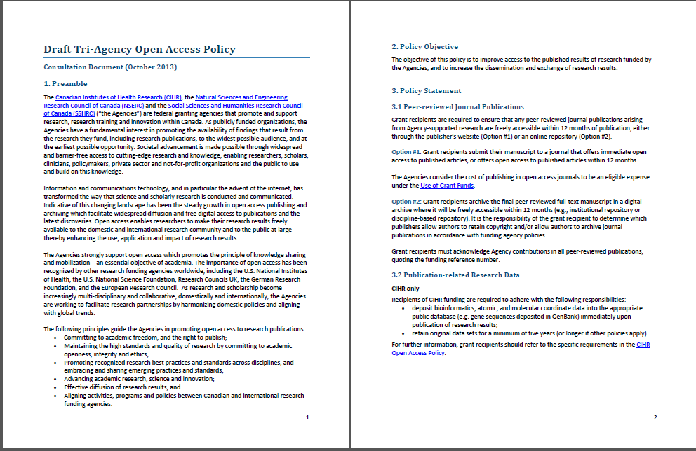
Consultation on the draft Tri-Agency Open Access Policy

Slide 54
At the institutional level:
The University of Alberta Research Policy (2013)
“Ensure that principles of stewardship are applied to research records, protecting the integrity of the assets”

Slide 55
So whether you like or not (and we think you should) …
Data management planning will soon become a standard part of the research process. We believe there is much to be gained from creating a data management plan at the outset of a project, such as citations, better collaborations, and the chance that your data will outlive you.
But what do you think?

