Slide 1

How acoustic distinctiveness affects spoken word recognition:
A pilot study
Matthew C. Kelley
Mental Lexicon 2018
Edmonton, AB, Canada
September 28, 2018

Slide 2
Spoken word recognition
Competition/activation is a predominant metaphor for word recognition (as in Luce & Pisoni, 1998; ten Bosch, Boves, & Ernestus, 2015; Marslen-Wilson, 1987; McClelland & Elman, 1986)
Potential candidates compete for activation in the process of recognizing the speech signal
Eventually, one candidate receives enough activation and is recognized

Slide 3
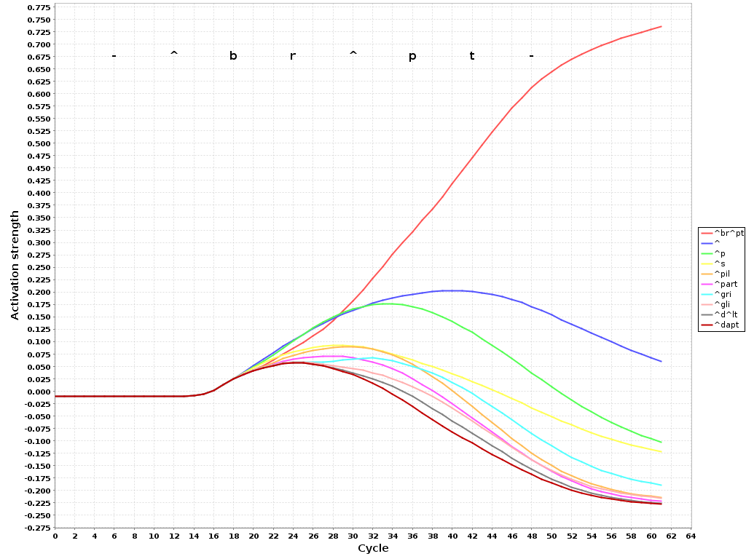

Slide 4
Phonological neighborhood density
Common quantification of competition
Taken as number of lexical entries that differ from a given item by one phoneme (edit distance)
  E.g., cat
  neighbors with bat, scat, and at
  but not bad
Predictive of lexical processing tasks for English (reviewed by Vitevitch & Luce, 2016)

Slide 5
Shortcomings of phonological neighborhood density
Equal weight assigned to all potential phoneme changes
  E.g., /pa͡ʊ/ pow is taken to be as close to /ba͡ʊ/ bow as it is to /na͡ʊ/ now
Equal weight assigned to all positions of phoneme changes
  E.g., /kɪt/ kit is taken to be as close to /sɪt/ sit as it is to /kɪs/ kiss
Relies on phonemic representations of words, which can be quite divorced from physical data
  Have also come under question as units of perception (e.g., Baayen et al., 2016; Ramscar & Port, 2016; Port, 2010; Mitterer et al., 2018)

Slide 6
Acoustic distance
Would a distance measure crafted using acoustic distance be more accurate for modeling purposes?
Motivations
  Position and type of segmental/acoustic change can be accounted for
  No reliance on pre-determined abstract unit, so more easily relatable to actual speaker productions

Slide 7
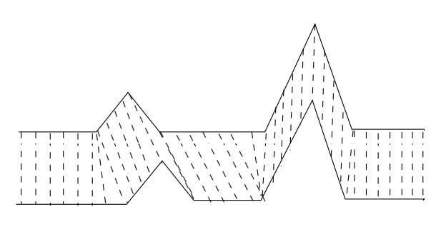
Calculating acoustic distance
Based on Mielke (2012), but with 25 ms windows, stepped at 10 ms
Convert recordings into sequences of frequency information (Mel frequency cepstral coefficients)
Use dynamic time warping algorithm to compare similar portions of data to each other
Take distance output from
Dynamic time warping as
distance from one word to
another
Dynamic time warping illustration

Slide 8
Using distance as a measure of competition
For each word, calculate the distance from it to all other words in the lexicon
Take the mean value of its distances as a measure of its overall acoustic distinctiveness
That value can then be used as a predictor in statistical modeling of participant behavior

Slide 9

A pilot use of acoustic distinctiveness
Modeling auditory lexical decision response time values from the Massive Auditory Lexical Decision database (Tucker et al., 2018)
Calculating distinctiveness based on the ≈26,000 word stimuli in the database
  All from one speaker; controls for between speaker differences
  Calculated using the fastdtw algorithm from the DynamicTimeWarp.jl package (Fowler, 2016) in the Julia programming language (Bezanson et al., 2017) for speed
Initial inspection seems somewhat sensible
  Nearest neighbors to cat: calf, brat, cut, gas, cask
  Nearest neighbors to mind: whine, gland, damp, lined,
  morgue

Slide 10
Model fitting
Generalized additive mixed models (Wood, 2011) fit to data
Baseline model (before adding variables of interest)
  Smooths for trial number, log frequency, log positional uniqueness point
  Smooth with random effects for subject
  Sex, age, and education level excluded during fitting process for not improving model fit
Predicting log reaction time from stimulus offset
  Factors out stimulus duration from response times

Slide 11
Modeling results
Effect of acoustic distinctiveness significant
Acoustic distinctiveness contributes more to improving modeling fit than neighborhood density (based on AIC)
Deviance explained higher with acoustic distinctiveness than neighborhood density (23.5% vs. 21.6%)
Model | Deviance explained | AIC | AIC difference
Baseline | 19.8% | 103887.3 | —
With acoustic distance | 23.5% | 101583.7 | 2303.6
With nbrhd density | 21.6% | 102821.1 | 1066.2
Nbrhd density and acoustic distance correlation: -0.46

Slide 12
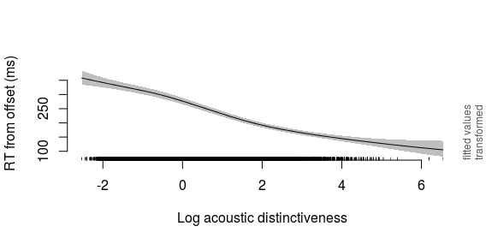
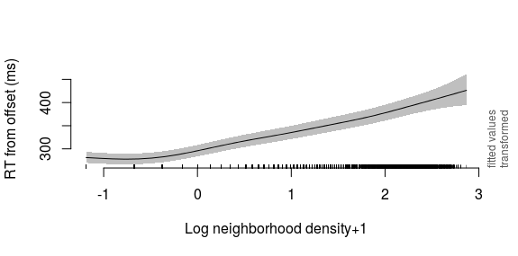

Slide 13
Density vs. distinctiveness
Similar trends between acoustic distinctiveness and neighborhood density
  Words that sound close to many other words take longer to identify
Density is difficult to understand in terms of acoustics
Distinctiveness characterizes the effect of stimulus duration on participant responses
Distinctiveness is more predictive on these data

Slide 14
Future work
Investigate other methods of calculating distance
  Cross-correlation, Euclidean distance over the sequence, different frequency representations
Relate findings back to current models of spoken word recognition
Release code for other researchers to use to calculate this measure
  Package in LexicalCharacteristics.jl (Kelley, 2018)
  Make implementation faster, e.g., GPU acceleration

Slide 15
Implications for the lexicon
Competition may arise at the phonetic level, rather than the phonological level
Inferences about competition can be made without resorting to phonemes or even segments
Lexical entries may be represented or accessed acoustically, rather than letter-like segments or phonemes (as suggested by Port, 2010; Ramscar & Port, 2016; Arnold et al. 2017; and Baayen et al., 2016)
Thank you!

Slide 16
References
Arnold, D., Tomaschek, F., Sering, K., Lopez, F., & Baayen, R. H. (2017). Words from spontaneous conversational speech can be recognized with human-like accuracy by an error-driven learning algorithm that discriminates between meanings straight from smart acoustic features, bypassing the phoneme as recognition unit. PloS one, 12(4), e0174623.
Baayen, R. H., Shaoul, C., Willits, J., & Ramscar, M. (2016). Comprehension without segmentation: A proof of concept with naive discriminative learning. Language, Cognition and Neuroscience, 31(1), 106-128.
Bezanson, J., Edelman, A., Karpinski, S., and Shah, V. B. (2017). Julia: A Fresh Approach to Numerical Computing. SIAM Review, 59: 65–98.
Fowler, J. DynamicTimeWarp.jl [software]. Available from https://github.com/joefowler/DynamicTimeWarp.jl
Gahl, S., & Strand, J. F. (2016). Many neighborhoods: Phonological and perceptual neighborhood density in lexical production and perception. Journal of memory and language, 89, 162–178.
Kelley, M. C. (2018) LexicalCharacteristics.jl [software package]. Available at https://gitlab.com/maetshju/LexicalCharacteristics.jl
Luce, P. A., & Pisoni, D. B. (1998). Recognizing spoken words: The neighborhood activation model. Ear and hearing, 19(1), 1.
Marslen-Wilson, W. D. (1987). Functional parallelism in spoken word-recognition. Cognition, 25(1-2), 71-102.
McClelland, J. L., & Elman, J. L. (1986). The TRACE model of speech perception. Cognitive psychology, 18(1), 1-86.
Mielke, J. (2012). A phonetically based metric of sound similarity. Lingua, 122(2), 145-163.
Mitterer, H., Reinisch, E., & McQueen, J. M. (2018). Allophones, not phonemes in spoken-word recognition. Journal of Memory and Language, 98, 77-92.
Port, R. F. (2010). Rich memory and distributed phonology. Language Sciences, 32(1), 43-55.
Ramscar, M., & Port, R. F. (2016). How spoken languages work in the absence of an inventory of discrete units. Language Sciences, 53, 58-74.
Ten Bosch, T., Boves, L., & Ernestus, M. (2015). Diana, an end-to-end computational model of human word comprehension. In Proceedings of the 18th International Congress of Phonetic Sciences (ICPhS 2015) (1-5).
Vitevitch, M. S., & Luce, P. A. (2016). Phonological neighborhood effects in spoken word perception and production. Annual review of linguistics, 2(1), 75–94.
Wood, S.N. (2011) Fast stable restricted maximum likelihood and marginal likelihood estimation of semiparametric generalized linear models. Journal of the Royal Statistical Society (B) 73(1):3-36

