Slide 1
Technological Protection Measures (Digital Locks)
*April 2020
Notes:
*Updated: December 2024
Hello, and welcome to the University of Alberta’s Opening Up Copyright instructional module on technological protection measures, or digital locks.

Slide 2

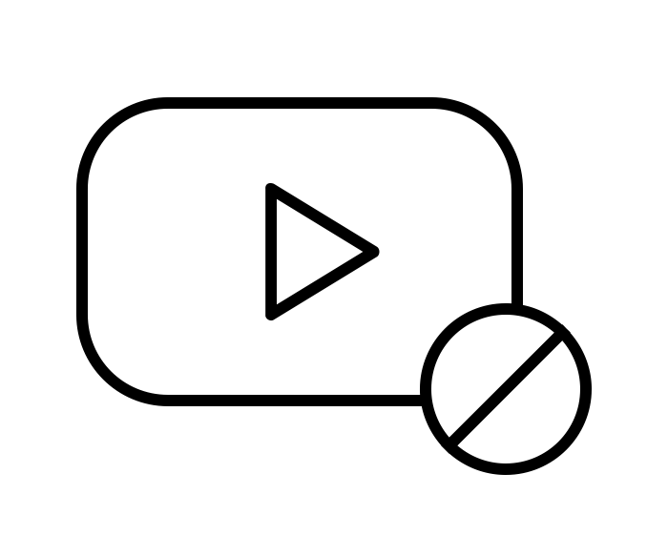
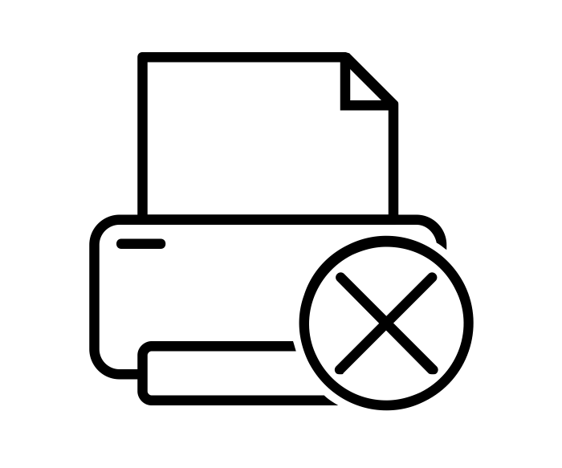
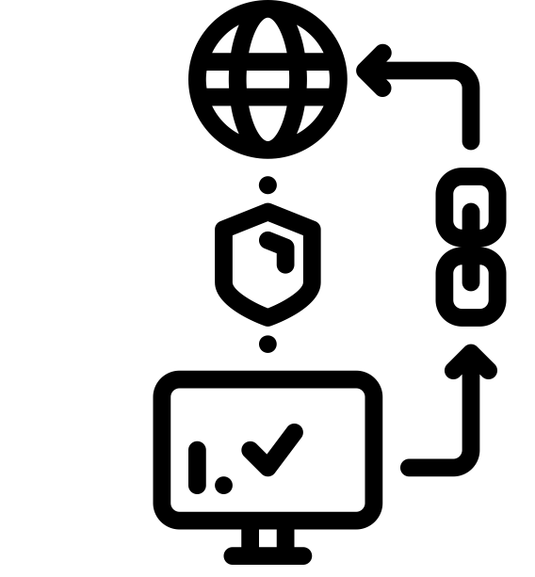




WHAT IS A TPM?
Technological Protection Measures (TPMs)
= Digital Locks
?
Notes:
Have you ever found a YouTube video that’s not available for viewing in your region? Viewed an electronic document that doesn’t allow you to print pages? Or used a piece of software that requires you to be online so your licence can be validated? These are just a few examples of what are called technological protection measures, or TPMs, or digital locks – which are designed to restrict access to or copying of copyright-protected content.
This module will explain what TPMs are in Canadian copyright law, why we have them, and how they might affect both user rights and creator rights.

Slide 3


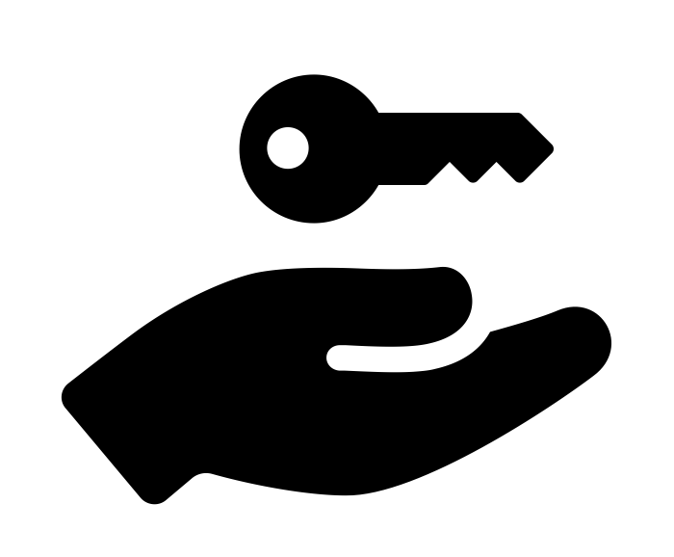


COPYRIGHT ACT, S. 41
Technology
Device
Component
s. 41
Notes:
Since 2012, Canada’s Copyright Act has made it illegal to bypass – or circumvent, to be specific – “any effective technology, device, or component” intended to control access to a work, or to protect a copyright holder’s exclusive rights over the use of a work through section 41 of the Copyright Act.

Slide 4
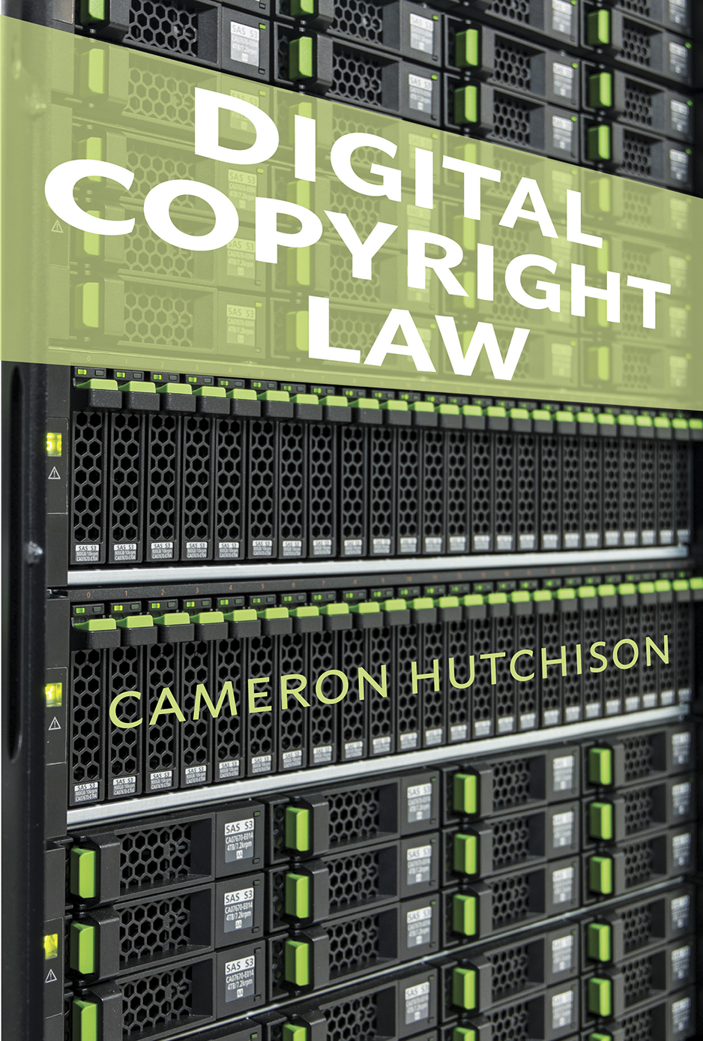
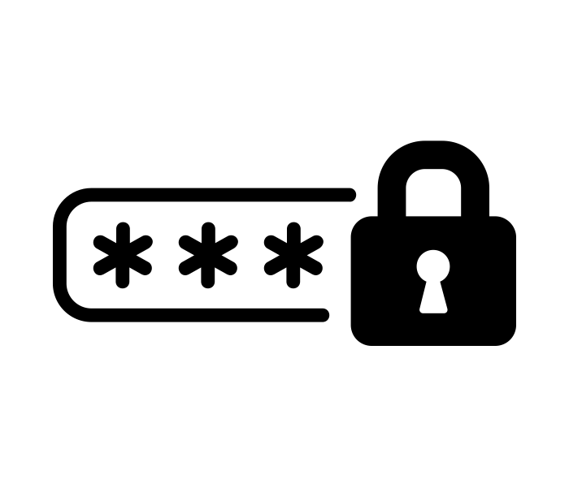
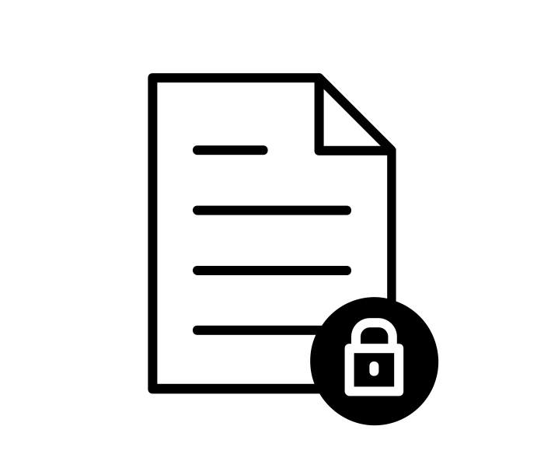
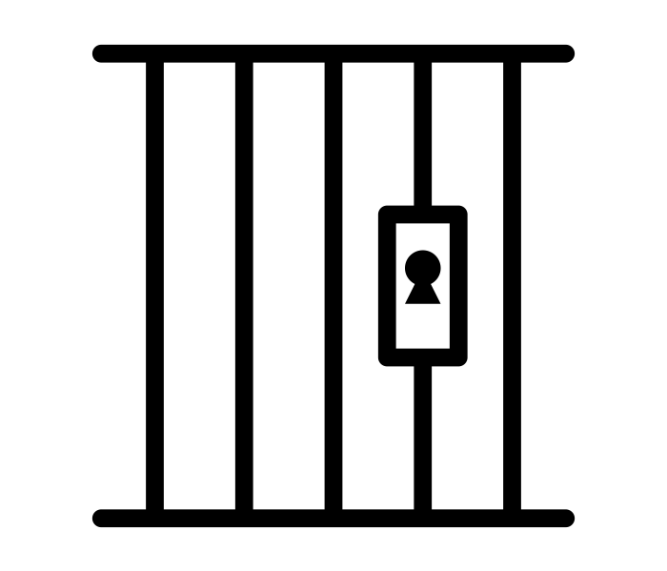
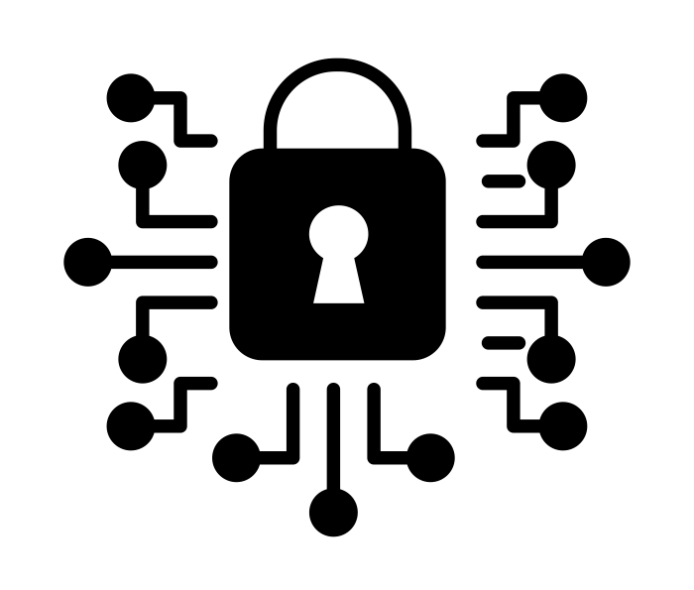


THE NATURE OF TPMs
Cameron Hutchison
Digital Copyright Law (Irwin Law, 2016)
TPMs for
controlling access:
TPMs for
controlling use:
?
TPMs: “… ensure the effective control and management of copyrights in the digital sphere” (Hutchison, 2016, p. 123).
Notes:
Cameron Hutchison, University of Alberta law professor and author of the 2016 book Digital Copyright Law, states that technological protection measures are intended to “ensure the effective control and management of copyrights in the digital sphere”. The implementation and enforcement of TPMs, however, have become controversial due to broad interpretations of what an “effective technology” might be, in addition to the risk they run of stifling innovation and restricting competition. The broad nature of TPMs as defined by the Copyright Act has thus led to many different protection measures being categorized as TPMs. These are generally divided into two sub-categories: TPMs that are for controlling access, and TPMs that are for controlling the use or the copying of a work.

Slide 5
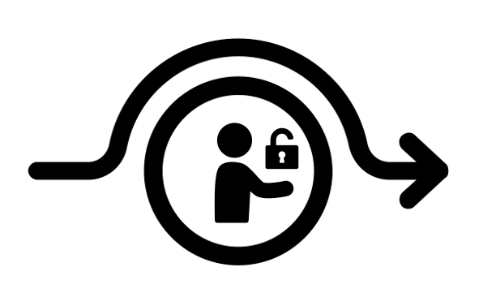
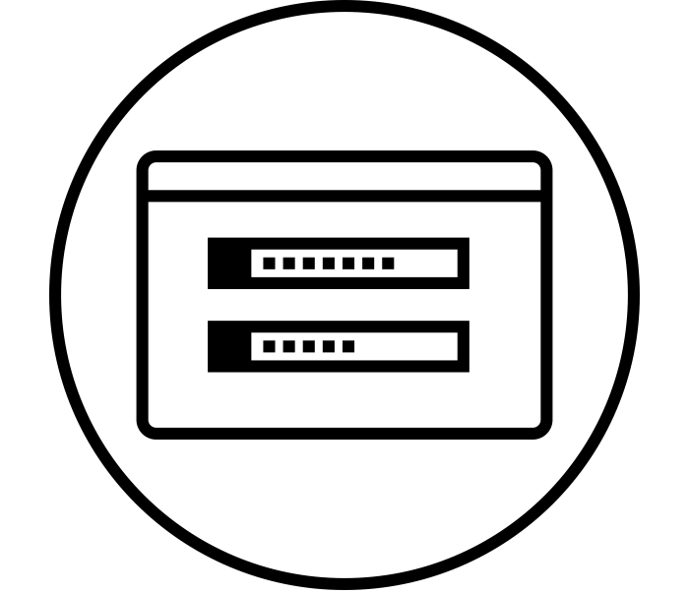
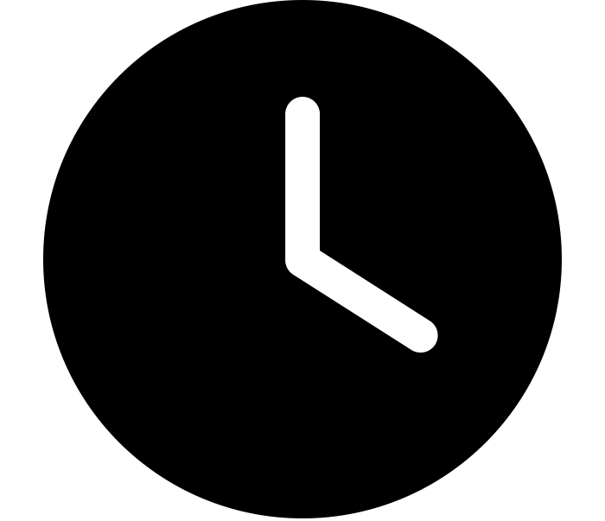
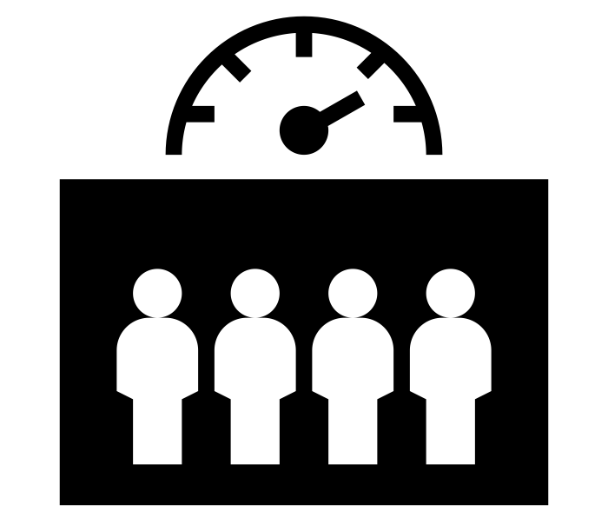
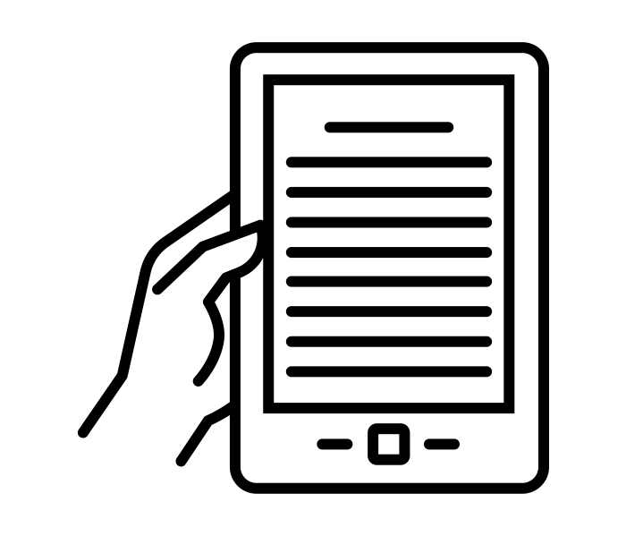
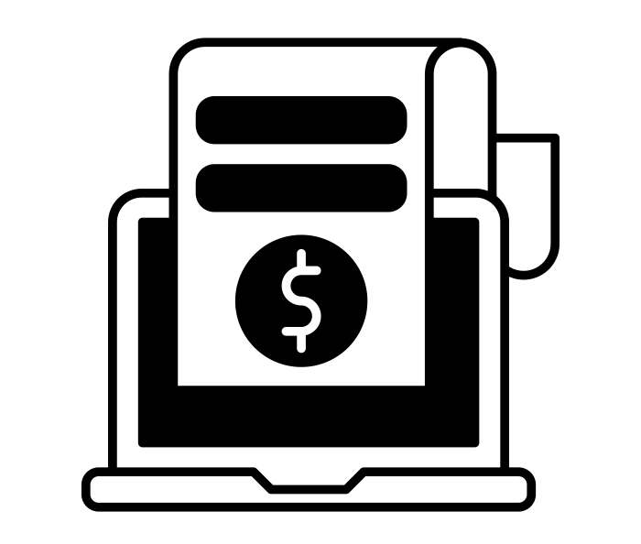
EXAMPLES OF TPMs
TPMs for controlling access:
A) Username and password
B) Registration keys
C) Time limits
D) Limits on number of users
F) Paywalls or
subscriptions
E) Encryption or scrambling
Notes:
TPMs that are for controlling access might include:
A username and password system
Registration keys, such as a software’s activation code
Time limits, like those set on your library eBooks with a 14-day restricted access period
Limits on the number of simultaneous users, like those that restrict the number of people using your Netflix account simultaneously
Encryption or scrambling, such as regional encoding on DVDs or IP blocking based on your location
And finally, paywalls or subscription software that limit access to online content

Slide 6

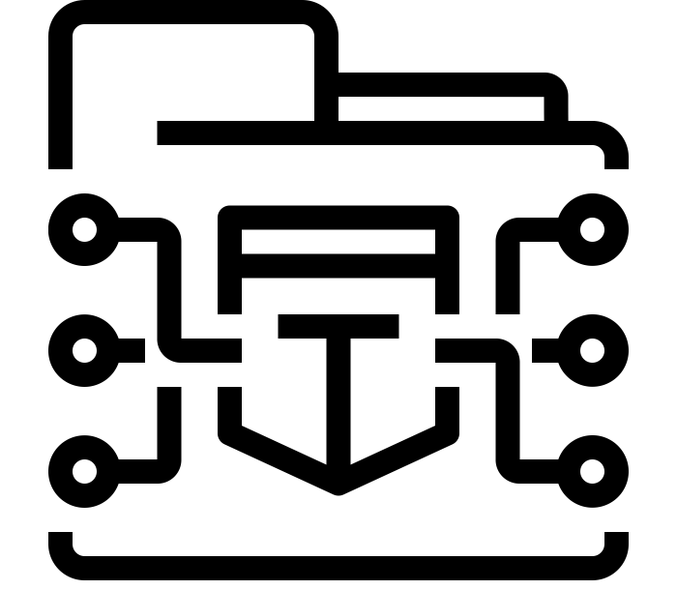
EXAMPLES OF TPMs
TPMs for controlling use:
A) Software or hardware with locks
B) Labelling and watermarks
C) Encryption systems
Notes:
TPMs that are for controlling the use, or the copying of a work, might include:
Software or hardware that “locks” a work so that you can’t copy, print, or download it. There are some PDF-based documents, including eBooks, that use these locking mechanisms
Labelling and watermarks, such as a company or artist’s logo on an image
And lastly, an encryption system that “scrambles” content so that you can’t view or copy it without authorization from the rights holder

Slide 7
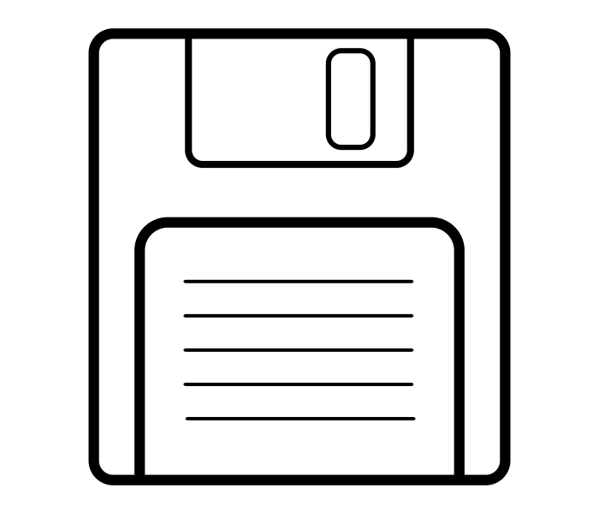
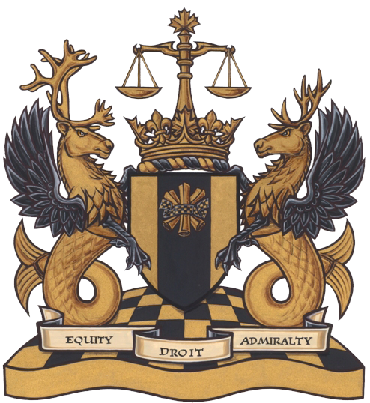
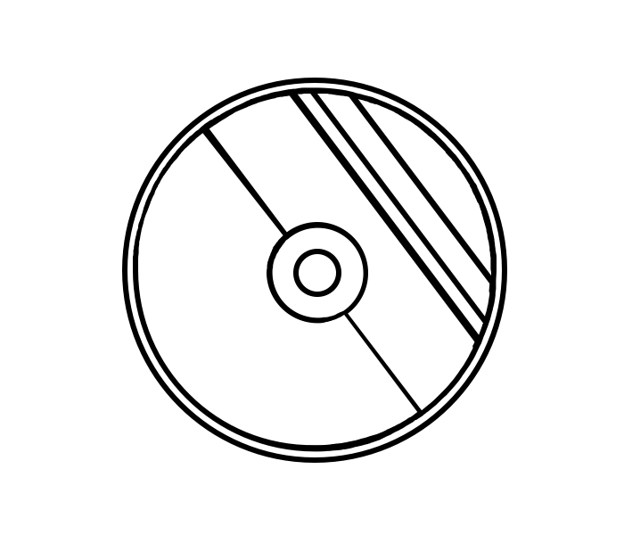
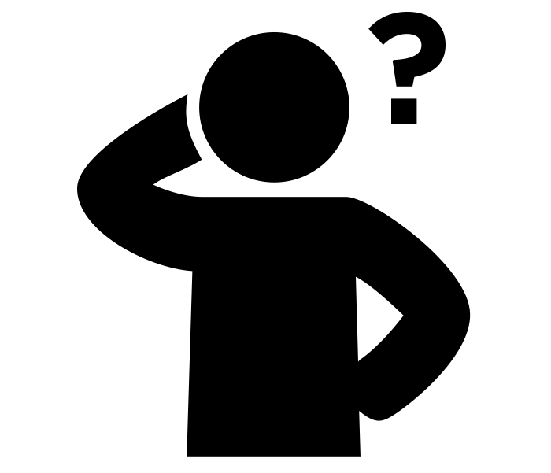
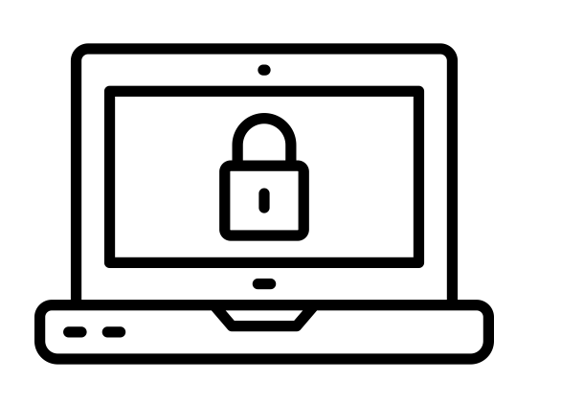
DEFINING TPMs
TPMs = Any effective technology
s. 41
Notes:
Since the Copyright Act says that these TPMs can be “any effective technology,” it stands to reason that a court would consider what this phrase means when deciding what is and is not a technological protection measure. Therefore, measures that have not yet been defined as TPMs could eventually be interpreted as such in future court rulings, long after their inception. This leaves room for many more potential TPMs to emerge as a result of this broad definition, and may lead to confusion around what a TPM can actually be.

Slide 8
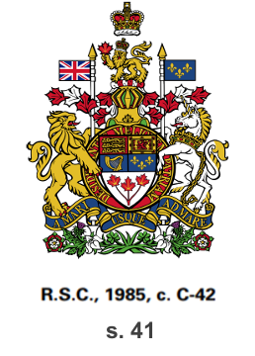
COPYRIGHT IMPLICATIONS
Broad interpretations of “effective” could make many activities violations of the Copyright Act
You risk violating the Copyright Act
You risk violating the Copyright Act by intentionally circumventing any TPMs
You risk violating the Copyright Act by intentionally circumventing any TPMs to gain access
You risk violating the Copyright Act by intentionally circumventing any TPMs to gain access to copyrighted material
Or… exceptions!
Notes:
So what does this mean for users of copyrighted material? In essence, you risk violating the Copyright Act by intentionally circumventing any technological protection measure to gain access to copyrighted material, whether or not you intend to copy it, unless you are relying on the very narrow exceptions in the Act. Broad interpretations of what an “effective” technological protection measure might be could lead several other activities that circumvent TPMs to be considered violations of the Copyright Act.

Slide 9
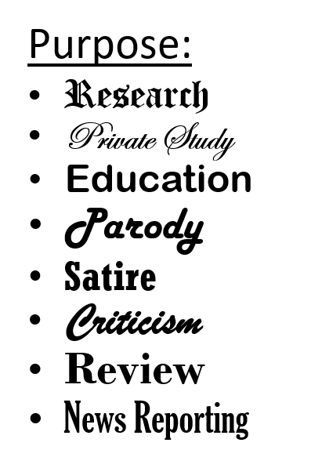
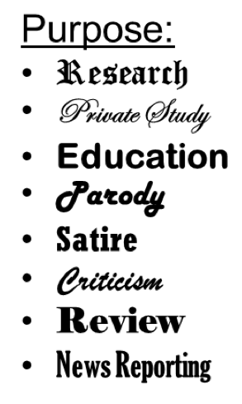
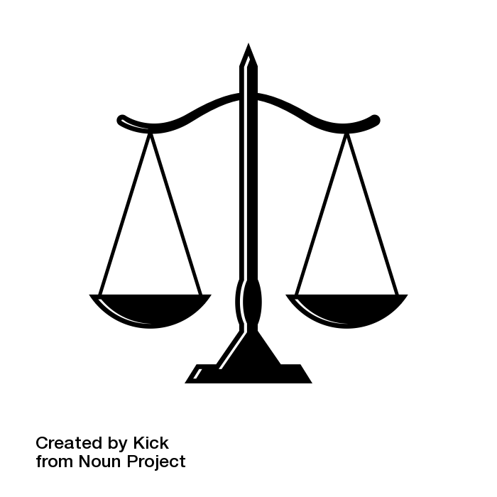
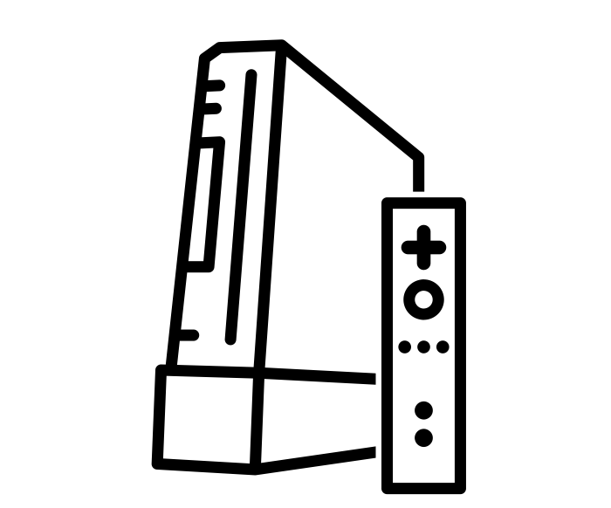
FAIR DEALING AND TPMs
Private Study
Private Study
Private Study
Notes:
Not only is TPM protection broad in that it covers both access controls and use controls, but users cannot rely on fair dealing as a valid defence to bypass or break a digital lock on copyright-protected material. The limited exceptions for bypassing a TPM do not include doing so for the purposes of fair dealing. For example, you might not lawfully be able to circumvent a TPM-enabled system, like a gaming console, for the purpose of learning how it works.

Slide 10

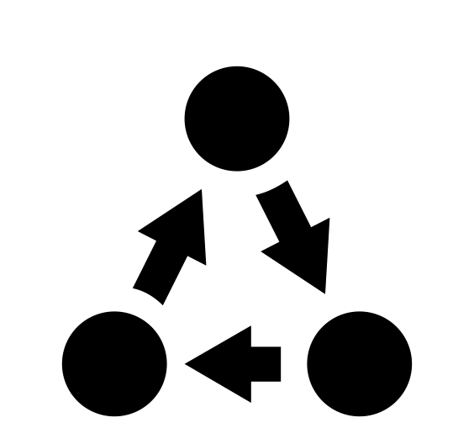
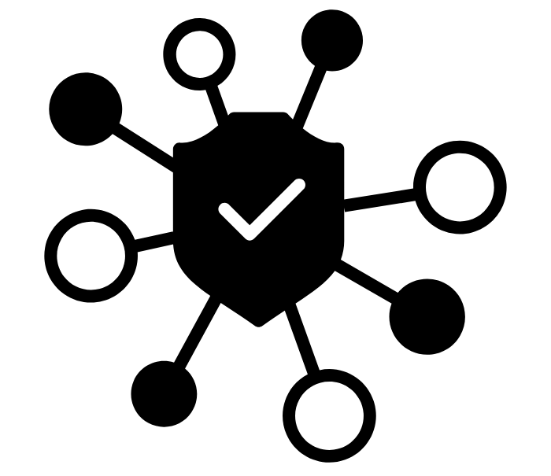





EXCEPTIONS
Notes:
Furthermore, the exceptions for lawfully circumventing a TPM are relatively narrow. For examples and information about these exceptions, please see our module on section 41 of the Copyright Act about TPMs.

Slide 11
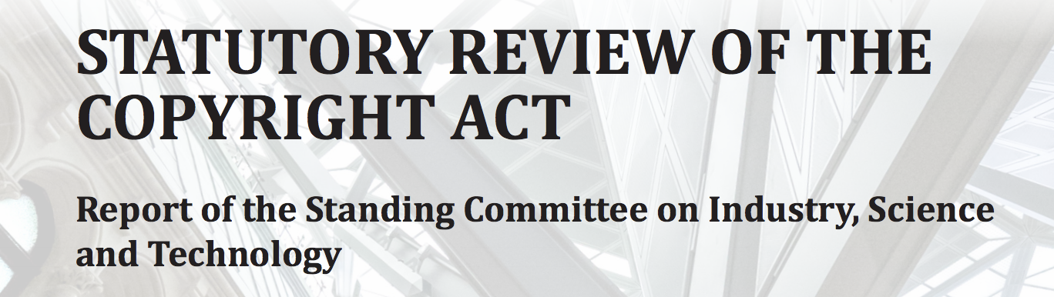

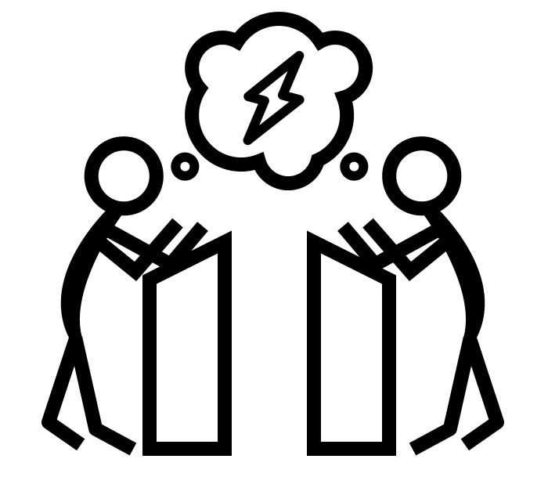
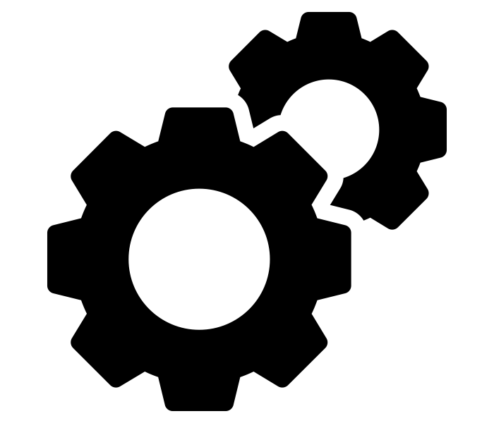
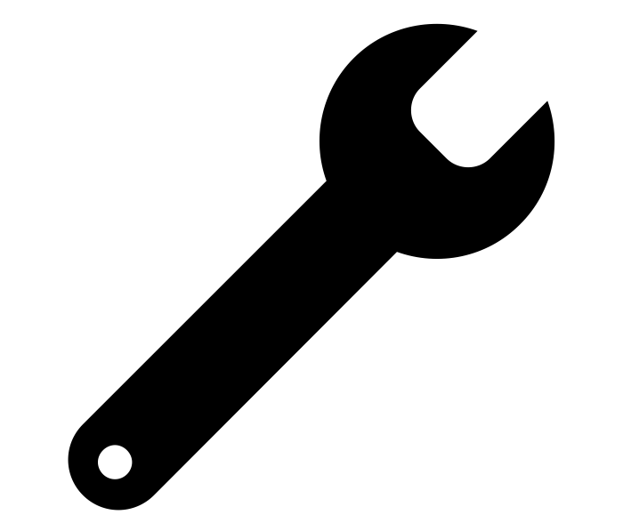
CONTROVERSY
RIGHTS OF CREATORS RIGHTS OF USERS
Recommendation 18
Allowing circumvention on legally-acquired devices when used for non-infringing purposes, such as the right to repair (INDU Committee, 2019, p. 69-71).
s. 41
Notes:
The anti-circumvention provisions in the Copyright Act are controversial – especially with the court’s broad interpretations of what “effective” means for TPMs. Do these provisions upset the balance of creators’ rights and users’ rights, since it’s now possible to violate the Copyright Act without violating copyright? In other words, whether or not your use infringes the copyright of a work, by simply accessing a TPM protected work, you are violating the TPM provisions in the Copyright Act.
It’s worth noting that the INDU Committee’s June 2019 report on the review of the Act recommended clearly allowing TPM circumvention on legally-acquired devices when they are used for non-infringing purposes. For example, one recommendation evokes the right to repair, stating that the Act should not prevent anyone from circumventing a TPM to lawfully conduct diagnosis, maintenance, and repair of mechanical equipment. Whether or not such recommendations are acted on when the Copyright Act is amended remains to be seen.

Slide 12


CONTROVERSY
?
s. 41
Notes:
While controversy and uncertainty around the TPM provisions in the Act remain, their implementation has had definitive repercussions in court proceedings. To learn how the Canadian Federal Court’s interpretation of TPMs lost a Windsor, Ontario company 12.7 million dollars, please watch our module on the Nintendo v. Go Cyber case.

Slide 13
LEARNING OBJECTIVES
You should now be able to:
Define the scope and provide examples of “technological protection measures” (TPMs) as they are defined in Canada’s Copyright Act
Understand how the Copyright Act protects TPMs from circumvention
Notes:
You should now be able to:
Define the scope and provide examples of “technological protection measures” (TPMs) as they are defined in Canada’s Copyright Act
Understand how the Copyright Act protects TPMs from circumvention

Slide 14
Notes:
This has been the University of Alberta’s Opening Up Copyright instructional module on technological protection measures, or digital locks. Thank you for your attention.

Slide 15
Canada’s Copyright Act defines technological protection measures, or TPMs, as “any effective ________, ________, or ________” intended to control access to a work.
  Technology
  Wall
  Device
  Riddle
  Nuisance
  Component
  Force field
An example of a technological protection measure might be any of the following except:
  A paywall
  A username and password system
  An encryption system
  A bodyguard

Slide 16
Users risk violating the Copyright Act by:
  Circumventing any technological protection measure to gain access to copyright-protected material, whether or not they copy it
  Looking for any technological protection measures that control access to a work
  Revealing the presence of a technological protection measure that controls the use of a work
  Yelling at kids to get off their lawn
Users may rely on fair dealing as a valid defence to bypass or break a digital lock on copyright-protected material.
  True
  False

Slide 17
Copyright at SFU: Technological protection measures (TPM) fact sheet. (2015, August 13). Simon Fraser University Library. Retrieved April 18, 2020, from https://www.lib.sfu.ca/help/academic-integrity/copyright/technological-protection-measures
Crowne, E. (2017). Federal Court interprets Canada’s technological protection measures for the first time. Journal of Intellectual Property Law & Practice, 12(6), 459-61. https://doi.org/10.1093/jiplp/jpx071
De Beer, J. (2005). Constitutional jurisdiction over paracopyright laws. Irwin Law Journal, 4, 89-124. https://ssrn.com/abstract=814074
Geist, M. (2015, November 10). Flawed copyright case places spotlight on Canada’s digital lock problem. Michael Geist. http://www.michaelgeist.ca/2015/11/flawed-copyright-case-places-spotlight-on-canadas-digital-lock-problem/
Geist, M. (2017, March 3). Canadian DMCA in action: Court awards massive damages in first major anti-circumvention copyright ruling. Michael Geist. http://www.michaelgeist.ca/2017/03/canadian-dmca-in-action-court-issues-massive-damage-award-in-first-major-anti-circumvention-copyright-ruling/

Slide 18
Hutchison, C. (2016). Digital Copyright Law. Irwin Law.
IFPI. (2003, March). The WIPO treaties: Technological measures. https://web.archive.org/web/20180417033805/https://www.ifpi.org/content/library/wipo-treaties-technical-measures.pdf
Kerr, I. R., Maurushat, A., & Tacit, C. S. (2002). Technical protection measures: Tilting at copyright’s windmill. Ottawa Law Review, 34(1), 7-82. https://rdo-olr.org/technical-protection-measures-tilting-at-copyrights-windmill/
Sapp, H. (2005). North American anti-circumvention: Implementation of the WIPO internet treaties in the United States, Mexico and Canada. Computer Law Review & Technology Journal, 10(1), 1-40.
World Intellectual Property Organization. (n.d.). WIPO copyright treaty (WCT). Retrieved from https://www.wipo.int/treaties/en/ip/wct/
Yolles, A. (2012). In defence of a defence: A demonstrable legitimate and non-infringing purpose as a full defence to anti-circumvention legislation. Canadian Journal of Law and Technology, 10(1), 75-88. https://ojs.library.dal.ca/CJLT/article/view/4832

Slide 19
Copyright Act, RSC 1985, c C-42. https://laws-lois.justice.gc.ca/eng/acts/c-42/page-1.html

Slide 20
iconsphere. (2016). Video block. The Noun Project. CC BY. https://thenounproject.com/icon/video-block-485863/
Ahmad Taufik. (2018). Disconnected printer. The Noun Project. CC BY. https://thenounproject.com/icon/disconnected-printer-2191368/
Berkah Icon. (2019). Website link. The Noun Project. CC BY. https://thenounproject.com/icon/website-link-2755326/
Adrien Coquet. (2018). Unlock. The Noun Project. CC BY. https://thenounproject.com/icon/unlock-1862800/
Nadir Balcikli. (2016). Copyright. The Noun Project. CC BY. https://thenounproject.com/icon/copyright-453533/
Government of Canada. (2018). Official rendition of the coat of arms of Canada. Converted to svg by Zscout370. Wikipedia. https://en.wikipedia.org/wiki/Arms_of_Canada#/media/File:Coat_of_arms_of_Canada.svg
Egon Låstad. (2016). Note-taking. The Noun Project. CC BY. https://thenounproject.com/icon/note-taking-665382/

Slide 21
Iconathon. (2019). Gamer. The Noun Project. CC BY. https://thenounproject.com/icon/gamer-2909380/
Adrien Coquet. (2019). Access. The Noun Project. CC BY. https://thenounproject.com/icon/access-2448901/
Kimmi Studio. (2017). Shield. The Noun Project. CC BY. https://thenounproject.com/icon/shield-874630/
Adrien Coquet. (2019). Password. The Noun Project. CC BY. https://thenounproject.com/icon/password-2631120/
Mohamad Arif Prasetyo. (2017). Private document. The Noun Project. CC BY. https://thenounproject.com/icon/private-document-1405844/
Vectors Point. (2019). Encryption. The Noun Project. CC BY. https://thenounproject.com/icon/encryption-2761067/
mikicon. (2016). Person. The Noun Project. CC BY. https://thenounproject.com/icon/person-737678/
Ralf Schmitzer. (2016). Prison. The Noun Project. CC BY. https://thenounproject.com/icon/prison-427669/

Slide 22
Ominisis. (2016). [Jail cell closing sound]. Freesound. CC 0. https://freesound.org/people/Omnisis/sounds/336888/
parkjisun. (2016). Handcuffs. The Noun Project. CC BY. https://thenounproject.com/icon/handcuffs-304420/
ScottHurly. (2016). Locking Handcuffs. Freesound. CC BY-NC. https://freesound.org/people/ScottHurly/sounds/366563/
Samoilova Liudmila. (2017). Password. The Noun Project. CC BY. https://thenounproject.com/icon/password-1361915/
Laymik. (2017). Ebook. The Noun Project. CC BY. https://thenounproject.com/icon/ebook-1352685/
Nithinan Tatah. (2019). Capacity. The Noun Project. CC BY. https://thenounproject.com/icon/capacity-2857996/
VectorBakery. (2017). Clock. The Noun Project. CC BY. https://thenounproject.com/icon/clock-1387785/
Cuby Design. (2018). Subscription model. The Noun Project. CC BY. https://thenounproject.com/icon/subscription-model-1562815/

Slide 23
ibrandify. (2019). Label. The Noun Project. CC BY. https://thenounproject.com/icon/label-3213464/
Kan Kingpetcharat. (2018). Data security. The Noun Project. CC BY. https://thenounproject.com/icon/data-security-1757359/
Thomas Deckert. (2019). Confused. The Noun Project. CC BY. https://thenounproject.com/icon/confused-2536418/
Federal Court. (2007). [Federal Court’s Coat of Arms]. https://www.fct-cf.gc.ca/en/pages/the-federal-courts-coat-of-arms
James Strange. (2018). CD. The Noun Project. CC BY. https://thenounproject.com/icon/cd-1618119/
popcornarts. (2019). Floppy Disk. The Noun Project. CC BY. https://thenounproject.com/icon/floppy-disk-3040140/
Edwin PM. (2018). Lock. The Noun Project. CC BY. https://thenounproject.com/icon/lock-1786028/
Kick. (2017). Scale. The Noun Project. CC BY. https://thenounproject.com/icon/scale-1320645/
Mr. Minuvi. (2017). Nintendo Wii. The Noun Project. CC BY. https://thenounproject.com/icon/nintendo-wii-942076/

Slide 24
Rflor. (2015). Police investigation. The Noun Project. CC BY. https://thenounproject.com/icon/police-investigation-286692/
Arthur Bauer. (2018). Interoperate. The Noun Project. CC BY. https://thenounproject.com/icon/interoperate-1624548/
Eliricon. (2017). Big data. The Noun Project. CC BY. https://thenounproject.com/icon/big-data-1434542/
Gregor Cresnar. (2018). Help. The Noun Project. CC BY. https://thenounproject.com/icon/help-1616214/
Montu Yadav. (2015). Broadcast. The Noun Project. CC BY. https://thenounproject.com/icon/broadcast-201837/
OCHA Visual. (2012). Emergency telecommunications. The Noun Project. https://thenounproject.com/icon/emergency-telecommunications-4213/
AVAM. (2019). Computer repair. The Noun Project. CC BY. https://thenounproject.com/icon/computer-repair-3455747/

Slide 25
Kholifah. (2024). Network security. The Noun Project. CC BY. https://thenounproject.com/icon/network-security-6744214/
Jason D. Rowley. (2016). Debate. The Noun Project. CC BY. https://thenounproject.com/icon/debate-435001/
DinosoftLabs. (2017). Magnifying glass. The Noun Project. CC BY. https://thenounproject.com/icon/magnifying-glass-802240/
Statutory review of the Copyright Act [Screenshot of cover page]. (2019). Retrieved from https://www.ourcommons.ca/Content/Committee/421/INDU/Reports/RP10537003/indurp16/indurp16-e.pdf
Vectors Point. (2020). Gears. The Noun Project. CC BY. https://thenounproject.com/icon/gears-3240686/
emel çelik. (2015). Wrench. The Noun Project. CC BY. https://thenounproject.com/icon/wrench-192666/

Slide 26
Closing Slides Music: Rybak, Nazar. (n.d.). Corporate Inspired. HookSounds. CC BY. http://www.hooksounds.com
Unattributed materials are contributions from the Opening Up Copyright Project Team and placed in the Public Domain.

Slide 27
University of Alberta. (2020). Technological Protection Measures (Digital Locks). Opening Up Copyright Instructional Module. https://sites.library.ualberta.ca/copyright/

