Slide 1


Broadband 101
Michael B. McNally
Alberta Rural Connectivity Form 2023
Nov. 6, 2023

Slide 2


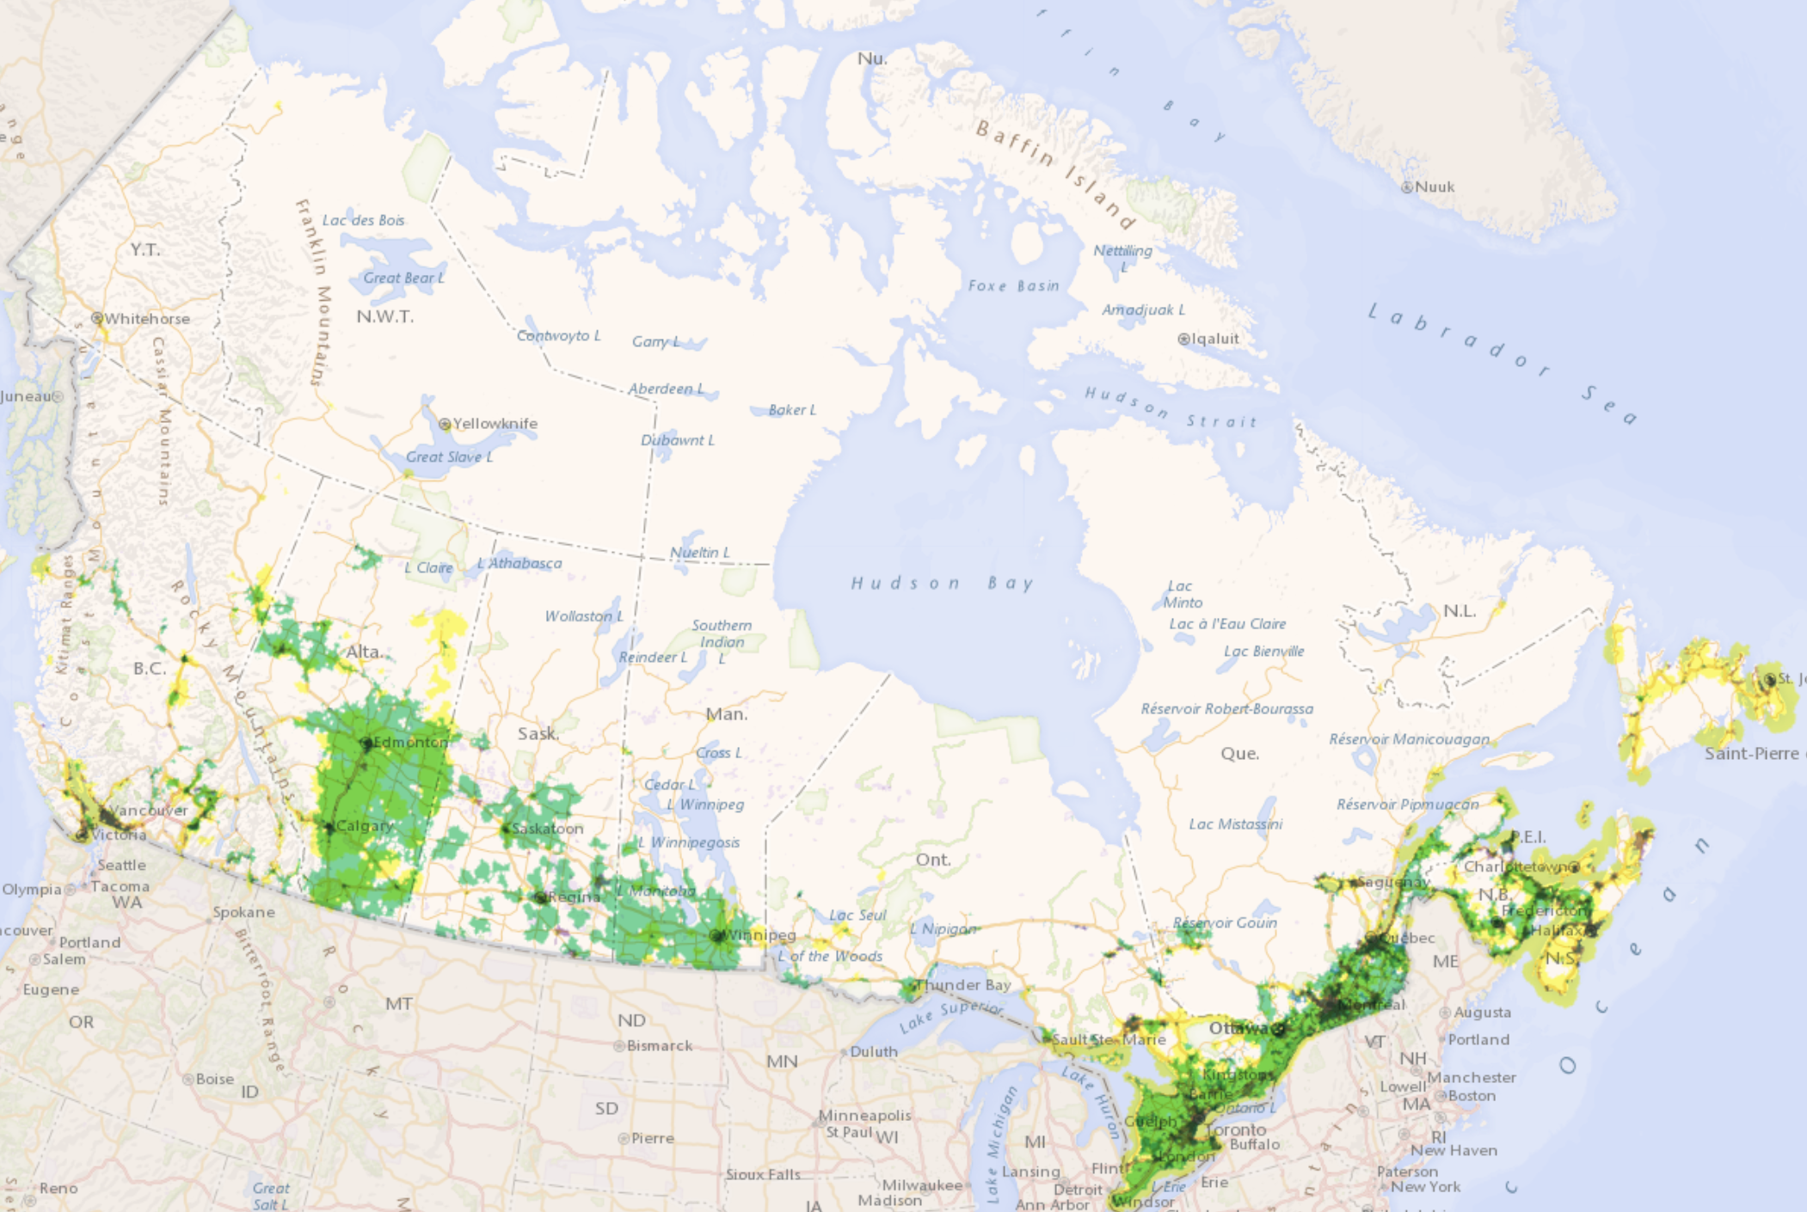

Outline
Putting Broadband in Context
Broadband Technologies
Policy and Regulation
2024 Broadband Landscape
2023 Alberta Broadband Toolkit
CRTC Broadband Availability Map (2023)
Alberta Rural Connectivity Form 2023
Notes:
Canadian Radio-television and Telecommunications Commission (CRTC). 2022. “Broadband Availability Map.” https://crtc.gc.ca/cartovista/internetcanada-en/

Slide 3
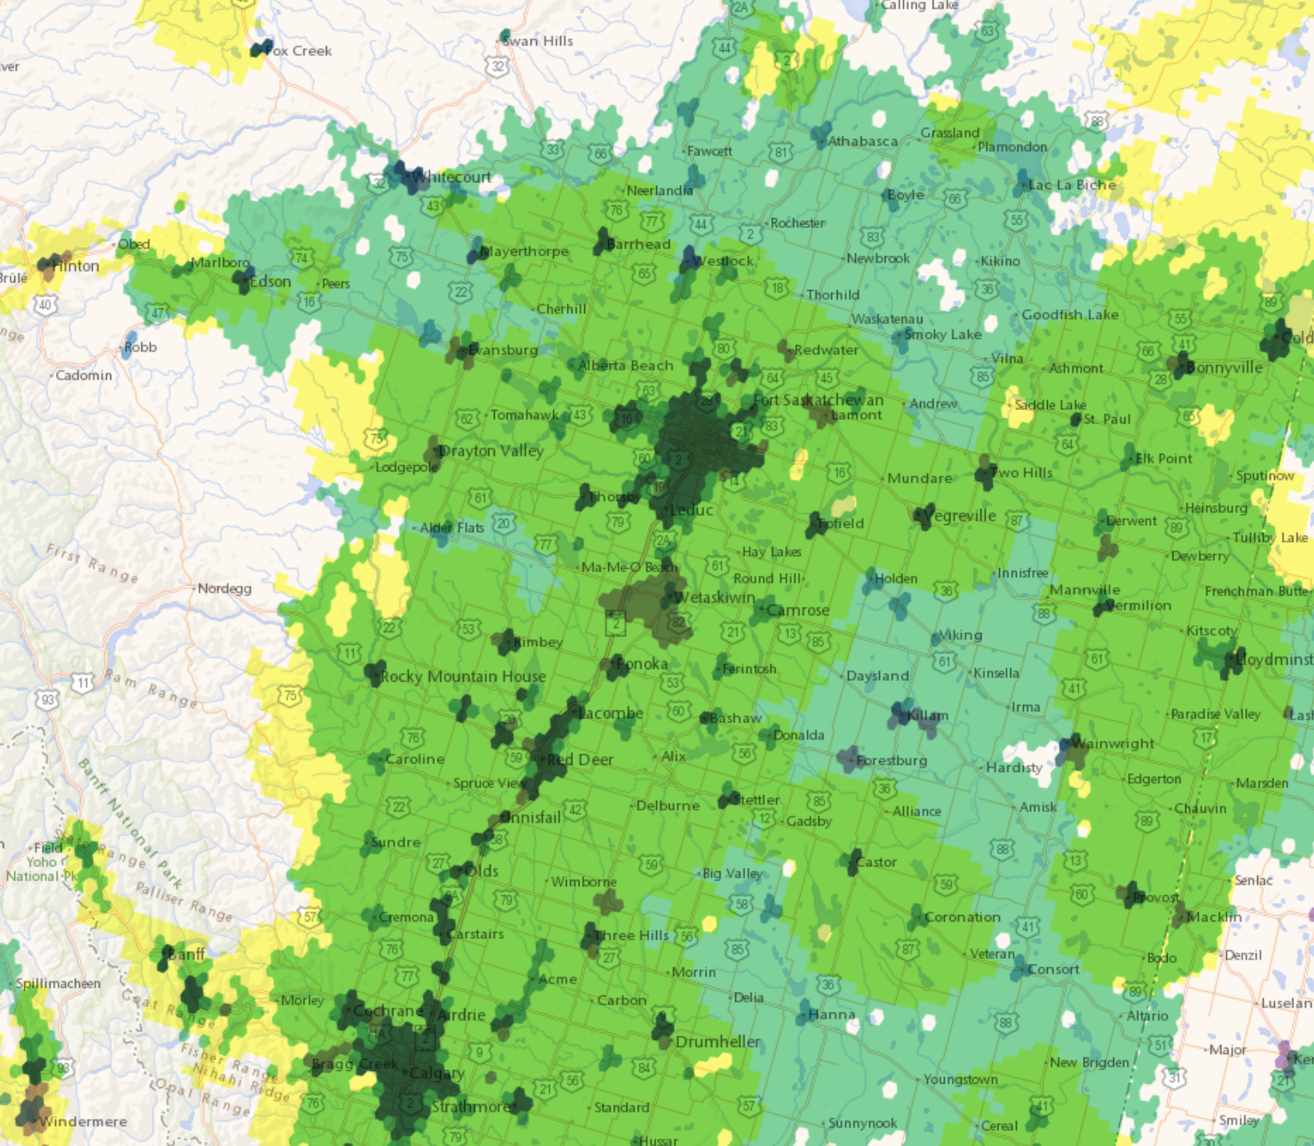
Outline
Putting Broadband in Context
Broadband Technologies
Policy and Regulation
2023 Broadband Landscape
2023 Alberta Broadband Toolkit
CRTC Broadband Availability Map (2023)
Alberta Rural Connectivity Form 2023
Notes:
Canadian Radio-television and Telecommunications Commission (CRTC). 2023. Broadband Availability Map. https://crtc.gc.ca/cartovista/internetcanada-en/

Slide 4
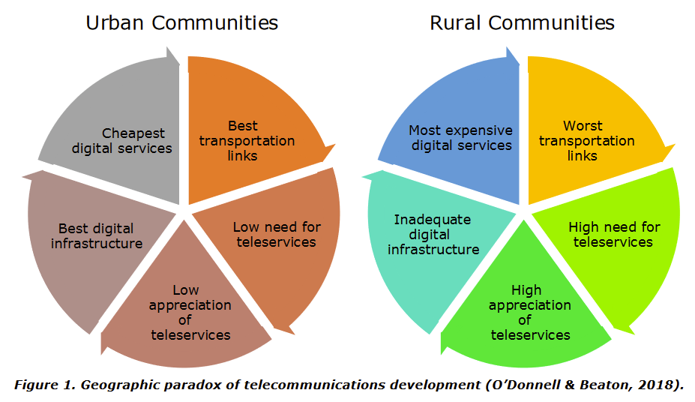
The Paradox of Telecom Development
Alberta Rural Connectivity Form 2023
Notes:
O'Donnell, S. & Beaton, B. (2018). A “whole-community” approach for sustainable digital infrastructure in remote and Northern First Nations. Northern Public Affairs, October, 34-37.

Slide 5
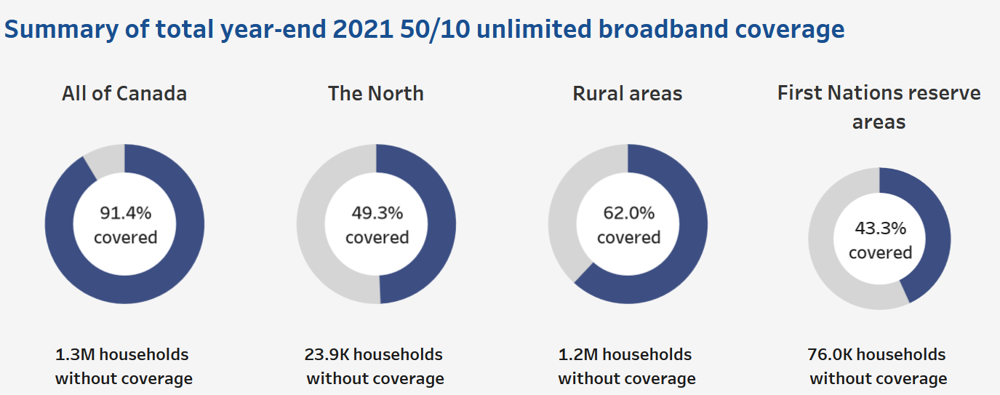
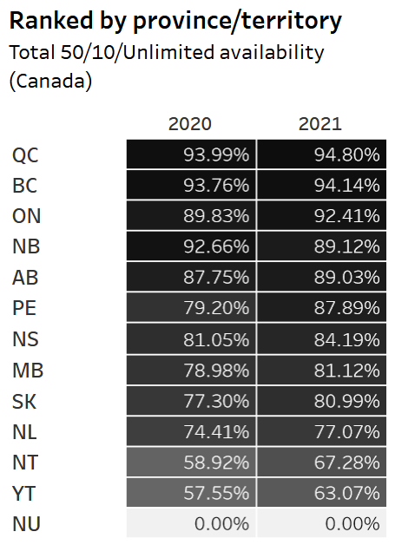
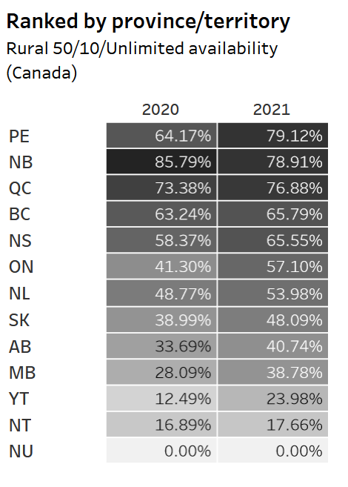
Latest CRTC Statistics
National overview
Provincial Ranks (Urban and Rural)
Provincial Ranks (Rural Only)
National Goals
2021 – 90% of households with 50/10 unlimited (Achieved)
2026 – 98% of households with 50/10 unlimited
2031 – 100% of households with 50/10 unlimited (on track)
Alberta Rural Connectivity Form 2023
Notes:
CRTC. 2023. Current Trends – High Speed Broadband. https://crtc.gc.ca/eng/publications/reports/policymonitoring/ban.htm

Slide 6

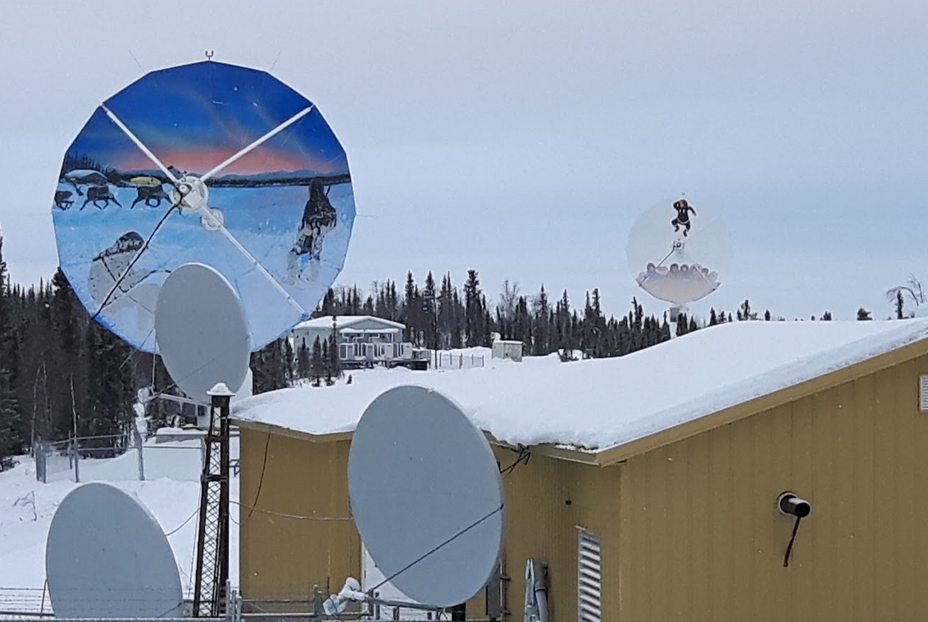

From Why? to How?
Rural connectivity a question of how? – How to get it right?
How to ensure we can connect the farm between two hamlets
How to ensure we don’t just connect Indigenous communities, but that we have broadband that is high quality, reliable and affordable
How to ensure the infrastructure we build suits current and future needs
Alberta Rural Connectivity Form 2023
Notes:
BASFPlantScience. 2009. “Farm in Schweden.” https://commons.wikimedia.org/wiki/File:Farm_Kartoffelfeld_Schweden.jpg
Michael B. McNally. 2019.
Hanne Pearce. 2016. “Server.” Understanding Community Broadband: The Alberta Broadband Toolkit. https://doi.org/10.7939/R3H708B16

Slide 7

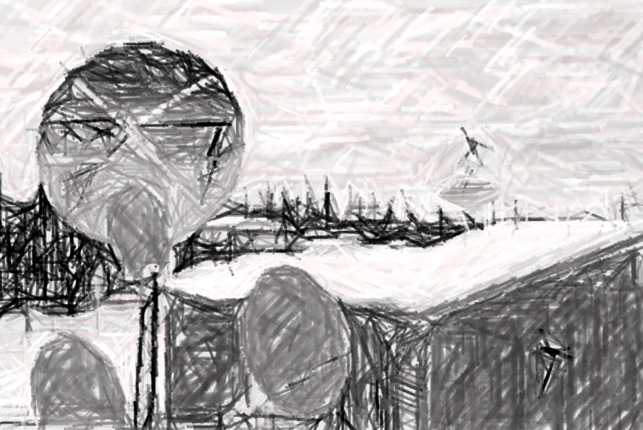

Back to Why?
Rural connectivity a question of how? – How to get it right?
How to ensure we can connect the farm between two hamlets
How to ensure we don’t just connect Indigenous communities, but that we have broadband that is high quality, reliable and affordable
How to ensure the infrastructure we build suits current and future needs
Why are rural, remote and Indigenous Communities still so far behind?
From Why? to How?
Alberta Rural Connectivity Form 2023
Notes:
BASFPlantScience. 2009. “Farm in Schweden.” https://commons.wikimedia.org/wiki/File:Farm_Kartoffelfeld_Schweden.jpg
Michael B. McNally. 2019.
Hanne Pearce. 2016. “Server.” Understanding Community Broadband: The Alberta Broadband Toolkit. https://doi.org/10.7939/R3H708B16

Slide 8
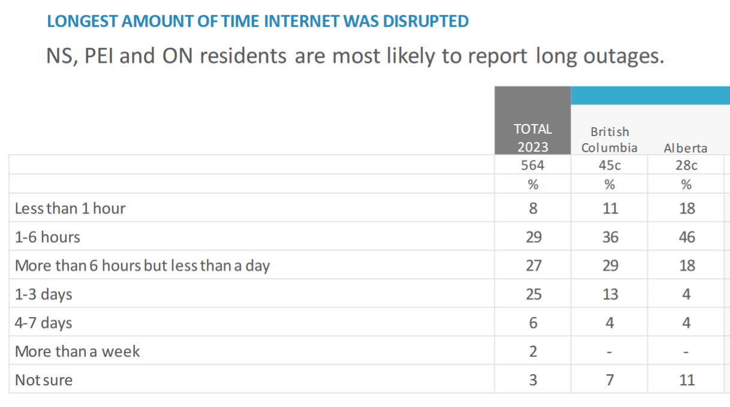
Key Concepts
Speed
  Usually “Megabits per second” (Mbps)
  Download and upload speed
  National targets (set 2016) 50 Mbps download/ 10 Mbps upload (50/10)
Cost
  Affordability
  Data caps/allowances
Quality
  Redundancy
  Reliability
CIRA (Canadian Internet Registration Authority)
Internet Factbook 2023 – Page 46
Alberta Rural Connectivity Form 2023
Notes:
Canadian Internet Registration Authority. 2023. CIRA Internet Factbook 2023. pg. 46. https://static.cira.ca/2023-07/2023%20Internet%20Trends%20Factbook.pdf?VersionId=O1QBl5i8uLDSa24feYuEacDxXZtnVRla

Slide 9
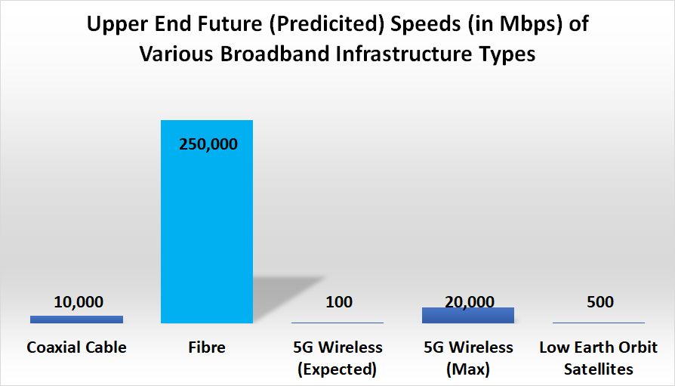
Fibre
Gold standard of broadband technologies
  Fastest
  Most reliable
  Synchronous connections
  High capacity
However
  Generally more expensive than wireless
Alberta Rural Connectivity Form 2023
Notes:
Data for this (and the following figures) are:
Organisation for Economic Cooperation and Development (OECD)—Working Party on Communication Infrastructures and Services Policy. 2015. Development of High Speed Networks and the Role of Municipal Networks. https://www.oecd.org/officialdocuments/publicdisplaydocumentpdf/?cote=DSTI/ICCP/CISP%282015%291/FINAL&docLanguage=En
OECD. 2018. Bridging the Rural Digital Divide. https://www.oecd-ilibrary.org/science-and-technology/bridging-the-rural-digital-divide_852bd3b9-en
CRTC. 2018. Telecom Decision CRTC 2018-44. https://crtc.gc.ca/eng/archive/2018/2018-44.htm
CRTC. 2016. Telecom Regulatory Policy CRTC 2016-496https://crtc.gc.ca/eng/archive/2016/2016-496.htm
CableLabs. N.d. “Docsis 4.0” https://www.cablelabs.com/technologies/docsis-4-0-technology
International Telecommunications Commission (ITU)—Broadband Commission. 2021. The State of Broadband: People Centred Approaches for Universal Broadband. https://www.itu.int/dms_pub/itu-s/opb/pol/S-POL-BROADBAND.23-2021-PDF-E.pdf
ITU—Broadband Commission. 2016. The State of Broadband: Broadband Catalyzing Sustainable Development. https://www.itu.int/dms_pub/itu-s/opb/pol/S-POL-BROADBAND.17-2016-PDF-E.pdf
ITU—Radiocommunication Study Groups—Working Party 5D. 2017. Minimum Requirements Related to Technical Performance for IMT-2020 Radio Interferences. https://www.itu.int/dms_pubrec/itu-r/rec/m/R-REC-M.2083-0-201509-I!!PDF-E.pdf

Slide 10




Wireless
Fixed Wireless (FWA) | Mobile Wireless | Satellite
Fixed point to point Cheap to deploy Varied speed | Mobile and higher speed Costly (to deploy and use) Dominated by Big 3 | Historically a ‘last resort’ New Low Earth Satellite (LEO) options Long term viability - ???
For more background on Wireless see ARCC’s 2021 Access Licensing Webinar at: https://www.youtube.com/watch?v=uO-Xu8RQGN8
Alberta Rural Connectivity Form 2023
Notes:
Hanne Pearce. 2016. “Fibre Optic Cable” and “Wireless Tower” Understanding Community Broadband: The Alberta Broadband Toolkit. https://doi.org/10.7939/R3H41JR36
Maruizio Pesce. 2015. “Smart Phone.” https://commons.wikimedia.org/wiki/File:Polaroid_Selfie_5,5%22_Android_Smartphone_(16675836918).jpg
Joe Rogan Experience. 2018. “Episode #1169 – Elon Musk.” https://www.youtube.com/watch?v=ycPr5-27vSI

Slide 11
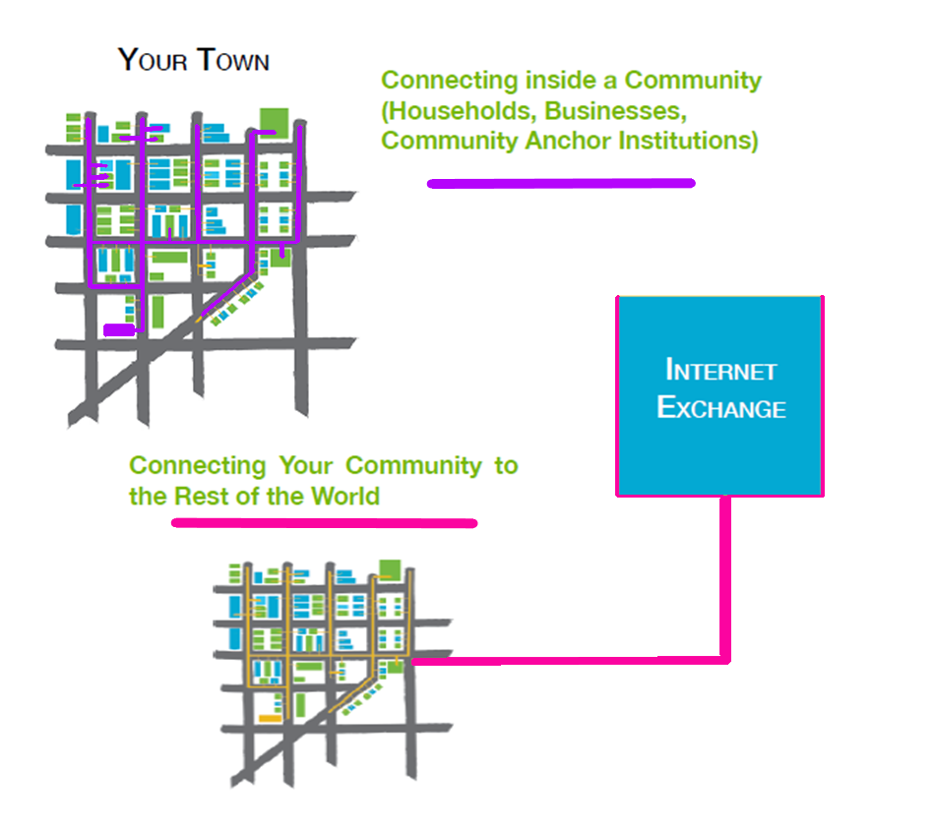
Getting to Calgary
Need both
First/last mile connections in a community
Backhaul/transport connection to Internet Exchange (in Calgary or Edmonton)
Alberta Rural Connectivity Form 2023
Notes:
Hanne Pearce/McNally et al. 2016. Understanding Community Broadband: The Alberta Broadband Toolkit. https://doi.org/10.7939/R3H41JR36

Slide 12


Policy and Regulation
Federal Department
  Funding
  Wireline policy
  Wireless policy and regulation
Arm’s length regulator
  Wireline regulation
  Some wireline policy
  Some wireless regulation
  Funding
+ Minister of Rural Economic Development
+ provincial bodies (Technology and Innovation)
Alberta Rural Connectivity Form 2023

Slide 13
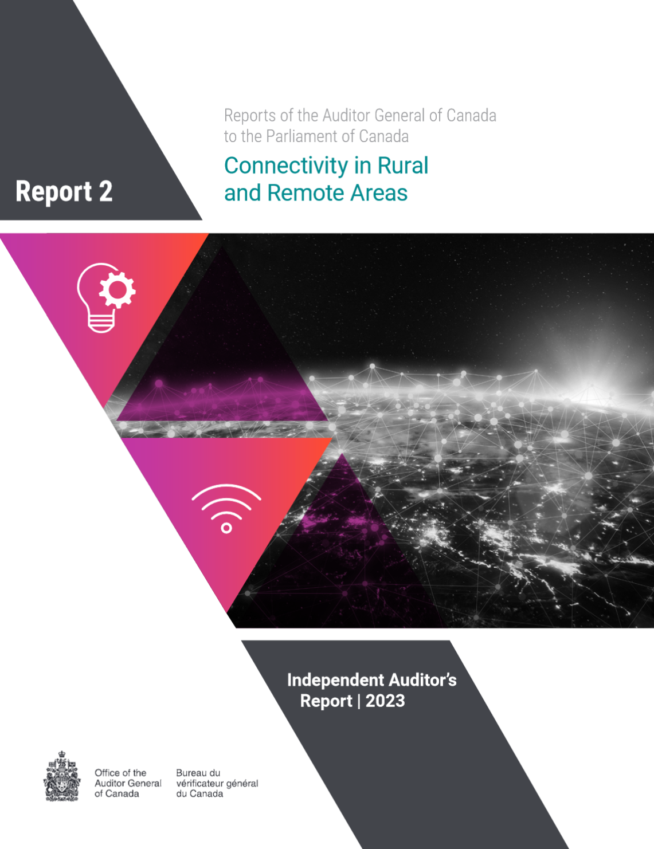
Policy and Regulation
Auditor General Key Findings:
  Unprecedented commitments
  $8 billion since 2014-15
  However, actual spending well below commitments
  Affordability not fully measured by ISED or CRTC
Report also contains ISED and CRTC responses to findings
Alberta Rural Connectivity Form 2023
Notes:
Office of the Auditor General of Canada. 2023. Connectivity in Rural and Remote Areas – Report 2. https://www.oag-bvg.gc.ca/internet/English/parl_oag_202303_02_e_44205.html

Slide 14

GoA Broadband Strategy
100% connectivity by Mar. 31, 2027 at 50/10
  Currently only 33% of rural, and
  20% of Indigenous communities at these speeds
$390 million in funding
  But only $36 million for new projects (Alberta Broadband Fund (ABF))
  ABF Intake 2 and Stream 2 applications to open in (late?) 2023
Mix of Fibre, FWA and LEO
Alberta Rural Connectivity Form 2023
Notes:
Alberta. 2022. Alberta Broadband Strategy 2022: Connecting Albertans, Growing the Economy. https://open.alberta.ca/publications/alberta-broadband-strategy-2022
Alberta. 2023. Alberta Broadband Fund. https://www.alberta.ca/alberta-broadband-fund

Slide 15
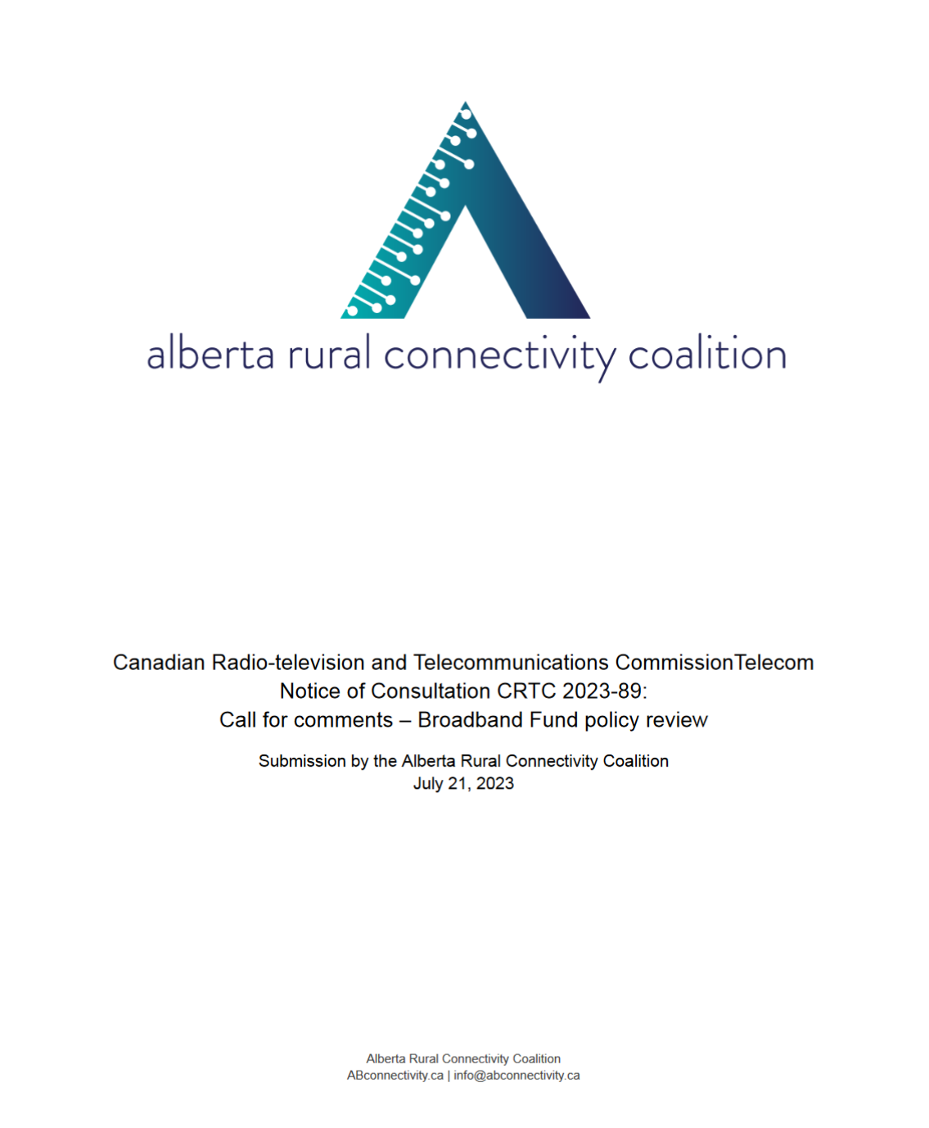
2023-24 Context
2023
  Rogers-Shaw merger
  ISED Spectrum Outlook 2023-27
  2023-24
  3800 MHz spectrum auction completion
  ISED Access Licensing Decision
  CRTC Broadband Fund Policy review
  CRTC Wholesale High-speed Access Service Framework review
  ABF Intake 2/Phase 2
Cover of the ARCC submission to the Broadband Fund Policy Review
Alberta Rural Connectivity Form 2023
Notes:
CRTC. 2023. Telecom Notice of Consultation CRTC 2023-56. https://crtc.gc.ca/eng/archive/2023/2023-56.htm
CRTC. 2023. Telecom Notice of Consultation CRTC 2023-89. https://crtc.gc.ca/eng/archive/2023/2023-89.htm
Innovation, Science and Economic Development Canada (ISED). 2021. Consultation on New Access Licensing Framework, Changes to Subordinate Licensing and White Space to Support Rural and Remote Development. https://ised-isde.canada.ca/site/spectrum-management-telecommunications/en/learn-more/key-documents/consultations/consultation-new-access-licensing-framework-changes-subordinate-licensing-and-white-space-support
ISED. 2023. Spectrum Outlook 2023 to 2027. https://ised-isde.canada.ca/site/spectrum-management-telecommunications/en/spectrum-allocation/spectrum-outlook-2023-2027
ISED. 2023. Auction of Spectrum Licences in the 3800 MHz Band. https://ised-isde.canada.ca/site/spectrum-management-telecommunications/en/spectrum-allocation/auction-spectrum-licences-3800-mhz-band

Slide 16
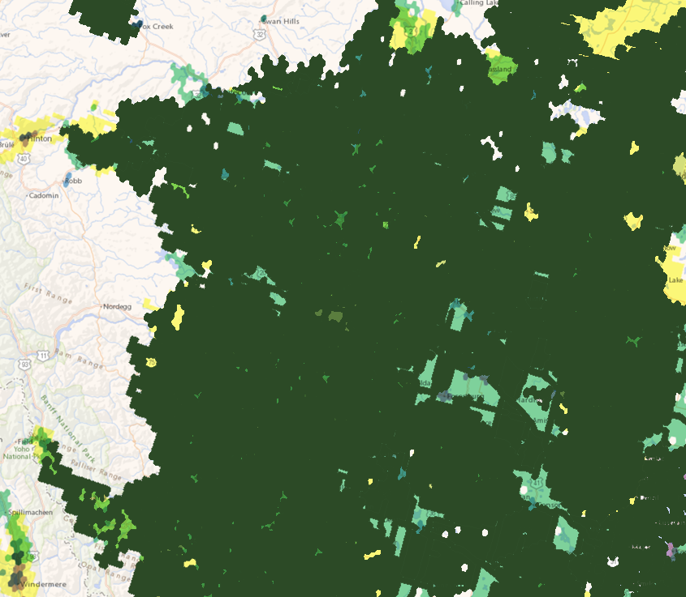
From How to What Next?
Connectivity is not inevitable, but the ‘why’ has never been clearer
Getting it right (the ‘how’) is key
Need to think about what next?
Affordability for the future
Digital Skills/Literacy
What can we do with 100% connected AB?
Is 50/10 still a viable target for 2026 or 2031
2026???
2027???
2031???
Alberta Rural Connectivity Form 2023

Slide 17




Understanding Community Broadband (2023)

Slide 18
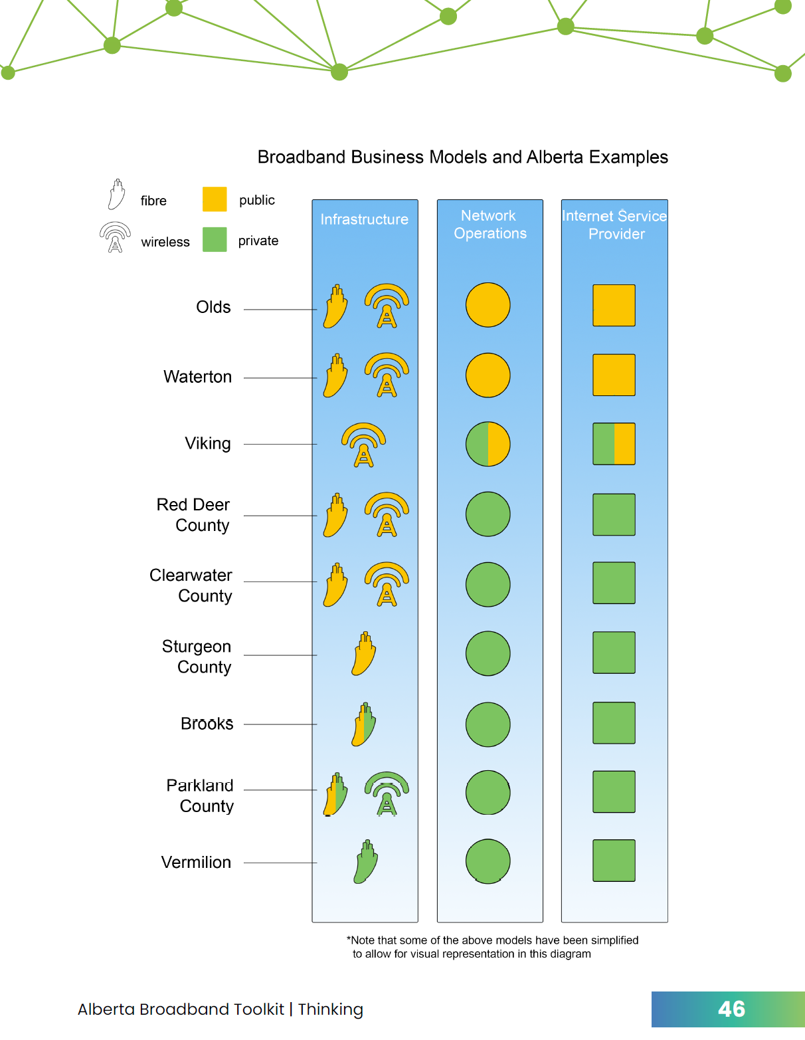
Understanding Community Broadband (2023)
Updates and expands 2016 toolkit
More information on community projects
Expanded content on business models

Slide 19
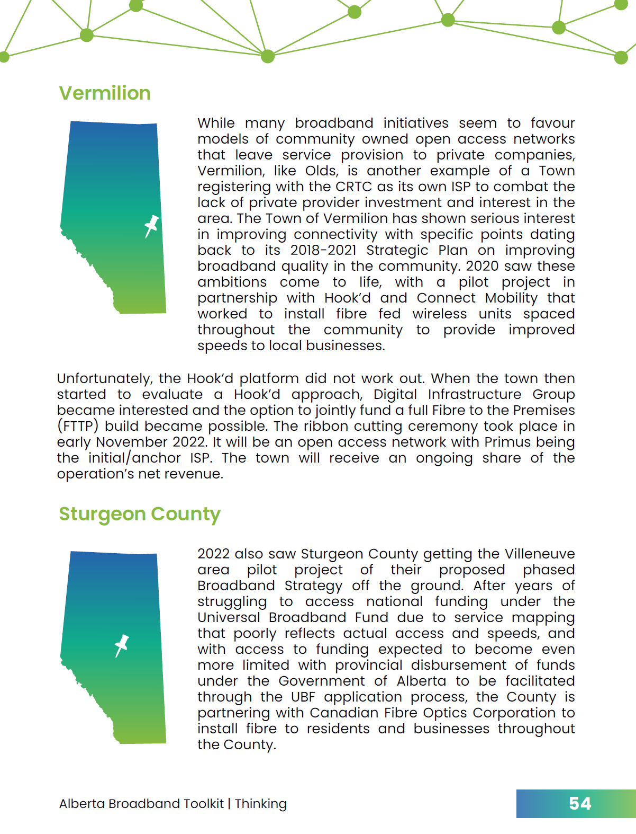
Understanding Community Broadband (2023)
Aimed to provide introduction to broadband for community leaders, elected officials, administrators
Contents include:
  Technology
  Business models
  Policy and regulation
  Pitfalls and Best Practices

Slide 20
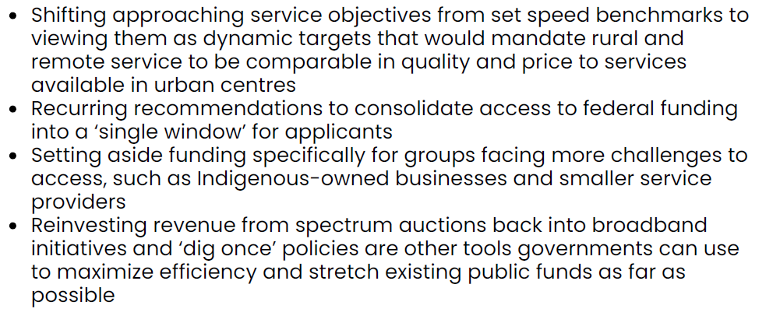
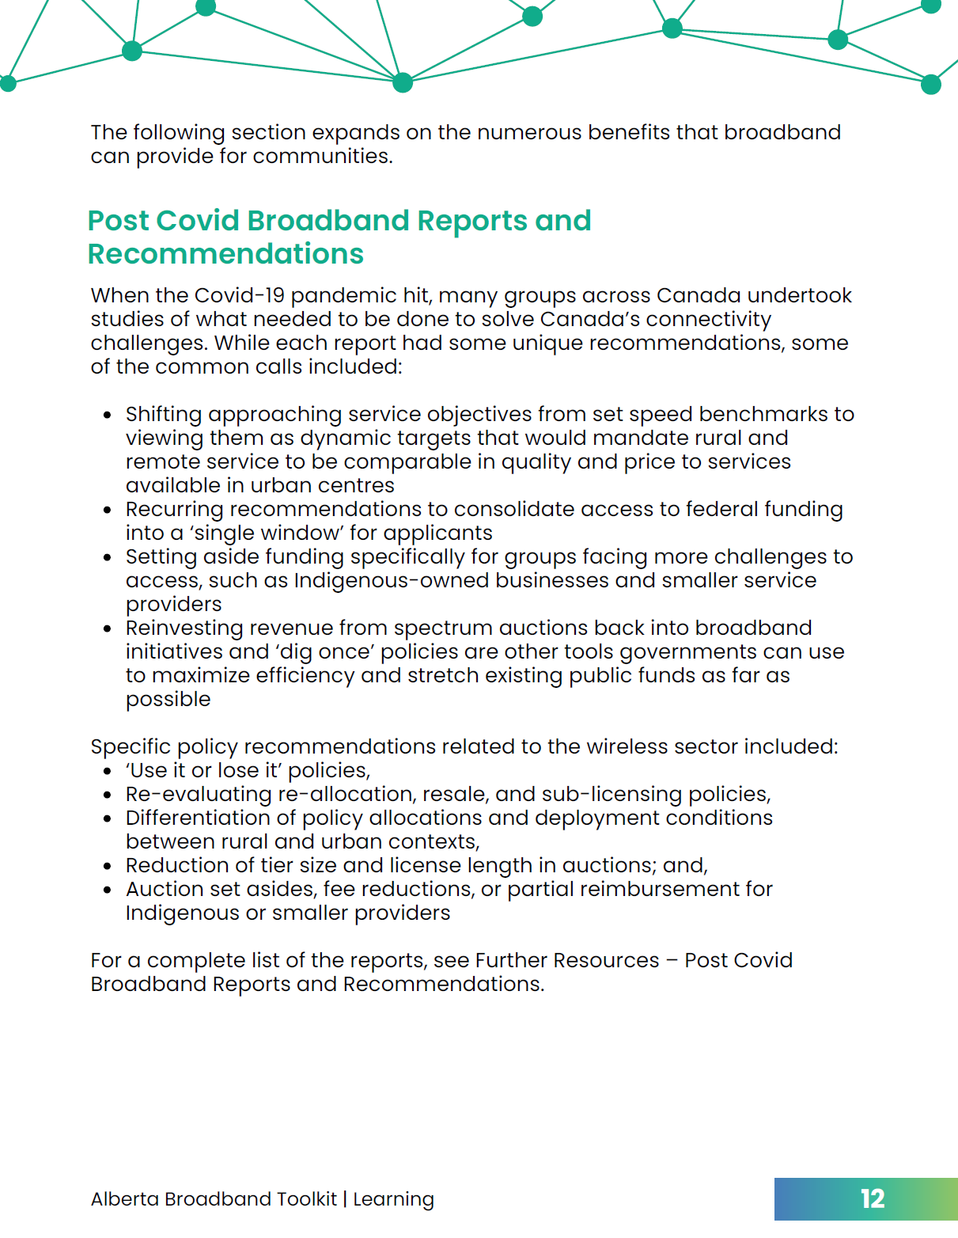
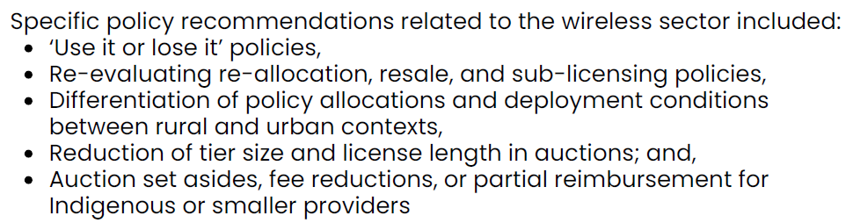
Post Covid Reports and Recommendations (p. 12)

Slide 21
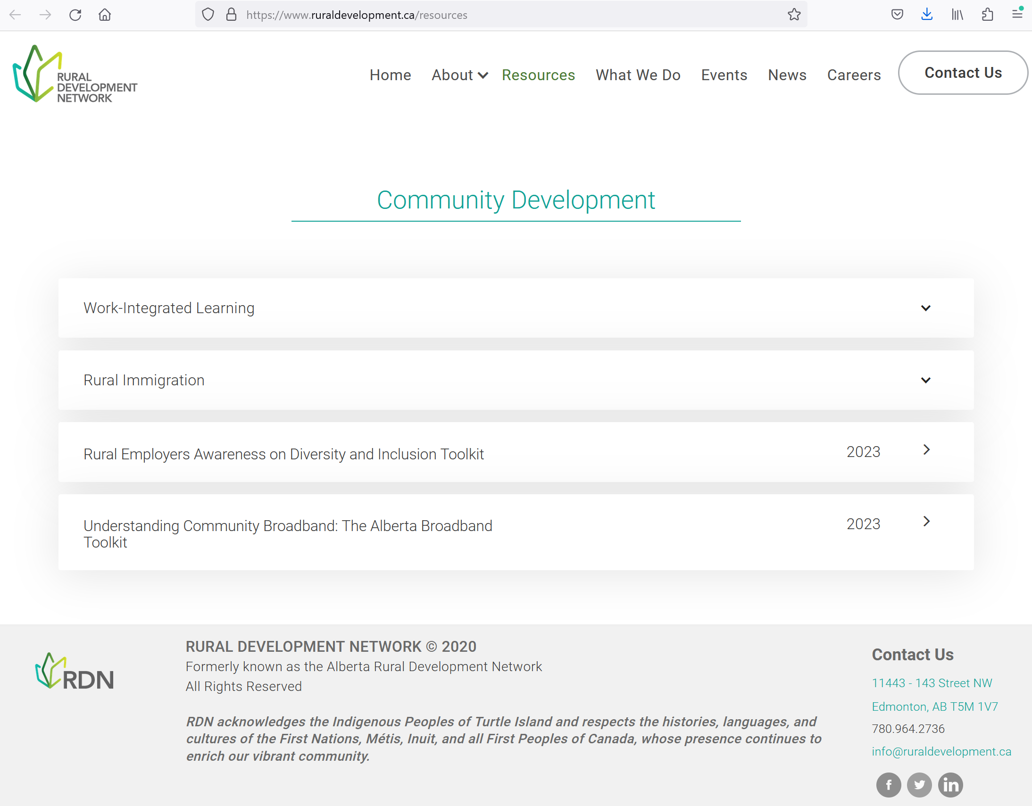

Slide 22
Sources
Alberta. 2022. Alberta Broadband Strategy 2022: Connecting Albertans, Growing the Economy. https://open.alberta.ca/publications/alberta-broadband-strategy-2022
Alberta. 2023. Alberta Broadband Fund. https://www.alberta.ca/alberta-broadband-fund
Canadian Internet Registration Authority. 2023. CIRA Internet Factbook 2023. pg. 46. https://static.cira.ca/2023-07/2023%20Internet%20Trends%20Factbook.pdf?VersionId=O1QBl5i8uLDSa24feYuEacDxXZtnVRla
Canadian Radio-television and Telecommunications Commission (CRTC). 2023. Broadband Availability Map. https://crtc.gc.ca/cartovista/internetcanada-en/
CRTC. 2023. Current Trends – High Speed Broadband. https://crtc.gc.ca/eng/publications/reports/policymonitoring/ban.htm
CRTC. 2023. Telecom Notice of Consultation CRTC 2023-56. https://crtc.gc.ca/eng/archive/2023/2023-56.htm
CRTC. 2023. Telecom Notice of Consultation CRTC 2023-89. https://crtc.gc.ca/eng/archive/2023/2023-89.htm
Alberta Rural Connectivity Form 2023

Slide 23
Sources
Innovation, Science and Economic Development Canada (ISED). 2021. Consultation on New Access Licensing Framework, Changes to Subordinate Licensing and White Space to Support Rural and Remote Development. https://ised-isde.canada.ca/site/spectrum-management-telecommunications/en/learn-more/key-documents/consultations/consultation-new-access-licensing-framework-changes-subordinate-licensing-and-white-space-support
ISED. 2023. Auction of Spectrum Licences in the 3800 MHz Band. https://ised-isde.canada.ca/site/spectrum-management-telecommunications/en/spectrum-allocation/auction-spectrum-licences-3800-mhz-band
ISED. 2023. Spectrum Outlook 2023 to 2027. https://ised-isde.canada.ca/site/spectrum-management-telecommunications/en/spectrum-allocation/spectrum-outlook-2023-2027
O'Donnell, S. & Beaton, B. (2018). A “whole-community” approach for sustainable digital infrastructure in remote and Northern First Nations. Northern Public Affairs, October, 34-37.
Office of the Auditor General of Canada. 2023. Connectivity in Rural and Remote Areas – Report 2. https://www.oag-bvg.gc.ca/internet/English/parl_oag_202303_02_e_44205.html
Alberta Rural Connectivity Form 2023

Slide 24
Additional Useful Links
Agricultural Produces Association of Saskatchewan. 2021. Rural Connectivity Task Force: Final Report. https://apas.ca/pub/documents/Advocacy%20and%20Resources/Rural%20Connectivity/rctf-final-report-final-web.pdf
Alberta Rural Connectivity Coalition/Michael B. McNally. “How Wireless Spectrum Regulation will Impact Rural Connectivity.” https://www.youtube.com/watch?v=uO-Xu8RQGN8
Canada – House of Commons – Standing Committee on Industry and Technology (INDU). 2022. Proposed Acquisition of Shaw Communications by Rogers Communications: Better Together?. 44th Parl. 1st Sess. https://www.ourcommons.ca/DocumentViewer/en/44-1/INDU/report-1/
Canadian Council of Academies. 2021. Waiting to Connect: Expert Panel on High-Throughput Networks for Rural and Remote Communities in Canada. https://www.cca-reports.ca/reports/high-throughput-networks-for-rural-and-remote-communities/
Cybera. 2021. State of Alberta Digital Infrastructure Report 2021. https://www.cybera.ca/wp-content/uploads/2021/07/State-of-Alberta-Digital-Infrastructure-Report-2021.pdf
Gregory Taylor/Calgary Economic Development. 2021. 5G and Connectivity. https://www.calgaryeconomicdevelopment.com/assets/Uploads/calgary+technology+5G-Connectivity-Report.pdf
Institute for Fiscal Studies and Democracy. 2021. Assessing the Efficacy for the Delivery of Rural Broadband. https://www.ifsd.ca/en/blog/reports/Assessing%20the%20efficacy%20of%20instruments%20for%20the%20delivery%20of%20rural%20broadband
Alberta Rural Connectivity Form 2023

