Slide 1


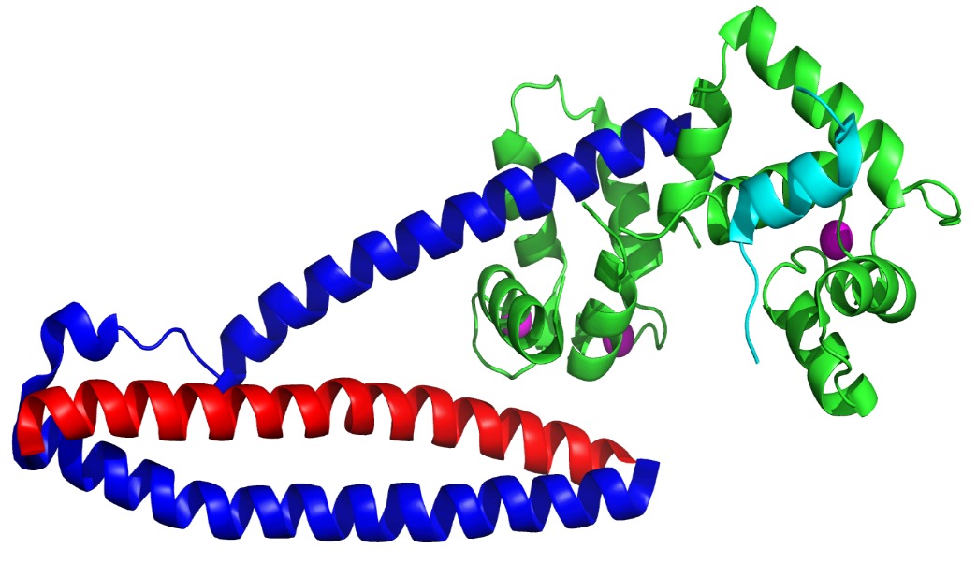
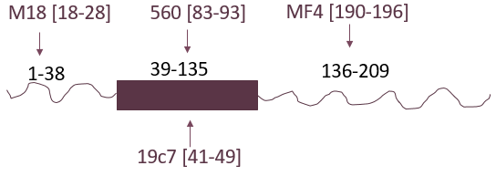
Troponin degradation as a more specific marker for myocardial infarction
Somaya Zahran¹, Vivian Figueiredo², George Cembrowski³, Michelle Graham⁴, Richard Schulz⁵, Peter Hwang⁶
1-Department of Medicine, University of Alberta 4-Cardiology Division, Department of Medicine, University of Alberta
2-Department of Biological Sciences, Univ. Federal de Ouro Preto, Brazil 5-Departments of Pediatrics and Pharmacology, University of Alberta
3-Department of Laboratory Medicine and Pathology, University of Alberta 6- Division of General Internal Medicine, Department of Medicine and Department of Biochemistry, University of Alberta
Introduction
Results
Troponin degradation is a more reliable indicator of infarct severity than total troponin level:
Type 2 MI < NSTEMI < STEMI
Conclusions
In type 1 myocardial infarction (MI), more commonly known as a “heart attack”, acute thrombus formation leads to an abrupt loss of blood supplying a vascular territory, causing a focal region of cellular necrosis. The gold standard diagnostic test for detecting MI is the serum cardiac troponin assay ¹.
The fundamental problem with the troponin assay is that it is not sufficiently specific for the focal necrosis produced by type 1 MI. Elevated serum troponin levels are observed in people running marathons and in healthy volunteers with atrial pacing-induced tachycardia². In acutely ill patients, a physiologic stressor (e.g., tachyarrhythmia, sepsis, or anemia) can cause ischemia in vulnerable watershed regions (those with a distal or tenuous vascular supply), causing troponin release in what is called a type 2 MI.
The C-terminus of troponin I becomes increasingly degraded in severe infarct
Proteolytic degradation of cardiac troponin I is a more specific marker for cellular necrosis than total troponin level
Proteolytic digestion at the C-terminus of cardiac troponin I is more consistently observed than digestion at the N-terminus
Distinguishing between intact and degraded forms of troponin may be useful for:
Identifying patients with focal infarct in need of revascularization
Monitoring intracellular proteolysis as a possible target for therapeutic intervention
Providing an impetus for standardizing the troponin I assay.
A
A
Hypothesis
Cell death leads to the activation of cytoplasmic proteases³, like caspases, calpains, and intracellular matrix metalloproteinases⁴. It has already been established that serum cardiac troponin I is proteolytically degraded in the setting of MI⁵. We postulate that cardiac troponin I released in focal infarct will be more proteolytically degraded than that released by milder ischemic processes.
B
B
N-terminus
Figure 1. Structure of cardiac troponin heterotrimer, with the troponin I subunit shown in blue/cyan. The N- and C-termini of troponin I are intrinsically disordered, making them highly susceptible to proteolytic degradation.
Future directions
C-terminus
Map time dependence of troponin degradation in relation to symptom onset and therapy
Measure correlation between troponin degradation and infarct size by cardiac MRI, clinical outcomes
Clinical trial to assess whether protease inhibitors can reduce cardiac troponin degradation and improve clinical outcomes in STEMI patients
Develop a universal reference material for cardiac troponin I
Structured core of
cardiac troponin I
Unstructured ends
of cardiac troponin I
Figure 3. Troponin levels in type 1 MI patients. Plots comparing total troponin level (as detected by antibody 560), as opposed to A) troponin with intact C-terminus (detected by antibody MF4) or B) troponin with intact N-terminus (detected by antibody M18).
Experimental design
Figure 4. A) Patients ordered according to total troponin level. B) Patients ordered according to degree of proteolytic degradation at the C-terminus of troponin I.
15 type 1 MI patients + 1 myocarditis patient
12 potential type 2 MI patients + 1 type 4 MI patient
Three sets of sandwich ELISA, using three different antibody combinations, each recognizing a different epitope of troponin I
*Obtain plasma sample from which last troponin was read
*Obtain additional serum sample with next blood work
*Samples stored at -80°C for future testing
Type 2 MI patients are a heterogeneous group
Infarct severity in type 2 MI patients depends on the severity of underlying atherosclerotic lesions
References
1. Thygesen, K. et al. Third Universal Definition of Myocardial Infarction. Circulation 126, 2020–(20352012).
2. Turer AT et al. Myocardial ischemia induced by rapid atrial pacing causes troponin T release detectable by a highly sensitive assay: insights from a coronary sinus sampling study. J Am Coll Cardiol 57, 2398-2405 (2011).
3. Müller, A. L. et al. Role of various proteases in cardiac remodeling and progression of heart failure. Heart Fail Rev 17, 395–409 (2012).
4. Wang W. et al. Intracellular action of matrix metalloproteinase-2 accounts for acute myocardial ischemia and reperfusion injury. Circulation 106, 1543-1549 (2002).
5. Madsen, L. H. et al. Time Course of Degradation of Cardiac Troponin I in Patients With Acute ST-Elevation Myocardial Infarction The ASSENT-2 Troponin Substudy. Circ Res 99, 1141–1147 (2006).
Acknowledgements
We thank Dr Hoon Sunwoo from Pharmacy and Pharmaceutical Sciences for his valuable advice in optimizing the ELISA assay
We thank the Divisions of General Internal Medicine, Cardiology, Critical Care Medicine, and Neurology for their help in recruiting patients
This work was funded by the University Hospital Foundation, startup funds from the Department of Medicine and Faculty of Medicine & Dentistry, and the Hwang Professional Corporation
Figure 2. Antibodies used in ELISA for cardiac troponin I:
19C7: Capture antibody
M18: Detection antibody for N-terminal region
560: Detection antibody for structured core
MF4: Detection antibody for C-terminal region
Figure 5. Schematic showing the impact of increasing severity of focal atherosclerotic lesions (along x-axis) and ischemia due to supply-demand imbalance (along y-axis) on infarct size in the heart (shown as circles on an oval-shaped heart). The boxed area with a dashed border highlights situations in which the decision of whether or not to proceed with angiography is debatable.

