Slide 1
Speedy Intro to Open Education
Centre for Teaching and Learning, University of Alberta
October 24, 2017
Unless otherwise noted, this work is licensed under a Creative Commons Attribution 4.0 International License.

Slide 2
Workshop Objectives:
Recognize the reasons, benefits, and outcomes of the open education movement.
Describe the benefits of OER and open licensing.
Recognize the values and importance of intellectual property and copyright and their relationship to public domain and creative commons licensing.
Recognize scenarios and opportunities for openly licensing educational material.
Unless otherwise noted, this work is licensed under a Creative Commons Attribution 4.0 International License.

Slide 3
Activity: Values and Experiences in Education
Reflect on your learning experiences (formal and informal)
Positive
Why?
Barrier(s)
to entry, participation, etc.
Unless otherwise noted, this work is licensed under a Creative Commons Attribution 4.0 International License.
Notes:
Activity:
Reflect on your teaching / learning experiences
(1) Think of one experience that was exceptionally positive. Why was it so positive?
(2) Think of one learning experience that felt negative. Why was it negative? What is the need that this experience did not meet? E.g. student in traditional course (enrol through registrar’s office, go to campus, etc)
Lifelong learner (advance your current practice or profession, “get it done” at work, curiosity, hobby)
Instructor preparing for classroom activities
Instructor supplementing current course content
Preparing to present at a conference
Share in pairs the positive and negative attributes of these experiences.
Facilitator - provide overview of Cost, Quality/Pedagogy, and Access/Discoverability. Participants to post or write their examples to one of the circles in the venn diagram (full version is on the next slide)

Slide 4
Activity: Values and Experiences in Education
Cost
Reflect on your learning experiences (formal and informal)
Positive
Why?
Barrier(s)
to entry, participation, etc.
Quality and Pedagogy
Access & Discovery
Diagram by Michael McNally is licensed under CC-BY 4.0
Unless otherwise noted, this work is licensed under a Creative Commons Attribution 4.0 International License.
Notes:
Facilitator - provide overview of Cost, Quality/Pedagogy, and Access/Discoverability. Participants to post or write their examples to one of the circles in the venn diagram (full version is on the next slide)

Slide 5
Why Open Education?
Government
Students
Cost
Institutional Leadership
There are three key objectives that motivate people to participate in the promotion of OERs:
to reduce student costs
to increase quality of teaching materials and opportunities for creative pedagogy (e.g. OER-enabled pedagogy)
to make educational material more accessible and discoverable
Quality and Pedagogy
Access & Discovery
Instructors
Library and
Bookstore
Centres for Teaching and Learning
Diagram by Michael McNally is licensed under CC-BY 4.0
Unless otherwise noted, this work is licensed under a Creative Commons Attribution 4.0 International License.
Notes:
Facilitator - provide overview of Cost, Quality/Pedagogy, and Access/Discoverability. Participants to post or write their examples to one of the circles in the venn diagram (full version is on the next slide)

Slide 6
Defining Open Education
Unless otherwise noted, this work is licensed under a Creative Commons Attribution 4.0 International License.

Slide 7
Defining Open Education
Scholarly Publishing and Academic Resources Coalition (SPARC)
“Open Education encompasses resources, tools, and practices that are free of legal, financial and technical barriers and can be fully used, shared and adapted. At the core of Open Education is open educational resources (OER), which are teaching, learning, and research resources that are free of cost and access barriers, and carry legal permission for open use.”
Open Education Consortium "sharing is probably the most basic characteristic of education: education is sharing knowledge, insights and information with others, upon which new knowledge, skills, ideas and understanding can be built."
The William and Flora Hewlett Foundation
"...is the simple and powerful idea that the world’s knowledge is a public good and that technology in general and the Web in particular provide an extraordinary opportunity for everyone to share, use, and reuse knowledge.
Unless otherwise noted, this work is licensed under a Creative Commons Attribution 4.0 International License.

Slide 8
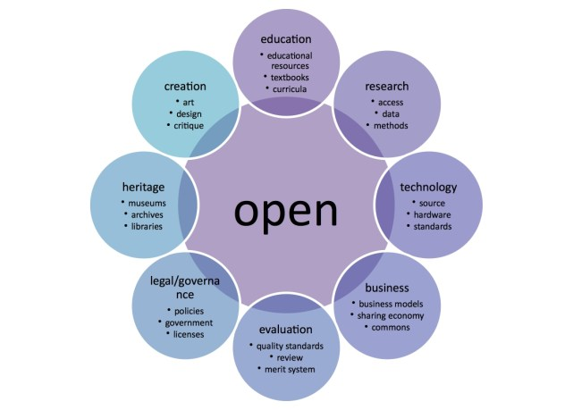
"Open Model" Graphic by Katja Mayer, is licensed under CC BY 4.0
Unless otherwise noted, this work is licensed under a Creative Commons Attribution 4.0 International License.
Notes:
Introduce that “open” is a movement occurring in education and beyond

Slide 9
"Open Model" Graphic by Katja Mayer, is licensed under CC BY 4.0
Unless otherwise noted, this work is licensed under a Creative Commons Attribution 4.0 International License.
Notes:
Today we are talking about ONE of these circles: Education, meaning Teaching.

Slide 10
Open Education
Open source software
OEP
Open
Content
(images, videos,
articles, music...)
OER
OCW
Open Access Publishing
Adaptation of "OER Mobile Course Open Diagram" by Classroom Aid is licensed under CC BY-NC-SA 3.0 Unported
Unless otherwise noted, this work is licensed under a Creative Commons Attribution 4.0 International License.
Notes:
This one is overwhelming but it helps us focus our attention today…

Slide 11
Centre for Teaching and Learning | UA Libraries | Copyright Office
Open Education
Open source software
OEP
Open
Content
(images, videos,
articles, music...)
OER
OCW
Open Access Publishing
Adaptation of "OER Mobile Course Open Diagram" by Classroom Aid is licensed under CC BY-NC-SA 3.0 Unported
Unless otherwise noted, this work is licensed under a Creative Commons Attribution 4.0 International License.
Notes:
All of these circles are activities we see at UofA. Today, we’re going to talk about Open Education specifically in the context of TEACHING. OER, OEP. “open course ware” applies to teaching, too, but it’s a little technical for our taste today, so let’s leave that alone. ;)

Slide 12
Defining Open Educational Resources
Unless otherwise noted, this work is licensed under a Creative Commons Attribution 4.0 International License.

Slide 13
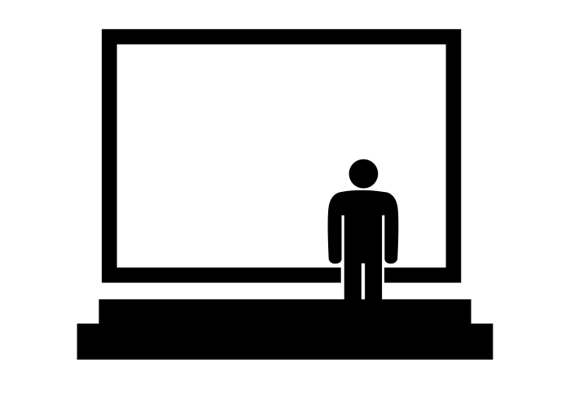
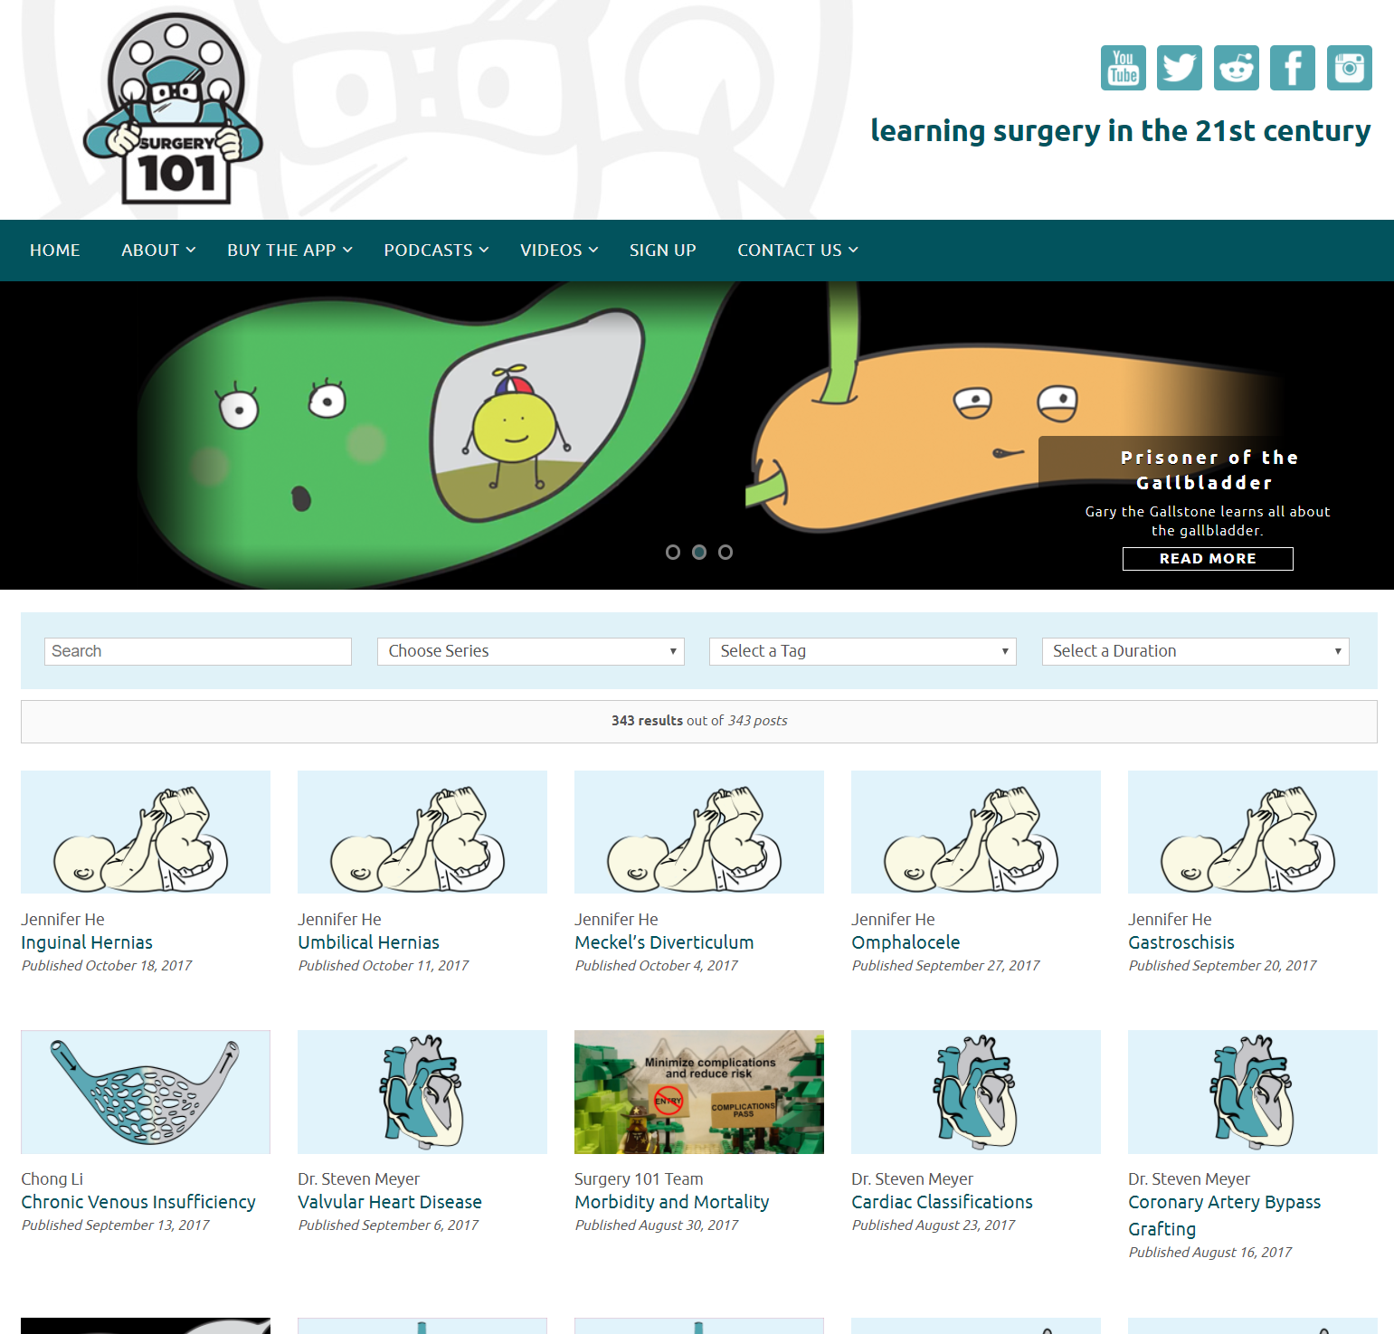
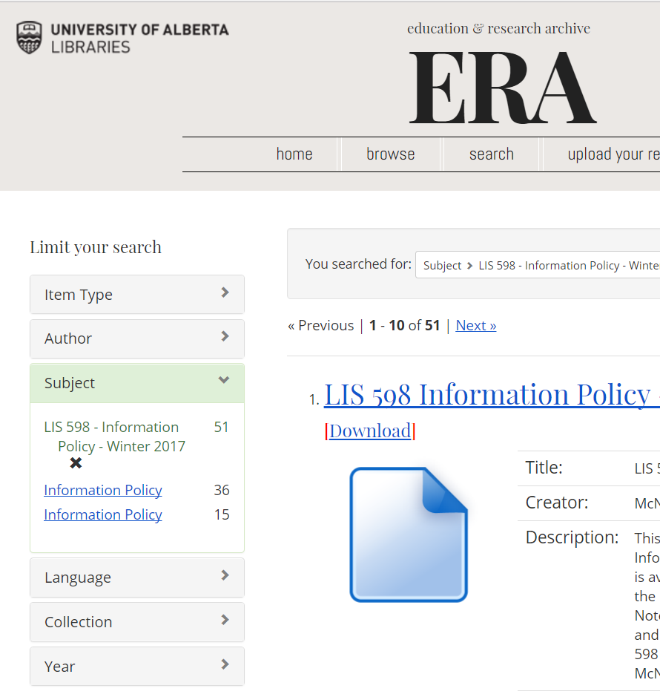
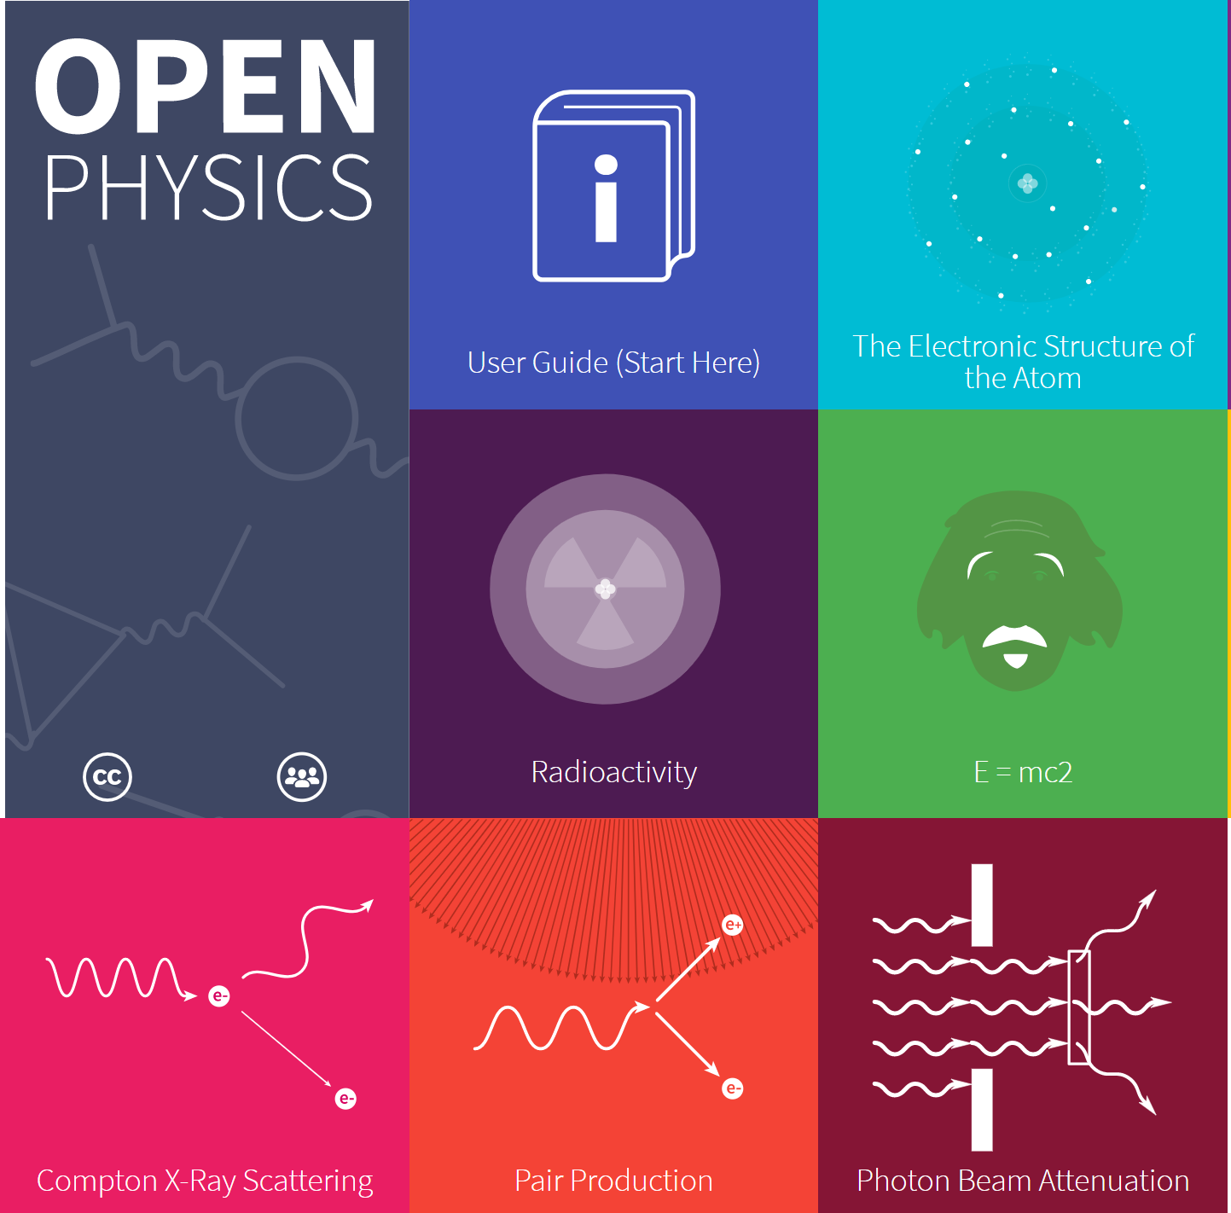
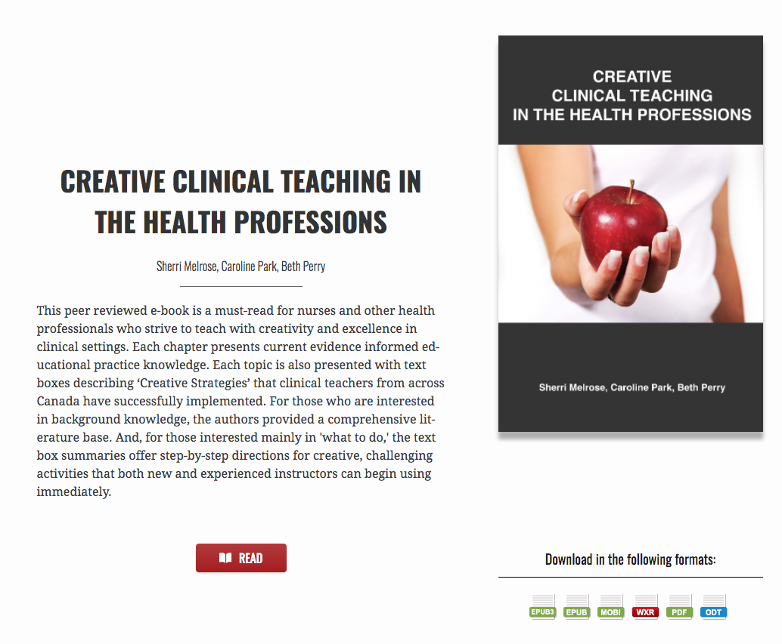
Open Educational Resources (OER)
textbooks | ancillary resources | lessons plans | assessments | assignments | videos, games | full courses | and more!
Unless otherwise noted, this work is licensed under a Creative Commons Attribution 4.0 International License.

Slide 14
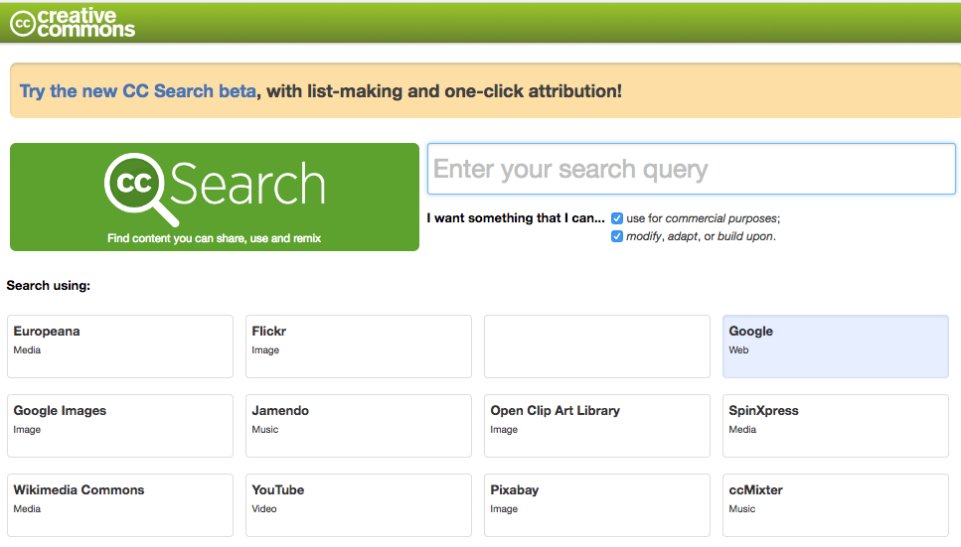
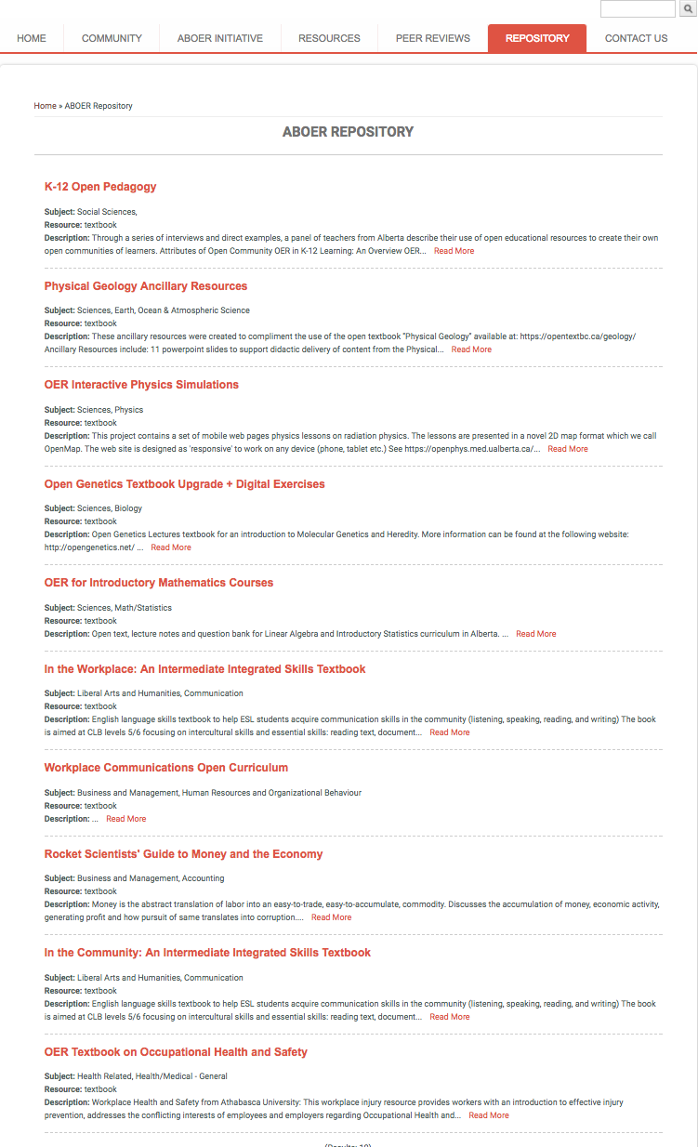
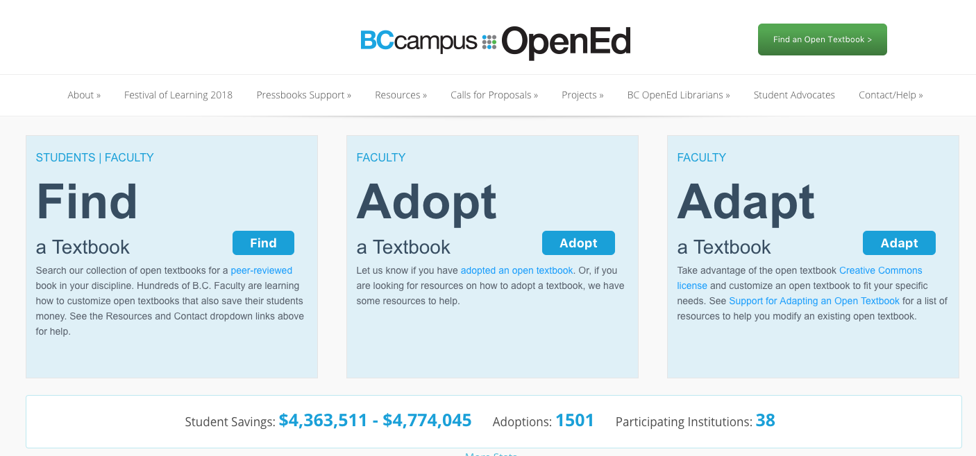
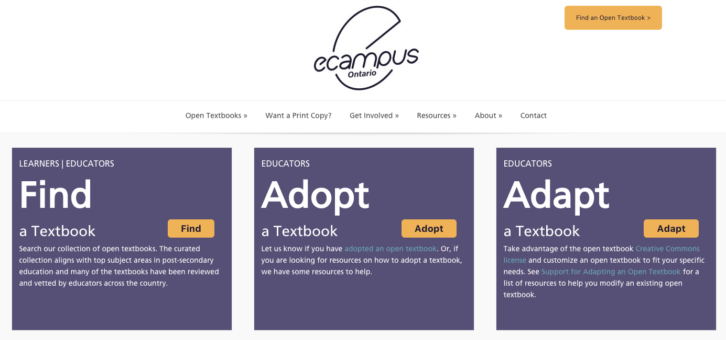
Where to find OER
https://search.creativecommons.org/
http://albertaoer.com/content/repository
https://open.bccampus.ca/
https://www.merlot.org
https://openlibrary.ecampusontario.ca/
https://www.skillscommons.org/
Unless otherwise noted, this work is licensed under a Creative Commons Attribution 4.0 International License.

Slide 15
Copyright, Open Licensing, and OER
Copyright is a set of limited rights established by law. It is immediate, time limited, and transferrable.
AASUA members retain the copyright in the course materials they create and assign an OER-compatible licence.
Open licensing is a core infrastructural element of OER.
Copyright status does not change when a standard open licence is assigned.
works in the public domain
term length expired OR
rights holder placed work in public domain (e.g., CC0) OR
work never qualified for copyright protection
works protected by copyright
openly licensed works
Open licences grant permission to use a copyright-protected work with few or no restrictions.
OER
Unless otherwise noted, this work is licensed under a Creative Commons Attribution 4.0 International License.
Notes:
Know their rights as an instructor
Relationship of IP, copyright, public domain and creative commons
Walk through of creative commons licensing
Send

Slide 16
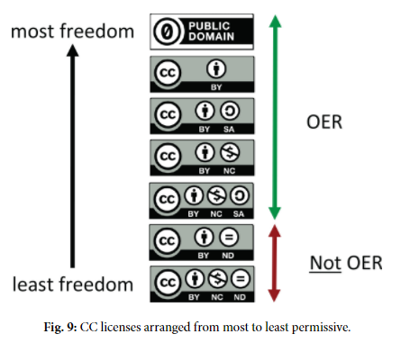
Copyright, Open Licensing, and OER
Creative Commons licences are the most common OER open licences.
Choose a licence https://creativecommons.org/choose/
Mark the work with the CC icon https://wiki.creativecommons.org/wiki/Marking_your_work_with_a_CC_license
Link icon to licence deed.
Include a statement.
by Cable Green is licensed under CC-BY 4.0
Unless otherwise noted, this work is licensed under a Creative Commons Attribution 4.0 International License.
Notes:
Know their rights as an instructor
Relationship of IP, copyright, public domain and creative commons
Walk through of creative commons licensing
Send

Slide 17
5 Rs of OER
free & online
“welcome to reuse & remix”
hesitation
Credit: Image by BC campus, CC-BY 4.0
Unless otherwise noted, this work is licensed under a Creative Commons Attribution 4.0 International License.

Slide 18
Wiley’s 5Rs and Creative Commons Licensing
 | Retain | Reuse | Revise | Remix | Redistribute
 | Make and own a copy | Use in a wide range of ways | Adapt, modify, and improve | Combine two or more | Share with others
Public Domain
CC-BY
CC-BY-SA |  |  | same license | same license
CC-BY-NC |  |  |  |  | non-commercial
CC-BY-NC-SA |  |  | same license | same license | non-commercial
CC-BY-ND |  |  | personal use only | personal use only
CC-BY-NC-ND |  |  | personal use only | personal use only | non-commercial
Give appropriate credit, provide a link to the license, and indicate if changes were made.
Unless otherwise noted, this work is licensed under a Creative Commons Attribution 4.0 International License.
Notes:
Live version of this diagram is available here: https://docs.google.com/presentation/d/1Tk9sBhdIAKvhzxqjR9SeYn_dfctl7wXRfvcHZgj4sQo/edit?usp=sharing

Slide 19
Activity
Unless otherwise noted, this work is licensed under a Creative Commons Attribution 4.0 International License.

Slide 20
Activity
Scenarios:
Teaching activity
3 OER w/ varied licensing
CC to 5R chart
Assess opportunities and limitations
Unless otherwise noted, this work is licensed under a Creative Commons Attribution 4.0 International License.

Slide 21
Examples
Examples
Students write or edit Wikipedia articles
Students remix audiovisual materials to both entertain and inform
Students create or revise/remix entire textbooks
Students openly license supplemental materials they create
Students create test banks
Students create their own assignments
Additional Ideas
Students create tutorial videos
Students create summaries
Students create worked examples
Students connect principles with popular culture
Students create games
Students create guided notes
Students create guides to direct other students through readings or lecture.
Select an activity based on the lesson pack provided.
What are the opportunities and limitations for student learning?
Unless otherwise noted, this work is licensed under a Creative Commons Attribution 4.0 International License.
Notes:
Split into groups. Hand out “course packs” (3 resources per group, here: https://docs.google.com/a/ualberta.ca/presentation/d/1MK_bm_8_HiqtSCfkkcUihu9oMr1cGaQEoJjvg7rLvck/edit?usp=drive_web)
Scene: “I am an instructor and you’re filling in to teach my class. Since this is fiction, you can choose the subject matter and the length of the class. The three sheets you have in your hand represent the resources I wnat you to teach my students. You have nothing else. Choose one of the activities on the slide based on the licensing of the resources I have given you. Use the 5R-CC chart as reference for your decision making”
Share with the group: what resources did you have to work with (everyone has different packs), what activity did you choose and why? What opportunities and limitations does this create for student learning?

Slide 22
Modelling Openness
Unless otherwise noted, this work is licensed under a Creative Commons Attribution 4.0 International License.

Slide 23
Making this Workshop Open:
Content was developed socially; diagrams were shared for input through open ed colleagues, Twitter, and #OpenEdMOOC
All activities, handouts, and lesson planning are CC-BY licensed and posted online.
Group work is summarized into an OER for future use.
You are WELCOME to retain, reuse, remix, revise, and redistribute this presentation!
Workshop Outline & Activities Transcript
Make a copy of this presentation
Unless otherwise noted, this work is licensed under a Creative Commons Attribution 4.0 International License.

Slide 24
Next Steps
Unless otherwise noted, this work is licensed under a Creative Commons Attribution 4.0 International License.

Slide 25
CTL Open Education page
UA Libraries Open Education libguide
Book a CTL consultation
Subject Matter Librarians
Speedy Intro to Open Education (webinar) October 27, 2017
Finding, Creating, and Using OER November 7, 2017
Krysta McNutt OER Program Lead Centre for Teaching and Learning krystam@ualberta.ca
Unless otherwise noted, this work is licensed under a Creative Commons Attribution 4.0 International License.

Slide 26
Resources and References
Wiley, David. “Defining the "Open" in Open Content and Open Educational Resources.” Iterating toward open, opencontent.org/definition/
Christiansen, E., McNally M., Lock, J., Welch, J., Sou, L. (2016). The starter kit. Retrieved from http://albertaoer.com/content/resources
Navigating open pedagogy, part 1 / You're the Teacher by Christina Hendricks is licensed under a Creative Commons Attribution 4.0 CC BY
Hendricks, Christina. “Navigating open pedagogy, part 1.” You’re the Teacher, 22 May, 2017, http://blogs.ubc.ca/chendricks/2017/05/22/navigating-open-pedagogy-pt1/
McNally, Michael B. “ERA.” LIS 598 Information Policy, Winter 2017 - ERA, era.library.ualberta.ca/collections/8s45qc73c
McNally, M.B. (2016). Open educational resources (OER): Background and some considerations [PowerPoint slides]. Retrieved from https://era.library.ualberta.ca/files/b5q47rn818#.WCS79S0rL4Y
Hegarty, Bronwyn. (2015). Attributes of Open Pedagogy: A Model for Using Open Educational Resources. Educational Technology. July– August. 3 - 13.
Unless otherwise noted, this work is licensed under a Creative Commons Attribution 4.0 International License.

Slide 27
Resources and References
Source of ‘Figure 9’: Green, C. 2017. Open Licensing and Open Education Licensing Policy. In: Jhangiani, R S and Biswas-Diener, R. (eds.) Open: The Philosophy and Practices that are Revolutionizing Education and Science. Pp. 29–41. London: Ubiquity Press. DOI: https://doi.org/10.5334/bbc.c. Licence: CC-BY 4.0
“Creative Commons Guide.” Copyright at UBC, copyright.ubc.ca/guidelines-and-resources/support-guides/creative-commons/
Wakaruk, Amanda. “Do it right the first time: Copyright, Creative Commons, and OER.” Alberta OER Summit. May 11, 2017. https://doi.org/10.7939/R3571809V
http://classroom-aid.com/oer-mobile-course-open-diagram/
"Open Model" by Creative Commons is licensed under CC BY 2.0
Creative Commons (CC) https://creativecommons.org/ CC Wiki https://wiki.creativecommons.org/
Wiley, David. “OER-Enabled Pedagogy.” Iterating toward openness, 2 May 2017, opencontent.org/blog/archives/5009
Unless otherwise noted, this work is licensed under a Creative Commons Attribution 4.0 International License.

Slide 28
How to Attribute this Workshop
“Adapted from “Speedy Intro to Open Education” by Krysta McNutt and Amanda Wakaruk licensed CC-BY 4.0”
or
McNutt, K., Wakaruk, A. (2017), “Speedy Intro to Open Education”, Centre for Teaching and Learning, University of Alberta, October 24, 2017, https://docs.google.com/presentation/d/1uwU_vRxUXMAdS3nqtVAm4Ffg-gqjMdM98Oc_F0iCiDs/view
Unless otherwise noted, this work is licensed under a Creative Commons Attribution 4.0 International License.

Slide 29
Map of Open Education
Teaching with OER - CTL
Publishing open access - Libraries
Teaching with OER (open educational practices)
(OER-enabled pedagogy)
(open pedagogy)
Free and unrestricted online access to research publications and data.
OER open educational resources
Open Access Publishing
Finding, Using, and Creating OER - CTL, Libraries, and Copyright Office
Unless otherwise noted, this work is licensed under a Creative Commons Attribution 4.0 International License.

Slide 30
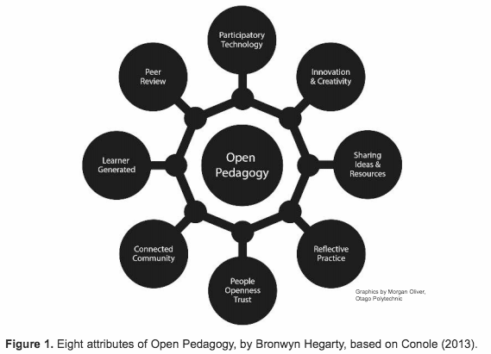
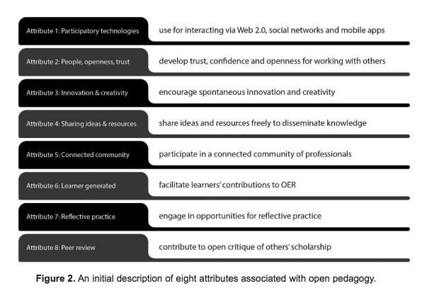
Open Education → Open Pedagogy → OER
Podcasts on Open Pedagogy and OER (for K-12) developed by Athabasca University: http://bolt.athabascau.ca/index.php/oer/multiply-k-12-alberta-oer-project/oer-podcasts/
Unless otherwise noted, this work is licensed under a Creative Commons Attribution 4.0 International License.
Notes:
Remove? Too much.

Slide 31
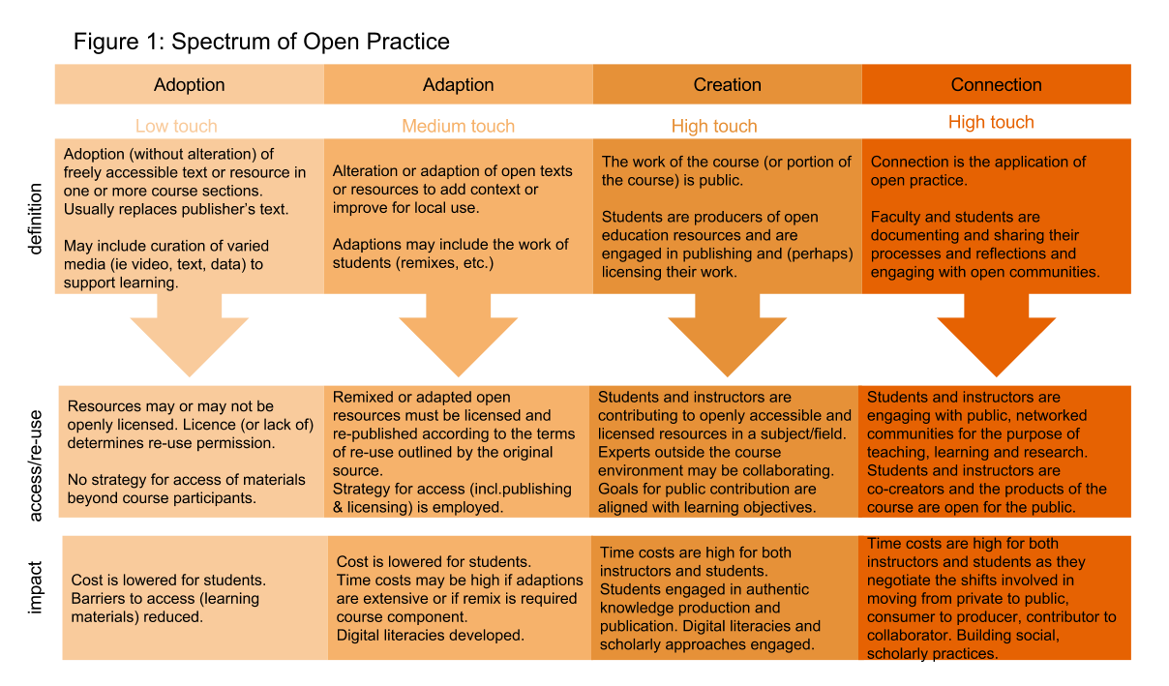
Unless otherwise noted, this work is licensed under a Creative Commons Attribution 4.0 International License.

