Slide 1
Measuring Research:
Impact Factors, Citation Metrics, and "Altmetrics"
Can Tweets be more important than a good Impact Factor?
Thane Chambers
Christina Hwang
Denis Lacroix
Dale Storie

Slide 2
Who Cited Whom?
Citation tracking is a traditional measure of research impact:
Measure the research output of an author
Measure the popularity or influence of a journal or article.

Slide 3
Metrics can measure:
Journal-level metric:
  Impact Factor, Eigenfactor, SJR, SNIP
Author-level metric:
  h-index, i10-index
Article or book-level metrics:
  citation counts, "altmetrics"

Slide 4
Impact Factor
“calculated by dividing the number of citations in the [Journal Citation Reports] year by the total number of articles published in the two previous years”

Slide 5
Impact Factor:
# of citations in 2011
_______________________________
# of articles published in 2009 & 2010

Slide 6
Journal Citation Reports
Exercise:
What is the Impact Factor for
  New England Journal of Medicine
  Nature
  Canadian Journal of Fisheries and Aquatic Sciences
Find the history journal with the highest Impact Factor?
Notes:
15 minutes

Slide 7
h-index
If you have 5 papers with 5 citations, your h-index = 5.

Slide 8
h-index
Benefits longer careers
  A scientist who has been working in the field for 30 years will have a higher index than someone with 10 years.
Can be used to compare scholars at similar points in their career who publish in the same discipline.

Slide 9
Scopus/Web of Science/Google Scholar
Exercise
What is the h-index for:
Faith Davis (Public Health Sciences)
Mike Belosevic (Biological Sciences)
Andy Knight (Humanities)
Notes:
30 minutes

Slide 10
Importance of citation metrics
Determine influence of a journal (Impact Factor), author, publication.
Faculty evaluation, promotion, merit, tenure
Grant applications

Slide 11
Case Study: Faculty of Nursing
http://bit.ly/UyeNNW
Notes:
40 minutes

Slide 12
Altmetrics
New metrics made possible by the Web and open access:
  # of downloads
  # of Tweets
  # of Shares in social media services, including academic tools such as Mendeley or CiteULike.

Slide 13
Altmetrics
impactstory.com
altmetrics.org
Public Library of Science (PLoS) article-level metrics

Slide 14
Altmetrics for the Humanities and Social Sciences
Denis Lacroix
Notes:
My portion of the talk is on alternative metrics that are especially useful for the HSS. I would like to show you some examples as we go along, but let me know if there is a tool that I forget to demonstrate and that you would like to see in action or if you have any questions along the way let me know.

Slide 15
Altmetrics for Citation Project
Only a fraction of HSS journals have an impact factor
Fields of study in the humanities are often small
Humanities publishing takes on many forms
  Book Citation Index
  Google Scholar / Publish or Perish
  Search bibliographies in databases for cited works (e.g. CAIRN, Erudit)
Authority control
  Crossref.org’s Cited-by linking
  Researcher ID (Thomson Reuters)
Notes:
Citation project consisted of 391 journal titles and only 40% had an impact factor, but a greater % had Scopus SJR and SNIP numbers.
Fields of study in the humanities are often small, which means there are few people around the world studying a particular topic which makes citation analysis much less informative and worthwhile. This is what phD graduate Bjorn Hammarfelt describes in his thesis entitled Following the Footnotes as rural, that is sparsely populated research fields. Hammarfelt goes on to describe humanities research as fragmented or independent and individualistic, divergent, wide ranging and interdisciplinary. In regards to interdisciplinary, Hammarfelt sees a social science trend in the humanities (gender studies, post-colonial studies…).
Humanities publishing takes on many forms other than journal articles: books, reviews, movies, dance performances, and even research grants (which contain references, but are rarely considered in citation analyses, see Bjorn Hammarfelt’s thesis for more info)
Web of Science and Scopus place greater emphasis on the Sciences for citation data and on journal articles. ISI’s Book Citation Index fills part of that gap in identifying cited information for books. Google Scholar cited data, as you know, are questionable (variant author names are or are not included, an array of sources are included in GS citation counts {including PowerPoints, Word documents…}, citation count limited to 1000). Publish or Perish is a free downloadable program that harvests data from Google Scholar based on author name and calculates numerous metrics including h-index. See next slide for example of PoP. PoP’s creator, Anne-Wil Harzing, says GS is especially useful for the HSS, because of the variety of publication formats included.
Search bibliographies in databases for cited works: Involves searching several individual databases, like Web of Science, JSTOR, CAIRN, ERUDIT, EBRARY… Very time consuming!
- Standardize author names, for example Andy Knight might also appear as WA Knight or A Knight or Andy Knight or W Andy Knight…
Crossref’s Cited-by linking system has had a slow uptake and the cited-by info varies greatly by discipline (as stated on the Cross-ref website).
Crossref in partnership with ORC-ID now offers the possibility for researchers and their organizations to create unique and persistent digital research identifiers, or ORCID identifiers, to facilitate finding all of their research and distinguishing them from every other researcher. Web of Science with its Researcher ID, offers the same possibility and is subsumed under ORC-ID. Is this something in which the UA Libraries will want to get involved by creating ORCIDs for UA researchers for use in ERA or should our role be limited to encouraging researchers and their faculties or departments to do so.

Slide 16
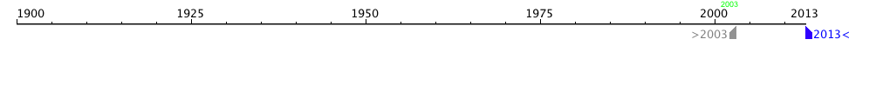
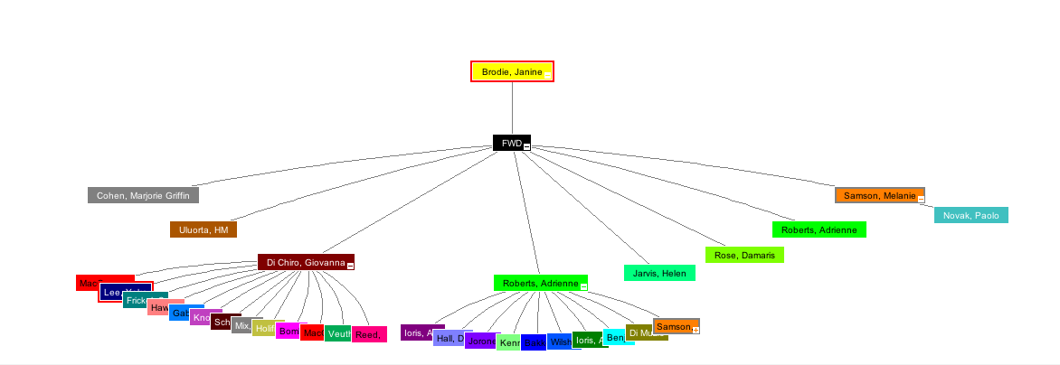
Notes:
Citation map for Janine Brodie’s book chapter
Globalization, In/Security, and the Paradoxes of the Social Author(s): Brodie, J (Brodie, Janine)^{1,2} Editor(s): Bakker, I; Gill, S Source: POWER, PRODUCTION AND SOCIAL REPRODUCTION: HUMAN IN/SECURITY IN THE GLOBAL POLITICAL ECONOMY Pages: 47-65 Published: 2003 Times Cited: 8 (from Web of Science)
Note that ISI does not provide the backward citations for this book chapter – she has referenced 52 publications
The map represents the first generation of documents citing this chapter as well as second generation documents that cite the first generation: there are only two documents that received 2nd generation citing.

Slide 17
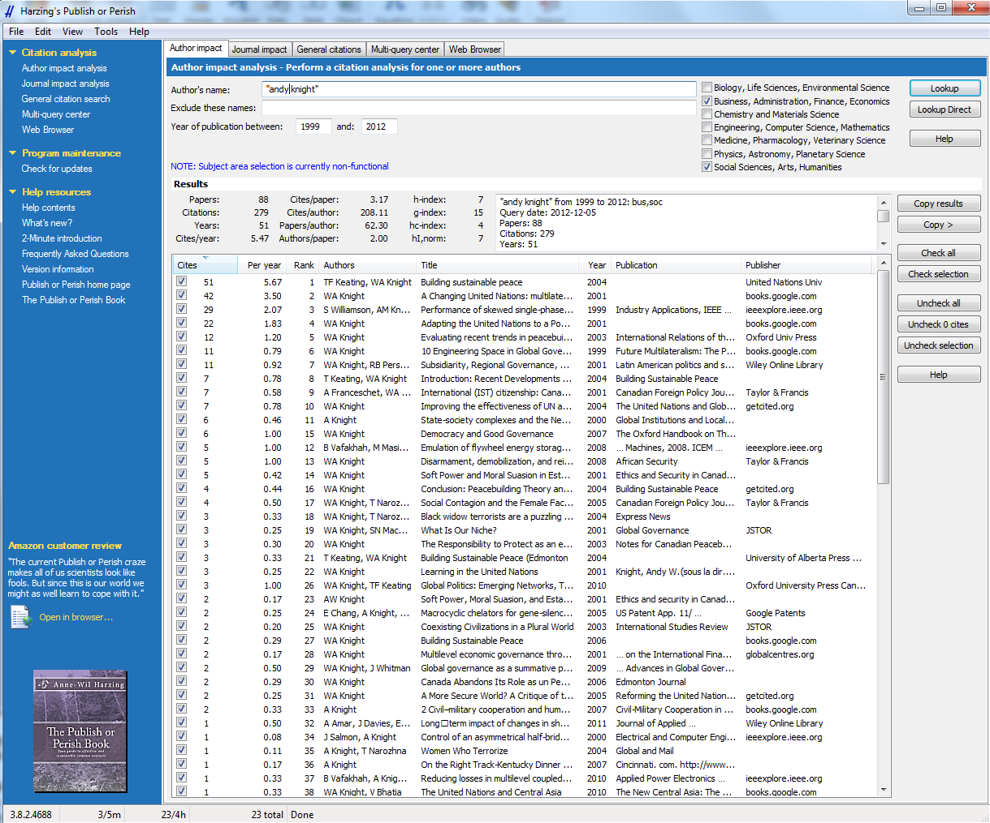
Notes:
Harzing’s Publish or Perish software results for a search on Andy Knight (poli sci prof)
The software calculates from Google Scholar results the h-index (an index that attempts to measure both the productivity and impact of the published work of a scientist or scholar.), the g-index (The g-index is an index for quantifying scientific productivity based on publication record. ) and other arcane popularity tests.

Slide 18
Altmetrics and the Social Web
Social Web: PLOS, Mendeley, CiteULike, Facebook, Twitter, Research blogging, Wikipedia, SlideShare…
  Impact Story (http://impactstory.org/)
  Altmetric Explorer (www.altmetric.com) & Altmetric It bookmarklet
  ReaderMeter – Mendeley altmetrics (http://readermeter.org/)
Notes:
Social Web metric tools tap into a variety of social web tools like PLOS, Mendeley… (going beyond GS) N.B. Most use DOIs or PubMed Ids to identify a publication and determine metrics for it. No DOI = no Impact.
Impact Story (used to be called Total Impact): ImpactStory is a website that makes it quick and easy to view the impact of a wide range of research output. It goes beyond traditional measurements of research output -- citations to papers -- to embrace a much broader evidence of use across a wide range of scholarly output types. The system aggregates impact data from many sources and displays it in a single report, which is given a permaurl for dissemination and can be updated any time. Uses online identifiers, like Google Scholar Profiles, DOIs, and PubMed IDs. Items found receive an impact category, like generally/highly “saved”, “cited”, “recommended”, “discussed”. (see C&RL News Nov. 2102 p. 597)
Sources: Facebook, PLOS, SlideShare, Github, Topsy, Figshare, Wikipedia, Scopus, CiteULike, Delicious, Mendeley, Dryad, Scienceseeker, PubMed. (http://impactstory.org/faq ). However, it is made for researchers to import their own publications and makes it difficult to add a long list of publications from RefWorks, for example. Initial tests of this source demonstrate that HSS faculty do not have a significant presence in social media, e.g. Andy Knight’s 1995 article, “Towards a subsidiarity model for peacemaking and preventive diplomacy”, which has 32 citations in Google Scholar receives 0 results in Impact Story. I double checked in Wikipedia and Twitter and indeed Andy Knight is not there. Is this a flaw in Impactstory or does not point to a gap that the Faculty of Arts could harness to promote its scholars?
Altmetric Explorer: Each week Altmetric captures hundreds of thousands of tweets, blog posts, news stories and other pieces of content that mention scholarly articles since 2011. (Subscription-based: 500 pounds / year)
The Explorer can browse, search and filter this data. Use it to deliver insights, track conversations and measure levels of attention over time or compared to your competitors. Altmetric IT is a free bookmarklet that searches the full-text article for the presence of a DOI and uses that find cited statistics.
Individual access to the social Web: PLOS provides article level metrics tracking influence of PLOS articles indicating download stats, and citation numbers in PLOS comments, notes or ratings.
Mendeley also allows access to article and discipline level stats regarding views and downloads.
See following screen for ReaderMeter screen shot for Mendeley metrics
Stay tuned : Gunther Eysenbach bought the following domain names twimpact.org, twimpactfactor.org and twimpactfactor.com in view of creating services to calculate and track twimpact and twindex metrics for publications and publishers.

Slide 19
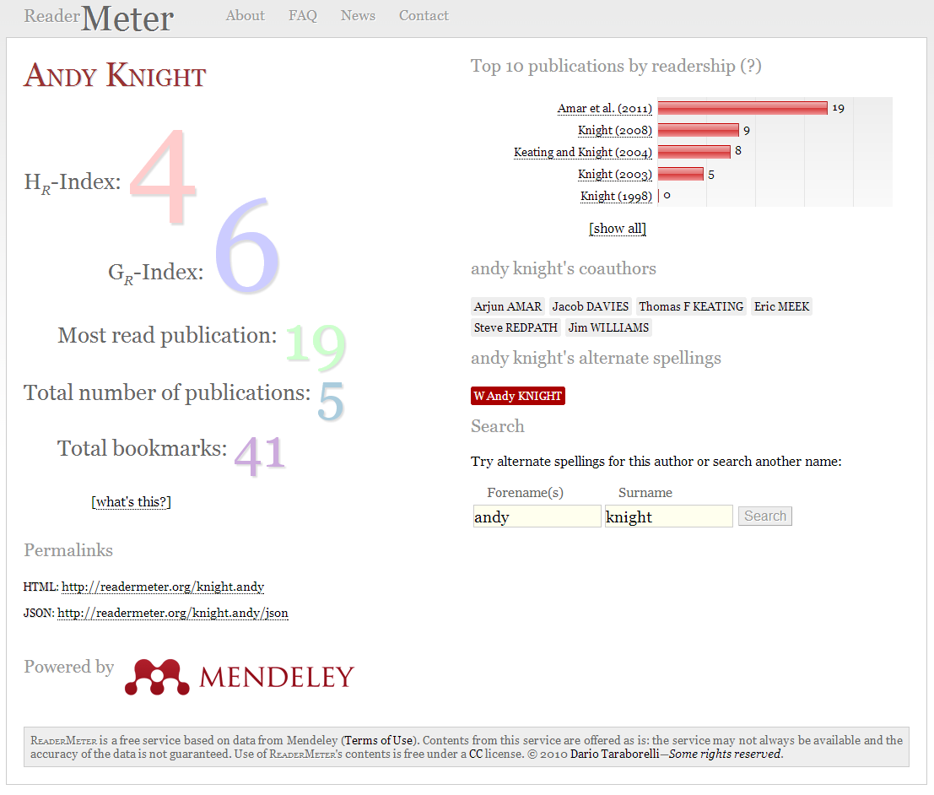
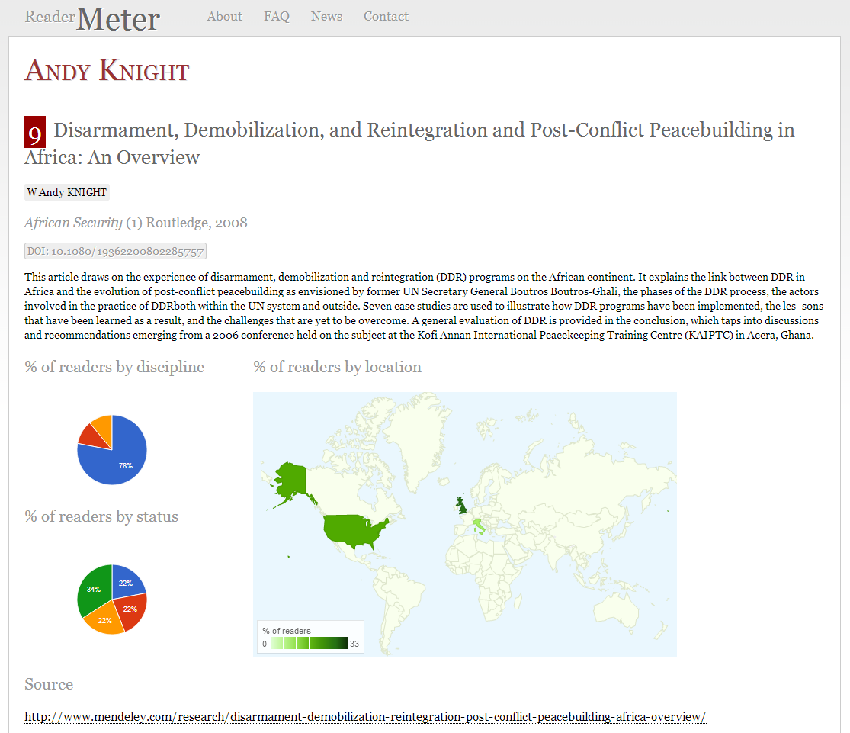

Slide 20
Citation Analysis and the humanities
Citations no longer represent adequately how an article is used (NISO Webinar: Beyond Publish or Perish: Alternative Metrics for Scholarship)
  Document downloading and viewing
    Academia.edu
    SSRN (Social Science Research Network)
    Mendeley: metrics on views & downloads
    VIVO: Semantic Web Application
  Library ownership of faculty publications
    OCLC WorldCat
Notes:
***Citations no longer represent adequately how an article is used (NISO Webinar: Beyond Publish or Perish: Alternative Metrics for Scholarship). Hammarfelt goes further by stating that the « The bibliometric community has rightly discouraged the use of traditional citation analysis of journals indexed in citation databases to evaluate the humanities.” In Norway, evaluation based on citation analysis is discouraged across the board (172). Hammarfelt concludes that a diversity of evaluation methods is preferable (173).
Document downloading and viewing
Academia.edu: free online paper-sharing platform to increase faculty visibility and monitor research within scholarly networks – includes profile views, document views, country-based page traffic, social interaction with scholars.
SSRN: online article repository – includes site-specific metrics for top papers, top authors, and top institutions.
Mendeley: researchers with profiles can chart document views and downloads and view popular articles within their fields.
VIVO: free downloadable semantic Web application created at Cornell to help with collaboration within and between institutions. Limited participation to date because of steep programming learning curve.
- Should academic libraries ask database vendors to provide document downloading/viewing stats for their content? Can they add the social web statistical searching aspect to their database (or at least downloading and viewing data)?
Should the UofA create ORCIDs and Researcher Ids for its researchers?
Can ERA play a role in providing altmetrics? Should papers in ERA also be uploaded to Mendeley and other such sites to increase visibility?

Slide 21
For more Information
Hammerfelt, Bjorn. Following the Footnotes: A Bibliometric Analysis of Citation Patterns in Literary Studies. PhD Thesis. Uppsala Universitet, 2012.
Howard, Jennifer. “Tracking Scholarly Influence Beyond the Impact Factor.” Chronicle of Higher Education. Wired Campus (28 Feb. 2012). Web.
Roemer, Robin Chin and Rachel Borchadt. “From Bibliometrics to altmetrics: A Changing Scholarly Landscape.” College & Research Libraries News 73.10 (Nov. 2012): 596-600.
Priem, Jason. Jason Priem / Home. Web. 3 Dec. 2012.
Society for Scholarly Publishing. Scholarly Kitchen. Web. 3 Dec. 2012.
Wouter, Paul. Citation Culture. Web. 3 Dec. 2012.

Slide 22
Exercise
Use: Impactstory.org, readermeter.org or altmetrics bookmarklet
Watson/Crick article on DNA:
10.1038/171737a0
Straus article on Knowledge Translation
10.1503/cmaj.081229

Slide 23
Caveats and cautions
Citations are not always received for valid reasons
Self-citation
Database coverage
  h-index will be different in Web of Science, Scopus and Google Scholar
  Humanities not covered well in citation databases

