Slide 1
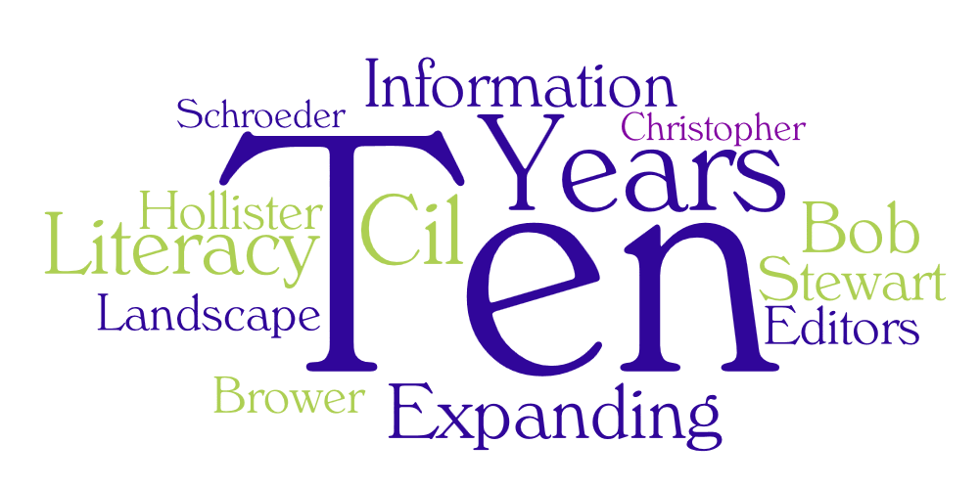
Notes:
First Slide -

Slide 2
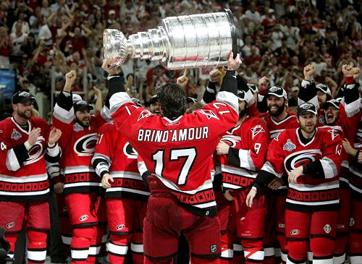
2006...
Cheney shoots fellow hunter in mishap on a Texas ranch (New York Times)
World's first woman space tourist to blast off Monday aboard Russian rocket (Canadian Press)
Le chanteur Paul McCartney et son épouse Heather Mills se séparent (La Presse Canadienne)
Da Vinci Code takes in estimated $29M (Associated Press)
Google buys out YouTube for $2.2 billion (World Today)
Notes:
CH -

Slide 3
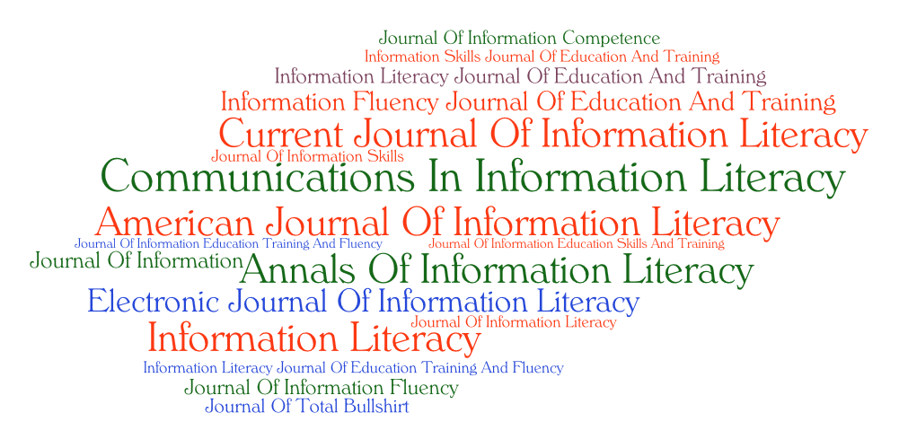
Notes:
CH -“First Steps” slide

Slide 4

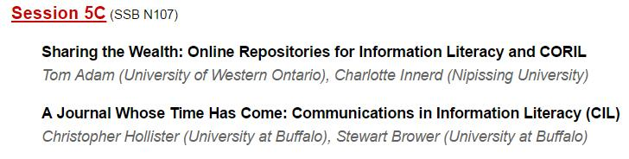
And so it began...
Notes:
CH -

Slide 5
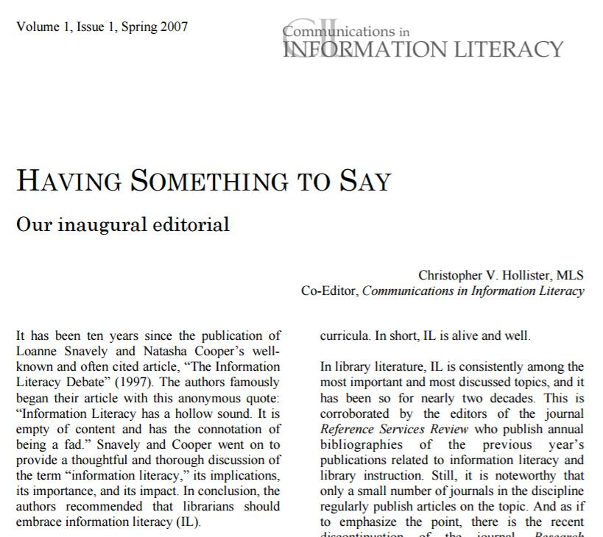
Notes:
CH -

Slide 6
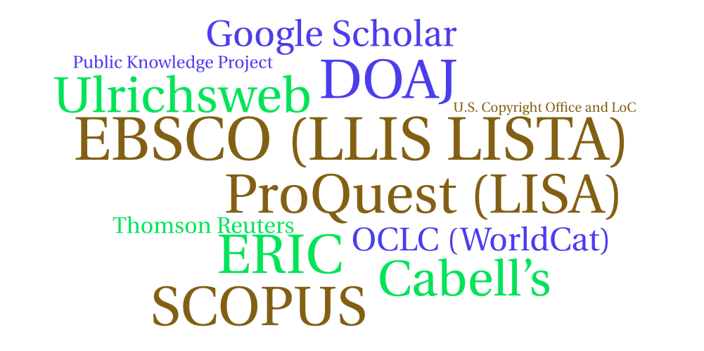
Decade of expansion...
Expanded reviewer pool four times
Welcomed Bob Schroeder, new editor-in-chief, 2012
Added perspectives section editors, 2014
Created book reviews section, 2014
Developing “innovations in professional practice” section, 2017
Migrating to bepress/Digital Commons, Portland State University, 2017
Notes:
CH-

Slide 7
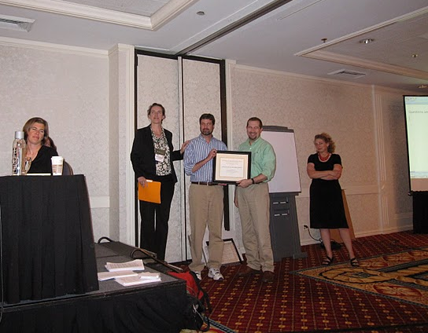
Recognition...
ACRL Instruction Section’s Special Certificate of Recognition and Appreciation (2009):
“In recognition of Stewart Brower and Christopher Hollister for launching Communications in Information Literacy, the first born-digital, open-access peer reviewed journal devoted entirely to information literacy.”
Susan Beck, 2009
Notes:
CH -

Slide 8
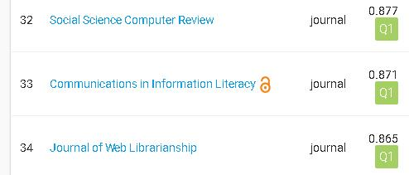
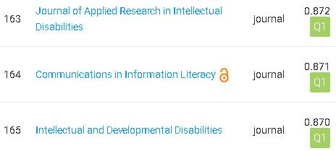
Impact...
2015 SJR (SCImago Journal Rank) Score: 0.87, 33/209 Library and Information Science (SCOPUS ®)
2015 SJR (SCImago Journal Rank) Score: 0.87, 164/1066 Education (SCOPUS ®)
Notes:
CH -

Slide 9
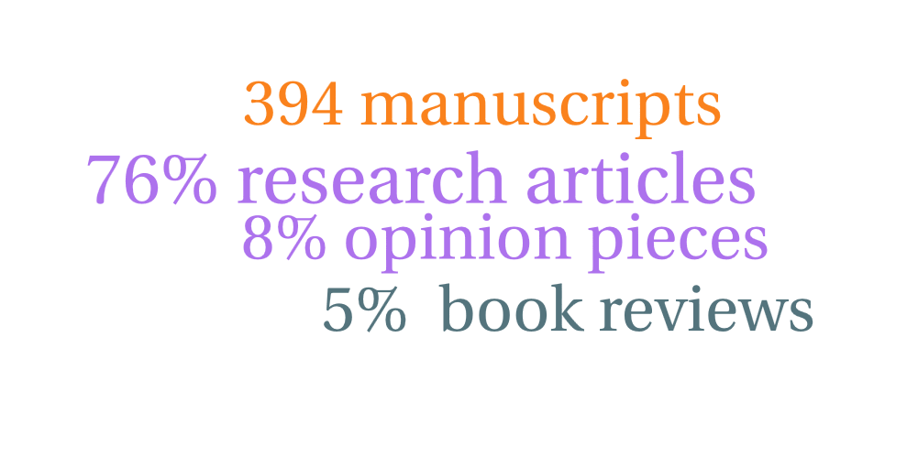
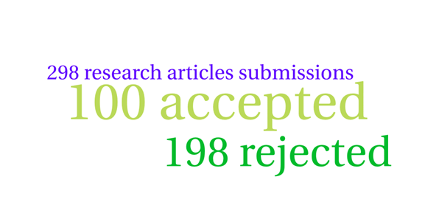
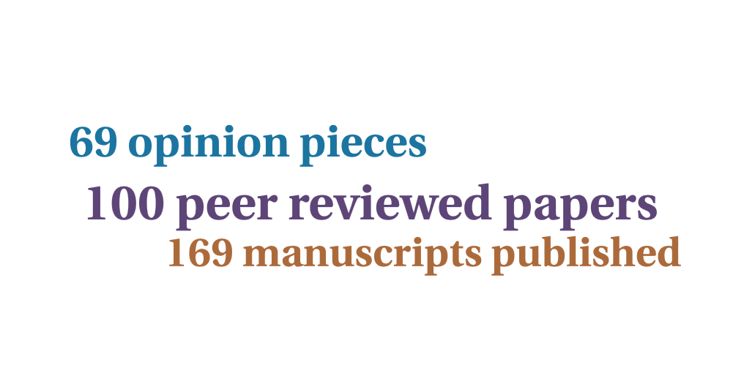
Notes:
(BOB) Setting the stage of our research: THE Study
394 manuscripts submitted over 10 years (ranging from 26 in 2008 to 67 in 2016 – an average of about 40 a year.)
• 5% of those manuscripts submitted were book reviews
• 18% of those manuscripts were Opinion pieces (editorials or Perspectives pieces)
• 76% of those manuscripts were research articles
Looking at the 76% of the submissions that were Research articles:
• 198 were rejected and only 100 were accepted for publication, giving an acceptance rate of 34%
In order to see the scholarly discourse created by the publication of CIL, we looked at the all of the manuscripts submitted from 2007 to 2016 that ended up being published.
These consisted of:
• 100 peer Reviewed papers
• 69 Opinion pieces (editorials and Perspectives pieces).
• For a total of 169 manuscripts.

Slide 10
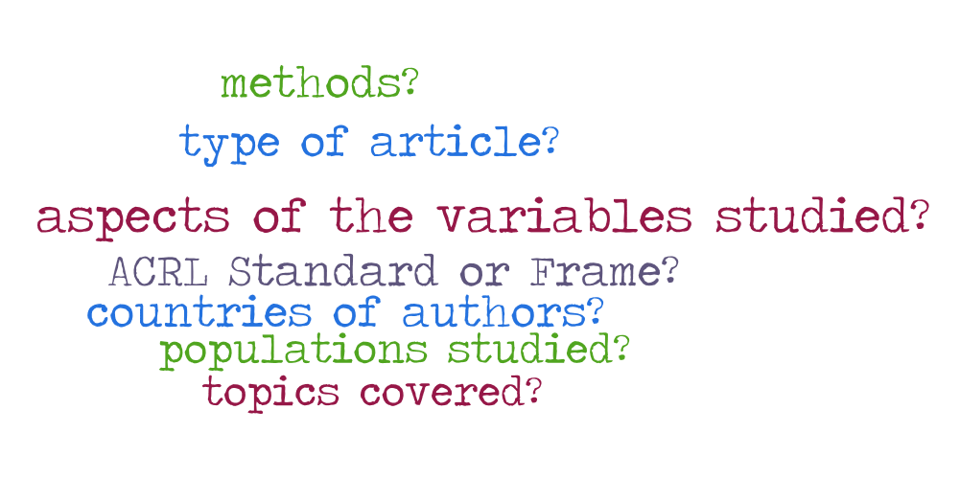
Notes:
(BOb) By reading the article abstracts and the articles themselves, we coded for a variety of characteristics, including:
• The countries of origins of the published authors
• The Topics covered
• The ACRL Standard or Frame covered
• The general type of article (case study, lit review, etc.)
• The methods used (if it was a research article)
• The populations studied in the article
• And for the research articles, other aspects of the variables studied – were they skills, opinions, attitudes, etc.

Slide 11
What other characteristics or aspects of these articles might be of interest to you or other readers?
What conversations do you see as not necessarily being supported by CIL over the last 10 years?
What conversations should we think about including?
Notes:
(Bob) Framing Questions:
We want to acknowledge our positions at the offset. We are the editors of this journal so we have shaped and curated this discourse intimately. So we are naturally close to this work and our analysis will show our biases. Given that, we are hoping to find not only “what was said” over the last 10 years, but also, as much as can be, “what wasn’t said” as part of the conversations in CIL.
After our presentation we hope to entertain all of your questions, and before we proceed we would like to offer up to framing questions as well, that will help us make this study better.
These framing question are:
1. What other characteristics or aspects of these articles might be of interest to you or other readers?
2. What conversations do you see as not necessarily being supported by CIL over the last 10 years?
3. What conversations should we think about including?

Slide 12

Notes:
Bob - Countries of authors:
WOW! BUMMER ! 277 out of 314 authors were from US colleges or universities - 88%
Realized this doesn't mean they were from the US - many people are in the US from other countries. But still, probably indicates CIL is highly US-centric.
Next highest were Canadian-affiliated librarians - 13 or 4%.

Slide 13
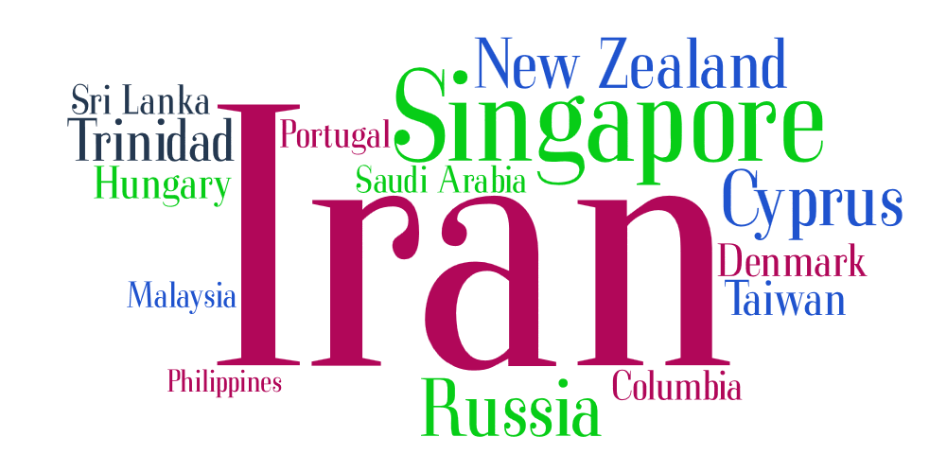
Notes:
[Bob]
As an aside, there are also 15 other countries submitting authors were from- but their work was not published .
The majority of rejections for these papers fell into 3 groups:
One are publications submitted by “paper mills”, mostly from Russia - these papers are not relevant to the topic of IL.
The second group are papers, that really didn’t meet our requirements for “new and interesting research”.
The third group was more problematical. They were papers that seemed to have promise regarding appropriate content, but they were not written in “American academic style” English.
Looking for remedies etc….

Slide 14
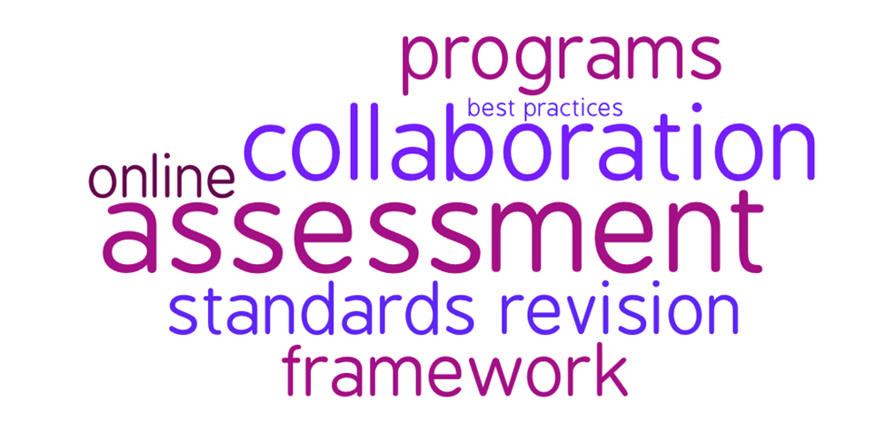
Notes:
Bob- Topics > 11:
We’ll be looking at the “Topics” covered in a variety of ways.
First, this slide shows the major topics covered, each being a major focus of paper at least 11 times.
Assessment leads with 22 paper having it as a major focus, or 13% of the published works.
Collaboration, most often collaboration between librarians and faculty, was focused on in 17 papers - which was surprising to me.
Programmatic work, as opposed to instruction in a single class, was the focus of 14 (or 8%) of the papers.
Unsurprisingly, the Standards Revisions (with 15 papers) and the new Framework (with 13) were in the top five topics.
Best Practices of some sort was the focus of 11 papers.
And Online Topics were the focus of 12 papers.

Slide 15
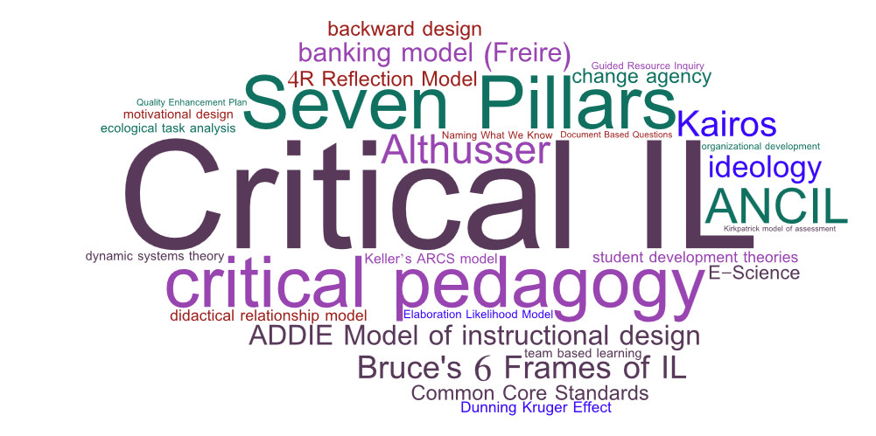
Notes:
Bob - Topics: Conceptual & Theoretical Models : All:
[Note: take our Bohannon sting.
There were many theoretical or conceptual models used the the papers.
As you can see from this word cloud they came from inside librarianship ( Bruce's 6 Frames of IL, the Seven Pillars of IL, ANCIL, etc.)
Many came from education and instructional design like ADDIE, student development theories, the Common Core Standards, backward design, etc.)
I think this is an indication of the variety of backgrounds academic librarians have, what with undergrad degrees and additional master's degrees from outside of LIS.
Looking a the papers that mentioned the same theoretical or conceptual model 2 times or more…
The “winner” is Critical IL (with 7 papers) , followed by critical pedagogy, with 4, and Paolo Freire’s Banking model of education with 2 papers.
Looking at this slide, and the relatively good showing or Critical Il topics, and remembering the one from above that talked about the major topics (of Assessment, the Standards, programs, etc) I think of an article coming out in our next issue of CIL (in June) entitled, “A Kairos of the Critical: Teaching Critically in a Time of Compliance.” I think CIL reflects the current time described in this article as ones of dueling paradigms of “the kairos of compliance” and “the kairos of the critical.”

Slide 16
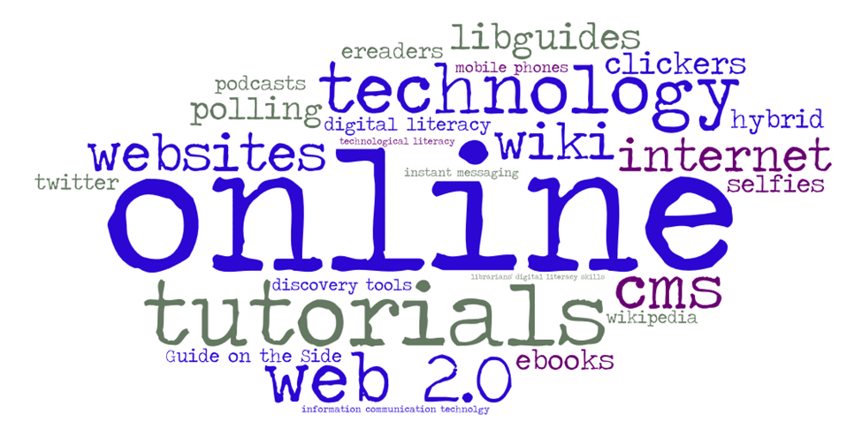
Notes:
BOb - Topics: Online & Technology: ALL:
Technology used in the classroom, pedagogically or for assessment, included, polling, wikis, clickers, ereaders, instant messaging, mobile phones, podcasts, selfies, twitter, and wikipedia.
Teaching with technology included web tutorials, libguides, and guides on the side.
Technology as objects of study in the classroom included websites, discovery tools, and ebooks.

Slide 17
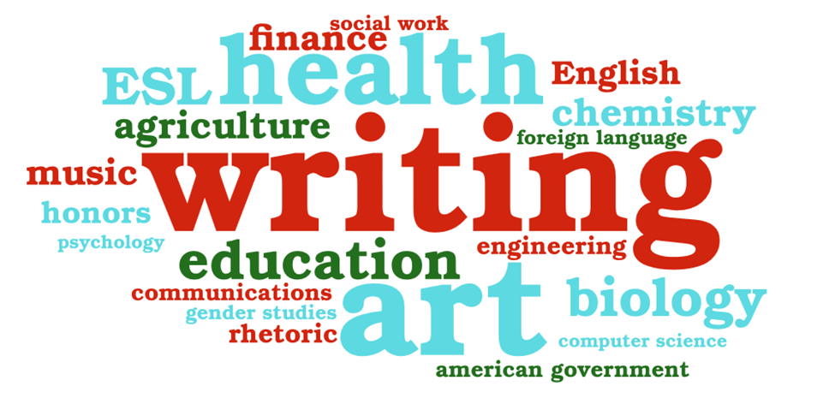
Notes:
[ CVH} Topics: Disciplines: All:
no surprise - Writing is the most written about discipline (and if you add in it’s cousins, Rhetoric, English, ESL, and Communications you get 10 papers in all.
Next, surprisingly to me, are ART and Health Sciences, with 4 papers each.
Education and Biology each have 3 papers, and the rest of the subject each have 1 paper.

Slide 18
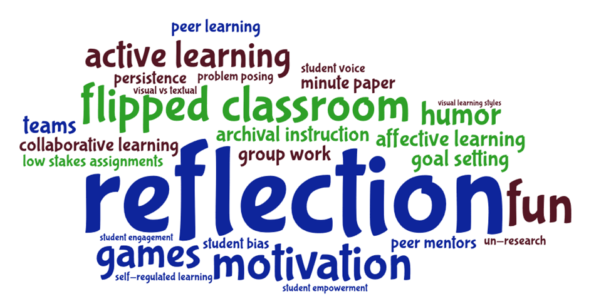
Notes:
(CH) Topics: Instructional techniques: All:
Reflection is the most published technique with 4 papers.
Interestingly “affective” issues of student learning are reasonably well-represented with 2 papers in Motivation, and one paper each in Affective Learning, Fun, Games, Humor, and Persistence.

Slide 19
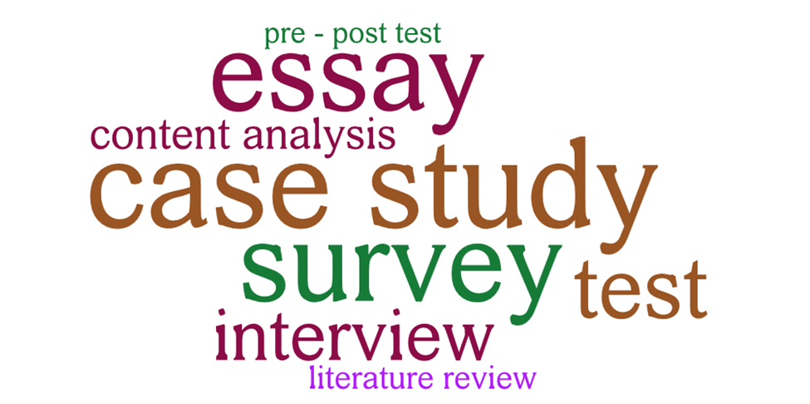
Notes:
(CH) Methods: Large” > 3 papers:
149 “methods” or genres were recognized in the 169 published articles. (some of the articles had more than one major method or genre - a Case Study could also contain a large survey for example.
Case Studies were the most numbers with 37, followed by Surveys with 35, and Essays with 22.
Interviews and Tests each were mentioned in 10 papers.
It would seem we reflect LIS’ focus on social science research but…
With 22 Essays and 8 Literature Reviews, the Humanities is also playing a role.
[Below from subsequent, deleted slide to use as you see fit…]
these were the less frequently used methods or genre, with 3 papers doing Focus Groups, and most of the rest with one paper each.
Having recently done work around autoethnography as a research method for LIS, I would like to entertain other, non-social science based methods, in the journal, if possible.
I suspect with librarians all having a BA in another discipline, and many haveing MA or PhD’s in other disciplines, there are a lot of different methods out there that might be applied to LIS questions?

Slide 20
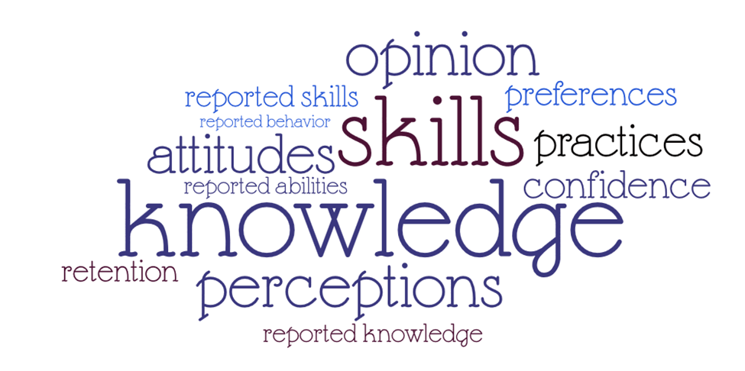
Notes:
{BOb} Variable Aspects: Large” > 2”
For the research articles that were looking at what we’re calling “aspects of variable”, these are the most often looked into.
Knowledge (mostly of students). Skills Perceptions and Opinions were most researched.
Knowledge, Skills, and Practices are the most “hard evidence” type aspects. Perceptions, Attitudes, Opinions, and Preferences, would be “softer variables. [ I’m not happy with the terminology I’m using so may need to find betterer words]
There were also many other “aspects” studied, usually only in one paper.
More that a few were “affective” variables - like Comfort, Engagement, Enjoyment, Feelings, Persistence, Reflections, and Valuing.

Slide 21
“If research doesn’t change you as a person, then you haven’t done it right.”
— Shawn Wilson, Research is Ceremony, p. 135.
Notes:
Chris Reflections:
Stewart Reflections:
Bob Reflections:
A recent article in “The Scholarly Kitchen” titled, The Decline and Fall of the Editor” has got me to ruminating on the role editors play, or should pay in curating, gatekeeping, or promoting “rigor” - depending on your point of view. Certainly with all the talk of Open Peer Review you have to say we’re living a time of changing roles.
After doing this 10 overview of the Il conversation captured in CIL (and which has a certain imprimatur and hopefully longish half-life) I’m wondering about what the other conversations were like. The ones in other journals (JIL, etc), the ones on blogs and on twitter, the ones on the ILI and Acrlframe lists, the ones at conferences, the ones that didn’t make it to scholarship but were maybe had at libraries across the world, or in the offices of librarians or the hallways of libraries. What portion of the scholarly conversations around IL is CIL preserving?
Looking at all the papers over the last 10 years has been an amazing experience for me. I’ve come to know librarians that I’ve met, or know though some of their scholarship in different ways by reading these articles. I’m reminded of Shawn Wilson’s “Research is Ceremony” book and thinking in terms of “librarianship is relationship”, or maybe “research is relationship.”.

Slide 22
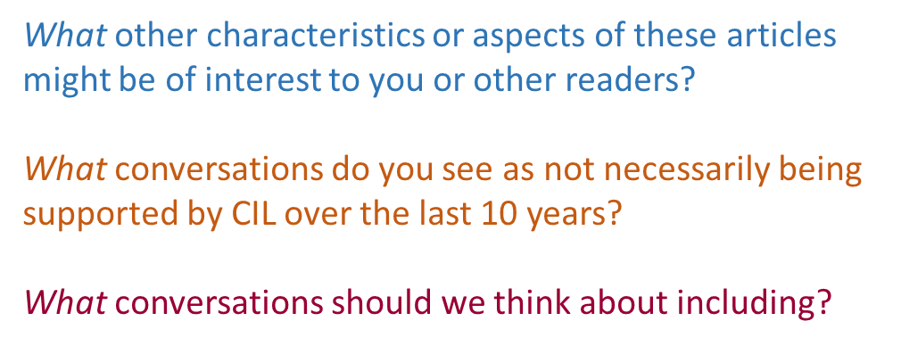
Notes:
BOb [ welcoming discussion} Last Slide

