Slide 1
Know Your Audience(s): Collaborating for Copyright Education
Julia Guy, Kris Joseph, Amanda Wakaruk, Adrian Sheppard, and Michael B. McNally
https://sites.library.ualberta.ca/copyright/ / copyright@ualberta.ca / mmcnally@ualberta.ca
Open Education 2019, Phoenix, AZ, Oct. 30, 2019

Slide 2
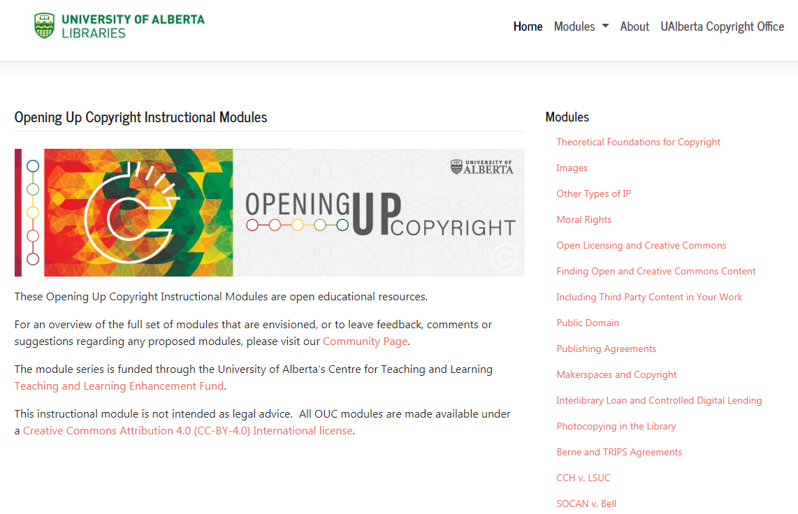
About OUC
Grant funded copyright literacy instructional video series
Currently 19 modules, each ~6-8 minutes
Modules range from introductory subjects to focus on the Copyright Act and key cases
All modules CC-BY 4.0
OUC Website: https://sites.library.ualberta.ca/copyright/

Slide 3
Collaboration
Copyright Office
Centre for Teaching and Learning
Technologies in Education
Adrian Sheppard
Amanda Wakaruk
Cosette Lemelin
Graeme Pate
Krysta McNutt
Anwen Burk
Matt Cheung
Jamie Stewart
University of Alberta Libraries
School of Library and Information Studies
Michelle Brailey
Jesse Carson
Luc Fagnan
Toby Grant
Julia Guy
Kris Joseph
Michael B. McNally

Slide 4
OUC Audiences
Library studies grad students
Staff, students and faculty at UofA
General public
OER community (adopters/adapters)
OUC Planning Document Showing Module Levels and Learner Pathways

Slide 5
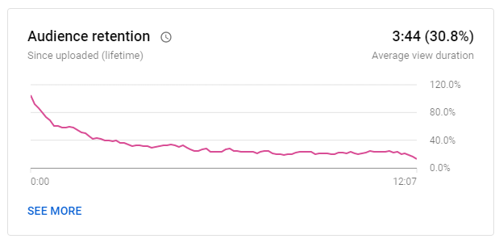
Engagement and Instructional Videos
Have learning objectives^{1, 2, 3}
Use scripts ^{2, 4}
Include interactivity ^{3, 5, 6}
Avoid jargon and chunk content^{2, 3, 4,} ^{5, 6}
Avoid text filled blocks⁴
Use conversational narrative⁵
Keep videos short (~3-4 min) ^{1, 2,} ⁵
“Photocopying in the Library” [OUC Module] – Audience Retention. (27, Oct. 2019).
YouTube Analytics.
1 – Evans (2014)
2 – Weeks and Davis (2017)
3 – Lo and Dale (2009)
4 – Clossen (2014)
5 – Martin and Martin (2015)
6 – Smith (2010)

Slide 6
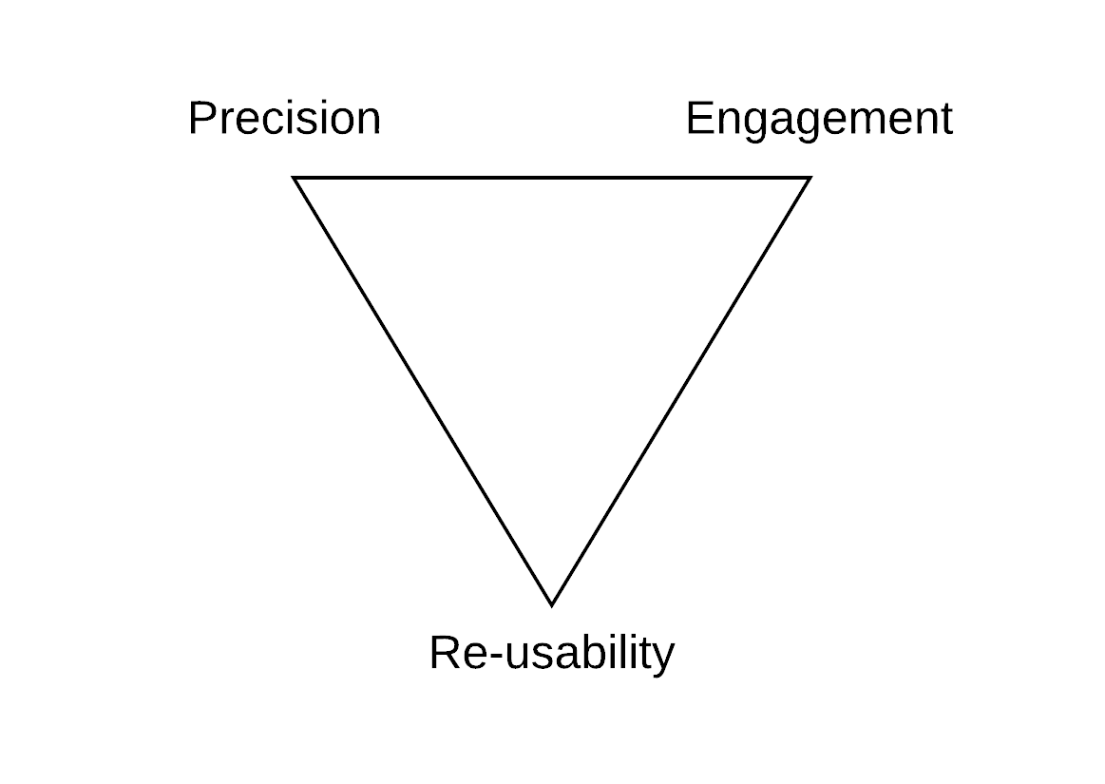
The Precision, Engagement, Re-usability Triangle
Variant of Atkinson’s (1999) “scope, schedule, cost” triangle
Tripartite set of bilateral tradeoffs
Tensions magnified by multiple audiences

Slide 7
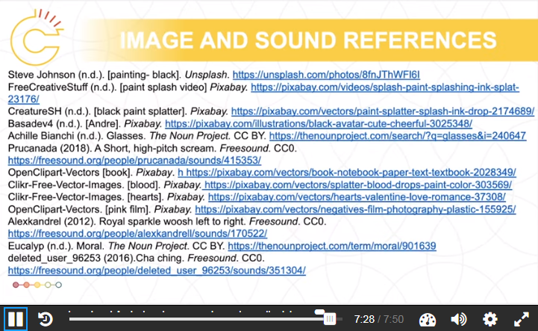
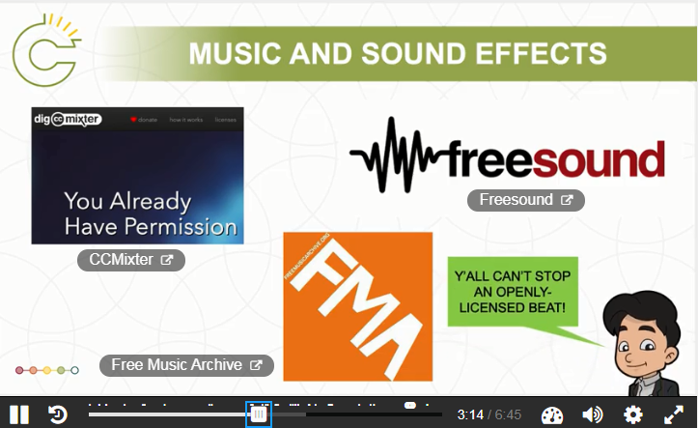
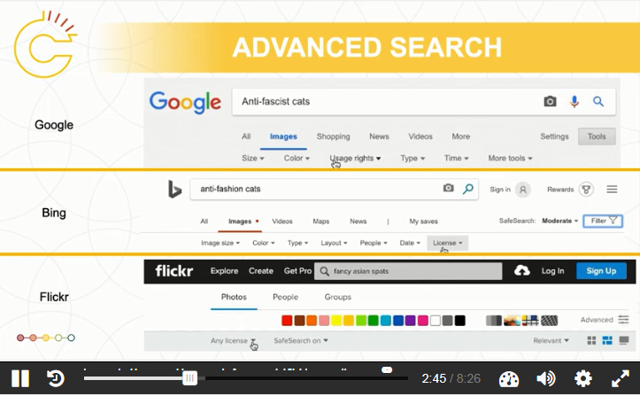
Modelling Use of Open Content
OUC Module – “Finding Open and Creative Commons Content” (screenshot)
OUC Module – “Moral Rights” (screenshot)
OUC Module – “Including Third Party Content in Your Work” (screenshot)

Slide 8
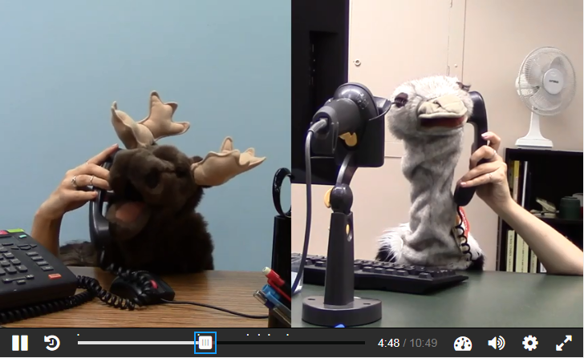
Enabling Reusability
Enabling reuse a key priority
Openly licensed and public domain content used for visuals
Transcripts and slides available for download
In some cases (puppet videos) engagement prioritized over reuse
OUC website: “Theoretical Foundations of Copyright” Module
OUC Module – “Interlibrary Loan and Controlled Digital Lending” (screenshot)

Slide 9
Creating Narratives
Narratives drive engagement (Laurillard, 1998)
Though narrativization needs to be balanced with precision
Two common approaches:
Character facing an issue/situation
Find relevant and notable court cases
OUC Module – “Section 13: Ownership of Copyright” (screenshot)
OUC Module – “Publishing Agreements” (screenshot)

Slide 10
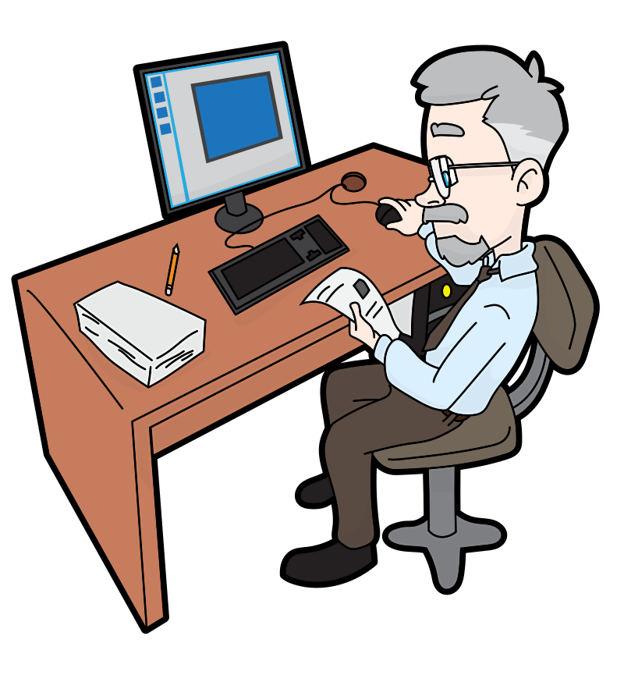
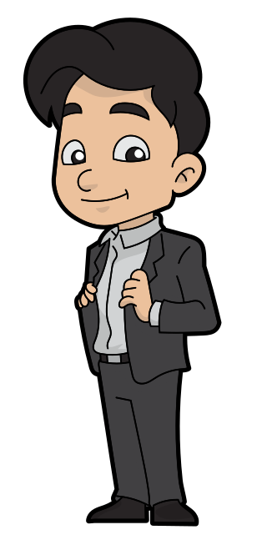
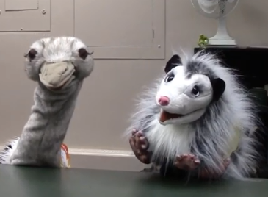
Achieving Inclusivity
Diversity a focus casting characters for narratives
Aim for diversity in:
Copyright users and creators
Occupation/social role
Racial and gender diversity
Aim to balance engagement and reusability

Slide 11
Recommendations
No one answer for resolving precision, engagement, reusability tensions
“Open enough” is often sufficient (McNally and Christiansen, 2019)
Consider modular design and layers (script, visuals, narration, interactivity)
Decision around precision, engagement and reusability create dependencies in the other layers
Collaboration key for addressing multiple audiences
LIS students with theatre backgrounds have been particularly effective collaborators
OUC Module – “The Berne and TRIPS Agreements” (screenshot)

Slide 12
Acknowledgements and Affiliations
The Opening Up Copyright Instructional Module Series is funded through a Teaching and Learning Enhancement Fund (TLEF) grant from the Centre for Teaching and Learning at the University of Alberta
Julia Guy – Master of Arts in Digital Humanities, and Master of Library and Information Studies Student, University of Alberta
Kris Joseph – Digital Scholarship Librarian, York University Libraries, York University
Amanda Wakaruk – Copyright Librarian, Copyright Office, University of Alberta
Adrian Sheppard – Director, Copyright Office, University of Alberta
Michael B. McNally – Associate Professor, Faculty of Education, University of Alberta

Slide 13
References
Atkinson, Roger. (1999). Project management: Cost, time and quality, two best guesses and a phenomenon, its time to accept other success criteria. International Journal of Project Management, 17(6), (December 1999): 337–42. https://doi.org/10.1016/S0263-7863(98)00069-6
Clossen, A. S. (2014). Beyond the Letter of the Law: Accessibility, Universal Design, and Human-Centered Design in Video Tutorials. Pennsylvania Libraries: Research & Practice, 2(1), 27–37. https://doi.org/10.5195/PALRAP.2014.43
Evans, R. (2014). Cooking up cauldrons of content: Recipes for video tutorials. Articles, Chapters and Online Publications. 32. Retrieved from https://digitalcommons.law.uga.edu/law_lib_artchop/32
Laurillard, D. (1998). Multimedia and the learner’s experience of narrative. Computers & Education, 31(2), 229–242. https://doi.org/10.1016/S0360-1315(98)00041-4
Lo, L. S., and Dale, J. M. (2009). Information literacy ‘learning’ via online tutorials: A collaboration between subject specialist and instructional design librarian.” Journal of Library and Information Services in Distance Learning, 3: 148-158.
Martin, N. A., and Martin, R. (2015). Would you watch it? Creating effective and engaging video tutorials.” Journal of Library and Information Services in Distance Learning, 9: 40-56.
McNally, M. B., & Christiansen, E. G. (2019). Open enough? Eight factors to consider when transitioning from closed to open resources and courses: A conceptual framework. First Monday, 24(6). https://doi.org/10.5210/fm.v24i6.9180
Smith, B., & Lee, L. (2017). Librarians and OER: Cultivating a Community of Practice To Be More Effective Advocates. Journal of Library & Information Services in Distance Learning, 11(1–2), 106–122. https://doi.org/10.1080/1533290X.2016.1226592
Weeks, T., and Davis, J. P. (2017). Evaluating best practices for video tutorials: A case study.” Journal of Library and Information Services in Distance Learning, 11(1-2): 183-195.

Slide 14
Image Sources
Image sources (Slide 10):
Mohamed_hassan. (n.d.). Programmer Computer Woman Support. Pixabay. CC0. https://pixabay.com/vectors/programmer-computer-woman-support-3607627/
GraphicMama-team. (2016) Arab girl. Pixabay. CC0 https://pixabay.com/en/arabian-arab-girl-female-ethnic-1456184/
Boss: Ghan Koon Lay. (n.d). Boss. The Noun Project. CC0. https://thenounproject.com/icon/1587076
Chrystalelizabeth. (2014) Teacher-bookworm-glasses-professor. Pixabay. CC0. https://pixabay.com/illustrations/teacher-bookworm-glasses-professor-359311/
Clip Art by Vector Toons. (2018). Charming Cartoon Businessman. Wikimedia Commons. CC BY. https://commons.wikimedia.org/wiki/File:Charming_Cartoon_Businessman.svg
Basadev4 (n.d.). [Andre]. Pixabay. https://pixabay.com/illustrations/black-avatar-cute-cheerful-3025348/
Parkjisun. (n.d). Goblin. The Noun Project. CC BY https://thenounproject.com/icon/1005005
Free Clip Art. (2018). Senior guy at the office. Wikimedia Commons. CC BY SA.https://commons.wikimedia.org/w/index.php?title=Special:Search&limit=50&offset=500&profile=default&search=man+cartoon&advancedSearch-current={%22namespaces%22:[6,12,14,100,106,0]}#/media/File:Senior_Guy_At_The_Office_Cartoon.svg
Rawpixel/3254 Bilder. (2018). Cartoon Lassig Charackter Zeichnung. Pixabay. CC 0. https://pixabay.com/de/illustrations/cartoon-l%C3%A4ssig-charakter-zeichnung-3685566/
Animal and Goodbrarian – OUC. (2019). OUC Module “Photocopying in the Library Module” (screenshot). CC BY. https://sites.library.ualberta.ca/copyright/photocopying-at-the-library/

