Slide 1
Perception and timing of acoustic distance
Matthew C. Kelley & Benjamin V. Tucker
Department of Linguistics
University of Alberta
ACOL, Nov. 6, 2021

Slide 2
Much ado about distance
Concept of “sound similarity” often invoked in linguistics (Luce, 1986; Luce & Pisoni, 1998)
Yet, similarity between words usually assessed textually
  Levenshtein distance on phoneme strings (Luce & Pisoni, 1998; Vitevitch & Luce, 2016)
Kelley & Tucker (2021) suggested dynamic time warping as a replacement
  Found dynamic time warping could be used to quantify lexical competition for auditory lexical decision

Slide 3
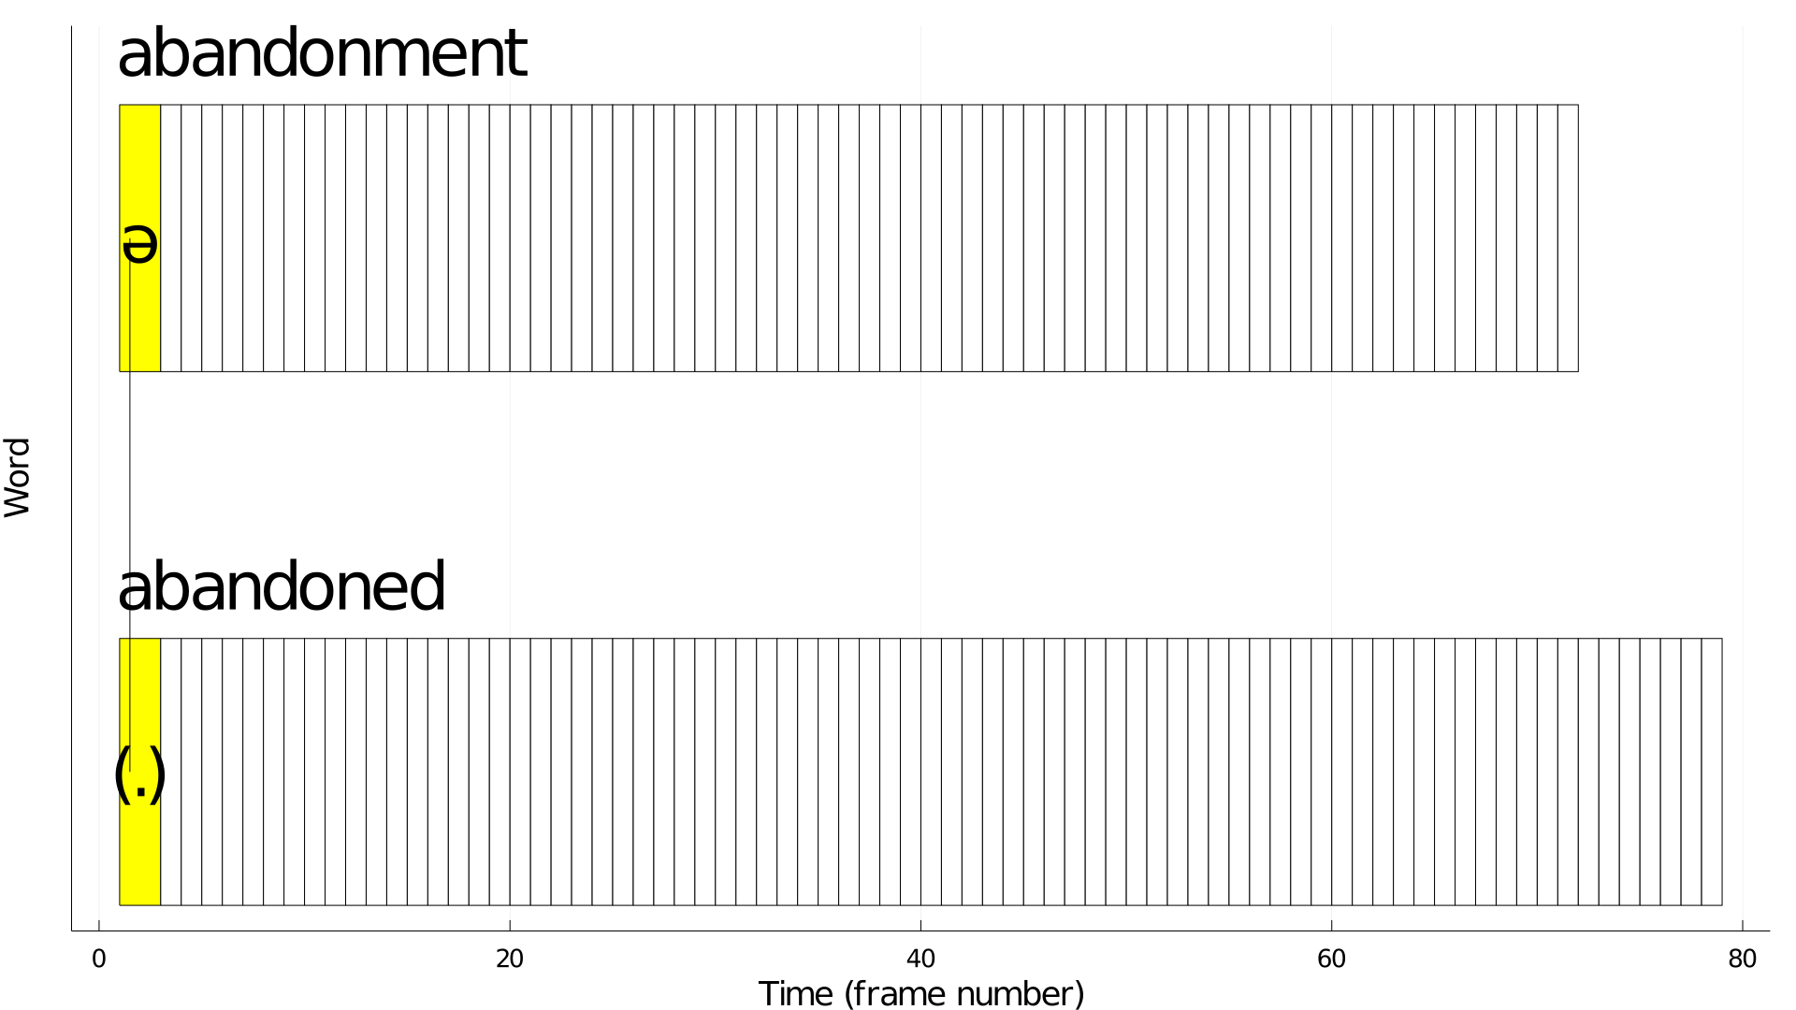
Dynamic time warping
History of use in speech recognition (Sakoe & Chiba, 1970)
Nonlinear comparison between time series
Two easily tunable parameters
  Distance function for comparison
  Radius for acceptable elasticity

Slide 4
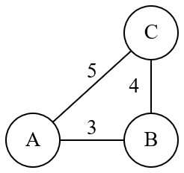
Properties of distance and comparison functions
Different distance functions have various properties
E.g., how much should outlying distance values affect absement?
  Distance from A to C?
    Manhattan (A -> B -> C) = 7
    Euclidean (A -> C) = 5
    Max component = 4
Should fit experimental data

Slide 5
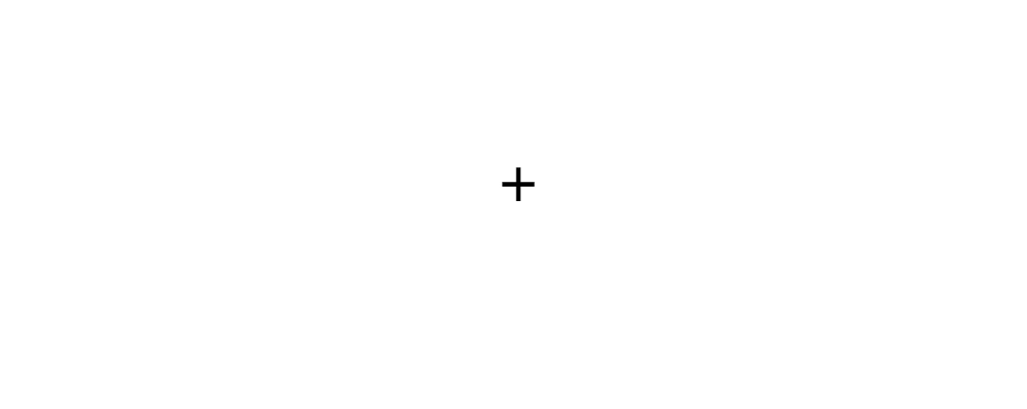
Experiment 1: How should distance within dynamic time warping be calculated?
37 participants from University of Alberta subject pool
Run online with jsPsych
Rating distance between synthetic vowels
  1 = same
  7 = very different
Vowels synthesized using KlattGrid in Praat
Example trial of experiment

Slide 6
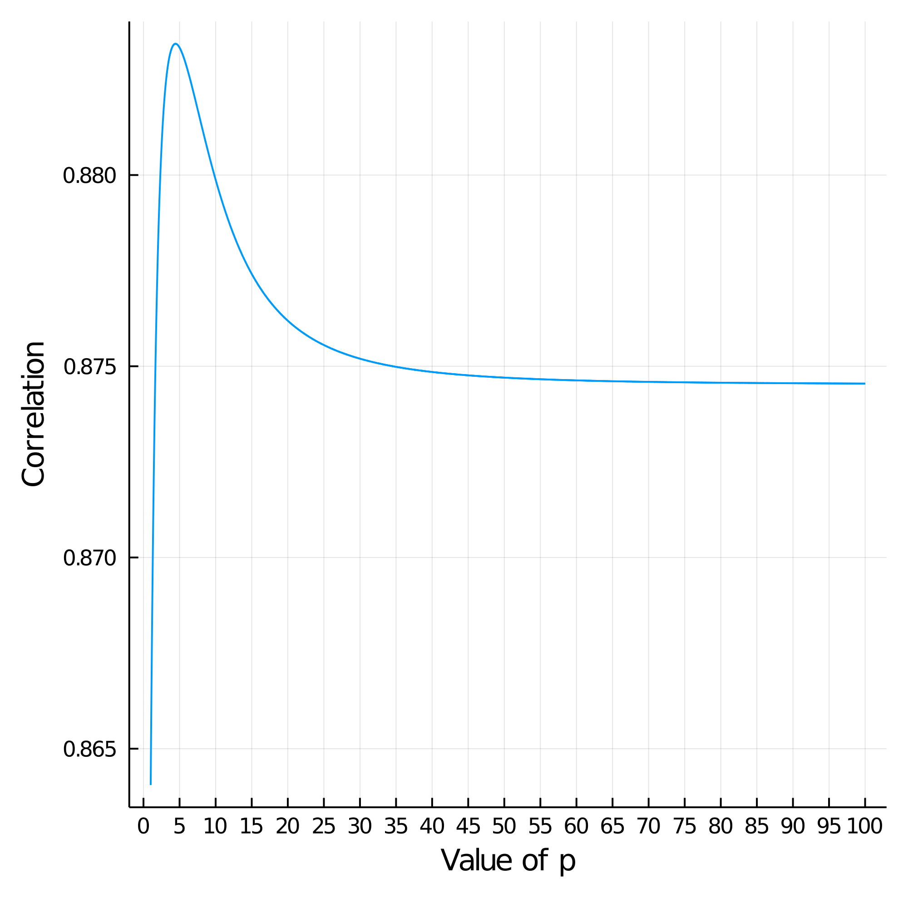
Experiment 1: Correlating machine and human distances
Compare correlation between pooled ratings to p-norm formulas
  Represented words as mel frequency cepstral coefficients
4.5-norm had highest correlation (r=0.883)
  2-norm not much worse (r=0.878)

Slide 7
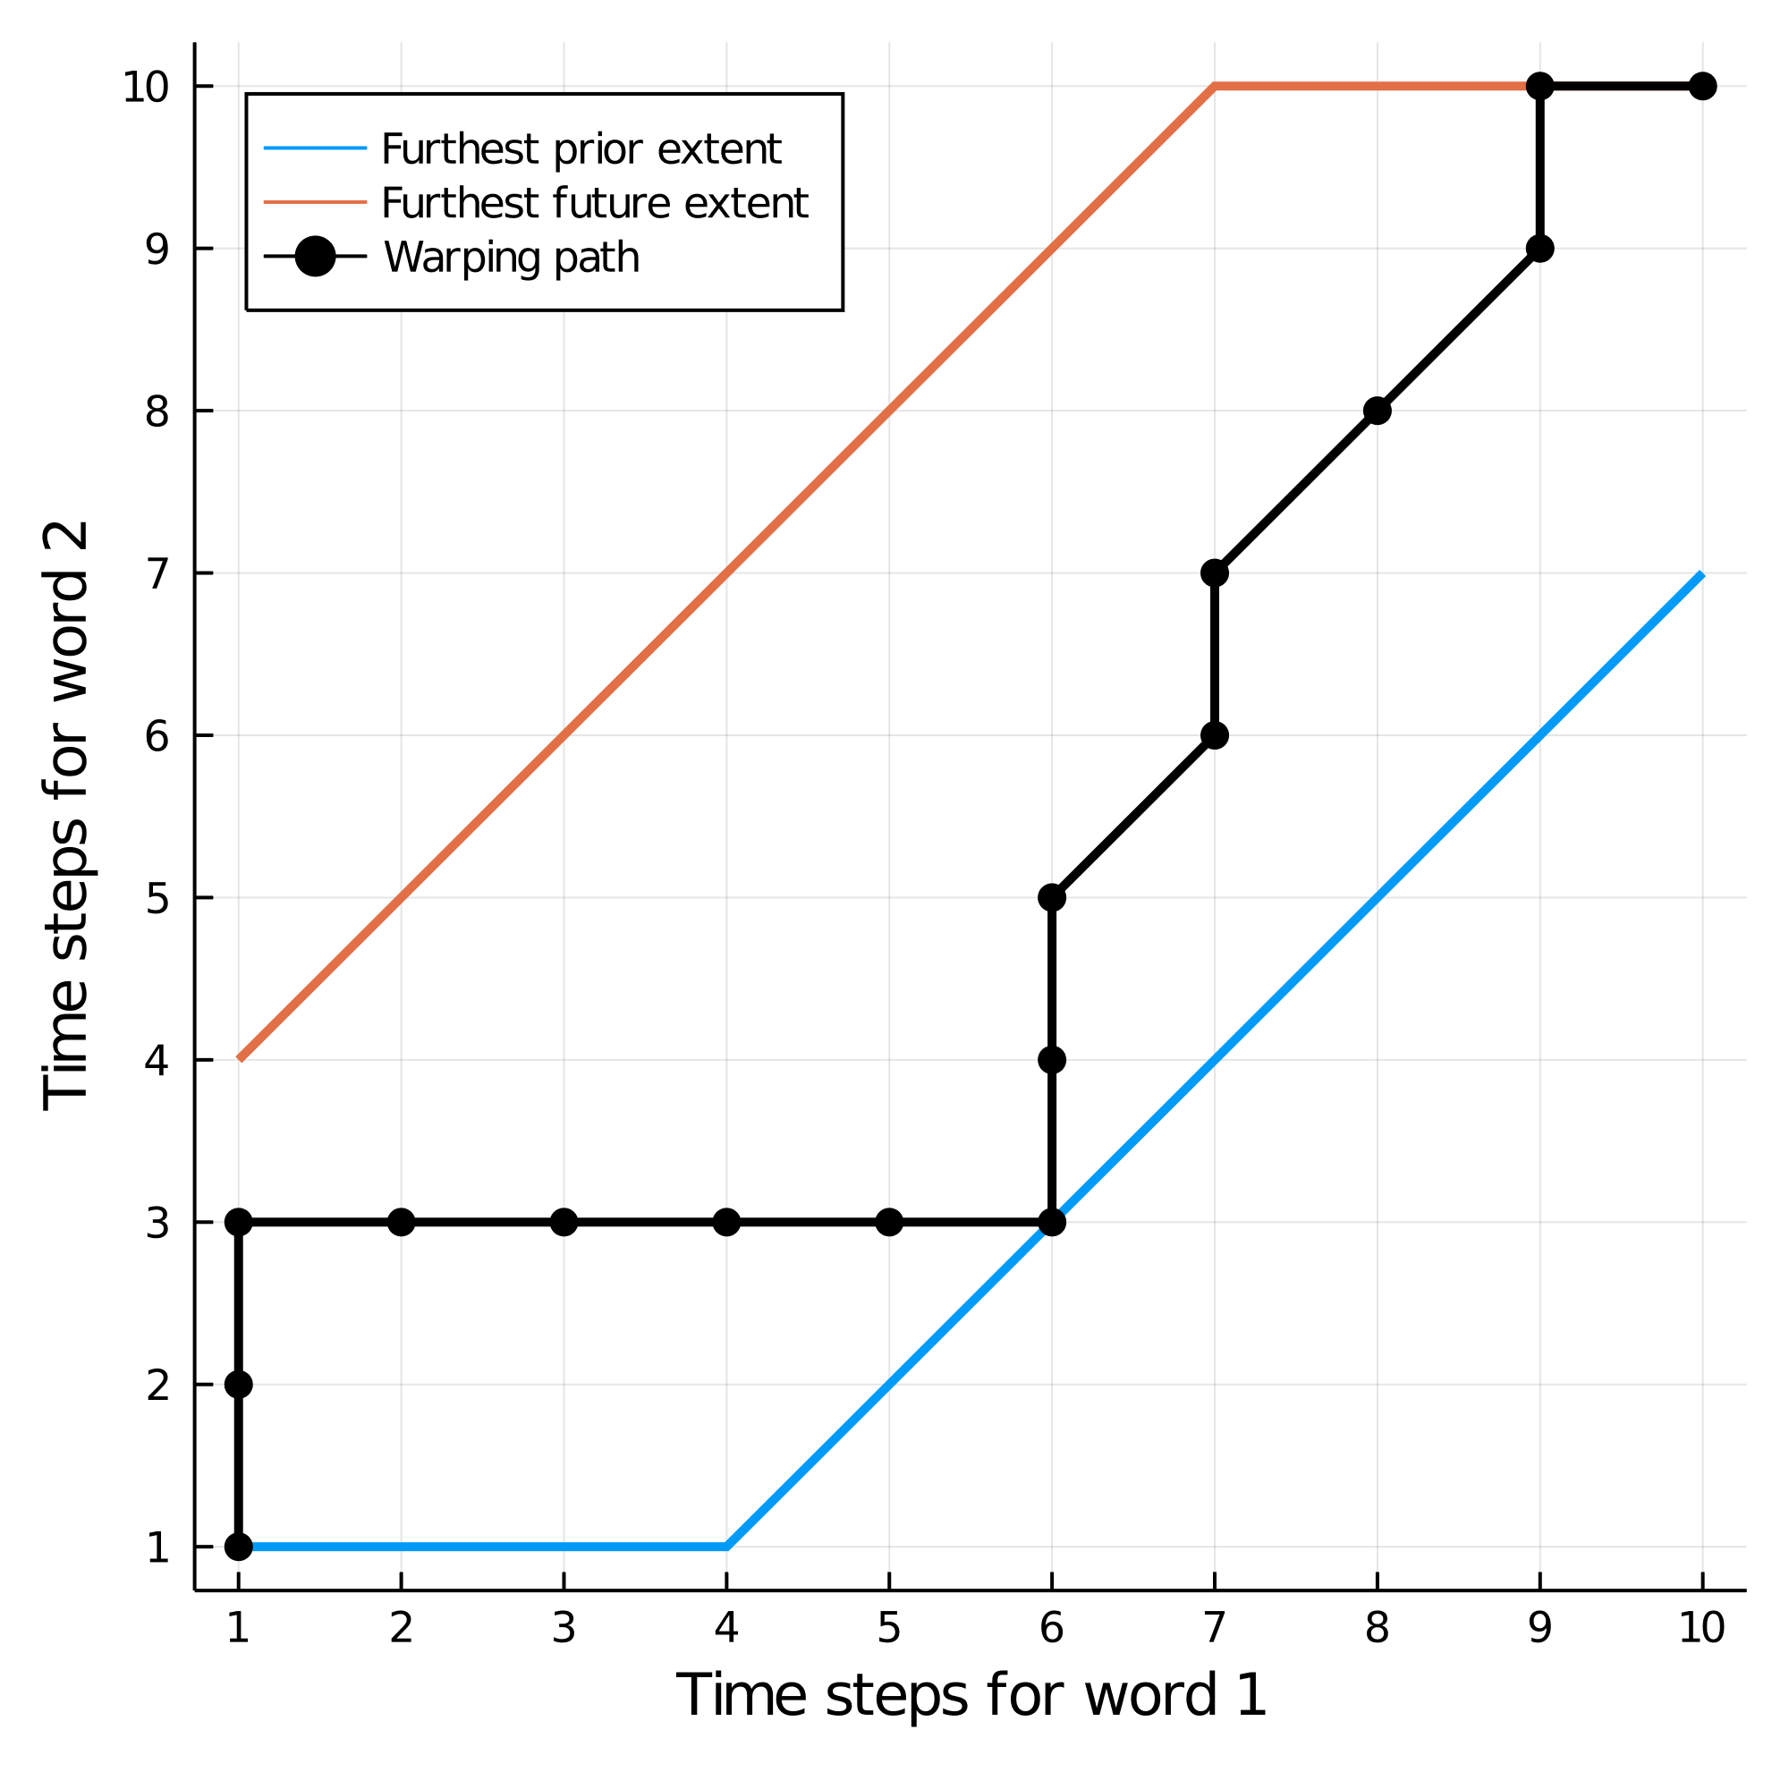
How elastic should comparisons be?
Perception must be resilient to mild temporal differences in production
  Otherwise, different speech rates would be intractable
Dynamic time warping can model this
Degree of elasticity should match experimental data

Slide 8

Experiment 2: How long should templates be compared with each other?
49 participants from University of Alberta subject pool
Run online with jsPsych
Respond whether second sound is shorter or longer than first
Vowels synthesized with KlattGrid in Praat
  3 categories: [i], [ɑ], and [u]
Example trial of experiment

Slide 9
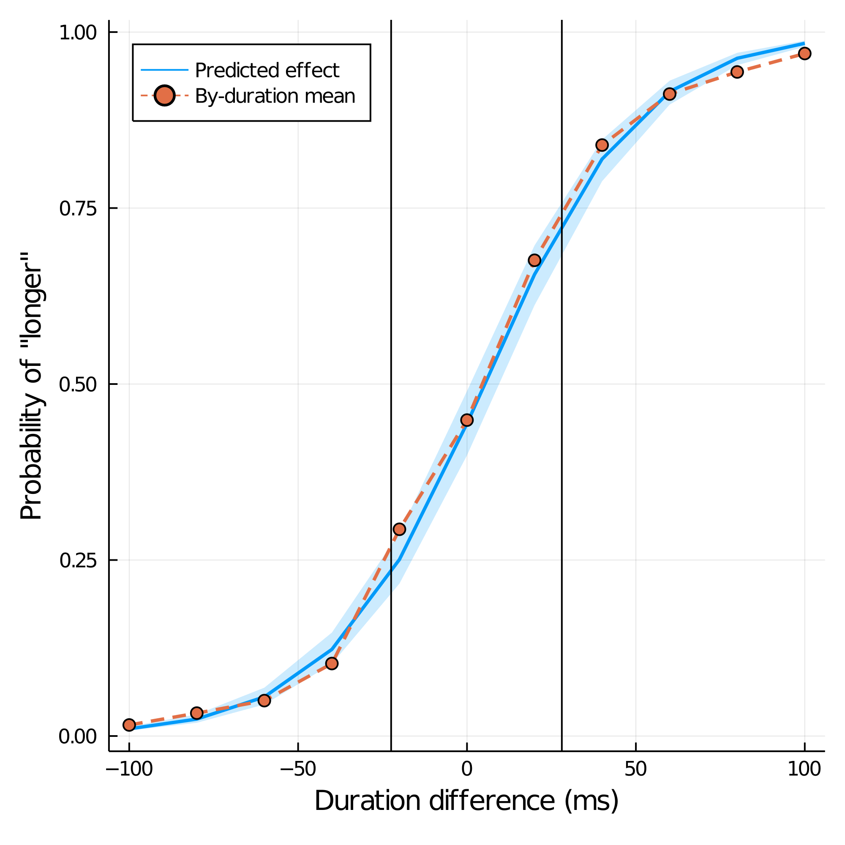
Experiment 2: What is the JND?
Analyze for just noticeable difference (JND)
Logistic mixed-effects regression
  Predict chance of responding that the second sound was longer than the first
JND is the average distance from 2nd quartile to 1st and 3rd quartiles
Found 25 ms threshold overall

Slide 10
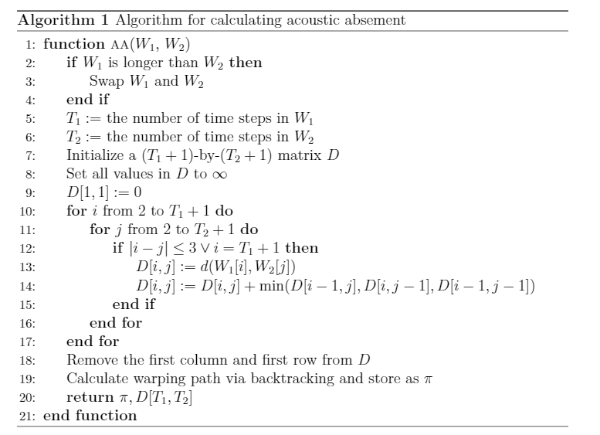
Tuning dynamic time warping calculations
Many distance formulas correlated highly with human judgments
  Euclidean distance could be preferred due to familiarity
Limit elasticity in dynamic time warping to approx. 25 ms
  Round up as appropriate for time sampling of acoustic representation

Slide 11
Implications for phonetic theory
Choice of individual distance function per se not particularly important
  Predicted by equivalence of vector norms in linear algebra
  Choice of acoustic features already sets distance between objects
  Ease of interpretation or calculation better motivation
Resolving power for vowel timing differences about 25 ms
  Other speech sounds may have different thresholds
  E.g., 50% crossover for stop VOT differences about 34 ms (Kewley Port et al., 1988)
  Requires further testing in other languages and for other speech sounds

Slide 12
References
Kelley, M. C., & Tucker, B. V. (2021). Using acoustic distance and acoustic absement to quantify lexical competition. Manuscript submitted for publication.
Kewley‐Port, D., Watson, C. S., & Foyle, D. C. (1988). Auditory temporal acuity in relation to category boundaries; speech and nonspeech stimuli. The Journal of the Acoustical Society of America, 83(3), 1133–1145.
Luce, P. A. (1986). Neighborhoods of Words in the Mental Lexicon (Technical Report No. 6; Research on Speech Perception).
Luce, P. A., & Pisoni, D. B. (1998). Recognizing Spoken Words: The Neighborhood Activation Model. Ear and Hearing, 19(1), 1–36.
Sakoe, H., & Chiba, S. (1970). A similarity evaluation of speech patterns by dynamic programming. Nat. Meeting of Institute of Electronic Communications Engineers of Japan, 136.
Vitevitch, M. S., & Luce, P. A. (2016). Phonological neighborhood effects in spoken word perception and production. Annual Review of Linguistics, 2(1), 75–94.

