Slide 1
Introduction to Open Educational Resources (OER)
Krysta McNutt, Centre for Teaching and Learning, University of Alberta, krystam@ualberta.ca
Unless otherwise noted, this work is licensed under a Creative Commons Attribution 4.0 International License.

Slide 2
Cost
Quality & Pedagogy
Access & Discovery
Unless otherwise noted, this work is licensed under a Creative Commons Attribution 4.0 International License.
Notes:
Krysta - 5 min

Slide 3
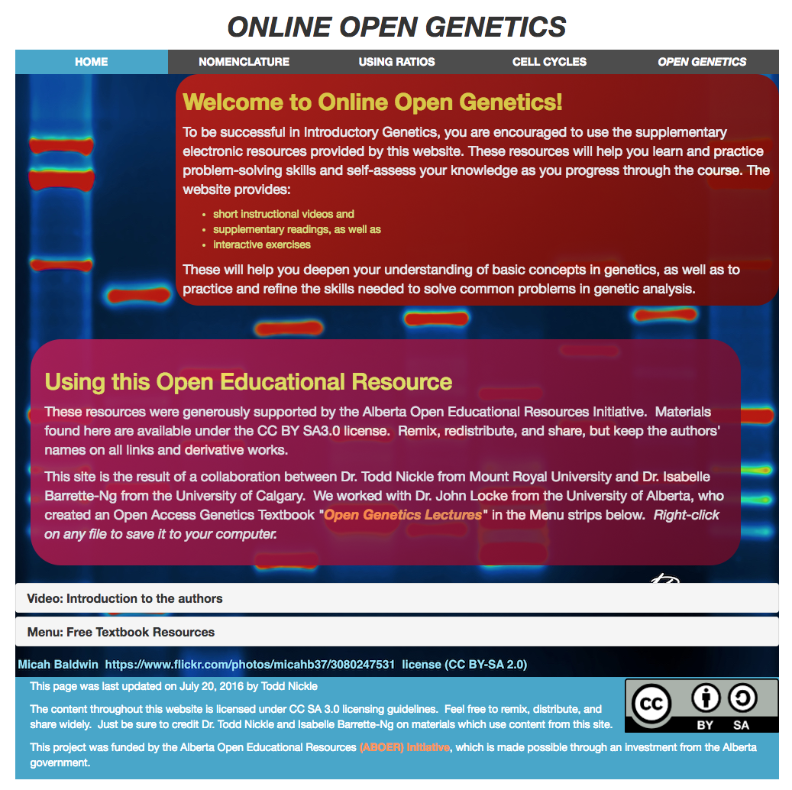
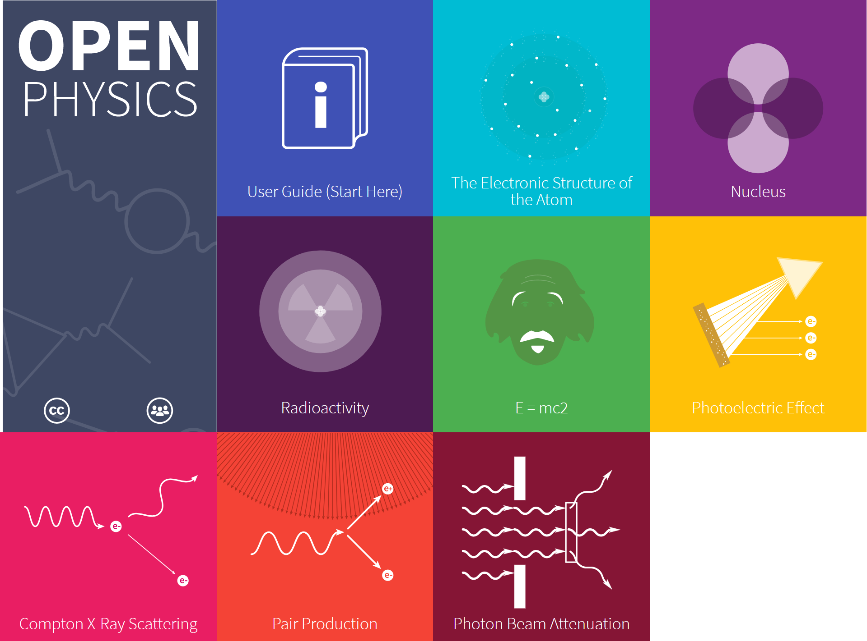
Freely accessible, openly, licensed text, media, or other digital assets for teaching,learning and research
Unless otherwise noted, this work is licensed under a Creative Commons Attribution 4.0 International License.
Notes:
Michelle
Ties into the broader open movement including OA and Open source code
Not just textbooks! We expect faculty are using these resources in bits and pieces throughout their courses without realizing it.
Some standout examples on our campus - Open genetics, open physics, surgery 101
These are exciting examples because they are reimagining learning materials
Benefits to students:
Cost savings
Interactive
Students can be involved in the creation
Benefits to faculty:
Can always update
Retain ownership over the content they create instead of transferring it to a publisher
Biggest question:
Question of quality of OER - Peer review process is being established and importance of using trusted repository just like all online content.

Slide 4
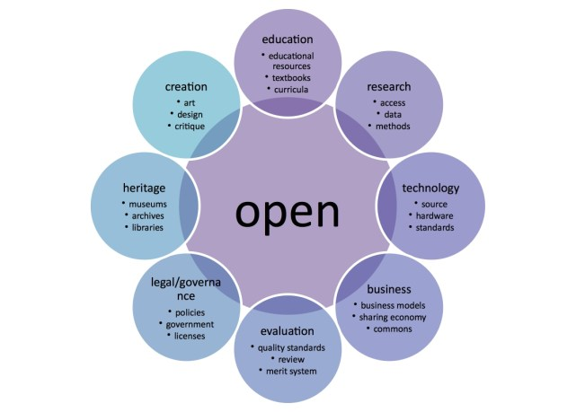
"Open Model" Graphic by Katja Mayer, is licensed under CC BY 4.0
Notes:
Michelle

Slide 5
"Open Model" Graphic by Katja Mayer, is licensed under CC BY 4.0
Notes:
Michelle

Slide 6
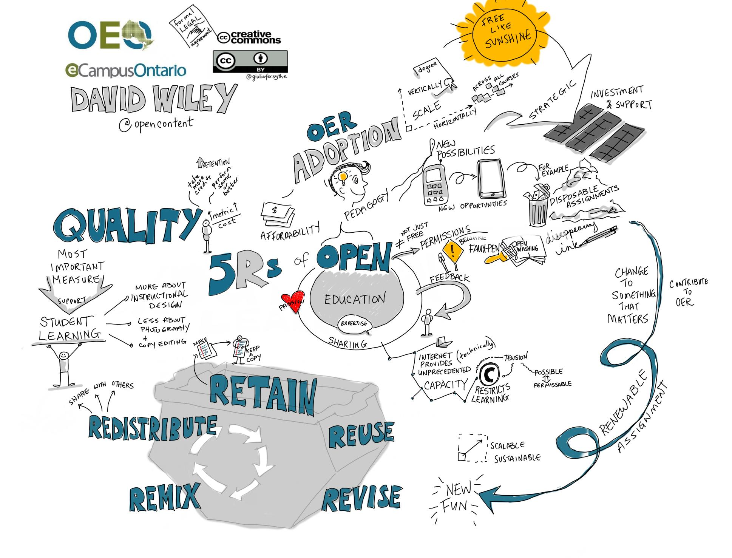
Credit to Giulia Forsythe: https://www.flickr.com/photos/gforsythe/33552562011
Notes:
Michelle
How is this content different from other OA content:
5 Rs are key
Remix
Redistribute
Retain
Reuse
Revise

Slide 7
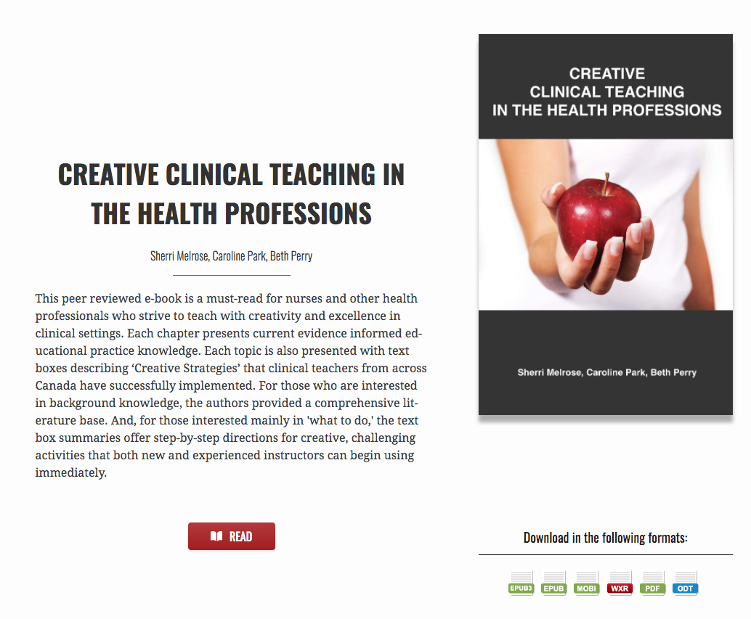
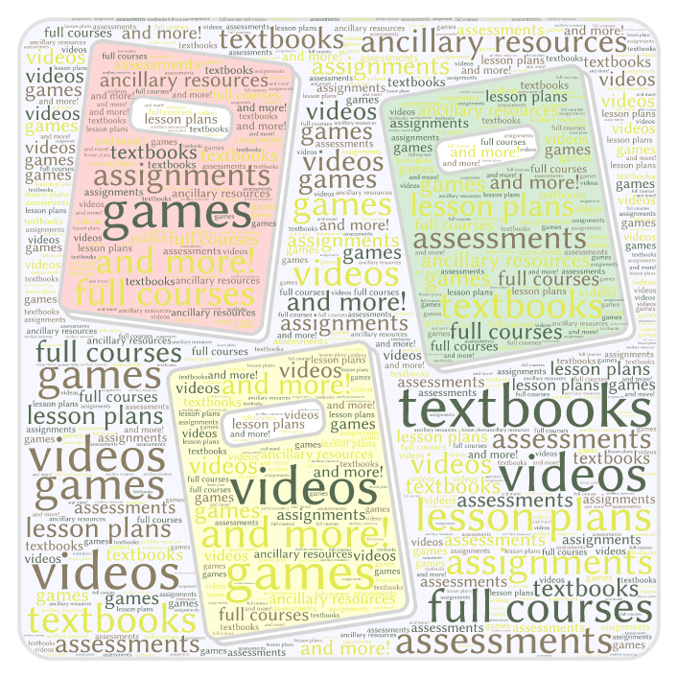
Open Educational Resources (OER)
Unless otherwise noted, this work is licensed under a Creative Commons Attribution 4.0 International License.

Slide 8
Examples of OER used in continuing education programs
Project Management
ESL (CBL 5/6)
Dental Community Education
Unless otherwise noted, this work is licensed under a Creative Commons Attribution 4.0 International License.
Notes:
Krysta
Project Management open textbook (open textbook which directly aligns with industry accreditation and increases accessibility to the profession outside of professional associations and publications)
Project Management for IDs open textbook (co-creating with students to again, align with industry accredibtation and increase accessibilty)
ESL (English Second Language) CBL Level 5/6 open textbook (to share about how two institutions collaborated to create an open textbook for broad use in post-secondary, community, and professional education settings)
(in progress) "Dental Community Education Package" (to share about how the community can come together to equip emerging professionals, practicing professionals, and community educators with well-crafted, accessible educational material)

Slide 9
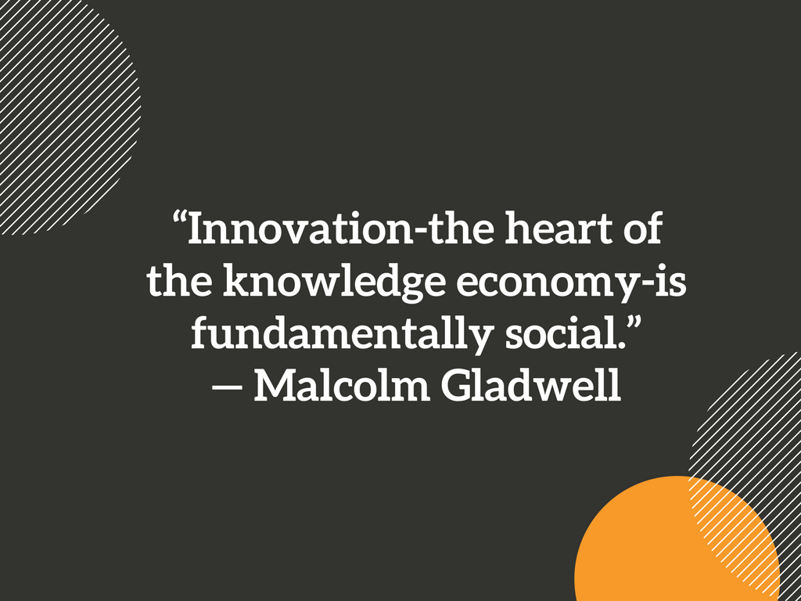
Notes:
Michelle
OER - The nature of collaboration, professional outreach, etc

Slide 10
Open licences grant permission to use a copyright-protected work with few or no restrictions.
Unless otherwise noted, this work is licensed under a Creative Commons Attribution 4.0 International License.
Unless otherwise noted, this work is licensed under a Creative Commons Attribution 4.0 International License.
Notes:
Krysta

Slide 11
Copyright status does not change when a standard open licence is assigned.
Open licences grant permission to use a copyright-protected work with few or no restrictions.
Unless otherwise noted, this work is licensed under a Creative Commons Attribution 4.0 International License.
Notes:
Krysta

Slide 12
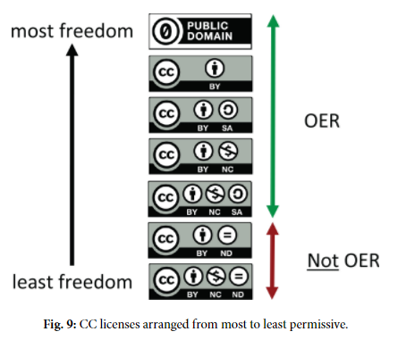
Copyright, Open Licensing, and OER
Creative Commons licences are the most common OER open licences.
Choose a licence.
Mark the work with CC icon & statement. (copy & paste)
by Cable Green is licensed under CC-BY 4.0
Unless otherwise noted, this work is licensed under a Creative Commons Attribution 4.0 International License.
Notes:
Krysta

Slide 13
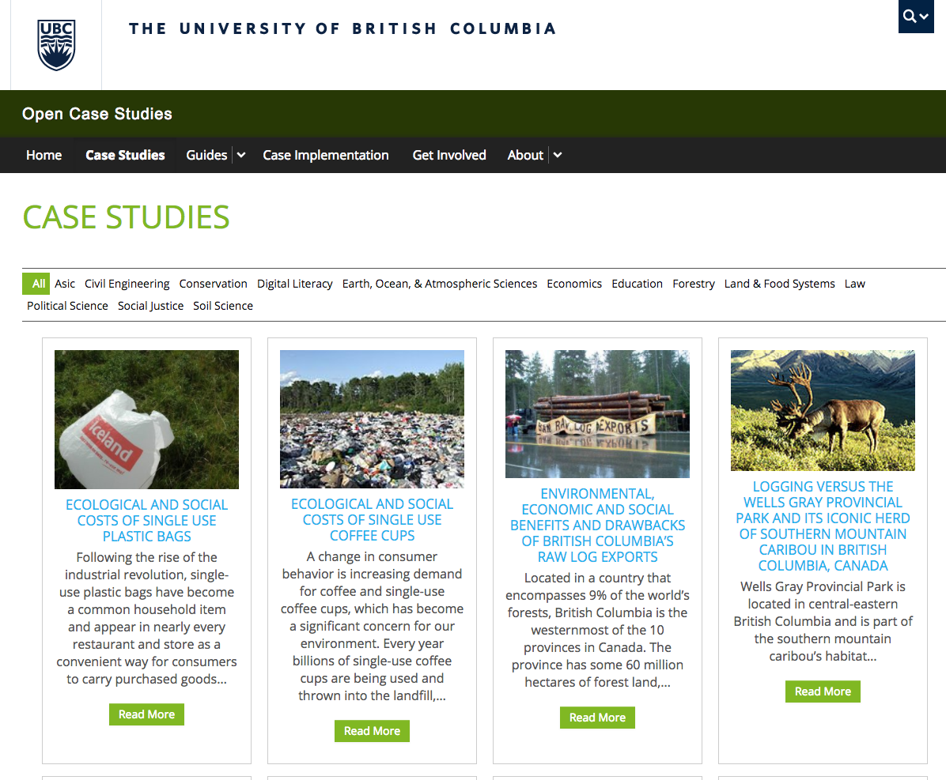
Unless otherwise noted, this work is licensed under a Creative Commons Attribution 4.0 International License.
Notes:
Krysta

Slide 14
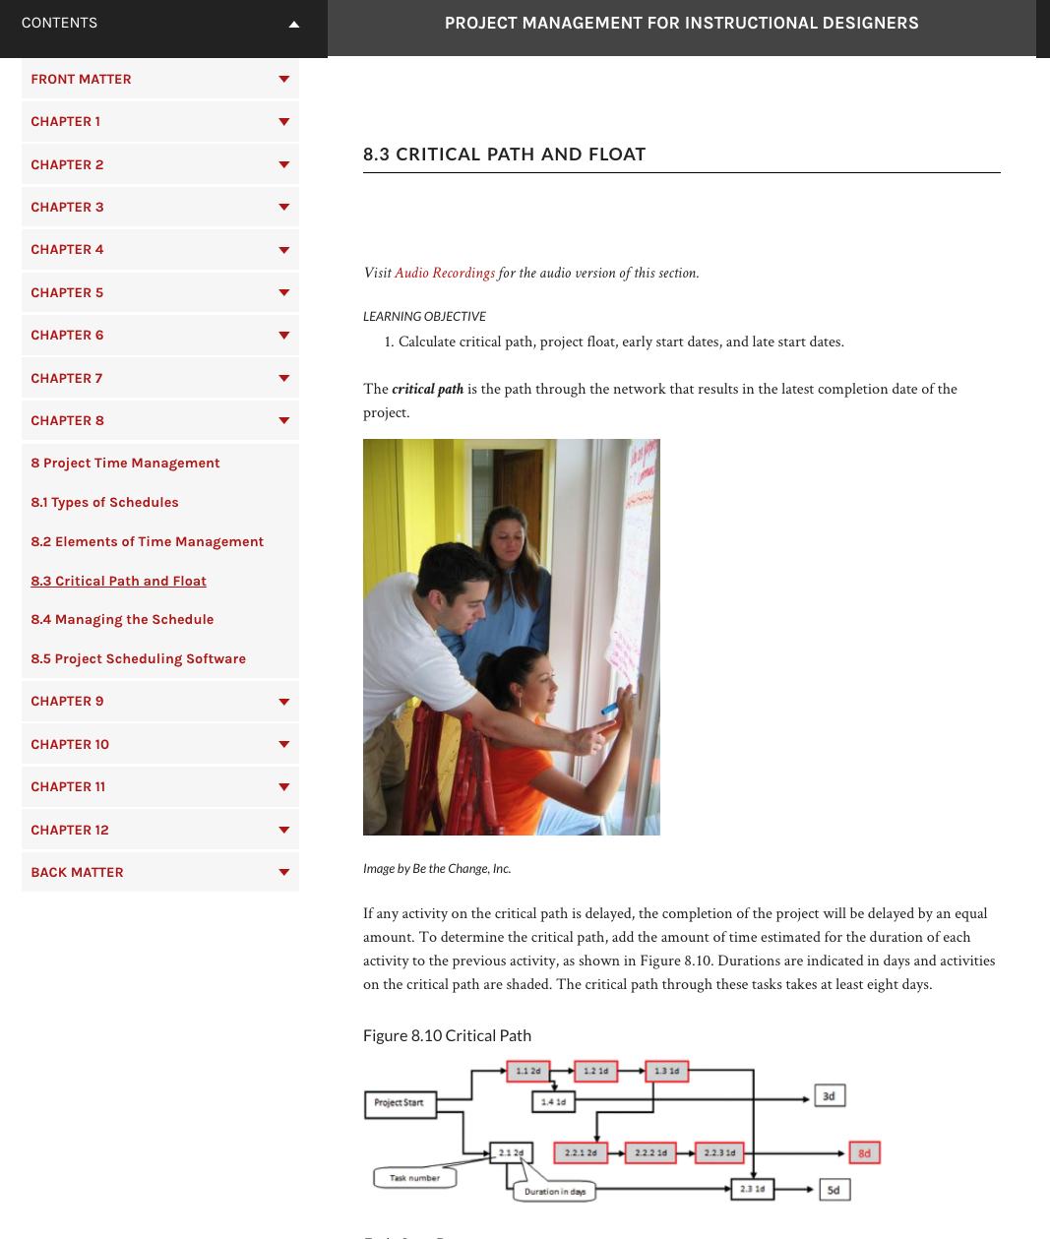
Project Management for Instructional Designers Wiley, et al.
Example Assignments:
Align each chapter with CAPM/PMP certification exam study requirements
Create industry-specific examples (e.g. cost and time estimating)
Capture industry-specific interviews to compliment each chapter
Update/modernize a section of the book
Create a glossary of key terms
Additional skill based Assignments:
Create text-to-speech audio recordings of each chapter
Replace copyright images with CC licensed images
Create an automated process for book conversion
Proofreading and editing
https://opencontent.org/blog/archives/2629
Unless otherwise noted, this work is licensed under a Creative Commons Attribution 4.0 International License.
Notes:
Krysta

Slide 15
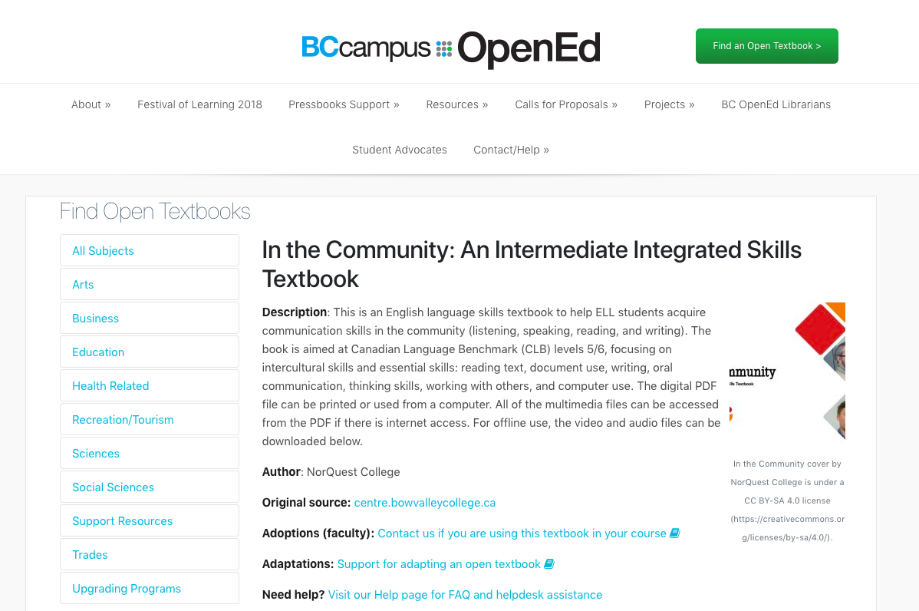
https://open.bccampus.ca/find-open-textbooks/?uuid=3988a71f-654e-4c7c-b662-1bd7fe4ffffe&contributor=&keyword=&subject=
Unless otherwise noted, this work is licensed under a Creative Commons Attribution 4.0 International License.
Notes:
Krysta

Slide 16
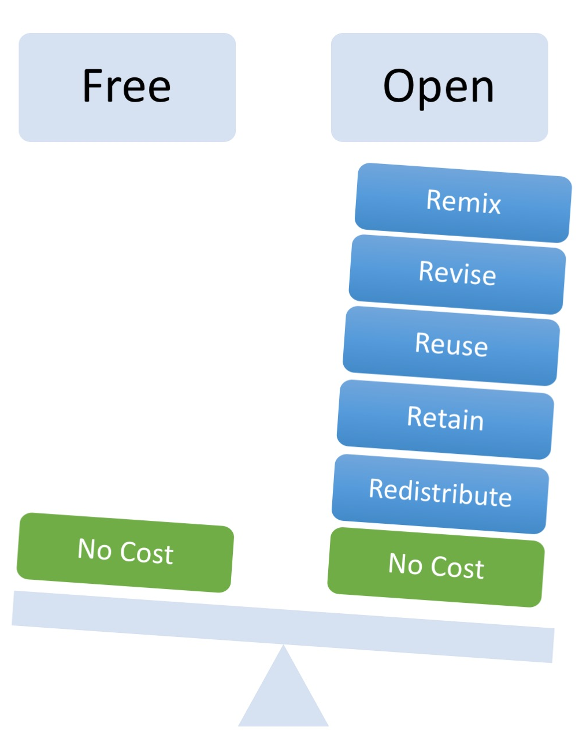
Combine two or more
Adapt, modify, and improve
Use in a wide range of ways
Make and own a copy
Share with others
Image by Designers for Learning: Gain Experience for Good, Jennifer Maddrell, Director (CC, BY, NC, SA)
Notes:
Krysta
Retain: Make, own, and control your own copy of content
Reuse: Use the content as-is
Revise: Adapt, adjust, modify, improve, or alter the content
Remix: Combine the original or revised content with other OER to create something new
Redistribute: Share your copies of the original content, revisions or remixes with others

Slide 17
Wiley’s 5Rs and Creative Commons Licensing
 | Retain | Reuse | Revise | Remix | Redistribute
 | Make and own a copy | Use in a wide range of ways | Adapt, modify, and improve | Combine two or more | Share with others
Public Domain
CC-BY
CC-BY-SA |  |  | same license | same license
CC-BY-NC |  |  |  |  | non-commercial
CC-BY-NC-SA |  |  | same license | same license | non-commercial
CC-BY-ND |  |  | personal use only | personal use only
CC-BY-NC-ND |  |  | personal use only | personal use only | non-commercial
OER
Not OER
Give appropriate credit, provide a link to the license, and indicate if changes were made.
Unless otherwise noted, this work is licensed under a Creative Commons Attribution 4.0 International License.
Notes:
Krysta

Slide 18
Activity
Unless otherwise noted, this work is licensed under a Creative Commons Attribution 4.0 International License.
Notes:
Krysta

Slide 19
Wiley’s 5Rs and Creative Commons Licensing
 | Retain | Reuse | Revise | Remix | Redistribute
 | Make and own a copy | Use in a wide range of ways | Adapt, modify, and improve | Combine two or more | Share with others
Public Domain
CC-BY
CC-BY-SA |  |  | same license | same license
CC-BY-NC |  |  |  |  | non-commercial
CC-BY-NC-SA |  |  | same license | same license | non-commercial
CC-BY-ND |  |  | personal use only | personal use only
CC-BY-NC-ND |  |  | personal use only | personal use only | non-commercial
OER
Not OER
Give appropriate credit, provide a link to the license, and indicate if changes were made.
Unless otherwise noted, this work is licensed under a Creative Commons Attribution 4.0 International License.
Notes:
Krysta

Slide 20
Students and Instructors → remix / create:
Remix audiovisual materials to both entertain and inform
Create or revise/remix entire textbooks
Create their own assignments
Create test banks
Remix/create tutorial videos
Remix/create summaries
Connect principles with popular culture
Create games
Remix/create create guided notes
Remix/create guides to direct other students through readings or lecture.
Select an activity based on the resource pack provided. What are the opportunities and limitations for student learning?
Unless otherwise noted, this work is licensed under a Creative Commons Attribution 4.0 International License.
Notes:
Krysta

Slide 21
Cost
Quality & Pedagogy
Access & Discovery
Unless otherwise noted, this work is licensed under a Creative Commons Attribution 4.0 International License.
Notes:
Reflection question - Michelle Closing - Krysta and Diane

Slide 22
Resources and References
Wiley, David. “Defining the "Open" in Open Content and Open Educational Resources.” Iterating toward open, opencontent.org/definition/
Christiansen, E., McNally M., Lock, J., Welch, J., Sou, L. (2016). The starter kit. Retrieved from http://albertaoer.com/content/resources
Navigating open pedagogy, part 1 / You're the Teacher by Christina Hendricks is licensed under a Creative Commons Attribution 4.0 CC BY
Hendricks, Christina. “Navigating open pedagogy, part 1.” You’re the Teacher, 22 May, 2017, http://blogs.ubc.ca/chendricks/2017/05/22/navigating-open-pedagogy-pt1/
McNally, Michael B. “ERA.” LIS 598 Information Policy, Winter 2017 - ERA, era.library.ualberta.ca/collections/8s45qc73c
McNally, M.B. (2016). Open educational resources (OER): Background and some considerations [PowerPoint slides]. Retrieved from https://era.library.ualberta.ca/files/b5q47rn818#.WCS79S0rL4Y
Cronin, Catherine. (2017). “Open Education Open Questions”. EDUCAUSE. Retrieved from: https://er.educause.edu/articles/2017/10/open-education-open-questions
Unless otherwise noted, this work is licensed under a Creative Commons Attribution 4.0 International License.

Slide 23
Resources and References
Source of ‘Figure 9’: Green, C. 2017. Open Licensing and Open Education Licensing Policy. In: Jhangiani, R S and Biswas-Diener, R. (eds.) Open: The Philosophy and Practices that are Revolutionizing Education and Science. Pp. 29–41. London: Ubiquity Press. DOI: https://doi.org/10.5334/bbc.c. Licence: CC-BY 4.0
“Creative Commons Guide.” Copyright at UBC, copyright.ubc.ca/guidelines-and-resources/support-guides/creative-commons/
Wakaruk, Amanda. “Do it right the first time: Copyright, Creative Commons, and OER.” Alberta OER Summit. May 11, 2017. https://doi.org/10.7939/R3571809V
http://classroom-aid.com/oer-mobile-course-open-diagram/
"Open Model" by Creative Commons is licensed under CC BY 2.0
Creative Commons (CC) https://creativecommons.org/ CC Wiki https://wiki.creativecommons.org/
Wiley, David. “OER-Enabled Pedagogy.” Iterating toward openness, 2 May 2017, opencontent.org/blog/archives/5009
Unless otherwise noted, this work is licensed under a Creative Commons Attribution 4.0 International License.

