Slide 1
Mapping the Retracted Literature in Pharmacy and Drug Publications
Janice Kung, John W. Scott Health Sciences Library Melissa Helwig, Dalhousie University UAL Research Symposium: Open Ideas Dec 12, 2017

Slide 2
What is a retracted publication?
A public statement that withdraws, cancels, refutes, or reverses the original statement – US National Library of Medicine
Plagiarism
Honest mistakes
Falsify data
Undisclosed conflicts of interest
Bad science
Bad ethics

Slide 3
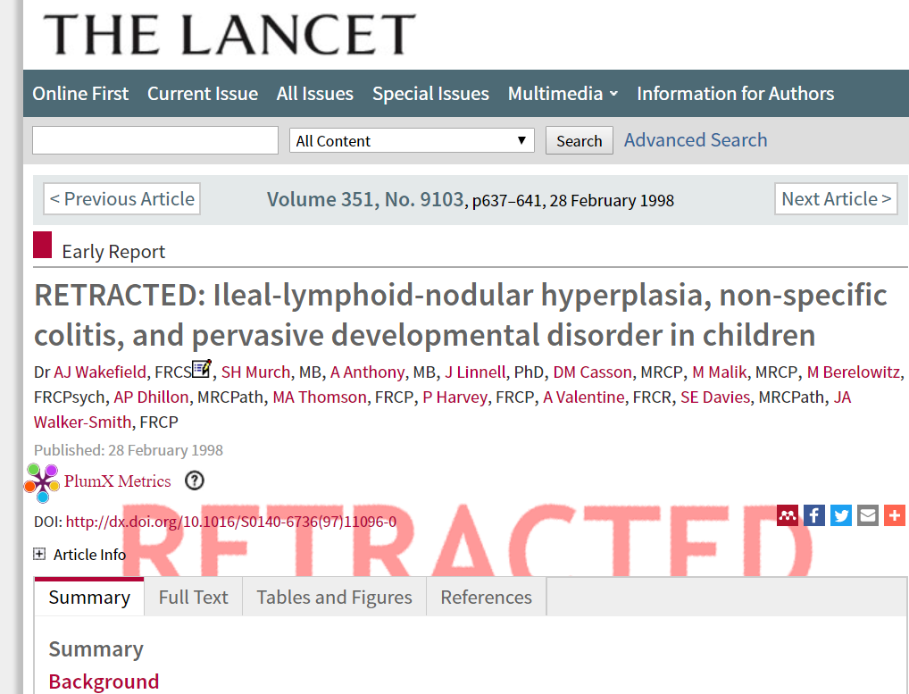
Notes:
Famous Lancet paper published in 1998, claimed the link between vaccines and autism.
http://www.nytimes.com/2010/02/03/health/research/03lancet.html
Failed to disclose conflict of interest
Questionable science → Did not receive proper ethics
Results could not be replicated
Retracted in 2010 when there was a tribunal conducted by British General Medical Council.
- Damage to public health has been done and continues

Slide 4
Notes:
The impact of retracted publications have been studied in a variety of disciplines and topics.
Prevalence of retracted papers over period of time
Impact Factors
Citations per paper
Retracted papers problematic because they could have ripple effect on subsequent publications if people continue to cite them as legitimate science.
Previous publications used various methods often with limited reporting structures for their methods. This project aims to develop a replicable reporting method for tracking retracted publications by reviewing the literature and contacting authors for detailed information regarding their methodology.

Slide 5
Two-part project
Part 1:
Develop systematic reporting structure
Retracted papers and their citations
Part 2:
Apply method to investigate impact of retracted papers in pharmacy and drug literature

