Slide 1
Citation Analysis
A Tool for Collection Development and
Enhanced Liaison Services
Christine Brown and Denis Lacroix

Slide 2
Outline
Project description
Research background
Methodology
Results
Future Directions

Slide 3
Introduction
Works published and cited from 1999 to 2009
Modern Languages and Cultural Studies (MLCS)
Linguistics
Political Science.
Reference study (Cullars 1989; Georgas and Cullars 2005)
Cited references counted and analyzed.
Describe nature of the publications produced
Notes:
Introduction
Citation analysis helps academic librarians’ analyze, describe, and contextualize what researchers are publishing and citing to inform work in collection development and liaison with university administration to promote faculty research in the humanities and social sciences. A symbiotic relationship exists between librarian and faculty researchers where both need each other to survive. This study addresses the use of citation analysis as a tool for understanding the complex landscape of research publishing in the humanities and social sciences.
The project’s objective is to explore systematically what faculty in three departments (Modern Languages, Linguistics, and Political Science) have published in the last ten years and what kind of sources they cited in those publications. The benefit of this project is to raise the profile of research in the humanities, something that keenly interests the Faculty of Arts. The other benefit is to inform librarians about the publication landscape and evolution in the three departments

Slide 4
Benefits
Provide the Faculty of Arts with data on the publication output
Describe the publication landscape and evolution
Help promote research in the Faculty of Arts
Inform collection development activities
Policy development/revision
Assessment – use of collection, user needs
Community outreach and liaison activities
Notes:
The humanities cannot focus solely on citation indexes for evaluating published research. Many humanities journals, especially in the area of foreign languages, are not part of citation indexes and the humanities offer a diverse and complex ecosystem that merit monitoring in its entirety. Another more comprehensive methodology, therefore, is necessary to help researchers and librarians measure the type of research produced in a department and the published information used to support the research. Knievel and Kellsey encourage “librarians to survey the specific research agendas of their local faculty”(166).

Slide 5
Background
Kellsey & Knievel (2004) suggest that “librarians […] survey the specific research agendas of their local faculty”.
Forms of publication
More books in HSS (Kyvik, 2003)
Humanities: 11.6% are books, 78.6% are articles, and 9% are reports
Soc Sci : 9.6% are books, 69.3% are articles and 20.3% are reports
Non-scholarly articles higher in the SS (Huang, 2008)
Language of publication
Humanities : 40% in English
Soc Sci : 51% in English
Rate of publication
3 publications / year in HSS
Scholarly pubs by 30% from 1980 to 2000 (Kyvik, 2003)
20% of faculty = 50% of total pubs
Notes:
We are implementing Knievel and Kellsey’s suggestion that “librarians […] survey the specific research agendas of their local faculty”(166). There is also a lack of comprehensive studies that encompass all forms of publication with a systematic look at language of publication(143)
Lack of comprehensive studies that encompass all forms of publication with a systematic look at language of publication
What we know from previous studies

Slide 6
Research Questions
Compare publication landscape
To disciplines and to each other
Past research
Types of sources used in research
Language and age of publication
Works produced and cited
Trend in research output over ten year period
Promotion of research and collection development
Notes:
What is the publication landscape of the three disciplines we are examining?
How does each landscape resemble the others and compare to previous research?
What types of sources are they using in their research?
What do we know about the language and age of publication in terms of work produced and cited?
How can we describe the trend in research output over a ten year period? What does this tell us about the information needs of the scholars?
How can this information be used to assist in efforts to promote the research of these faculty and in collection development activities?

Slide 7
Methodology
Objectives:
Publishing landscape of UA HSS faculty
Referencing landscape of UA HSS faculty (sample of 1500 works)
10 years of FT faculty publications: 1999-2009
Three academic disciplines at the UA: Romance languages, political science and linguistics
Notes:
Objectives serve to describe the publishing landscape of full-time UA HSS faculty and the citation landscape (ie. the works they cited) from a sample of 1500 cited works (500 from each of the 3 depts. studied).
All FT faculty publications in 3 disciplines (rom langs, poli sci, and ling) over a 10 year period (1999-2009) were included in the study
We entered the publications into RefWorks
Coded the publications in MS Excel
- The coding criteria were:
- Type of source used by researcher,
- Journal evaluation (peer-reviewed, popular, impact factors and other rankings…) and publishers
- Number of pages and citations
- Language and age of publications
- Library holdings of faculty published and cited works

Slide 8
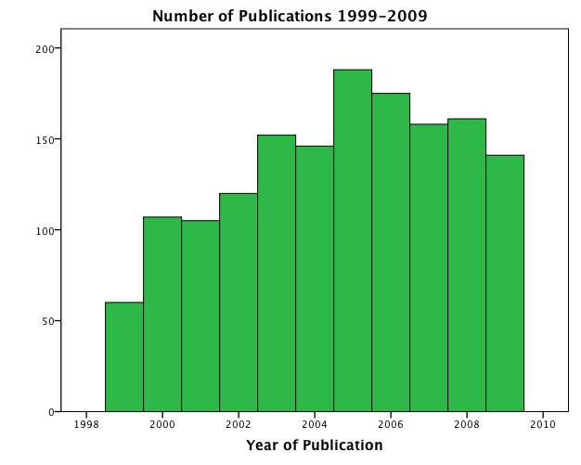
Author Productivity
Notes:
Overall publication rates increased from 2000 to 2005. This seems to follow the finding of Kyvik (43) who reported an increase of 30% in publications from 1980 to 2000. Since 2005 we see decreases in overall publications. We wonder if this is the result of budget cuts that began in about 2003.

Slide 9
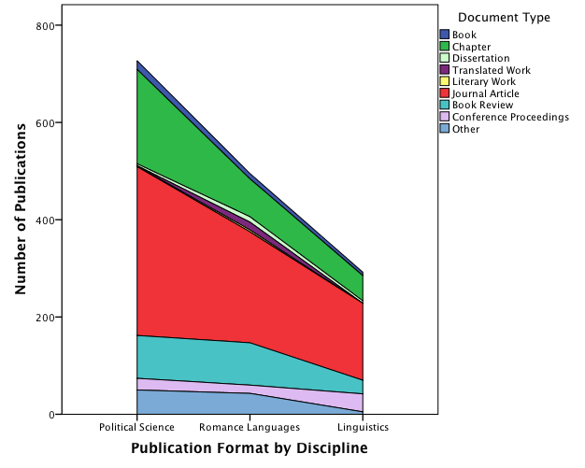
Publication Formats
Notes:
Differences from other published studies:
Journal article publication ranges from 48% to 54% compared to 83% in Humanities and 73% Social Sciences (Kyvik 39)
In our study we found a difference in book publications when separating books and book chapters we found that the U of A faculty in these disciplines publish about 2.5% of their publications in books and 16% to 27% in book chapter compared to other findings that simply estimate book publication at about 10% for Social Sciences and 12% for Humanities.

Slide 10
Discipline Comparison
Notes:
The faculty in the disciplines examined compare well with the finding of Kyvik that Humanities and Social Science faculty published three publications per year (37). It is interesting to note that significant proportions of the faculty contribute 80% of the overall number of publications.

Slide 11
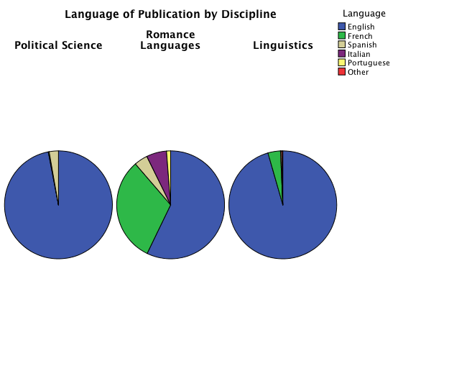
Language of Publications
Spanish
Italian
English
French
Notes:
Overall, language of publication follows the standard patter of the majority of publication being in English. Although faculty who work in the Romance Languages teach in different languages, they tend to publish in English more often.

Slide 12
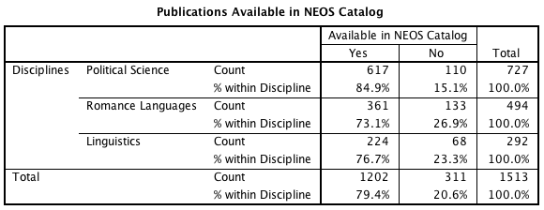
Local Availability
Notes:
The Library Catalog provided access to 79% of the publications of the departments being investigated. Our collection provides the best access to political science materials with only 15% not being locally available. A total of 73% of the materials published by faculty working in the romance languages were locally available as were 77% of the materials published linguistics faculty. The weakest area for our collection was in the area of conference proceedings. We do not own 84% of the conference proceedings in which linguistics faculty published and 47% of the proceedings in which romance languages faculty published.

Slide 13
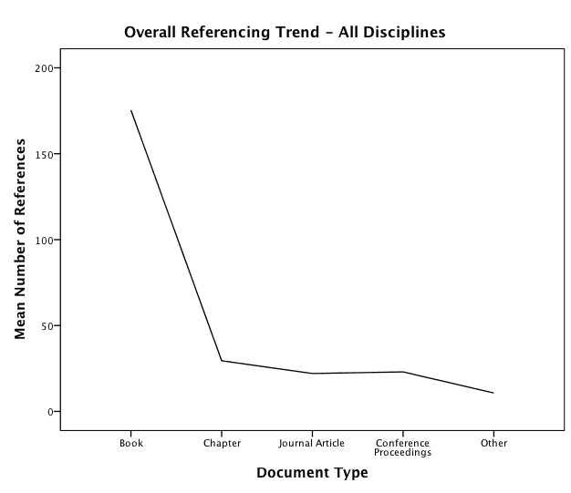
Referencing – Overall Trend

Slide 14
Referencing by Discipline
Notes:
When looking at the publications we found that typical patterns in referencing where more references were made in book publication (mean of 175 references per book) while journal articles (mean of 22) and conference proceedings (mean of 23) had fewer. The patterns for the number of references were similar for Political Science and Romance Languages except that the mean number of references in conference proceeding in Political Science was higher than in Romance Languages. Linguistics saw fewer references in books but more in journal and conference proceedings.

Slide 15
Journal Evaluation Tools
Notes:
Ulrich’s provided more evaluation than MLA. It does verify that the scholars in Political Science and Romance Languages do publish in the popular literature.

Slide 16
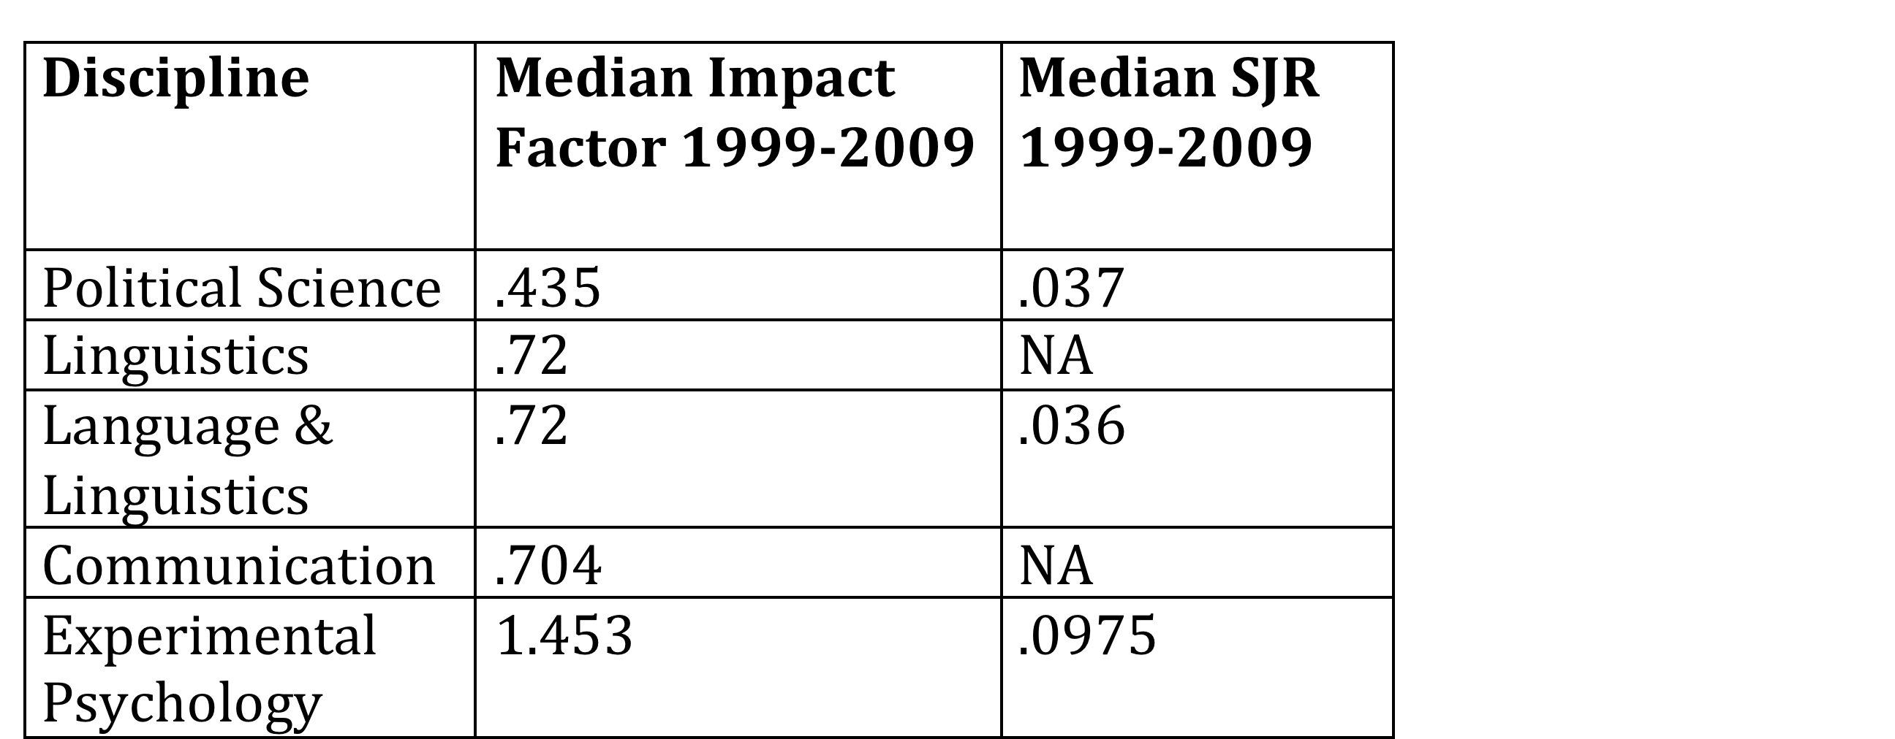
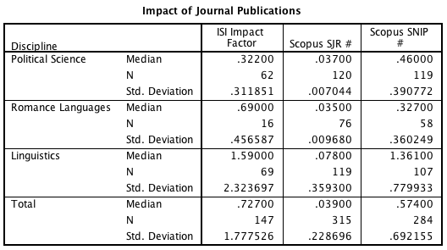
Impact Measures
Notes:
When journals were evaluated in by ISI or Scopus faculty publications tend to fit within the normal patterns of impact. Median Impact factors for journal publication in Linguistics are above the median impact factor for that subject discipline but are closer to the median impact factor for Experimental Psychology (the specific area in which many of the Linguistics faculty publish). Both Political Science and Romance Languages compare fare well when compared to their broad ISI subject areas.
When comparing the median SJR rankings for these disciplines we see that U of A faculty publications meet or placing close to the median SJR rankings for their broad discipline categories.

Slide 17
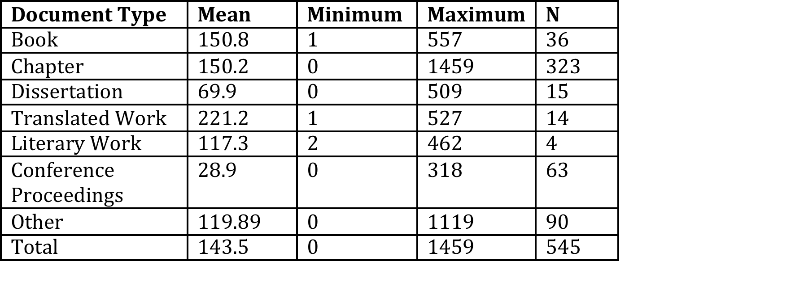
Alternate Measures
Number of OCLC Libraries Owning Faculty Publications
Notes:
While standard evaluation tools are helpful in assessing impact of journal publications. We recorded the number of OCLC Libraries owning other formats of publications and found that this could be a tool to assess the impact of these formats of publication. Book publications or the books in which faculty published chapters were held by a mean of 150 OCLC Libraries in 2012.

Slide 18
Summary
Collection strength reflects publication patterns of faculty
Impact of faculty publications falls close to median for discipline
Language and rate of publication follow trends
Publication list to institutional repository
Notes:
Preliminary results show that our collection reflects the areas in which faculty in Political Science, Romance Languages, and Linguistics published. The impact of the faculty publications falls close to or above median impact factors for their broad subject disciplines. Language and rate of publication also follow trends within Humanities and Social Science publication patterns.
Publication list has been submitted to ERA so that this work can be found via internet searches
Coding will continue on a sample of citations from the publications to see if citation practices follow similar patterns found by other researchers. We will also be tracking the proportion of publications/citations that are available freely on the Internet.

Slide 19
Future Directions
Complete coding of last few Political Science publications
Code samples of cited works
Present results to Faculty of Arts
Code monographs with Book Citation Index data and reanalyze
Notes:
Eventually it may be possible to add more altmetrics.

Slide 20
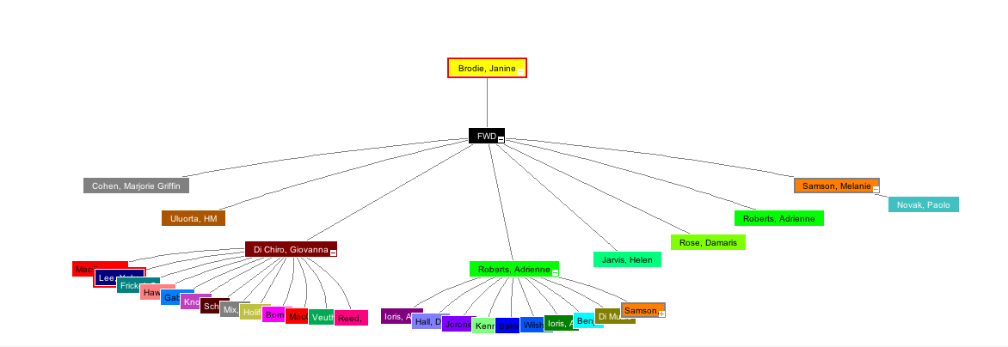
Book Citation Index Map Example
Notes:
Citation map for Janine Brodie’s book chapter
Globalization, In/Security, and the Paradoxes of the Social Author(s): Brodie, J (Brodie, Janine)^{1,2} Editor(s): Bakker, I; Gill, S Source: POWER, PRODUCTION AND SOCIAL REPRODUCTION: HUMAN IN/SECURITY IN THE GLOBAL POLITICAL ECONOMY Pages: 47-65 Published: 2003 Times Cited: 8 (from Web of Science)
Note that ISI does not provide the backward citations for this book chapter – she has referenced 52 publications
The map represents the first generation of documents citing this chapter as well as second generation documents that cite the first generation: there are only two documents that received 2nd generation citing.

Slide 21
Altmetrics
Only a fraction of HSS journals have an impact factor
Citations no longer represent adequately how an article is used (NISO Webinar: Beyond Publish or Perish: Alternative Metrics for Scholarship)
Crossref.org’s Cited-by linking
Scopus, Web of Science (Journal and Book Citation) , PubMed Central
Google Scholar
Social Web: PLOS, Mendeley, CiteULike, Facebook, Twitter, Research blogging, Wikipedia, SlideShare…
Impact Story (http://impactstory.org/)
Altmetric Explorer (www.altmetric.com)
Document downloading and viewing
Library ownership of faculty publications
OCLC WorldCat
Notes:
Crossref’s Cited-by linking system has had a slow uptake and the cited-by info varies greatly by discipline (as stated on the Cross-ref website).
Crossref in partnership with ORC-ID now offers the possibility for researchers and their organizations to create unique and persistent digital research identifiers, or ORCID identifiers, to facilitate finding all of their research and distinguishing them from every other researcher. Web of Science with its Researcher ID, offers the same possibility. Is this something in which the UA Libraries will want to get involved by creating ORCIDs for UA researchers for use in ERA or should our role be limited to encouraging researchers and their faculties or departments to do so.
Web of Science and Scopus place greater emphasis on the Sciences for citation data. Google Scholar cited data, as you know, are questionable (variant author names are or are not included, an array of sources are included in GS citation counts {including PowerPoints, Word documents…}, citation count limited to 1000).
Impact Story: ImpactStory is a website that makes it quick and easy to view the impact of a wide range of research output. It goes beyond traditional measurements of research output -- citations to papers -- to embrace a much broader evidence of use across a wide range of scholarly output types. The system aggregates impact data from many sources and displays it in a single report, which is given a permaurl for dissemination and can be updated any time.
Sources: Facebook, PLOS, SlideShare, Github, Topsy, Figshare, Wikipedia, Scopus, CiteULike, Delicious, Mendeley, Dryad, Scienceseeker, PubMed. (http://impactstory.org/faq ). However, it is made for researchers to import their own publications and makes it difficult to add a long list of publications from RefWorks, for example. Initial tests of this source demonstrate that HSS faculty do not have a significant presence in social media, e.g. Andy Knight’s 1995 article, “Towards a subsidiarity model for peacemaking and preventive diplomacy”, which has 32 citations in Google Scholar receives 0 results in Impact Story. I double checked in Wikipedia and Twitter and indeed Andy Knight is not there. Is this a flaw in Impactstory or does not point to a gap that the Faculty of Arts could harness to promote its scholars?
Altmetric Explorer: Each week Altmetric captures hundreds of thousands of tweets, blog posts, news stories and other pieces of content that mention scholarly articles since 2011. (Subscription-based: 500 pounds / year)
The Explorer can browse, search and filter this data. Use it to deliver insights, track conversations and measure levels of attention over time or compared to your competitors.
- Should academic libraries ask database vendors to provide document downloading/viewing stats for their content? Can they add the social web statistical searching aspect to their database?
- An alternative metric to counting how many libraries own a researcher’s monograph using OCLC WorldCat, for example, would be to rank book publishers (including Open Access publishers) by their academic quality (see Janice Lewis’ article in College and Research Libraries, « An Assessment of Publisher Quality by Polticial Science Librarians » and Jeffrey Beall’s criteria for determining predatory OA publishers).

Slide 22
Thanks & Questions
Thank you to the University of Alberta Libraries who have provided some funding for the research
Thank you to our research assistants:
Susanne King-Jones
Eric An
Jessica Thorlakson
Nicole LaPointe & Peter Box
Questions?

